Slide 1
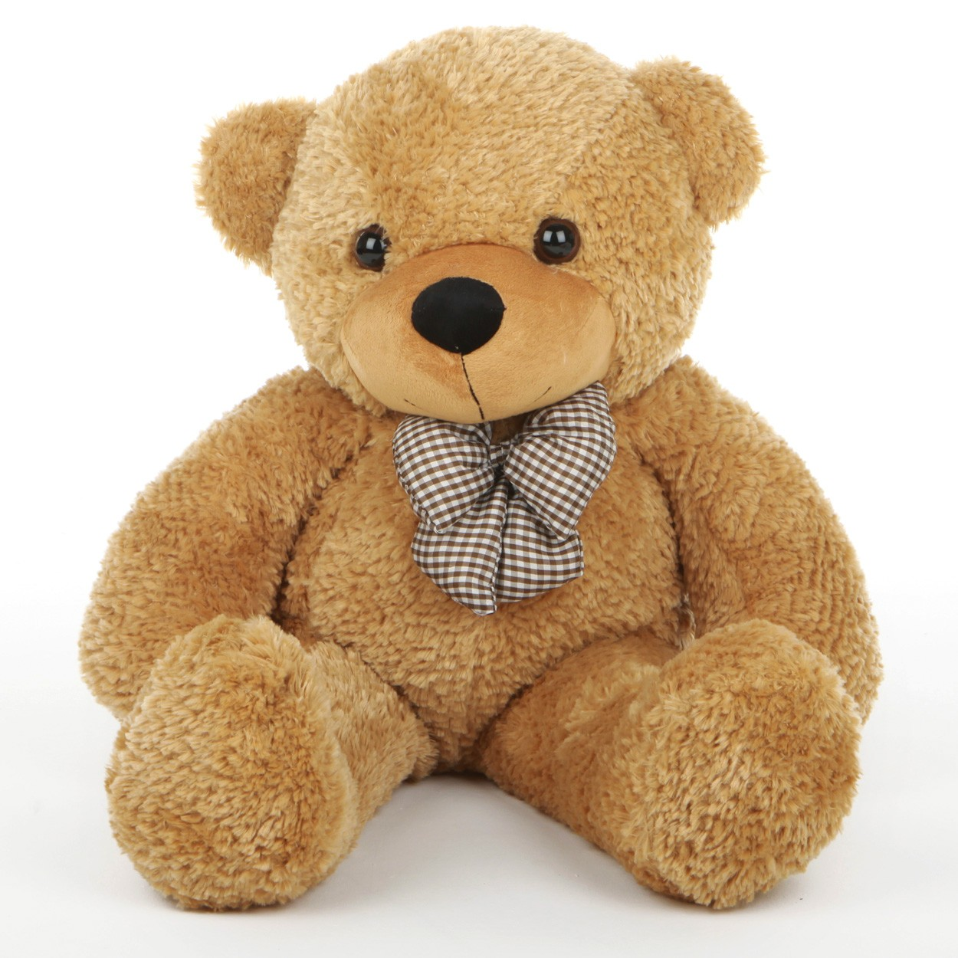
Injecting Life into Toys
Notes:
The goal of this project is to ponder about the next generation of toys, and perhaps ultimately design ones that interact and evolve with children as they grow, while remaining as inexpensive as today’s passive toys.

Slide 2
Notes:
The goal of this project is to ponder about the next generation of toys, and perhaps ultimately design ones that interact and evolve with children as they grow, while presrving the many good qualities of today’s passive toys.

Slide 3
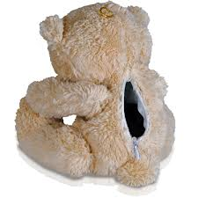

Notes:
And in thinking of this vision, we are considering the possiblity of inserting a smartphone into the toy, in a way that the camera of the smartphone aligns with the teddy bears eyes, and the mcirophone and speakers are at a location where acoustic signals can be audible both ways.

Slide 4




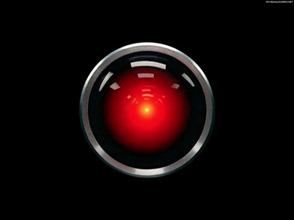


Notes:
If slight manufacturing innovation can do this right, we can suddenly bring the entire research and innovation in the smartphone platform to the toy industry, and perhaps even get in return, a set of new problems that arises from the domain of children and toys.
Clearly, applications could be many.

Slide 5

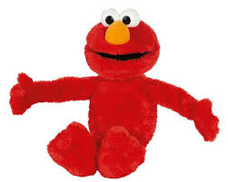
Activity Journals
Sleep, Eat, Potty
Training Apps …
Educational Toys
Early Development
Detection
Children + Toys Social Networks
Data + collaborative analytics
→ Adaptivity to age, maturity
Notes:
While this is the high level vision, the central research component in this project pertains to understanding the interaction vocabulary of a child. What do I mean by that.

Slide 6




Gesture + Response APIs, SDK
App Store
for Toys
App developer
Data + Analytics
Grandmom
Control Panel
for toys
Notes:
While this is the high level vision, the central research component in this project pertains to understanding the interaction vocabulary of a child. What do I mean by that.

Slide 7
First step in this project …
Understanding the child’s “language of interaction”

Slide 8
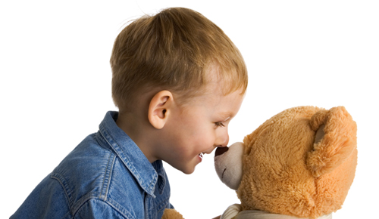
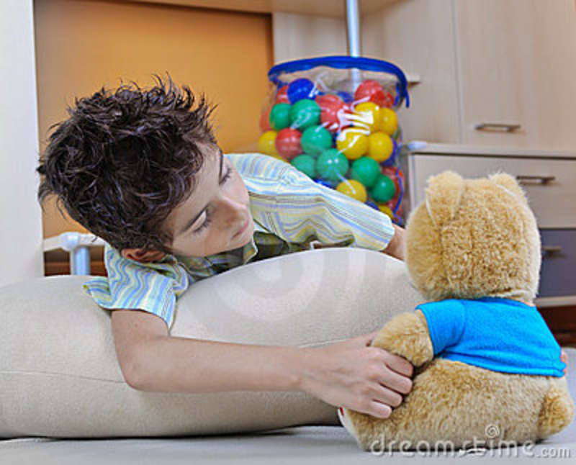
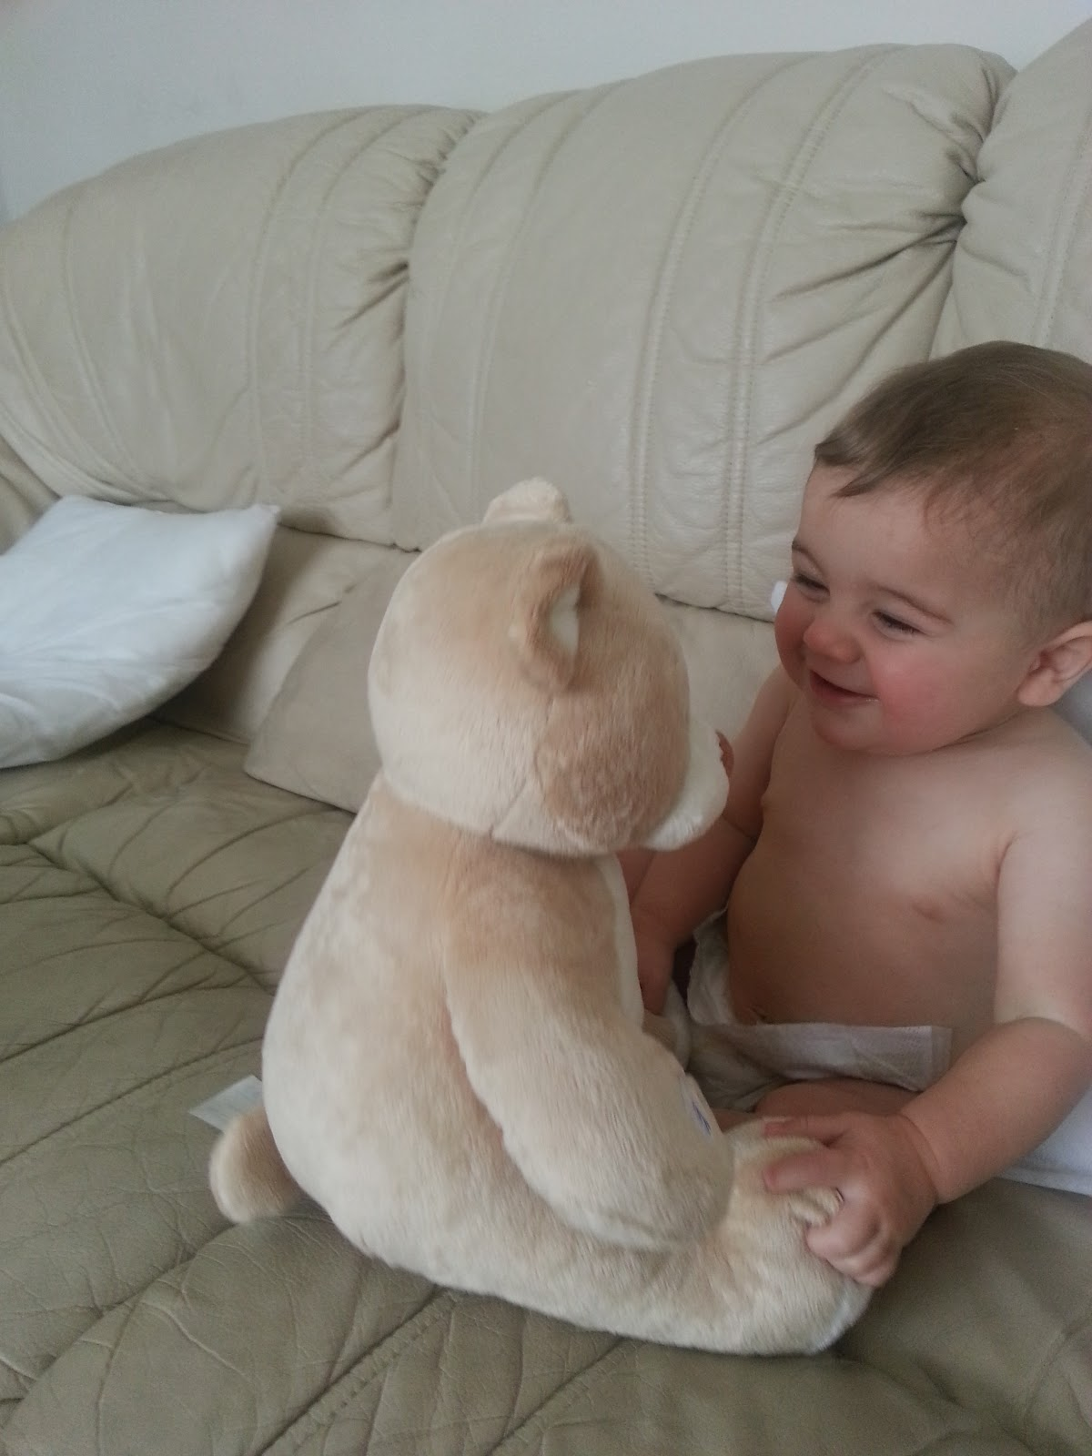


Language of Interaction

Slide 9
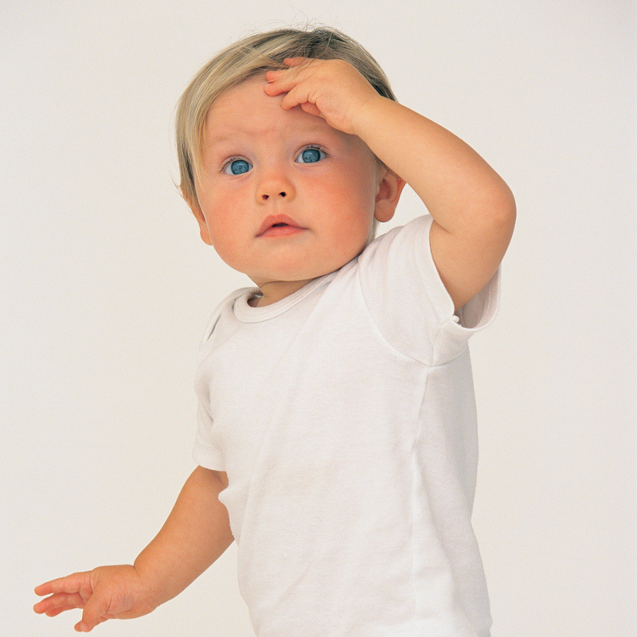
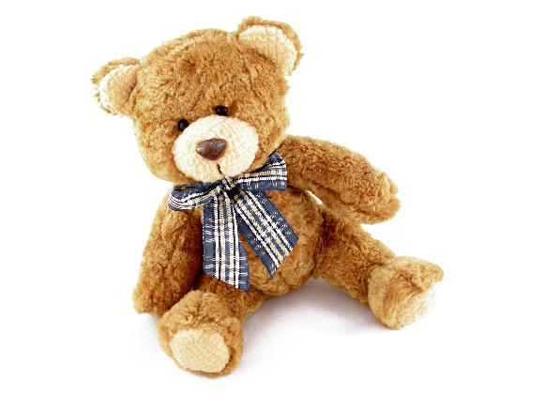
Language of Interaction
Throw the toy
”Ouch! It hurts"
“Sorry” … Hug
Vibrate. “Let’s eat”

Slide 10
Language of Interaction
Gestures
Responses

Slide 11
This project:
Attempts to only recognize the child’s
“motion gesture vocabulary”

Slide 12



Motion Gestures
:
:
:
Notes:
Why do we choose toys as the tool to understand children…
Today’s toys are simply programmed, having no capability for sensing

Slide 13
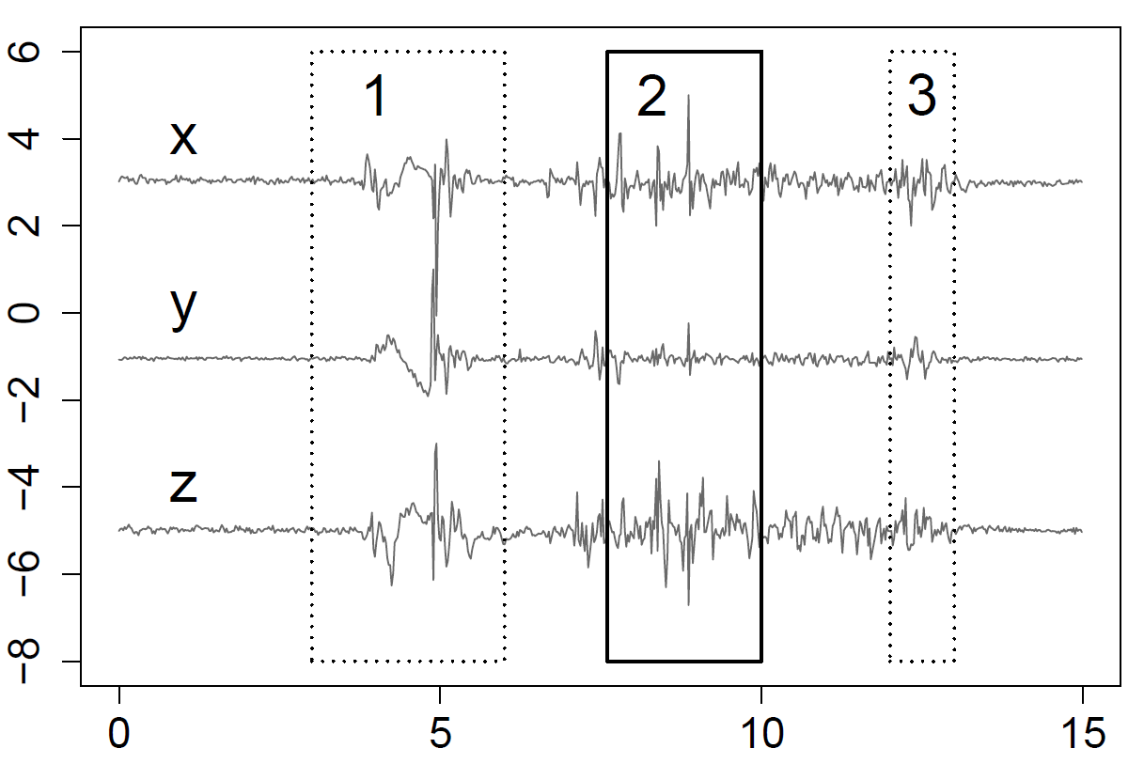
Linear Acceleration
Time (seconds)

Slide 14
Let’s just get real data …
Before we go too far with solutions

Slide 15
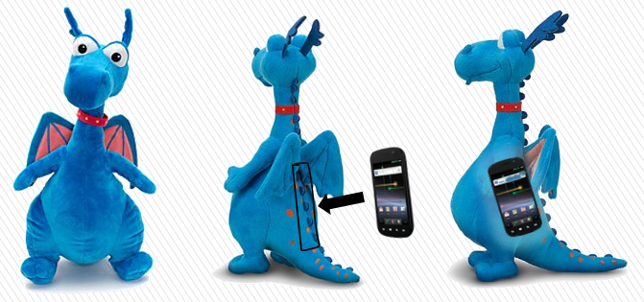
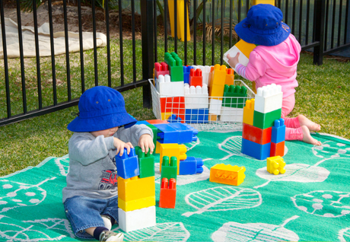
Data Collection
Experiments in toddler day care facility
  Multi-modal sensing app on phones inserted in toys
  Continuous passive sensing
  Hand written ground truth (time : activity)

Slide 16
Real-World Challenges
Observations from Passive Sensing Data
  No pre-defined gestures to train on
  No start and end markers for gestures
  Not every action is a gesture
    Many indeliberate motions exhibiting high energy
  Signals from similar gesture look different
  Data shows sparse gestures (bursty interaction with toy)
Need some way to generate more gesture data
Need some way to narrow down search space … some hint

Slide 17
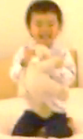
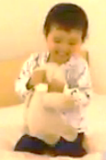
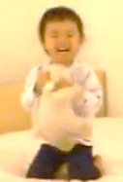
An Observation
Children tend to repeat gestures
  When toy responds to the gesture
Leverage this opportunity
  Suspect gesture in real time (allow for false positives)
  Generate arbitrary response (e.g., cartoon sounds)
  Look for repeat gesture
Shaking the toy
Hearing the sound
Shaking the toy again

Slide 18
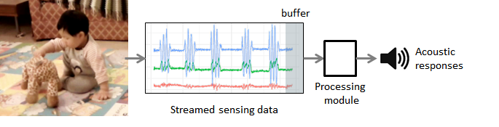
Buzz: A System Overview
Streamed sensing data buffer
Front End
δ
processing
Acoustic
Responses
Update
Signal
Processing
Gesture
Extraction
Clustering
Highlight
Segmentation
DTW
Choose threshold
Back End
Notes:
Front end is for giving responses and collecting sensing data. Four types of sounds respond to different eneryBack End is for signal processing and gesture clustering. In future work, the back end can update the front end, so that the front end can compare the sensed data with gesture fingerprints in real time.
We carefully tuned the size of energy window (responsive but also collects enough information), the feedback sounds (realistic sounds not as good as cartoon sounds)

Slide 19

Back End Tasks
When to respond → signal segmentation
2. Are they gestures? → signal self-similarity
3. Collating gestures → clustering
10
1
2
3
2
11
10
G1
G2
1
2
3
2
11

Slide 20
1. Segmentation
Choosing when to respond
  Too quickly is annoying … too many false positives
  Too late does not exhibit responsiveness
Matter of choosing window size and amp. threshold

Slide 21
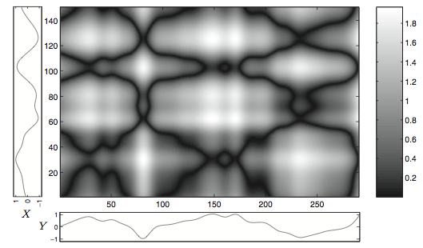
2. Signal (dis)Similarity
Dynamic Time Warping (DTW)
  Compute signal distance between two signal segments
DTW handles the situation
when a same gesture is performed under different speeds.
a

Slide 22
Basics of Dynamic Time Warping (DTW)

Slide 23
What is Special about Time Series Data?
Gene expression time series are expected to vary not only in terms of expression amplitudes, but also in terms of time progression since biological processes may unfold with different rates in response to different experimental conditions or within different organisms and individuals.
time

Slide 24
Why Dynamic Time Warping?
i
i
i
i
i+2
time
time
Any distance (Euclidean, Manhattan, …) which aligns the i-th point on one time series with the i-th point on the other will produce a poor similarity score.
A non-linear (elastic) alignment produces a more intuitive similarity measure, allowing similar shapes to match even if they are out of phase in the time axis.

Slide 25
Warping Function
Time Series A
1
i_{s}
n
m
p_{k}
To find the best alignment between A and B one needs to find the path through the grid
P = p₁, … , p_{s} , … , p_{k}
p_{s} = (i_{s} , j_{s} )
which minimizes the total distance between them.
P is called a warping function.
j_{s}
p_{s}
Time Series B
1
p₁

Slide 26
Time-Normalized Distance Measure
Time Series A
i_{s}
Time-normalized distance between A and B :
1
n
m
p_{k}
D(A , B ) =
d(p_{s}): distance between i_{s} and j_{s}
w_{s} > 0: weighting coefficient.
j_{s}
p_{s}
Best alignment path between A and B :
P₀ = (D(A , B )).
Time Series B
1
p₁

Slide 27
Optimisations to the DTW Algorithm
Time Series A
1
i_{s}
n
The number of possible warping paths through the grid is exponentially explosive!
m
reduction of the search space
Restrictions on the warping function:
monotonicity
continuity
boundary conditions
warping window
slope constraint.
j_{s}
Time Series B
1

Slide 28
Restrictions on the Warping Function
Monotonicity: i_{s-1} ≤ i_{s} and j_{s-1} ≤ j_{s}.
The alignment path does not go back in “time” index.
Continuity: i_{s} – i_{s-1} ≤ 1 and j_{s} – j_{s-1} ≤ 1.
The alignment path does not jump in “time” index.
j
j
i
i
Guarantees that features are not repeated in the alignment.
Guarantees that the alignment does not omit important features.

Slide 29
Restrictions on the Warping Function
Boundary Conditions: i₁ = 1, i_{k} = n and j₁ = 1, j_{k} = m.
The alignment path starts at the bottom left and ends at the top right.
Warping Window: |i_{s} – j_{s}| ≤ r, where r > 0 is the window length.
A good alignment path is unlikely to wander too far from the diagonal.
m
r
j
j
(1,1)
i
n
i
Guarantees that the alignment does not consider partially one of the sequences.
Guarantees that the alignment does not try to skip different features and gets stuck at similar features.

Slide 30
Restrictions on the Warping Function
Slope Constraint: ( j_{sp} – j_{s0}) / ( i_{sp} – i_{s0}) ≤ p and ( i_{sq} – i_{s0}) / ( j_{sq} – j_{s0}) ≤ q , where q ≥ 0 is the number of steps in the x-direction and p ≥ 0 is the number of steps in the y-direction. After q steps in x one must step in y and vice versa: S = p / q ∈[0 , ∝].
The alignment path should not be too steep or too shallow.
j
≤ p
≤ q
i
Prevents that very short parts of the sequences are matched to very long ones.

Slide 31
The Choice of the Weighting Coefficient
Time-normalized distance between A and B :
Weighting Coefficient Definitions
Symmetric form
w_{s} = (i_{s} – i_{s-1}) + (j_{s} – j_{s-1}),
then C = n + m.
Asymmetric form
w_{s} = (i_{s} – i_{s-1}),
then C = n.
Or equivalently,
w_{s} = (j_{s} – j_{s-1}),
then C = m.
D(A , B ) =
complicates optimisation
Seeking a weighting coefficient function which guarantees that:
is independent of the warping function. Thus
D(A , B ) =
can be solved by use of dynamic programming.

Slide 32
DTW Algorithm at Work
Start with the calculation of g(1,1) = d(1,1).
Time Series A
Calculate the first row g(i, 1) = g(i–1, 1) + d(i, 1).
1
i
n
m
Calculate the first column g(1, j) = g(1, j) + d(1, j).
Move to the second row g(i, 2) = min(g(i, 1), g(i–1, 1), g(i – 1, 2)) + d(i, 2). Book keep for each cell the index of this neighboring cell, which contributes the minimum score (red arrows).
i = j - r
j
Carry on from left to right and from bottom to top with the rest of the grid g(i, j) = min(g(i, j–1), g(i–1, j–1), g(i – 1, j)) + d(i, j).
Trace back the best path through the grid starting from g(n, m) and moving towards g(1,1) by following the red arrows.
Time Series B
1
i = j + r

Slide 33
DTW Algorithm: Example
Time Series A
-0.87 -0.84 -0.85 -0.82 -0.23 1.95 1.36 0.60 0.0 -0.29
-0.88 -0.91 -0.84 -0.82 -0.24 1.92 1.41 0.51 0.03 -0.18
0.51
0.51
0.49
0.49
0.35
0.17
0.21
0.33
0.41
0.49
0.27
0.27
0.26
0.25
0.16
0.18
0.23
0.25
0.31
0.68
0.13
0.13
0.13
0.12
0.08
0.26
0.40
0.47
0.49
0.49
-0.60 -0.65 -0.71 -0.58 -0.17 0.77 1.94 -0.46 -0.62 -0.68 -0.63 -0.32 0.74 1.97
0.08
0.08
0.08
0.08
0.10
0.31
0.47
0.57
0.62
0.65
0.06
0.06
0.06
0.07
0.11
0.32
0.50
0.60
0.65
0.68
0.04
0.04
0.06
0.08
0.11
0.32
0.49
0.59
0.64
0.66
0.02
0.05
0.08
0.11
0.13
0.34
0.49
0.58
0.63
0.66
Time Series B
Euclidean distance between vectors

Slide 34
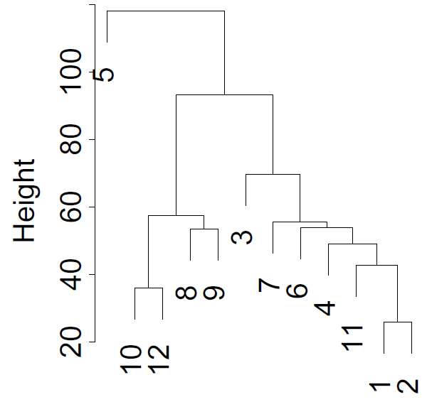
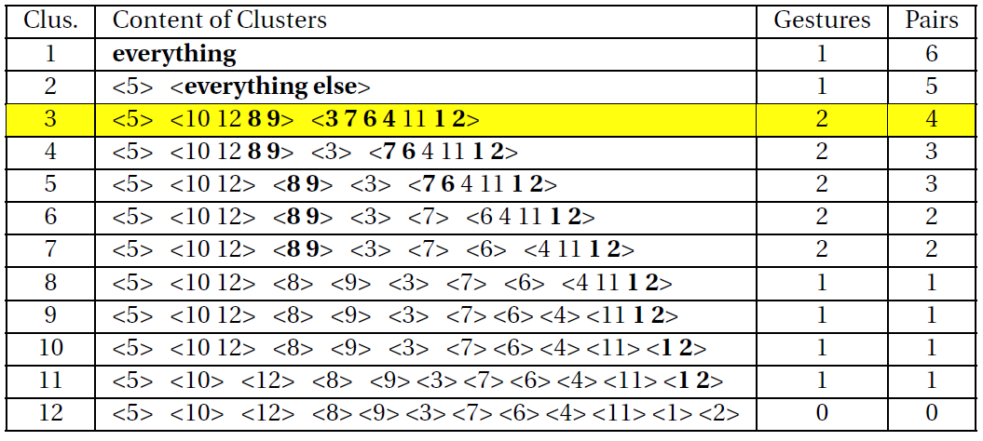
3. Hierarchical Clustering
Assume gestures repeated after a feedback
  Count the number of neighbor pairs in a subtree
  If no neighbor-pair in a subtree → non-gesture
  If a subtree has at least one neighbor pair → gesture
Cut the tree such that
  Maximize number of gestures, and then neighbor pairs
max
max

Slide 35
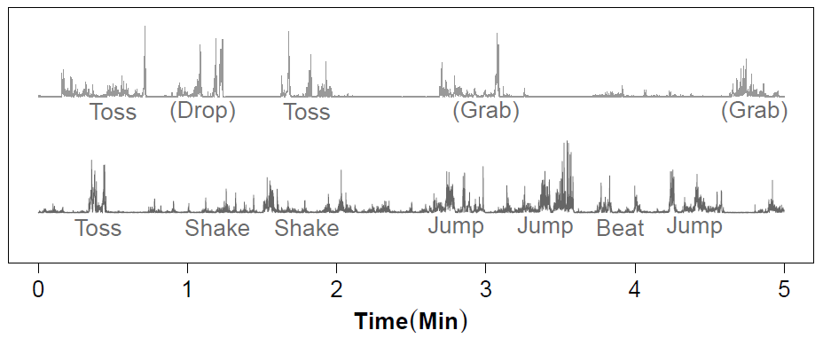
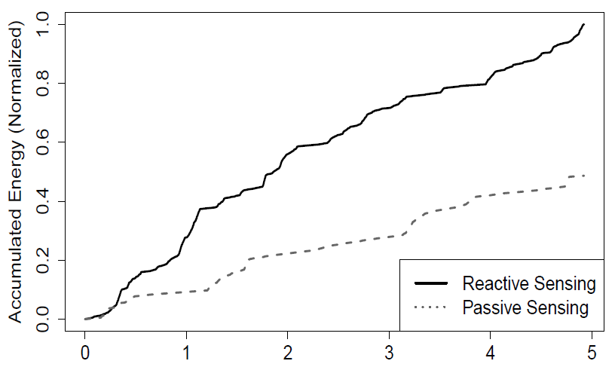
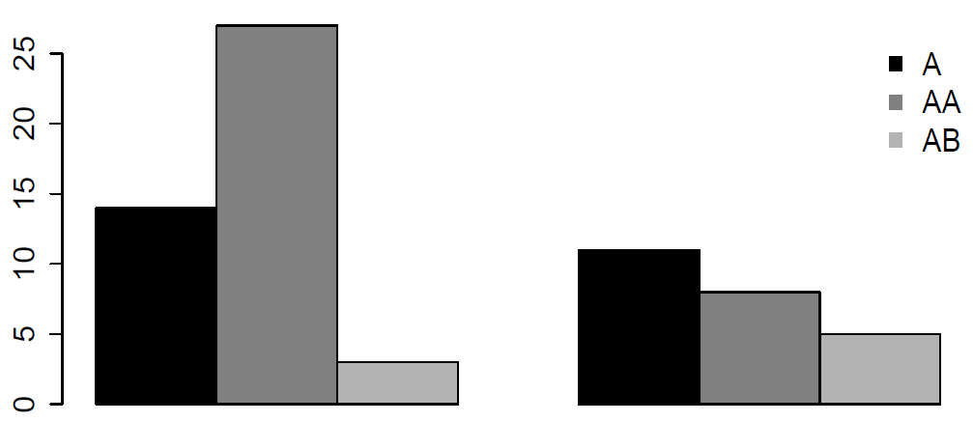
Results
Passive
More
Gestures
Linear Acceleration
Sensor Readings
Reactive
Time (min)
Time (min)
More
Repetitions
More
Activities
Gesture Counts
Accumulated Energy
Reactive
Passive
Time (min)
Notes:
The benefit of reactive sensing
(Need to explain A, AA, AB)

Slide 36
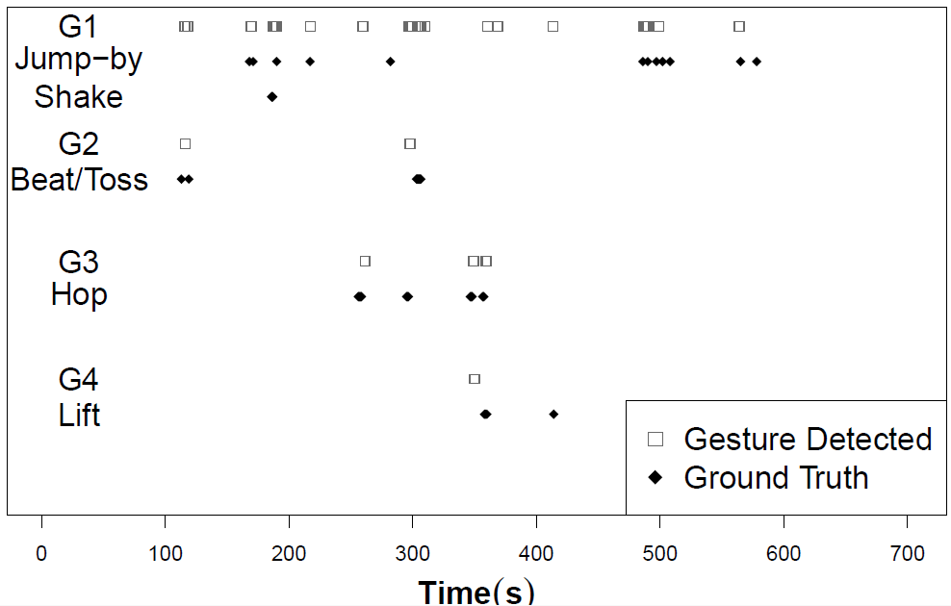
Results
Ground truth: 2 children, 6 gestures (38 instances)
Detected: 4 gestures, precision: 85.1%, recall: 81.6%
False
Positive
False
Negative

Slide 37
Many Limitations
Small data set
  IRB constraints, difficult to work with toddlers
Better algorithms
  Hidden Markov models, time frequency analysis, etc.
Energy consumption
  This paper side steps energy … but possible to optimize
Better definition of gestures
  Stepping on toy, or flicking it … defined as non-gestures
  But need to be reconsidered

Slide 38

Conclusion
Smartphones: a powerful platform for sensing,
learning and communication
We explore implications of brining these
capabilities to toys
Toys today are pre-pogrammed, non-evolving, costly ..
Might be possible to leverage mobile devices to enable
a new eco-system of toys and apps … that interact
and grow with children

Slide 39
Questions!
Paper available at synrg.csl.illinois.edu

Slide 40
Backup Slides

Slide 41
The Ecosystem of Toys
Toys
Toy Manufacturers
Building toys for apps
(E.g., allow camera)
Tuning apps for toys
Parents
Buying toys
Buying apps
App Store
App
App
Children
Playing toys
App Developers
Building apps
(E.g., education apps)
Data
Researchers
Analyzing data
(E.g., recognizing autism)
App
Data
Framework
Providing API & Software Updates
Collecting Statistical Data

Slide 42
Hold her up.
"Good morning"
Jumping.
"Tickled"
"Good morning"
"Let's jump."
Tickle her.
"I am hungry."
Feed her.
"I am full. Thanks"
Notes:
Why do we choose toys as the tool to understand children…
Today’s toys are simply programmed, having no capability for sensing

Slide 43




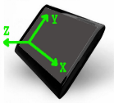







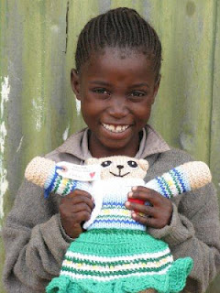


What if we insert phones into toys?
Upgrade new functions
Interaction with children
Sensing: motion
voice
face
mood
Understand children, in order to:
+
Intellectual Development
Knowledge Learning
Toy Social:
Mental Health
(Recognize Autism)
Character Building
Notes:
Based on the understanding, the toy can update itself as the children grow.

Slide 44
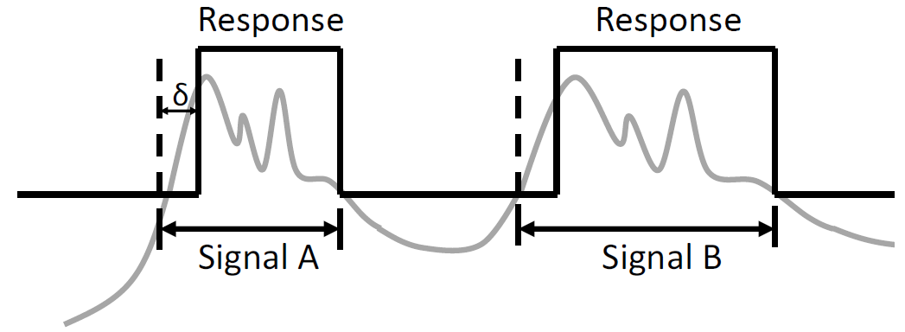
1. Segmentation
Choosing when to respond
  Too quickly is annoying … too many false positives
  Too late does not exhibit responsiveness

Slide 45
Symmetric DTW Algorithm
(warping window, no slope constraint)
Time Series A
g(n, m)
1
i
n
m
Initial condition: g(1,1) = 2d(1,1).
DP-equation:
g(i, j – 1) + d(i, j)
g(i, j) = min g(i – 1, j – 1) + 2d(i, j) .
g(i – 1, j) + d(i, j)
Warping window: j – r ≤ i ≤ j + r.
Time-normalized distance:
D(A , B ) = g(n, m) / C
C = n + m.
i = j - r
j
1
1
2
Time Series B
1
i = j + r
g(1,1)

Slide 46
Asymmetric DTW Algorithm
(warping window, no slope constraint)
Time Series A
g(n, m)
1
i
n
m
Initial condition: g(1,1) = d(1,1).
DP-equation:
g(i, j – 1)
g(i, j) = min g(i – 1, j – 1) + d(i, j) .
g(i – 1, j) + d(i, j)
Warping window: j – r ≤ i ≤ j + r.
Time-normalized distance:
D(A , B ) = g(n, m) / C
C = n.
i = j - r
j
1
0
1
Time Series B
1
i = j + r
g(1,1)

Slide 47
Quazi-symmetric DTW Algorithm
(warping window, no slope constraint)
Time Series A
g(n, m)
1
i
n
m
Initial condition: g(1,1) = d(1,1).
DP-equation:
g(i, j – 1) + d(i, j)
g(i, j) = min g(i – 1, j – 1) + d(i, j) .
g(i – 1, j) + d(i, j)
Warping window: j – r ≤ i ≤ j + r.
Time-normalized distance:
D(A , B ) = g(n, m) / C
C = n + m.
i = j - r
j
1
1
1
Time Series B
1
i = j + r
g(1,1)

