Slide 1

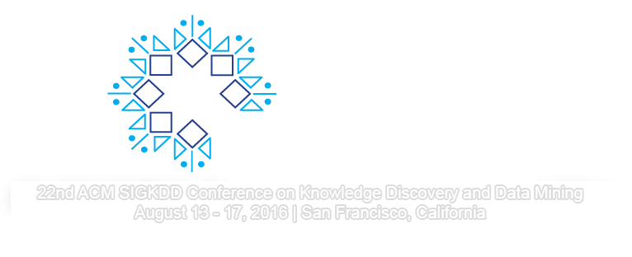
Extracting Optimal Performance from Dynamic Time Warping
Abdullah Mueen
mueen@unm.edu
Eamonn Keogh
eamonn@cs.ucr.edu
We will start at 8:10am, to allow stragglers to find us. In the meantime, download:
www.cs.unm.edu/~mueen/DTW1.pdf or ../DTW1.pptx and ../DTW2.pdf / DTW2.pptx

Slide 2
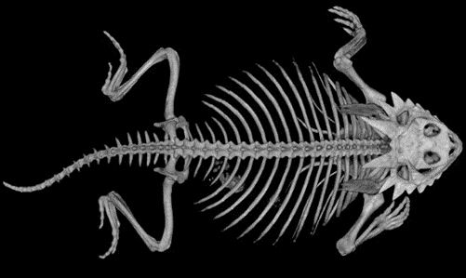






Acknowledgements
The following people helped with advice or images: Diego Silva, Hoang Anh Dau, Tony Bagnall, Mohammad Shokoohi-Yekta, Bing Hu, Chotirat (Ann) Ratanamahatana , François Petitjean (If we forgot anyone, apologies)
We also acknowledge the following sponsors and funding agencies: MERL Labs, Samsung, Siemens, Google, MSR/IARPA, NSF IIS-1161997 II and SHF-1527127
However any errors or opinions are solely due to A.M and E.K
Notes:
Data used was Trace_TEST([ 15 13 29 17 7 9 19 24 2 28 16 23 ],2:end)'

Slide 3

Disclaimer
Some of the slides are more “wordy” than we would like.
Our idea is to expose you to all the important issues in the next few hours. If you need to, you can follow up later by re-reading the slides (augmented by notes/references)
Feel free to use these slides for teaching, but please let us know if you do so.
Many slides have additional notes

Slide 4
Approximate Outline
The First Act: How to do DTW correctly
Keogh
The Second Act: How to do DTW fast
Mueen

Slide 5
What are Time Series? 1 of 2
A time series is a collection of observations made sequentially in time.
More than most types of data, time series lend themselves to visual inspection and intuitions…
For example, looking at the numbers in this blue vector tells us nothing.
But after plotting the data, we can recognize a heartbeat, and possibly even diagnose this person's disease.
This tutorial will leverage the visual intuitiveness time series.
25.350
25.350
25.400
25.400
25.325
25.225
25.200
25.175
..
24.625
24.675
24.675
24.675
29
28
27
26
25
24
23
0
100
200
300
400
500

Slide 6
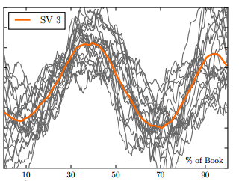
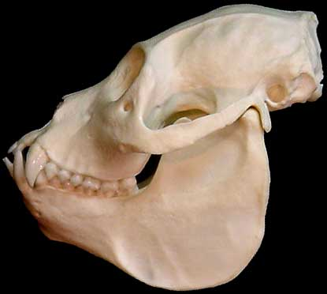


What are Time Series? 2 of 2
As an aside… (not the main point for today)
Many types of data that are not true time series can be fruitfully transformed into time series, including DNA, speech, textures, core samples, ASCII text, historical handwriting, novels and even shapes.
This fact greatly expands the purview of DTW
Mantled Howler Monkey
Alouatta palliata
0
50
100
150
200
250
300
350
400
450
Notes:
The emotional arcs of stories are dominated by six basic shapes : http://arxiv.org/pdf/1606.07772v2.pdf
For DNA to time series see Thanawin Rakthanmanon, Bilson Campana, Abdullah Mueen, Gustavo Batista, Brandon Westover, Qiang Zhu, Jesin Zakaria, Eamonn Keogh (2012). Searching and Mining Trillions of Time Series Subsequences under Dynamic Time Warping SIGKDD 2012. Best paper award
Or see https://www.youtube.com/watch?v=IjGZ6kF2gbQ

Slide 7
What is Dynamic Time Warping?
DTW is an algorithm for measuring similarity between two time series which may vary (i.e. warp) in timing.
This invariance to warping is critical in many domains, for many tasks.
Without warping invariance, we are often condemned to very poor results.
Euclidean Distance
DTW
Notes:
Data used was Trace_TEST([ 15 13 29 17 7 9 19 24 2 28 16 23 ],2:end)'

Slide 8
Why Study DTW? 1 of 5
Why should you spend several hours studying DTW?
On the face of it, this seems strange.
We probably would not spend hours on just the Hamming distance, or the just the Jaccard similarity etc.

Slide 9
Why Study DTW? 2 of 5
It is almost impossible to overstate the ubiquity of DTW in data analytics
It is used in: robotics, biometrics, medicine, metrology, bioinformatics, video games, gesture recognition, image processing, seismology, music processing, entomology, anthropology, computational photography, bioacoustics, finance ,…

Slide 10
Why Study DTW? 3 of 5
While the is no free lunch, multiple rigorous independent studies¹ show that for the core problem of time series classification, Nearest Neighbor DTW is very hard to beat.
Moreover, where NN-DTW can be beaten, it typically by a very small margin, at the cost of huge effort in coding/complexity of implementation, and a large time and space overhead.
¹This paper conducts 35 million experiments, on 85 datasets, with dozens of rival methods
http://arxiv.org/abs/1602.01711 The Great Time Series Classification Bake Off. Bagnall et al.

Slide 11
Why Study DTW? 4 of 5
While DTW is easy to implement, there are common mistakes that can hurt efficiency and effectiveness.
Efficiency: You can use DTW to search one billion subsequences in under two minutes, using all the “tricks” shown in this tutorial. However a naïve off-the-shelf recursion-based DTW implementation would take six years¹.
Effectiveness: While DTW is quite robust, there are some “silly” things you could do to cripple its effectiveness; not z-normalizing, set the wrong warping window, enforcing the endpoint constraint in certain datasets…
¹The recursive version of cDTW₁₀ takes about 0.19 seconds for length 128 (see slide notes)
Notes:
EDU>> a=random_walk(128,1);
EDU>> b=random_walk(128,1);
EDU>> tic, DTW(a,b);,toc
Elapsed time is 0.189441 seconds.
This is with cDTW, with, w set to 10
(0.189441 * 1000000000) seconds in years = 6.00315126 years

Slide 12
Why Study DTW? 5 of 5
Finally, many of the ideas we will discuss today to make DTW effective and efficient, can be applied to other domains. (constraining distance measures that are “too” invariant, lower bounding search, just-in-time normalization, early abandoning, cascading multiple lower bounds… )
So, even if you don’t care about DTW per se, we hope you will find some ideas you can use.

Slide 13
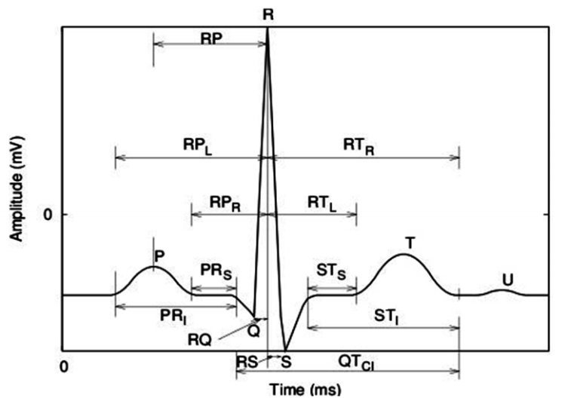
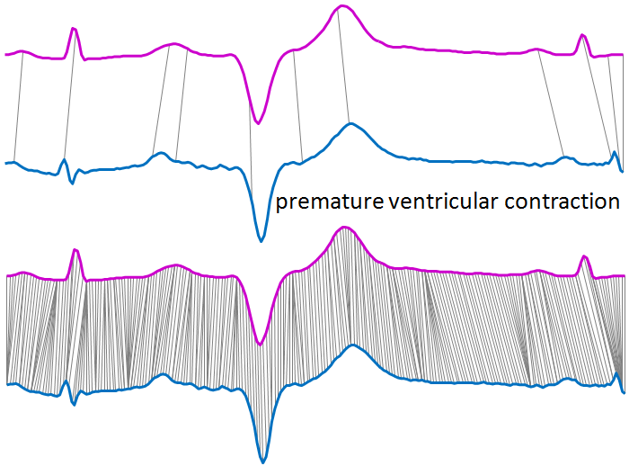
An Unstated Assumption
For all time series, faces, gait, fish and heartbeats, we could design and extract features, and just represent the objects as feature vectors. However, in the dozens of cases where we compared this type of approach to just using DTW on the raw data, DTW almost always wins!
So, at the very least, try the simplest ideas first, and DTW is very simple.
Bazett’s formula
1NN DTW
Accuracy
98% plus
(10 classes)
Accuracy
75 to 95%
(10 classes)
PR Interval, PR Segment, Corrected-QT Interval, ST Segment , ST Interval , RR Interval , RQ Amplitude, R_{peak} to T_{onset} Segment RS Amplitude , Angle Q, Angle R, Angle S,..
Parameter-free or parameter-lite, robust to noise etc.
F1={7.3,4.2,5.2,1.2,6.7, …}
Notes:
Left image
H. C. Bazett, “An Analysis of the Time-Relations of Electrocardiograms,” Heart, Vol. 7, 1920, pp. 353-370.
Evaluation of Electrocardiogram for Biometric Authentication , Yogendra Narain Singh, S. K. Singh
Right image
https://www.youtube.com/watch?v=d_qLzMMuVQg

Slide 14
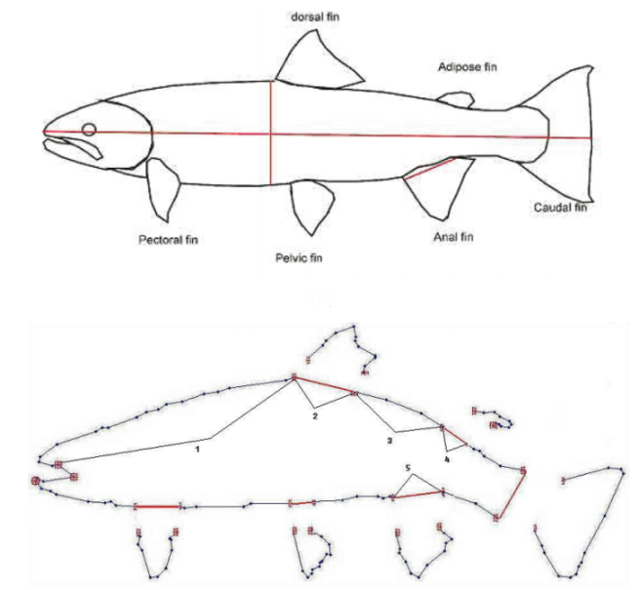
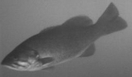
An Unstated Assumption (alterative)
For all time series, heartbeats, gait, faces, and even fish!, we could design and extract features, and just represent the objects as feature vectors. However, in the dozen of cases where we compared this type of approach to just using DTW on the raw data, DTW almost always wins!
So, at the very least, try the simplest ideas first, and DTW is very simple.
1NN DTW
Accuracy
86.0%
Accuracy
75.7%
length between the nose and dorsal fin
width of the dorsal fin
distance between the dorsal fin and adipose fin
width of the adipose fin
width of the anal fin
F1={5.1,1.2,2.9,1.0,2.2}
-
-
2
2
-
-
1
1
0
0
1
1
2
2
Notes:
Left image
Contour Matching for Fish Species Recognition and Migration Monitoring Dah-Jye Lee1, James K. Archibald , Robert B. Schoenberger, Aaron W. Dennis1, and Dennis K. Shiozawa
Right image
Ken Ueno, Xiaopeng Xi, Eamonn Keogh, Dah-Jye Lee (2006). Anytime Classification Using the Nearest Neighbor Algorithm with Applications to Stream Mining. ICDM 2006

Slide 15
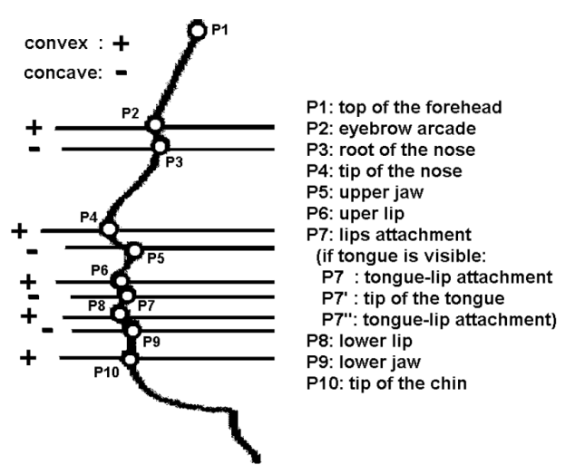
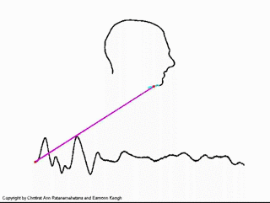
An Unstated Assumption (alterative)
For all time series, heartbeats, gait, fish and faces, we could design and extract features, and just represent the objects as feature vectors. However, in the dozen of cases where we compared this type of approach to just using DTW on the raw data, DTW almost always wins!
So, at the very least, try the simplest ideas first, and DTW is very simple.
1NN DTW
Accuracy
90% plus
(10 classes)
Accuracy
70 to 80%
(10 classes)
How many fiducials? Pantic suggests 10, Campos suggests 8, Dariush suggests 9, Liposcak suggests 12…
Parameter-free or parameter-lite, robust to changes of expression..
F1={7.4,1.3,2.1,1.2,4.6, 5.6, 43.3}
Notes:
Left image
FACIAL ACTION RECOGNITION IN FACE PROFILE IMAGE SEQUENCES. Maja Pantic
http://www2.cmpe.boun.edu.tr/courses/cmpe58Z/spring2010/files/projects/faceprofile-proposal.pdf
Right image
Ken Ueno, Xiaopeng Xi, Eamonn Keogh, Dah-Jye Lee (2006). Anytime Classification Using the Nearest Neighbor Algorithm with Applications to Stream Mining. ICDM 2006

Slide 16
A Visual Intuition of Distance Measures
We have two time series, what is the distance between them?
Equivalently, how similar are they?
n

Slide 17
Euclidean Distance
One-to-one mapping

Slide 18
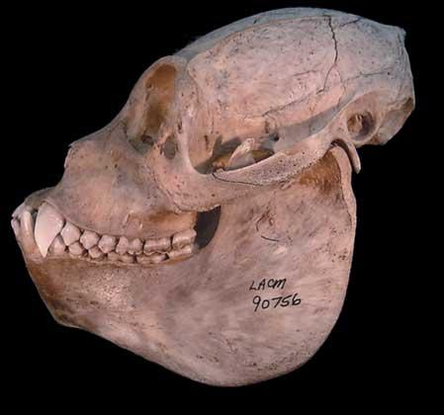
Mantled Howler Monkey
Alouatta palliata
Euclidean Distance
Red Howler Monkey
Alouatta seniculus

Slide 19
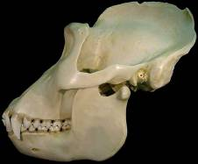
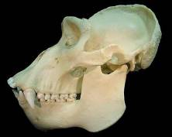
Lowland Gorilla
Gorilla gorilla graueri
DTW
Alignment
Mountain Gorilla
Gorilla gorilla beringei
One-to-many mapping
Notes:
Is man an ape or an angel?
Now I am on the side of the angels.
Benjamin Disraeli, 25 November 1864

Slide 20
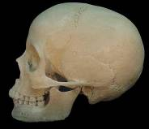
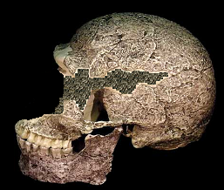
A
B
C
This region will not be matched
LCSS
Alignment
One-to-many mapping
With some points allowed to be unmapped
DTW

Slide 21
How is DTW Calculated? I
We create a matrix the size of |Q| by |C|, then fill it in with the distance between every possible pair of points in our two time series.
Q
C
C
Q
Notes:
Time Warps, String Edits, and Macromolecules: The Theory and Practice of Sequence Comparison. By David Sankoff and Joseph Kruskal
is a classic reference for this

Slide 22
Every possible warping between two time series, is a path through the matrix. We want the best one…
How is DTW Calculated? II
Q
C
C
Q
This recursive function gives us the minimum cost path
γ(i,j) = d(q_{i},c_{j}) + min{ γ(i-1,j-1), γ(i-1,j ), γ(i,j-1) }
Warping path w

Slide 23
We can visualize the recursive function as a “step pattern” of allowable moves, or search operators
γ(i,j) = d(q_{i},c_{j}) + min{ γ(i-1,j-1), γ(i-1,j ), γ(i,j-1)}
This suggests two generalizations.
  We could weight the diagonal step, to “discourage” the warping path wandering too far from the diagonal.
  We could create other steps patterns, including asymmetric step patterns.
RabinerJuangStepPattern IV
Both ideas were extensively studied when DTW was the dominant speech processing algorithm, but have not been investigated extensively in the data mining context.
Empirically, they seem to make little difference.
We only consider the classic symmetric1 step pattern in our work.
Notes:
J. B. Kruskal: An overview of sequence comparison, In: Time Warps, String Edits, and Macromolecules: The Theory and Practice of Sequence Comparison, Eds.: D. Sankoff and J. B. Kruskal, Addison-Wesley, Reading, Mass., 1983, 1-44.
Toni Giorgino Computing and Visualizing Dynamic Time Warping Alignments in R: The dtw Package

Slide 24
How is DTW Calculated? Disclaimer!
In practice we don’t use recursion to calculate DTW. Instead we use an equivalent iterative method (which we will explain later).
The iterative method is both absolutely faster, and it is allows many speed-up optimizations (early abandoning etc).
The time difference is several orders of magnitude.
However, there is no logical difference between the two methods for the first half of this tutorial.
Logically correct, but too slow and memory intensive
This recursive function gives us the minimum cost path
γ(i,j) = d(q_{i},c_{j}) + min{ γ(i-1,j-1), γ(i-1,j ), γ(i,j-1) }

Slide 25
DTW is a Distance Measure, not a Metric 1 of 2
Requirements to be a metric
D(A,B) = D(B,A) Symmetry
D(A,A) = 0 Constancy of Self-Similarity
D(A,B) = 0 IIf A=B Positivity (Separation)
D(A,B) ≤ D(A,C) + D(B,C) Triangular Inequality
Yes for DTW
No for DTW
Normally we prefer metrics over measures for two reasons:
Non-Metrics can sometimes give pathological solutions when clustering or classifying data etc.
Almost all speed-up “tricks” for high dimensional data exploit the Triangular Inequality.

Slide 26
DTW is a Distance Measure, not a Metric 2 of 2
Non-Metrics can sometimes give pathological solutions when clustering or classifying data etc.
  DTW is almost a metric! That is to say if you randomly sample a million triples A, B and C, you will probably find D(A,B) ≤ D(A,C) + D(B,C) is obeyed for 999,999 of them.
  *Moreover, in the limit, as w approaches zero, DTW is a metric. As we will see, we almost always use a very small value of w.
Almost all speed-up “tricks” for high dimensional data exploit the Triangular Inequality.
  This used to be a big issue, but after a decade of research, the community has found alterative techniques that allow us to speed up DTW (Second half of the tutorial).
*We will explain what “w” is in a few slides.

Slide 27
DTW: Time and Space complexity
The “off-the-shelf” DTW has
  a time complexity of O(n²) (with a large constant factor)
  a space complexity of O(n²)
This is the most cited reason for not using DTW.
However, as we will show in the second half of this tutorial. DTW can have
  a space complexity of O(n)
  an amortized time complexity of O(n) (with a very small constant factor)

Slide 28
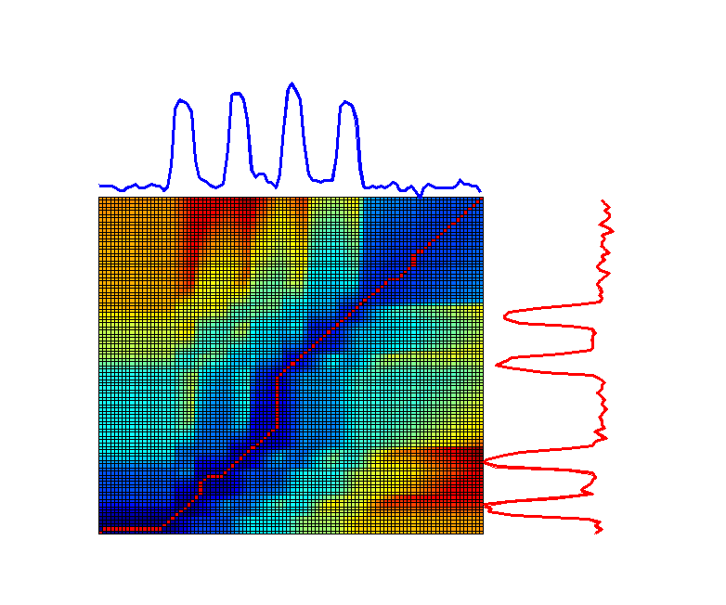
Let us visualize the cumulative matrix on a real world problem I
This example shows two one-week periods from an electrical power demand time series.
Note that although they both describe 4-day work weeks, the blue sequence had Monday as a holiday, and the red sequence had Wednesday as a holiday.

Slide 29
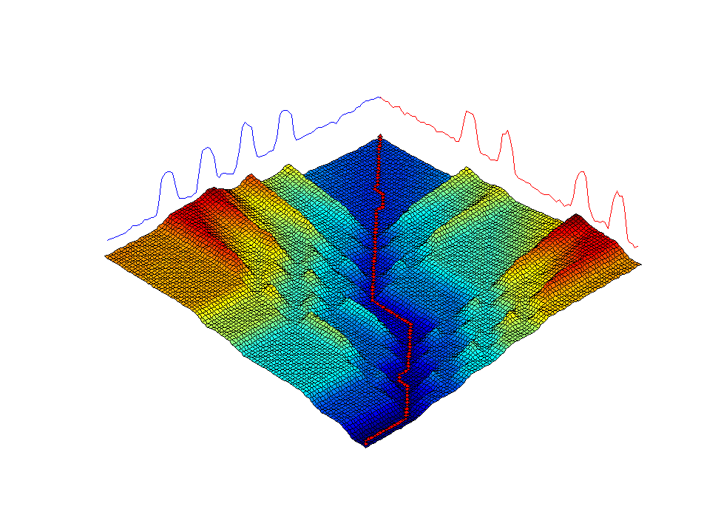
Let us visualize the cumulative matrix on a real world problem II

Slide 30
Understanding w, the Warping Constraint
The value of w is the maximum amount the warping path is allow to deviate from the diagonal.
It is normally expressed as the ratio w = r/n (or as a percentage)
C
r
Q
We need to understand w because:
The most useful speedup tricks all exploit w.
The value chosen for w can greatly affect accuracy.
n
Sakoe-Chiba Band
Notes:
EDU>> a=random_walk(128,1);
EDU>> b=random_walk(128,1);
EDU>> tic, DTW(a,b);,toc
Elapsed time is 0.189441 seconds.
This is with cDTW, with, w set to 10
(0.189441 * 1000000000) seconds in years = 6.00315126 years

Slide 31
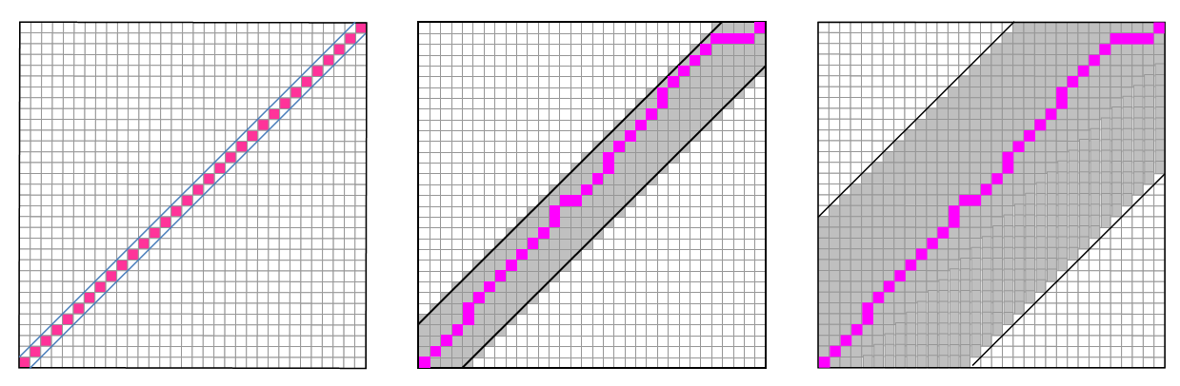
Preamble: Reading the plots for..
The value of w vs. some measure of quality
Testing every value of w, from w = 0 to w = 20
0.2
Note: The leftmost data point, when w = 0, is the Euclidean Distance error
e
t
This is just a meta-slide, on how to read a figure
a
R
r
o
r
r
E
Test Error Rate
0
Warping Window Width
0
5
10
15
20
We use the simple 1NN classifier
Time needed: Milliseconds,…. Seconds,…. Minutes,… (at least, if naively implemented)
Notes:
EDU>> a=random_walk(128,1);
EDU>> b=random_walk(128,1);
EDU>> tic, DTW(a,b);,toc
Elapsed time is 0.189441 seconds.
This is with cDTW, with, w set to 10
(0.189441 * 1000000000) seconds in years = 6.00315126 years

Slide 32
How important is the value of w?
To find out, we measured the testing accuracy on some UCR datasets
We tested every value of w, from w = 0 to w = 20
Trace
ShapesAll
Meat
0.2
0.25
0.14
e
t
Test Error Rate
a
R
r
o
r
r
E
0
0.17
0
0
5
10
15
20
0
5
10
15
20
0
5
10
15
20
Warping Window Width
There is high variability: Any warping hurts for Meat (such datasets are rare), any amount of warping above 5 is optimal for Trace, and ShapesAll really needs 7, not more, not less.
How can we set the value of w?
Notes:
EDU>> a=random_walk(128,1);
EDU>> b=random_walk(128,1);
EDU>> tic, DTW(a,b);,toc
Elapsed time is 0.189441 seconds.
This is with cDTW, with, w set to 10
(0.189441 * 1000000000) seconds in years = 6.00315126 years

Slide 33
How can we set the value of w?
We can set the value of w using leave-one-out cross-validation on the testing data. So long as we have enough labeled data, this generally works very well, as shown below:
Trace
ShapesAll
Meat
0.2
0.25
0.14
e
t
Test Error Rate
a
R
r
o
r
r
E
Train Error Rate
0
0.17
0
0
5
10
15
20
0
5
10
15
20
0
5
10
15
20
Warping Window Width
Not perfect, but close
What do you do if you don’t have enough labeled data? (open problem)
One Idea: Find a dataset that is similar, that does have labeled data, and hope the best setting generalizes from that dataset.
Notes:
EDU>> a=random_walk(128,1);
EDU>> b=random_walk(128,1);
EDU>> tic, DTW(a,b);,toc
Elapsed time is 0.189441 seconds.
This is with cDTW, with, w set to 10
(0.189441 * 1000000000) seconds in years = 6.00315126 years

Slide 34
The value of w vs. data size
For classification and query-by-content, the best setting of w also depends on the size of the training dataset.
If we are given more training data, we should expect:
  The error rate to decrease (as with all ML problems and all data types)
  The best value for w to get smaller (it is possible to construct synthetic counterexamples)
This implies that with enough training data, you would not need DTW!
ShapesAll
ShapesAll
0.25
0.25
If given more training data….
… we expect the best value for w to decline.
w = 7
0.17
0.17
0
5
10
15
20
0
5
10
15
20
w = 4
Notes:
EDU>> a=random_walk(128,1);
EDU>> b=random_walk(128,1);
EDU>> tic, DTW(a,b);,toc
Elapsed time is 0.189441 seconds.
This is with cDTW, with, w set to 10
(0.189441 * 1000000000) seconds in years = 6.00315126 years

Slide 35
..this implies that with enough training data, you would not need DTW!
Empirically, these seems to be universally true. 1NN-DTW classification is generally much more accurate than 1NN-ED classification for small datasets. However, as you add more training data, the gap begins to close, and eventually converges.
To our knowledge, there is no research on quantifying how fast they converge, if they must converge, the relative benefit of a new training object for each approach etc.
As a practical matter, this observation probably does not matter much.
We rarely have the luxury lots of training data
If we did, it would probably still be faster to do 1NN-DTW with less data, than 1NN-ED with lots of data.
Two-Pat Dataset
0.03
CBF Dataset
0.5
Out-of-Sample Error Rate
Euclidean
DTW
0.02
Euclidean
DTW
0.01
0
0
3000
6000
0
0
3000
6000
Increasingly Large Training Sets
Increasingly Large Training Sets
Notes:
We conducted experiments on two highly warped datasets that are often used to highlight the superiority of DTW, Two-Pat and CBF. For each problem we created 10,000 test time series, and increasingly large training datasets of size 50, 100, 200,…6,400. We measured the classification accuracy of 1NN for the various datasets, using both Euclidean distance and DTW with 10% warping window.

Slide 36
Revisited: How important is the value of w? 1 of 5
While the community has just begun to understand that the setting of w is important for classification, it is not well appreciated that it is just as important for clustering.
Below we show the rand-index vs w for three datasets, clustered using TADPole. As we can see, the value of w is critical.
1
Two Patterns
Rand Index
0.8
0.6
Coffee
0.4
Swedish Leaf
0
5
10
15
20
Warping Window Width (as % of time series length)
Notes:
See Hoang Anh Dau, Nurjahan Begum and Eamonn Keogh. Semi-Supervision Dramatically Improves Time Series Clustering under Dynamic Time Warping. ACM CIKM 2016
http://www.cs.ucr.edu/~eamonn/CIKM_2016_DTW_clustering.pdf

Slide 37
Revisited: How important is the value of w? 2 of 5
Why is the value of w is so critical? The Goldilocks Principle
Lets make a dataset of time series of length 100. The dataset is mostly a flat line with a little noise. The red class has a single “spike” somewhere between 1 and 40. The blue class has a single “spike” somewhere between 60 and 100.

Slide 38
Revisited: How important is the value of w? 3 of 5
Why is the value of w is so critical? The Goldilocks Principle
Lets make a dataset of time series of length 100. The dataset is mostly a flat line with a little noise. The red class has a single “spike” somewhere between 1 and 40. The blue class has a single “spike” somewhere between 60 and 100.
With no warping allowed, we map the top of the spike on the source to a low spot on the target.
With a little warping allowed, we map the spike on the source to spike on the target. Success!
With unlimited warping allowed, we can map the top of the spike on the source to a very far away spike, which what defines the opposite class!
Dist = 18.4
Dist = 1.62
Dist = 0.82

Slide 39
Revisited: How important is the value of w? 4 of 5
Why is the value of w is so critical? The Goldilocks Principle
Lets make a dataset of time series of length 100. The dataset is mostly a flat line with a little noise. The red class has a single “spike” somewhere between 1 and 40. The blue class has a single “spike” somewhere between 60 and 100.
  With no warping allowed, we get random results
  With a little warping allowed (say 10%), a red can “warp” to a red, and vice versa
  With 100% warping allowed, a blue could warp to a red, and vice versa.

Slide 40
Revisited: How important is the value of w? 5 of 5
Important note: The best value of w for classification may not be the best value for clustering.
MiddlePhalanxTW
0.6
0.8
In retrospect it is not surprising that these values are at best weakly related. For 1NN classification only the distance between the unlabeled exemplar and it’s single nearest neighbor matters.
However, for clustering, the mutual distance among small groups of objects matter.
0.55
0.6
Classification Accuracy
Rand Index
0.5
0.4
0.45
0.2
0
10
20
Increasing values of w
The Rand-Index and the classification accuracy vs. the warping window width, for the MiddlePhalanxTW dataset.
Notes:
See CIKM 2016 paper by Dau Hoang Anh
Semi-Supervision Dramatically Improves Time Series Clustering under Dynamic Time Warping

Slide 41
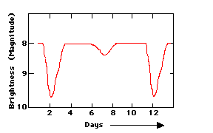
Time series of different lengths 1 of 2
What if you have two time series that are different lengths? For example, here Run B is only 81% the length of Run A.
This situation occurs quite a lot:
  Heartbeats recorded at 60bpm vs. 50bpm
  Star light curves come in discrete classes, but each class can have variable periods.
  An utterance of ‘Mississippi’ may take 0.6 to 0.9 seconds
  Etc.
This global difference in scaling is typically independent of the local scaling that DTW is designed to handle.
Run A
Run B
Star light curve
Notes:
EDU>> a=random_walk(128,1);
EDU>> b=random_walk(128,1);
EDU>> tic, DTW(a,b);,toc
Elapsed time is 0.189441 seconds.
This is with cDTW, with, w set to 10
(0.189441 * 1000000000) seconds in years = 6.00315126 years

Slide 42
Time series of different lengths 2 of 2
What if you have two time series that are different lengths? For example, here B is only 81% the length of A.
There are at least two things you can do:
1) Compare them in their native lengths.
2) Re-interpolate them to have the same length.
An inelegant, but quick way to do this in Matlab is:
Bnew= B(1:0.81:end);
Empirically makes little or no difference for classification, clustering etc.
However, the equal length case is much easier to handle, so we assume it from now on.
Run A
Run B
DTW(A , B) = 2.68
DTW(A , Bnew) = 2.71
Notes:
EDU>> a=random_walk(128,1);
EDU>> b=random_walk(128,1);
EDU>> tic, DTW(a,b);,toc
Elapsed time is 0.189441 seconds.
This is with cDTW, with, w set to 10
(0.189441 * 1000000000) seconds in years = 6.00315126 years

Slide 43
The Importance of Endpoints: 1 of 3
Consider the two time series below. They are similar, but out of phase, exactly the case that DTW is designed for.
Let us compare them using DTW….
0
5
10
15
20
25
30
35
40
45
50
Thanks to Diego Silva for help with this example
Notes:
EDU>> a=random_walk(128,1);
EDU>> b=random_walk(128,1);
EDU>> tic, DTW(a,b);,toc
Elapsed time is 0.189441 seconds.
This is with cDTW, with, w set to 10
(0.189441 * 1000000000) seconds in years = 6.00315126 years

Slide 44
The Importance of Endpoints: 2 of 3
DTW can be invariant to all the warping, but it cannot handle the difference at the very beginning of these two time series. Recall the boundary constraint:
  Boundary Condition: w₁ = (1,1) and w_{K} = (m,n), this requires the warping path to start and finish in diagonally opposite corner cells of the matrix.
This constraint means that DTW must match the pairs of beginning (and end) points, even though they may be a poor match, as here.
This region corresponds to only 6% of the length of the signals, yet it accounts for 70.5% of the DTW distance.
0
5
10
15
20
25
30
35
40
45
50

Slide 45
The Importance of Endpoints: 3 of 3
Possible Fixes (Open problem)
1) Use a better subsequence extraction algorithm. For example, the heartbeats to the right were very badly extracted, and have a large variability in the endpoints.
0
40
80
120
160
2) Recall the warping path is:
  W = w₁, w₂, w₃, … w_{K-2},w_{K-1},…,w_{K}
If you fear that the error is concentrated at the ends, you can multiple the first and last r elements by a weight Ŵ, with 0 ≤ Ŵ ≤ 1
3) Open-Ended Warping: Redefine the endpoint constraint. Change…
  Boundary conditions: w₁ = (1,1) and w_{K} = (m,n), this requires the warping path to start and finish in diagonally opposite corner cells of the matrix.
…to
    Boundary conditions: w₁ = (1,B) or (B,1) and w_{K} = (m-C,n) or (m,n-C), with 0 ≤ B ≤ r, and 0 ≤ C ≤ r this requires the warping path to start and finish in a cyan cell.
r
Only top right section of the warping matrix shown for brevity
Notes:
Open-Ended Warping: Here is a good refernce
Matching incomplete time series with dynamic time warping: an algorithm and an application to post-stroke rehabilitation
Paolo Tormene Toni Giorgino Silvana Quaglini, Mario Stefanelli

Slide 46
The Importance of Z-Normalization 1 of 3
Essentially all datasets must have every subsequence z-normalized.
There are a handful of occasions where it does not make sense to z-normalize, but in those cases, DTW probably does not make sense either.
In this example, we begin by extracting heartbeats from two unrelated people.
Even without normalization, it happens that both sets have almost the same mean and standard deviation. Given that, do we need to bother to normalize them? (next slide)
BIDMC Congestive Heart Failure Database: chf11
1
0
-1
-2
BIDMC Congestive Heart Failure Database: chf10
-3
0
1000
Extracted beats
chf10
chf11
0
150
300

Slide 47
The Importance of Z-Normalization 2 of 3
Surprisingly z-normalizing can be a computational bottleneck, but later we will show you how to fix that.
Without normalization, the results are very poor, some blue heartbeats are closer to red heartbeats than there are to another blue beat .
With normalization, the results are perfect.
BIDMC Congestive Heart Failure Database: chf11
1
0
-1
-2
BIDMC Congestive Heart Failure Database: chf10
-3
0
1000
Extracted beats
chf10
chf11
0
150
300
In this example, we extracted heartbeats from two different time series, and clustered them with and without normalization.
Un-normalized
Normalized

Slide 48
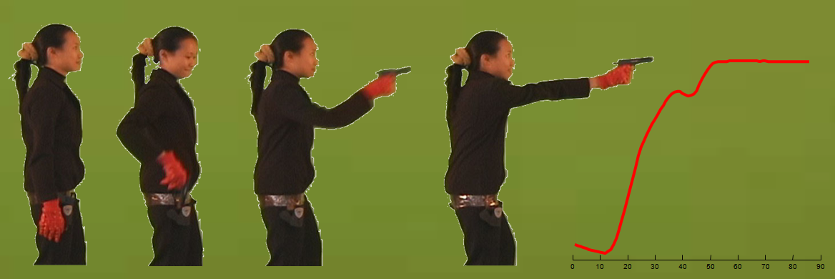
The Importance of Z-Normalization 3 of 3
Preempting a common misunderstanding
It is not sufficient to normalize the entire time series. You must normalize each subsequence
While there are a handful of normalization techniques , in most cases z-normalizing seems best:
T = (T-mean(T))/std(T)
Consider for example the famous Gun/Point dataset. Do we need to normalize it?
Not as it stands… …but suppose
The camera pans down? (the mean changes)
The camera zooms out? (the STD changes)
The actor wears high heel shoes? (the mean changes)
We find a shorter actor? (the mean and the STD change)

Slide 49
Can you beat 1NN-DTW?
Lots of papers claim to be able to beat 1NN-DTW, is that true?
Hmm…, no and yes.
No: More than 90% of such claims are false to cherry-picking, training and testing on the same data, the Texas Sharpshooter fallacy (see next slide) , etc
Yes: There are a handful of such methods, but…
  They sometimes win, but typically by very slim margins (say 1 to 3% better).
  They come at a huge cost of coding effort, time complexity.
  They just beat the most basic 1NN-DTW, with the simple CV trick to learn the warping window. It is less clear they could beat KNN-DTW, when a little more effort was spent to find a good warping window.
  We strongly recommend the bake-offs/discussion by Dr. Tony Bagnall.
At a minimum, it is clear that 1NN-DTW will get you within 98% of the best accuracy possible, in the first five minutes.
Notes:
Open-Ended Warping: Here is a good refernce
Matching incomplete time series with dynamic time warping: an algorithm and an application to post-stroke rehabilitation
Paolo Tormene Toni Giorgino Silvana Quaglini, Mario Stefanelli

Slide 50

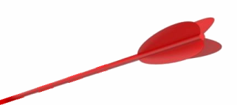
Can you beat 1NN-DTW?
The Texas Sharpshooter Fallacy
A paper in SIGMOD 2016 claims “Our STS3 approach is more accurate than DTW in our suitable scenarios”.
They then note “DTW outperforms STS3 in 79.5% cases.” !?! (our emphasis)
They then do a post-hoc explanation of why they think they won on 20.5% of the cases that “suit them”.
The problem is the post-hoc analysis, this is a form of the Texas Sharpshooter Fallacy. Below is a visual representation.
This is what they show you, and you are impressed…
Notes:
Open-Ended Warping: Here is a good refernce
Matching incomplete time series with dynamic time warping: an algorithm and an application to post-stroke rehabilitation
Paolo Tormene Toni Giorgino Silvana Quaglini, Mario Stefanelli

Slide 51



Can you beat 1NN-DTW?
The Texas Sharpshooter Fallacy
A paper in SIGMOD 2016 claims “Our STS3 approach is more accurate than DTW in our suitable scenarios”.
They then note “DTW outperforms STS3 in 79.5% cases.” !?! (our emphasis)
They then do a post-hoc explanation of why they think they won on 20.5% of the cases that “suit them”.
The problem is the post-hoc analysis, this is a form of the Texas Sharpshooter Fallacy. Below is a visual representation.
This is what they show you, and you are impressed…
…until you realize that they shot the arrow first, and then painted the target around it!
Notes:
Open-Ended Warping: Here is a good refernce
Matching incomplete time series with dynamic time warping: an algorithm and an application to post-stroke rehabilitation
Paolo Tormene Toni Giorgino Silvana Quaglini, Mario Stefanelli

Slide 52
Can you beat 1NN-DTW?
A good visual trick to compare algorithms of the 80 or so labeled time series in the public domain is the Texas Sharpshooter plot.
For each dataset
  First you compute the baseline accuracy of the approach you hope to beat.
  Then you compute the expected improvement we would get using your proposed approach (at this stage, learning any parameters and settings) using only the training data. Note that the expected improvement could be negative.
  Then compute the actual improvement obtained (using these now hardcoded parameters and settings) by testing on the test dataset.
You can plot the point {expected improvement , actual improvement } in a 2D grid, as below.
In this example, we predicted the expected improvement would be 10%, and the actual improvement obtained was 7%, pretty close!
We need to do these for all 80 or so datasets. What are the possible outcomes?
7%
Actual Accuracy Gain
10%
Expected Accuracy Gain

Slide 53
Can you beat 1NN-DTW? 3 of 3
With a Texas Sharpshooter plot, each dataset falls into one of four possibilities.
We expected an improvement and we got it! This is clearly the best case.
We expected to do worse, and we did. This is still a good case, we know not to use our proposed algorithm for these datasets
We expected to do worse, but we did better. This is the wasted opportunity case.
We expected to do better, but actually did worse. This is the worst case.
Texas Sharpshooter Plot
Now that we know how to read the plots, we will use it to see if DTW is better than Euclidean Distance,
Expected Improvement: We will search over different warping window constraints, from 0% to 100%, in 1% increments, looking for the warping window size that gives the highest 1NN training accuracy (if there are ties, we choose the smaller warping window size).
Actual Improvement: Using the warping window size we learned in the last phase, we test the holdout test data on the training set with 1NN.
We expected to do worse, but we did better
We expected an improvement and we got it!
Actual Accuracy Gain
We expected to do worse, and we did
We expected to do better, but actually did worse
Expected Accuracy Gain

Slide 54
The results are strongly supportive of the claim “DTW better than Euclidean distance for most problems”
We sometimes had difficultly in predicting when DTW would be better/worse, but many of the training sets are tiny, making such tests very difficult.
For example, 51 is BeetleFy, with just 20 train and 20 test instances. Here we expected to do a little better, but we did a little worse.
In contrast, for 76 (LargeKitchenAppliances) we had 375 train and 375 test instances, and where able to more accurately predict a large improvement.
2.2
78
2
82
1.8
1.6
76
Actual Accuracy Gain
1.4
41
40
68
10
42
52
39
15
1.2
70
9
5
27
38
7
13
85
14
29
6
72
80
59
64
60
3
28
79
11
19
32
71
8
36
81
2
43
74
44
58
1
37
45
48
54
23
67
62
65
18
84
75
83
86
1
20
63
24
73
77
16
34
56
21
30
25
12
49
26
55
22
17
4
31
50
35
53
69
61
33
47
46
57
66
51
0.8
0.8
1
1.2
1.4
1.6
1.8
2
2.2
Expected Accuracy Gain

Slide 55
Can you beat 1NN-DTW?
Recall the paper in SIGMOD that claimed “Our STS3 approach is more accurate than DTW in our suitable scenarios”. And “DTW outperforms STS3 in 79.5% cases.”
They are claiming to be better for 1/5th of the datasets, but in essence they are only reporting one axis of the Sharpshooter plot.
They did (slightly) win 20.5% of the time.
They lost 79.5% of the time.
Breakeven point
*We had considered trying to reimplment this work to make this plot. But the idea has 3 parameters, and the writing is quite vague..

Slide 56
Can you beat 1NN-DTW?
Recall the paper in SIGMOD that claimed “Our STS3 approach is more accurate than DTW in our suitable scenarios”. And “DTW outperforms STS3 in 79.5% cases.”
They are claiming to be better for 1/5th of the datasets, but in essence they are only reporting one axis of the Sharpshooter plot.
It may be* that if we computed the Sharpshooter plot it would look like the below (for two selected points only)
They did (slightly) win 20.5% of the time, but they did not predict ahead of time that they would win.
They lost 79.5% of the time.
Moreover, on a huge fraction of the datasets they lost on, they might have said “you should use our algorithm here, we think we will win”, and we would have been much worse off!
Actual Accuracy Gain
*We had considered trying to reimplment this work to make this plot. But the idea has 3 parameters, and the writing is quite vague..
Expected Accuracy Gain

Slide 57
Can you beat 1NN-DTW?
Summary for this section:
I think that at least 90% of the claims to beat DTW are wrong.
Of the 10% of claims that remain
  They are beating the simplest 1NN-DTW with w learned in a simple way. Using KNN-DTW , smoothing the data, relaxing the endpoint constraints, better methods for learning w etc, would often close some or all the gap.
  The improvements are so small in most cases, it takes a sophisticated and sensitive test to be sure you have a real improvement.
The Texas Sharpshooter test is a great sanity check for this, but you should see the work of Anthony Bagnall and students https://arxiv.org/abs/1602.01711 for a more principled methods.

Slide 58
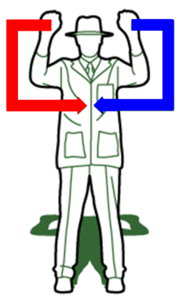
Generalizing to Multi-Dimensional Data 1 of 4
It is increasingly common to encounter Multi-Dimensional (MD) time series data. Here we measure the X-axis acceleration of both the left and right hand.
Given these pair of 2D objects…
Q
x
y
C
x
y
There are two obvious ways to compute the MD DTW score.
Independent: Just compute the DTW score for each dimension independently, and sum up each score.
Dependent: Create a single distance matrix that reflect the distance between each corresponding pair of time series, then find the single warping path and distance as per normal.
DTW_{I}(Q,C) = DTW(Q_{x},C_{x}) + DTW(Q_{y},C_{y}) = 2.4
(b)
DTW_{D}(Q,C) = DTW({Q_{x},Q_{y}},{C_{x},C_{y}}) = 3.2

Slide 59

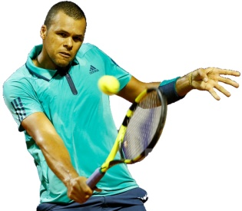
Generalizing to Multi-Dimensional Data 2 of 4
So, of DTW_{I} and DTW_{D} which is best?
Lets think of it this way:
The thing we want classify is an physical process, the utterance of the word “bicycle”, the beat of a heart, an autograph, a tennis shot etc.
We cannot see the actual event, just 2 or more time series it created.
  If the physical process affects the time series simultaneously, then DTW_{D} will probably be best. We call this the tightly coupled case.
  If the physical process affects the time series with varying lags, then DTW_{I} will probably be best. We call this the loosely coupled case.
Example: Suppose we measure the directionless acceleration of the left and right wrists of a tennis player.
The “physical process” is a backhand stoke. If a two-handed backstroke, the two time series are tightly coupled. If a one-handed backhand, the two hands will be very loosely coupled .
Jo-Wilfried Tsonga

Slide 60
Generalizing to Multi-Dimensional Data 3 of 4
We can demonstrate the claim in the last slide with experiments.
Let us begin with a dataset that we are 100% sure is tightly coupled, then slowly add some random time lags into the data…
We know that the handwriting dataset is tightly coupled. We find that DTW_{D} has an error-rate of about 0.42, much better than that DTW_{I} has an error-rate of about 0.55.
However, as we uncouple the perfect synchronization by adding some random lag, DTW_{D} quickly gets worse, while that DTW_{I} is barely effected.
handwriting dataset
0.8
DTW_{D}
0.7
DTW_{I}
Error Rate
0.6
0.5
0.4
0
5
10
15
20
25
30
35
40
More Random Lag →
(b)
Word Recognition from Articulatory Movement Data
This effect is observed on real data
Note the results here show that..
Using 2D can be better than 1D
Neither DTW_{I} nor DTW_{D} dominates
Data | DTW(_{1st}) | DTW(_{2nd}) | DTW_{I} | DTW_{D}
T1_{Z} UL_{X} | 0.34 | 0.59 | 0.25 | 0.31
T1_{Y} T1_{Z} | 0.38 | 0.34 | 0.24 | 0.15
Notes:
We consider a handwriting dataset, which we are confident is in D. Because we are considering the X and Y accelerations of the point of the writing tip of a pen, the two dimensions are physically coupled. Here, an event is the production of one of the twenty-six lower-case letters. We estimate the error rate of classification by randomly dividing the 5,000 objects into a stratified 1,000/4,000 train test split thirty times and reporting the average error rate.
It is critical to note that, in this dataset, if we were considering only the one-dimensional case, our synthetic modifications of the data would make essentially no difference to the distances DTW returns, or the overall error rate.

Slide 61
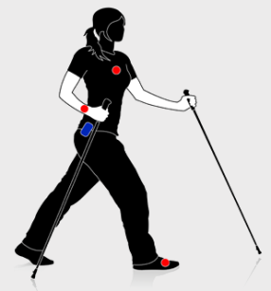
Generalizing to Multi-Dimensional Data 4 of 4
Critical Point: You can generalize DTW to 2,3,4,…1,000 dimensions.
However, it is very unlikely that more than 2 to 4 is useful, after that, you are almost certainly condemned to the curse of dimensionality.
Consider a physical activity dataset containing 36 axis synchronous measurements from three Inertial Measurement Units (IMUs) located on the wrist, chest and ankle. This dataset has eight subjects performing activities such as: rope-jumping, running, folding laundry, ascending-stairs.
Using all dimensions is a disaster!
Using the best three is a lot better than using the best one, so there is evidence that Multi-Dimensional DTW really does help.
PAMAP, Physical Activity Monitoring for Aging People www.pamap.org/
(we used DTW with w = 0 for simplicity here, we could do better by tuning w)
Which Dimensions? | Accuracy
All dimensions | 0.19
A single random dimension (on average) | 0.51
The best single dimension (as predicted by CV) | 0.72
The best 3 dimensions (as predicted by CV) | 0.89
(b)
Notes:
We consider a handwriting dataset, which we are confident is in D. Because we are considering the X and Y accelerations of the point of the writing tip of a pen, the two dimensions are physically coupled. Here, an event is the production of one of the twenty-six lower-case letters. We estimate the error rate of classification by randomly dividing the 5,000 objects into a stratified 1,000/4,000 train test split thirty times and reporting the average error rate.
It is critical to note that, in this dataset, if we were considering only the one-dimensional case, our synthetic modifications of the data would make essentially no difference to the distances DTW returns, or the overall error rate.

Slide 62
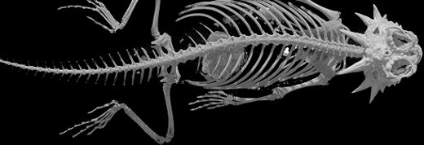

Summary…

Slide 63
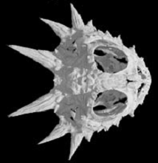
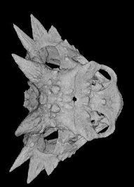
Flat-tailed Horned Lizard
Phrynosoma mcallii
Summary…
DTW is an extraordinarily powerful and useful tool.
Its uses are limited only by our imaginations.
We believe it will remain and important part of the data mining toolbox for decades to come.
Texas Horned Lizard
Phrynosoma cornutum

Slide 64

Coffee Break!
When we come back after the break
Dr. Mueen will take over
We will learn how to speed up DTW, and scale up to a trillion subsequences!
Notes:
EDU>> a=random_walk(128,1);
EDU>> b=random_walk(128,1);
EDU>> tic, DTW(a,b);,toc
Elapsed time is 0.189441 seconds.
This is with cDTW, with, w set to 10
(0.189441 * 1000000000) seconds in years = 6.00315126 years

