Slide 1
ECE 476
Power System Analysis
Lecture 9: Transformers
Prof. Tom Overbye
Dept. of Electrical and Computer Engineering
University of Illinois at Urbana-Champaign
overbye@illinois.edu

Slide 2
Announcements
Please read Chapter 3
HW 4 is 4.32, 4.41, 5.1, 5.7, 5.14; this one must be turned in on Sept 22 (hence there will be no quiz that day)
Exam 1 is Thursday Oct 6 in class
  Closed book, closed notes, but you may bring one 8.5 by 11 inch note sheet and standard calculators
Power Area Scholarships, Awards (Oct 1 deadlines, except Nov 1 for Grainger)
http://energy.ece.illinois.edu/
Turn into Prof Sauer (4046 or 4060)

Slide 3
Three Line Models

Slide 4
Power Transfer in Short Lines
Often we'd like to know the maximum power that could be transferred through a short transmission line
I₁
I₁
+
Transmission
Line with
Impedance Z
+
V₁
S₁₂
S₂₁
V₂
-
-

Slide 5
Power Transfer in Lossless Lines

Slide 6
Limits Affecting Max. Power Transfer
Thermal limits
  limit is due to heating of conductor and hence depends heavily on ambient conditions.
  For many lines, sagging is the limiting constraint.
  Newer conductors limit can limit sag. For example, in 2004 ORNL working with 3M announced lines with a core consisting of ceramic Nextel fibers. These lines can operate at 200 degrees C.
  Trees grow, and will eventually hit lines if they are planted under the line.

Slide 7
Other Limits Affecting Power Transfer
Angle limits
  while the maximum power transfer occurs when line angle difference is 90 degrees, actual limit is substantially less due to multiple lines in the system
Voltage stability limits
  as power transfers increases, reactive losses increase as I²X. As reactive power increases the voltage falls, resulting in a potentially cascading voltage collapse.

Slide 8
Example 5.8

Slide 9
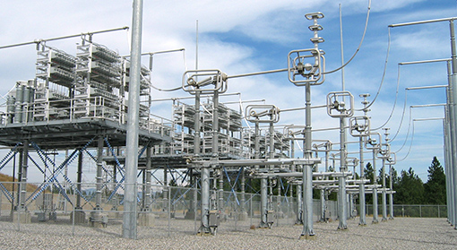
Transmission Line Series Compensation
One way to increase the transmission capacity of a transmission line that is limited by its reactance is to add series compensation
  Capacitors are placed in series with the transmission line
  (covered in Example 5.10)
Image shows
BPA series
capacitors in
a 500 kV
line
Image: https://www.bpa.gov/news/newsroom/Pages/Chief-engineers-reunite-reminisce-for-BPAs-75th.aspx

Slide 10
Transmission Line Series Compensation
Amount of series compensation is expressed as a percentage of the total line reactance (e.g., 50%)
The series capacitance is usually setup so that it can be bypassed sometimes
  There can be excessive reactive power generation on the system during light loads, like at night
There can be a concern with sub-synchronous interactions (SSI)

Slide 11
Example 5.10

Slide 12
Transformers Overview
Power systems are characterized by many different voltage levels, ranging from 765 kV down to 240/120 volts.
Transformers are used to transfer power between different voltage levels.
The ability to inexpensively change voltage levels is a key advantage of ac systems over dc systems.
In this section we’ll development models for the transformer and discuss various ways of connecting three phase transformers.

Slide 13
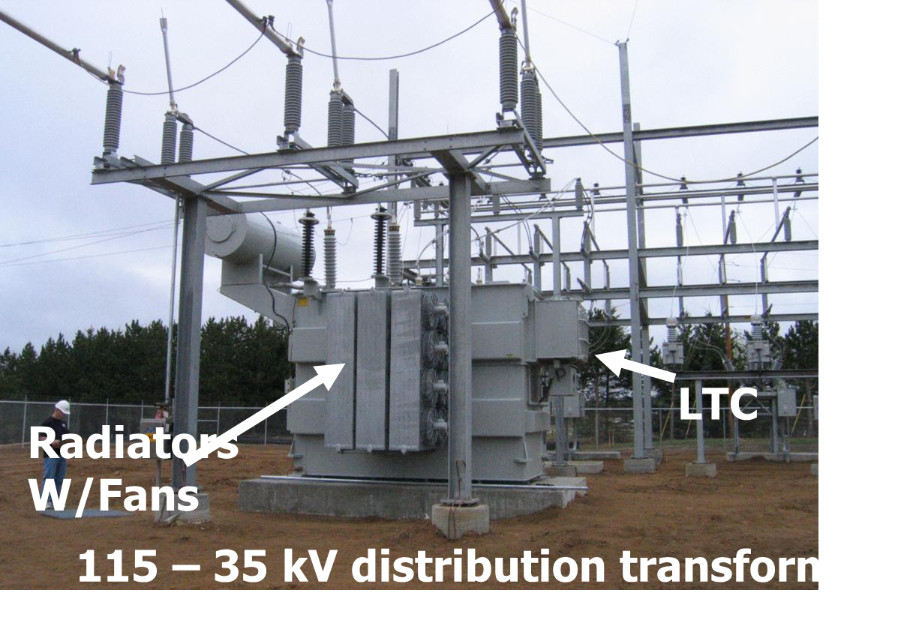
Transmission to Distribution Transfomer

Slide 14
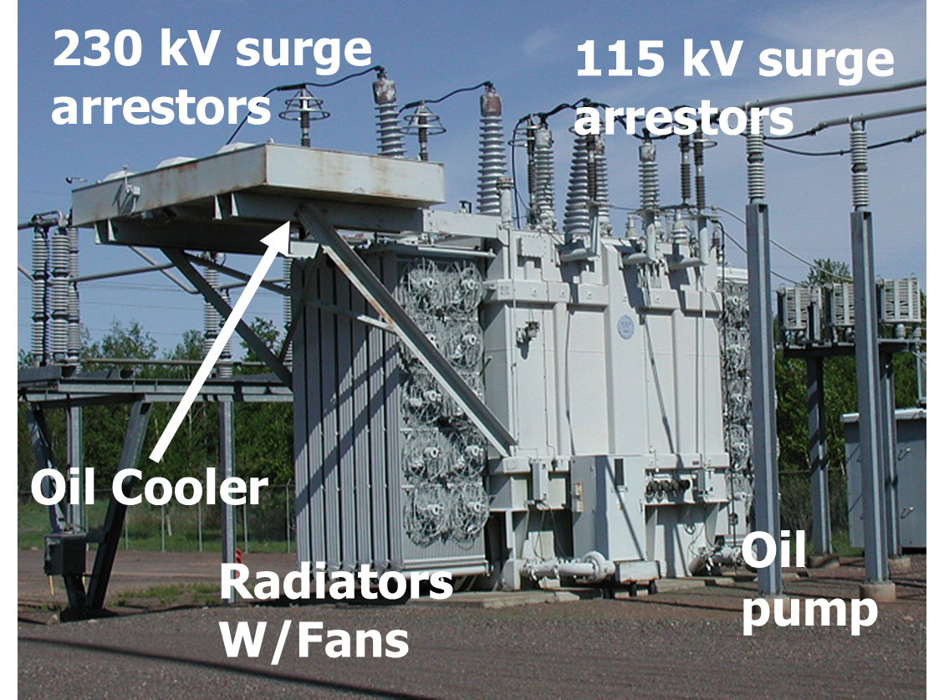
Transmission Level Transformer

Slide 15
Ideal Transformer
First we review the voltage/current relationships for an ideal transformer
  no real power losses
  magnetic core has infinite permeability
  no leakage flux
We’ll define the “primary” side of the transformer as the side that usually takes power, and the secondary as the side that usually delivers power.
  primary is usually the side with the higher voltage, but may be the low voltage side on a generator step-up transformer.

Slide 16
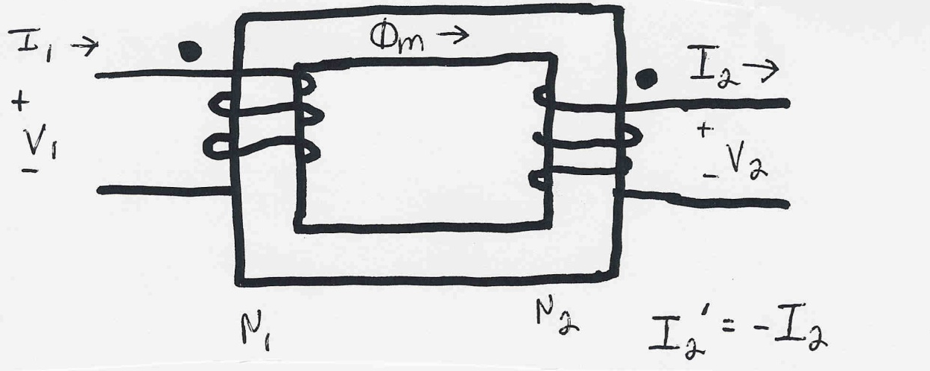
Ideal Transformer Relationships

Slide 17
Current Relationships

Slide 18
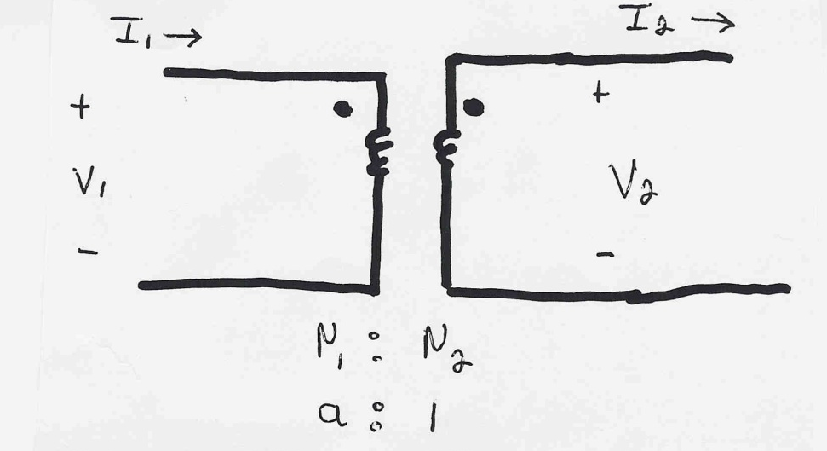
Current/Voltage Relationships

Slide 19
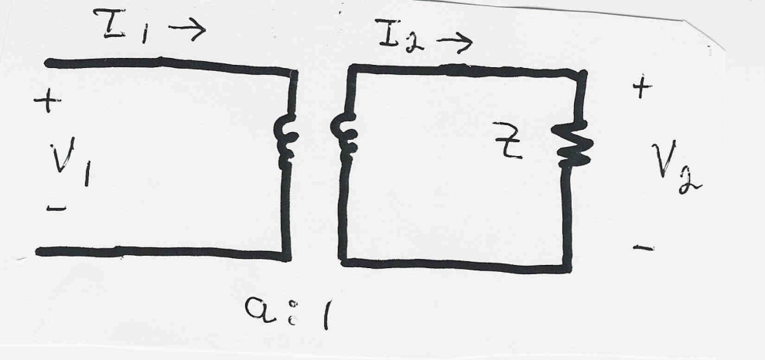
Impedance Transformation Example
Example: Calculate the primary voltage and current for an impedance load on the secondary

Slide 20
Real Transformers
Real transformers
  have losses
  have leakage flux
  have finite permeability of magnetic core
Real power losses
  resistance in windings (i² R)
  core losses due to eddy currents and hysteresis

Slide 21
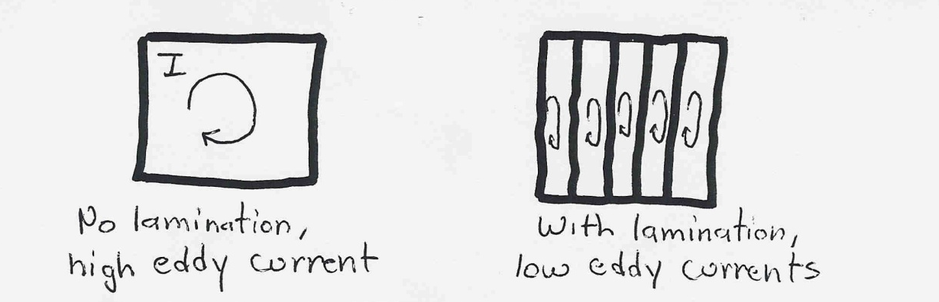
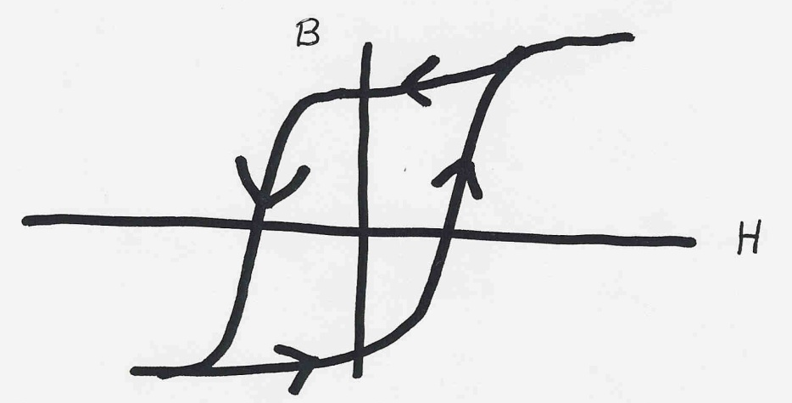
Transformer Core losses
Eddy currents arise because of changing flux in core.
Eddy currents are reduced by laminating the core
Hysteresis losses are proportional to area of BH curve
and the frequency
These losses are reduced by using material with a
thin BH curve

Slide 22
Effect of Leakage Flux

Slide 23
Effect of Finite Core Permeability

Slide 24
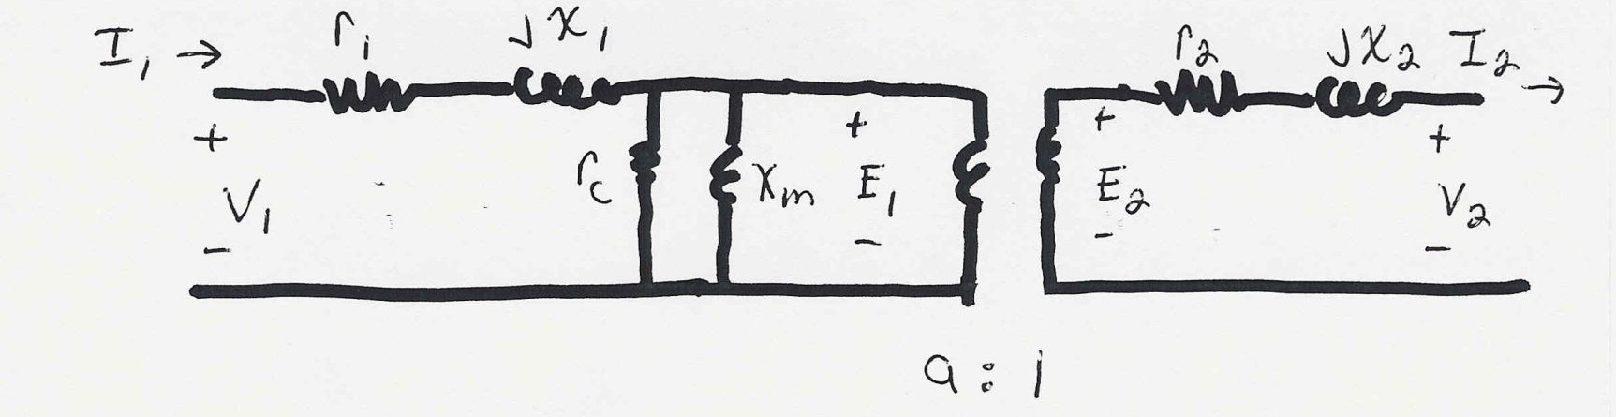
Transformer Equivalent Circuit
Using the previous relationships, we can derive an
equivalent circuit model for the real transformer

Slide 25
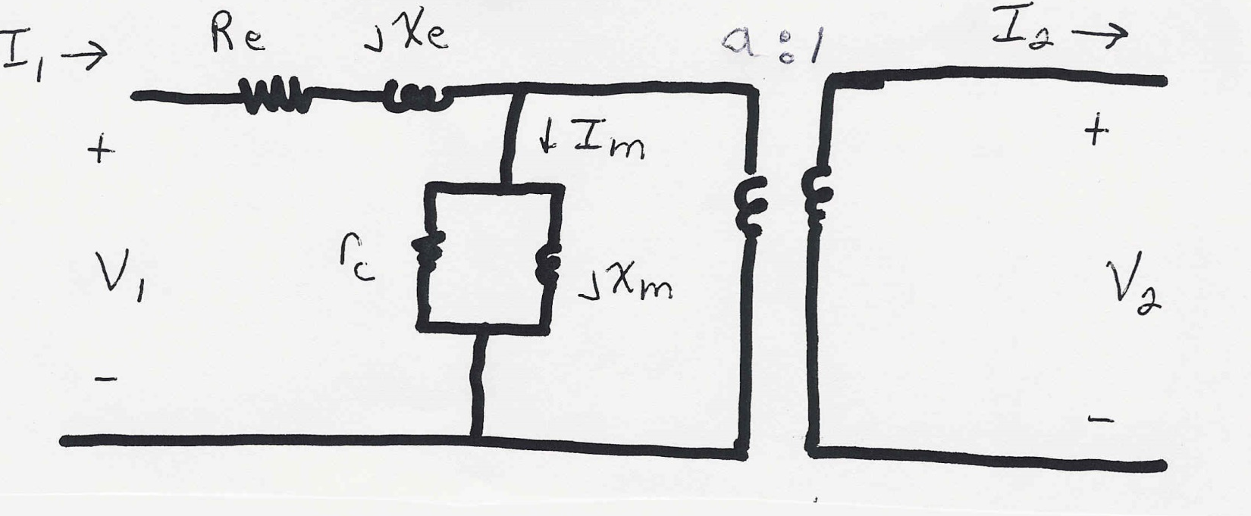
Simplified Equivalent Circuit

Slide 26
Calculation of Model Parameters
The parameters of the model are determined based upon
  nameplate data: gives the rated voltages and power
  open circuit test: rated voltage is applied to primary with secondary open; measure the primary current and losses (the test may also be done applying the voltage to the secondary, calculating the values, then referring the values back to the primary side).
  short circuit test: with secondary shorted, apply voltage to primary to get rated current to flow; measure voltage and losses.

Slide 27
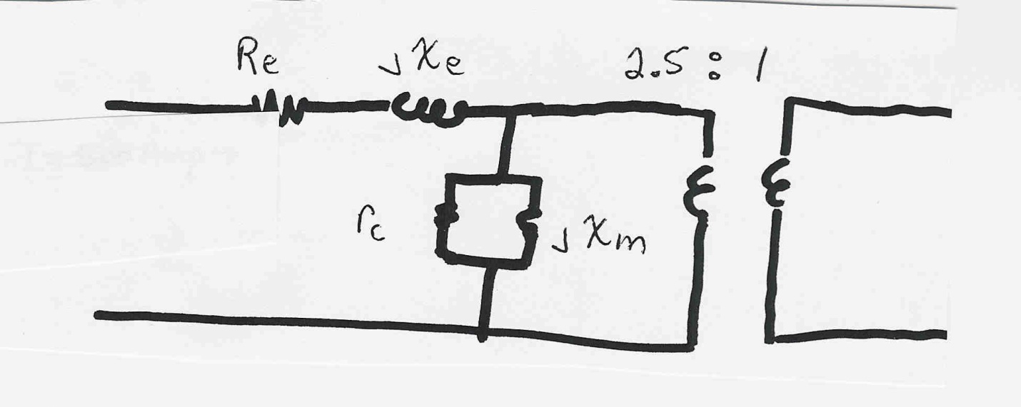
Transformer Example
Example: A single phase, 100 MVA, 200/80 kV transformer has the following test data:
open circuit: 20 amps, with 10 kW losses
short circuit: 30 kV, with 500 kW losses
Determine the model parameters.

Slide 28
Transformer Example, cont’d

Slide 29
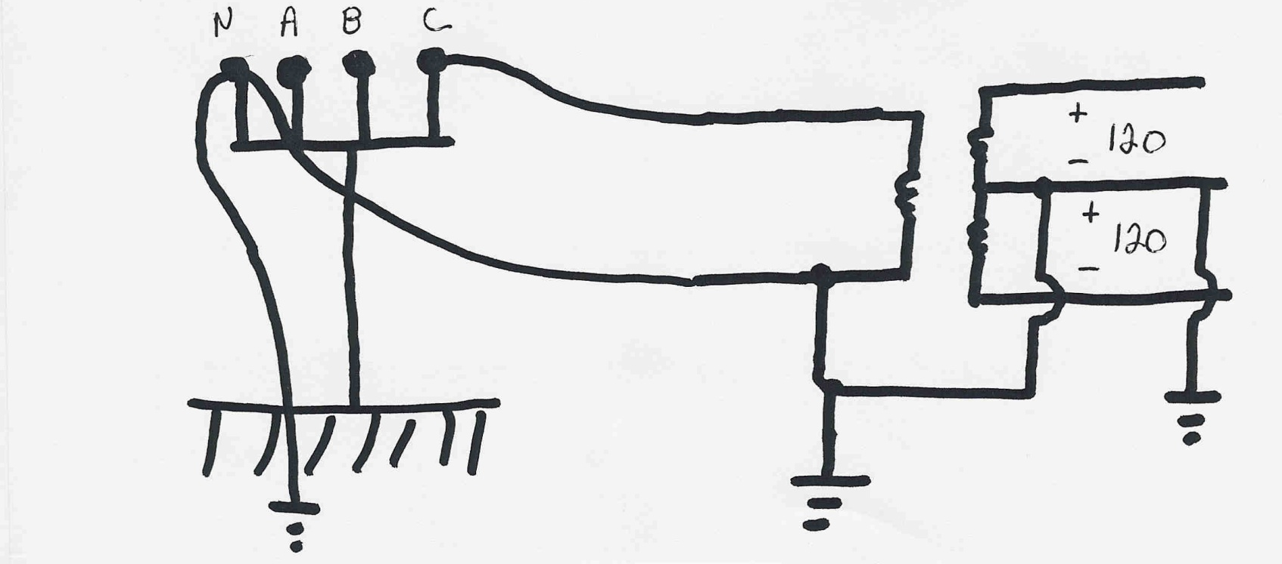
Residential Distribution Transformers
Single phase transformers are commonly used in
residential distribution systems. Most distribution
systems are 4 wire, with a multi-grounded, common
neutral.

