Slide 1
ECE 476
Power System Analysis
Lecture 7: Transmission Line Parameters
Prof. Tom Overbye
Dept. of Electrical and Computer Engineering
University of Illinois at Urbana-Champaign
overbye@illinois.edu

Slide 2
Announcements
Please read Chapters 4 and 5 (skim 4.7, 4.11, 4.12)
HW 3 is 4.9 (use lecture results for 4.8 comparison), 4.12, 4.19 (just compare 4.19a to 4.19b), 4.25
  It does not need to be turned in, but will be covered by an in-class quiz on Thursday Sept 15
  Positive sequence is same as per phase; it will be covered in Chapter 8
  Use Table A.4 values to determine the Geometric Mean Radius of the wires (i.e., the ninth column).

Slide 3
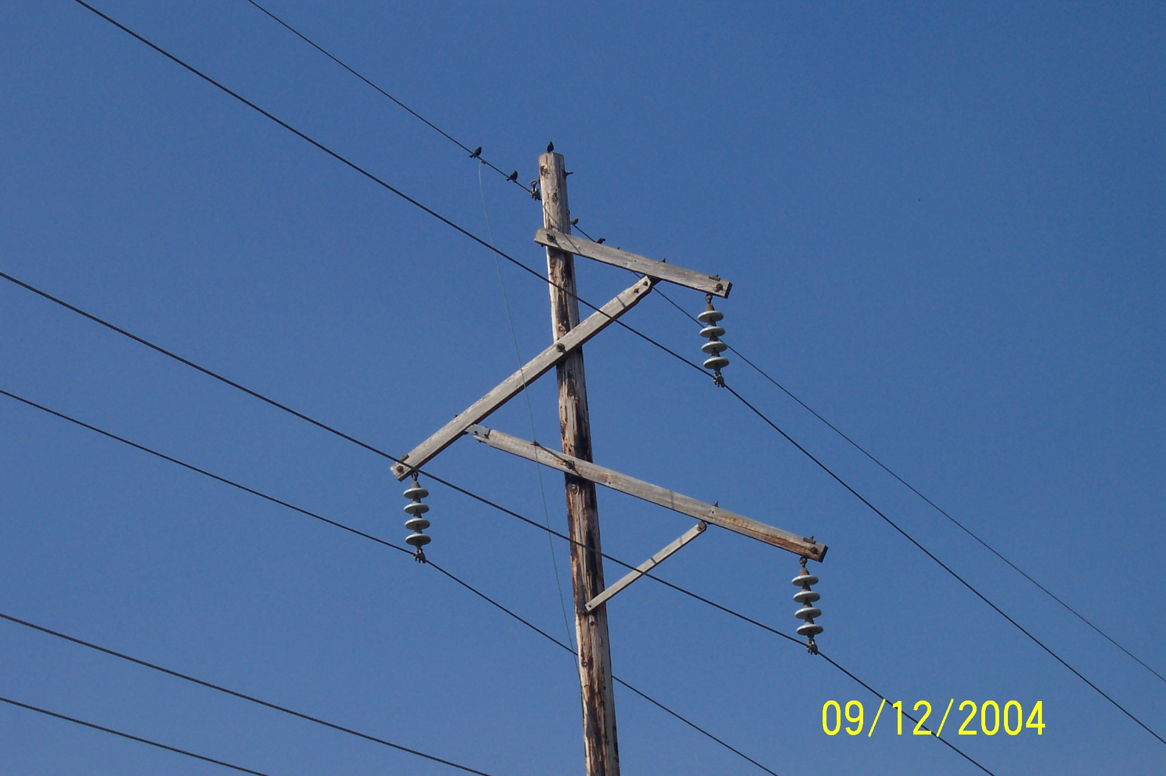
Birds Do Not Sit on High Voltage Lines

Slide 4
Voltage Difference

Slide 5
Voltage Difference, cont’d

Slide 6
Multi-Conductor Case

Slide 7
Multi-Conductor Case, cont’d

Slide 8
Absolute Voltage Defined

Slide 9
Three Conductor Case
A
Assume we have three infinitely long conductors, A, B, & C, each with radius r and distance D from the other two conductors.
Assume charge densities such
that q_{a} + q_{b} + q_{c} = 0
C
B

Slide 10
Line Capacitance

Slide 11
Line Capacitance, cont’d

Slide 12
Bundled Conductor Capacitance

Slide 13
Line Capacitance, cont’d

Slide 14
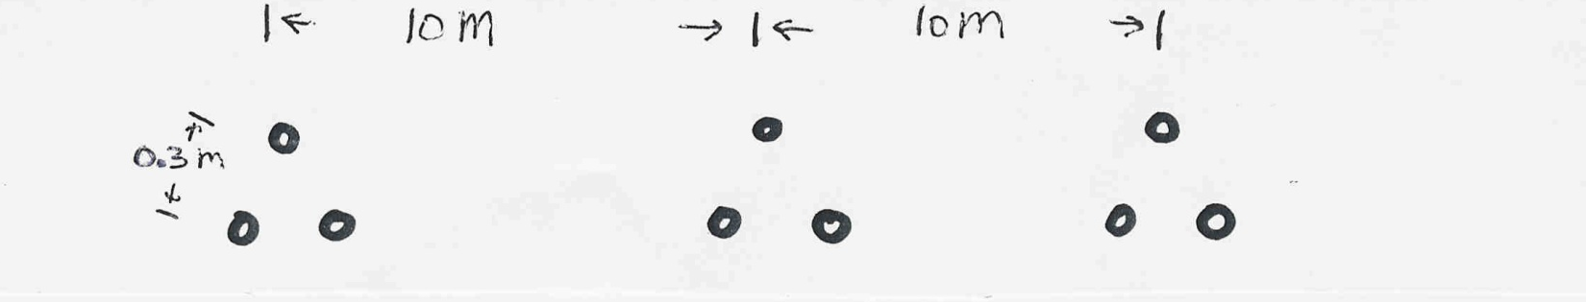
Line Capacitance Example
Calculate the per phase capacitance and susceptance
of a balanced 3φ, 60 Hz, transmission line with horizontal phase spacing of 10m using three conductor bundling with a spacing between conductors in the bundle of 0.3m. Assume the line is uniformly transposed and the conductors have a a 1cm radius.

Slide 15
Line Capacitance Example, cont’d

Slide 16
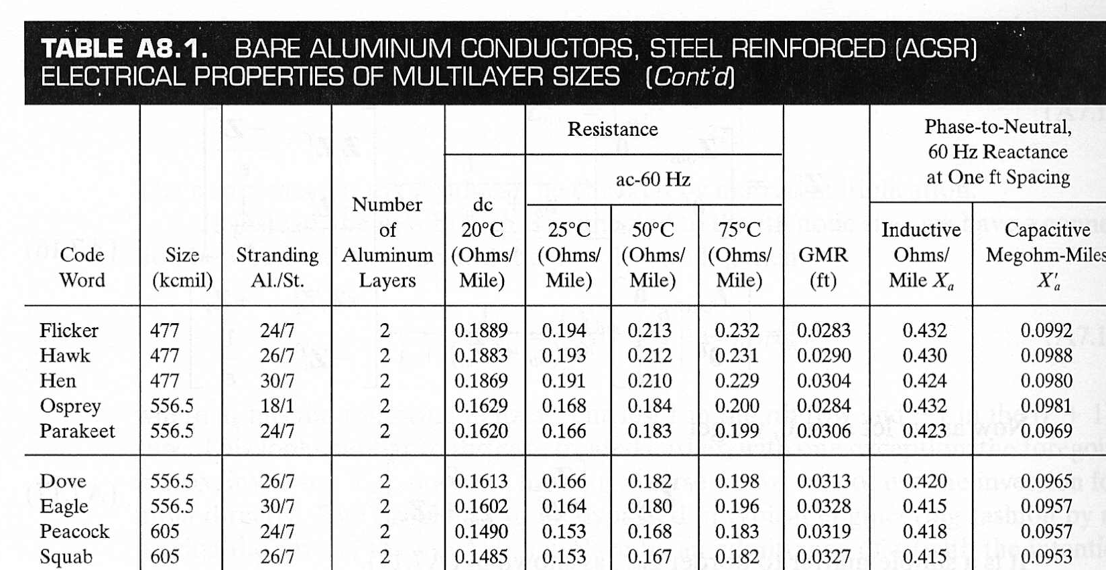
ACSR Table Data (Similar to Table A.4)
GMR is equivalent to r’
Inductance and Capacitance
assume a D_{m} of 1 ft.

Slide 17
ACSR Data, cont’d
Term independent
of conductor with
D_{m} in feet.
Term from table assuming
a one foot spacing

Slide 18
ACSR Data, Cont.
Term independent
of conductor with
D_{m} in feet.
Term from table assuming
a one foot spacing

Slide 19
Dove Example

Slide 20
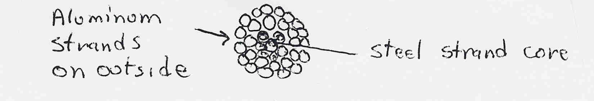
Line Conductors
Typical transmission lines use multi-strand conductors
ACSR (aluminum conductor steel reinforced)
conductors are most common. A typical Al. to St. ratio is about 4 to 1.

Slide 21
Line Conductors, cont’d
Total conductor area is given in circular mils. One circular mil is the area of a circle with a diameter of 0.001 = π × 0.0005² square inches
Example: what is the area of a solid, 1” diameter circular wire?
Answer: 1000 kcmil (kilo circular mils)
Because conductors are stranded, the equivalent radius must be provided by the manufacturer. In tables this value is known as the GMR and is usually expressed in feet.

Slide 22
Line Resistance

Slide 23
Line Resistance, cont’d
Because ac current tends to flow towards the surface of a conductor, the resistance of a line at 60 Hz is slightly higher than at dc.
Resistivity and hence line resistance increase as conductor temperature increases (changes is about 10% between 25°C and 50°C, 0.4% per degree C)
Because ACSR conductors are stranded, actual resistance, inductance and capacitance needs to be determined from tables.

Slide 24
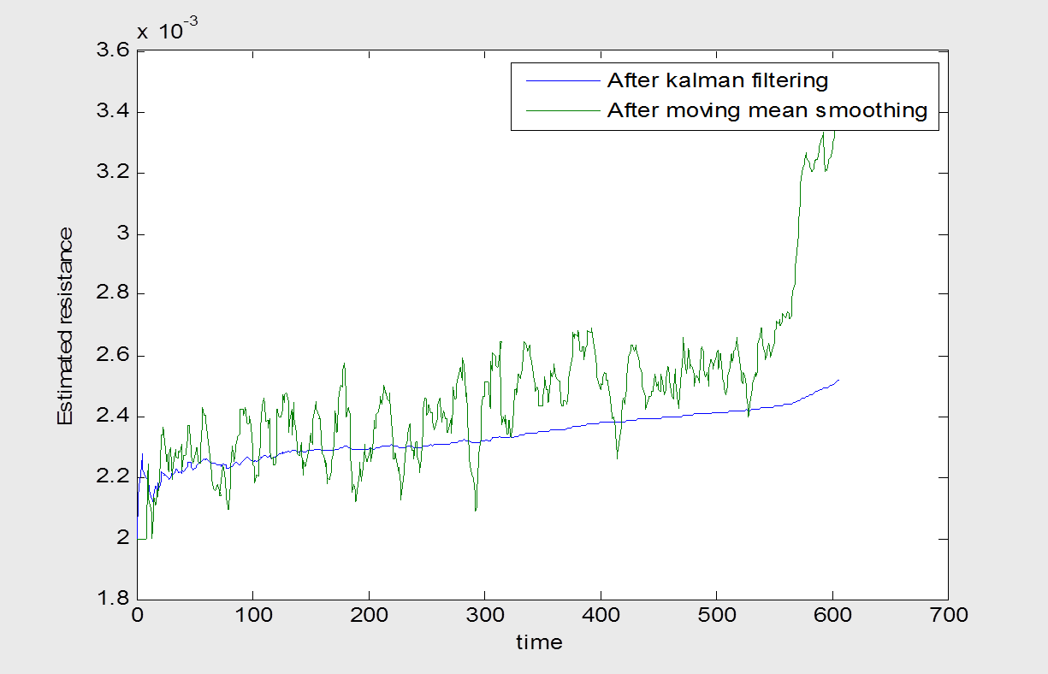
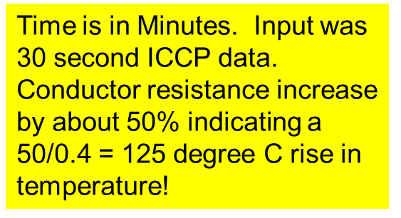
Variation in Line Resistance Example

Slide 25
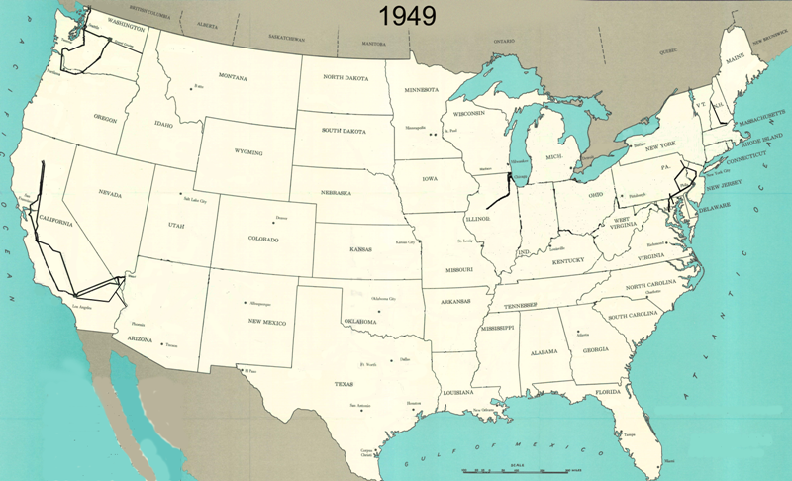
345 kV+ Transmission Growth at a Glance

Slide 26
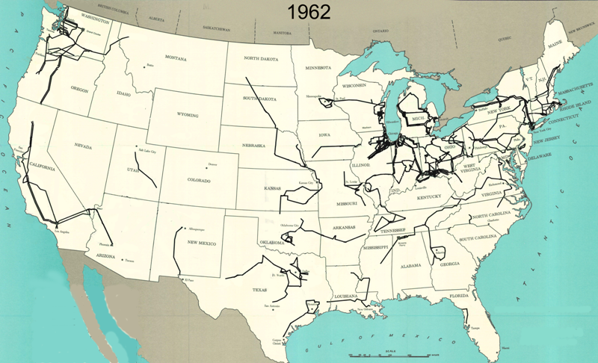
345 kV+ Transmission Growth at a Glance
Notes:
Note that these facilities have exceeded their lives and key ones like the Mt Storm – Doubs 500kV line built in 1966 that Dominium announced is in need of replacment. Going to upgrade capacity using triple ACSR in lieu of double all alumimum conductors too. See 4/11 SNL article…

Slide 27
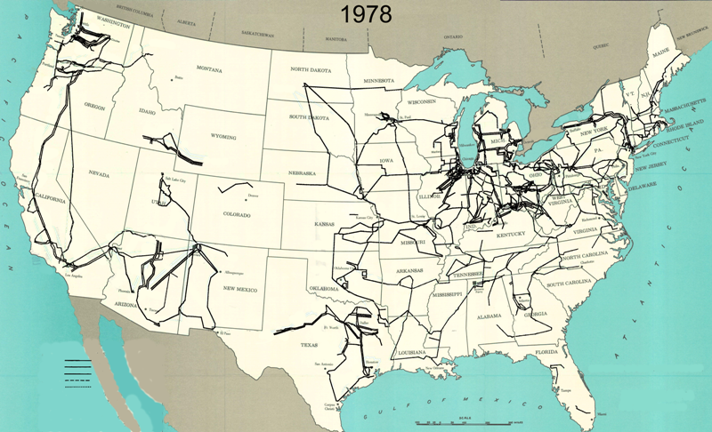
345 kV+ Transmission Growth at a Glance

Slide 28
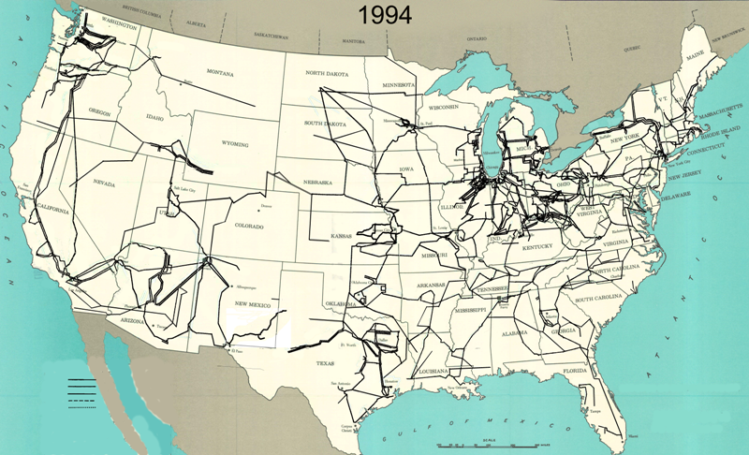
345 kV+ Transmission Growth at a Glance

Slide 29
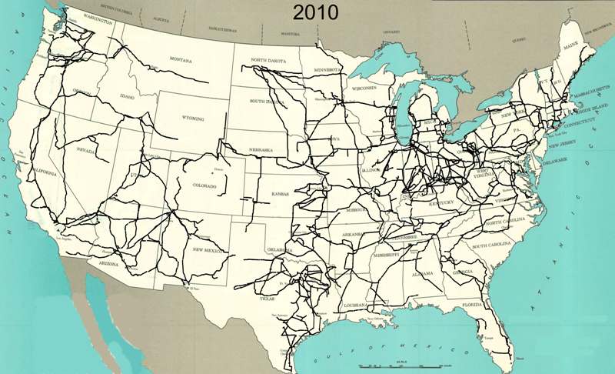
345 kV+ Transmission Growth at a Glance

Slide 30
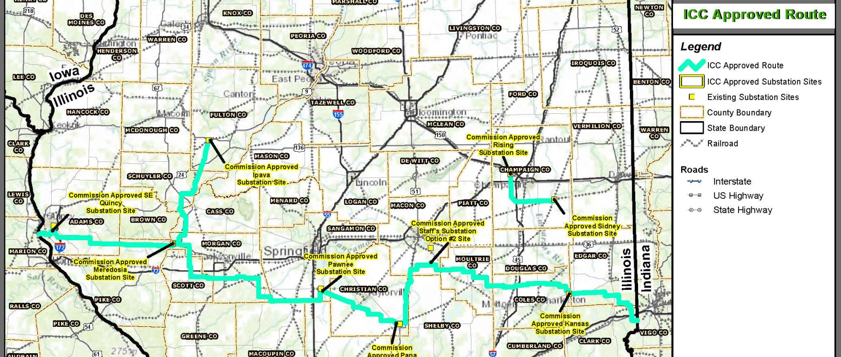
Ameren Illinois Rivers 345 kV Project
Ameren is in the process of building a number of 345 kV transmission lines across Central Illinois.
  Locally this includes a line between Sidney and Rising
  in Champaign County
http://www.ilriverstransmission.com/maps

Slide 31
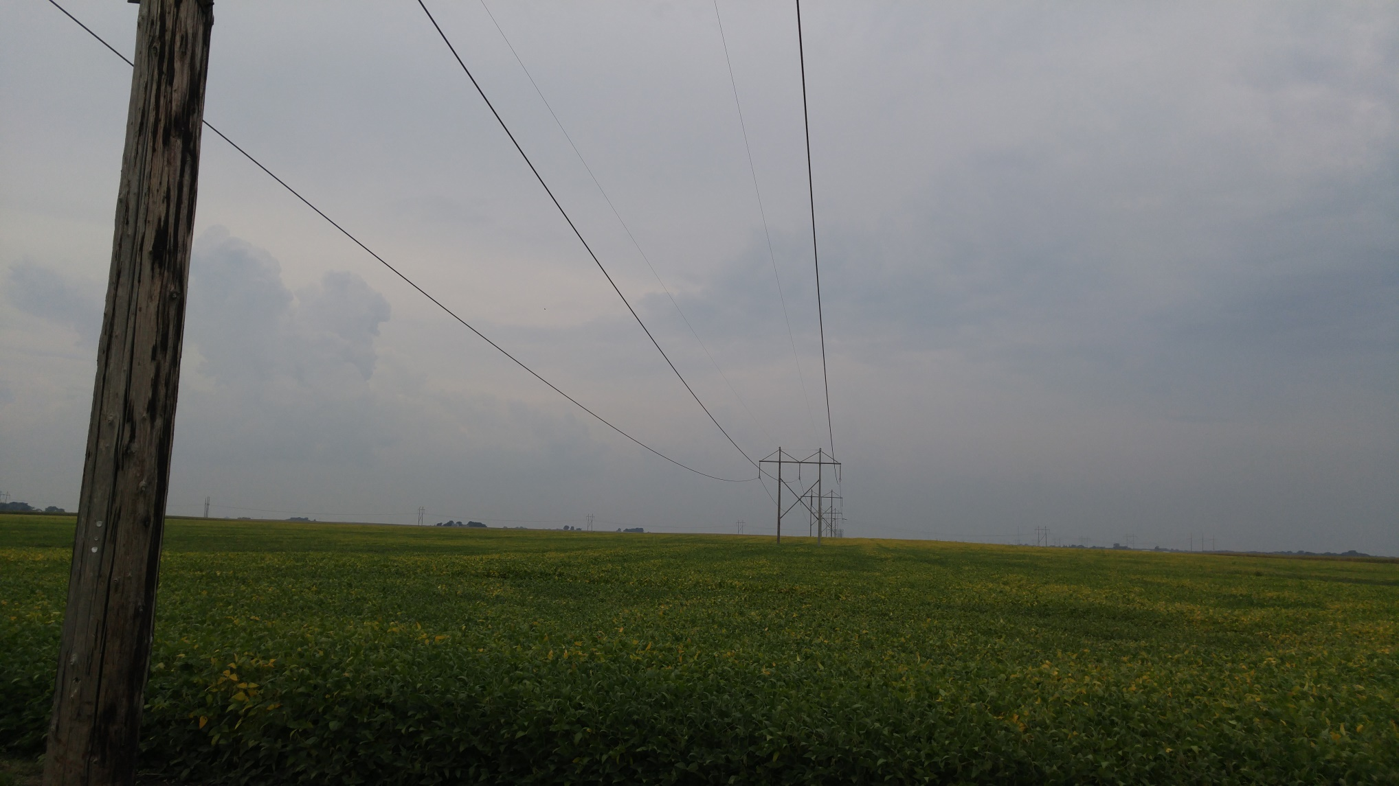
Sidney to Bunsonville 345 kV

Slide 32
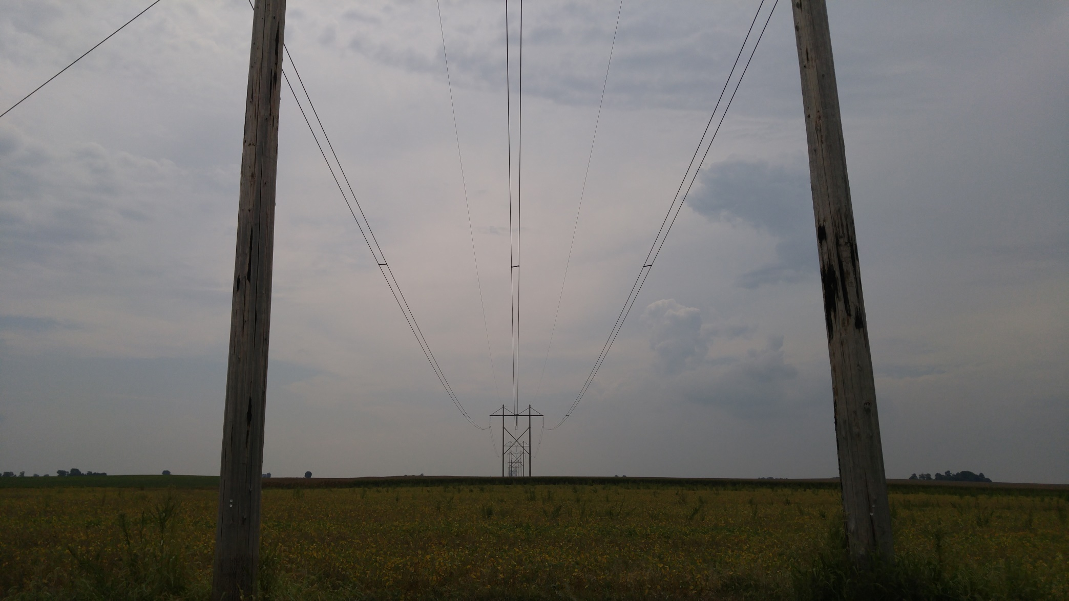
Sidney to Kansas (IL) 345

Slide 33
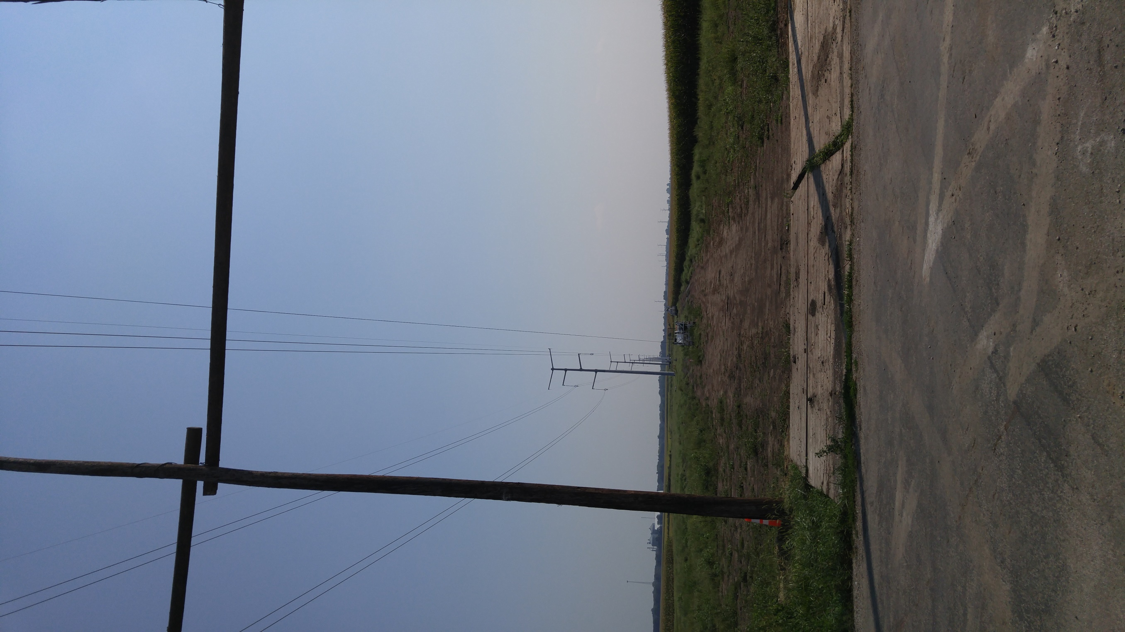
Sidney to Rising 345 kV

Slide 34
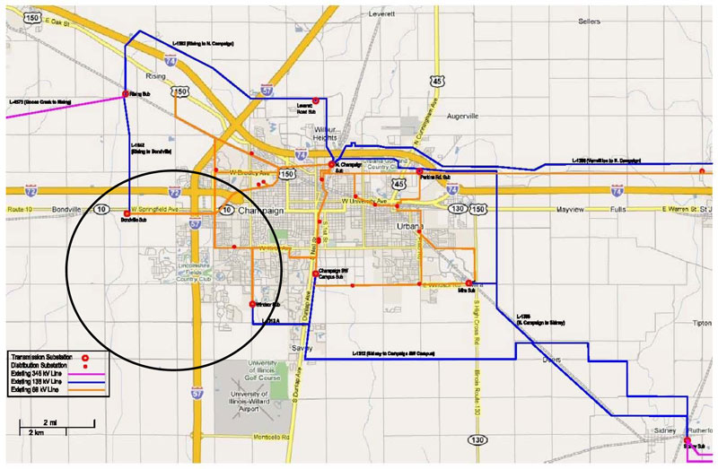
Champaign-Urbana Part of Grid

Slide 35
Additional Transmission Topics
Multi-circuit lines: Multiple lines often share a common transmission right-of-way. This DOES cause mutual inductance and capacitance, but is often ignored in system analysis.
Cables: There are about 3000 miles of underground ac cables in U.S. Cables are primarily used in urban areas. In a cable the conductors are tightly spaced, (< 1ft) with oil impregnated paper commonly used to provide insulation
  inductance is lower
  capacitance is higher, limiting cable length

Slide 36
Additional Transmission Topics
Ground wires: Transmission lines are usually protected from lightning strikes with a ground wire. This topmost wire (or wires) helps to attenuate the transient voltages/currents that arise during a lighting strike. The ground wire is typically grounded at each pole.
Corona discharge: Due to high electric fields around lines, the air molecules become ionized. This causes a crackling sound and may cause the line to glow!

Slide 37
Additional Transmission Topics
Shunt conductance: Usually ignored. A small current may flow through contaminants on insulators.
DC Transmission: Because of the large fixed cost necessary to convert ac to dc and then back to ac, dc transmission is only practical for several specialized applications
  long distance overhead power transfer (> 400 miles)
  long cable power transfer such as underwater
  providing an asynchronous means of joining different power systems (such as the Eastern and Western grids).

Slide 38
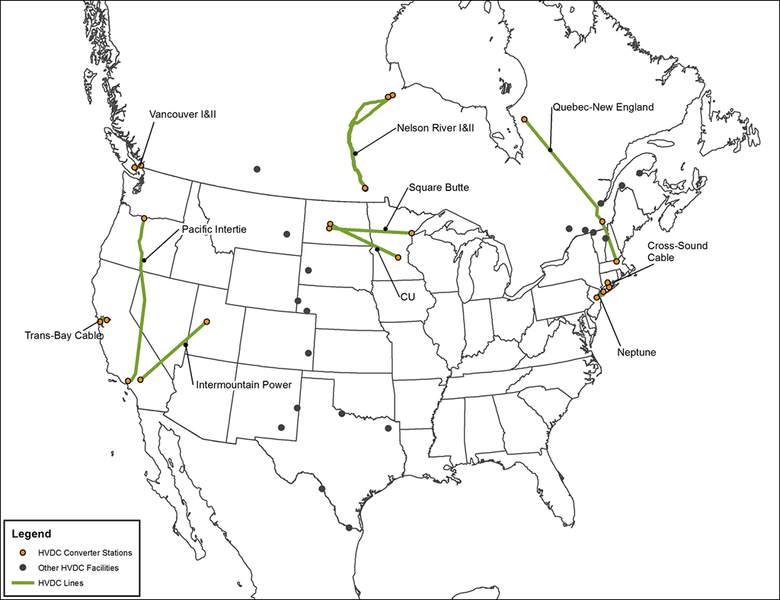
HVDC Lines in North America
http://www.grainbeltexpresscleanline.com/site/page/history_of_hvdc_transmission

