Slide 1
ECE 476 Power System Analysis
Lecture 6: Transmission Line Parameters
Prof. Tom Overbye
Dept. of Electrical and Computer Engineering
University of Illinois at Urbana-Champaign
overbye@illinois.edu
Special Guest Lecturer: TA Iyke Idehen

Slide 2
Announcements
Please read Chapters 4 and 5
Quiz today on HW 2
HW 3 is 4.9 (use lecture results for 4.8 comparison), 4.12, 4.19 (just compare 4.19a to 4.19b), 4.25
It does not need to be turned in, but will be covered by an in-class quiz on Thursday Sept 15
Positive sequence is same as per phase; it will be covered in Chapter 8
Use Table A.4 values to determine the Geometric Mean Radius of the wires (i.e., the ninth column).

Slide 3
Many-Conductor Case, cont’d

Slide 4
Many-Conductor Case, cont’d

Slide 5
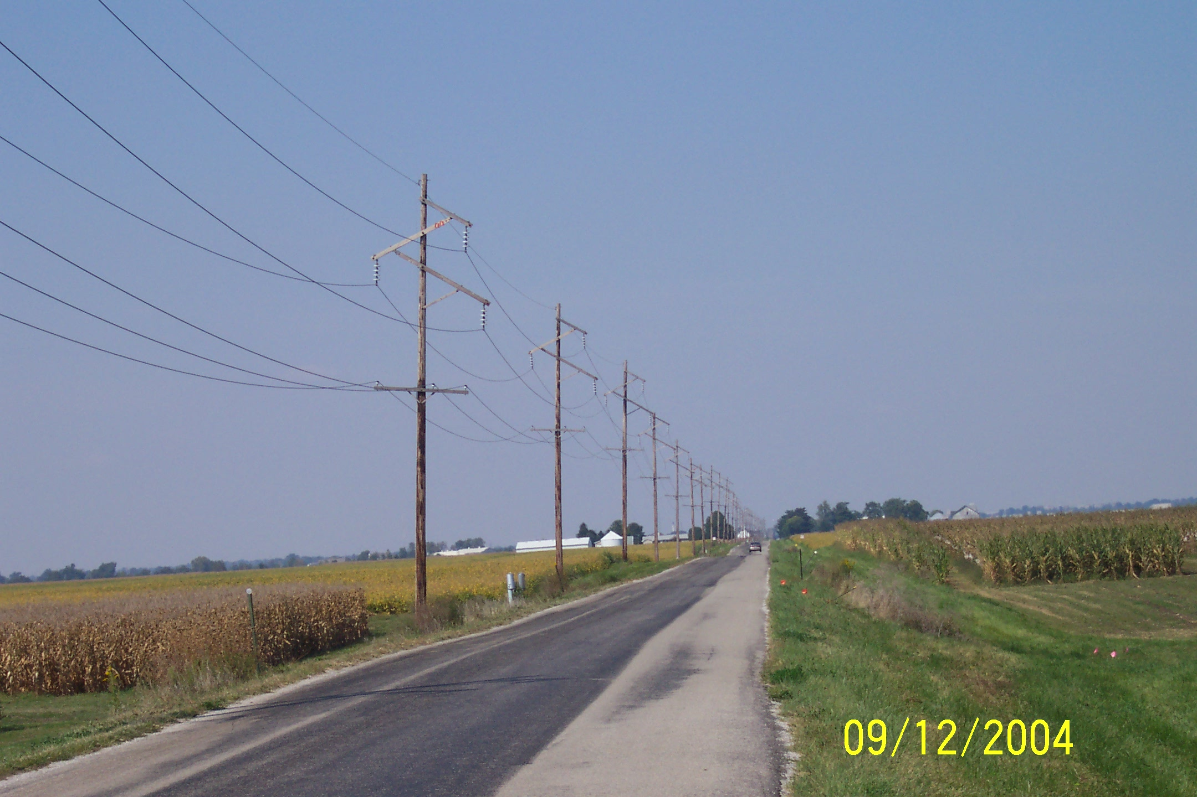
Symmetric Line Spacing – 69 kV

Slide 6
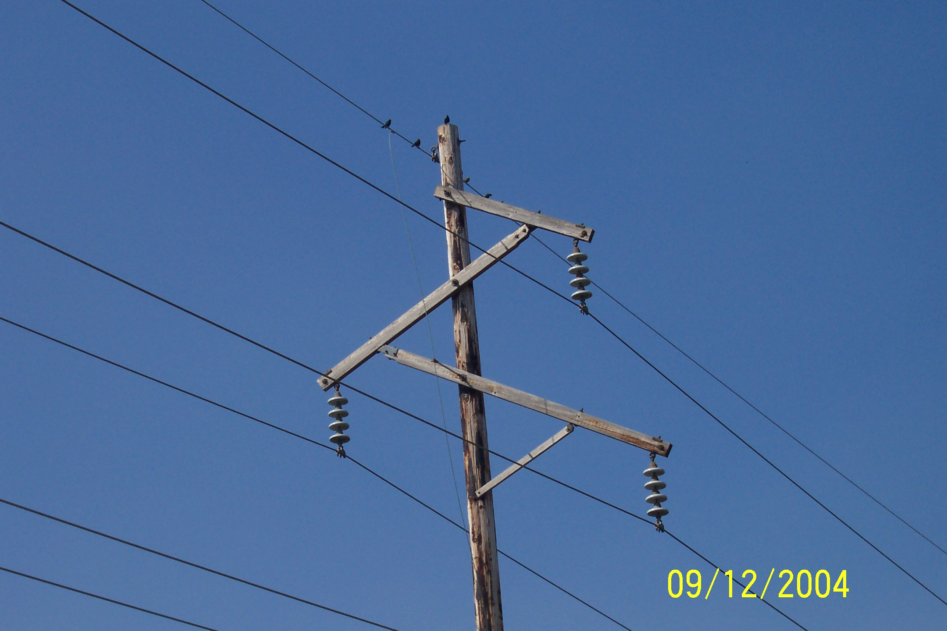
Birds Do Not Sit on the Conductors

Slide 7
Line Inductance Example
Calculate the reactance for a balanced 3φ, 60Hz
transmission line with a conductor geometry of an
equilateral triangle with D = 5m, r = 1.24cm (Rook conductor) and a length of 5 miles.

Slide 8
Line Inductance Example, cont’d

Slide 9
Conductor Bundling
To increase the capacity of high voltage transmission
lines it is very common to use a number of
conductors per phase. This is known as conductor
bundling. Typical values are two conductors for
345 kV lines, three for 500 kV and four for 765 kV.

Slide 10
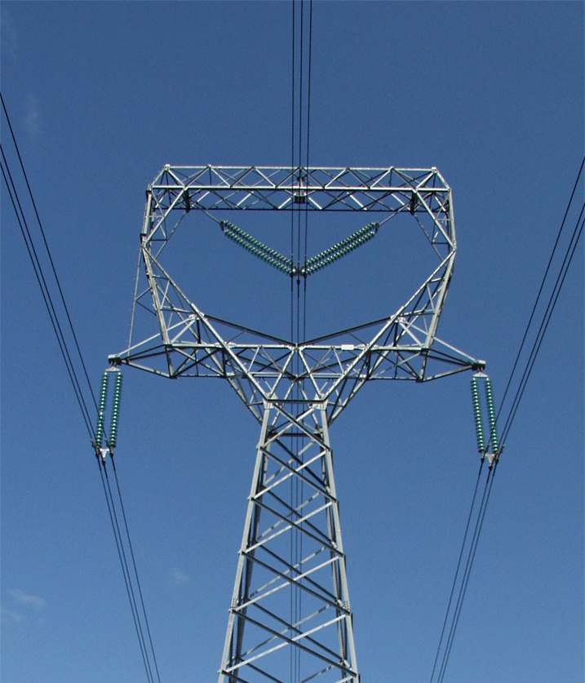
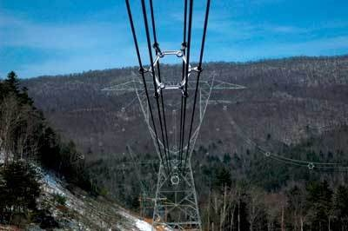
Bundled Conductor Pictures
The AEP Wyoming-Jackson Ferry 765 kV line uses
6-bundle conductors. Conductors in a bundle are at the same voltage!
Photo Source: BPA and American Electric Power

Slide 11
Bundled Conductor Flux Linkages
For the line shown on the left,
define d_{ij} as the distance bet-
ween conductors i and j. We
can then determine λ for each

Slide 12
Bundled Conductors, cont’d

Slide 13
Bundled Conductors, cont’d

Slide 14
Inductance of Bundle

Slide 15
Inductance of Bundle, cont’d

Slide 16
Bundle Inductance Example
Consider the previous example of the three phases
symmetrically spaced 5 meters apart using wire
with a radius of r = 1.24 cm. Except now assume
each phase has 4 conductors in a square bundle,
spaced 0.25 meters apart. What is the new inductance
per meter?
0.25 M
0.25 M
0.25 M

Slide 17
Transmission Tower Configurations
The problem with the line analysis we’ve done so far is we have assumed a symmetrical tower configuration. Such a tower figuration is seldom practical.
Therefore in
general D_{ab} ≠
D_{ac} ≠ D_{bc}
Unless something
was done this would
result in unbalanced
phases
Typical Transmission Tower
Configuration

Slide 18
Transposition
To keep system balanced, over the length of a transmission line the conductors are rotated so each phase occupies each position on tower for an equal distance. This is known as transposition.
Aerial or side view of conductor positions over the length
of the transmission line.

Slide 19
Line Transposition Example

Slide 20
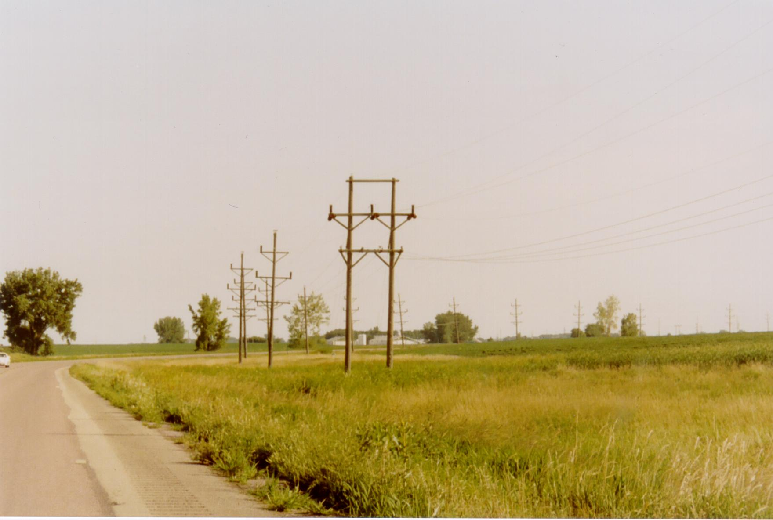
Line Transposition Example

Slide 21
Transposition Impact on Flux Linkages
“a” phase in
position “1”
“a” phase in
position “3”
“a” phase in
position “2”

Slide 22
Transposition Impact, cont’d

Slide 23
Inductance of Transposed Line

Slide 24
Inductance with Bundling

Slide 25
Inductance Example
Calculate the per phase inductance and reactance of a balanced 3φ, 60 Hz, line with horizontal phase spacing of 10m using three conductor bundling with a spacing between conductors in the bundle of 0.3m. Assume the line is uniformly transposed and the conductors have a 1cm radius.
Answer: D_{m} = 12.6 m, R_{b}= 0.0889 m Inductance = 9.9 x 10⁻⁷ H/m, Reactance = 0.6 Ω/Mile

Slide 26
Line Conductors
Typical transmission lines use multi-strand conductors
ACSR (aluminum conductor steel reinforced) conductors are most common. A typical Al. to St. ratio is about 4 to 1.

Slide 27
Line Conductors, cont’d
Total conductor area is given in circular mils. One circular mil is the area of a circle with a diameter of 0.001 = π × 0.0005² square inches
Example: what is the the area of a solid, 1” diameter circular wire? Answer: 1000 kcmil (kilo circular mils)
Because conductors are stranded, the equivalent radius must be provided by the manufacturer. In tables this value is known as the GMR and is usually expressed in feet.

Slide 28
Line Resistance

Slide 29
Line Resistance, cont’d
Because ac current tends to flow towards the surface of a conductor, the resistance of a line at 60 Hz is slightly higher than at dc.
Resistivity and hence line resistance increase as conductor temperature increases (changes is about 8% between 25°C and 50°C)
Because ACSR conductors are stranded, actual resistance, inductance and capacitance needs to be determined from tables.

Slide 30
Review of Electric Fields

Slide 31
Gauss’s Law Example
Similar to Ampere’s Circuital law, Gauss’s Law is most useful for cases with symmetry.
Example: Calculate D about an infinitely long wire that has a charge density of q coulombs/meter.
Since D comes
radially out inte-
grate over the
cylinder bounding
the wire

Slide 32
Electric Fields
The electric field, E, is related to the electric flux density, D, by
D = ε E
where
E = electric field (volts/m)
ε = permittivity in farads/m (F/m)
ε = ε_{o} ε_{r}
ε_{o} = permittivity of free space (8.854×10⁻¹² F/m)
ε_{r} = relative permittivity or the dielectric constant (≈1 for dry air, 2 to 6 for most dielectrics)

Slide 33
Voltage Difference

