Slide 1
ECE 476
Power System Analysis
Lecture 5: Power System Operations
Prof. Tom Overbye
Dept. of Electrical and Computer Engineering
University of Illinois at Urbana-Champaign
overbye@illinois.edu

Slide 2
Announcements
Please read Chapters 4 and 5
HW 2 is 2.43, 2.47, 2.50, 2.52
  It does not need to be turned in, but will be covered by an in-class quiz on Thursday Sept 8

Slide 3
Power System Operations Overview
Goal is to provide an intuitive feel for power system operation
Emphasis will be on the impact of the transmission system
Introduce basic power flow concepts through small system examples

Slide 4
Power System Basics
All power systems have three major components: Generation, Load and Transmission/Distribution.
Generation: Creates electric power.
Load: Consumes electric power.
Transmission/Distribution: Transmits electric power from generation to load.
  Lines/transformers operating at voltages above 100 kV are usually called the transmission system. The transmission system is usually networked.
  Lines/transformers operating at voltages below 100 kV are usually called the distribution system (radial).

Slide 5
Simulation of the
Eastern Interconnect

Slide 6
Small PowerWorld Simulator Case
Load with
green
arrows
indicating
amount
of MW
flow
Note the
power
balance at
each bus
Used
to control
output of
generator
Direction of arrow is used to indicate
direction of real power (MW) flow

Slide 7
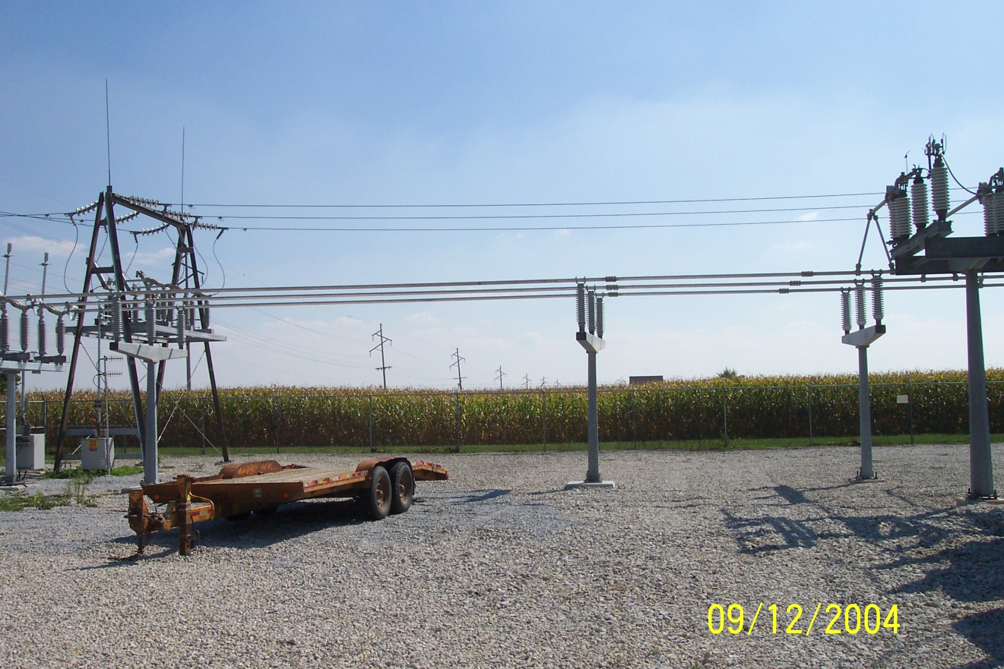
A Substation “Bus”

Slide 8
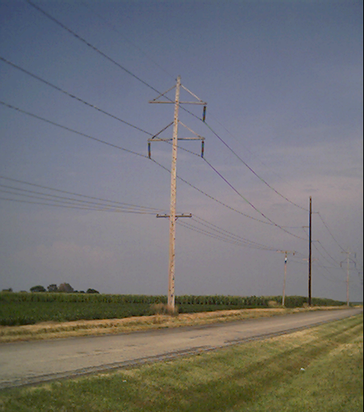
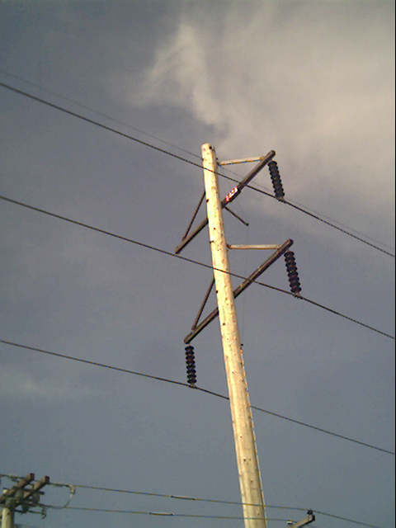
Three Phase Transmission Lines

Slide 9
Power Balance Constraints
Power flow refers to how the power is moving through the system.
At all times in the simulation the total power flowing into any bus MUST be zero!
This is know as Kirchhoff’s law. And it can not be repealed or modified.
Power is lost in the transmission system.

Slide 10
Basic Power Control
Opening or closing a circuit breaker causes the power flow to instantaneously(nearly) change.
No other way to directly control power flow in a transmission line.
By changing generation or load, or by switching other lines, we can indirectly change this flow.

Slide 11
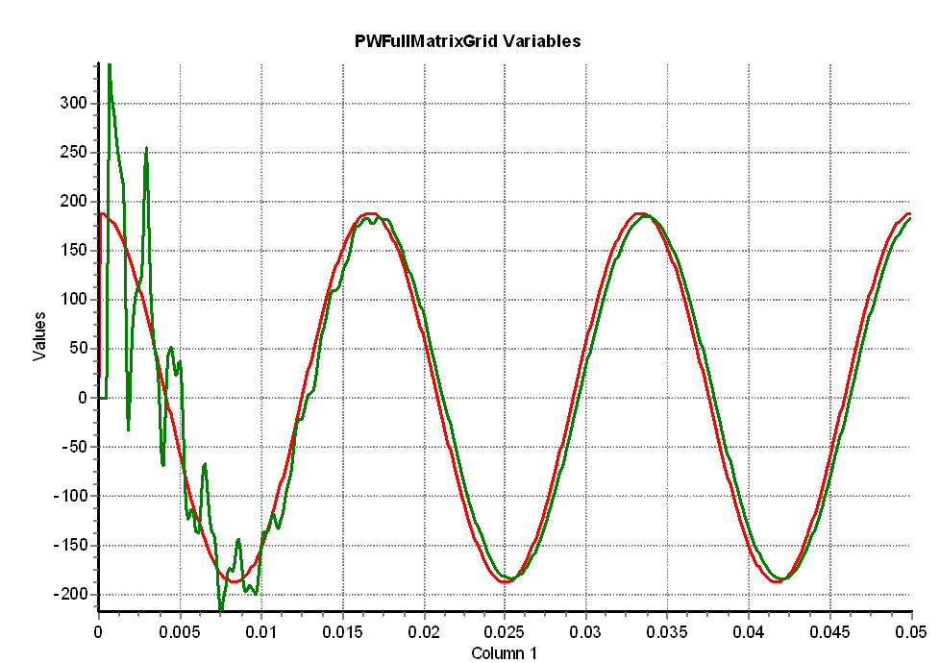
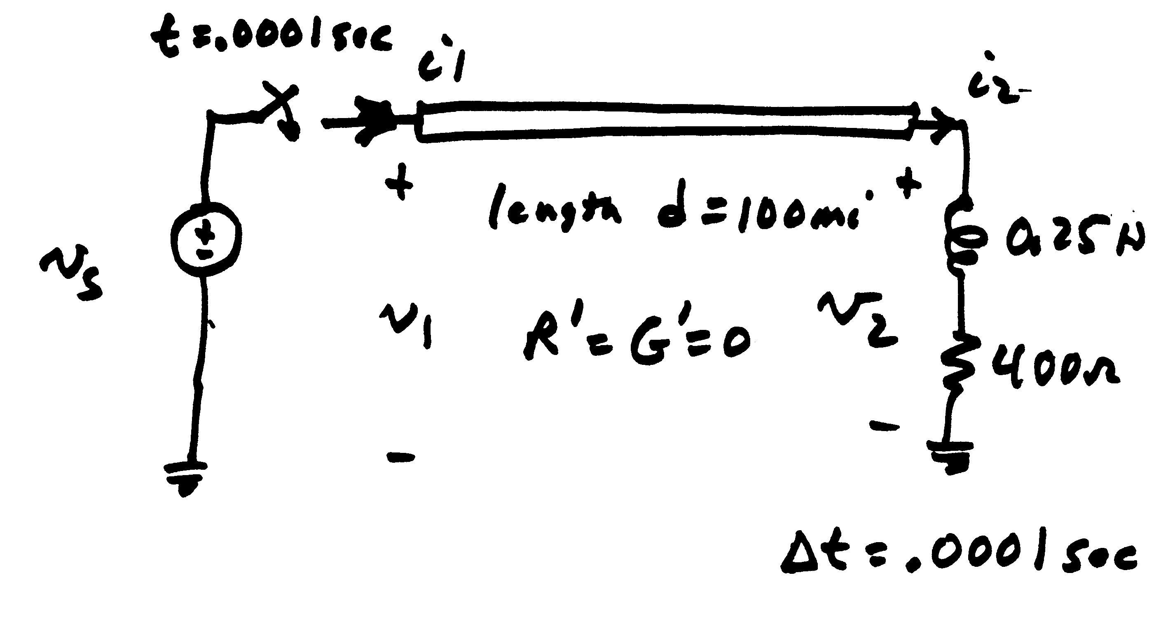
Modeling Consideration – Change is Not Really Instantaneous!
The change isn’t really instantaneous because of propagation delays, which are near the speed of light; there also wave reflection issues
  This will be addressed more in Chapters 5 and 13
Red is the v_{s} end, green the v₂ end

Slide 12
Transmission Line Limits
Power flow in transmission line is limited by heating considerations.
Losses (I² R) can heat up the line, causing it to sag.
Each line has a limit; Simulator does not allow you to continually exceed this limit. Many utilities use winter/summer limits.

Slide 13
Overloaded Transmission Line

Slide 14
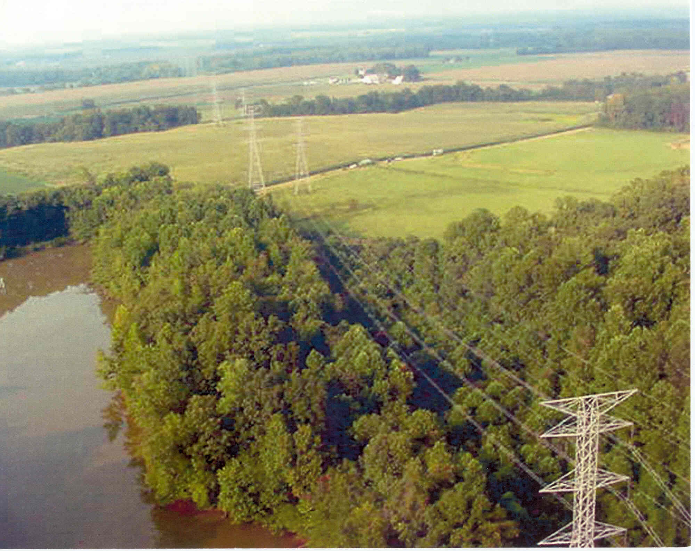
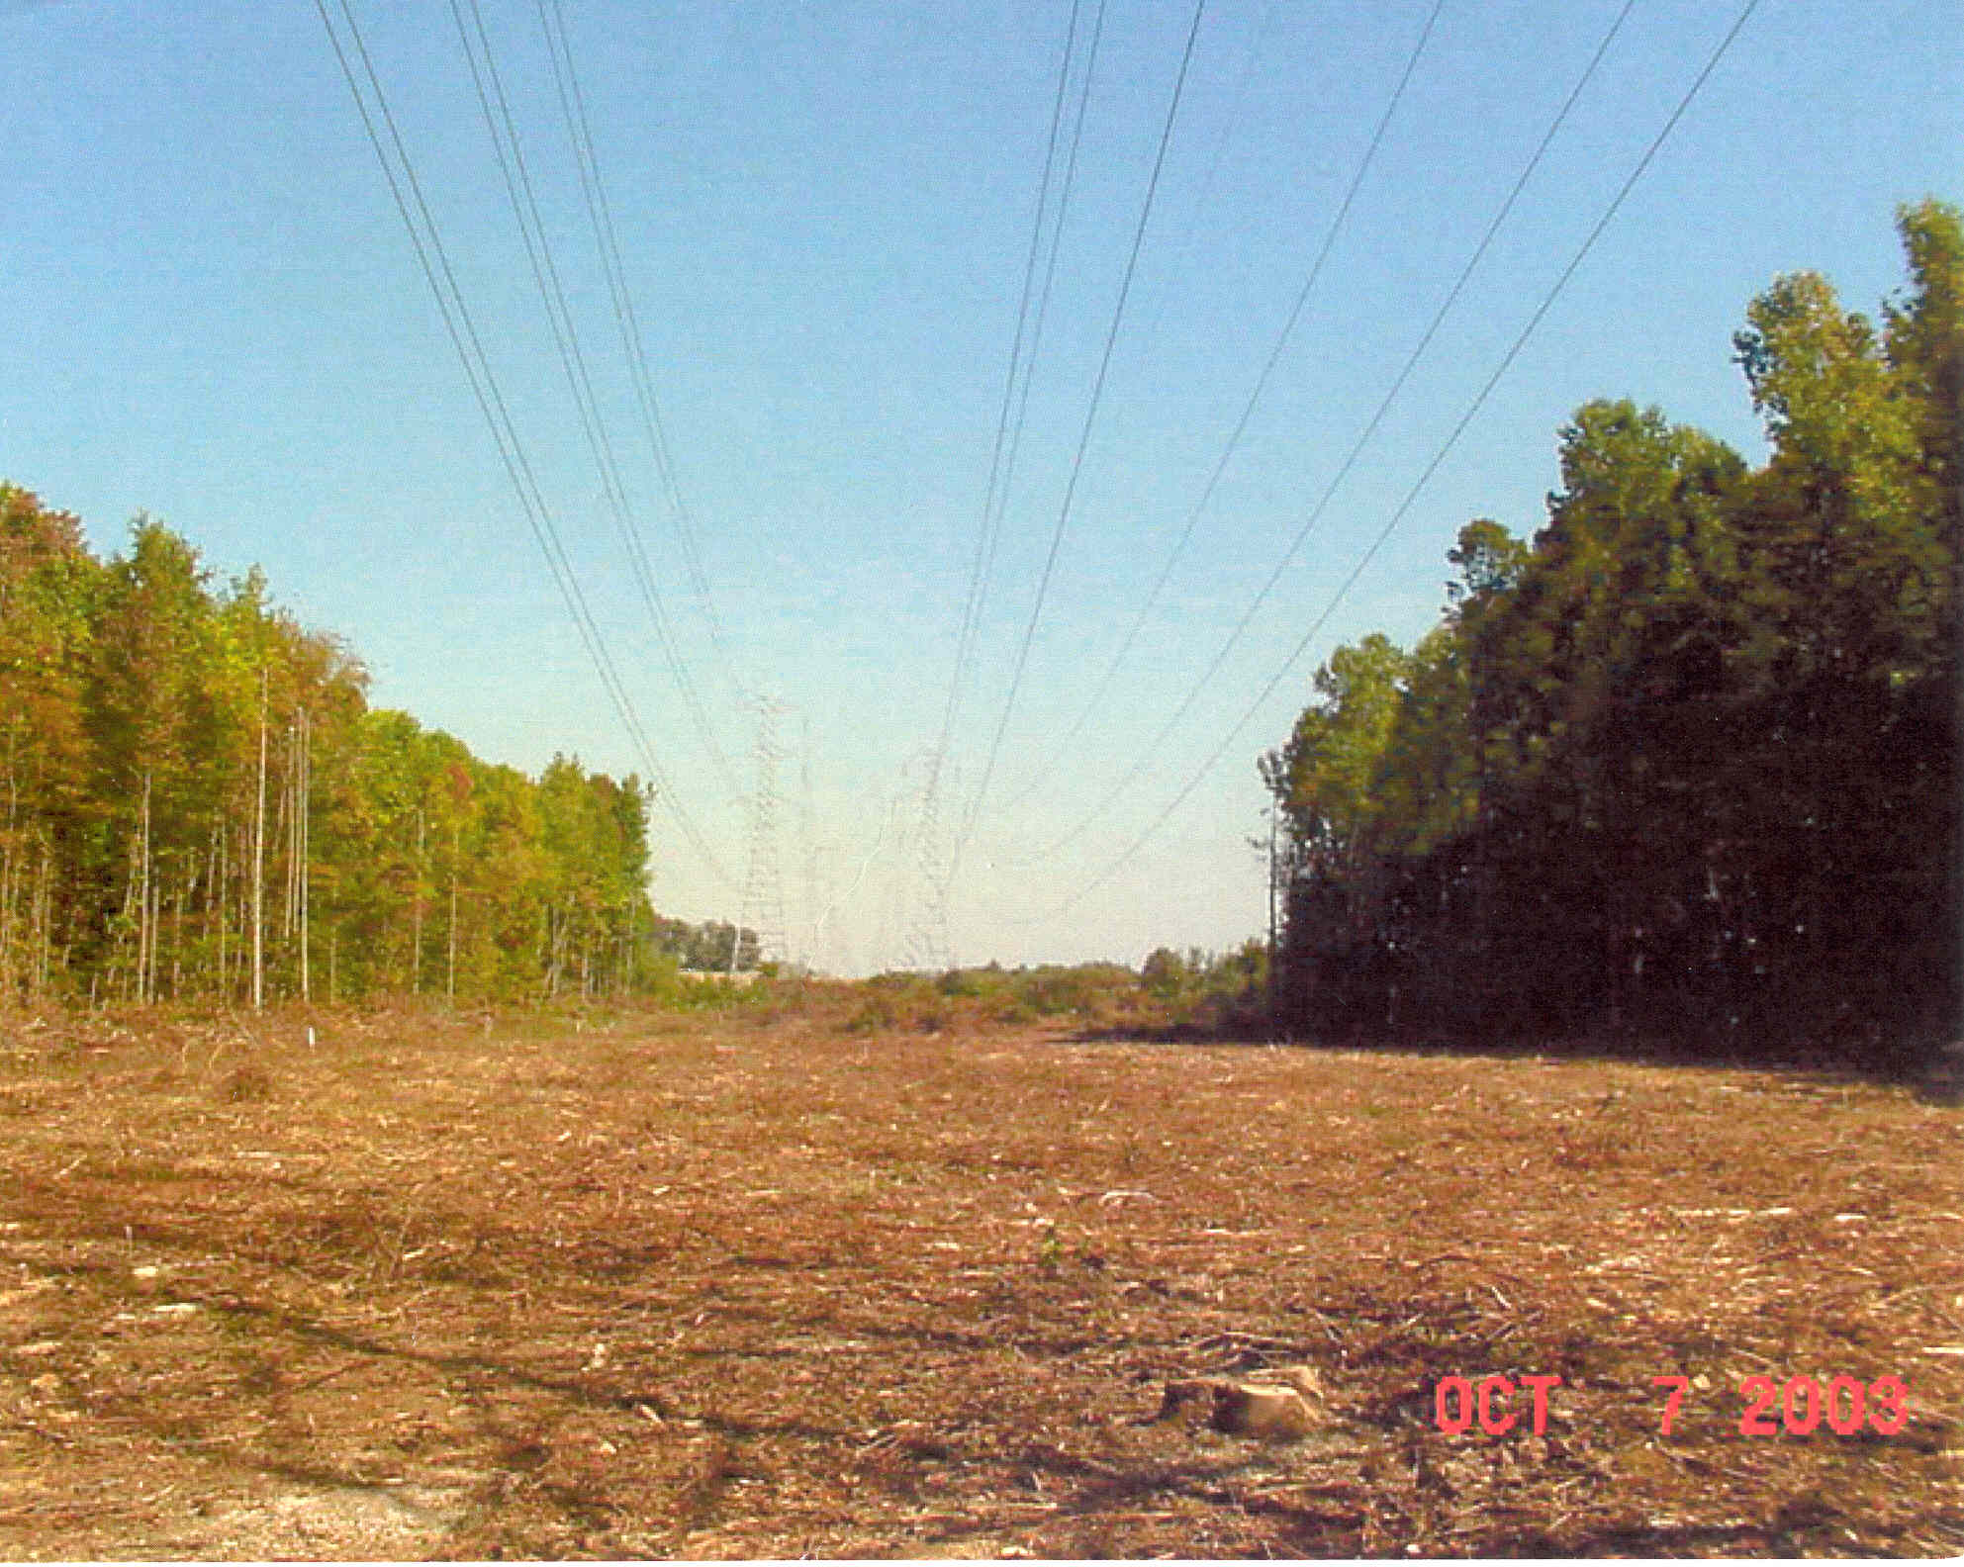
Transmission Lines and Trees
We like trees, and they grow; but when trees get close to lines bad things can occur
Before “Trimming”
After “Trimming”

Slide 15
Interconnected Operation
Power systems are interconnected across large distances. For example most of North America east of the Rockies is one system, with most of Texas and Quebec being major exceptions
Individual utilities only own and operate a small portion of the system, which is referred to an operating area (or an area).

Slide 16
Operating Areas
Transmission lines that join two areas are known as tie-lines.
The net power out of an area is the sum of the flow on its tie-lines.
The flow out of an area is equal to
total gen - total load - total losses = tie-flow

Slide 17
Area Control Error (ACE)
The area control error is the difference between the actual flow out of an area, and the scheduled flow.
  There is also a frequency dependent component that we’ll address in Chapter 12
Ideally the ACE should always be zero.
Because the load is constantly changing, each utility must constantly change its generation to “chase” the ACE.

Slide 18
Automatic Generation Control
Most utilities use automatic generation control (AGC) to automatically change their generation to keep their ACE close to zero.
Usually the utility control center calculates ACE based upon tie-line flows; then the AGC module sends control signals out to the generators every couple seconds.

Slide 19
Three Bus Case on AGC
Generation
is automatically
changed to match
change in load
Net tie flow is
close to zero

Slide 20
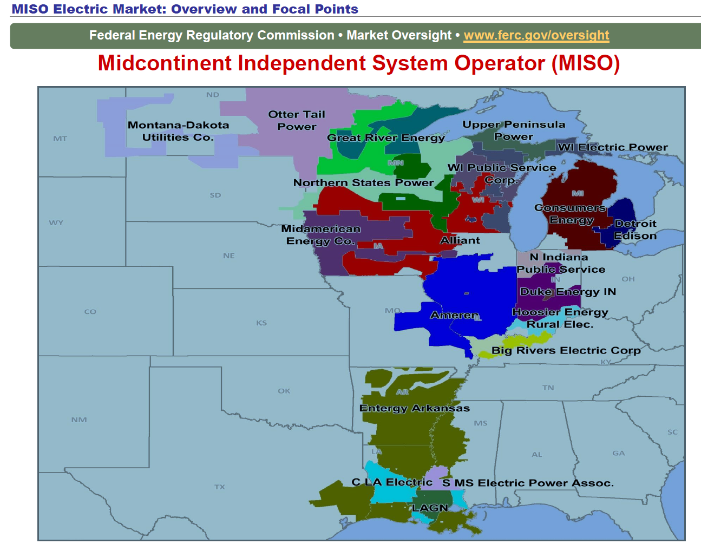
MISO Real-Time ACE
Previously
individual
utilities did
their own
ACE
calculations;
now we are
part of MISO,
which does
one for the
region
https://www.misoenergy.org/MARKETSOPERATIONS/REALTIMEMARKETDATA/Pages/ACEChart.aspx

Slide 21
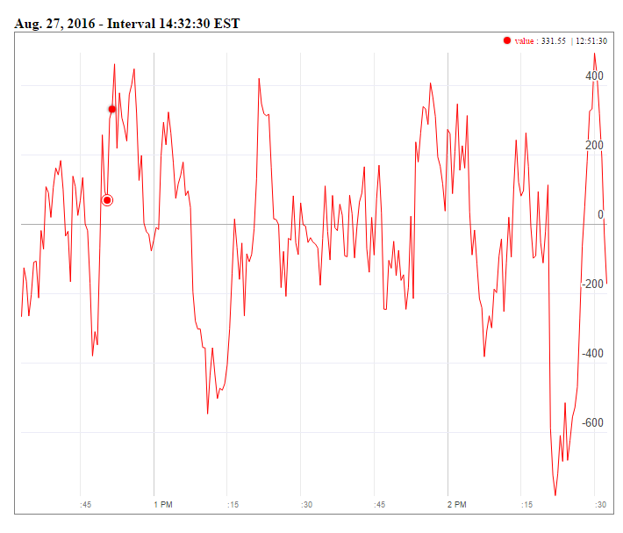
MISO Real-Time ACE
MISO's real-time ACE is available online (along with lots of other data)
https://www.misoenergy.org/MARKETSOPERATIONS/REALTIMEMARKETDATA/Pages/ACEChart.aspx

Slide 22
Generator Costs
There are many fixed and variable costs associated with power system operation.
The major variable cost is associated with generation.
Cost to generate a MWh can vary widely.
For some types of units (such as hydro and nuclear) it is difficult to quantify.
For thermal units it is much easier. These costs will be discussed later in the course.

Slide 23
Economic Dispatch
Economic dispatch (ED) determines the least cost dispatch of generation for an area.
For a lossless system, the ED occurs when all the generators have equal marginal costs.
IC₁(P_{G,1}) = IC₂(P_{G,2}) = … = IC_{m}(P_{G,m})

Slide 24
Power Transactions
Power transactions are contracts between areas to do power transactions.
Contracts can be for any amount of time at any price for any amount of power.
Scheduled power transactions are implemented by modifying the area ACE:
ACE = P_{actual,tie-flow} - P_{sched}

Slide 25
100 MW Transaction
Net tie-line
flow is now
100 MW
Scheduled 100 MW
Transaction from Left to Right

Slide 26
Security Constrained ED
Transmission constraints often limit system economics.
Such limits required a constrained dispatch in order to maintain system security.
In three bus case the generation at bus 3 must be constrained to avoid overloading the line from bus 2 to bus 3.

Slide 27
Security Constrained Dispatch
Dispatch is no longer optimal due to need to keep line
from bus 2 to bus 3 from overloading

Slide 28
Multi-Area Operation
If Areas have direct interconnections, then they may directly transact up to the capacity of their tie-lines.
Actual power flows through the entire network according to the impedance of the transmission lines.
Flow through other areas is known as “parallel path” or “loop flows.”

Slide 29
Seven Bus Case: One-line
System has
three areas
Area top
has five
buses
Area left has one bus
Area right has one bus

Slide 30
Seven Bus Case: Area View
Actual
flow
between
areas
System has
40 MW of
“Loop Flow”
Scheduled
flow
Loop flow can result in higher losses

Slide 31
Seven Bus - Loop Flow?
Note that
Top’s
Losses have
increased
from
7.09MW to
9.44 MW
100 MW Transaction
between Left and Right
Transaction has actually decreased
the loop flow

Slide 32
Pricing Electricity
Cost to supply electricity to bus is called the locational marginal price (LMP)
Presently some electric makets post LMPs on the web
In an ideal electricity market with no transmission limitations the LMPs are equal
Transmission constraints can segment a market, resulting in differing LMP
Determination of LMPs requires the solution on an Optimal Power Flow (OPF)

Slide 33
3 BUS LMPS - OVERLOAD IGNORED
Gen 2’s
cost
is $12
per
MWh
Gen 1’s
cost
is $10
per
MWh
Line from Bus 1 to Bus 3 is over-loaded; all buses have same marginal cost

Slide 34
LINE OVERLOAD ENFORCED
Line from 1 to 3 is no longer overloaded, but now
the marginal cost of electricity at 3 is $14 / MWh

Slide 35
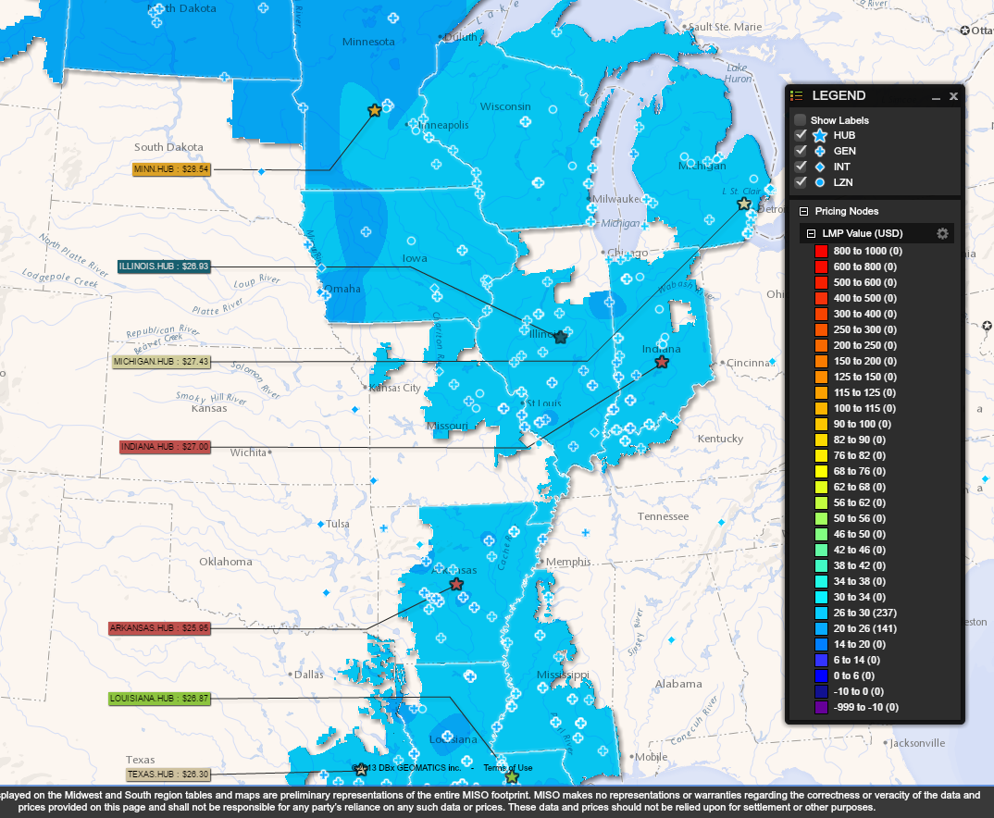
MISO LMPs 9/5/16 at 8:35 PM
https://www.misoenergy.org/LMPContourMap/MISO_All.html

