Slide 1
ECE 476 Power System Analysis
Lecture 4:Per Phase Analysis, Transmission Line Parameters
Prof. Tom Overbye
Dept. of Electrical and Computer Engineering
University of Illinois at Urbana-Champaign
overbye@illinois.edu
Special Guest Lecturer: TA Iyke Idehen

Slide 2
Announcements
Please read Chapters 4 and 5
HW 2 is 2.43, 2.47, 2.50, 2.52
It does not need to be turned in, but will be covered by an in-class quiz on Thursday Sept 8

Slide 3
Per Phase Analysis
Per phase analysis allows analysis of balanced 3φ systems with the same effort as for a single phase system
Balanced 3φ Theorem: For a balanced 3φ system with
All loads and sources Y connected
No mutual Inductance between phases

Slide 4
Per Phase Analysis, cont’d
Then
All neutrals are at the same potential
All phases are COMPLETELY decoupled
All system values are the same sequence as sources. The sequence order we’ve been using (phase b lags phase a and phase c lags phase a) is known as “positive” sequence; later in the course we’ll discuss negative and zero sequence systems.

Slide 5
Per Phase Analysis Procedure
To do per phase analysis
Convert all Δ load/sources to equivalent Y’s
Solve phase “a” independent of the other phases
Total system power S = 3 V_{a} I_{a}*
If desired, phase “b” and “c” values can be determined by inspection (i.e., ±120° degree phase shifts)
If necessary, go back to original circuit to determine line-line values or internal Δ values.

Slide 6
Per Phase Example
Assume a 3φ, Y-connected generator with V_{an} = 1∠0° volts supplies a Δ-connected load with Z_{Δ} = -jΩ through a transmission line with impedance of j0.1Ω per phase. The load is also connected to a Δ-connected generator with V_{a”b”} = 1∠0° through a second transmission line which also has an impedance of j0.1Ω per phase.
Find
1. The load voltage V_{a’b’}
2. The total power supplied by each generator, S_{Y} and S_{Δ}

Slide 7
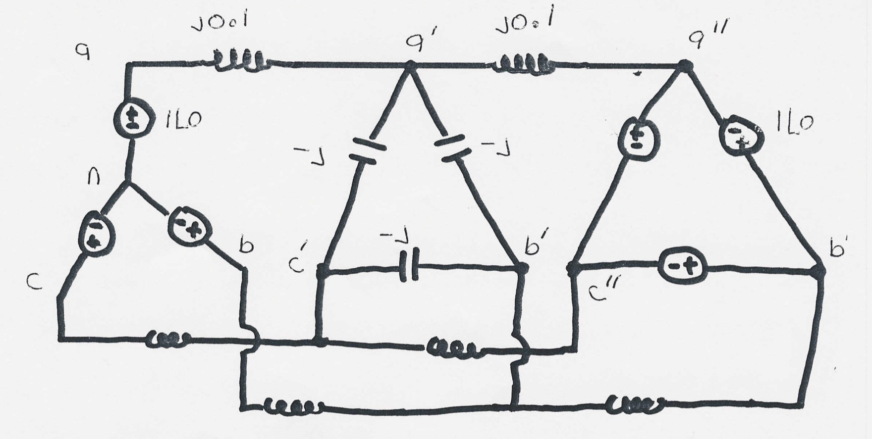
Per Phase Example, cont’d

Slide 8
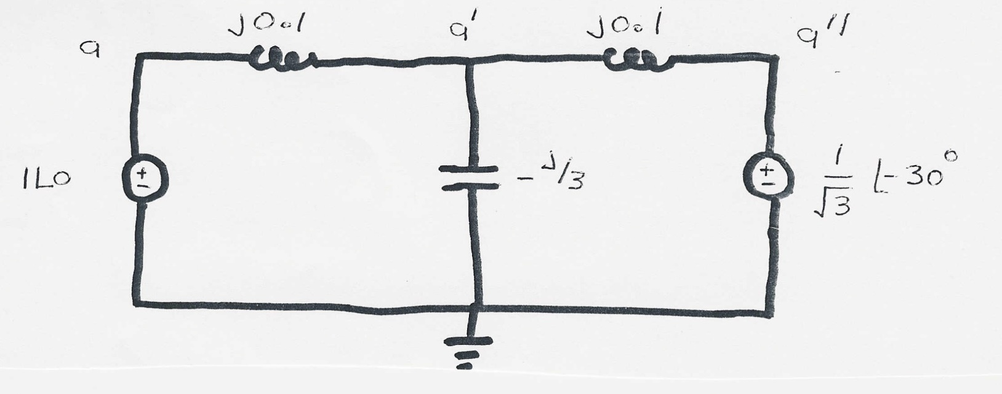
Per Phase Example, cont’d

Slide 9
Per Phase Example, cont’d

Slide 10
Per Phase Example, cont’d

Slide 11
Development of Line Models
Goals of this section are
develop a simple model for transmission lines
gain an intuitive feel for how the geometry of the transmission line affects the model parameters

Slide 12
Primary Methods for Power Transfer
The most common methods for transfer of electric power are
Overhead ac
Underground ac
Overhead dc
Underground dc
other

Slide 13
Magnetics Review
Ampere’s circuital law:

Slide 14
Line Integrals
Line integrals are a generalization of traditional integration
Integration along the
x-axis
Integration along a
general path, which
may be closed
Ampere’s law is most useful in cases of symmetry, such as with an infinitely long line

Slide 15
Magnetic Flux Density
Magnetic fields are usually measured in terms of flux density

Slide 16
Magnetic Flux

Slide 17
Magnetic Fields from Single Wire
Assume we have an infinitely long wire with current of 1000A. How much magnetic flux passes through a 1 meter square, located between 4 and 5 meters from the wire?
Direction of H is given
by the “Right-hand” Rule
Easiest way to solve the problem is to take advantage
of symmetry. For an integration path we’ll choose a
circle with a radius of x.

Slide 18
Two Conductor Line Inductance
Key problem with the previous derivation is we assumed no return path for the current. Now consider the case of two wires, each carrying the same current I, but in opposite directions; assume the wires are separated by distance R.
R
To determine the
inductance of each
conductor we integrate
as before. However
now we get some
field cancellation
Creates counter-
clockwise field
Creates a
clockwise field

Slide 19
Two Conductor Case, cont’d
R
R
Rp
Direction of integration
Key Point: As we integrate for the left line, at distance 2R from
the left line the net flux linked due to the Right line is zero!
Use superposition to get total flux linkage.
Left Current
Right Current

Slide 20
Two Conductor Inductance

Slide 21
Many-Conductor Case
Now assume we now have k conductors, each with
current i_{k}, arranged in some specified geometry.
We’d like to find flux linkages of each conductor.
Each conductor’s flux
linkage, λ_{k}, depends upon
its own current and the
current in all the other
conductors.
To derive λ₁ we’ll be integrating from conductor 1 (at origin)
to the right along the x-axis.

Slide 22
Many-Conductor Case, cont’d
R_{k} is the
distance
from con-
ductor k
to point
c.
At point b the net
contribution to λ₁
from i_{k} , λ_{1k}, is zero.
We’d like to integrate the flux crossing between b to c. But the flux crossing between a and c is easier to calculate and provides a very good approximation of λ_{1k}. Point a is at distance d_{1k} from conductor k.

Slide 23
Many-Conductor Case, cont’d

Slide 24
Many-Conductor Case, cont’d

