Slide 1
ECE 476
Renewable Energy Systems
Lecture 3: Complex Power, Three-Phase
Prof. Tom Overbye
Dept. of Electrical and Computer Engineering
University of Illinois at Urbana-Champaign
overbye@illinois.edu

Slide 2
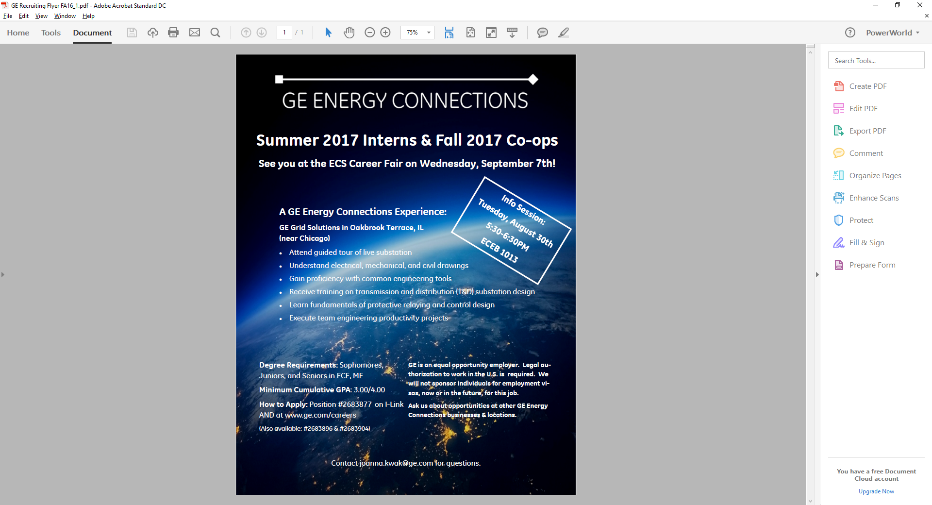

Slide 3
Announcements
Please read Chapters 2 and 4
HW 1 is 2.7, 16, 24, 33; due Thursday 9/1
  Problem 2.47 moved to HW 2
  HW 1 will be turned in (for other homework we may have an in-class quiz)
  For Problem 2.33 you need to use the PowerWorld Software. You can download the software and cases at the below link; get Version 19 (August 11, 2016) www.powerworld.com/gloveroverbyesarma

Slide 4
Power Consumption in Devices

Slide 5
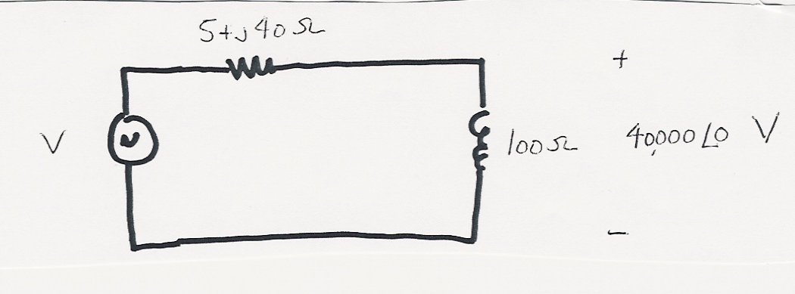
Example
First solve
basic circuit

Slide 6
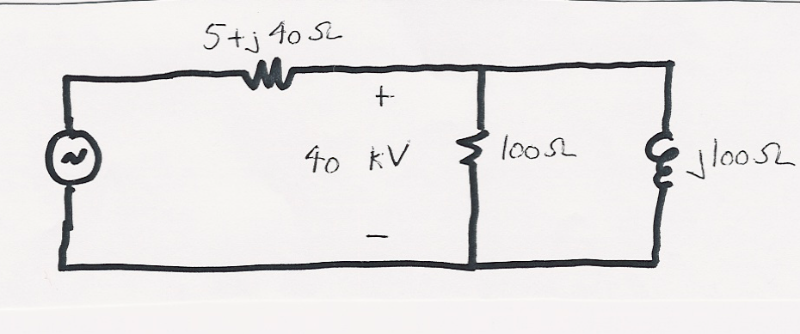
Example, cont’d
Now add additional
reactive power load
and resolve

Slide 7
Power System Notation
Power system components are usually shown as
“one-line diagrams.” Previous circuit redrawn
Transmission lines are shown as a single line
Arrows are
used to
show loads
Generators are
shown as circles

Slide 8
Reactive Compensation
Key idea of reactive compensation is to supply reactive
power locally. In the previous example this can
be done by adding a 16 Mvar capacitor at the load
Compensated circuit is identical to first example with
just real power load

Slide 9
Reactive Compensation, cont’d
Reactive compensation decreased the line flow from 564 Amps to 400 Amps. This has advantages
  Lines losses, which are equal to I² R decrease
  Lower current allows utility to use small wires, or alternatively, supply more load over the same wires
  Voltage drop on the line is less
Reactive compensation is used extensively by utilities
Capacitors can be used to “correct” a load’s power factor to an arbitrary value.

Slide 10
Power Factor Correction Example

Slide 11
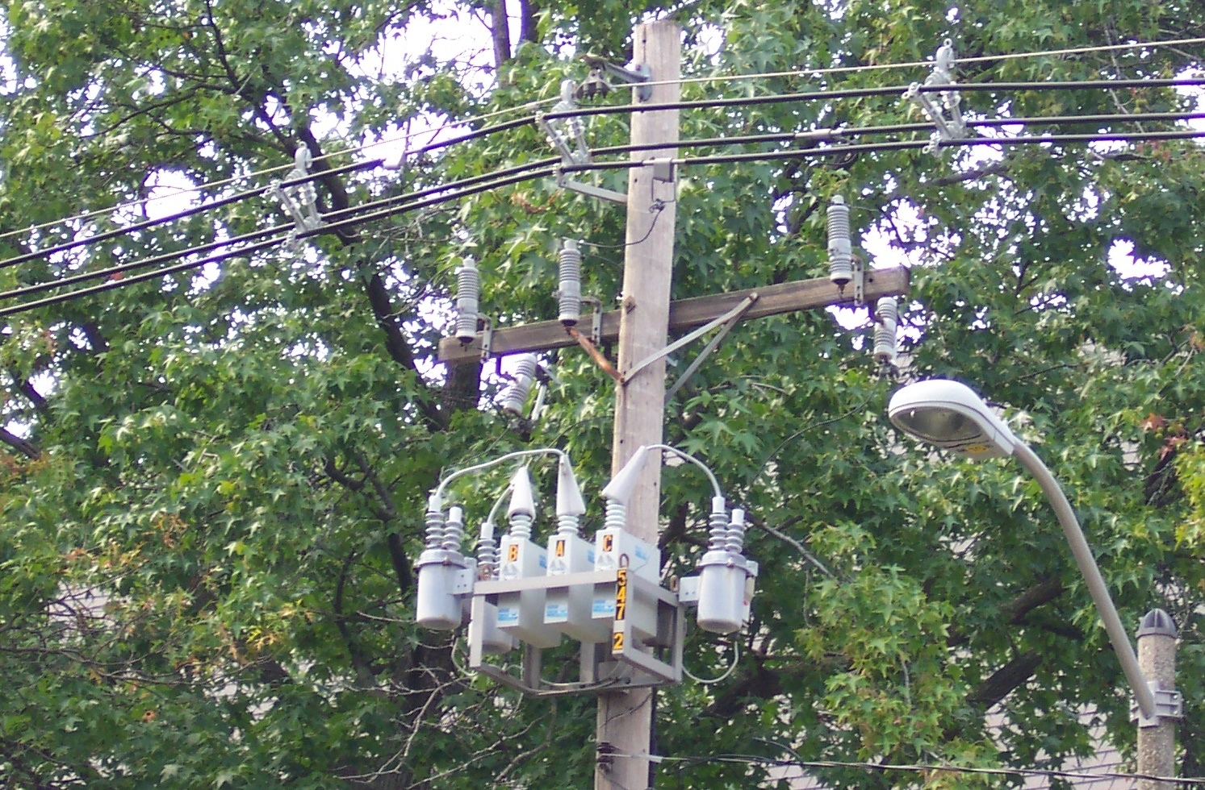
Distribution System Capacitors

Slide 12
Definition of Reactive Power

Slide 13
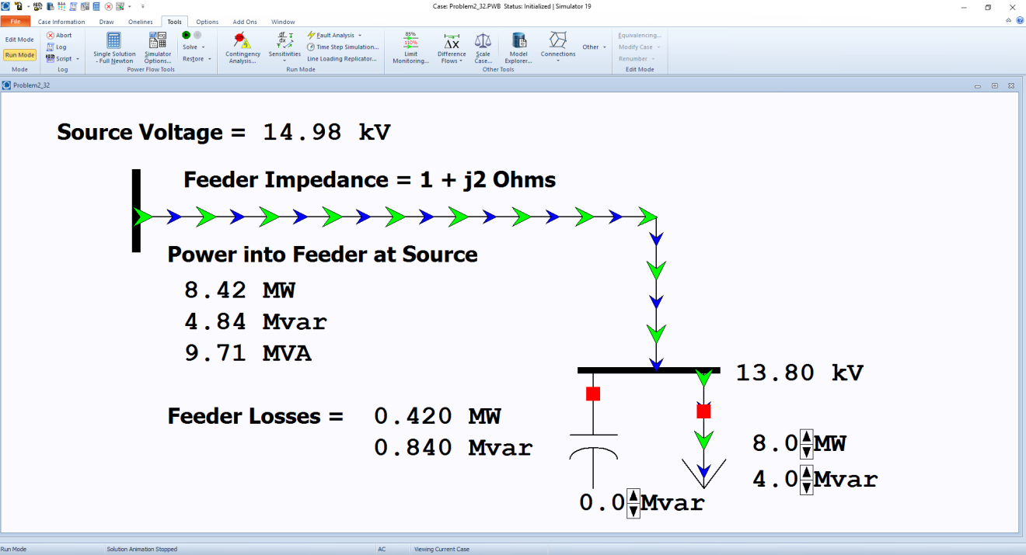
PowerWorld Simulator Overview
Used for power system analysis and visualization
  Runs in Windows
Download free 42 bus educational version at
  http://www.powerworld.com/gloveroverbyesarma
Image on right
shows the
problem 2.33
power
system (case)

Slide 14
Balanced Three-Phase (φ) Systems
A balanced three-phase (φ) system has
  three voltage sources with equal magnitude, but with an angle shift of 120°
  equal loads on each phase
  equal impedance on the lines connecting the generators to the loads
Bulk power systems are almost exclusively 3φ
Single-phase is used primarily only in low voltage, low power settings, such as residential and some commercial

Slide 15
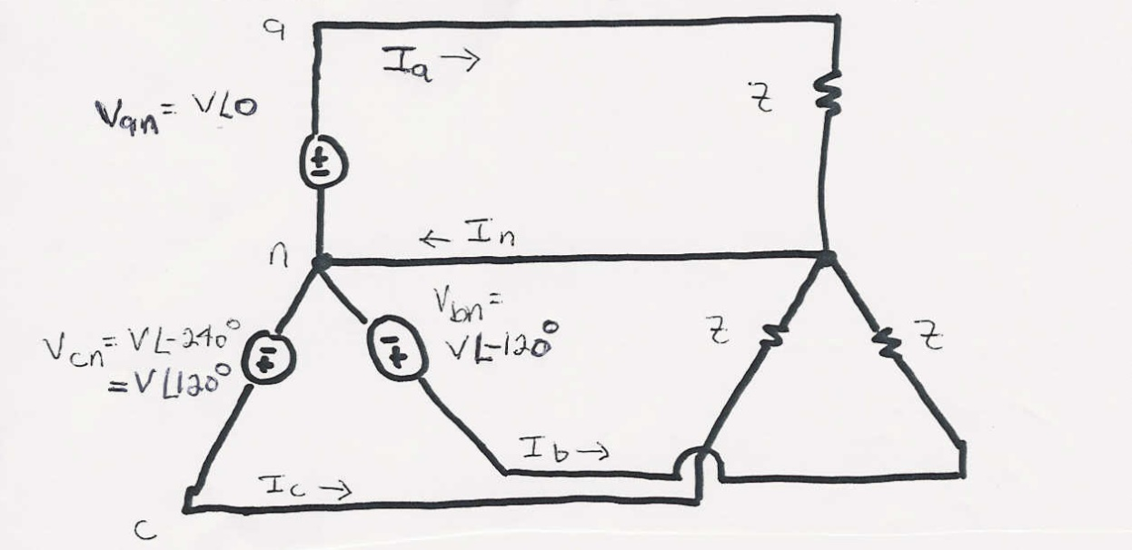
Balanced 3φ -- No Neutral Current

Slide 16
Advantages of 3φ Power
Can transmit more power for same amount of wire (twice as much as single phase)
Torque produced by 3φ machines is constant
Three-phase machines use less material for same power rating
Three-phase machines start more easily than single-phase machines

Slide 17
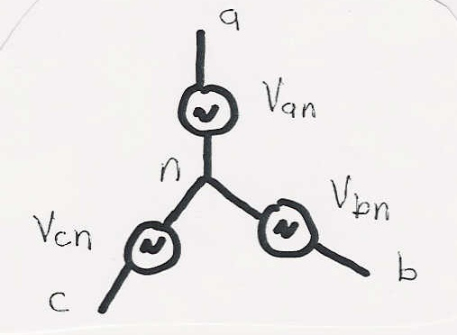
Three-Phase - Wye Connection
There are two ways to connect 3φ systems
  Wye (Y)
  Delta (Δ)

Slide 18
Wye Connection Line Voltages
V_{cn}
V_{ab}
V_{ca}
-V_{bn}
V_{an}
V_{bn}
(α = 0 in this case)
V_{bc}
Line-to-line
voltages are
also balanced

Slide 19
Wye Connection, cont’d
Define voltage/current across/through device to be phase voltage/current
Define voltage/current across/through lines to be line voltage/current

Slide 20
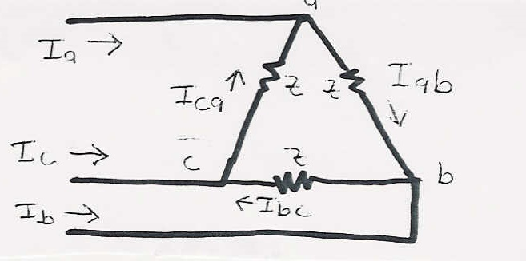
Delta Connection
I_{ca}
I_{c}
I_{b}
I_{ab}
I_{bc}
I_{a}

Slide 21
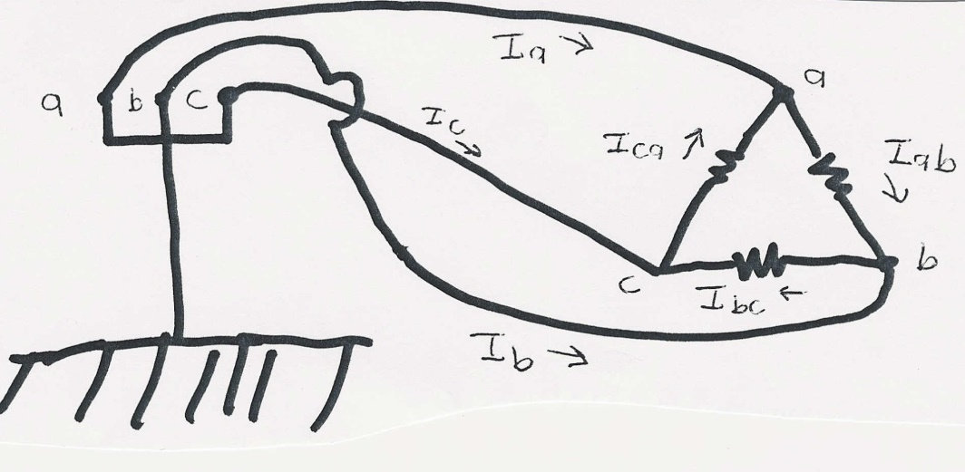
Three-Phase Example
Assume a Δ-connected load is supplied from a 3φ
13.8 kV (L-L) source with Z = 100∠20°Ω

Slide 22
Three-Phase Example, cont’d

Slide 23
Delta-Wye Transformation

Slide 24
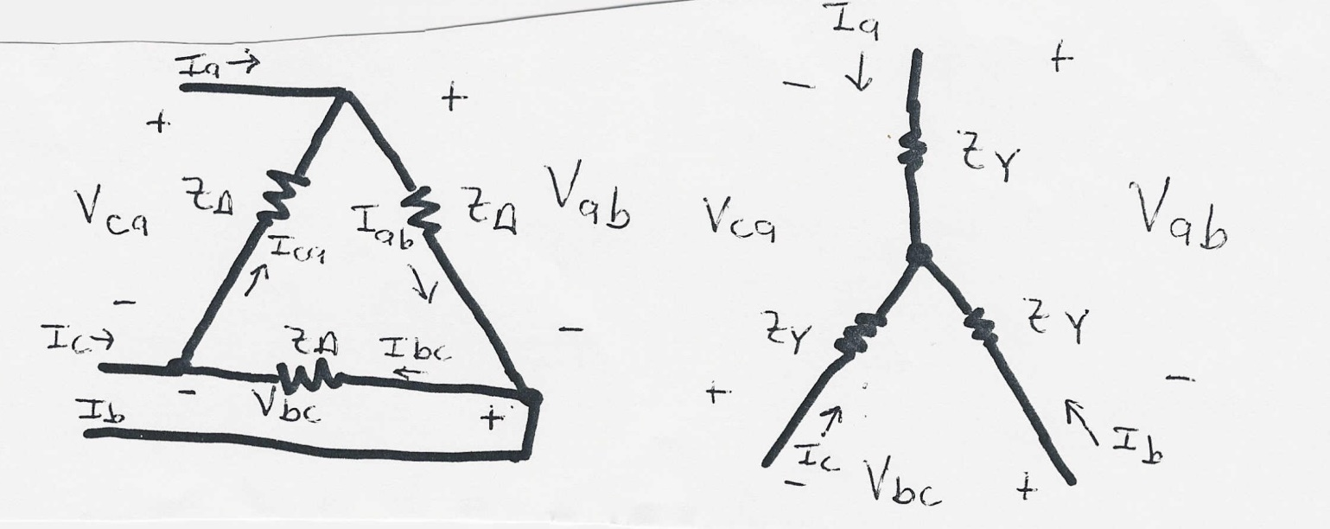
Delta-Wye Transformation Proof

Slide 25
Delta-Wye Transformation, cont’d

Slide 26
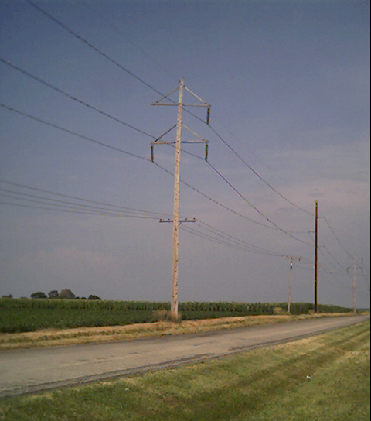
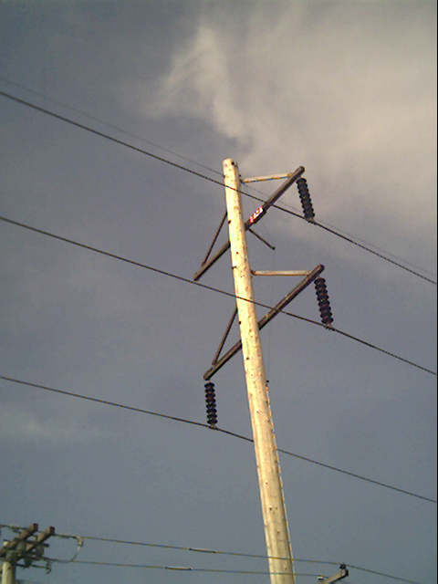
Three Phase Transmission Line

Slide 27
Per Phase Analysis
Per phase analysis allows analysis of balanced 3φ systems with the same effort as for a single phase system
Balanced 3φ Theorem: For a balanced 3φ system with
  All loads and sources Y connected
  No mutual Inductance between phases

Slide 28
Per Phase Analysis, cont’d
Then
  All neutrals are at the same potential
  All phases are COMPLETELY decoupled
  All system values are the same sequence as sources. The sequence order we’ve been using (phase b lags phase a and phase c lags phase a) is known as “positive” sequence; later in the course we’ll discuss negative and zero sequence systems.

