Slide 1
ECE 476
Power System Analysis
Lecture 25: Transient Stability,
High Impact Events
Prof. Tom Overbye
Dept. of Electrical and Computer Engineering
University of Illinois at Urbana-Champaign
overbye@illinois.edu

Slide 2
Announcements
Please read Chapters 12 and 14
HW 10 is due today (or you can take the quiz)
HW 11 is 11.25, 12.3, 12.11, 14.15
  Should be done before the final but is not turned in
Chapter 6 Design Project 1 is due on Tuesday Dec 6.
  Simplified to change limit on Cedar69-Olive69 to 95 MVA
  Contingency low voltages limit to 0.93 per unit
Final exam is on Monday December 12, 1:30-4:30pm
  Comprehensive, closed book/notes; three note sheets allowed
  Last name A-H in ECEB 3013, rest in ECE 3017

Slide 3
In the News: Saving Clinton Nuclear Power Plant
In June 2016 Exelon said that they would close the Clinton and Quad Cities Nuclear plants in June 2017 and June 2018 respectively if there was not support from the State
On Nov 30, 2016 Exelon announced they had an agreement with Governor Rauner on the Future Energy Jobs Bill to keep these plants open
  Exelon says the bill will save 4200 jobs at the plants
  Exelon says rate increase would be less than $0.25 per month for ComEd residential customers
Bill has not yet passed the legislature
Source: Chicago Tribune, Dec 1, 2016; Exelon
2

Slide 4
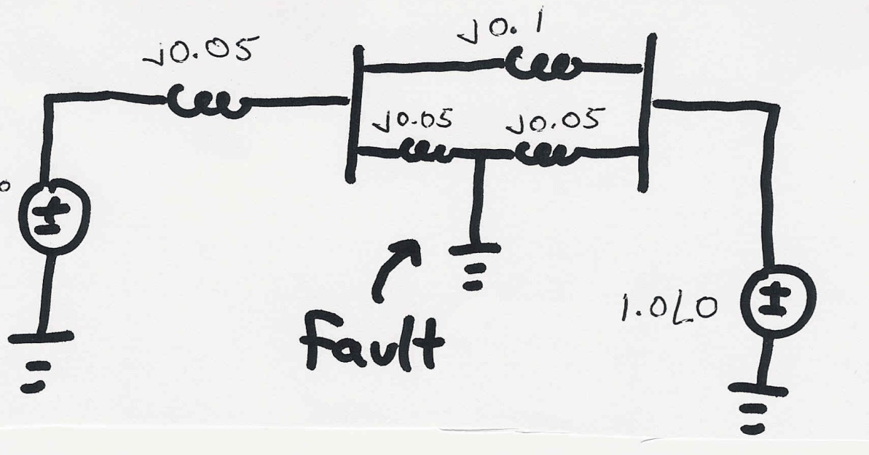
Transient Stability Example
A 60 Hz generator is supplying 550 MW to an infinite bus (with 1.0 per unit voltage) through two parallel transmission lines. Determine initial angle change for a fault midway down one of the lines.
H = 20 seconds, D = 0.1. Use Δt=0.01 second.
E_{a}
3

Slide 5
Transient Stability Example, cont'd
4

Slide 6
Transient Stability Example, cont'd
5

Slide 7
Transient Stability Example, cont'd
6

Slide 8
Transient Stability Example, cont'd
7

Slide 9
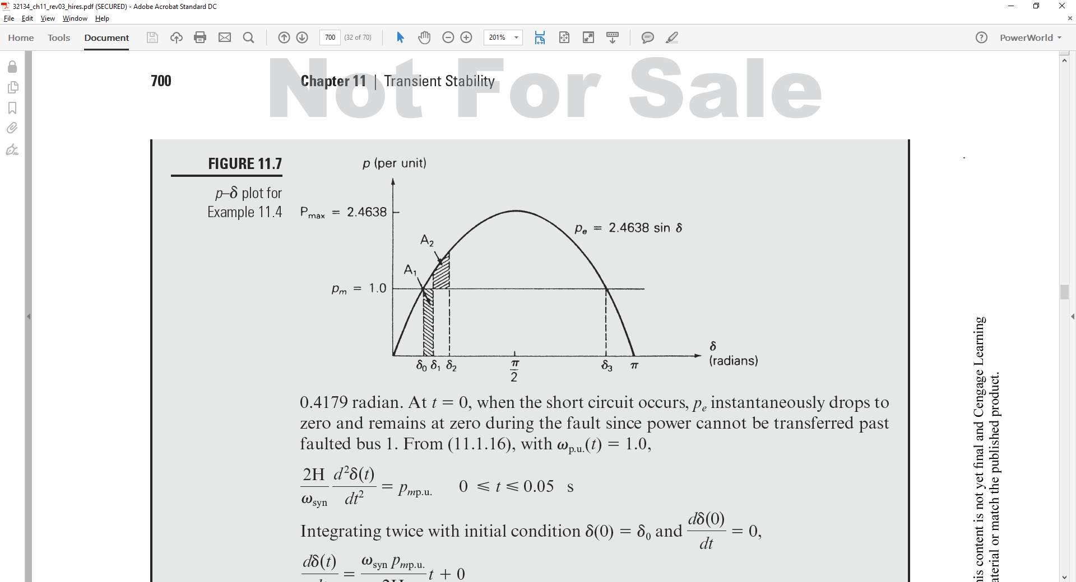
Example 11.4: Equal Area
8

Slide 10
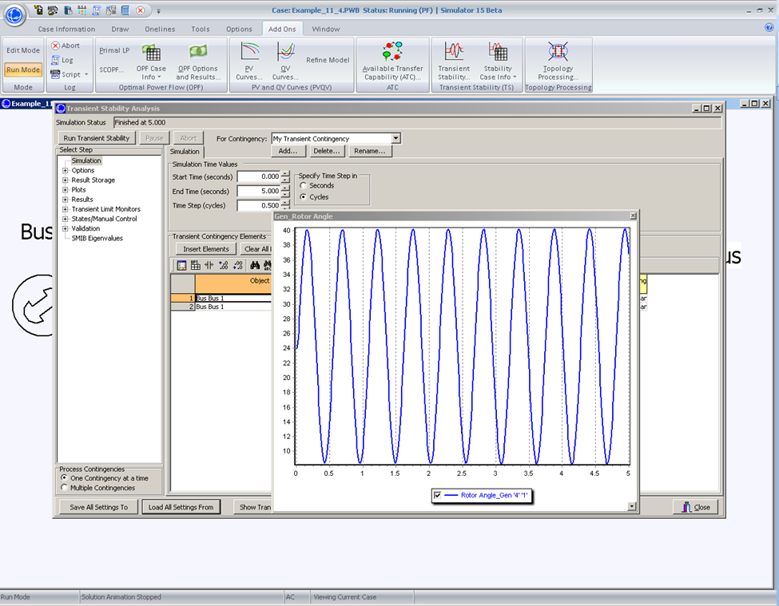
Example 11.4: Undamped
9

Slide 11
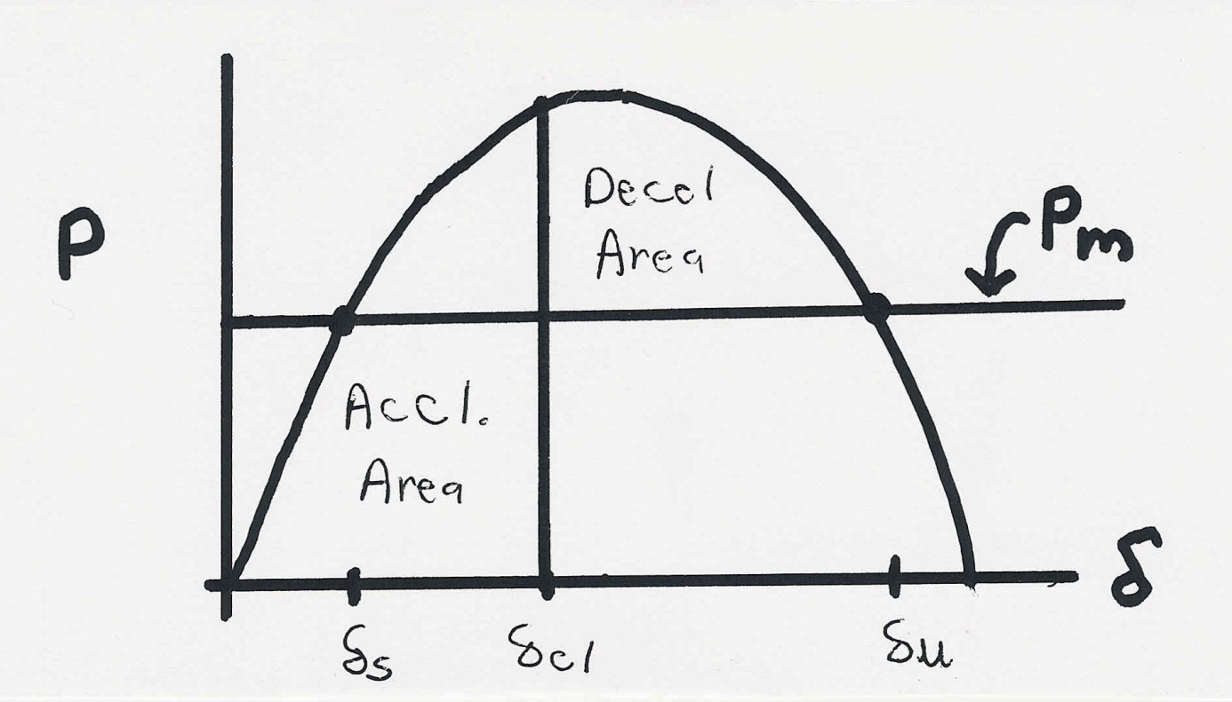
Equal Area Criteria
The goal of the equal area criteria is to try to determine whether a system is stable or not without having to completely integrate the system response.
System will
be stable after
the fault if
the Decel
Area is greater
than the
Accel. Area
10

Slide 12
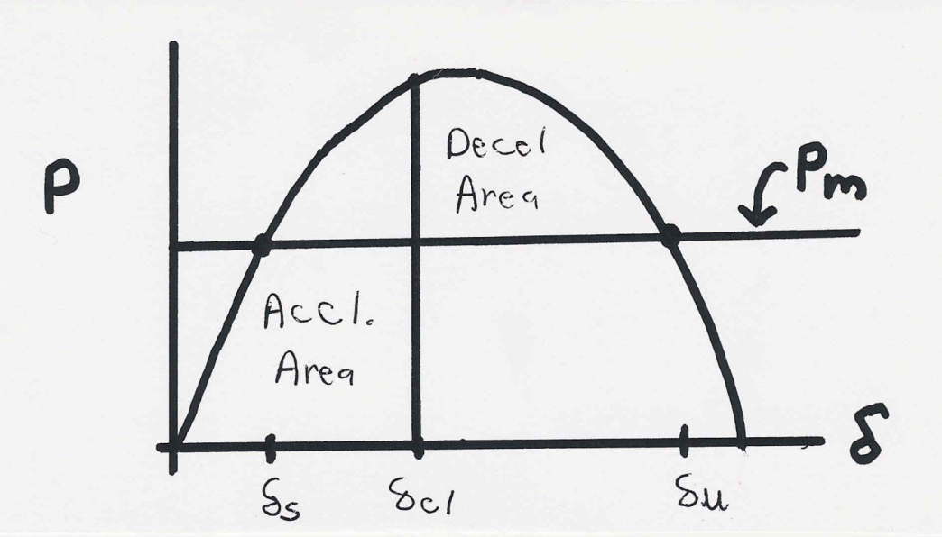
Example 11.5: Critical Clearing Time
11

Slide 13
Two-Axis Synchronous Machine Model
Classical model is appropriate only for the most basic studies; no longer widely used in practice
More realistic models are required to couple in other devices such as exciters and governors
A more realistic synchronous machine model requires that the machine be expressed in a reference frame that rotates at rotor speed
Standard approach is d-q reference frame, in which the major (direct or d-axis) is aligned with the rotor poles and the quadrature (q-axis) leads the direct axis by 90°
12

Slide 14
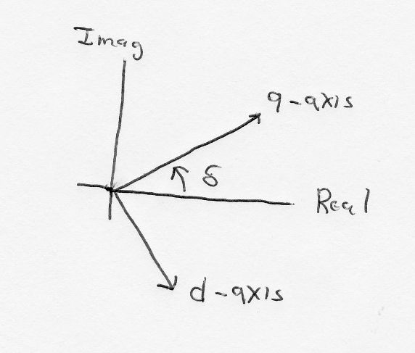
D-q Reference Frame
Machine voltage and current are “transformed” into the d-q reference frame using the rotor angle, δ
  Terminal voltage in network (power flow) reference frame are V_{T} = V_{r} - V_{i}
13

Slide 15
Two-Axis Model Equations
Numerous models exist for synchronous machines. The following is a relatively simple model that represents the field winding and one damper winding; it also includes the generator swing eq.
14

Slide 16
Generator Torque and Initial Conditions
The generator electrical torque is given by
Recall p_{e} = T_{e}ω_{p.u} (sometimes ω_{p.u is} assumed=1.0)
Solving the differential equations requires determining δ; it is determined by noting that in steady-state
Then δ is the angle of
15

Slide 17
Example 11.10
Determine the initial conditions for the Example 11.3 case with the classical generator replaced by a two-axis model with H = 3.0 per unit-seconds, D = 0, = 2.1, = 2.0, = 0.3, = 0.5, all per unit using the 100 MVA system base
First determine the current out of the generator from the initial conditions, then the terminal voltage
16

Slide 18
Example 11.10, cont.
We can then get the initial angle, and initial
d and q values
17

Slide 19
Example 11.10, cont.
The initial state variable are determined by solving with the differential equations equal to zero.
The transient stability solution is then solved by numerically integrating the differential equations, coupled with solving the algebraic equations
18

Slide 20
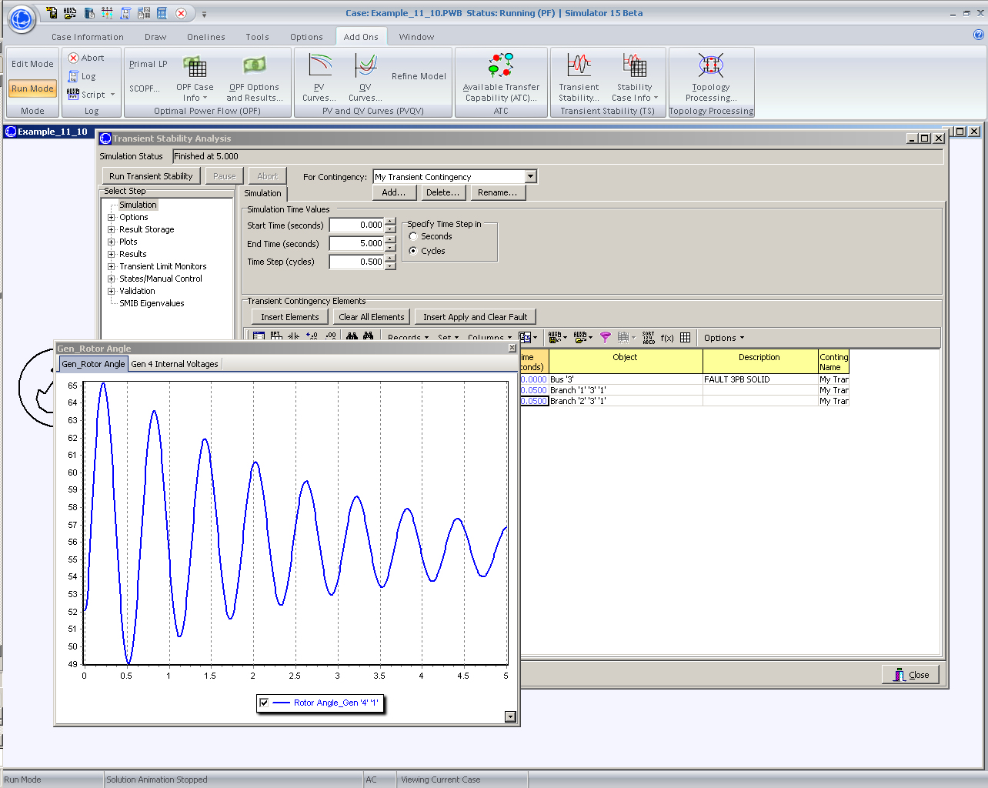
PowerWorld Solution of 11.10
19

Slide 21
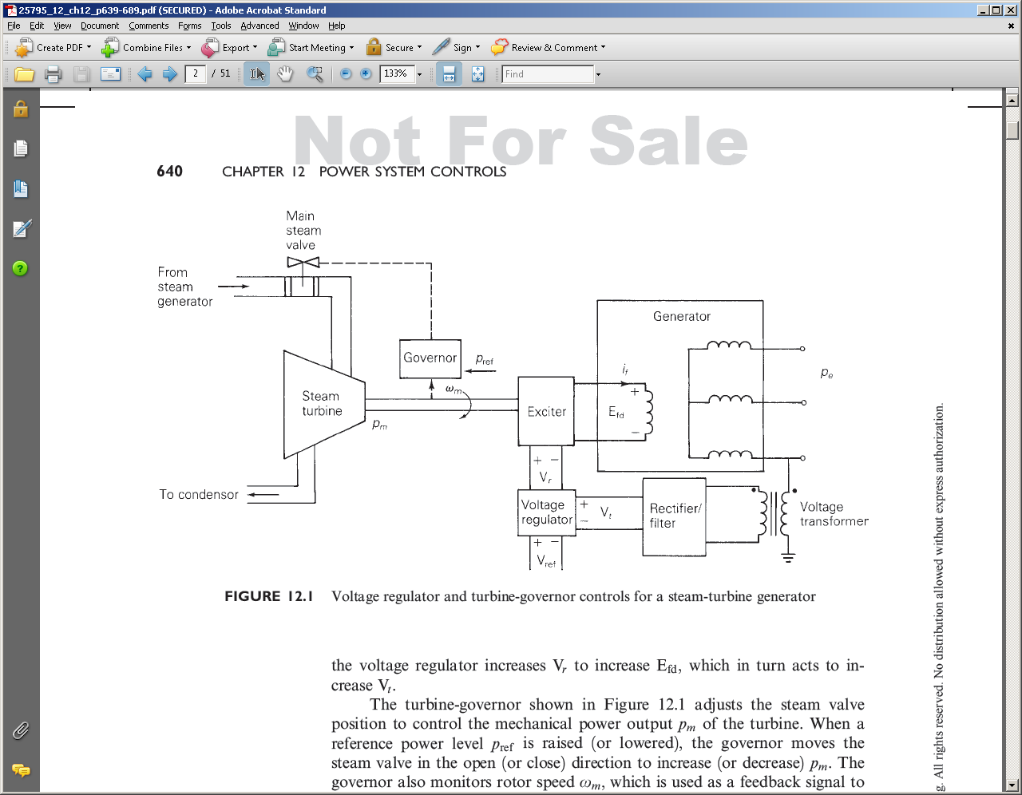
Generator Exciters and Governors
The two-axis synchronous model takes as an input the field voltage and the mechanical power. The next section discusses how these values are controlled
20

Slide 22
Generator Exciters
The purpose of the exciter is to maintain the generator terminal voltage (or other close by voltage) at a specified value.
  Input is the sensed voltage
  Output is the field voltage to the machine, Efd
Physically several technologies are used.
  Older generators used dc machines with brushes transferring the power
  With the newer brushless (or static) exciters power is obtained from an “inverted” synchronous generator whose field voltage is on the stator and armature windings are on rotor; output is rectified to create dc.
21

Slide 23
Exciter Block Diagrams
Block diagrams are used to setup the transient stability models. The common IEEE Type 1 exciter is shown below (neglecting saturation); this is a dc type exciter. Initial state values are determined by knowing Efd and the terminal voltage Vt.
22

Slide 24
Exciter Block Diagram Example
Consider again the Example 11.10 case, with an IEEE T1 exciter with T_{r} = 0, K_{a} = 100, T_{a} = 0.05, V_{rmax} = 5, V_{rmin} = -5, K_{e} = 1, T_{e} = 0.26, K_{f} = 0.01 and T_{f} = 1.0. Determine the initial states. Initial value of Efd = 2.9135 and Vt = 1.0946
23

Slide 25
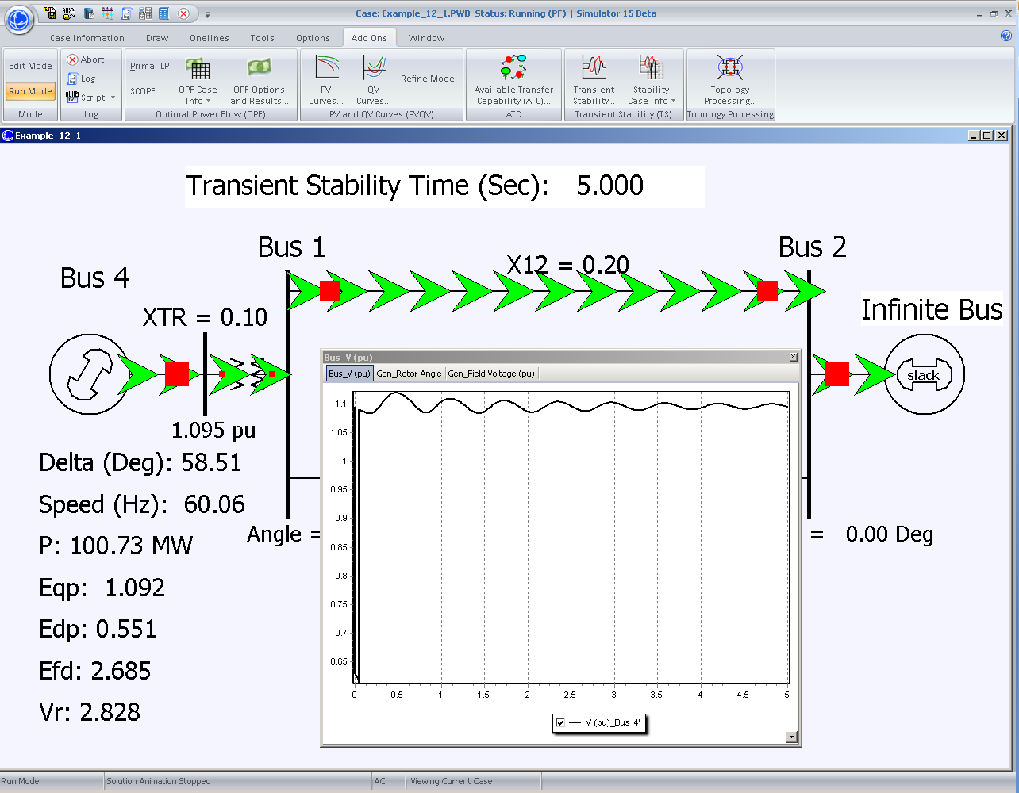
PowerWorld Example 12.1 Solution
24

Slide 26
2007 CWLP Dallman Accident
In 2007 there was an explosion at the CWLP 86 MW Dallman 1 generator. The explosion was eventually determined to be caused by a sticky valve that prevented the cutoff of steam into the turbine when the generator went off line. So the generator turbine continued to accelerate up to over 6000 rpm (3600 normal).
  High speed caused parts of the generator to shoot out
  Hydrogen escaped from the cooling system, and eventually escaped causing the explosion
  Repairs took about 18 months, costing more than $52 million
25

Slide 27
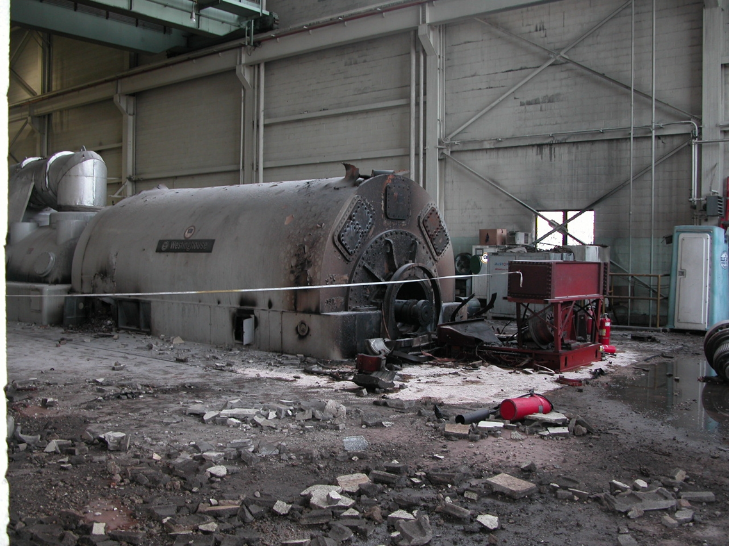
Dallman After the Accident
26

Slide 28
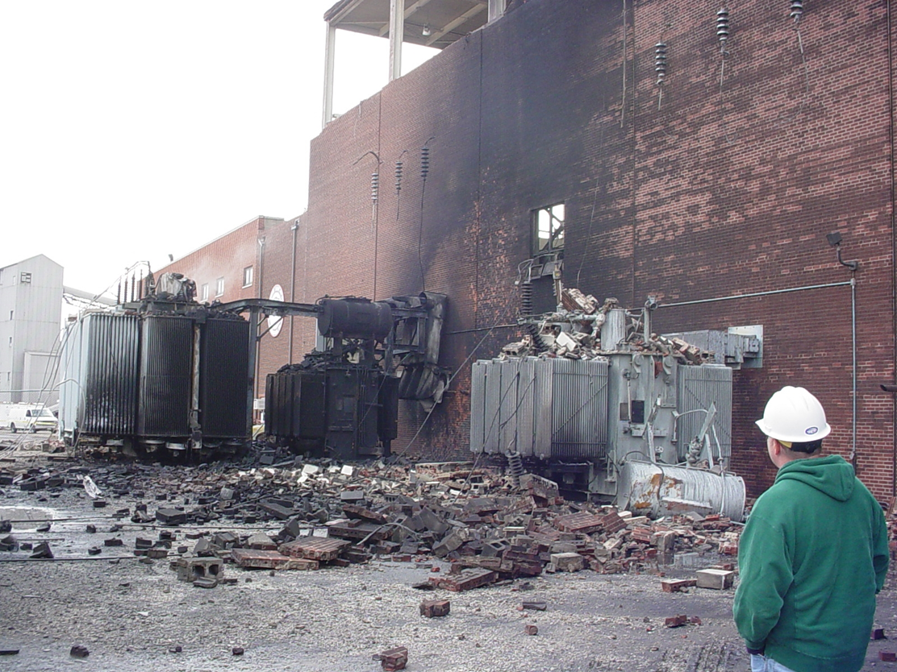
Outside of Dallman
27

