Slide 1
ECE 476
Power System Analysis
Lecture 24: Transient Stability
Prof. Tom Overbye
Dept. of Electrical and Computer Engineering
University of Illinois at Urbana-Champaign
overbye@illinois.edu

Slide 2
Announcements
Please read Chapters 11 and 12
HW 10 is 11.1, 11.4, 11.12, 11.19, 11.21; quiz on Dec 1 (hence it will not be turned in)
  We will be dropping your lowest two HW and/or Quiz scores
Chapter 6 Design Project 1 is assigned. Will count as 3 regular home works and is due on Tuesday Dec 6.
  For tower configurations assume a symmetric conductor spacing, with the distance in feet given by the following formula: (Last two digits of your EIN+150)/10. Example student A has an UIN of xxx65. Then spacing is (65+150)/10 = 21.50 ft.
Final exam is on Monday December 12, 1:30-4:30pm
  Comprehensive, closed book/notes; three note sheets allowed
  Last name A-H in ECEB 3013, rest in ECE 3017

Slide 3
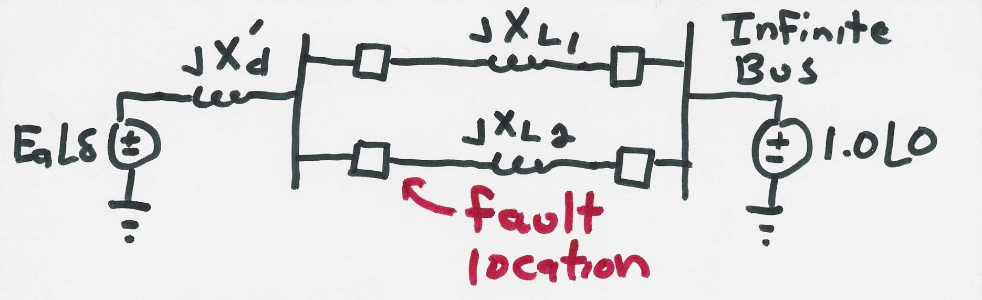
SMIB Example
Assume a generator is supplying power to an infinite bus through two parallel transmission lines. Then a balanced three phase fault occurs at the terminal of one of the lines. The fault is cleared by the opening of this line’s circuit breakers.
2

Slide 4
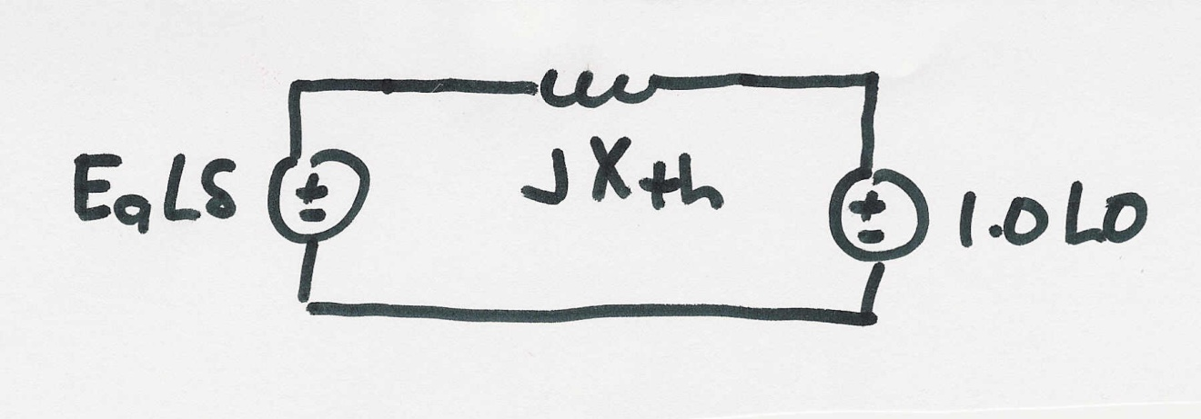
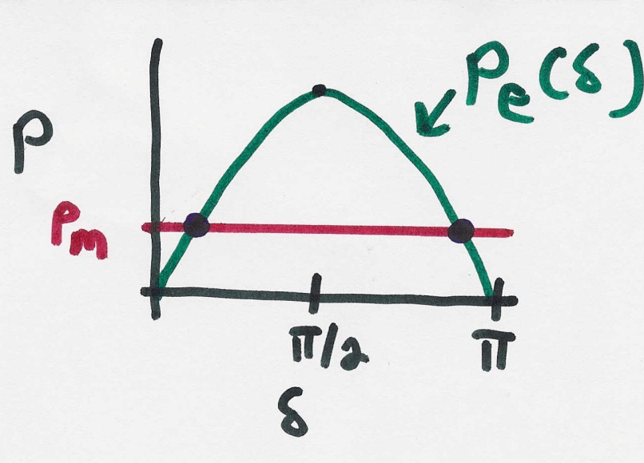
SMIB Example, cont’d
Simplified prefault system
3

Slide 5
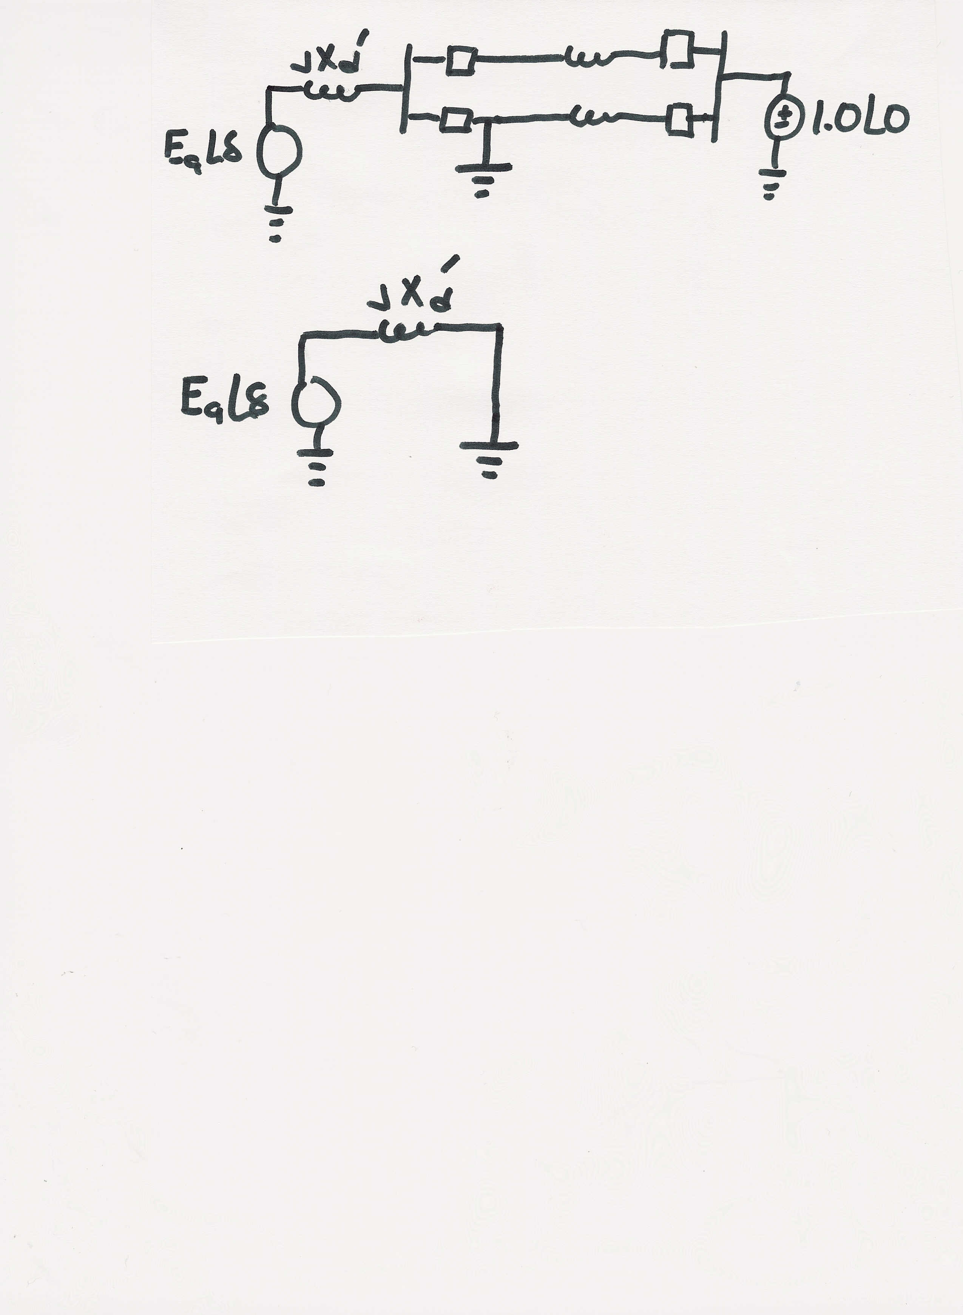
SMIB Example, Faulted System
During the fault the system changes
The equivalent system during the fault is then
During this fault no
power can be transferred
from the generator to
the system
4

Slide 6
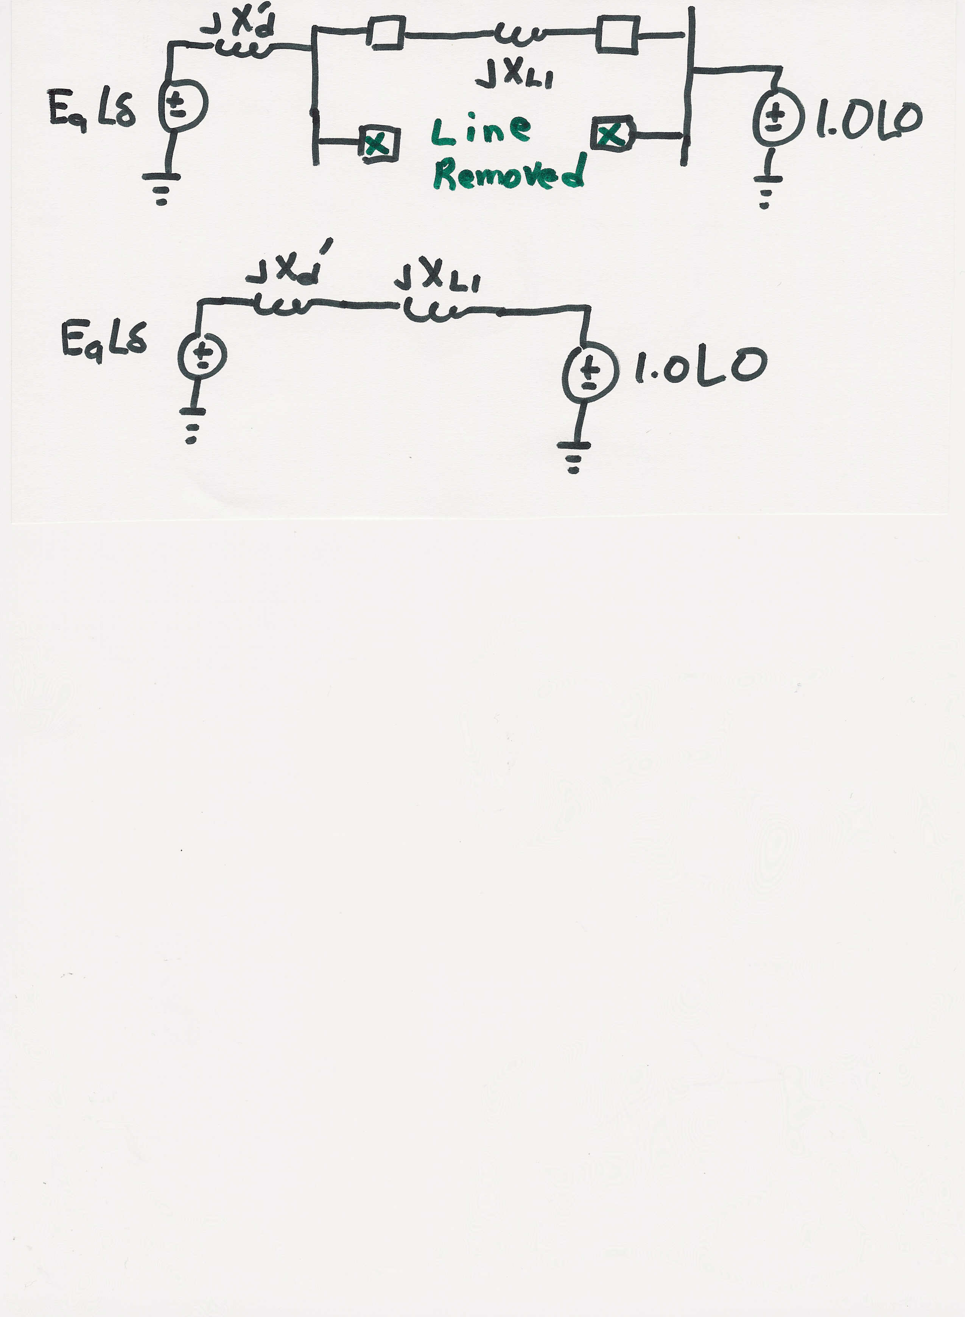
SMIB Example, Post Fault System
After the fault the system again changes
The equivalent system after the fault is then
5

Slide 7
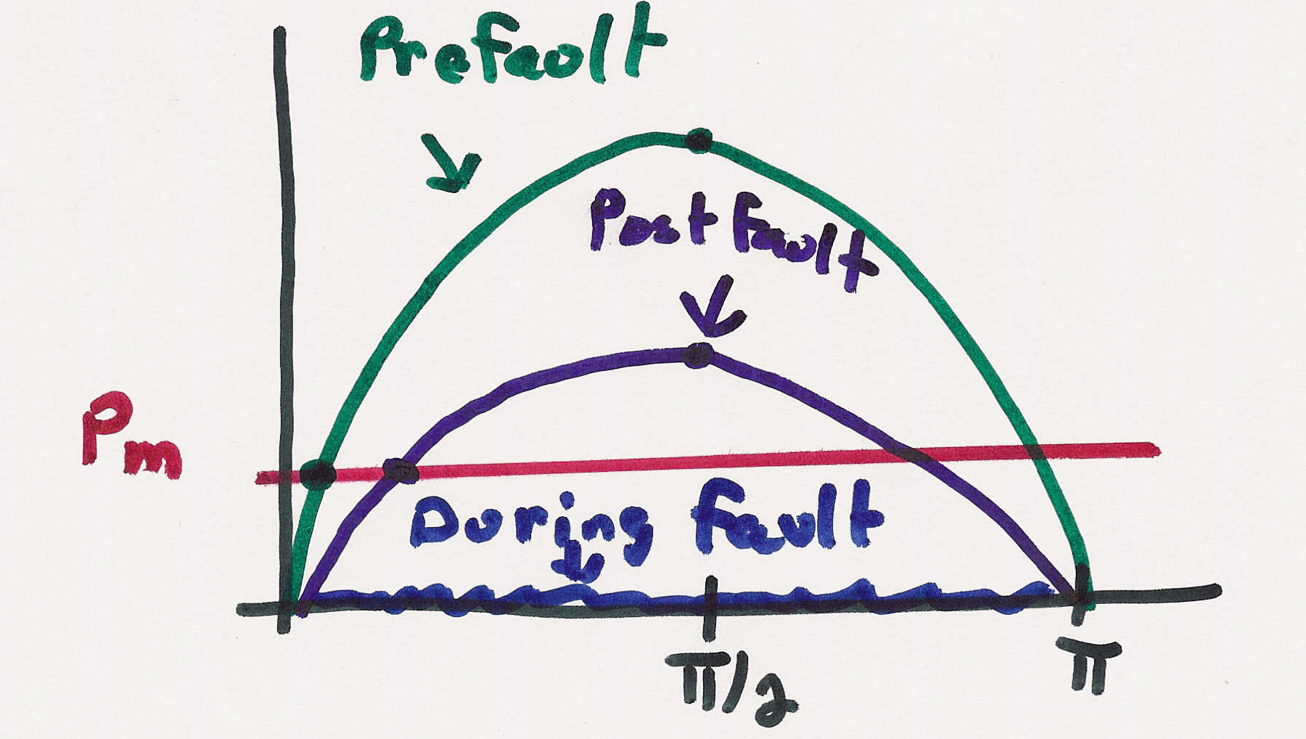
SMIB Example, Dynamics
6

Slide 8
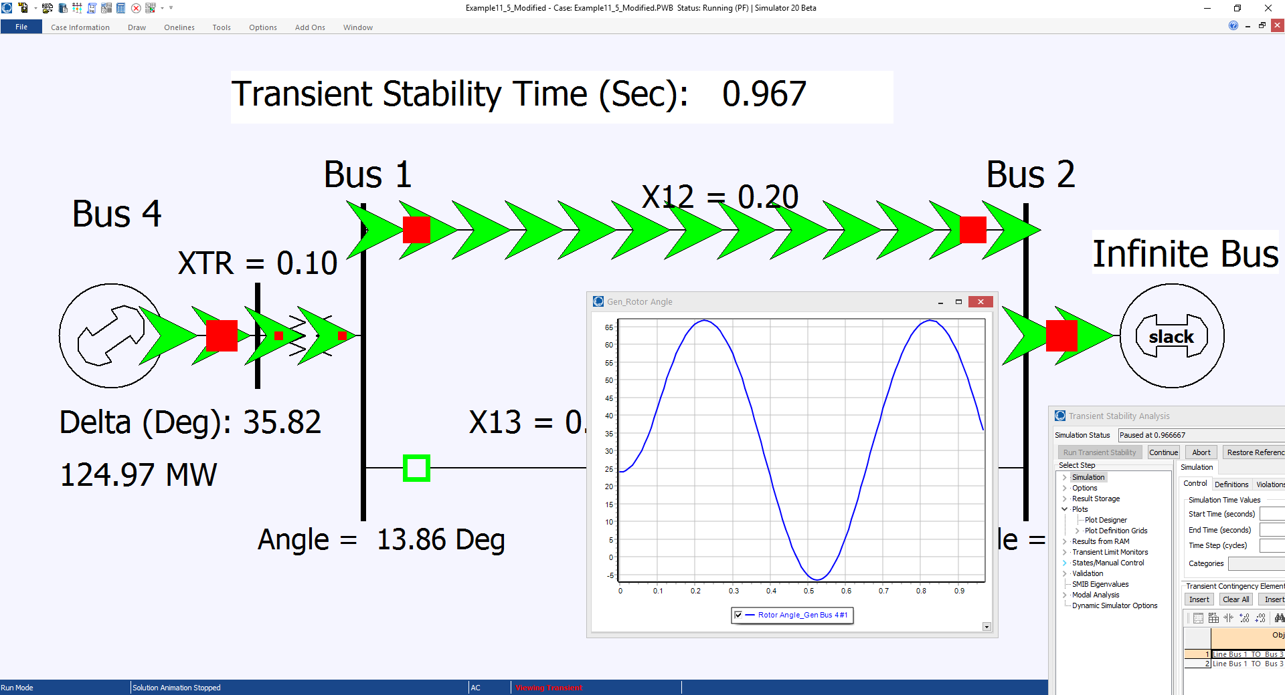
Modified Example 11.5

Slide 9
Differential Algebraic Equations
Many problems, including many in the power area, can be formulated as a set of differential, algebraic equations (DAE) of the form
A power example is transient stability, in which f represents (primarily) the generator dynamics, and g (primarily) the bus power balance equations
We'll initially consider the simpler problem of just
8

Slide 10
Ordinary Differential Equations (ODEs)
Assume we have a problem of the form
This is known as an initial value problem, since the initial value of x is given at some time t₀
  We need to determine x(t) for future time
  Initial value, x₀, must be either be given or determined by solving for an equilibrium point, f(x) = 0
  Higher-order systems can be put into this first order form
Except for special cases, such as linear systems, an analytic solution is usually not possible – numerical methods must be used
9

Slide 11

Initial value Problem Examples
Example 2
is similar
to the
SMIB
swing
equation
10

Slide 12
Numerical Solution Methods
Numerical solution methods do not generate exact solutions; they practically always introduce some error
  Methods assume time advances in discrete increments, called a stepsize (or time step), Δt
  Speed accuracy tradeoff: a smaller Δt usually gives a better solution, but it takes longer to compute
  Numeric roundoff error due to finite computer word size
Key issue is the derivative of x, f(x) depends on x, the value we are trying to determine
A solution exists as long as f(x) is continuously differentiable
11

Slide 13
Numerical Solution Methods
There are a wide variety of different solution approaches, we will only touch on several
One-step methods: require information about solution just at one point, x(t)
  Forward Euler
  Runge-Kutta
Multi-step methods: make use of information at more than one point, x(t), x(t-Δt), x(t-Δ2t)…
  Adams-Bashforth
Predictor-Corrector Methods: implicit
  Backward Euler
12

Slide 14
Error Propagation
At each time step the total round-off error is the sum of the local round-off at time and the propagated error from steps 1, 2 , … , k − 1
An algorithm with the desirable property that local round-off error decays with increasing number of steps is said to be numerically stable
Otherwise, the algorithm is numerically unstable
Numerically unstable algorithms can nevertheless give quite good performance if appropriate time steps are used
  This is particularly true when coupled with algebraic equations
13

Slide 15
Euler’s Method
14

Slide 16
Euler’s Method Algorithm
15

Slide 17
Euler’s Method Example 1
16

Slide 18
Euler’s Method Example 1, cont’d
t | x^{actual}(t) | x(t) Δt=0.1 | x(t) Δt=0.05
0 | 10 | 10 | 10
0.1 | 9.048 | 9 | 9.02
0.2 | 8.187 | 8.10 | 8.15
0.3 | 7.408 | 7.29 | 7.35
… | … | … | …
1.0 | 3.678 | 3.49 | 3.58
… | … | … | …
2.0 | 1.353 | 1.22 | 1.29
17

Slide 19
Euler’s Method Example 2
18

Slide 20
Euler's Method Example 2, cont'd
19

Slide 21
Euler's Method Example 2, cont'd
t | x₁^{actual}(t) | x₁(t) Δt=0.25
0 | 1 | 1
0.25 | 0.9689 | 1
0.50 | 0.8776 | 0.9375
0.75 | 0.7317 | 0.8125
1.00 | 0.5403 | 0.6289
… | … | …
10.0 | -0.8391 | -3.129
100.0 | 0.8623 | -151,983
Since we
know from
the exact
solution that
x1 is bounded
between
-1 and 1,
clearly the
method is
numerically
unstable
20

Slide 22
Euler's Method Example 2, cont'd
Below is a comparison of the solution values for x₁(t)
at time t = 10 seconds
Δt | x₁(10)
actual | -0.8391
0.25 | -3.129
0.10 | -1.4088
0.01 | -0.8823
0.001 | -0.8423
21

Slide 23
Second Order Runge-Kutta Method
Runge-Kutta methods improve on Euler's method by evaluating f(x) at selected points over the time step
Simplest method is the second order method in which
That is, k₁ is what we get from Euler's; k₂ improves on this by reevaluating at the estimated end of the time step
22

Slide 24
RK2 Versus Euler's
RK2 requires twice the function evaluations per iteration, but gives much better results
With RK2 the error tends to vary with the cube of the step size, compared with the square of the step size for Euler's
The smaller error allows for larger step sizes compared to Eulers
23

Slide 25
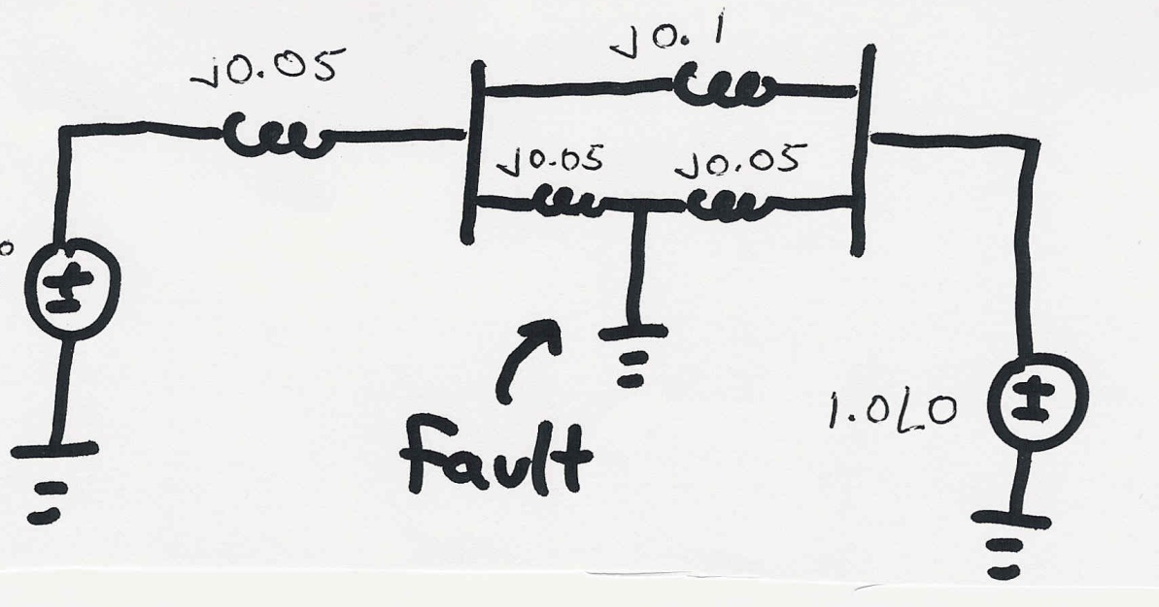
Transient Stability Example
A 60 Hz generator is supplying 550 MW to an infinite bus (with 1.0 per unit voltage) through two parallel transmission lines. Determine initial angle change for a fault midway down one of the lines.
H = 20 seconds, D = 0.1. Use Δt=0.01 second.
E_{a}
24

Slide 26
Transient Stability Example, cont'd
25

Slide 27
Transient Stability Example, cont'd
26

Slide 28
Transient Stability Example, cont'd
27

Slide 29
Transient Stability Example, cont'd
28

