Slide 1
ECE 476
Power System Analysis
Lecture 22: Protection, Small Event Blackouts Indices
Prof. Tom Overbye
Dept. of Electrical and Computer Engineering
University of Illinois at Urbana-Champaign
overbye@illinois.edu

Slide 2
Announcements
Please read Chapters 9, 10 and 11
HW 9 is 8.14, 9.1, 9.2 (bus 3), 9.15, 9.64; this should be turned in on Nov 10 (hence no quiz)
Chapter 6 Design Project 1 is assigned. It will count as three regular home works and is due on Dec 3.
  For tower configurations assume a symmetric conductor spacing, with the distance in feet given by the following formula: (Last two digits of your EIN+150)/10. Example student A has an UIN of xxx65. Then his/her spacing is (65+150)/10 = 21.50 ft.
Exam 2 is during class on Tuesday November 15
Final exam is on Monday December 12, 1:30-4:30pm

Slide 3
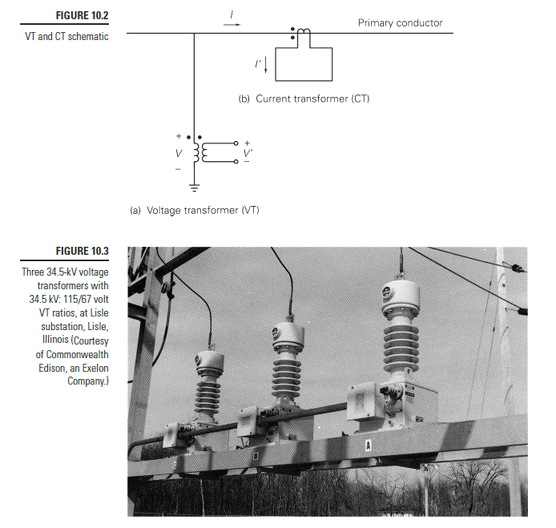
Instrument Transformers
Current transformers (CTs) and voltage transformers (VTs) are used to sense the system
  Their accuracy
  varies depending
  on application with
  “revenue quality”
  devices used when
  there is a need for
  high accuracy such as
  for interchange
  calculations; less
  accuracy is needed for
  faults
2

Slide 4
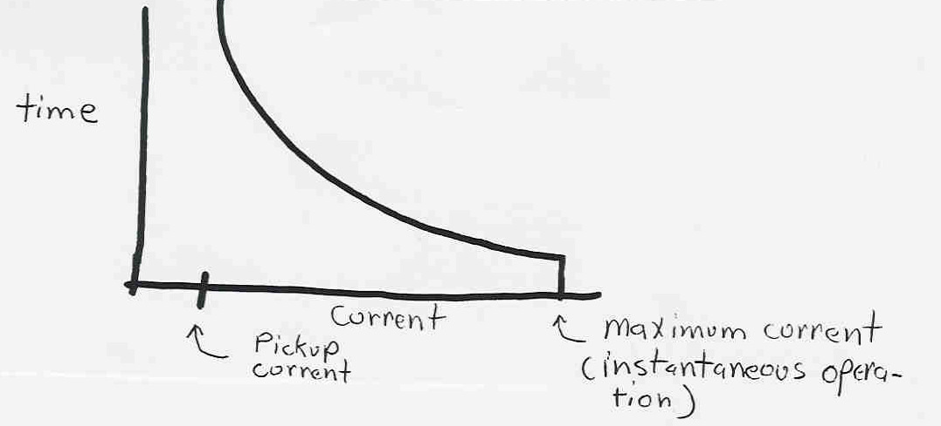
Inverse Time Overcurrent Relays
Inverse time overcurrent relays respond instan-taneously to a current above their maximum setting
They respond slower to currents below this value but above the pickup current value
3

Slide 5
Inverse Time Relays, cont'd
The inverse time characteristic provides backup protection since relays further upstream (closer to power source) should eventually trip if relays closer to the fault fail
Challenge is to make sure the minimum pickup current is set low enough to pick up all likely faults, but high enough not to trip on load current
When outaged feeders are returned to service there can be a large in-rush current as all the motors try to simultaneously start; this in-rush current may re-trip the feeder
4

Slide 6
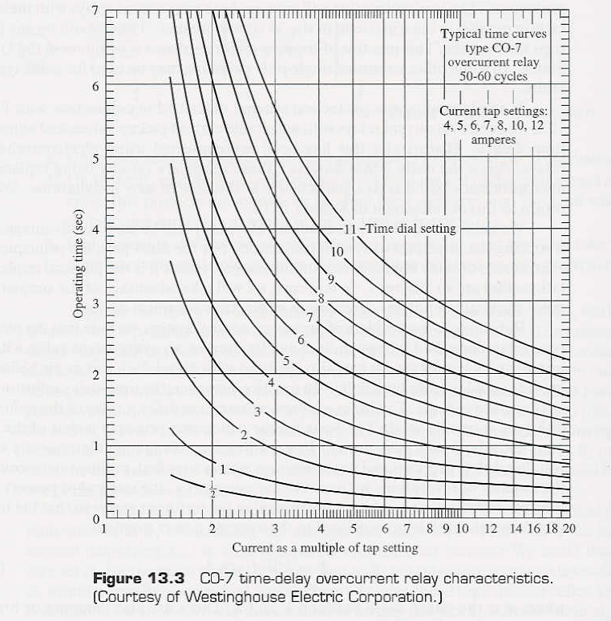
Inverse Time Overcurrent Relays
Current and time
settings had been adjusted using dials
on the relay
Relays have
traditionally been
electromechanical
devices, but are
gradually being
replaced by
digital relays
5

Slide 7
Protection of Network Systems
In a networked system there are a number of difference sources of power. Power flows are bidirectional
Networked system offer greater reliability, since the failure of a single device does not result in a loss of load
Networked systems are usually used with the transmission system, and are sometimes used with the distribution systems, particularly in urban areas
6

Slide 8
Network System Protection
Removing networked elements require the opening of circuit breakers at both ends of the device
There are several common protection schemes; multiple overlapping schemes are usually used
  Directional relays with communication between the device terminals
  Impedance (distance) relays.
  Differential protection
7

Slide 9
Directional Relays
Directional relays are commonly used to protect high voltage transmission lines
Voltage and current measurements are used to determine direction of current flow (into or out of line)
Relays on both ends of line communicate and will only trip the line if excessive current is flowing into the line from both ends
  line carrier communication is popular in which a high frequency signal (30 kHz to 300 kHz) is used
  microwave communication is sometimes used; radio can also be used
  Security is a concern
8

Slide 10
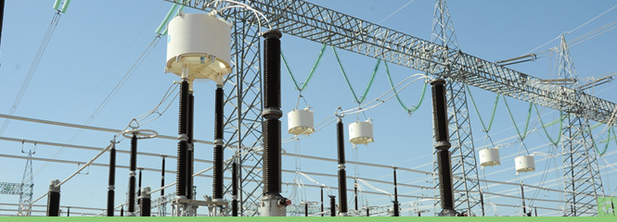
Line Carrier Communication,
Line Traps
Line traps are connection in series with lines to allow the power frequency (50 or 60 Hz) to pass with low impedance but to show high impedance at the line carrier frequency
Image source: qualitypower.com/line-trap.html
9

Slide 11
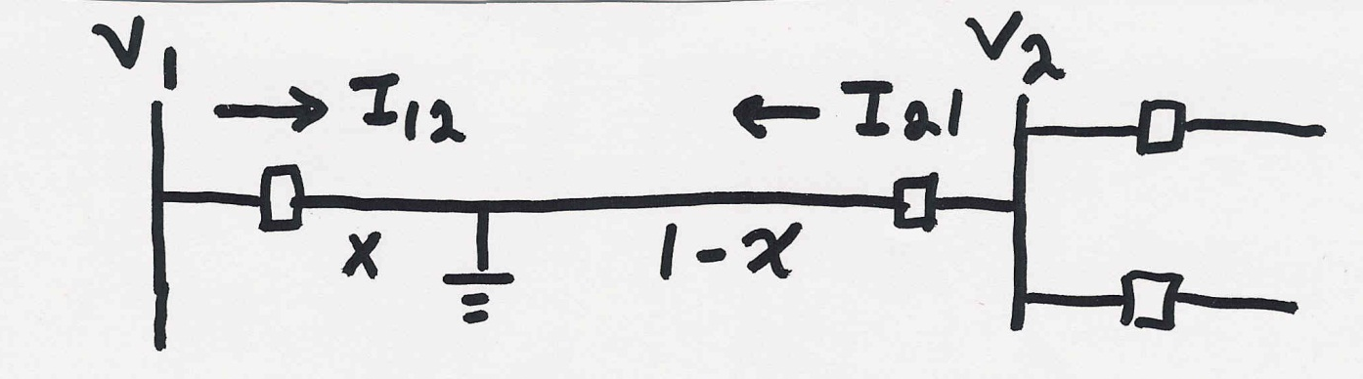
Impedance Relays
Impedance (distance) relays measure ratio of voltage to current to determine if a fault exists on a particular line

Slide 12
Impedance Relays Protection Zones
To avoid inadvertent tripping for faults on other transmission lines, impedance relays usually have several zones of protection:
  zone 1 may be 80% of line for a 3φ fault; trip is instantaneous
  zone 2 may cover 120% of line but with a delay to prevent tripping for faults on adjacent lines
  zone 3 went further; most removed due to 8/14/03 events
The key problem is that different fault types will present the relays with different apparent impedances; adequate protection for a 3φ fault gives very limited protection for LL faults
11

Slide 13
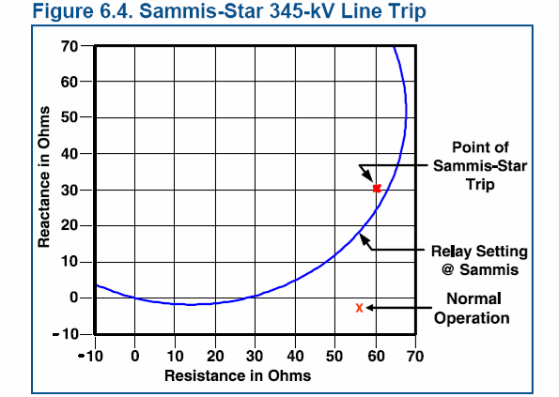
Impedance Relay Trip Characteristics
Source: August 14th 2003 Blackout Final Report, p. 78
12

Slide 14
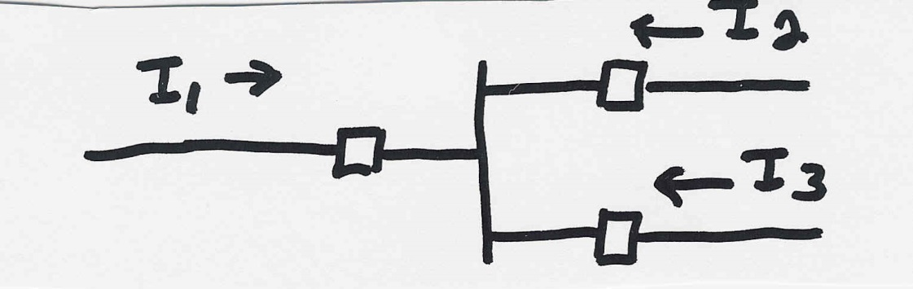
Differential Relays
Main idea behind differential protection is that during normal operation the net current into a device should sum to zero for each phase
  transformer turns ratios must, of course, be considered
Differential protection is used with geographically local devices
  buses
  transformers
  generators
13

Slide 15
Other Types of Relays
In addition to providing fault protection, relays are used to protect the system against operational problems as well
Being automatic devices, relays can respond much quicker than a human operator and therefore have an advantage when time is of the essence
Other common types of relays include
  under-frequency for load: e.g., 10% of system load must be shed if system frequency falls to 59.3 Hz
  over-frequency on generators
  under-voltage on loads (less common)
14

Slide 16
Digital Fault Recorders (DFRs)
During major system disturbances numerous relays at a number of substations may operate
Event reconstruction requires time synchronization between substations to figure out the sequence of events
Most utilities now have digital fault recorders (DFRs) to provide a detailed recording of system events with time resolution of at least 1 microsecond
Some of this functionality is now included in digital relays
15

Slide 17
Use of GPS for Fault Location
Since power system lines may span hundreds of miles, a key difficulty in power system restoration is determining the location of the fault
One newer technique is the use of the global positioning system (GPS).
GPS can provide time synchronization of about 1 microsecond
Since the traveling electromagnetic waves propagate at about the speed of light (300m per microsecond), the fault location can be found by comparing arrival times of the waves at each substation
16

Slide 18

The Real Cause of Most
Blackouts!
Photo source: http://save-the-squirrels.com
17

Slide 19
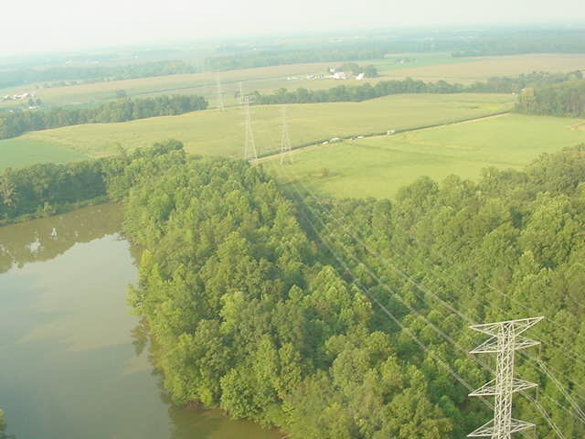
And Sometimes It’s the Trees
18

Slide 20
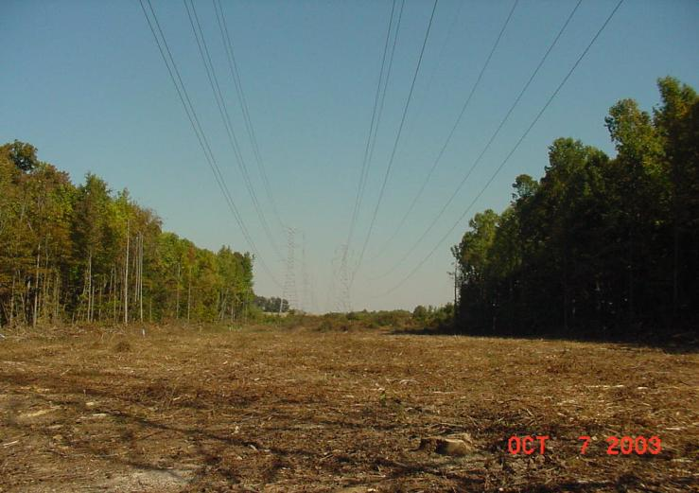
Same Trees After “Trimming”
19

Slide 21
Standard Indices for Small Events
(IEEE Std 1366-2012)
System Average Interruption Duration Index (SAIDI) represents the average amount of time the supply to a customer is interrupted per year (expressed in minutes per year)
System Average Interruption Frequency Index (SAIFI) represents the average number of times per year the supply to a customer is interrupted per year (expressed in interruptions per year)
  Both are averages for a system so some people have higher values, some lower
20

Slide 22
IEEE Std 1366-2012
Major Event Days (MED)
A MED is a day in which the SAIDI exceeds a threshold; all indices are calculated with the MEDs removed
  Typically one per year (give or take)
  Purpose of removal is to allow indices to give good indication of normal operational and design stress
  MEDs are analyzed separately
  Just looking at standard indices doesn’t indicate what is really going on.
21

Slide 23
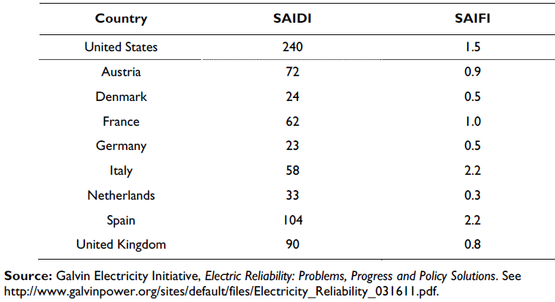
Comparison of International Reliability Indices
Source: Table 2 of http://www.fas.org/sgp/crs/misc/R42696.pdf
22

Slide 24
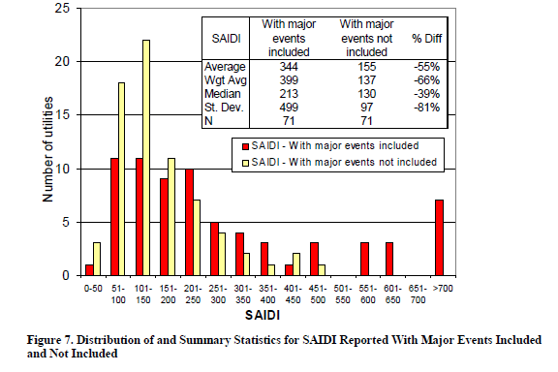
SAIDIs Without and
With Major Events
Source: http://certs.lbl.gov/pdf/lbnl1092e-puc-reliability-data.pdf
23

Slide 25
Larger Scale Blackouts
The North American Electric Reliability Corporation (NERC) requires reporting of events the interrupt more than 300 MWs or affect at least 50,000 customers
  From 1984 to 2006 there were 861 events reported, but only about 300 met the criteria
  Average of blackouts that met the criteria affected several hundred thousand customers, but large outages affected many more (like August 14, 2003 with more than 50 million people).
Source: www.uvm.edu/~phines/publications/2008/Hines_2008_blackouts.pdf
24

Slide 26
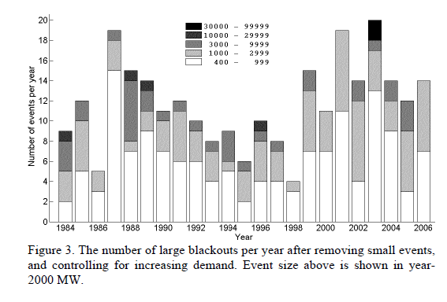
Large Blackouts in North America By Event Size and Year
25

Slide 27
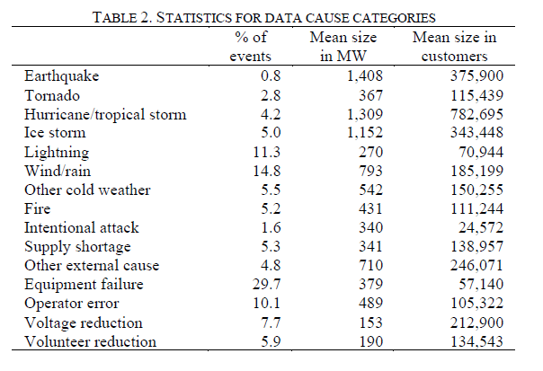
Causes of Large Blackouts
26

