Slide 1
ECE 476
Power System Analysis
Lecture 20: Symmetrical Components, Grounding, Unbalanced Faults
Prof. Tom Overbye
Dept. of Electrical and Computer Engineering
University of Illinois at Urbana-Champaign
overbye@illinois.edu

Slide 2
Announcements
Please read Chapters 8 and 9
HW 8 is 7.6, 7.14, 7.20, 7.29, 8.3; it will be covered by an in-class quiz on due on Thursday Nov 3 (hence you will not need to turn it in)
Chapter 6 Design Project 1 is assigned. It will count as three regular home works and is due on Dec 3.
  For tower configurations assume a symmetric conductor spacing, with the distance in feet given by the following formula: (Last two digits of your EIN+150)/10. Example student A has an UIN of xxx65. Then his/her spacing is (65+150)/10 = 21.50 ft.
Exam 2 is during class on Tuesday November 15
Final exam is on Monday December 12, 1:30-4:30pm

Slide 3
Problem 7.28
2

Slide 4
Analysis of Unsymmetric Systems
Except for the balanced three-phase fault, faults result in an unbalanced system.
The most common types of faults are single line-ground (SLG) and line-line (LL). Other types are double line-ground (DLG), open conductor, and balanced three phase.
System is only unbalanced at point of fault!
The easiest method to analyze unbalanced system operation due to faults is through the use of symmetrical components
3

Slide 5
Symmetric Components
The key idea of symmetrical component analysis is to decompose the system into three sequence networks. The networks are then coupled only at the point of the unbalance (i.e., the fault)
The three sequence networks are known as the
  positive sequence (this is the one we’ve been using)
  negative sequence
  zero sequence
Presented in paper by Charles .L Fortescue in 1918 (judged as most important power paper of 20th century)
Heydt, G. T.; Venkata, S. S.; Balijepalli, N. (October 24, 2000). "High Impact Papers in Power Engineering, 1900-1999" Proceedings 2000 North American Power Symposium, vol. 1, October 2000. North American Power Symposium (NAPS). Waterloo, Ontario.
4

Slide 6
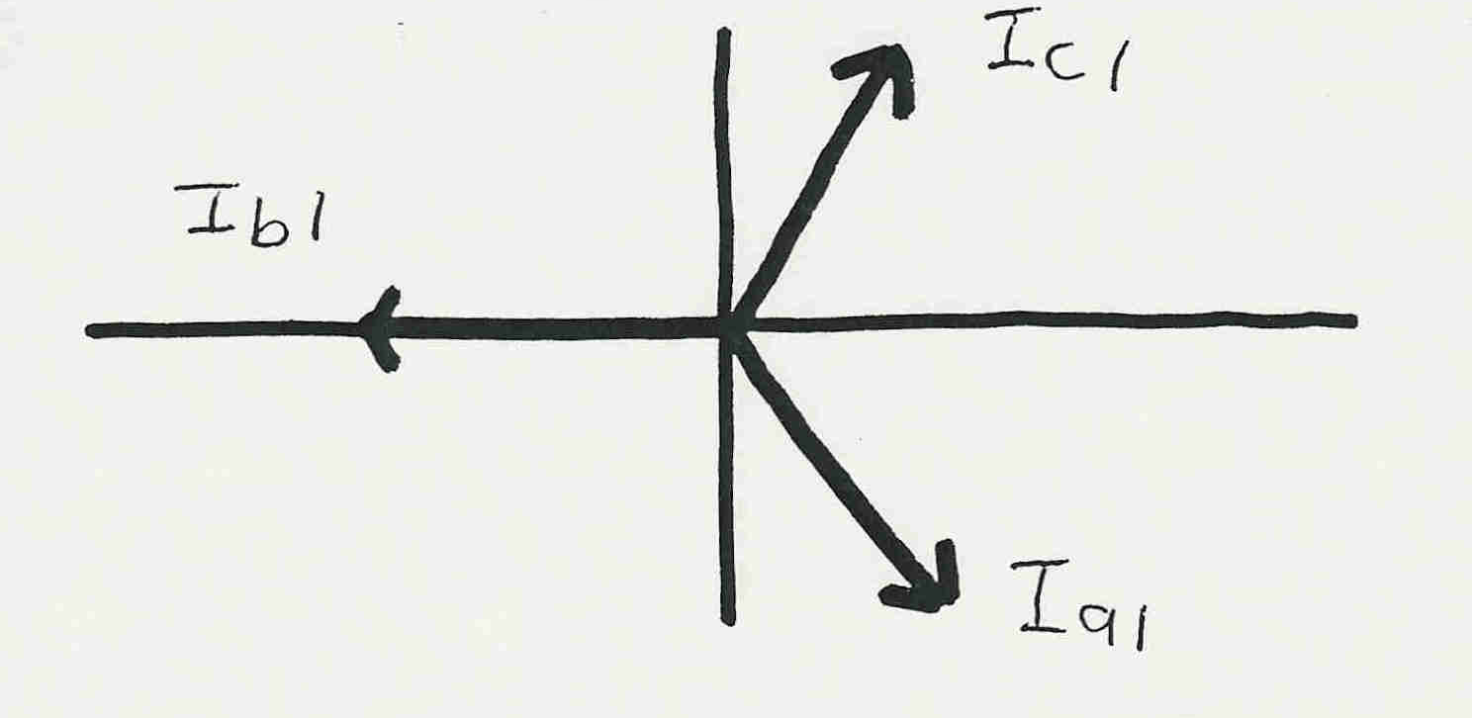
Positive Sequence Sets
The positive sequence sets have three phase currents/voltages with equal magnitude, with phase b lagging phase a by 120°, and phase c lagging phase b by 120°.
We’ve been studying positive sequence sets
Positive sequence
sets have zero
neutral current
5

Slide 7
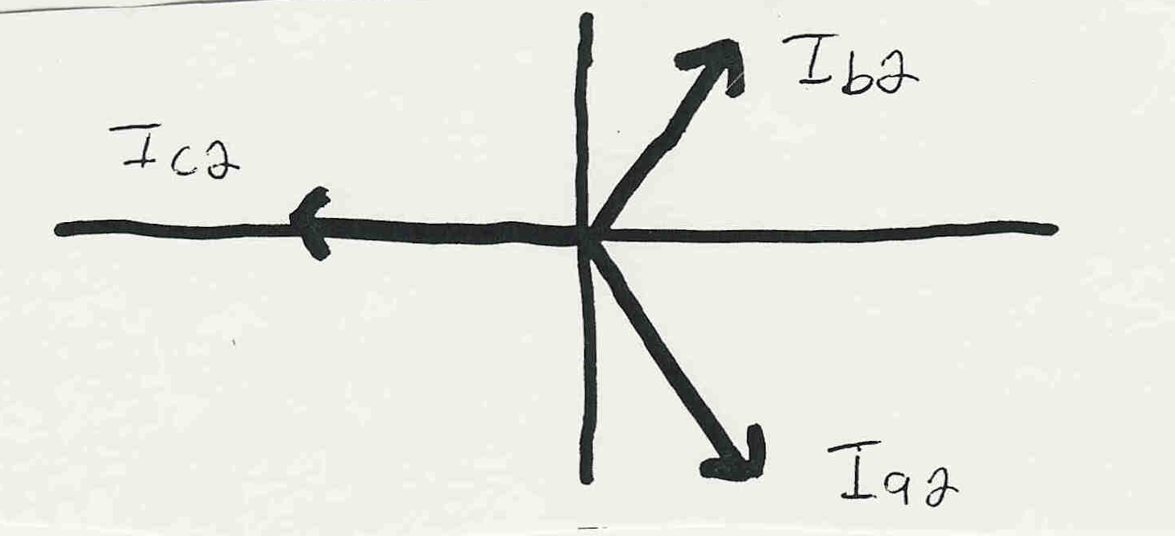
Negative Sequence Sets
The negative sequence sets have three phase currents/voltages with equal magnitude, with phase b leading phase a by 120°, and phase c leading phase b by 120°.
Negative sequence sets are similar to positive sequence, except the phase order is reversed
Negative sequence
sets have zero
neutral current
6

Slide 8
Zero Sequence Sets
Zero sequence sets have three values with equal magnitude and angle.
Zero sequence sets have neutral current
7

Slide 9
Sequence Set Representation
Any arbitrary set of three phasors, say I_{a}, I_{b}, I_{c} can be represented as a sum of the three sequence sets
8

Slide 10
Conversion from Sequence to Phase
9

Slide 11
Conversion Sequence to Phase
10

Slide 12
Conversion Phase to Sequence
11

Slide 13
Symmetrical Component Example 1
12

Slide 14
Symmetrical Component Example 2
13

Slide 15
Symmetrical Component Example 3
14

Slide 16
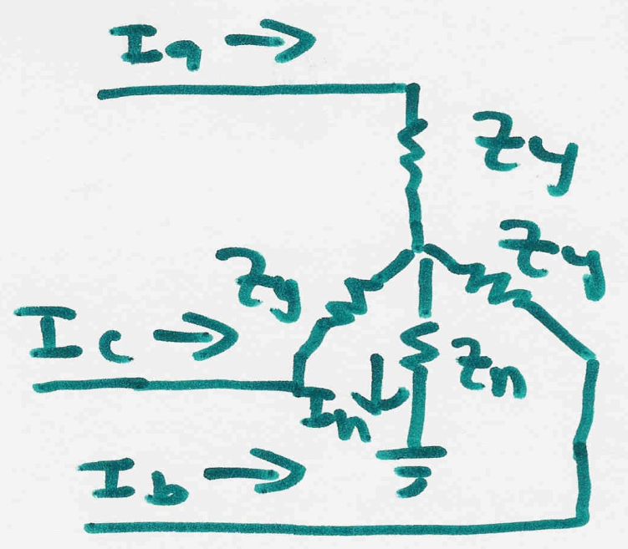
Use of Symmetrical Components
Consider the following wye-connected load:
15

Slide 17
Use of Symmetrical Components
16

Slide 18
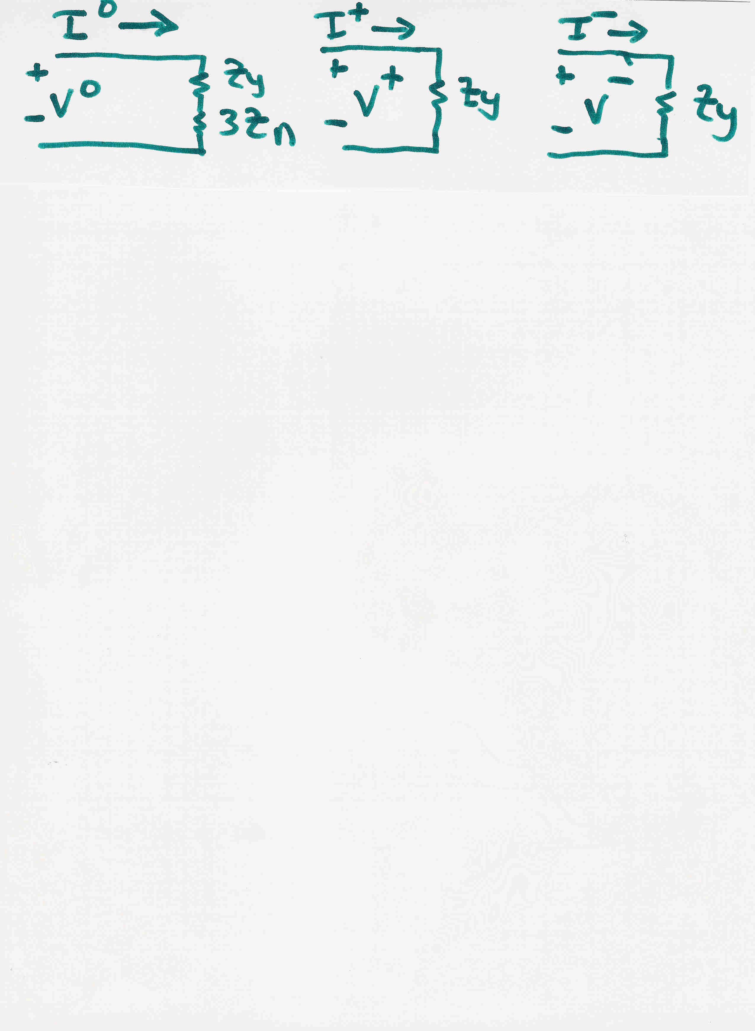
Networks are Now Decoupled
17

Slide 19
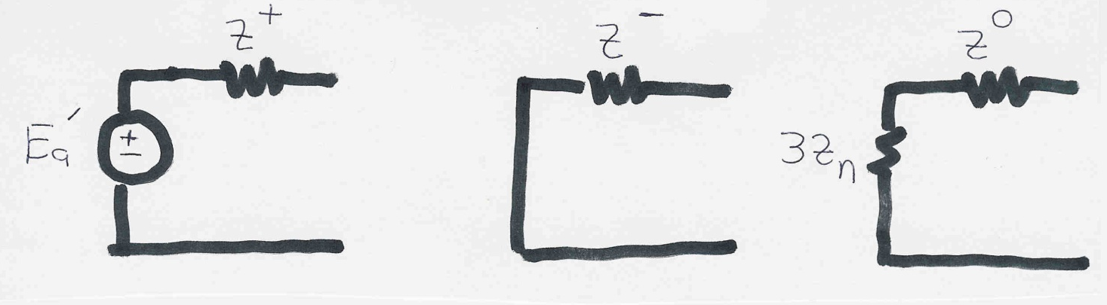
Sequence diagrams for generators
Key point: generators only produce positive sequence voltages; therefore only the positive sequence has a voltage source
During a fault Z⁺ ≈ Z⁻ ≈ X_{d}”. The zero sequence impedance is usually substantially smaller. The value of Z_{n} depends on whether the generator is grounded
18

Slide 20
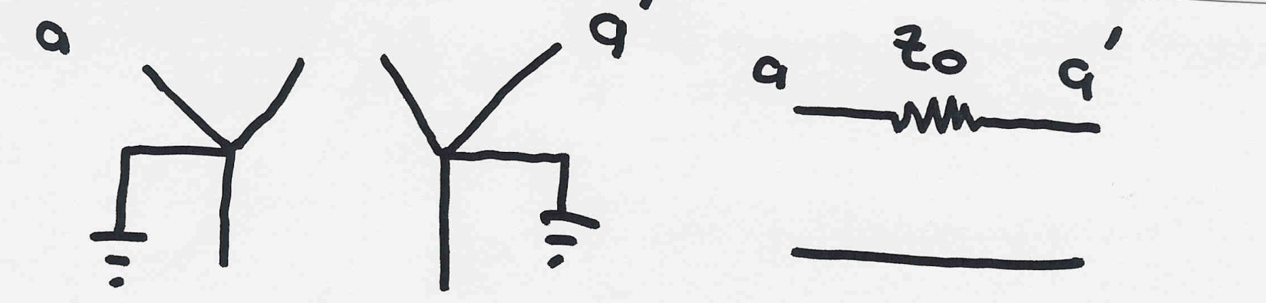
Sequence diagrams for Transformers
The positive and negative sequence diagrams for transformers are similar to those for transmission lines.
The zero sequence network depends upon both how the transformer is grounded and its type of connection. The easiest to understand is a double grounded wye-wye
19

Slide 21
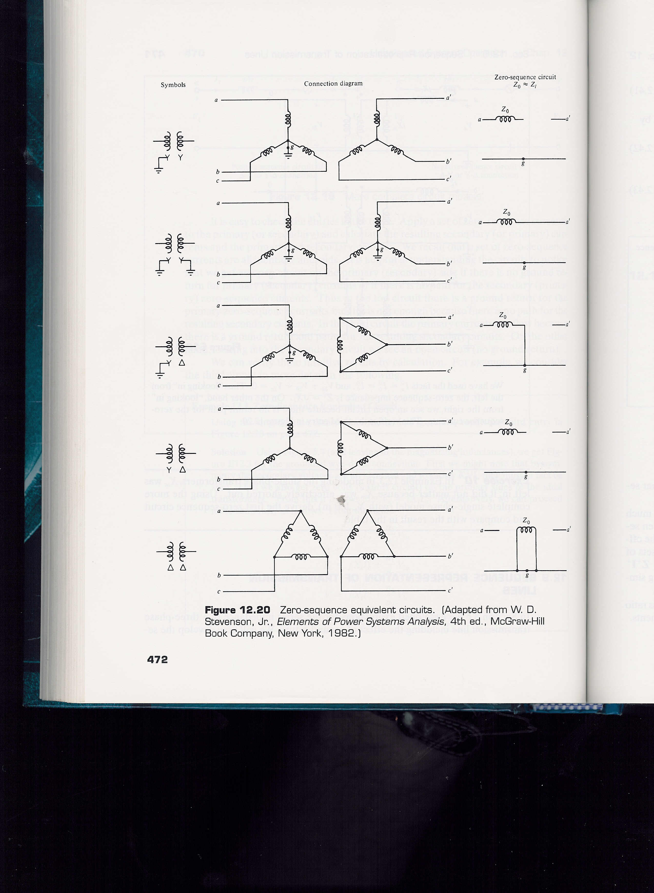
Transformer Sequence Diagrams
20

Slide 22
Grounding
When studying unbalanced system operation how a system is grounded can have a major impact on the fault flows
Ground current does not come into play during balanced system analysis (since net current to ground would be zero).
Becomes important in the study of unbalanced systems, such as during most faults.
21

Slide 23
Grounding, cont’d
Voltages are always defined as a voltage difference. The ground is used to establish the zero voltage reference point
  ground need not be the actual ground (e.g., an airplane)
During balanced system operation we can ignore the ground since there is no neutral current
There are two primary reasons for grounding electrical systems
  safety
  protect equipment
22

Slide 24
How good a conductor is dirt?
There is nothing magical about an earth ground. All the electrical laws, such as Ohm’s law, still apply.
Therefore to determine the resistance of the ground we can treat it like any other resistive material:
23

Slide 25
How good a conductor is dirt?
24

Slide 26
How good a conductor is dirt?
25

Slide 27
Calculation of grounding resistance
Because of its large cross sectional area the earth is actually a pretty good conductor.
Devices are physically grounded by having a conductor in physical contact with the ground; having a fairly large area of contact is important.
Most of the resistance associated with establishing an earth ground comes within a short distance of the grounding point.
Typical substation grounding resistance is between 0.1 and 1 ohm; fence is also grounded, usually by connecting it to the substation ground grid.
26

Slide 28
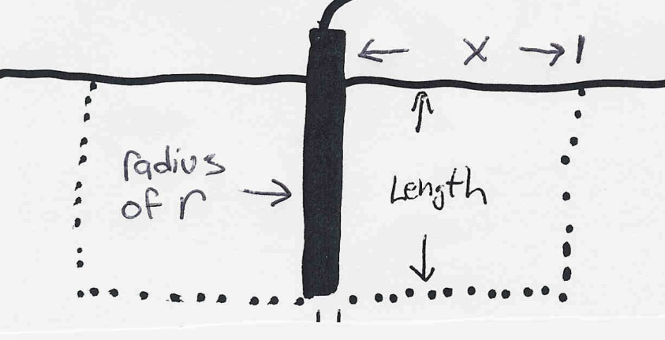
Calculation of grounding R, cont’d
Example: Calculate the resistance from a grounding rod out to a radial distance x from the rod, assuming the rod has a radius of r:
27

Slide 29
Calculation of grounding R, cont’d
The actual values will be
substantially less since
we’ve assumed no current
flowing downward into
the ground
28

Slide 30
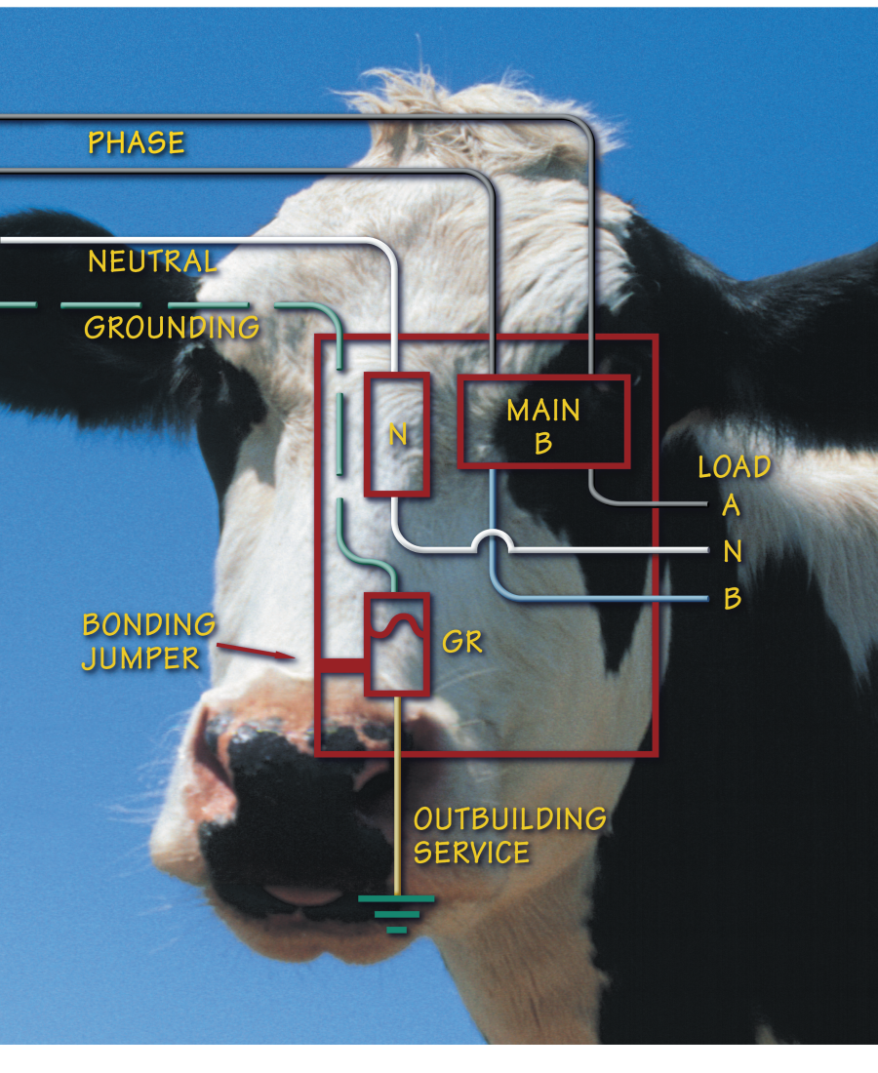
Stray Voltage
Stray voltage is a voltage difference between two objects that should not have a voltage difference
Small voltage differences
often exist between objects grounded at difference locations
It can be a large issue in rural locations, affecting things
like dairy milk production
Image Source: www.wisconsinpublicservice.com/business/pdf/farm_voltage.pdf

