Slide 1
ECE 476
Power System Analysis
Lecture 19: Short Circuit Analysis
Prof. Tom Overbye
Dept. of Electrical and Computer Engineering
University of Illinois at Urbana-Champaign
overbye@illinois.edu

Slide 2
Announcements
Please read Chapters 7 and 8
HW 7 is due today
HW 8 is 7.6, 7.14, 7.20, 7.29, 8.3; it will be covered by an in-class quiz on due on Thursday Nov 3 (hence you will not need to turn it in)
Exam 2 is during class on Tuesday November 15
Final exam is on Monday December 12, 1:30-4:30pm

Slide 3
Fault Analysis
The cause of electric power system faults is insulation breakdown
This breakdown can be due to a variety of different factors
  lightning
  wires blowing together in the wind
  animals or plants coming in contact with the wires
  salt spray or pollution on insulators
2

Slide 4
Fault Types
There are two main types of faults
  symmetric faults: system remains balanced; these faults are relatively rare, but are the easiest to analyze so we’ll consider them first.
  unsymmetric faults: system is no longer balanced; very common, but more difficult to analyze
The most common type of fault on a three phase system by far is the single line-to-ground (SLG), followed by the line-to-line faults (LL), double line-to-ground (DLG) faults, and balanced three phase faults
3

Slide 5
Lightning Strike Event Sequence
Lighting hits line, setting up an ionized path to ground
  30 million lightning strikes per year in US!
  a single typical stroke might have 25,000 amps, with a rise time of 10 μs, dissipated in 200 μs.
  multiple strokes can occur in a single flash, causing the lightning to appear to flicker, with the total event lasting up to a second.
Conduction path is maintained by ionized air after lightning stroke energy has dissipated, resulting in high fault currents (often > 25,000 amps!)
4

Slide 6
Lightning Strike Sequence, cont’d
Within one to two cycles (16 ms) relays at both ends of line detect high currents, signaling circuit breakers to open the line
  nearby locations see decreased voltages
Circuit breakers open to de-energize line in an additional one to two cycles
  breaking tens of thousands of amps of fault current is no small feat!
  with line removed voltages usually return to near normal
Circuit breakers may reclose after several seconds, trying to restore faulted line to service
5

Slide 7
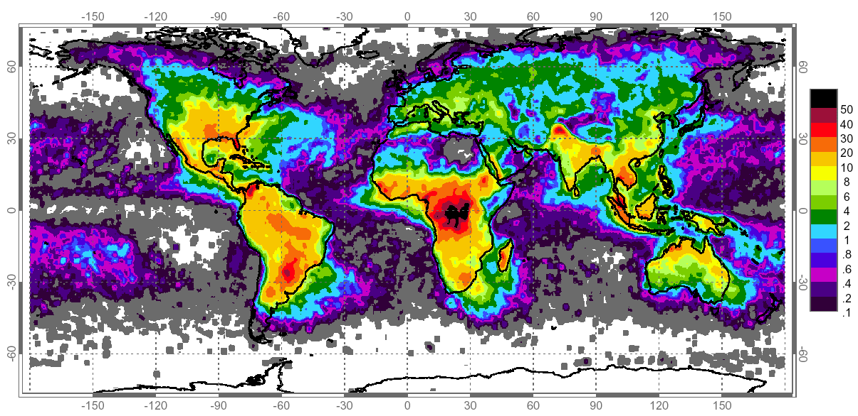
Worldwide Lightning Strike Density
Units are Lightning Flashes per square km per year; Florida is
top location in the US; very few on the West Coast, or HI, AK. This
is an important consideration when talking about electric reliability!
6
Source: http://science.nasa.gov/science-news/science-at-nasa/2001/ast05dec_1/

Slide 8
Fault Analysis
Fault currents cause equipment damage due to both thermal and mechanical processes
Goal of fault analysis is to determine the magnitudes of the currents present during the fault
  need to determine the maximum current to insure devices can survive the fault
  need to determine the maximum current the circuit breakers (CBs) need to interrupt to correctly size the CBs
7

Slide 9
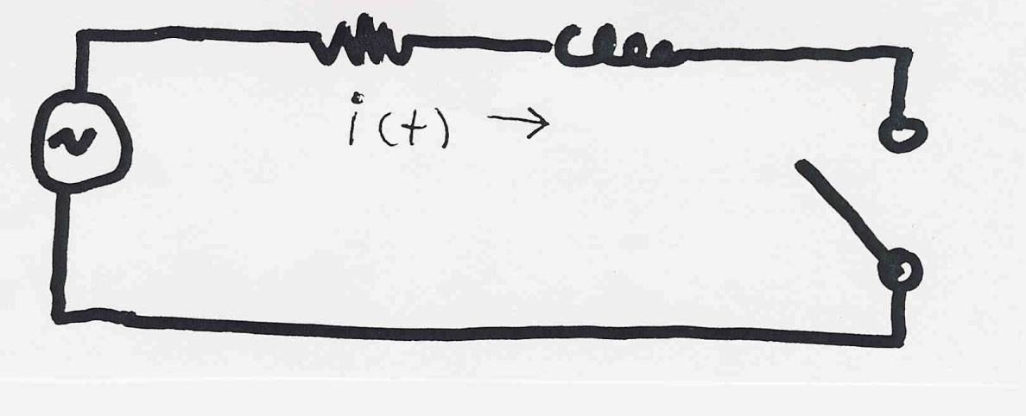
RL Circuit Analysis
To understand fault analysis we need to review the behavior of an RL circuit
Before the switch is closed obviously i(t) = 0.
When the switch is closed at t=0 the current will
have two components: 1) a steady-state value
2) a transient value
8

Slide 10
RL Circuit Analysis, cont’d
9

Slide 11
RL Circuit Analysis, cont’d
10

Slide 12
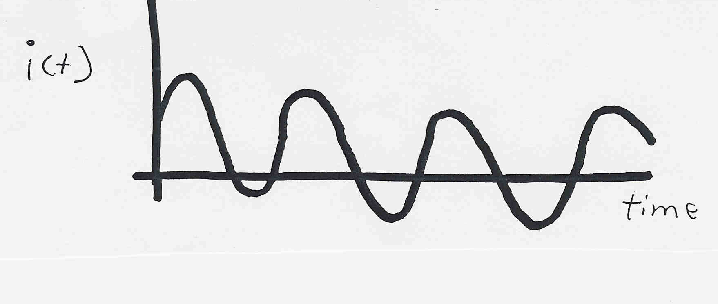
Time varying current
11

Slide 13
RL Circuit Analysis, cont’d
12

Slide 14
RMS for Fault Current
13

Slide 15
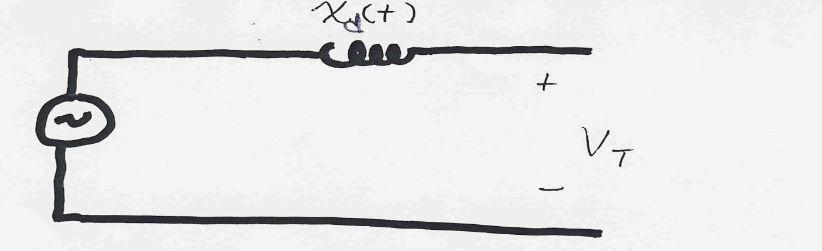
Generator Modeling During Faults
During a fault the only devices that can contribute fault current are those with energy storage
Thus the models of generators (and other rotating machines) are very important since they contribute the bulk of the fault current.
Generators can be approximated as a constant voltage behind a time-varying reactance
14

Slide 16
Generator Modeling, cont’d
15

Slide 17
Generator Modeling, cont’d
16

Slide 18
Generator Modeling, cont'd
17

Slide 19
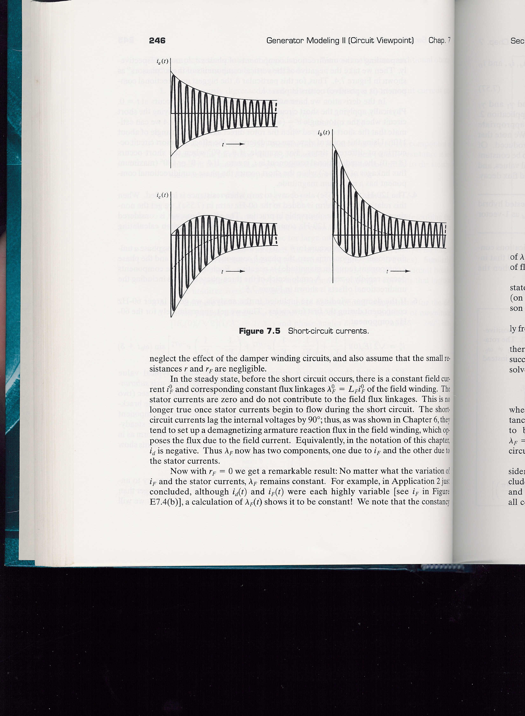
Generator Short Circuit Currents
18

Slide 20
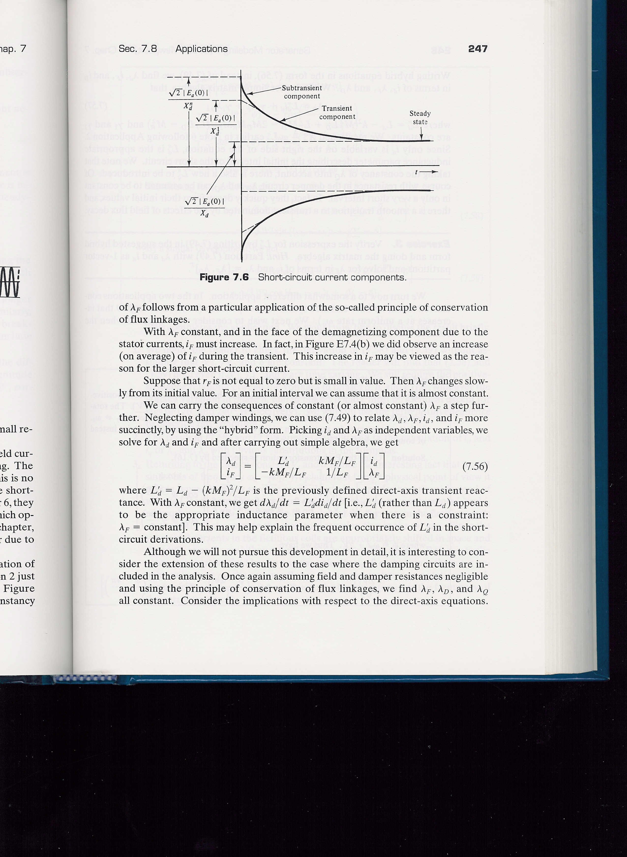
Generator Short Circuit Currents
19

Slide 21
Generator Short Circuit Example
A 500 MVA, 20 kV, 3φ is operated with an internal voltage of 1.05 pu. Assume a solid 3φ fault occurs on the generator's terminal and that the circuit breaker operates after three cycles. Determine the fault current. Assume
20

Slide 22
Generator S.C. Example, cont'd
21

Slide 23
Generator S.C. Example, cont'd
22

Slide 24
Network Fault Analysis Simplifications
To simplify analysis of fault currents in networks we'll make several simplifications:
  Transmission lines are represented by their series reactance
  Transformers are represented by their leakage reactances
  Synchronous machines are modeled as a constant voltage behind direct-axis subtransient reactance
  Induction motors are ignored or treated as synchronous machines
  Other (nonspinning) loads are ignored
23

Slide 25
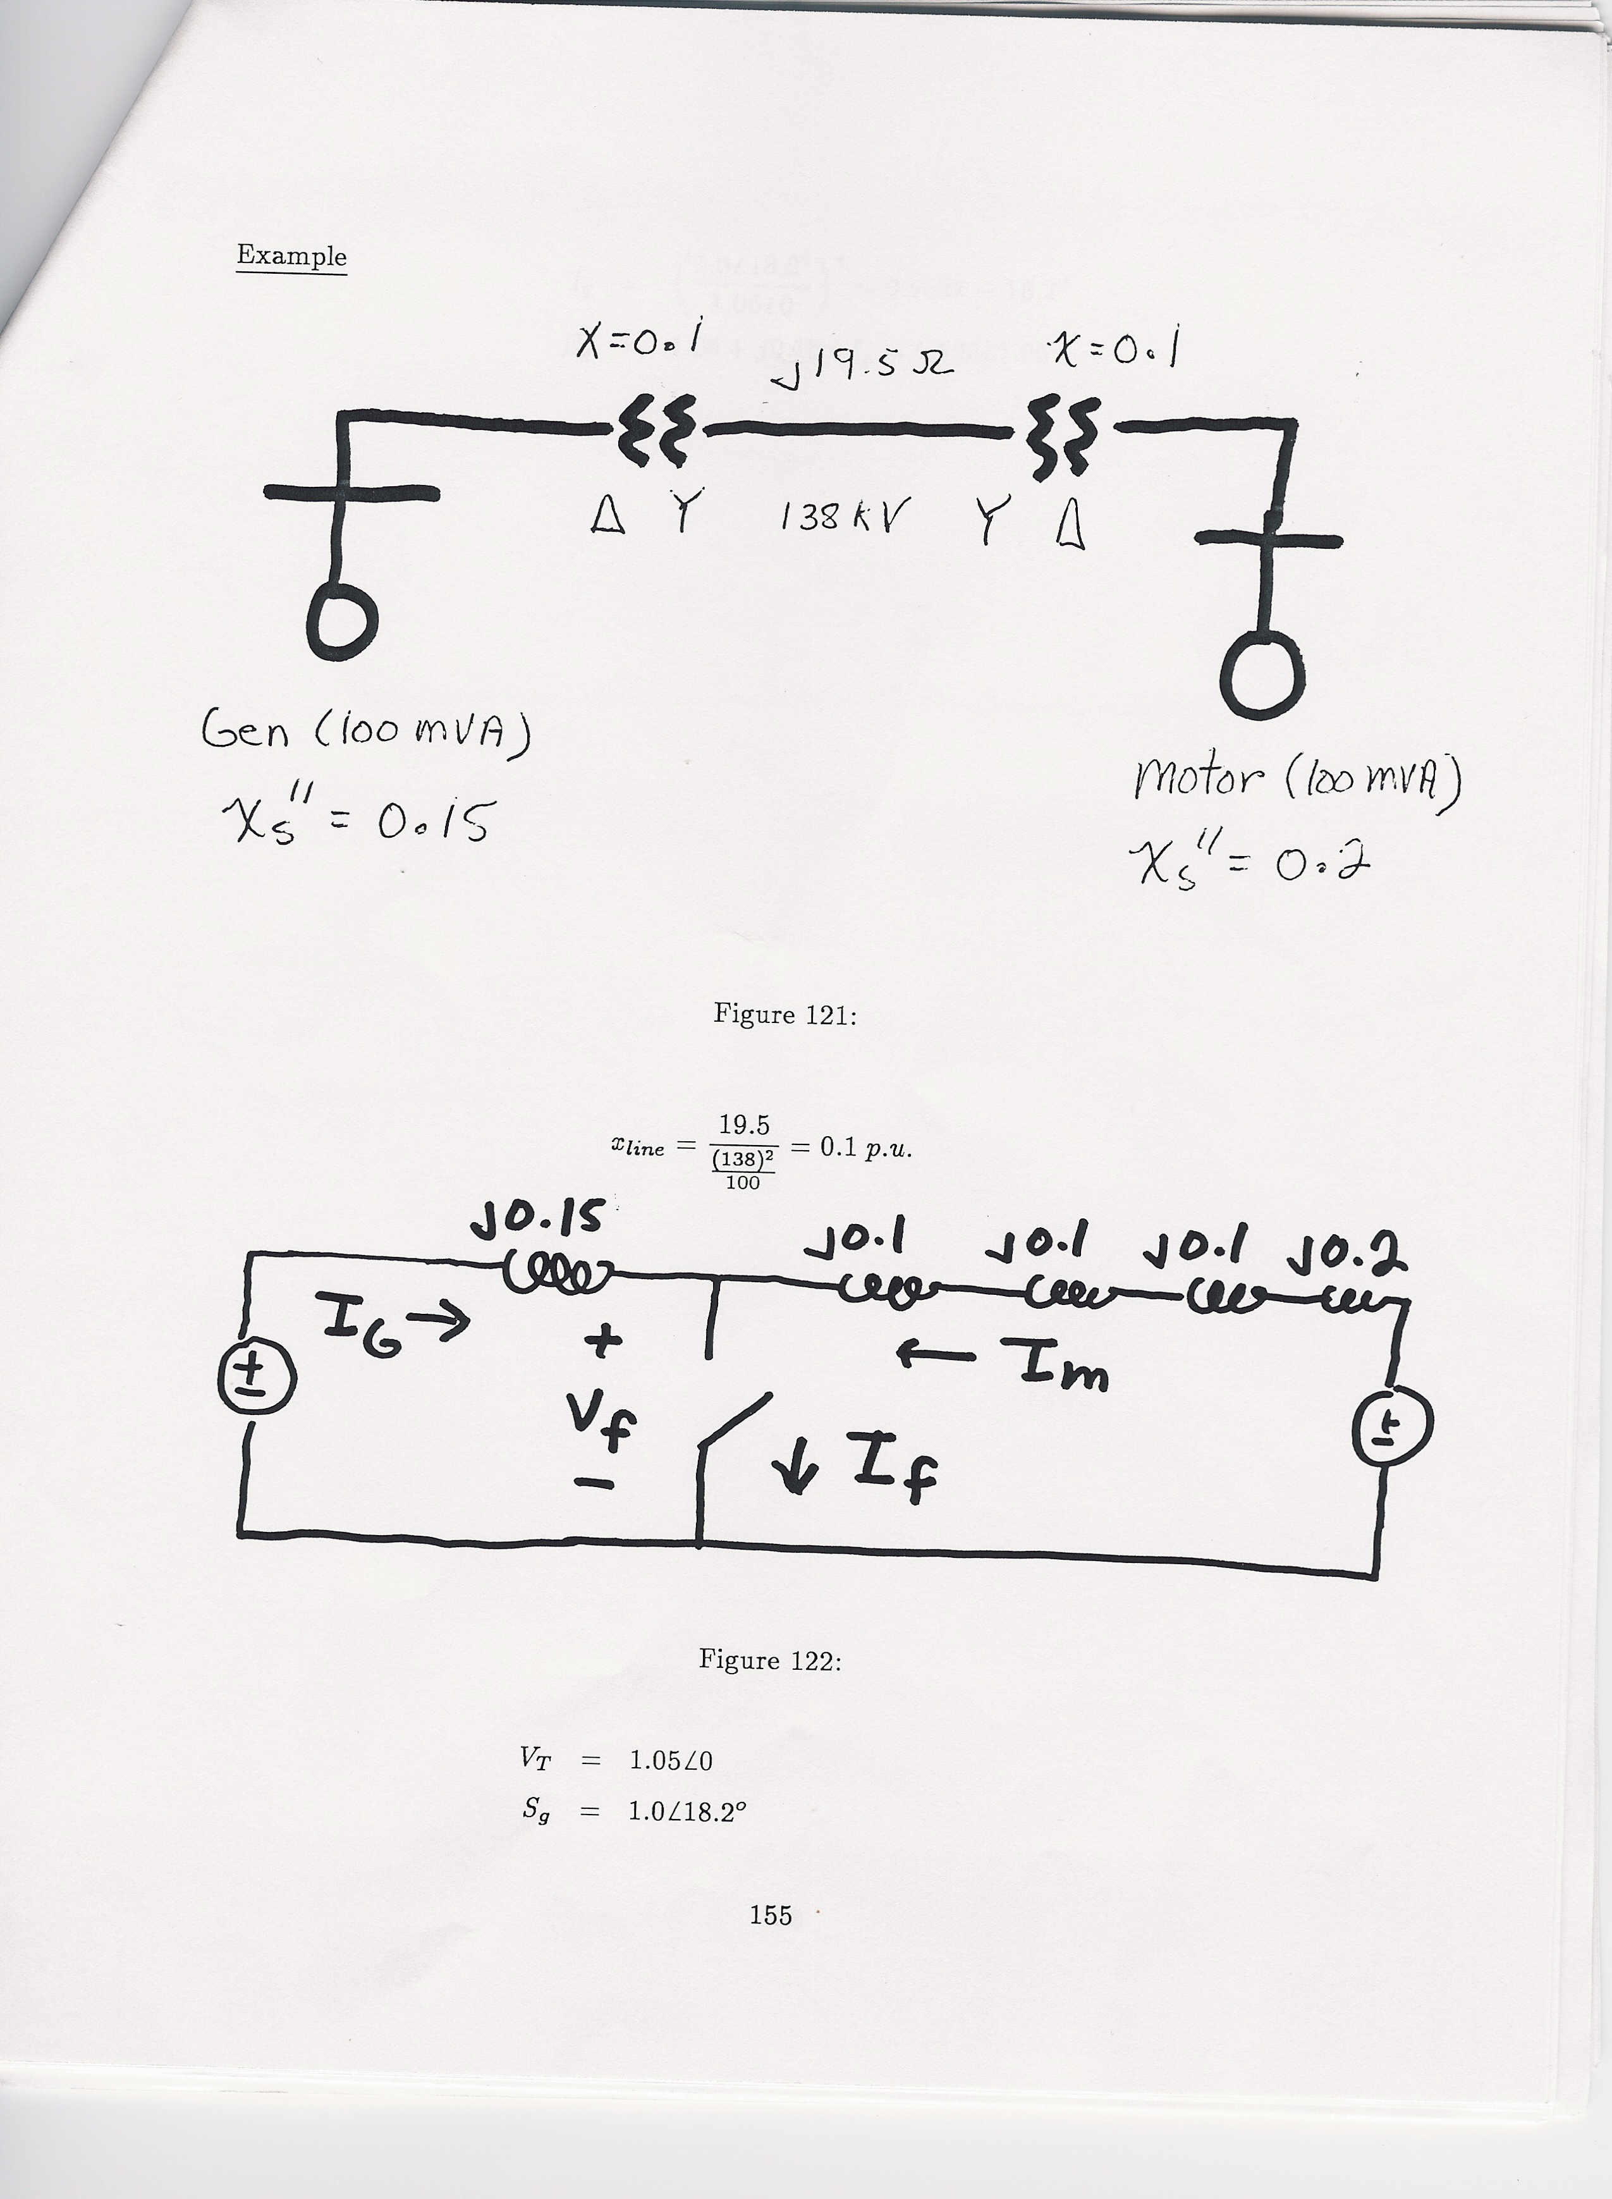
Network Fault Example
For the following network assume a fault on the
terminal of the generator; all data is per unit
except for the transmission line reactance
generator has 1.05
terminal voltage &
supplies 100 MVA
with 0.95 lag pf
24

Slide 26
Network Fault Example, cont'd
Faulted network per unit diagram
25

Slide 27
Network Fault Example, cont'd
26

Slide 28
Fault Analysis Solution Techniques
Circuit models used during the fault allow the network to be represented as a linear circuit
There are two main methods for solving for fault currents:
  Direct method: Use prefault conditions to solve for the internal machine voltages; then apply fault and solve directly
  Superposition: Fault is represented by two opposing
  voltage sources; solve system by superposition
    first voltage just represents the prefault operating point
    second system only has a single voltage source
27

Slide 29
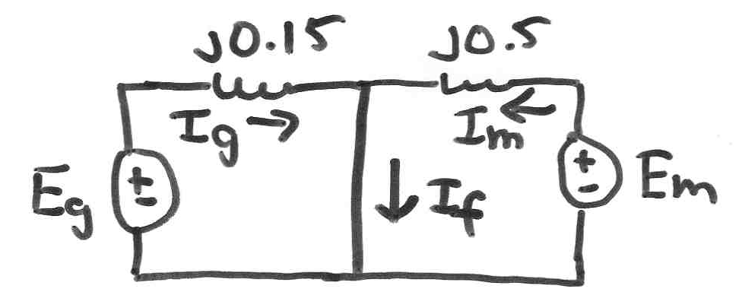
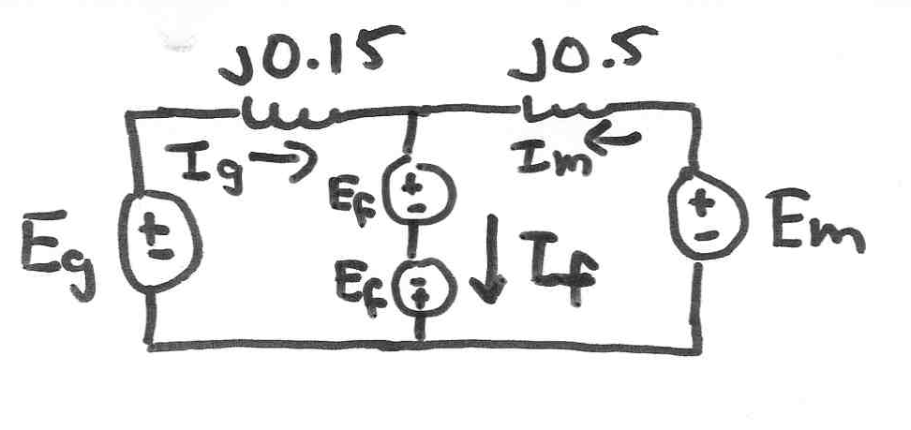
Superposition Approach
Faulted Condition
Fault is represented
by two equal and
opposite voltage
sources, each with
a magnitude equal
to the pre-fault voltage
Exact Equivalent to Faulted Condition
28

Slide 30
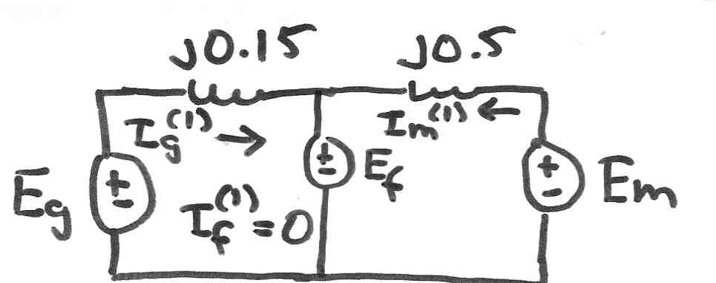
Superposition Approach, cont’d
Since this is now a linear network, the faulted voltages
and currents are just the sum of the pre-fault conditions
[the (1) component] and the conditions with just a single
voltage source at the fault location [the (2) component]
Pre-fault (1) component equal to the pre-fault
power flow solution
Obviously the
pre-fault
“fault current”
is zero!
29

Slide 31
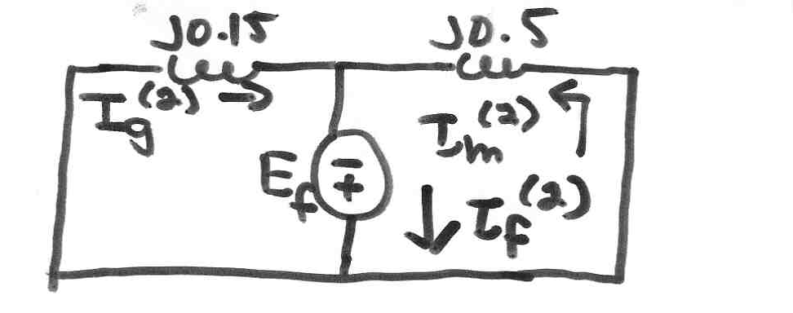
Superposition Approach, cont’d
Fault (1) component due to a single voltage source
at the fault location, with a magnitude equal to the
negative of the pre-fault voltage at the fault location.
30

Slide 32
Two Bus Superposition Solution
This matches
what we
calculated
earlier
31

Slide 33
Extension to Larger Systems
However to use this
approach we need to
first determine I_{f}
32

Slide 34
Determination of Fault Current
33

Slide 35
Determination of Fault Current
34

Slide 36
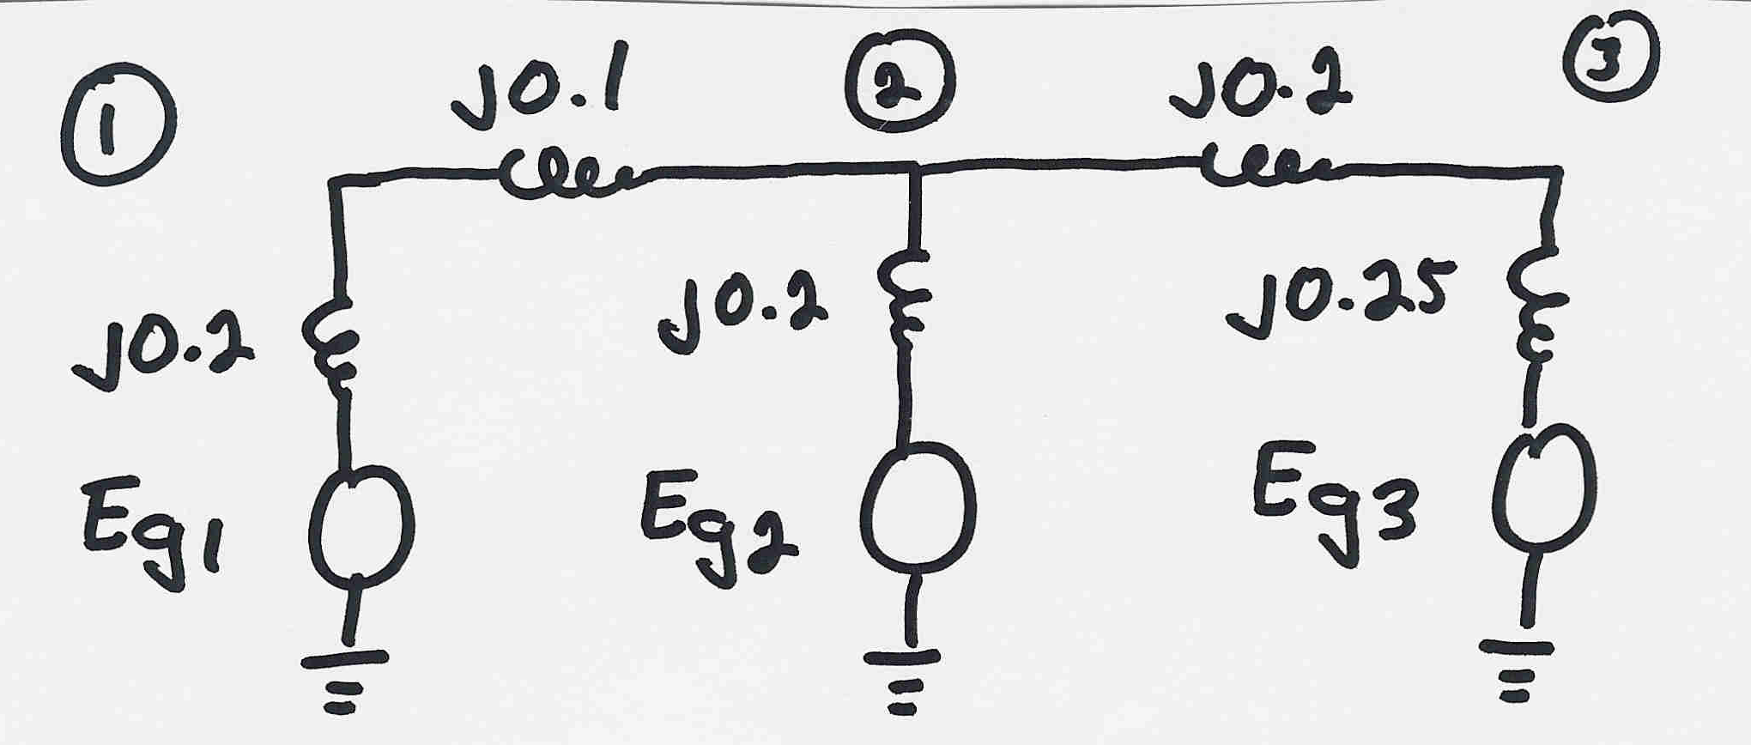
Three Gen System Fault Example
35

Slide 37
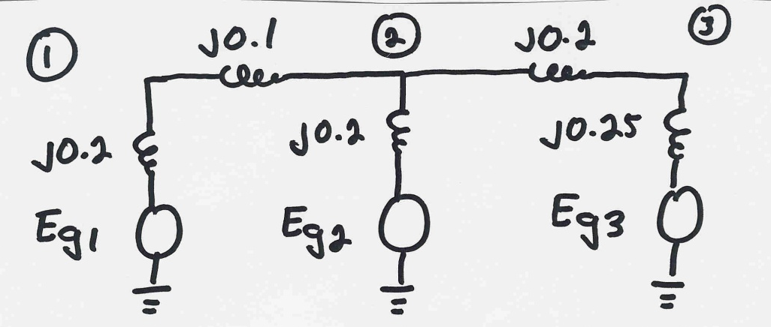
Three Gen Example, cont’d
36

Slide 38
Three Gen Example, cont’d
37

Slide 39
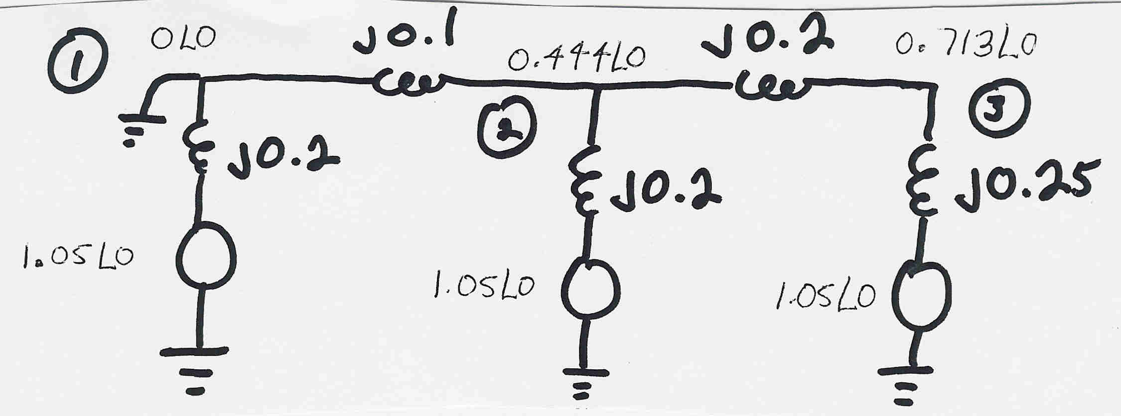
Three Gen Example, cont’d
38

Slide 40
PowerWorld Example 7.5: Bus 2 Fault
39

