Slide 1
ECE 476
Power System Analysis
Lecture 14: Power Flow
Prof. Tom Overbye
Dept. of Electrical and Computer Engineering
University of Illinois at Urbana-Champaign
overbye@illinois.edu

Slide 2
Announcements
Please read Chapter 6
HW 6 is 6.9, 6.18, 6.34, 6.38, 6.48, 6.53; this one must be turned in on Oct 20 (hence there will be no quiz that day); (there is no HW due on Oct 12 and no quiz)

Slide 3
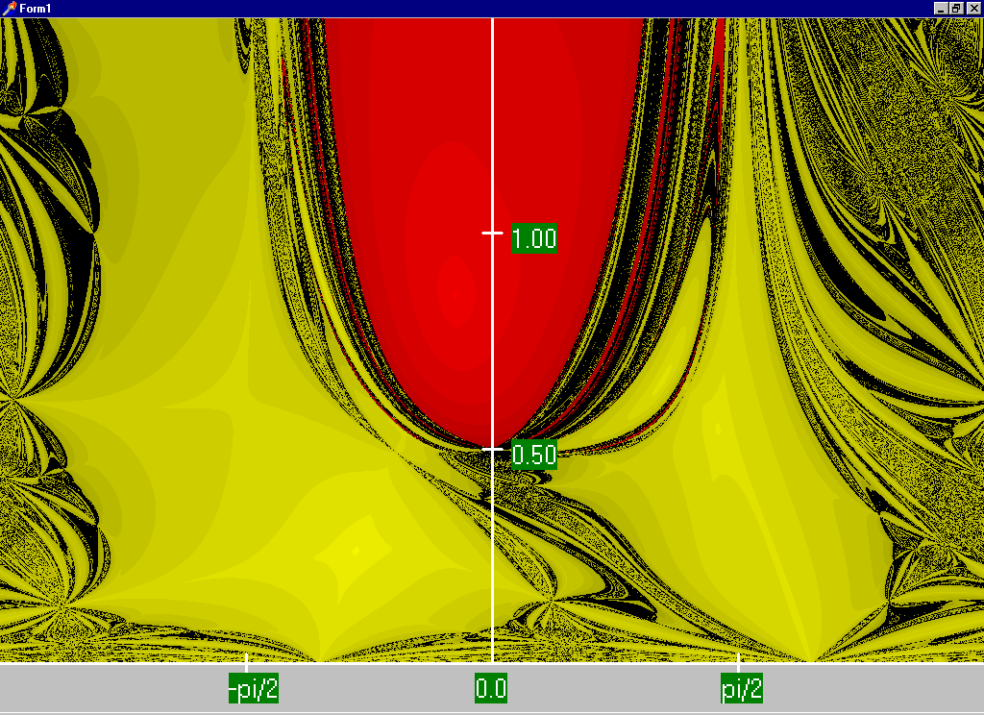
Two Bus Region of Convergence
Slide shows the region of convergence for different initial
guesses of bus 2 angle (x-axis) and magnitude (y-axis)
Red region
converges
to the high
voltage
solution,
while the
yellow region
converges
to the low
voltage
solution

Slide 4
August 14, 2003 Day Ahead Power Flow Low Voltage Solution Contour
The day
ahead
model had
65
energized
115,138,
or 230 kV
buses
with
voltages
below
0.90 pu
The lowest 138 kV voltage was 0.836 pu; lowest 34.5 kV was 0.621 pu;
case contained 42,766 buses; case had been used daily all summer

Slide 5
PV Buses
Since the voltage magnitude at PV buses is fixed there is no need to explicitly include these voltages in x or write the reactive power balance equations
  the reactive power output of the generator varies to maintain the fixed terminal voltage (within limits)
  optionally these variations/equations can be included by just writing the explicit voltage constraint for the generator bus
  |V_{i} | – V_{i setpoint} = 0

Slide 6
Three Bus PV Case Example

Slide 7
Generator Reactive Power Limits
The reactive power output of generators varies to maintain the terminal voltage; on a real generator this is done by the exciter
To maintain higher voltages requires more reactive power
Generators have reactive power limits, which are dependent upon the generator's MW output
These limits must be considered during the power flow solution
These limits will be discussed further with the Newton-Raphson algorithm

Slide 8
Generator Reactive Limits, cont'd
During power flow once a solution is obtained check to make generator reactive power output is within its limits
If the reactive power is outside of the limits, fix Q at the max or min value, and resolve treating the generator as a PQ bus
  this is know as "type-switching"
  also need to check if a PQ generator can again regulate
Rule of thumb: to raise system voltage we need to supply more vars

Slide 9
The N-R Power Flow: 5-bus Example
T2
800 MVA
345/15 kV
1
T1
5
4
3
520 MVA
Line 3 345 kV
50 mi
400 MVA
15 kV
800 MVA
15 kV
400 MVA
15/345 kV
345 kV 100 mi
345 kV 200 mi
40 Mvar
80 MW
Line 2
Line 1
2
280 Mvar
800 MW
Single-line diagram
8

Slide 10
The N-R Power Flow: 5-bus Example
Bus | Type | V per unit | δ degrees | P_{G} per unit | Q_{G} per unit | P_{L} per unit | Q_{L} per unit | Q_{Gmax} per unit | Q_{Gmin} per unit
1 | Swing | 1.0 | 0 | ⎯ | ⎯ | 0 | 0 | ⎯ | ⎯
2 | Load | ⎯ | ⎯ | 0 | 0 | 8.0 | 2.8 | ⎯ | ⎯
3 | Constant voltage | 1.05 | ⎯ | 5.2 | ⎯ | 0.8 | 0.4 | 4.0 | -2.8
4 | Load | ⎯ | ⎯ | 0 | 0 | 0 | 0 | ⎯ | ⎯
5 | Load | ⎯ | ⎯ | 0 | 0 | 0 | 0 | ⎯ | ⎯
Table 1.
Bus input
data
Bus-to-Bus | R’ per unit | X’ per unit | G’ per unit | B’ per unit | Maximum MVA per unit
2-4 | 0.0090 | 0.100 | 0 | 1.72 | 12.0
2-5 | 0.0045 | 0.050 | 0 | 0.88 | 12.0
4-5 | 0.00225 | 0.025 | 0 | 0.44 | 12.0
Table 2.
Line input data
9
Notes:
9

Slide 11
The N-R Power Flow: 5-bus Example
Bus-to-Bus | R per unit | X per unit | G_{c} per unit | B_{m} per unit | Maximum MVA per unit | Maximum TAP Setting per unit
1-5 | 0.00150 | 0.02 | 0 | 0 | 6.0 | —
3-4 | 0.00075 | 0.01 | 0 | 0 | 10.0 | —
Table 3.
Transformer
input data
Bus | Input Data | Unknowns
1 | V₁ = 1.0, δ₁ = 0 | P₁, Q₁
2 | P₂ = P_{G2}-P_{L2} = -8 Q₂ = Q_{G2}-Q_{L2} = -2.8 | V₂, δ₂
3 | V₃ = 1.05 P₃ = P_{G3}-P_{L3} = 4.4 | Q₃, δ₃
4 | P₄ = 0, Q₄ = 0 | V₄, δ₄
5 | P₅ = 0, Q₅ = 0 | V₅, δ₅
Table 4. Input data
and unknowns
10
Notes:
10

Slide 12
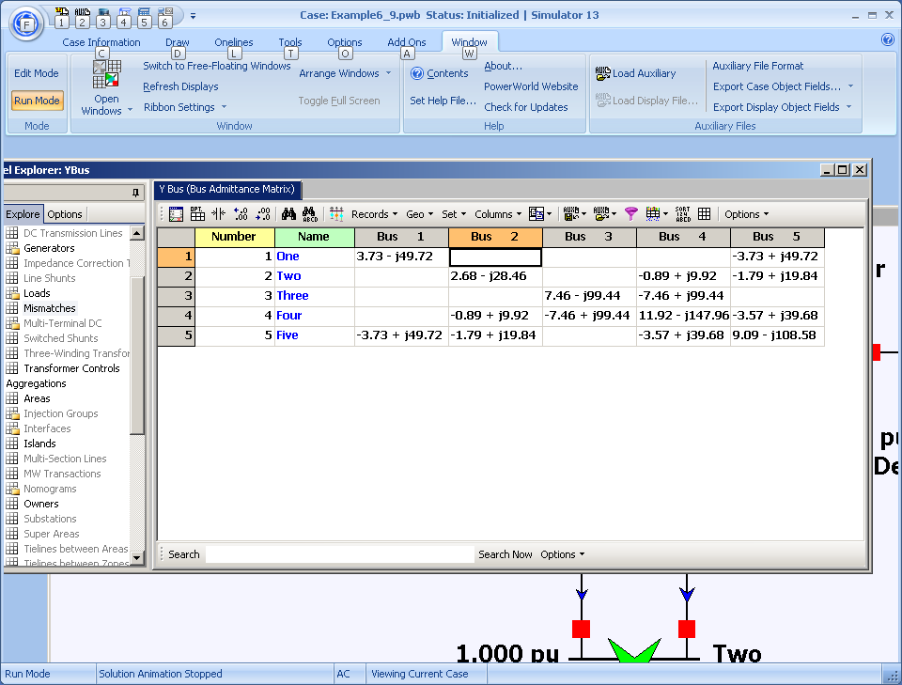
Time to Close the Hood: Let the Computer Do the Math! (Ybus Shown)
11
Notes:
11

Slide 13
Ybus Details
Elements of Y_{bus} connected to bus 2
12
Notes:
12

Slide 14
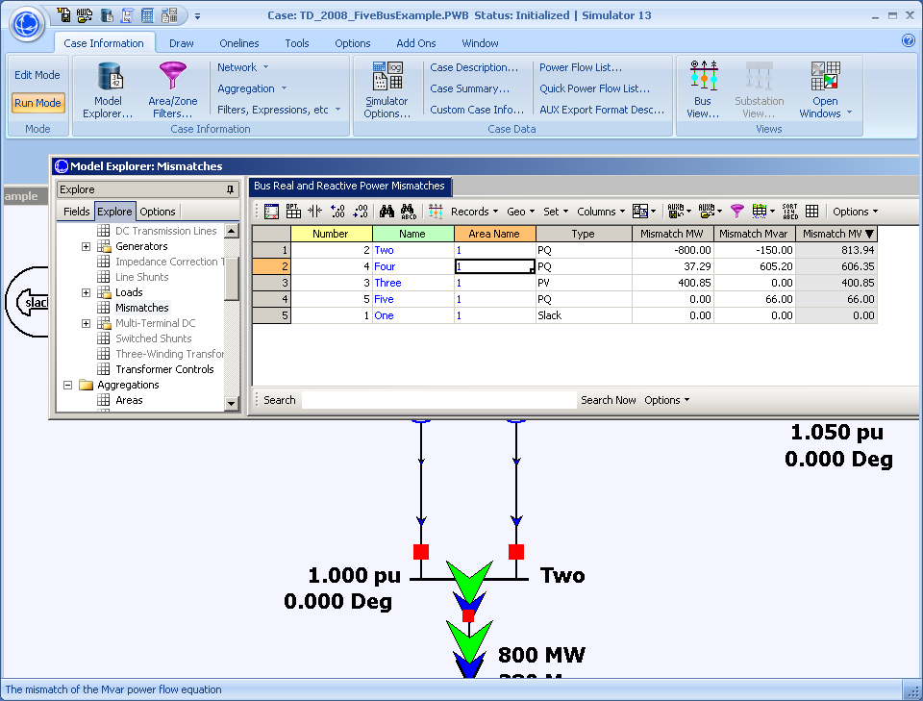
Here are the Initial Bus Mismatches
13
Notes:
13

Slide 15
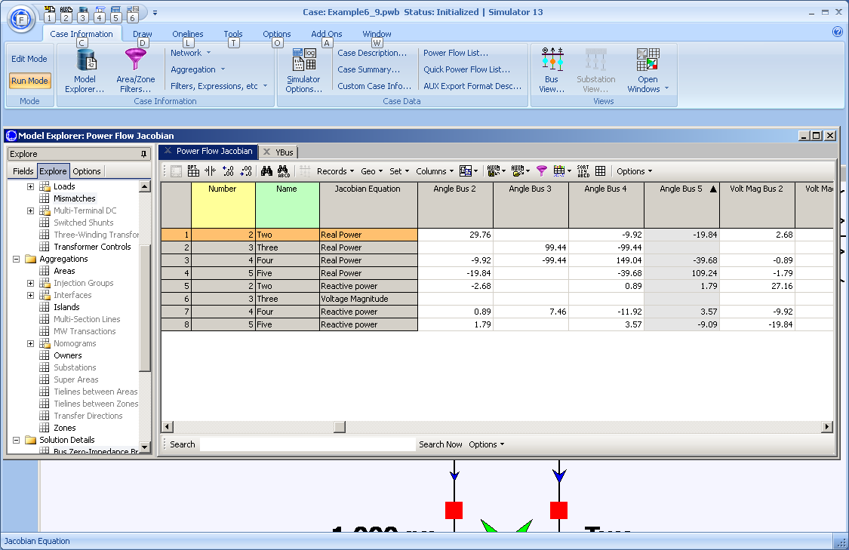
And the Initial Power Flow Jacobian
14
Notes:
14

Slide 16
And the Hand Calculation Details!
15
Notes:
15

Slide 17
Five Bus Power System Solved
16
Notes:
16

Slide 18
37 Bus Example Design Case
17
Notes:
17

Slide 19
Good Power System Operation
Good power system operation requires that there be no reliability violations for either the current condition or in the event of statistically likely contingencies
  Reliability requires as a minimum that there be no transmission line/transformer limit violations and that bus voltages be within acceptable limits (perhaps 0.95 to 1.08)
  Example contingencies are the loss of any single device. This is known as n-1 reliability.
North American Electric Reliability Corporation now has legal authority to enforce reliability standards (and there are now lots of them). See
http://www.nerc.com for details (click on Standards)
18
Notes:
18

Slide 20
Looking at the Impact of Line Outages
Opening one line (Tim69-Hannah69) causes an overload.
This would not be allowed
19
Notes:
19

Slide 21
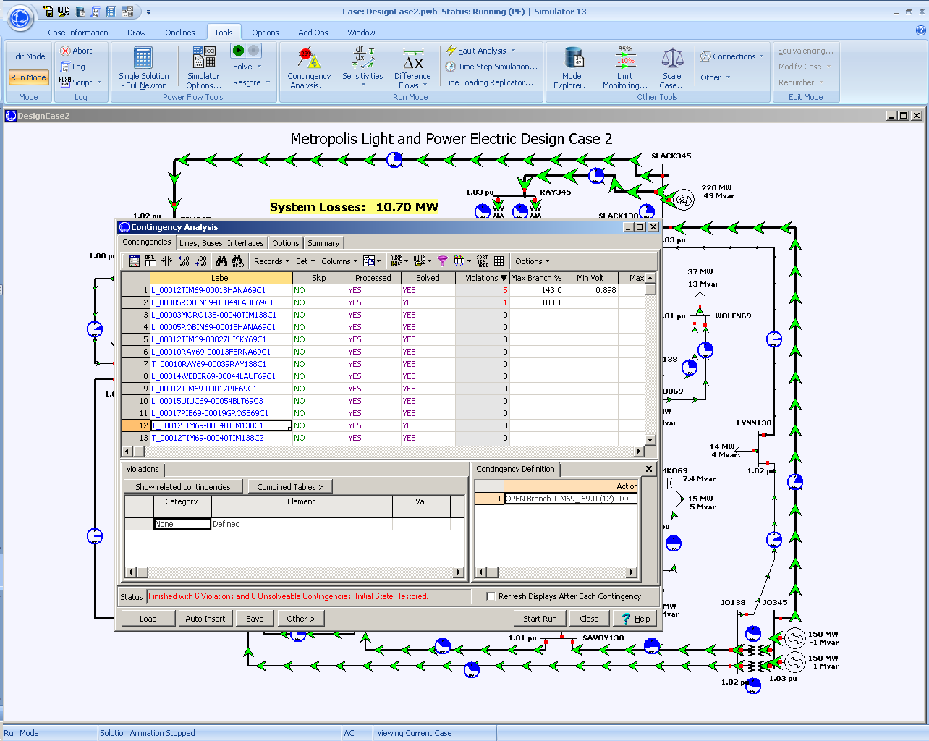
Contingency Analysis
Contingency
analysis provides
an automatic
way of looking
at all the
statistically
likely
contingencies. In
this example the
contingency set
Is all the single
line/transformer
outages
20
Notes:
20

Slide 22
Power Flow And Design
One common usage of the power flow is to determine how the system should be modified to remove contingencies problems or serve new load
  In an operational context this requires working with the existing electric grid
  In a planning context additions to the grid can be considered
In the next example we look at how to remove the existing contingency violations while serving new load.
21
Notes:
21

Slide 23
An Unreliable Solution
Case now has nine separate contingencies with reliability
violations
22
Notes:
22

Slide 24
A Reliable Solution
Previous case was augmented with the addition of a
138 kV Transmission Line
23
Notes:
23

Slide 25
Generation Changes and The Slack Bus
The power flow is a steady-state analysis tool, so the assumption is total load plus losses is always equal to total generation
  Generation mismatch is made up at the slack bus
When doing generation change power flow studies one always needs to be cognizant of where the generation is being made up
  Common options include system slack, distributed across multiple generators by participation factors or by economics
24
Notes:
24

Slide 26
Generation Change Example 1
Display shows “Difference Flows” between original 37 bus case,
and case with a BLT138 generation outage;
note all the power change is picked up at the slack
25
Notes:
25

Slide 27
Generation Change Example 2
Display repeats previous case except now the change in
generation is picked up by other generators using a
participation factor approach
26
Notes:
26

Slide 28
Voltage Regulation Example: 37 Buses
Display shows voltage contour of the power system, demo
will show the impact of generator voltage set point,
reactive power limits, and switched capacitors
27
Notes:
27

