Slide 1
ECE 476
Power System Analysis
Lecture 13: Power Flow
Prof. Tom Overbye
Dept. of Electrical and Computer Engineering
University of Illinois at Urbana-Champaign
overbye@illinois.edu

Slide 2
Announcements
Please read Chapter 2.4, Chapter 6 up to 6.6
HW 5 is 5.31, 5.43, 3.4, 3.10, 3.14, 3.19, 3.23, 3.60, 6.30 should be done before exam 1
Exam 1 is Thursday Oct 6 in class
  Closed book, closed notes, but you may bring one 8.5 by 11 inch note sheet and standard calculators
  Last name A-M here, N to Z in ECEB 1013
McKinley Health Center encourages all students to get their flu shot
  Details and clinics at http://mckinley.illinois.edu/fluclinic

Slide 3
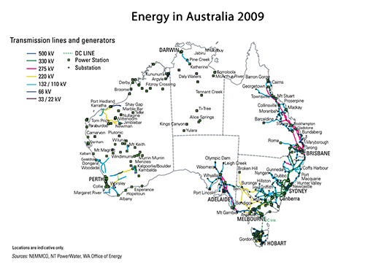
In the News: South Australia Blackout
On 9/28/16 at 418pm (local time) South Australia experienced a state-wide blackout
  Load at the time of the blackout was 1900 MW (850,000 customers, 1.7 million people)
  South Australia was importing
  600 MWs from Victoria
Initial investigations
indicate loss of 275 kV
lines due to storms
Some speculation about
wind power fluctuations
being a potential cause
Sources www.aemo.com.au/Media-Centre/Media-Statement-3---South-Australia-Update,
jo.nova.s3.amazonaws.com/graph/energy/electricity/electricity_grid_australia_2009_s.gif

Slide 4
Value of Electricity and the Cost of Blackouts
The derived value from electricity (in say $/kWh) varies widely (e.g., during exams engineering students value the small kWhs for their calculators very highly)
Costs of blackouts can be quite nonlinear with respect to extent and duration
  Momentary blackouts can have high costs, though this can be reduced by using an uninterruptible power supply (UPS)
Estimated economic impact of the 8/14/03 blackout was about $6 billion (50 million people, hours to days)
Annual cost of US blackouts estimated to be $25 to $200 billion
A source: energy.gov/sites/prod/files/2013/08/f2/Grid%20Resiliency%20Report_FINAL.pdf

Slide 5
Newton-Raphson Comments
When close to the solution the error decreases quite quickly -- method has quadratic convergence
f(x^{(v)}) is known as the mismatch, which we would like to drive to zero
Stopping criteria is when ⏐f(x^{(v)}) ⏐ < ε
Results are dependent upon the initial guess. What if we had guessed x⁽⁰⁾ = 0, or x ⁽⁰⁾ = -1?
A solution’s region of attraction (ROA) is the set of initial guesses that converge to the particular solution. The ROA is often hard to determine

Slide 6
Multi-Variable Newton-Raphson

Slide 7
Multi-Variable Case, cont’d

Slide 8
Multi-Variable Case, cont’d

Slide 9
Jacobian Matrix

Slide 10
Multi-Variable Example

Slide 11
Multi-variable Example, cont’d

Slide 12
Multi-variable Example, cont’d

Slide 13
NR Application to Power Flow

Slide 14
Real Power Balance Equations

Slide 15
Newton-Raphson Power Flow

Slide 16
Power Flow Variables

Slide 17
N-R Power Flow Solution

Slide 18
Power Flow Jacobian Matrix

Slide 19
Power Flow Jacobian Matrix, cont’d

Slide 20
Two Bus Newton-Raphson Example
For the two bus power system shown below, use the
Newton-Raphson power flow to determine the
voltage magnitude and angle at bus two. Assume
that bus one is the slack and S_{Base} = 100 MVA.

Slide 21
Two Bus Example, cont’d

Slide 22
Two Bus Example, cont’d

Slide 23
Two Bus Example, First Iteration

Slide 24
Two Bus Example, Next Iterations

Slide 25
Two Bus Solved Values
Once the voltage angle and magnitude at bus 2 are
known we can calculate all the other system values,
such as the line flows and the generator reactive
power output

Slide 26
Two Bus Case Low Voltage Solution

Slide 27
Low Voltage Solution, cont'd
Low voltage solution

Slide 28
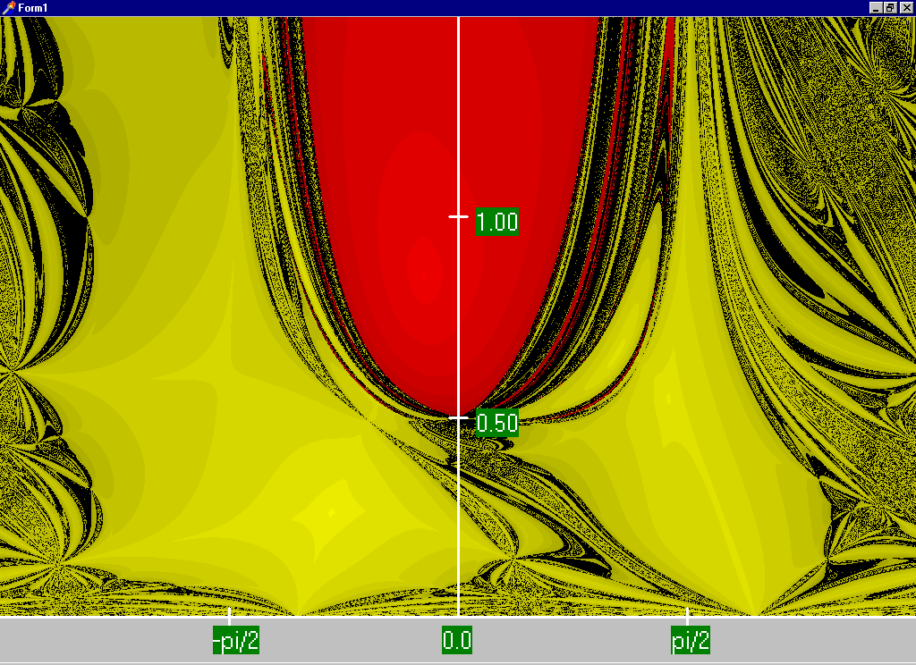
Two Bus Region of Convergence
Slide shows the region of convergence for different initial
guesses of bus 2 angle (x-axis) and magnitude (y-axis)
Red region
converges
to the high
voltage
solution,
while the
yellow region
converges
to the low
voltage
solution

