Slide 1
ECE 476
Power System Analysis
Lecture 11: Load and Generators, Bus Admittance Matrix
Prof. Tom Overbye
Dept. of Electrical and Computer Engineering
University of Illinois at Urbana-Champaign
overbye@illinois.edu

Slide 2
Announcements
Please read Chapter 2.4, Chapter 6 up to 6.6
HW 5 is 5.31, 5.43, 3.4, 3.10, 3.14, 3.19, 3.23, 3.60, 6.30 should be done before exam 1
Exam 1 is Thursday Oct 6 in class
  Closed book, closed notes, but you may bring one 8.5 by 11 inch note sheet and standard calculators
  Last name A-M here, N to Z in ECEB 1013
Power Area Scholarships, Awards (Oct 1 deadlines, except Nov 1 for Grainger)
  http://energy.ece.illinois.edu/
  Turn both into Prof Sauer (4046 or 4060)

Slide 3
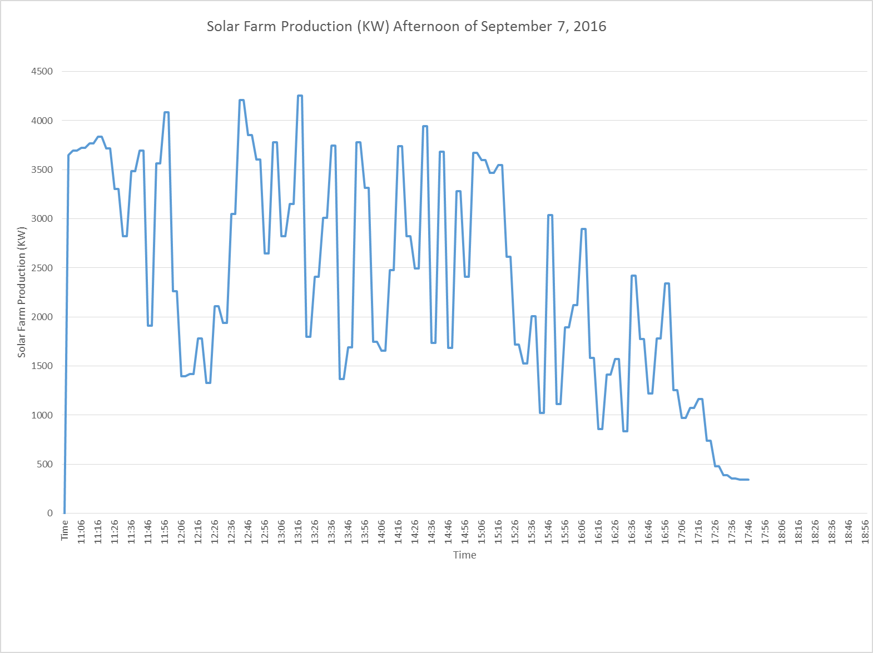
UIUC Solar Farm Output: 9/7/16
Data from Keith Erickson, UIUC
Details on UIUC Solar Farm at icap.sustainability.illinois.edu/files/project/175/solar-farm-project-fact-sheet_with-faqs_121515%282%29.pdf

Slide 4
Autotransformers
Autotransformers are transformers in which the primary and secondary windings are coupled magnetically and electrically.
This results in lower cost, smaller size and weight, lower leakage reactance
The key disadvantage is loss of electrical isolation between the voltage levels. Hence auto-transformers are not used when turns ratio is large. For example in stepping down 7160/240 V we do not ever want 7160 on the low side!
Modeled as regular transformers in power flow

Slide 5
Load Models
Ultimate goal is to supply loads with electricity at constant frequency and voltage
Electrical characteristics of individual loads matter, but usually they can only be estimated
  actual loads are constantly changing, consisting of a large number of individual devices
  only limited network observability of load characteristics
Aggregate models are typically used for analysis
Two common models
  constant power: S_{i} = P_{i} + jQ_{i}
  constant impedance: S_{i} = |V|² / Z_{i}

Slide 6
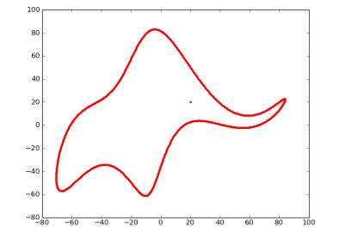
Scientific Modeling Quotes
"All models are wrong but some are useful,“
  George Box, Empirical Model-Building and Response Surfaces, (1987, p. 424)
  Box went on to say that the practical question is how wrong they have to be to not be useful
“Everything should be made as
simple as possible, but not simpler.”
  Albert Einstein [maybe]
“With four parameters I can fit an elephant, and with five I can make him wiggle his trunk”.
  John von Neumann
Drawing an elephant with four complex parameters” by Jurgen Mayer, Khaled Khairy, and Jonathon Howard, Am. J. Phys. 78, 648 (2010), DOI:10.1119/1.3254017

Slide 7
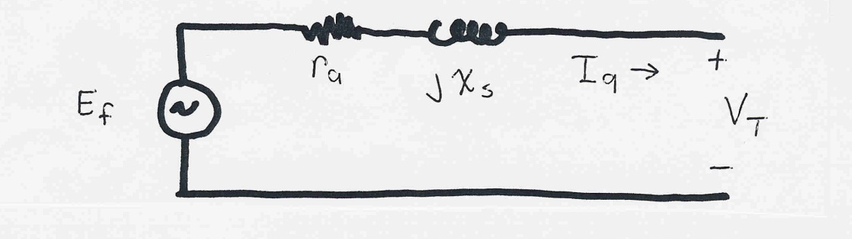
Generator Models
Engineering models depend upon application
Generators are usually synchronous machines
For generators we will use two different models:
  a steady-state model, treating the generator as a constant power source operating at a fixed voltage; this model will be used for power flow and economic analysis
  a short term model treating the generator as a constant voltage source behind a possibly time-varying reactance

Slide 8
Power Flow Analysis
We now have the necessary models to start to develop the power system analysis tools
The most common power system analysis tool is the power flow (also known sometimes as the load flow)
  power flow determines how the power flows in a network
  also used to determine all bus voltages and all currents
  because of constant power models, power flow is a nonlinear analysis technique
  power flow is a steady-state analysis tool

Slide 9
Linear versus Nonlinear Systems
A function H is linear if
H(α₁μ₁ + α₂μ₂) = α₁H(μ₁) + α₂H(μ₂)
That is
1) the output is proportional to the input
2) the principle of superposition holds
Linear Example: y = H(x) = c x
y = c(x₁+x₂) = cx₁ + c x₂
Nonlinear Example: y = H(x) = c x²
y = c(x₁+x₂)² ≠ (cx₁)² + (c x₂)²

Slide 10
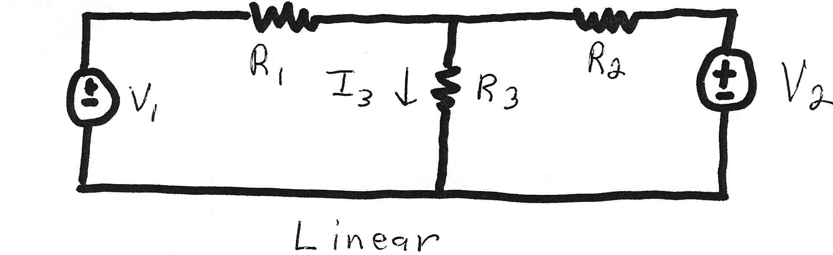
Linear Power System Elements

Slide 11
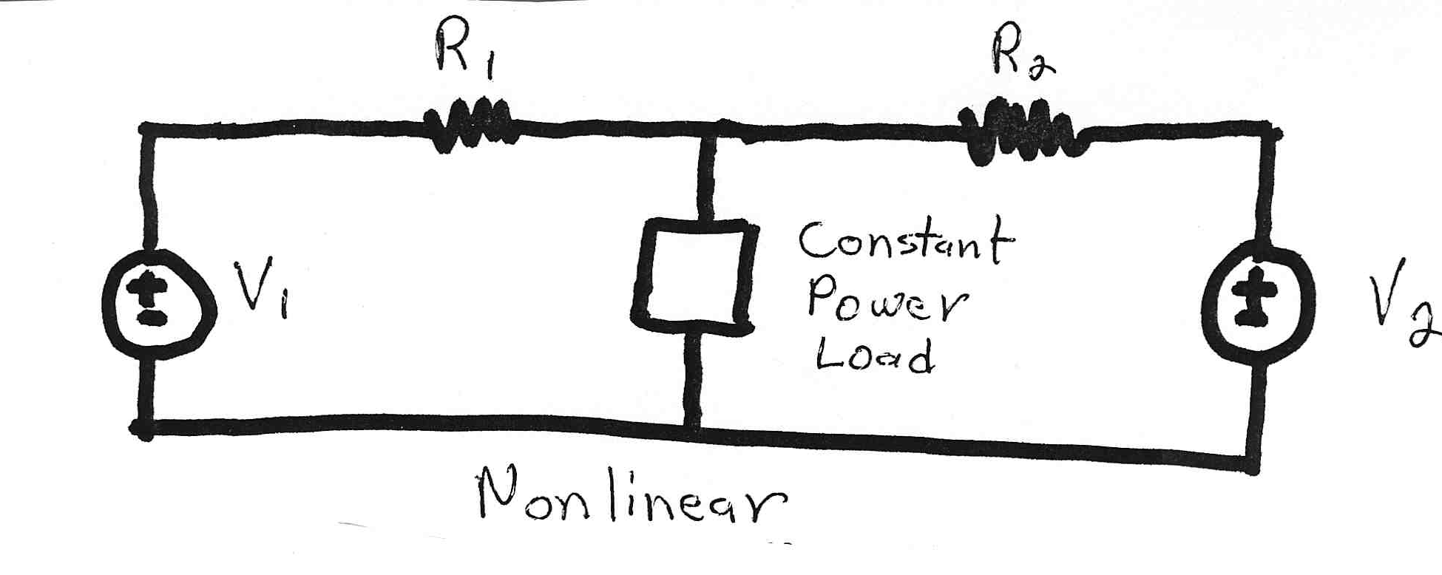
Nonlinear Power System Elements
Constant power loads and generator injections are nonlinear and hence systems with these elements can not be analyzed by superposition
Nonlinear problems can be very difficult to solve,
and usually require an iterative approach

Slide 12
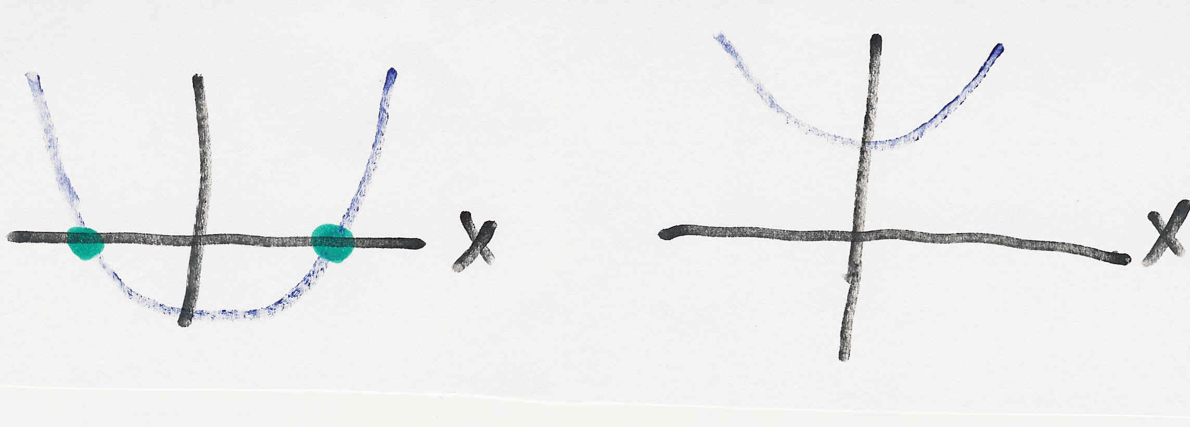
Nonlinear Systems May Have Multiple Solutions or No Solution
Example 1: x² - 2 = 0 has solutions x = ±1.414…
Example 2: x² + 2 = 0 has no real solution
f(x) = x² - 2
f(x) = x² + 2
two solutions where f(x) = 0
no solution f(x) = 0

Slide 13
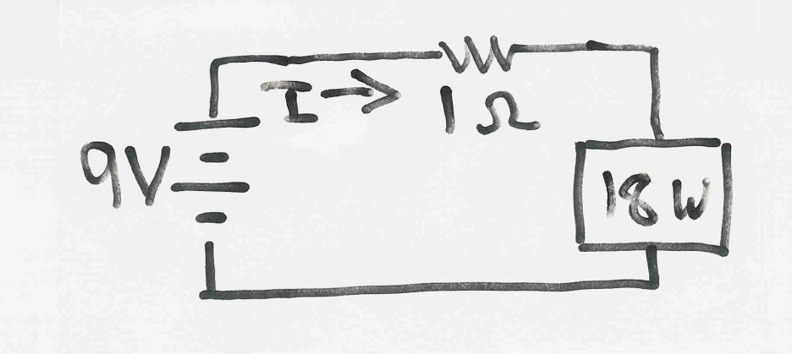
Multiple Solution Example 3
The dc system shown below has two solutions:
where the 18 watt
load is a resistive
load
What is the
maximum
P_{Load}?

Slide 14
Bus Admittance Matrix or Y_{bus}
First step in solving the power flow is to create what is known as the bus admittance matrix, often call the Y_{bus}.
The Y_{bus} gives the relationships between all the bus current injections, I, and all the bus voltages, V,
I = Y_{bus} V
The Y_{bus} is developed by applying KCL at each bus in the system to relate the bus current injections, the bus voltages, and the branch impedances and admittances

Slide 15
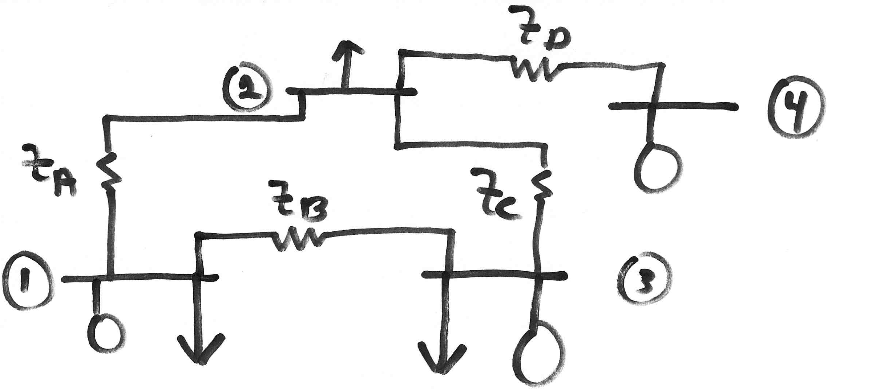
Y_{bus} Example
Determine the bus admittance matrix for the network
shown below, assuming the current injection at each
bus i is I_{i} = I_{Gi} - I_{Di} where I_{Gi} is the current injection into the
bus from the generator and I_{Di} is the current flowing into the load

Slide 16
Y_{bus} Example, cont’d

Slide 17
Y_{bus} Example, cont’d
For a system with n buses, Y_{bus} is an n by n
symmetric matrix (i.e., one where A_{ij} = A_{ji})

Slide 18
Y_{bus} General Form
The diagonal terms, Y_{ii}, are the self admittance terms, equal to the sum of the admittances of all devices incident to bus i.
The off-diagonal terms, Y_{ij}, are equal to the negative of the sum of the admittances joining the two buses.
With large systems Y_{bus} is a sparse matrix (that is, most entries are zero)
Shunt terms, such as with the π line model, only affect the diagonal terms.

Slide 19
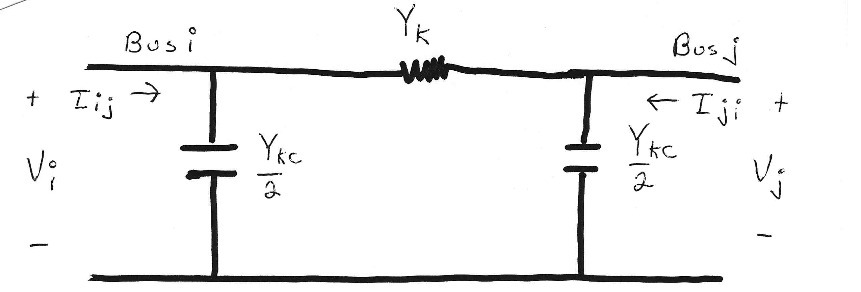
Modeling Shunts in the Y_{bus}

Slide 20
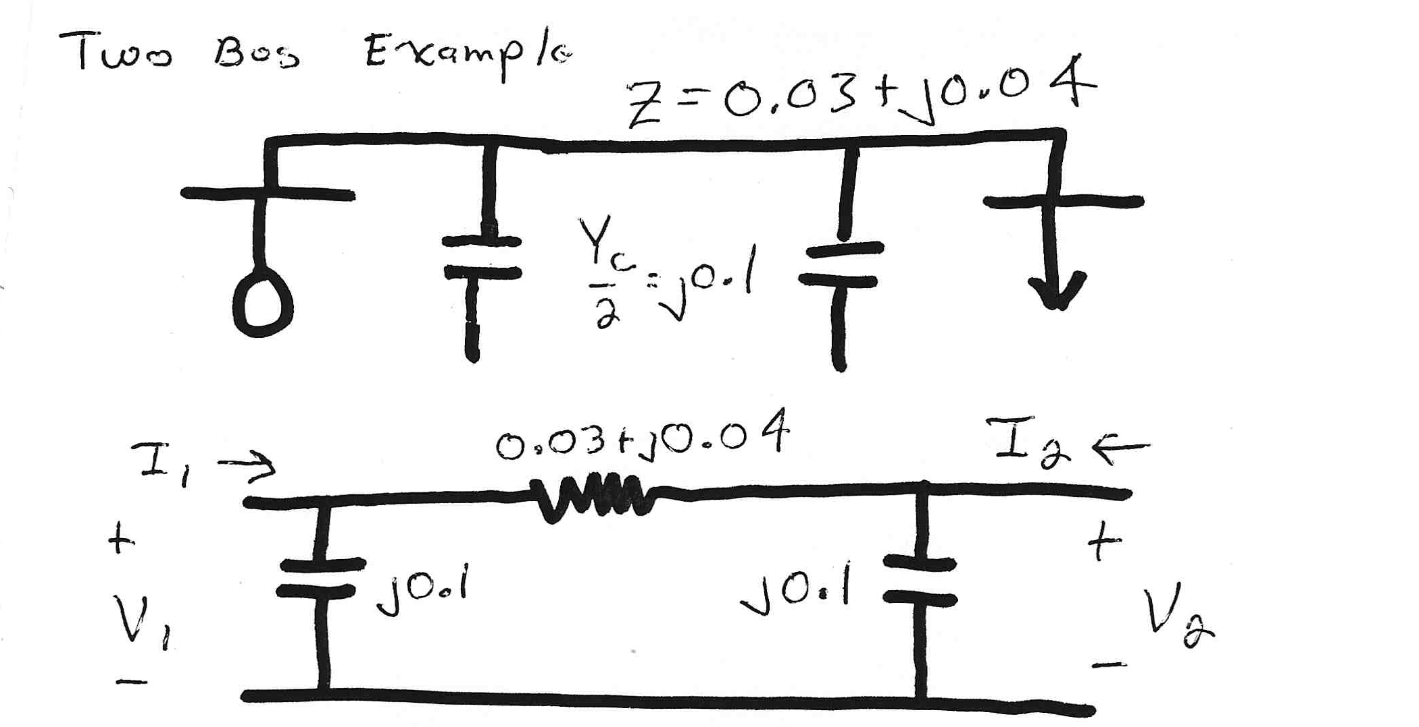
Two Bus System Example
What if
we remove
the shunts?

Slide 21
Using the Y_{bus}

Slide 22
Solving for Bus Currents

Slide 23
Solving for Bus Voltages

