Slide 1
ECE 476
Power System Analysis
Lecture 1:Introduction
Prof. Tom Overbye
Dept. of Electrical and Computer Engineering
University of Illinois at Urbana-Champaign
overbye@illinois.edu

Slide 2
About Prof. Tom Overbye
Professional
  Received BSEE, MSEE, and Ph.D. all from University of Wisconsin at Madison (83, 88, 91)
  Worked for eight years as engineer for an electric utility (Madison Gas & Electric)
  Have been at UI since 1991, doing teaching and doing research in the area of electric power systems
  Developed commercial power system analysis package, known now as PowerWorld Simulator. This package has been sold to about 600 different corporate entities worldwide
  DOE investigator for 8/14/2003 blackout

Slide 3


About Prof. Tom Overbye
Nonprofessional
  Married to Jo
  Have three children
    Tim age 21
    Hannah age 19
    Amanda age 17
  Live in country by Homer on
  the Salt Fork River
  We’ve homeschooled our kids
  all the way through, with Tim
  now starting his fourth year
  at UIUC in ME and Hannah her
  second year in psychology

Slide 4


About Iyke Idehen
3rd year graduate student
  BSc (ECE, University of Benin, Nigeria)
  MSc (EE, Tuskegee University, Alabama)
  Research Area
    Power Systems and Control
    Data visualization
  Advisor: Prof. Tom Overbye
  Hobbies & Interests: Soccer, Music, Travel
Hollywood, 2014
Soccer field by FAR/PAR (2014)
Courtesy: Won Jang

Slide 5
Simple Power System
Every power system has three major components
  generation: source of power, ideally with a specified voltage and frequency
  load: consumes power; ideally with a constant resistive value
  transmission system: transmits power; ideally as a perfect conductor

Slide 6
Complications
No ideal voltage sources exist
Loads are seldom constant
Transmission system has resistance, inductance, capacitance and flow limitations
Simple system has no redundancy so power system will not work if any component fails

Slide 7
Notation - Power
Power: Instantaneous consumption of energy
Power Units
Watts = voltage x current for dc (W)
kW – 1 x 10³ Watt
MW – 1 x 10⁶ Watt
GW – 1 x 10⁹ Watt
Installed U.S. generation capacity is about
1000 GW ( about 3 kW per person)
Maximum load of Champaign/Urbana about 300 MW

Slide 8
Notation - Energy
Energy: Integration of power over time; energy is what people really want from a power system
Energy Units
  Joule = 1 Watt-second (J)
  kWh = Kilowatthour (3.6 x 10⁶ J)
  Btu = 1055 J; 1 MBtu=0.292 MWh
  One gallon of gas has about 0.125 MBtu (36.5 kWh);
U.S. electric energy consumption is about 3600 billion kWh (about 13,333 kWh per person, which means on average we each use 1.5 kW of power continuously)

Slide 9
Power System Examples
Electric utility: can range from quite small, such as an island, to one covering half the continent
  there are four major interconnected ac power systems in North American, each operating at 60 Hz ac; 50 Hz is used in some other countries.
Airplanes and Spaceships: reduction in weight is primary consideration; frequency is 400 Hz.
Ships and submarines
Automobiles: dc with 12 volts standard
Battery operated portable systems

Slide 10
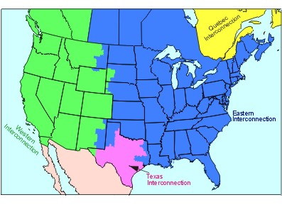
North America Interconnections

Slide 11
Electric Systems in Energy Context
Class focuses on electric power systems, but we first need to put the electric system in context of the total energy delivery system
Electricity is used primarily as a means for energy transportation
  Use other sources of energy to create it, and it is usually converted into another form of energy when used
About 40% of US energy is transported in electric form
Concerns about need to reduce CO2 emissions and fossil fuel depletion are becoming main drivers for change in world energy infrastructure

Slide 12
Looking at the 2015 Energy Pie: Where the USA Got Its Energy
About 40% of our energy is consumed in the form of electricity, a percentage that is gradually increasing. The vast majority on the non-fossil fuel energy is electric!
In 2015 we got about 1.9% of
our energy from wind and 0.6% from solar (PV and solar thermal), 0.2% from geothermal
About 81% Fossil Fuels
(86% in 1990 and 2000)
Total of 97.5 Quad; 1 Quad = 293 billion kWh (actual), 1 Quad = 98 billion kWh (used, taking into account efficiency)
Source: EIA Monthly Energy Review, July 2016

Slide 13
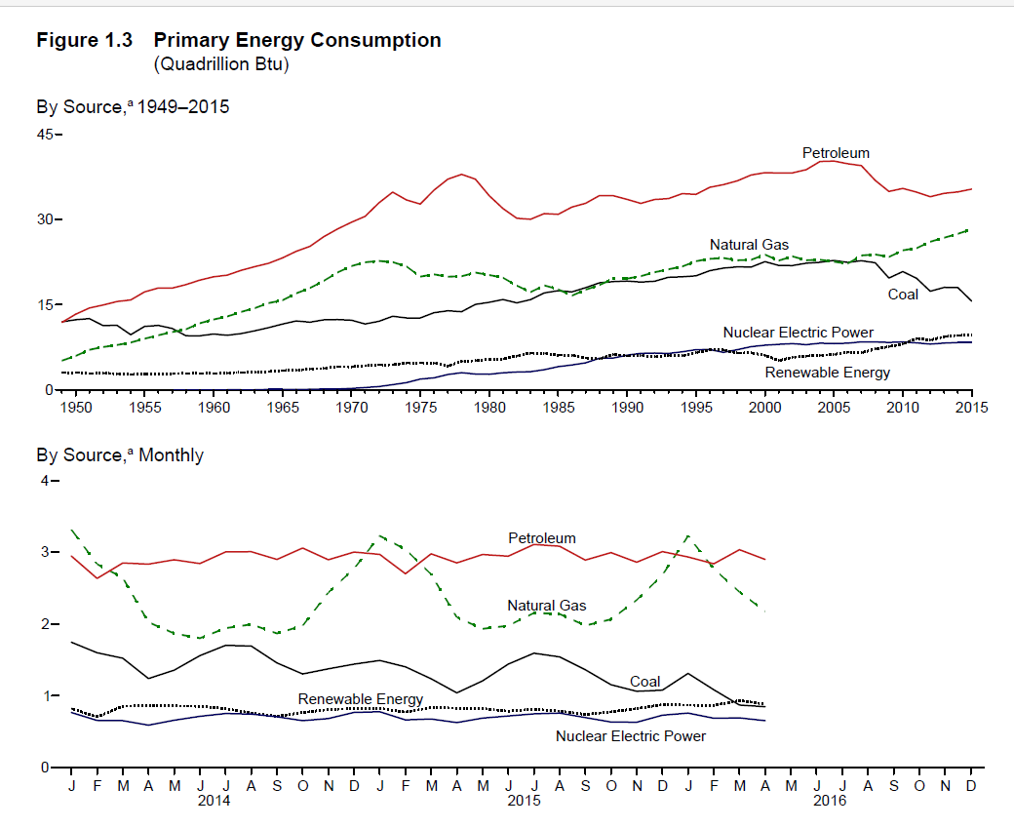
US Historical Energy Usage
Source: EIA Monthly Energy Review, July 2016

Slide 14
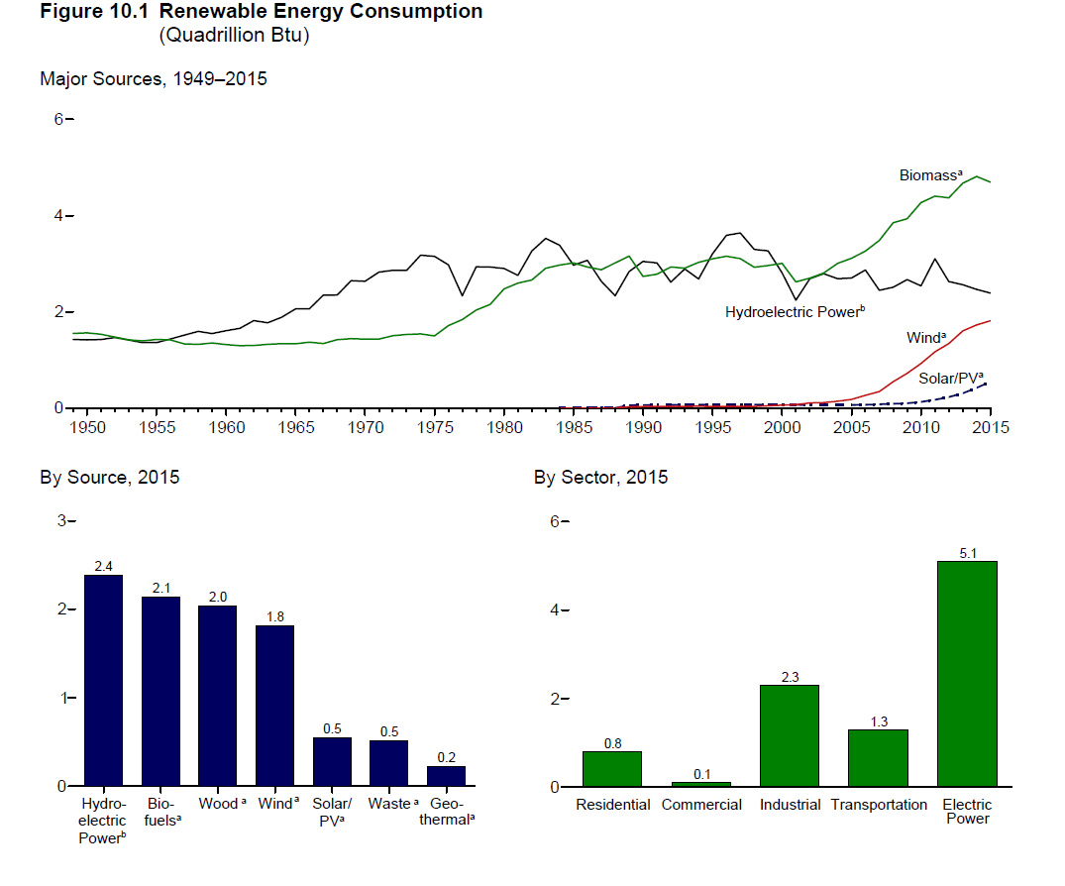
Renewable Energy Consumption
Source: EIA Monthly Energy Review, July 2016

Slide 15
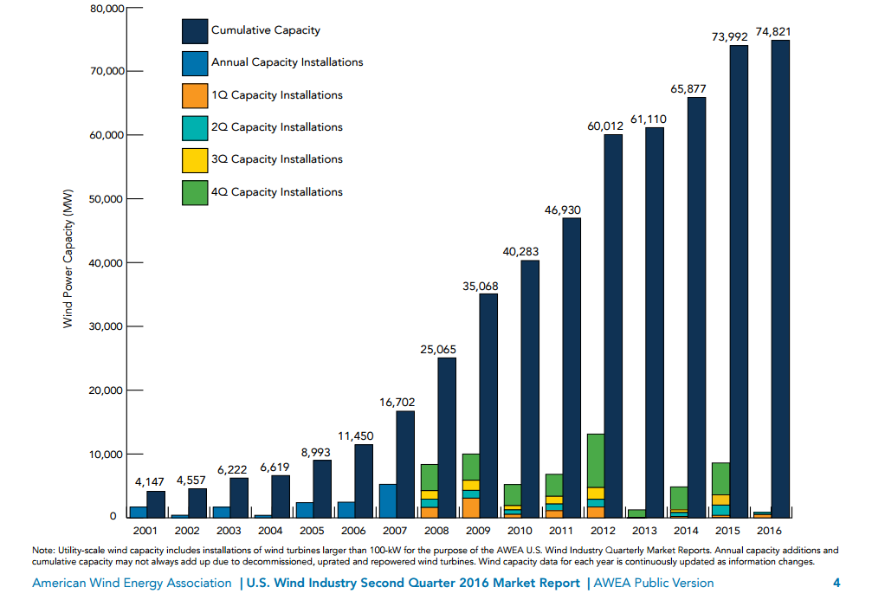
Growth in US Wind Power Capacity
The quick
development
time for wind
of 6 months
to a year
means that
changes in
federal tax
incentives
can have
an almost
immediate
impact on
construction
Source: AWEA Wind Power Outlook 2 Qtr, 2016

Slide 16
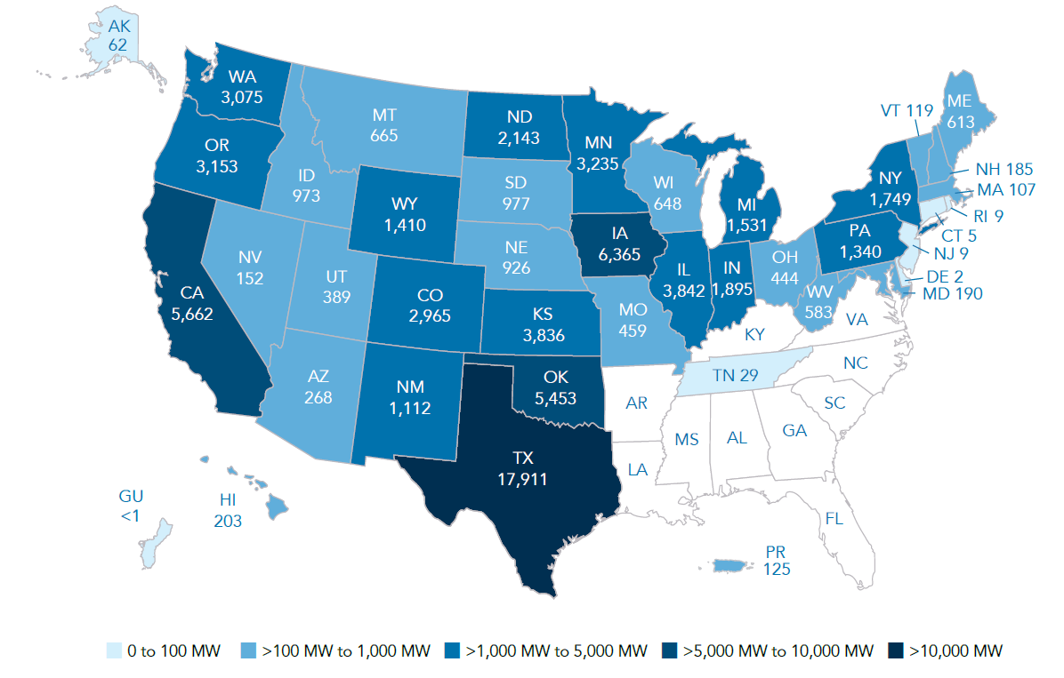
Wind Capacity Installations by State
Source: AWEA Wind Power Outlook 2 Qtr, 2016

Slide 17
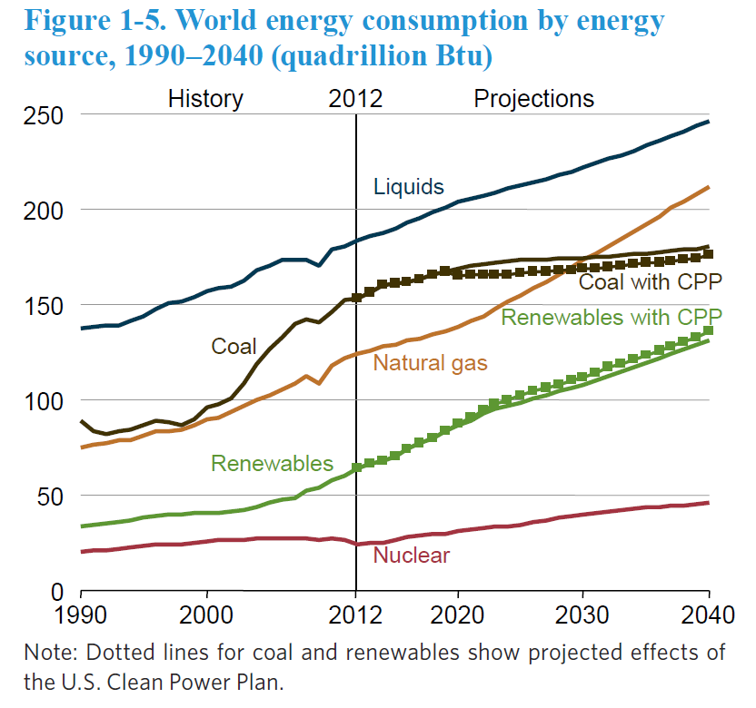
The World
Source: EIA, International Energy Outlook 2016

Slide 18
Energy Economics
Electric generating technologies involve a tradeoff between fixed costs (costs to build them) and operating costs
  Nuclear and solar high fixed costs, but low operating costs (though cost of solar has decreased substantially recently)
  Natural gas/oil have low fixed costs but can have higher operating costs (dependent upon fuel prices)
  Coal, wind, hydro are in between
Also the units capacity factor is important to determining ultimate cost of electricity

Slide 19
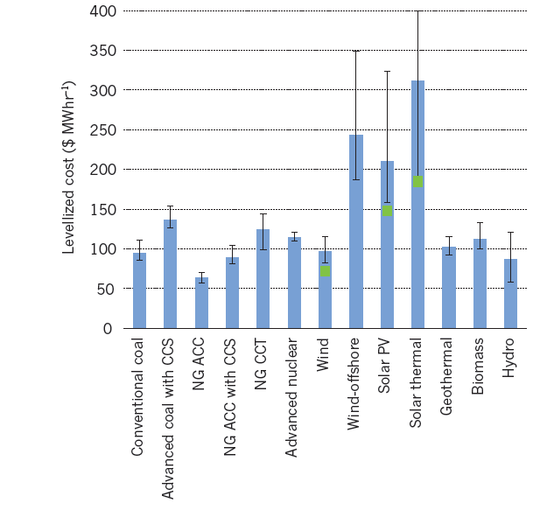
Ball park Energy Costs
Energy costs depend
upon the capacity factor
for the generator.
The capacity factor is the
ratio of the electricity
actually produced,
divided by its maximum
potential output. It is
usually expressed on an
annual basis.
Source: Steve Chu and Arun Majumdar, “Opportunities and challenges for a sustainable energy future,” Nature, August 2012, Figure 6

Slide 20
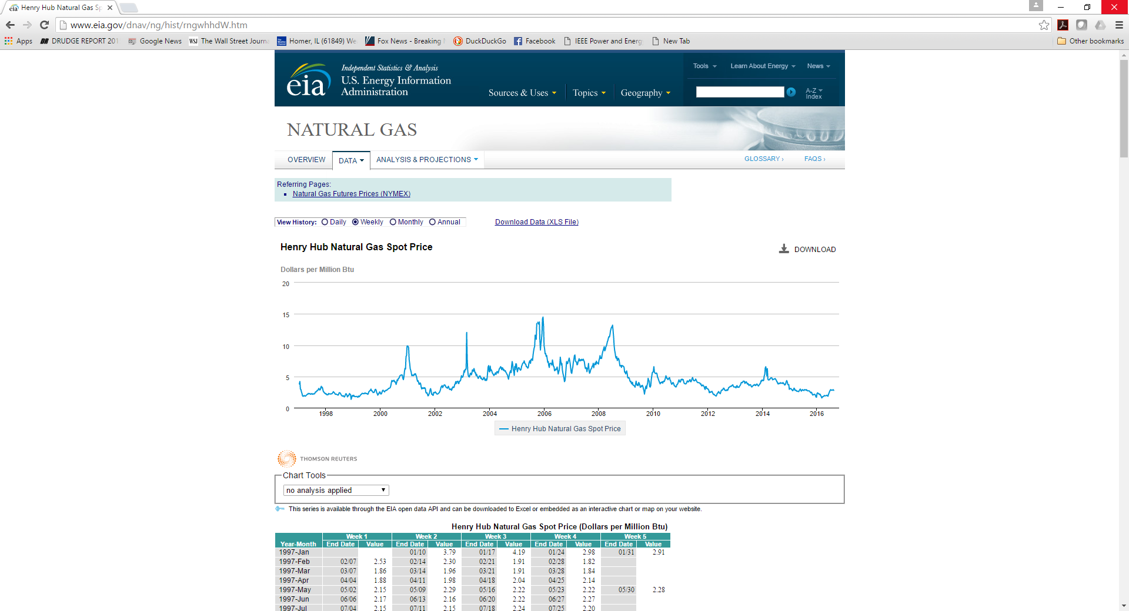
Natural Gas Prices 1997 to 2015
Marginal cost for natural gas fired electricity price
in $/MWh is about 7-10 times gas price
Source: http://www.eia.gov/dnav/ng/hist/rngwhhdW.htm

Slide 21
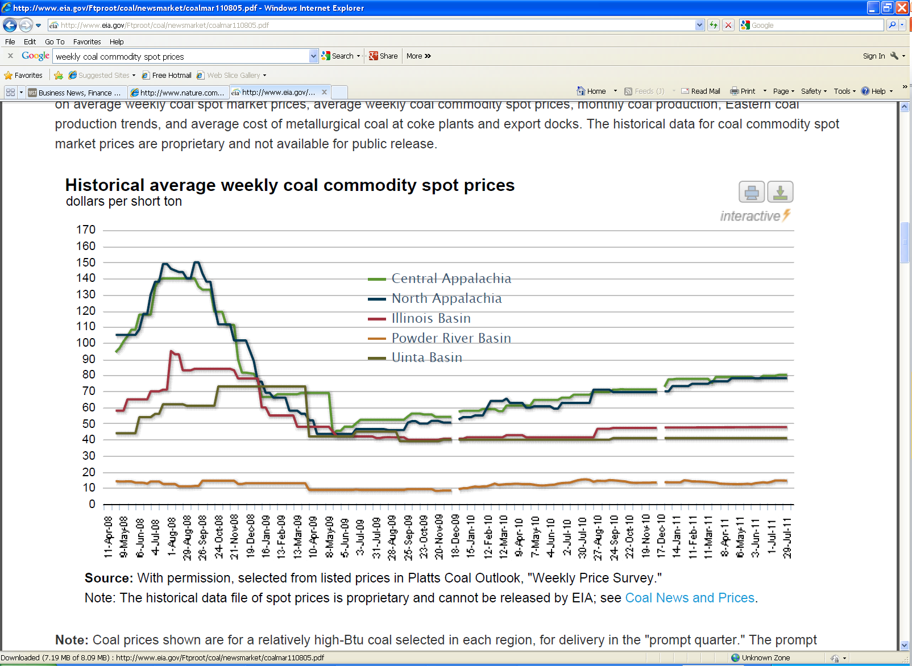
Coal Prices have Fallen Substantially from Five Years Ago
July 2016 prices
per ton range from $8.70 to
$43.35
BTU content per pound varies between about 8000
and 15,000 Btu/lb, giving costs of around $1 to 2/Mbtu
Source: eia.gov/coal

Slide 22
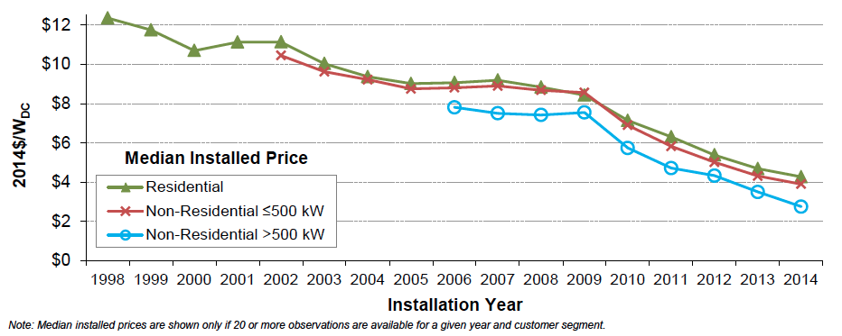
Solar PV Prices
Image: http://cleantechnica.com/2015/08/13/us-solar-pv-cost-fell-50-5-years-government-report/screen-shot-2015-08-12-at-12-33-53-pm/

Slide 23
Course Syllabus
Introduction and review of phasors & three phase
Transmission line modeling
Per unit analysis and change of base
Models for transformers, generators, and loads
Power flow analysis and control
Economic system operation/restructuring
Short circuit analysis
Transient stability
System protection
Distribution systems

Slide 24
Brief History of Electric Power
First real practical uses of electricity began with the telegraph (1860's) and then arc lighting in the 1870’s
Early 1880’s – Edison introduced Pearl Street dc system in Manhattan supplying 59 customers
1884 – Sprague produces practical dc motor
1885 – invention of transformer
Mid 1880’s – Westinghouse/Tesla introduce rival ac system
Late 1880’s – Tesla invents ac induction motor
1893 – Three-phase transmission line at 2.3 kV

Slide 25
History, cont’d
1896 – ac lines deliver electricity from hydro generation at Niagara Falls to Buffalo, 20 miles away; also 30kV line in Germany
Early 1900’s – Private utilities supply all customers in area (city); recognized as a natural monopoly; states step in to begin regulation
By 1920’s – Large interstate holding companies control most electricity systems

Slide 26
History, cont’d
1935 – Congress passes Public Utility Holding Company Act to establish national regulation, breaking up large interstate utilities (repealed 2005)
    This gave rise to electric utilities that only operated in one state
1935/6 – Rural Electrification Act brought electricity to rural areas
1930’s – Electric utilities established as vertical monopolies
Frequency standardized in the 1930’s

Slide 27
Vertical Monopolies
Within a particular geographic market, the electric utility had an exclusive franchise
Generation
In return for this exclusive
franchise, the utility had the
obligation to serve all
existing and future customers
at rates determined jointly
by utility and regulators
It was a “cost plus” business
Transmission
Distribution
Customer Service

Slide 28
Vertical Monopolies
Within its service territory each utility was the only game in town
Neighboring utilities functioned more as colleagues than competitors
Utilities gradually interconnected their systems so by 1970 transmission lines crisscrossed North America, with voltages up to 765 kV
Economies of scale keep resulted in decreasing rates, so most every one was happy

Slide 29
History, cont’d -- 1970’s
1970’s brought inflation, increased fossil-fuel prices, calls for conservation and growing environmental concerns
Increasing rates replaced decreasing ones
As a result, U.S. Congress passed Public Utilities Regulator Policies Act (PURPA) in 1978, which mandated utilities must purchase power from independent generators located in their service territory (modified 2005)
PURPA introduced some competition

Slide 30
PURPA and Renewables
PURPA, through favorable contracts, caused the growth of a large amount of renewable energy in the 1980’s (about 12,000 MW of wind, geothermal, small scale hydro, biomass, and solar thermal)
  These were known as “qualifying facilities” (QFs)
  California added about 6000 MW of QF capacity during the 1980’s, including 1600 MW of wind, 2700 MW of geothermal, and 1200 MW of biomass
  By the 1990’s the ten-year QFs contracts written at rates of $60/MWh in 1980’s, and they were no longer profitable at the $30/MWh 1990 values so many sites were retired or abandoned

Slide 31
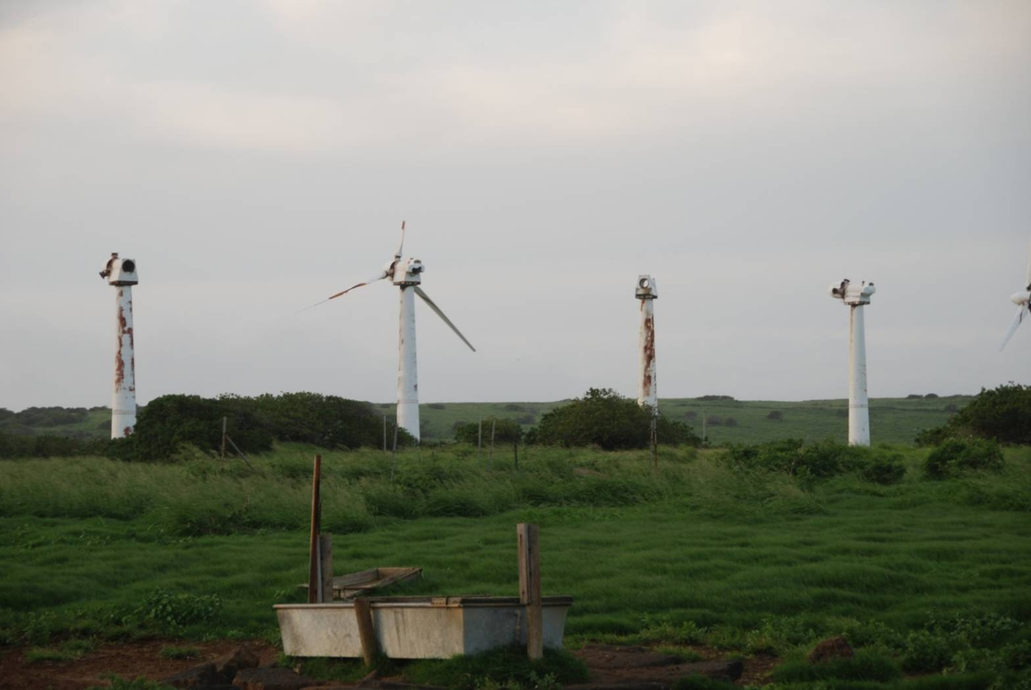
Abandoned Wind Farm Need South Point in Hawaii
Source: Prof. Sanders

