Slide 1
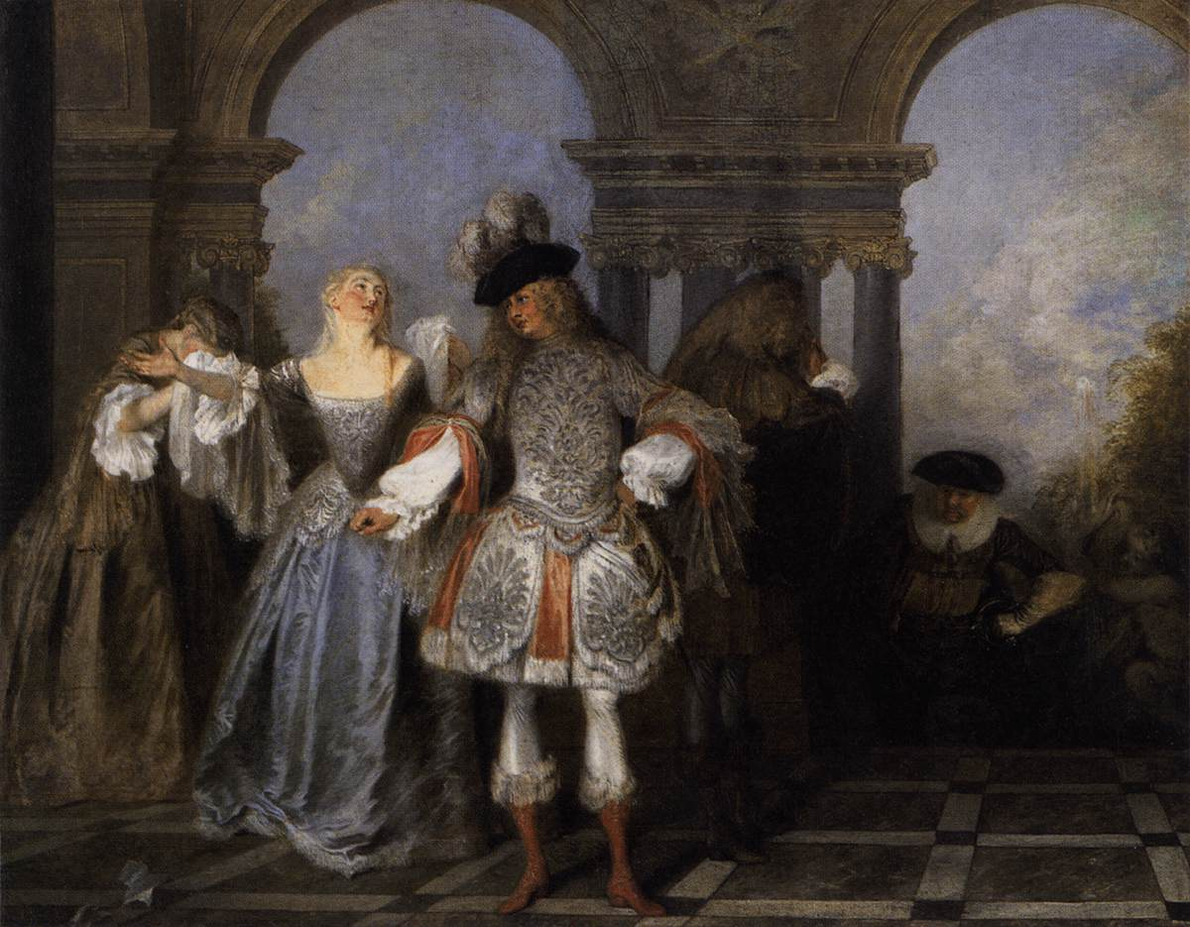
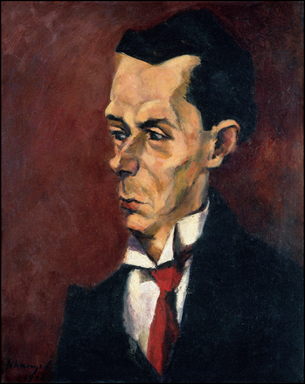
Lecture 36: Actor-critic deep reinforcement learning
CC-BY 4.0: copy at will, but cite the source
Mark Hasegawa-Johnson
April 2022
Actors from the Comédie Française, by Antoine Watteau, 1720. Public Domain, https://commons.wikimedia.org/w/index.php?curid=15418670
The Critic, by Lajos Tihanyi. Oil on canvas, 1916.
Public Domain, https://commons.wikimedia.org/w/index.php?curid=17837438

Slide 2
Outline
Two approaches to solving an MDP
Two approaches to deep reinforcement learning
Combining the two, in order to solve the problems with either

Slide 3
Solving an MDP
Remember that, if you know $P(s’|s,a)$, you can solve for the optimum policy $π(s)$. This is done by solving Bellman’s equation:
$$U\left(s\right)=R\left(s\right)+γ\max_{a}{\sum_{s^{′}}{P\left(s^{′} | s,a\right)U\left(s′\right)}} ∀s,s′$$
Bellman’s equation is N nonlinear equations in N unknowns (N is the number of states). In general, the only way to solve it is by exhaustively testing every possible policy ($O\left\{d^{N}\right\}$ computations where d is the number of possible actions).

Slide 4
Two approaches to solving an MDP
We’ve learned two practical algorithms for solving an MDP:
Value Iteration: focuses on finding $U(s)$
Policy Iteration: focus on finding $π(s)$

Slide 5
Two approaches to solving an MDP
Value Iteration: focuses on finding $U(s)$
Initialize with the value of a length-0 path: $U_{0}\left(s\right)=0$
Iterate by finding the best value of a length-t path:
$$U_{t}\left(s\right)=R\left(s\right)+γ\max_{a∈A(s)}{\sum_{s′}{P(s^{′}|s,a)U_{t−1}(s)}}$$

Slide 6
Value Iteration
$$U_{2}\left(s\right)=R\left(s\right)+γ\max_{a}{\sum_{s′}{P\left(s^{′} | s,a\right)U_{1}\left(s′\right)}}$$
$$\sum_{s′}{P\left(s^{′} | s,down\right)U_{1}\left(s′\right)}$$
$$\sum_{s′}{P\left(s^{′} | s,up\right)U_{1}\left(s′\right)}$$
$$−0.04$$ | $$−0.04$$ | $$+0.06$$
$$−0.04$$ |  | $$−0.14$$
$$−0.04$$ | $$−0.04$$ | $$−0.04$$ | $$−0.04$$
$$−0.04$$ | $$−0.04$$ | $$+0.06$$
$$−0.04$$ |  | $$−0.14$$
$$−0.04$$ | $$−0.04$$ | $$−0.04$$ | $$−0.81$$
$$U_{2}\left(s\right) (γ=1)$$
$$U_{1}(s)$$
$$−0.08$$ | $$−0.08$$ | $$+0.75$$
$$−0.08$$ |  | $$−0.08$$
$$−0.08$$ | $$−0.08$$ | $$−0.08$$ | $$−0.08$$
$$−0.04$$ | $$−0.04$$ | $$−0.04$$
$$−0.04$$ |  | $$−0.04$$
$$−0.04$$ | $$−0.04$$ | $$−0.04$$ | $$−0.04$$
$$\sum_{s′}{P\left(s^{′} | s,left\right)U_{1}\left(s′\right)}$$
$$\sum_{s′}{P\left(s^{′} | s,right\right)U_{1}\left(s′\right)}$$
$$−0.04$$ | $$−0.04$$ | $$−0.04$$
$$−0.04$$ |  | $$−0.04$$
$$−0.04$$ | $$−0.04$$ | $$−0.04$$ | $$−0.14$$
$$−0.04$$ | $$−0.04$$ | $$+0.79$$
$$−0.04$$ |  | $$−0.81$$
$$−0.04$$ | $$−0.04$$ | $$−0.04$$ | $$−0.14$$

Slide 7
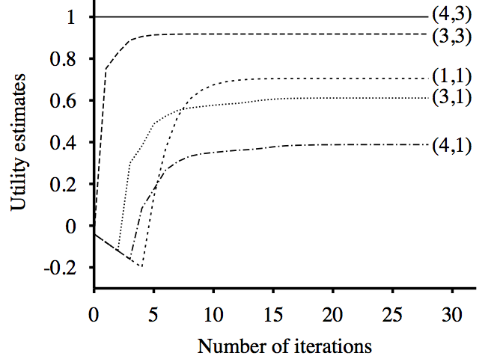
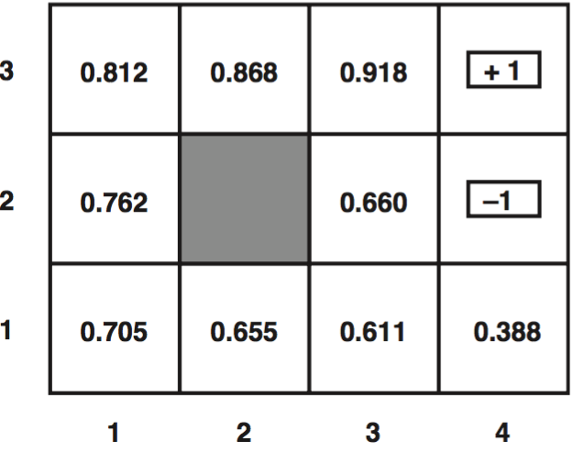
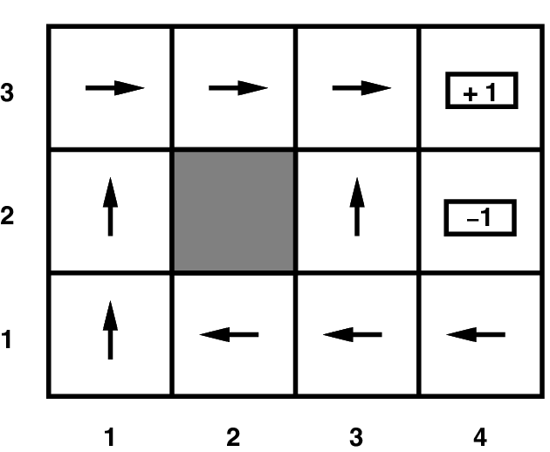
Value iteration
Optimal utilities with discount factor 1
(Result of value iteration)
Final policy

Slide 8
Two approaches to solving an MDP
Policy Iteration: focus on finding $π(s)$
Initialize with a completely arbitrary initial policy, e.g.:
$$π_{0}\left(s\right)=Left$$
Iterate:
Policy evaluation: find out the value of each state under current policy:
$$U^{π}\left(s\right)=R\left(s\right)+γ\sum_{s^{′}}{P\left(s^{′} | s,π\left(s\right)\right)U^{π}\left(s′\right)}$$
Policy improvement: change the action, in each state, to improve value:
$$π\left(s\right)\text{=}\underset{a∈A(s)}{argmax}{\sum_{s^{′}}{P\left(s^{′} | s,a\right)U^{π}\left(s\right)}}$$

Slide 9
1. Policy Evaluation:
$$π_{0}\left(s\right):$$
$$→$$ | $$→$$ | $$→$$
$$→$$ |  | $$→$$
$$→$$ | $$→$$ | $$→$$ | $$→$$
$$U^{π_{0}}(s)=R\left(s\right)+γ\sum_{s′}{P\left(s^{′} | s,π_{0}(s)\right)U^{π_{0}}\left(s′\right)}$$
…write it in matrix form:
$$\left[\begin{matrix}U^{π_{0}}(1) \\ ⋮ \\ U^{π_{0}}(N)\end{matrix}\right]=\left[\begin{matrix}R (1) \\ ⋮ \\ R (N)\end{matrix}\right]+γ\left[\begin{matrix}P(1|1,π\left(1\right)) & ⋯ & P(N|1,π\left(N\right)) \\ ⋮ & ⋱ & ⋮ \\ P(1|N,π\left(1\right)) & ⋯ & P(N|N,π\left(N\right))\end{matrix}\right]\left[\begin{matrix}U^{π_{0}}(1) \\ ⋮ \\ U^{π_{0}}(N)\end{matrix}\right]$$
$$+0.50$$ | $$+0.69$$ | $$+0.74$$
$$−0.65$$ |  | $$−0.90$$
$$−1.40$$ | $$−1.44$$ | $$−1.39$$ | $$−1.40$$
$$U^{π_{0}\left(s\right)}\left(s\right):$$
…and solve it:

Slide 10
2. Policy Improvement:
$$π_{0}\left(s\right):$$
$$→$$ | $$→$$ | $$→$$
$$→$$ |  | $$→$$
$$→$$ | $$→$$ | $$→$$ | $$→$$
$$U^{π_{0}}(s)=R\left(s\right)+γ\sum_{s′}{P\left(s^{′} | s,π_{0}(s)\right)U^{π_{0}}\left(s′\right)}$$
$$π_{1}(s)=\underset{a}{argmax}{\sum_{s′}{P\left(s^{′} | s,π_{0}(s)\right)U^{π_{0}}\left(s′\right)}}$$
$$π_{1}(s)$$
$$→$$ | $$→$$ | $$→$$
$$↑$$ |  | $$↑$$
$$↑$$ | $$→$$ | $$↑$$ | $$↑$$
$$+0.50$$ | $$+0.69$$ | $$+0.74$$
$$−0.65$$ |  | $$−0.90$$
$$−1.40$$ | $$−1.44$$ | $$−1.39$$ | $$−1.40$$
$$U^{π_{0}\left(s\right)}\left(s\right):$$

Slide 11
Outline
Two approaches to solving an MDP
Two approaches to deep reinforcement learning
Combining the two, in order to solve the problems with either

Slide 12
Two approaches to deep reinforcement learning
Deep Q learning: train a network to estimate Q(s,a)
Like value iteration: we focus on Q(s,a), which is closely related to U(s)
Big problem: Q(s,a) is very noisy, needs lots of smoothing
Imitation learning: train a network to imitate a human being
Like policy iteration: focus directly on estimating $π(s)$
Big problem: the only way to train this is by imitating a human!

Slide 13
Deep Q learning
Train the neural network weights in order to minimize the mean-squared error:
$$ℒ=\frac{1}{2}E\left[{\left(f\left(\vec{s},\vec{a}\right)−Q_{local} (\vec{s},\vec{a}) \right)}^{2}\right]$$
$Q_{local} (\vec{s},\vec{a})$is the estimated value of the current action:
$$Q_{local}({\vec{s}}_{t},{\vec{a}}_{t})=R_{t}({\vec{s}}_{t})+γ\max_{\vec{a}′}{f\left({\vec{s}}_{t+1},\vec{a}′\right)}$$
$$f\left(\vec{s},\vec{a}\right)$$
$$1$$
$$1$$
$$1$$
$$1$$
$$s_{1}$$
$$…$$
$$s_{D}$$
$$a_{1}$$
$$…$$
$$a_{C}$$
$$1$$
$$…$$

Slide 14
Imitation Learning
If we have $|A|$ possible, actions, $1≤a≤|A|$, we could train the network to learn a hidden layer $h(s)$ so that:
$$π_{a}\left(s\right)=\frac{exp⁡\left(w_{a}^{T}h(s)\right)}{\sum_{k=1}^{|A|}{exp⁡\left(w_{k}^{T}h(s)\right)}}=P\left(A=a|S=s\right)$$
Meaning “the probability that the best action is a.”

Slide 15
Two approaches to deep reinforcement learning
Deep Q learning: train a network to estimate Q(s,a)
Like value iteration: we focus on Q(s,a), which is closely related to U(s)
Big problem: Q(s,a) is very noisy, needs lots of smoothing
Imitation learning: train a network to imitate a human being
Like policy iteration: focus directly on estimating $π(s)$
Big problem: the only way to train this is by imitating a human!

Slide 16
Outline
Two approaches to solving an MDP
Two approaches to deep reinforcement learning
Combining the two, in order to solve the problems with either

Slide 17
The Actor-Critic Algorithm
Deep Q-learning gives us a network Q(s,a) which is very noisy, so we don’t really want to trust it
A policy network can directly estimate $π(s)$. The only problem is that we have no way to train it, unless we imitate human behavior.

Slide 18
Actor-critic algorithm
So let’s train two neural nets!
$Q_{t}\left(s,a\right)$ is the critic, and is trained according to the deep Q-learning algorithm (MMSE).
$π_{a}\left(s\right)$ is the actor, and is trained to satisfy the critic
Actors from the Comédie Française, by Antoine Watteau, 1720. Public Domain, https://commons.wikimedia.org/w/index.php?curid=15418670
The Critic, by Lajos Tihanyi. Oil on canvas, 1916.
Public Domain, https://commons.wikimedia.org/w/index.php?curid=17837438

Slide 19
The Actor-Critic Algorithm
Main idea:
The actor is a policy network that decides what action to perform:
$π_{a}\left(s\right)=$Probability that $a$ is the best action in state $s$
The critic is a deep Q-learning network that estimates the quality of that action ($Q(s,a)$).
$Q\left(s,a\right)=$ Expected sum of future rewards if $(s,a)$
The critic is noisy, so they don’t get to decide the action. Instead, we only use the critic to help us to train the actor.

Slide 20
The Actor-Critic Algorithm
$π_{a}\left(s\right)=$Probability that $a$ is the best action in state $s$
$Q\left(s,a\right)=$ Expected sum of future rewards if $(s,a)$
The critic is noisy, so they don’t get to decide the action. Instead, we only use the critic to help us to train the actor.
$$ℒ=−\sum_{a}{π_{a}(s)Q(s,a)}$$
The training loss = negative expected sum of future rewards given action $a$, averaged over the probability with which the actor chooses action $a$.

Slide 21
The Actor-Critic Algorithm: Forward-Prop
Actor
$$s$$
$$π_{a}\left(s\right)=P(a|s)$$
Critic
$$Q_{t}(s,a)$$
$$s$$

Slide 22
The Actor-Critic Algorithm: Back-Prop
Actor
$$s$$
$$π_{a}\left(s\right)$$
$$ℒ_{actor}=−\sum_{a}{π_{a}(s)Q_{t}(s,a)}$$
Critic
$$Q_{t}(s,a)$$
$$s$$
$$ℒ_{critic}=\frac{1}{2}{\left(Q_{t}\left(\vec{s},\vec{a}\right)−Q_{local} (\vec{s},\vec{a}) \right)}^{2}$$

Slide 23
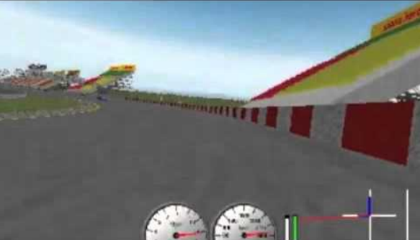
Asynchronous advantage actor-critic (A3C)
TORCS car racing simulation video
Mnih et al. Asynchronous Methods for Deep Reinforcement Learning. ICML 2016

Slide 24
Overview: All of the Model-Free Reinforcement Learning Algorithms You’ve Learned
Policy learning: learn $π\left(s\right)$ directly
Imitation learning
Q-learning: learn $Q\left(s,a\right)=R\left(s\right)+γ\sum_{s′}{P\left(s^{′} | s,a\right)U(s^{′})}$
Table-based: TD, SARSA
Deep Q-learning
Actor-Critic: learn both

