Slide 1
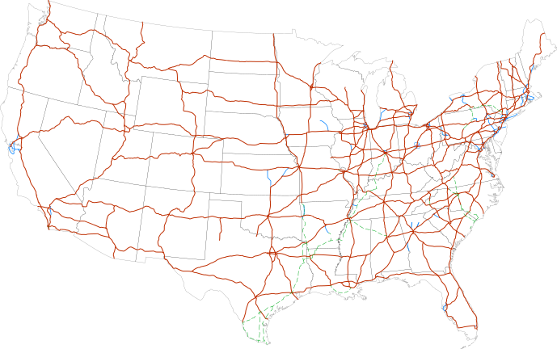
CS440/ECE 448 Lecture 15: Search
CC-SA 4.0, Mark Hasegawa-Johnson, 2/2022

Slide 2
Outline of today’s lecture
Initial state, goal state, transition model
General algorithm for solving search problems
First data structure: a frontier queue
Second data structure: a search tree
Third data structure: explored set
Fourth data structure: explored dict
Breadth-first search (BFS) and Depth-first search (DFS)
Completeness
Optimality
Time Complexity
Space Complexity

Slide 3
Search
We will consider the problem of designing goal-based agents in fully observable, deterministic, discrete, static, known environments
Environment is sequential: agent’s action changes its state
Agent must plan the best sequence of actions to achieve a goal
Start state
Goal state

Slide 4
Search problem components
Initial state
Actions
Transition model
What successor state results from performing a given action in a given predecessor state?
Goal state
Path cost
Assume that it is a sum of nonnegative step costs
The optimal solution is the sequence of actions that gives the lowest path cost for reaching the goal
Initial
state
Goal state

Slide 5
Knowledge Representation: State
State = description of the world
Must have enough detail to decide whether or not you’re currently in the initial state
Must have enough detail to decide whether or not you’ve reached the goal state
Often but not always: “defining the state” and “defining the transition model” are the same thing

Slide 6
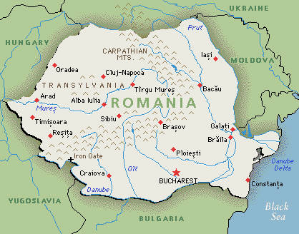
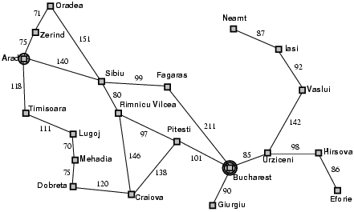
Example of state definition: Romania
On vacation in Romania; currently in Arad
Flight leaves tomorrow from Bucharest
state = name of the city
Path cost
Sum of edge costs (total distance traveled)

Slide 7
Example of state definition: Maze solving
Initial
state
State = (x,y), current position of the agent
Goal state

Slide 8
Example of state definition: Traveling salesman problem
Goal: visit every city in the United States
Path cost: total miles traveled
Initial state: Champaign, IL
Action: travel from one city to another
Transition model: when you visit a city, mark it as “visited.”

Slide 9
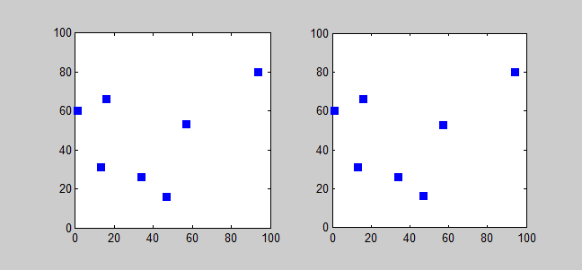
Example of state definition: Traveling salesman problem
state = (agent, goals)
agent = (agent_x,agent_y) is current position of the agent
goals = [goal[0], goal[1], …] lists the goals that have not yet been reached
goal[i] = (goal_x, goal_y) tells the location of the i’th remaining goal
Solving TSP using a branch-and-bound algorithm. CC-BY-SA 3.0, Saurabh Harsh, 2012, https://commons.wikimedia.org/wiki/File:Branchbound.gif

Slide 10
Outline of today’s lecture
Initial state, goal state, transition model
General algorithm for solving search problems
First data structure: a frontier queue
Second data structure: a search tree
Third data structure: explored set
Fourth data structure: explored dict
Breadth-first search (BFS) and Depth-first search (DFS)
Completeness
Optimality
Time Complexity
Space Complexity

Slide 11
How does this problem differ from every problem you’ve ever seen before?
Search differs from most Computer Science problems in that the state space might be infinite. We don’t assume, in advance, that we can enumerate every possible configuration of the world.
Traditional definition of Dijkstra’s algorithm:
First, list all of the possible states in the “not explored” list
Then, move them to the “explored” list after we visit them
Modifying Dijkstra’s algorithm for the infinite-world assumption:
Instead of a list of all possible states, we have a method (next_state,cost)=Transition_Model( current_state, action)
Instead of an infinite “not explored” list, we have a finite “frontier.”

Slide 12
First data structure: Frontier
Frontier = set of nodes that you know how to reach, but you haven’t yet tested to see what comes next after those states
node = ( state, parent_node, path_cost )
Initialize: frontier = { (initial_state, None, 0) }
Iterate, until goal is reached:
Set current_state to some node from the frontier, remove it from the frontier.
Expand current_state:
If it’s the goal, then you’re done! Return the corresponding path.
If not, then find its children, and transition costs, using (next_state,cost)=Transition_Model( current_state, action), and add them to the frontier.

Slide 13
Example: Romania
On vacation in Romania; currently in Arad
Flight leaves tomorrow from Bucharest
Initial state
Arad
Actions
Go from one city to another
Transition model
If you go from city A to city B, you end up in city B
Goal state
Bucharest
Path cost
Sum of edge costs (total distance traveled)

Slide 14
Search step 0
Frontier: { Arad }
Tree:
Arad, 0

Slide 15
Search step 1
Frontier: { Sibiu, Zerind, Timisoara }
Tree:
Arad, 0
Sibiu, 140
Timisoara, 118
Zerind, 75

Slide 16
Tree Search: Basic idea
SEARCH for an optimal solution
Maintain a frontier of unexpanded states
At each step, pick a state from the frontier to expand:
Check to see whether or not this state is the goal state. If so, DONE!
If not, then list all of the states you can reach from this state, add them to the frontier, and add them to the tree
BACK-TRACE: go back up the tree; list, in reverse order, all of the actions you need to perform in order to reach the goal state.
ACT: the agent reads off the sequence of necessary actions, in order, and does them.

Slide 17
Nodes vs. States
State = description of the world
Must have enough detail to decide whether or not you’re currently in the initial state
Must have enough detail to decide whether or not you’ve reached the goal state
Often but not always: “defining the state” and “defining the transition model” are the same thing
Node = a point in the search tree
Knows the ID of its STATE
Knows the ID of its PARENT NODE
Knows the COST of the path
Starting state
Action
Successor state
…
…
…
…
Goal state

Slide 18
Search step 1
Frontier: { Sibiu, Zerind, Timisoara }
Tree:
Arad, 0
Sibiu, 140
Timisoara, 118
Zerind, 75

Slide 19
Search step 2 Expand Sibiu
Frontier: { Sibiu, Zerind, Timisoara }
Tree:
Arad, 0
Sibiu, 140
Timisoara, 118
Zerind, 75

Slide 20
Search step 2 Expanded Sibiu
Frontier: { Zerind, Timisoara, Oradea, Arad,
Rimnicu Vilcea, Fagaras }
Tree:
Arad, 0
Sibiu, 140
Timisoara, 118
Zerind, 75
Oradea, 291
Arad, 280
Ramnicu Valcea, 220
Fagaras, 239

Slide 21
Tree Search: Computational Complexity
b = “branching factor” = max # states you can reach from any given state
d = “depth” = # layers in the tree (# moves that you have made)
Complexity of Tree Search = $O\{b^{d}\}$
If the world is infinite (there are an infinite number of possible states), then $O\{b^{d}\}$ is a reasonable cost to pay.
But what if (as in the Romania example) the world is finite? What if there are only N cities, where $O\{N\}<O\{b^{d}\}$? … it’s foolish to suffer $O\{b^{d}\}$ complexity for a tree search, when an exhaustive search would be only $O\{N\}$.

Slide 22
Third data structure: Explored set
How to limit complexity to $O\{\min\left(N,b^{d}\right)\}$: use an explored set
When you expand a state, do the following for each child state.
Check to see whether it’s already been explored.
If so:
Skip it.
If not:
Add it to the frontier
Add it to the tree
Add it to the explored set

Slide 23
Search step 0
Frontier: { Arad }
Explored: { Arad }
Tree:
Arad, 0

Slide 24
Search step 1: expand Arad
Frontier: { Sibiu, Zerind, Timisoara }
Explored: { Arad, Sibiu, Zerind, Timisoara }
Arad, 0
Sibiu, 140
Timisoara, 118
Zerind, 75

Slide 25
Search step 2: expand Sibiu
Frontier: { Zerind, Timisoara, Oradea, Ramnicu Valcea, Fagaras }
Explored: { Arad, Sibiu, Zerind, Timisoara, Oradea, Ramnicu Valcea, Fagaras }
Arad, 0
Sibiu, 140
Timisoara, 118
Zerind, 75
Oradea, 291
Ramnicu Valcea, 220
Fagaras, 239

Slide 26
Search step 3: expand Zerind
Frontier: { Timisoara, Oradea, Ramnicu Valcea, Fagaras }
Explored: { Arad, Sibiu, Zerind, Timisoara, Oradea, Ramnicu Valcea, Fagaras }
Arad, 0
Sibiu, 140
Timisoara, 118
Zerind, 75
Oradea, 291
Ramnicu Valcea, 220
Fagaras, 239

Slide 27
We don’t add Oradea to the frontier again, b/c already in explored set
But our new path to Oradea is shorter – only 146km, instead of 291km!
Can we go back and fix our mistake?
Frontier: { Timisoara, Oradea, Ramnicu Valcea, Fagaras }
Explored: { Arad, Sibiu, Zerind, Timisoara, Oradea, Ramnicu Valcea, Fagaras }
Arad, 0
Sibiu, 140
Timisoara, 118
Zerind, 75
Oradea, 291
Ramnicu Valcea, 220
Fagaras, 239

Slide 28
Fourth data structure: Explored Dictionary
Explored = dictionary mapping from state ID to path cost
If a child state is in the explored dict, and our new path has HIGHER COST, then
Skip it.
If a child state is in the explored dict, but our new path has LOWER COST, then:
Update the dict: explored[state] = new_cost
Put the new (state, parent, cost) tuple into the frontier and the tree

Slide 29
Search step 3: expanded Zerind
Frontier: { Timisoara, Oradea, Rimnicu Vilcea, Fagaras }
Explored: { Arad:0, Sibiu:140, Zerind:75, Timisoara:118, Oradea:291, Rimnicu Vilcea:220, Fagaras:239 }
Arad, 0
Sibiu, 140
Timisoara, 118
Zerind, 75
Oradea, 291
Rimnicu Vilcea, 220
Fagaras, 239

Slide 30
Frontier: { Timisoara, Oradea, Ramnicu Valcea, Fagaras }
Explored: { Arad:0, Sibiu:140, Zerind:75, Timisoara:118, Oradea:146, Rimnicu Vilcea:220, Fagaras:239 }
Arad, 0
Sibiu, 140
Timisoara, 118
Zerind, 75
Oradea, 291
Ramnicu Valcea, 220
Fagaras, 239
Oradea, 146

Slide 31
Outline of today’s lecture
Initial state, goal state, transition model
General algorithm for solving search problems
First data structure: a frontier queue
Second data structure: a search tree
Third data structure: a “visited states” dict
Breadth-first search (BFS) and Depth-first search (DFS)
Completeness
Optimality
Time Complexity
Space Complexity

Slide 32
In which order should you pick nodes from the frontier?
LIFO (last-in, first-out) = Depth-First Search (DFS):
the next node you expand will always be the one most recently added to the frontier.
FIFO (first-in, first-out) = Breadth-First Search (BFS):
the next node you expand will always be the one least recently added to the frontier.

Slide 33
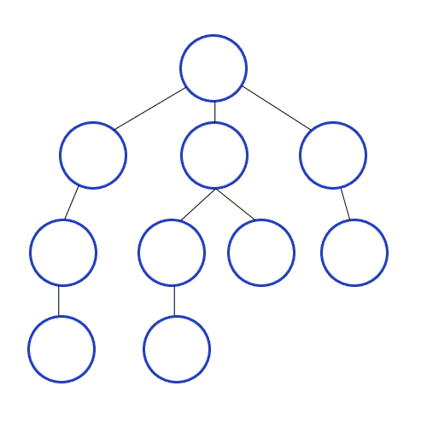
Depth-first search (DFS)
Expand frontier in LIFO order (last in, first out).
Result: most recently discovered path is pursued, all the way to the end.
Depth-first-search. CC-BY-SA 3.0, Mre, 2009
https://commons.wikimedia.org/wiki/File:Depth-First-Search.gif

Slide 34
Analysis of search strategies
Strategies are evaluated along the following criteria:
Completeness: does it always find a solution if one exists?
Optimality: does it always find a least-cost solution?
Time complexity: number of nodes generated
Space complexity: maximum number of nodes in memory
Time and space complexity are measured in terms of
b: maximum branching factor of the search tree
d: depth of the optimal solution
m: maximum length of any path in the state space (may be infinite)

Slide 35
Depth-first search (DFS)
Incomplete: If there are an infinite number of states, DFS might go down a path of infinite length, and might never find a solution.
Suboptimal: DFS returns the first path it finds, which might not be the shortest path.
Time Complexity: $O\{b^{m}\}$, where m is the longest possible path length.
Space Complexity: only $O\{m\}$! Once you’ve finished a path, you can delete it from the tree!
Depth-first-search. CC-BY-SA 3.0, Mre, 2009
https://commons.wikimedia.org/wiki/File:Depth-First-Search.gif

Slide 36
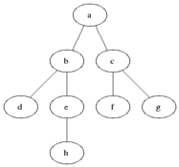
Breadth-first search (BFS)
Expand the frontier in FIFO order (first-in, first-out).
Result: all paths of length d are explored, then all paths of length d+1, and so on.
Animated-BFS. CC-SA 3.0, Blake Matheny, 2007
https://commons.wikimedia.org/wiki/File:Animated_BFS.gif

Slide 37
Breadth-first search (BFS)
Complete: if a finite-length path exists, BFS will find it.
Optimal: BFS returns the first solution it finds, which is always the shortest path.
Time Complexity: $O\{b^{d}\}$, where d is the length of the best path. This is usually much less than $O\{b^{m}\}$, because $d<m$.
Space Complexity: $O\{b^{d}\}$. No part of the tree can be deleted until you’ve found the solution.
Animated-BFS. CC-SA 3.0, Blake Matheny, 2007
https://commons.wikimedia.org/wiki/File:Animated_BFS.gif

Slide 38
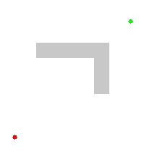
BFS: How to do it
Notice that BFS searches in exactly the same order as Dijkstra’s algorithm.
BFS is the normal way you would implement Dijkstra’s algorithm for a possibly-infinite search space.
Dijkstra’s progress, CC-BY 3.0, Subh83, 2011
https://commons.wikimedia.org/wiki/File:Dijkstras_progress_animation.gif

Slide 39
Outline of today’s lecture
Initial state, goal state, transition model
General algorithm for solving search problems
First data structure: a frontier queue
Second data structure: a search tree
Third data structure: a “visited states” dict
Breadth-first search (BFS) and Depth-first search (DFS)

