Slide 1
Lecture 27 Exam 3 Review
Mark Hasegawa-Johnson
May 3, 2021

Slide 2
Outline: Exam 3 will be multiple-choice, on prairielearn, including 24 problems
4 problems: Midterm 1 material
4 problems: Midterm 2 material
4-5 problems: minimax, alpha-beta, expectiminimax
3-4 problems: game theory
5-7 problems: MDP, reinforcement learning
1 problem: AI fairness (definitions of fairness; causal graphs)
1 problem: computer vision (similar triangles; convolution)

Slide 3
Outline: Exam 3 will be multiple-choice, on prairielearn, including 24 problems
4 problems: Midterm 1 material
4 problems: Midterm 2 material
4-5 problems: minimax, alpha-beta, expectiminimax
3-4 problems: game theory
5-7 problems: MDP, reinforcement learning
1 problem: AI fairness (definitions of fairness; causal graphs)
1 problem: computer vision (similar triangles; convolution)

Slide 4
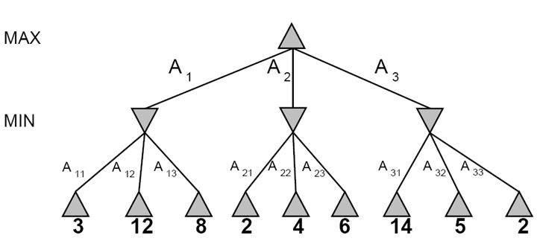
Computing the minimax value of a node
3
3
2
2
Minimax(node) =
Utility(node) if node is terminal
max_{action} Minimax(Succ(node, action)) if player = MAX
min_{action} Minimax(Succ(node, action)) if player = MIN

Slide 5
The pruning thresholds, alpha and beta
Alpha-beta pruning requires us to keep track of two pruning thresholds, alpha and beta.
alpha ($α$) is the highest score that MAX knows how to force MIN to accept.
beta ($β$) is the lowest score that MIN knows how to force MAX to accept.
$α<β$

Slide 6
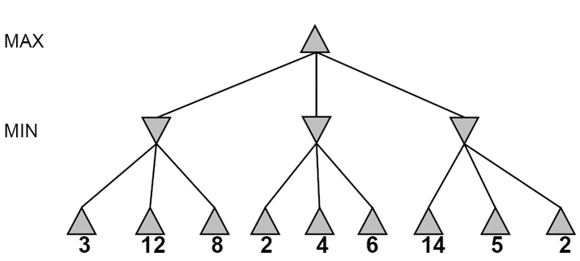
Computational Complexity
X
X
X
X
2
5
14
Consider a sequence of two levels, with n moves per level, and with optimal ordering.
There are $n^{2}$ terminal nodes.
Alpha-beta will evaluate all the daughters of the first daughter: $n$ nodes.
Alpha-beta will also evaluate the first daughter of each non-first daughter: $n−1$ nodes.
In total, alpha-beta will evaluate $2n−1$ out of every $n^{2}$ nodes.
For a tree of depth d, the number of nodes evaluated by alpha-beta is
$${\left(2n−1\right)}^{d/2}= O\{n^{d/2}\}$$

Slide 7
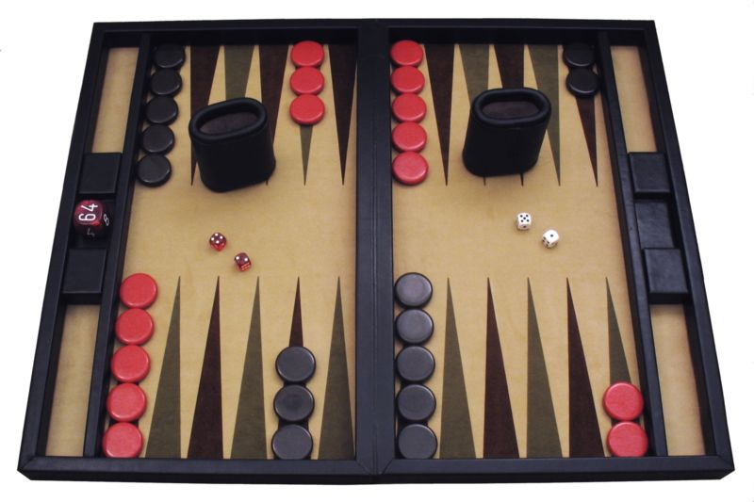
Expectiminimax: notation
= MAX node. $U\left(s\right)=\max_{a∈A(s)}{Q(s,a)}$
= MIN node. $U\left(s\right)=\min_{a∈A(s)}{Q(s,a)}$
= Chance node. $Q\left(s,a\right)=\sum_{s′}{P\left(s^{′} | s,a\right)U(s^{′})}$

Slide 8
Outline: Exam 3 will be multiple-choice, on prairielearn, including 24 problems
4 problems: Midterm 1 material
4 problems: Midterm 2 material
4-5 problems: minimax, alpha-beta, expectiminimax
3-4 problems: game theory
5-7 problems: MDP, reinforcement learning
1 problem: AI fairness (definitions of fairness; causal graphs)
1 problem: computer vision (similar triangles; convolution)

Slide 9
Notation: simultaneous games
🐶
The payoff matrix shows:
Each column is a different move for player 1.
Each row is a different move for player 2.
Each square is labeled with the rewards earned by each player in that square.
L
R
🐱
🐱
L
R
L
R
🐶1 🐱2
🐶7 🐱4
🐶5 🐱1
🐶5 🐱4
🐱
L
R
2
4
L
1
7
🐶
1
4
R
5
5
Payoff matrix

Slide 10
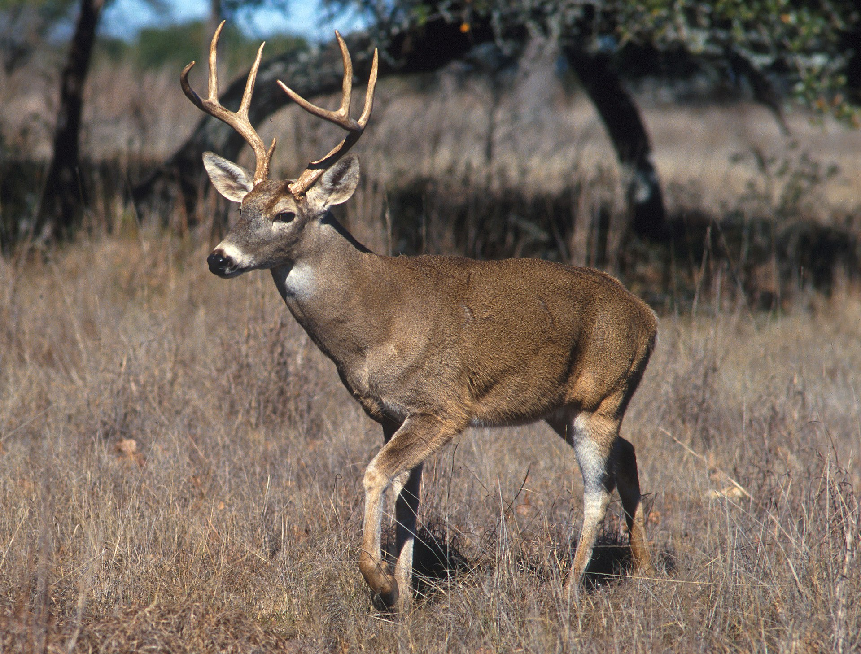
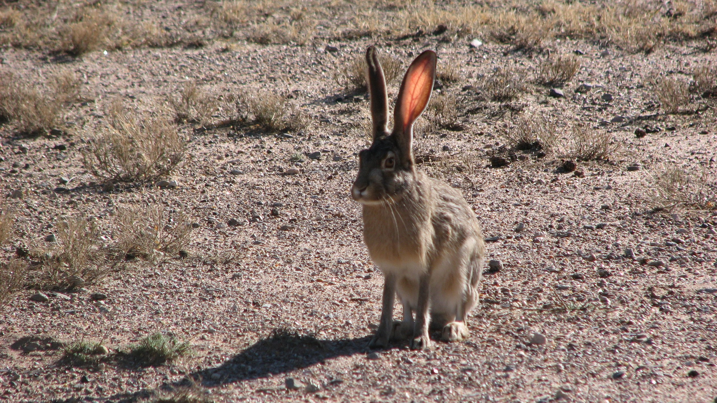
Nash Equilibrium
Alice
 | Defect | Cooperate
Defect
Cooperate
10
0
10
10
Bob
10
100
0
100
Photo by Scott Bauer, Public Domain, https://commons.wikimedia.org/w/index.php?curid=245466
By Ancheta Wis, CC BY-SA 3.0, https://commons.wikimedia.org/w/index.php?curid=68432449
A Nash Equilibrium is a game outcome such that each player, knowing the other player’s move in advance, responds rationally.

Slide 11
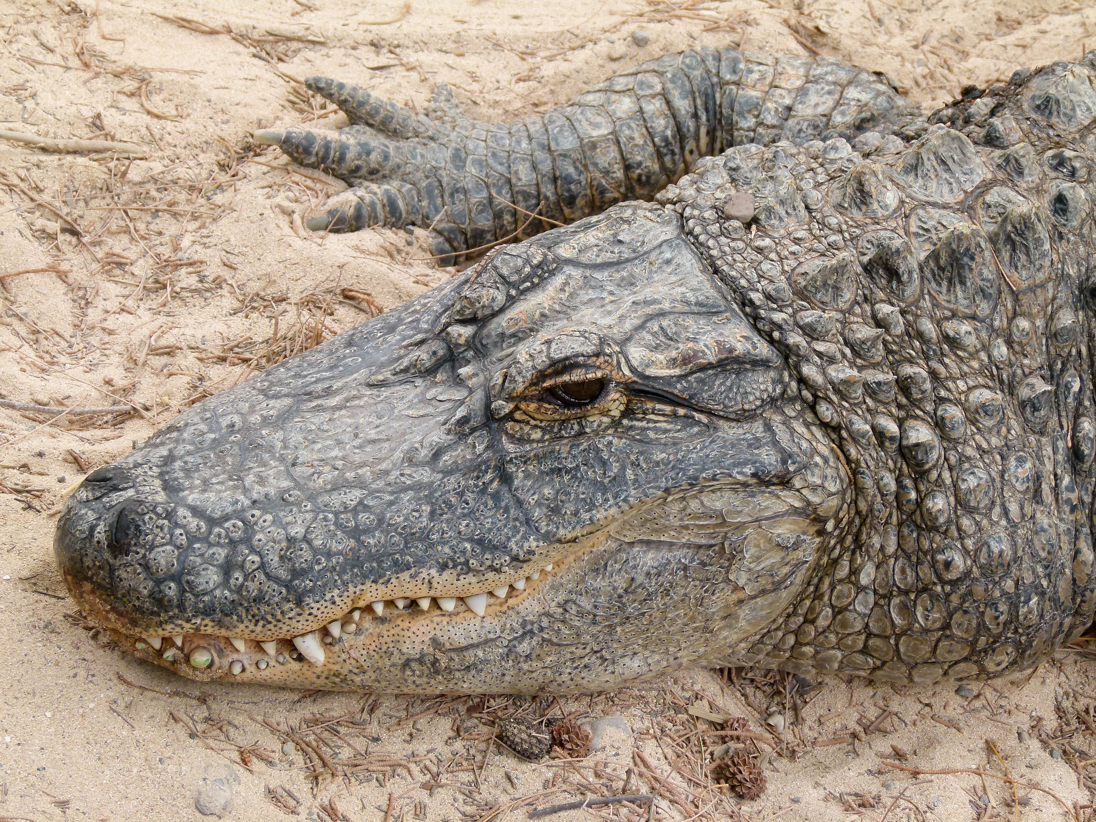
Pareto optimal outcome
 | Stag | Alligator
Stag
Alligator
Alice
10
0
20
0
Bob
0
20
Photo by Scott Bauer, Public Domain, https://commons.wikimedia.org/w/index.php?curid=245466
0
10
By Ancheta Wis, CC BY-SA 3.0, https://commons.wikimedia.org/w/index.php?curid=68432449
An outcome is Pareto-optimal if the only way to increase value for one player is by decreasing value for the other.
(Stag,Stag) is Pareto-optimal: one could increase Alice’s value, but only by decreasing Bob’s value.
(Alligator,Alligator) is Pareto-optimal: one could increase Bob’s value, but only by decreasing Alice’s value.

Slide 12
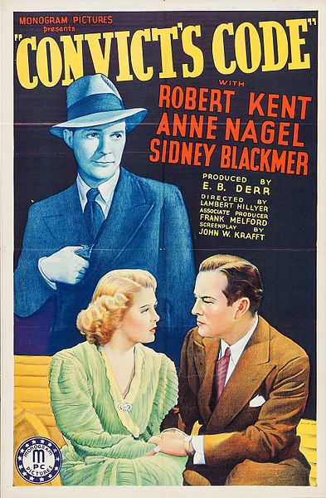
Dominant strategy
 | Alice: Testify | Alice: Refuse
Bob: Testify
Bob: Refuse
If you didn’t know in advance what your opponent was going to do, what would you do?
If Bob knew that Alice was going to refuse, then it be rational for Bob to testify (he’d get 0 years, instead of 1).
If Bob knew that Alice was going to testify, then it would still be rational for him to testify (he’d get 5 years, instead of 10).
A dominant strategy is an action that minimizes cost, for one player, regardless of what the other player does.
-5
-10
-5
0
0
-1
-10
-1
By Monogram Pictures, Public Domain, https://commons.wikimedia.org/w/index.php?curid=50338507

Slide 13
Mixed-strategy Nash Equilibrium
 | Defect w/ Prob. $1−p$ | Coop. w/ Prob. $p$
Defect w/ Prob. $1−q$
Coop. w/ Prob. $q$
Alice
$$a$$
$$b$$
$$w$$
$$x$$
Bob
$$c$$
$$d$$
$$y$$
$$z$$
For Bob, random selection is rational only if he can’t improve his winnings by definitively choosing one action or the other. If Alice’s strategy is to cooperate w/probability p,
If Bob defects, he expects to win $\left(1−p\right)w+px$.
If Bob cooperates, he expects to win $\left(1−p\right)y+pz$.
So
it’s only logical for Bob to use a mixed strategy if $\left(1−p\right)w+px=\left(1−p\right)y+pz$.

Slide 14
Outline: Exam 3 will be multiple-choice, on prairielearn, including 24 problems
4 problems: Midterm 1 material
4 problems: Midterm 2 material
4-5 problems: minimax, alpha-beta, expectiminimax
3-4 problems: game theory
5-7 problems: MDP, reinforcement learning
1 problem: AI fairness (definitions of fairness; causal graphs)
1 problem: computer vision (similar triangles; convolution)

Slide 15
The Bellman equation
Recursive relationship between the utilities of successive states:
For N states, we get N nonlinear equations in N unknowns
Known quantities: $P(s’|s,a)$, $R(s)$, and $γ$. Unknowns: $U(s)$.
Solving these N equations solves the MDP.
Nonlinear -> no closed-form solution.
If it weren’t for the “max,” this would be N linear equations in N unknowns. We could solve it by just inverting an NxN matrix.
The “max” means that there is no closed-form solution. Need to use an iterative solution method, which might not converge to the globally optimum soluton.
Two solution methods: value iteration and policy iteration

Slide 16
Method 1: Value iteration
Start out with iteration $i=0$, every $U_{i} (s) = 0$
Iterate until convergence
During the i^{th} iteration, update the utility of each state according to this rule:
In the limit of infinitely many iterations, guaranteed to find the correct utility values.
Error decreases exponentially, so in practice, don’t need an infinite number of iterations…

Slide 17
Method 2: Policy Iteration
Start with some initial policy π₀ and alternate between the following steps:
Policy Evaluation: calculate the utility of every state under the assumption that the given policy is fixed and unchanging.
$$U^{π}\left(s\right)=R\left(s\right)+γ\sum_{s′}{P(s^{′}|s,π\left(s\right))U^{π}\left(s′\right)}$$
Policy Improvement: calculate a new policy π_{i+1} based on the updated utilities.
$$π_{i+1}\left(s\right)=\underset{a}{argmax}{\sum_{s′}{P(s^{′}|s,a)U^{π}\left(s′\right)}}$$

Slide 18
Mode-Based Reinforcement Learning
The observation-model-policy loop:
Observation: Follow some initial policy, to guide your actions. Create a replay buffer, i.e., a list of observed (s,a,R,s’) tuples.
Model: Try to learn $P(s’|s,a)$ and $R(s)$.
Policy: Use your estimated $P(s’|s,a)$ and $R(s)$ to decide on a new policy, and repeat.

Slide 19
How to trade off exploration vs. exploitation
Epsilon-first strategy: when you reach state $s$, check how many times you’ve tested each of its available actions.
Explore for the first $ε$ trials: If the least-explored action has been tested fewer than $ϵ$ times, then perform that action ($ϵ$ is an integer).
Exploit thereafter: Once you’ve finished exploring, start exploiting (work to maximize your personal utility).
Epsilon-greedy strategy: in every state, every time, forever,
Explore with probability $0<ε<1$: choose any action, uniformly at random.
Exploit with probability $(1−ε)$: choose the action with the highest expected utility, according to your current estimates.
Guarantee: $P(s’|s,a)$ converges to its true value as #trials $→∞$.

Slide 20
Q-learning
Q-learning is a model-free reinforcement learning strategy. It learns a function Q(s,a) such that $U\left(s\right)=\max_{a∈A\left(s\right)}{Q\left(s,a\right)}$. Bellman’s equation therefore becomes:
$$Q\left(s,a\right)=R\left(s\right)+γ\sum_{s′}{P\left(s^{′} | s,a\right)\max_{a′∈A(s′)}{Q(s′,a′)}}$$
Remember, it has these steps::
Collect our current reward, R(s)
Discount all future rewards by $γ$
Make a transition to a future state, s’, according to P(s’|s,a)
Choose the optimum action, a’, from state s’, and collect all future rewards.

Slide 21
TD learning
When you reach state s, use your current exploration versus exploitation policy, $π_{t}(s)$, to choose some action ${a=π}_{t}(s)$.
Observe the tuple (s,a,R,s’), and calculate:
$$Q_{local}\left(s,a\right)=R_{t}(s)+γ\max_{a′∈A(s′)}{Q_{t}(s′,a′)}$$
Calculate the time difference, and update:
$$Q_{t+1}\left(s,a\right)=Q_{t}\left(s,a\right)+α\left(Q_{local}\left(s,a\right)−Q_{t}\left(s,a\right)\right)$$
Repeat.

Slide 22
On-policy learning: SARSA
We can create an “on-policy learning” algorithm by deciding in advance which action ($a’$) we’ll perform in state $s’$, and then using that action in the update equation:
Use your current exploration versus exploitation policy, $π_{t}(s)$, to choose some action ${a=π}_{t}(s)$.
Observe the state $s’$ that you end up in, and then use your current policy to choose ${a^{′}=π}_{t}(s′)$.
Instead of the observation (s,a,R,s’), you now have the observation (s,a,R,s’,a’). Calculate Qlocal and the update equation as:
$$Q_{local}\left(s,a\right)=R_{t}(s)+γQ_{t}(s′,a′)$$
$$Q_{t+1}\left(s,a\right)=Q_{t}\left(s,a\right)+α\left(Q_{local}\left(s,a\right)−Q_{t}\left(s,a\right)\right)$$
Go to step 2.

Slide 23
Deep Q-learning
Let’s define deep Q learning using the same $Q_{local}$:
$$ℒ=\frac{1}{2}E\left[{\left(Q\left(s,a\right)−Q_{local}(s,a) \right)}^{2}\right]$$
where $Q_{local}(s,a)$ is:
$$Q_{local}(s,a)=R_{t}(s)+γ\max_{a′}{Q\left(s′,a′\right)}$$
Now we have an L that depends only on things we know ($Q\left(s,a\right)$, $R_{t}(s)$, and $Q\left(s′,a′\right)$), so it can be calculated, differentiated, and used to update the neural network.
$$…$$

Slide 24
Policy learning methods
Suppose that $s$ is continuous, but $a$ is discrete (e.g., a one-hot vector).
Then learning the policy directly can be much faster than learning Q values.
We can train a neural network for a stochastic policy---a policy that chooses an action at random, using the probability distribution:
$$π\left(s,a\right)=\frac{e^{f(s,a)}}{\sum_{a′}{e^{f(s,a′)}}}$$

Slide 25
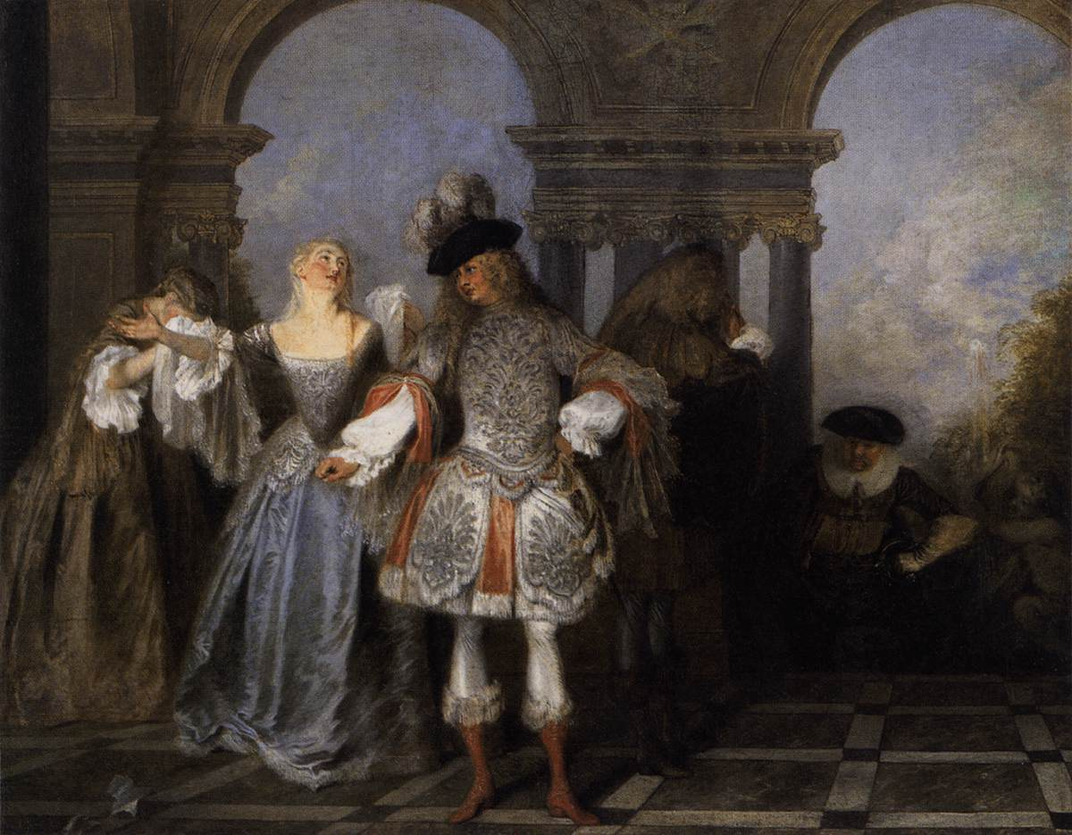
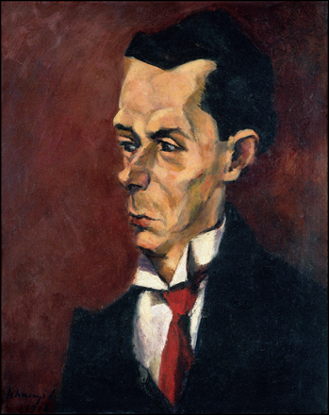
Actor-critic algorithm
So let’s train two neural nets!
$Q\left(s,a\right)$ is the critic, and is trained according to the deep Q-learning algorithm (MMSE).
$π\left(s,a\right)$ is the actor, and is trained to satisfy the critic:
Actors from the Comédie Française, by Antoine Watteau, 1720. Public Domain, https://commons.wikimedia.org/w/index.php?curid=15418670
The Critic, by Lajos Tihanyi. Oil on canvas, 1916.
Public Domain, https://commons.wikimedia.org/w/index.php?curid=17837438
$$π\left(s,a\right)=argmax\sum_{a}{π\left(s,a\right)Q\left(s,a\right)}$$

Slide 26
Outline: Exam 3 will be multiple-choice, on prairielearn, including 24 problems
4 problems: Midterm 1 material
4 problems: Midterm 2 material
4-5 problems: minimax, alpha-beta, expectiminimax
3-4 problems: game theory
5-7 problems: MDP, reinforcement learning
1 problem: AI fairness (definitions of fairness; causal graphs)
1 problem: computer vision (similar triangles; convolution)

Slide 27
Standard Definitions of Fairness in AI
Demographic Parity:
The probability of a positive outcome is the same, regardless of protected attribute.
$$P\left(\hat{Y}=1|A=a\right)=P\left(\hat{Y}=1|A=a′\right) ∀a,a′$$
Predictive Parity:
Precision is the same, regardless of protected attribute.
$$P\left(Y=1|\hat{Y}=1,A=a\right)=P\left(Y=1|\hat{Y}=1,A=a′\right) ∀a,a′$$
Error Rate Balance:
Recall is the same, regardless of protected attribute.
$$P\left(\hat{Y}=1|Y=1,A=a\right)=P\left(\hat{Y}=1|Y=1,A=a′\right) ∀\hat{y},a,a′$$

Slide 28
State-of-the-art Solution: Explain Your Assumptions to Your Users
The Transparency Dogma says that an algorithm’s assumptions should be published in a way that users can understand, so that users can participate in a public debate about the fairness of the assumptions.
A common way to do this is by drawing a Bayesian network.
Example shown: the Bickel-Hammel-O’Connell data. Admission was conditionally independent of Gender, given Department.
Gender
Department
Admission

Slide 29
Outline: Exam 3 will be multiple-choice, on prairielearn, including 24 problems
4 problems: Midterm 1 material
4 problems: Midterm 2 material
4-5 problems: minimax, alpha-beta, expectiminimax
3-4 problems: game theory
5-7 problems: MDP, reinforcement learning
1 problem: AI fairness (definitions of fairness; causal graphs)
1 problem: computer vision (similar triangles; convolution)

Slide 30
The pinhole camera equations
These are similar triangles! So
$$\frac{y′}{f}=\frac{−y}{z}, \frac{x′}{f}=\frac{−x}{z}$$
Solving for (x’,y’), we get the pinhole camera equations:
$$x^{′}=\frac{−fx}{z}, y′=\frac{−fy}{z}$$
y’
z
Image
plane
Pinhole
y
z
Object
f

Slide 31
Vanishing point
y
Suppose we are imaging a couple of parallel lines, for which x and y depend on z:
Line 1: ${ax}_{1}+z=b_{1},{cy}_{1}+z=d_{1}$
Line 2: $ax_{2}+z=b_{2},{cy}_{2}+z=d_{2}$
So
Line 1: $\lim_{z→∞}{x_{1}′}=\frac{f}{a}$, $\lim_{z→∞}y_{1}^{′}=\frac{f}{c}$
Line 2: $\lim_{z→∞}{x_{2}′}=\frac{f}{a}$, $\lim_{z→∞}y_{2}^{′}=\frac{f}{c}$
y’
z
Image
plane
Pinhole
-f
Object

Slide 33
Difference of Gaussians
A “difference-of-Gaussians” filter looks kind of like this:
$$h_{x}′\left(x’,0\right)$$
A “difference-of-Gaussians” filter is created by subtracting two Gaussian-blur filters, like this:
$$h\left[m,n\right]=\frac{1}{2πσ^{2}}e^{−\left({\left(\frac{m}{σ}\right)}^{2}+{\left(\frac{n}{σ}\right)}^{2}\right)}$$
$$h_{x}′\left[m,n\right]=\frac{h\left[m,n+1\right]−h\left[m,n−1\right]}{2}$$
$$h_{y}′\left[m,n\right]=\frac{h\left[m+1,n\right]−h\left[m−1,n\right]}{2}$$
$$x’$$
$$h_{x}′\left(1,y′\right)$$
$$y’$$

Slide 34
Some Sample Problems
Review exam Question 3: Alpha-beta pruning
Review exam Question 10: Game theory
Review exam Question 14: MDP

Slide 35
Question 3: alpha-beta pruning
Write down minimax value of each node.
How will the game proceed?
Cross out branches that would be pruned by alpha-beta.
Suppose you could re-order the branches using some heuristic. What re-ordering would maximize the number pruned?

Slide 36
Question 3: alpha-beta pruning
Write down minimax value of each node.
How will the game proceed?
Cross out branches that would be pruned by alpha-beta.
Suppose you could re-order the branches using some heuristic. What re-ordering would maximize the number pruned?

Slide 37
Question 3: alpha-beta pruning
Write down minimax value of each node.
How will the game proceed?
Cross out branches that would be pruned by alpha-beta.
Suppose you could re-order the branches using some heuristic. What re-ordering would maximize the number pruned?

Slide 38
Question 3: alpha-beta pruning
Write down minimax value of each node.
How will the game proceed?
Cross out branches that would be pruned by alpha-beta.
Suppose you could re-order the branches using some heuristic. What re-ordering would maximize the number pruned?

Slide 39
Question 3: alpha-beta pruning
5
Write down minimax value of each node.
How will the game proceed?
Cross out branches that would be pruned by alpha-beta.
Suppose you could re-order the branches using some heuristic. What re-ordering would maximize the number pruned?
5
$$≤3$$
$$≤2$$
$$≤1$$
X
X
X
X
X
X
X
X
X
5
6
7
11
3
4
5
10
2
5
6
8
1
2
6
15

Slide 40
Question 10: Game theory
Suppose that both Alice and Bob want to go from one place to another. There are two routes, R1 and R2. The utility of a route is inversely proportional to the number of cars on the road. For instance, if both Alice and Bob choose route R1, the utility of R1 for each of them is 1/2.
Write out the payoff matrix.
Is this a zero-sum game?
Find dominant strategies, if any. If there are no dominant strategies, explain why not.
Find pure strategy equilibria, if any. If there is no pure strategy equilibrium, explain why not.
Find the mixed-strategy equilibrium.

Slide 41
Question 10: Game theory
Suppose that both Alice and Bob want to go from one place to another. There are two routes, R1 and R2. The utility of a route is inversely proportional to the number of cars on the road. For instance, if both Alice and Bob choose route R1, the utility of R1 for each of them is 1/2.
Write out the payoff matrix.
 | B:R1 | B:R2
A:R1 | 0.5,0.5 | 1,1
A:R2 | 1,1 | 0.5,0.5

Slide 42
Question 10: Game theory
Suppose that both Alice and Bob want to go from one place to another. There are two routes, R1 and R2. The utility of a route is inversely proportional to the number of cars on the road. For instance, if both Alice and Bob choose route R1, the utility of R1 for each of them is 1/2.
Write out the payoff matrix.
 | B:R1 | B:R2
A:R1 | 0.5,0.5 | 1,1
A:R2 | 1,1 | 0.5,0.5
Is this a zero-sum game?
No. The rewards for Alice and Bob don’t sum to zero within each square.

Slide 43
Question 10: Game theory
 | B:R1 | B:R2
A:R1 | 0.5,0.5 | 1,1
A:R2 | 1,1 | 0.5,0.5
Find dominant strategy, if any. If there is none, explain why not.
There is no dominant strategy. The best action for Alice depends on what Bob does. The best action for Bob depends on what Alice does.
Find pure-strategy equilibria, if any. If there is none, explain why not.
There are two. If Alice takes R1 and Bob takes R2, then Alice has no reason to want to change. Similarly, if Alice takes R2 and Bob takes R1, then Alice has no reason to want to change.

Slide 44
Question 10: Game theory
 | B:R1 | B:R2
A:R1 | 0.5,0.5 | 1,1
A:R2 | 1,1 | 0.5,0.5
Find the mixed-strategy equilibrium.
Suppose Alice chooses R2 with probability p. Then it is rational for Bob to choose randomly only if
$$0.5\left(1−p\right)+p=\left(1−p\right)+0.5p$$
So p=0.5. Since it is now rational for Bob to choose randomly, suppose he chooses R2 with probability q. Then it is rational for Alice to choose randomly only if
$$0.5\left(1−q\right)+q=\left(1−q\right)+0.5q$$
So random choice is a Nash equilibrium only if p=0.5, q=0.5.

Slide 45
Question 14: MDP
Consider a 3x2 gridworld, with rewards for each state as shown at right. Robot starts in the square with R(s)=0; if it reaches the square with R(s)=-1 or R(s)=1, the game ends. Transition probability is
$P\left(s^{′} | s,a\right)=\left\{\begin{matrix}0.8 & s^{′}=a \\ 0.2 & s^{′}=s\end{matrix}\right.$
What is U(s) after second round of value iteration, with $γ=1$?
After how many rounds of value iteration is U(s)>0, for the first time, in the starting state?
-0.04 | -0.04
-1 | 1
0 | -0.04

Slide 46
Question 14: MDP
What is U(s) after second round of value iteration, with $γ=1$?
$$U_{t+1}\left(s\right)=R\left(s\right)+γ\max_{a}{\sum_{s′}{P(s^{′}|s,a)U_{t}(s^{′})}}$$
So if we start with $U_{0}\left(s\right)=0$, then we have $U_{1}\left(s\right)=R(s)$, and $U_{2}\left(s\right)$ as shown at right.
$$R(s)=−0.04$$ | $$R(s)=−0.04$$
$$R(s)=−1$$ | $$R(s)=1$$
$$R(s)=0$$ | $$R(s)=−0.04$$
$$U_{2}\left(s\right)=−0.08$$ | $$U_{2}\left(s\right)=0.752$$
$$U_{2}\left(s\right)=−1$$ | $$U_{2}\left(s\right)=1$$
$$U_{2}\left(s\right)=−0.032$$ | $$U_{2}\left(s\right)=0.752$$

Slide 47
Question 14: MDP
After how many rounds of value iteration is U(s)>0, for the first time, in the starting state?
$$U_{t+1}\left(s\right)=R\left(s\right)+γ\max_{a}{\sum_{s′}{P(s^{′}|s,a)U_{t}(s^{′})}}$$
$U_{1}\left(s\right)=R(s)$. $U_{2}\left(s\right)$ takes into account rewards that can be earned after taking up to one step. In general, $U_{t}\left(s\right)$ takes into account rewards that can be earned after taking up to t-1 steps. The R(s)=1 square is t-1=2 steps away from the start state, so $U_{t}\left(s\right)$ will be able to count that reward on iteration number t=3.
$$R(s)=−0.04$$ | $$R(s)=−0.04$$
$$R(s)=−1$$ | $$R(s)=1$$
$$R(s)=0$$ | $$R(s)=−0.04$$
$$U_{2}\left(s\right)=−0.08$$ | $$U_{2}\left(s\right)=0.752$$
$$U_{2}\left(s\right)=−1$$ | $$U_{2}\left(s\right)=1$$
$$U_{2}\left(s\right)=−0.032$$ | $$U_{2}\left(s\right)=0.752$$

Slide 48
Outline: Exam 3 will be multiple-choice, on prairielearn, including 24 problems
4 problems: Midterm 1 material
4 problems: Midterm 2 material
4-5 problems: minimax, alpha-beta, expectiminimax
3-4 problems: game theory
5-7 problems: MDP, reinforcement learning
1 problem: AI fairness (definitions of fairness; causal graphs)
1 problem: computer vision (similar triangles; convolution)

