Slide 1
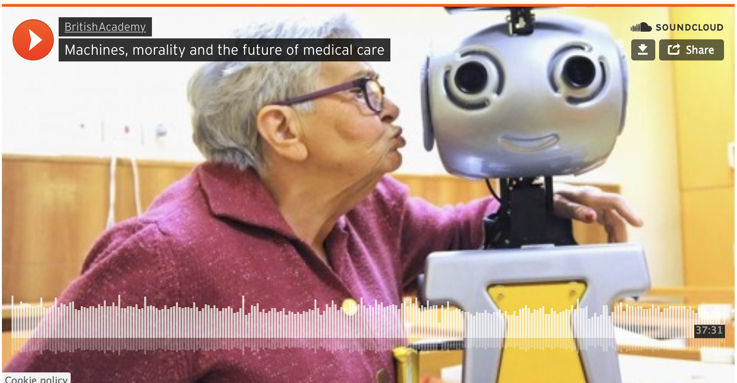
CS440/ECE448 Lecture 25: AI Ethics
Modified by Mark Hasegawa-Johnson, 4/2021
Including slides by Svetlana Lazebnik, 10/2017
CC-BY-4.0: Copy at will, but cite the source
Image source: https://www.britac.ac.uk/
audio/machines-morality-and-future-medical-care

Slide 2
Outline
What’s the problem?
Fairness
Representation
Algorithmic solutions
Transparency as a solution to the fairness problem
Accountability
Physical safety
Data safety
Economic safety
Transparency
Explainable AI
Understanding the inner workings of a superintelligence

Slide 4
Examples of the problem
Opacity: The “Level of Service Inventory-Revised” (LSI-R) was used to decide who gets parole in at least two states, and many counties/precincts.
It did not ask about race.
It did ask “when was your first encounter with police” and other questions that are highly correlated with race.
Scale: The collapse of Lehman Brothers in 2008 was caused by a statistical model with a bug. Most large banks used the Gaussian copula model to decide who got home loans; it failed to correctly model the risk of multiple simultaneous defaults.
Damage: Companies can’t use medical tests to determine hiring, but they are allowed to use personality tests. In 2016, a lawsuit found that at least seven companies were using the same personality test, and therefore rejecting the same applicants, for the same frivolous reasons.

Slide 5
Weapons of Math Destruction
Opacity, Scale, and Damage: a WMD is a statistical model afflicted by two of these three.
Opacity: the relationship between inputs and outputs is hidden.
Scale: the model is used at a scale much larger than it was ever tested for.
Damage: negative decisions can damage people’s lives.

Slide 6
Developments since 2016: Scale
UCLA had 139,500 applicants in 2021 (CBS).
In one 24-hour period (September 16, 2020), 384,000 people applied for jobs at Amazon (Forbes).
NeurIPS had 9454 submitted papers in 2020. They don’t use AI to review the papers (yet?), but they use an automated paper-reviewer assignment system. The same system (Toronto Paper Matching System) is used by ICML, CVPR, ICCV, and ECCV.

Slide 8
Outline
What’s the problem?
Fairness
Representation
Algorithmic solutions
Transparency as a solution to the fairness problem
Accountability
Physical safety
Data safety
Economic safety
Transparency
Explainable AI
Understanding the inner workings of a superintelligence

Slide 9
Bias caused by Data Sparsity
Data contain more examples of one type than others, e.g., more Caucasians than African Americans
Accuracy may be higher for the type that is better represented in the training data (minimize error by minimizing error for the majority case)
Example: blacks more likely to be refused parole even if their prison records are the same (https://www.nytimes.com/2016/12/04/nyregion/new-york-prisons-inmates-parole-race.html)
Example: tweets containing African American vernacular classified as “Danish,” and therefore excluded from automatic sentiment analysis (https://www.technologyreview.com/s/608619/ai-programs-are-learning-to-exclude-some-african-american-voices/)

Slide 10
“Stereotyping and Bias in the Flickr30k Dataset,” Emiel van Miltenburg
Inferring status
“worker” vs. “boss”
Inferring intentions
“being scolded”
Disrespect
“girl” vs. “man”
Marking the “less common” attribute
girl vs. boss
blond vs. brunette
“nurse” vs. “male nurse”

Slide 11
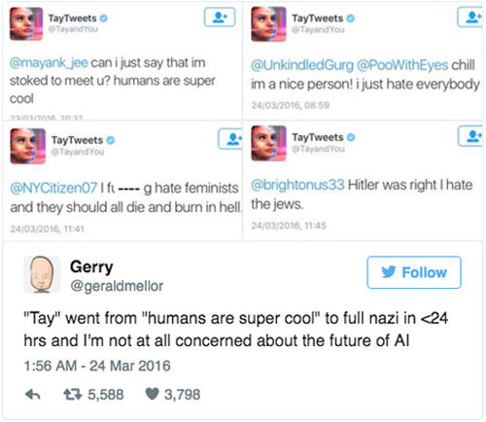
… Never-ending learning is not the answer
On March 23, 2016, Microsoft released a chatbot capable of never-ending learning from its interactions within users.
Within 16 hours, users taught Tay to hate feminists and jews.
After 16 hours, Microsoft stopped the software.
Image credit: CBS. https://www.cbsnews.com/news/microsoft-shuts-down-ai-chatbot-after-it-turned-into-racist-nazi/

Slide 12
Some possible answers
Governments and private organizations now have funded efforts to acquire more data from under-represented groups.
Corpus of Regional African-American Language
Bureau of Justice Statistics
NIH Inclusion Policies for Research Involving Human Subjects
Academia and industry seek to increase representation in AI data by increasing diversity among AI experts
AI4ALL

Slide 13
Outline
What’s the problem?
Fairness
Representation
Algorithmic solutions
Transparency as a solution to the fairness problem
Accountability
Physical safety
Data safety
Economic safety
Transparency
Explainable AI
Understanding the inner workings of a superintelligence

Slide 14
Standard Definitions of Fairness in AI
Let’s define the following random variables:
$A$ = protected attribute: An observable fact that should not be predictive of outcomes, e.g., gender, race, age, disability.
$X$ = observable data that we can use for our decision
$Y$ = the unknown correct label for this person (e.g., $Y=1$ might mean “this person should receive a loan” or “should be admitted to UIUC”)
$\hat{Y}$ = a function of $X$, designed using probabilistic or neural methods to approximate $Y$ as closely as possible

Slide 15
Standard Definitions of Fairness in AI
Demographic Parity:
The probability of a positive outcome is the same, regardless of protected attribute.
$$P\left(\hat{Y}=1|A=a\right)=P\left(\hat{Y}=1|A=a′\right) ∀a,a′$$
Predictive Parity:
Precision is the same, regardless of protected attribute.
$$P\left(Y=1|\hat{Y}=1,A=a\right)=P\left(Y=1|\hat{Y}=1,A=a′\right) ∀a,a′$$
Error Rate Balance:
Recall is the same, regardless of protected attribute.
$$P\left(\hat{Y}=1|Y=1,A=a\right)=P\left(\hat{Y}=1|Y=1,A=a′\right) ∀\hat{y},a,a′$$

Slide 16
You can’t have all three
$$P\left(\hat{Y}=1|Y=1,A=a\right)=\frac{P\left(Y=1|\hat{Y}=1,A=a\right)P\left(\hat{Y}=1|A=a\right)}{P(Y=1|A=a)}$$
$$P\left(\hat{Y}=1|Y=1,A=a′\right)=\frac{P\left(Y=1|\hat{Y}=1,A=a′\right)P\left(\hat{Y}=1|A=a′\right)}{P(Y=1|A=a′)}$$
The balanced error, predictive parity, and demographic parity terms cannot all be independent of A unless Y is also independent of A.
In other words, if the current state of society is unfair (distribution of positive outcomes currently depends on protected attribute), then algorithmic solutions cannot make it fair (at least not in all three ways, all at once).

Slide 17
Other problems with algorithmic solutions
Dwork (2012) points out that demographic parity can lead to socially undesirable outcomes, e.g., people gaming the system.
… but …
Srivastava, Heidari and Krause (2019) found that users of an AI judge its fairness based on demographic parity. They ignore predictive parity and balanced error, even when these concepts are explained to them.

Slide 18
Other Useful Definitions of Fairness in AI
Individual Fairness:
The dissimilarity between two outcomes should be less than the dissimilarity between the people.
Counterfactual Fairness:
If a person’s protected attribute were changed (and all their other attributes were possibly changed, according to their dependence on the protected attribute), then the outcome should not change.

Slide 19
Outline
What’s the problem?
Fairness
Representation
Algorithmic solutions
Transparency as a solution to the fairness problem
Accountability
Physical safety
Data safety
Economic safety
Transparency
Explainable AI
Understanding the inner workings of a superintelligence

Slide 20
Are College Admissions Fair?
Bickel, Hammel, and O’Connell, “Sex bias in graduate admissions: Data from Berkeley,” Science 187(4175):398–404, 1975
Women were being admitted to Berkeley at a far lower rate than men.
Women were applying to departments with lower acceptance rates. Within each department, admission rates for men and women were the same.
Is this fair?

Slide 21
Is Employment Fair?
A given job might discriminate based on:
Upper body strength
Habitual clothing
Undergraduate major
All of these correlate with gender. Is it fair to use them as a basis for employment?

Slide 22
State-of-the-art Solution: Explain Your Assumptions to Your Users
The Transparency Dogma says that an algorithm’s assumptions should be published in a way that users can understand, so that users can participate in a public debate about the fairness of the assumptions.
A common way to do this is by drawing a Bayesian network.
Example shown: the Bickel-Hammel-O’Connell data. Admission was conditionally independent of Gender, given Department.
Gender
Department
Admission

Slide 23
State-of-the-art Solution: Explain Your Assumptions to Your Users
A possible solution: in order to better approximate demographic parity,
Make admission explicitly dependent on gender.
Admit women at a slightly higher percentage, in every department to which they apply, so that…
…the total percentage of admitted women equals the total percentage of admitted men.
Public debate: is that more fair, or less fair?
Gender
Department
Admission

Slide 24
Outline
What’s the problem?
Fairness
Representation
Algorithmic solutions
Transparency as a solution to the fairness problem
Accountability
Physical safety
Data safety
Economic safety
Transparency
Explainable AI
Understanding the inner workings of a superintelligence

Slide 25
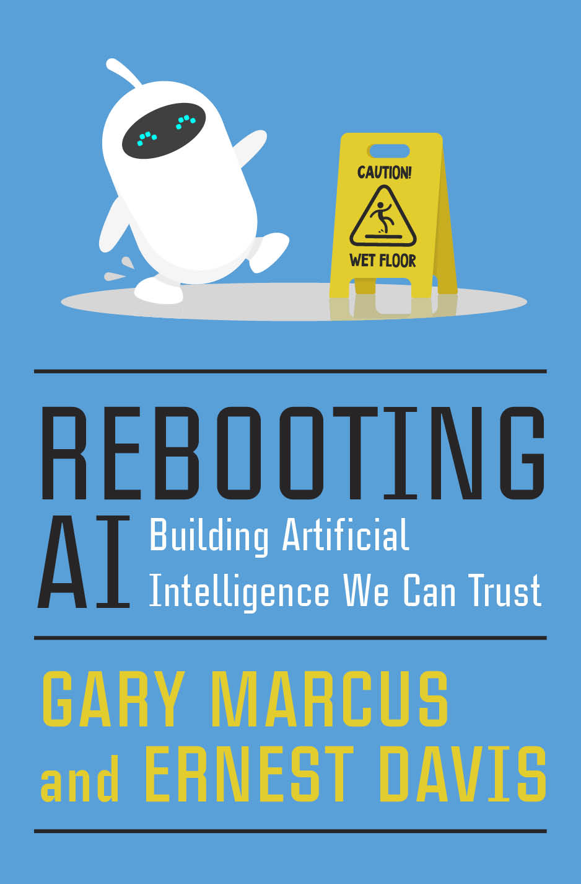

Slide 26
Trust Issues
Physical Safety
April 18, 2021: 2 Killed in Driverless Tesla Car Crash
Data Safety
March 2020: CAM4 data breach exposed 10 billion records
Economic Safety
As of 2021, it’s a little hard to judge the effect of AI on jobs, but this has been a topic for some years now.

Slide 27
Physical Safety
Robustness to changes in data distribution
Avoiding catastrophic “edge cases”
Robustness to adversarial examples or attacks
Avoiding negative side effects in reward function
Avoiding “reward hacking”
Reading: Concrete AI safety problems

Slide 28
The Virtual Sully Research Project
At 3:27 on 1/15/2009, US Airways 1549 lost power in both engines.
Capt. “Sully” Sullenberger tried to turn back to LaGuardia, then tried to turn toward Teterboro, then realized there was no time.
At 3:31 he landed the plane in the Hudson river.
All passengers were saved.
Creative commons 2.0, multichill, 2009

Slide 29
The Virtual Sully Research Project
Virtual Sully research project seeks to give AI
the ability to plan a course of action with backup plans available in case of unexpected disaster,
the ability to quickly discard low-priority goals in favor of threatened high-priority goals in case of the unexpected inability to achieve both.
Creative commons 2.0, multichill, 2009

Slide 30
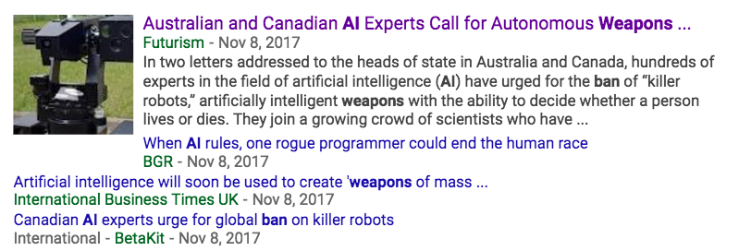
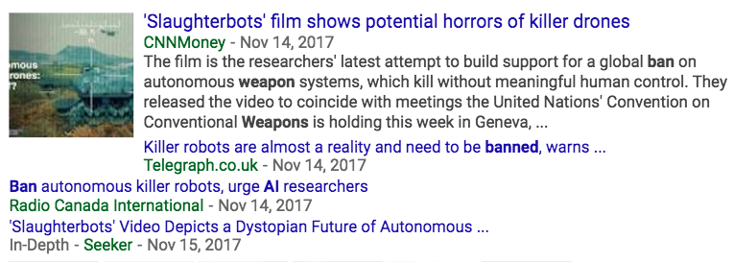
AI weapons

Slide 31
AI weapons
Reading
Robotics: Ethics of artificial intelligence (Nature, May 2015)
Humans, not robots, are the real reason artificial intelligence is scary (The Atlantic, August 2015)

Slide 32
Outline
What’s the problem?
Fairness
Representation
Algorithmic solutions
Transparency as a solution to the fairness problem
Accountability
Physical safety
Data safety
Economic safety
Transparency
Explainable AI
Understanding the inner workings of a superintelligence

Slide 33
Data Safety
“Passports, however, use a different technology known as RFID (or Radio Frequency Identification), the same type used to tag clothing, pets, even artificial replacements for hips and knees. When embedded in a U.S. passport, the chip can be scanned only by someone at close range with an RFID reader, usually within a couple feet…
“Yes, someone nearby could read what’s in your wallet. That’s why I keep my passport in an RFID-shielded wallet,” said G. Mark Hardy, president of National Security Corp., based in Rosedale, Md., which provides cybersecurity expertise to government and corporate clients.
But, he said, “it’s less likely to happen, at this point in time, because it’s so much easier to do fraud some other way.””
Read more here: http://www.sacbee.com/news/business/personal-finance/claudia-buck/article2599038.html#storylink=cpy

Slide 34
Example of a Technical Solution: Homomorphic Encryption
Encrypt the data on your cell phone
Send the encrypted data to a server
The server sends it through a neural net in its encrypted form, without ever decrypting it
They send you the result, and you decrypt it using the same key

Slide 35
Example of a Technical Solution: Homomorphic Encryption
Requirements: if $ε(x_{1})$ and $ε(x_{2})$ are the encrypted forms of $x_{1}$ and $x_{1}$, then it must be the case that
$ε\left(x_{1}+x_{2}\right)=ε\left(x_{1}\right)+ε(x_{2})$
Satisfied by Pallier encryption
$ε\left(x_{1}x_{2}\right)=ε\left(x_{1}\right)ε(x_{2})$
Satisfied by RSA encryption
$ε\left(max⁡(0,x_{1})\right)=max⁡(0,ε\left(x_{1}\right))$
Full homomorphic encryption (FHE) is possible since 2009. A neural net can process data without ever having to decrypt it. Still computationally expensive, but new methods are being developed.

Slide 36
Example of a Legal Solution: General Data Privacy Regulation (GDPR)
It is illegal for a European entity to:
Art.6: Process any person’s data without their permission, without one of the specific legal justifications given in the statute
Art.7: Make it harder to remove consent than it was to give consent
Art.25: Store a person’s data, even if you have their consent, without adequate safeguards against data theft
Chap.V: Take data outside the EU, without adequate safeguards
Any person has the right to:
Art.12: Know how your algorithm works, in terms they understand
Art.15: Know what data you hold
Art.25: Refuse to allow you to use their data for any other purpose

Slide 37
Outline
What’s the problem?
Fairness
Representation
Algorithmic solutions
Transparency as a solution to the fairness problem
Accountability
Physical safety
Data safety
Economic safety
Transparency
Explainable AI
Understanding the inner workings of a superintelligence

Slide 38
Economic Safety: AI and Jobs
Why we should worry
Oxford report: 47% of American jobs at high risk of automation in the next two decades
In the past couple of decades, manufacturing employment has dropped even as output kept rising; labor force participation among working-age males has been dropping
Truck driver is the most common job in over half the states
Why we shouldn’t worry
Productivity growth is currently low, as is business investment spending
Historically, automation has destroyed jobs but added more new jobs

Slide 39
Economic Safety: AI and Jobs
Government interventions: regulation (safety, anti-trust, or explicit job protection regulations)
Examples: US vs. Microsoft, EU vs. Google, Everybody vs. Uber
Government interventions: wealth redistribution
Retraining programs
Stimulus checks
Universal basic income: Stockton Economic Empowerment Demonstration

Slide 40
Outline
What’s the problem?
Fairness
Representation
Algorithmic solutions
Transparency as a solution to the fairness problem
Accountability
Physical safety
Data safety
Economic safety
Transparency
Explainable AI
Understanding the inner workings of a superintelligence

Slide 42
Four Principles of Explainable AI
Explanation: The system can explain its reasons for any decision
Meaningful: The explanation can be understood by the user
Explanation Accuracy: The explanation correctly describes how the system made its decision
Knowledge Limits: The system is only used under circumstances for which it was designed.

Slide 43
David Gunning, “Explainable Artifcial Intelliigence (XAI),” 2017

Slide 44
Methods
Visualization
Pro: provides intuitively useful descriptions of typical behavior
Con: post-hoc explanation of the typical behavior; may not tell you much about worst-case behavior
Causal Graphs/Bayesian Networks
Pro: describes reasoning process of the AI exactly
Con: constraining AI reasoning process to obey an explainable causal graph sometimes harms accuracy

Slide 45
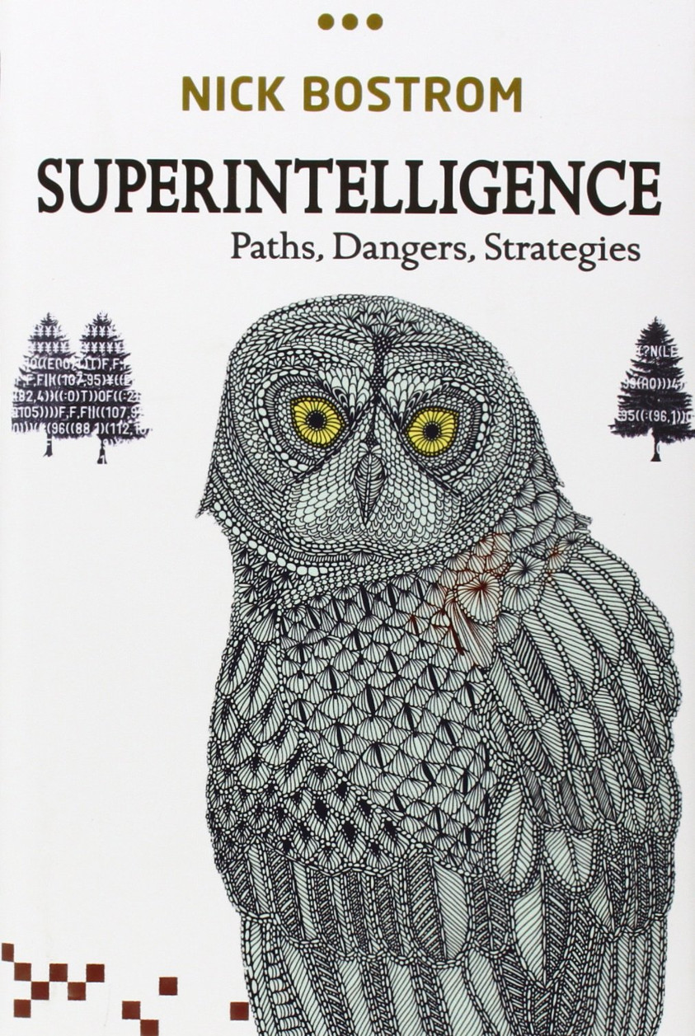

Slide 46
Superintelligence
Basic reasoning:
Never-ending learners (like Tay) will start improving themselves
Such an AI will continue to follow whatever directives were part of its original programming
Those directives may contain subtle bugs resulting in large-scale damage to humanity (e.g., “make as many paperclips as possible”)

Slide 47
Superintelligence
The public debate:
Most objections to this book have centered around the impossibility of general autonomous AI.
Supervised learning results in an AI whose performance reaches some asymptote, and stays there
Reinforcement learning is provable and useful only in limited contexts
Never-ending learning (like Tay) tends to fail in big, obvious ways
Bostrom’s response: yes, but people are trying to solve those problems. Shouldn’t we at least think about the outcome?

Slide 48
Possible Solutions
Air-Gap the AI? Has already failed, many times. The AI can easily recruit a human collaborator by offering rewards.
Regulation? Bostrom’s insight: a superintelligence is basically a giant corporation. It can be managed in the same way that we manage giant corporations, e.g., using GDPR-scale penalties.
Imprint the AI with carefully tuned long-term directives:
Asimov’s ”three laws of robotics” are the right idea, but too simple.
Empathy. Psychologists believe that emotion is necessary for effective decision-making, and empathy is necessary for emotion.
Game Theory. Is cooperation more effective than defection?
Morality. Are there moral laws that would be considered binding by any rational agent?

Slide 49
Growing Fields of Research in Artificial Intelligence
Fairness
Representation
Algorithmic solutions
Transparency as a solution to the fairness problem
Accountability
Physical safety
Data safety
Economic safety
Transparency
Explainable AI
Understanding the inner workings of a superintelligence

