Slide 1
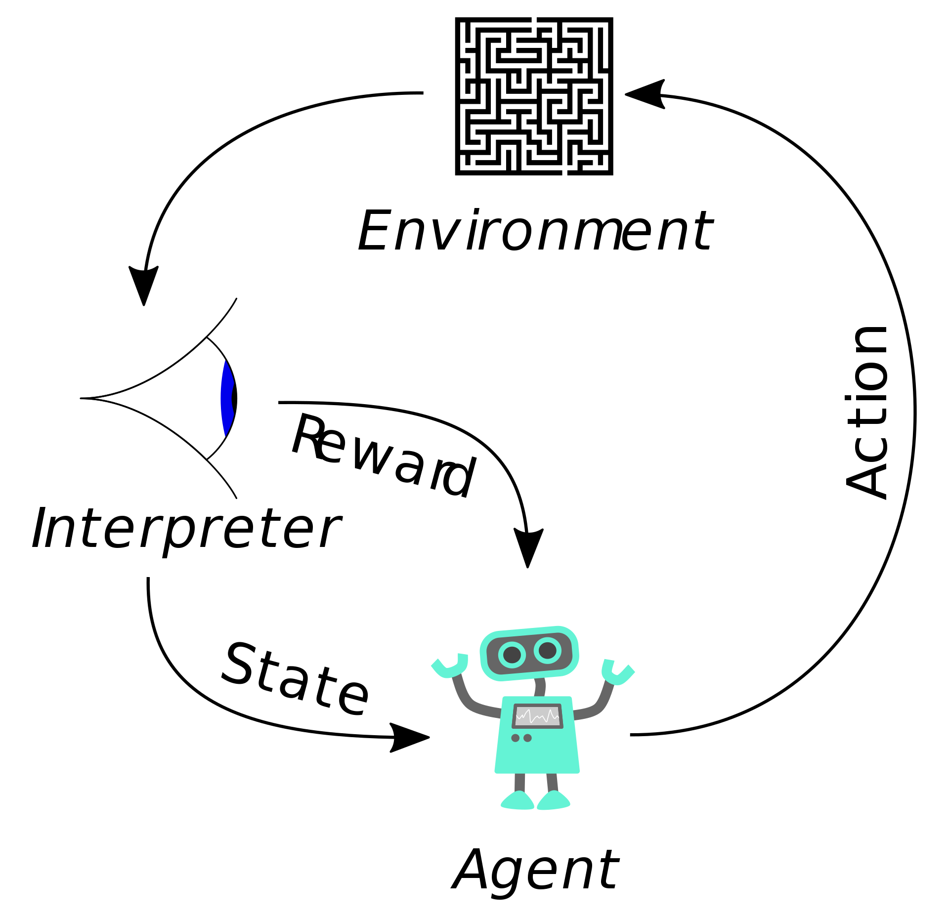
Model-Free Reinforcement Learning CS440/ECE448 Lecture 24
Mark Hasegawa-Johnson, 4/2021,
including slides by Svetlana Lazebnik, 11/2017
CC-BY 4.0: you may remix or redistribute if you cite the source
Image: Megajuice, CC0, https://commons.wikimedia.org/
w/index.php?curid=57895741

Slide 2
What we’ve learned so far
Markov Decision Process (MDP): Given P(s’|s,a) and R(s), you can solve for $π^{∗}(s)$, the optimal policy, by finding U(s), the value of each state, using either value iteration or policy iteration.
Model-Based Reinforcement Learning: If P(s’|s,a) and R(s) are unknown, you can find for $π(s)$ by using the observation-model-policy loop:
Observation: Create a training dataset by trying n consecutive actions, using an exploration-exploitation tradeoff like epsilon-first or epsilon-greedy
Model: Estimate P(s’|s,a) and R(s) using maximum likelihood estimation or Laplace smoothing
Policy: Find the optimum policy using value iteration or policy iteration.

Slide 3
Today: Model-Free Learning
Why can’t we just learn a model (neural net, or even a table lookup) that does this:
Model
$$s$$
$${a=π}^{∗}(s)$$

Slide 4
Outline
Policy learning
Imitation learning
Q-learning
Table-based: TD, SARSA
Deep Q-learning
Actor-Critic RL

Slide 5
Policy Learning
Why can’t we just learn a model (neural net, or even a table lookup) that does this:
Model
$$s$$
$$a=π(s)$$

Slide 6
Probabilistic Policy
If we have $|A|$ possible, actions, $1≤a≤|A|$, we could train the network to learn a hidden layer $h(s)$ so that:
$$π_{a}\left(s\right)=\frac{exp⁡\left(w_{a}^{T}h(s)\right)}{\sum_{k=1}^{|A|}{exp⁡\left(w_{k}^{T}h(s)\right)}}=P\left(A=a|S=s\right)$$
Meaning “the probability that the best action is a.”

Slide 7
How do we train it?
Training data only give us $\left(s_{i},a_{i},s_{i}^{′},R_{i}\right)$.
BAD IDEA: train the network to choose $A=a_{i}$ that maximizes the immediate reward, $R_{i}$, and just ignore future rewards.
GOOD IDEA: Train the network to maximize $U\left(s_{i}^{′}\right)=$ sum of all future rewards.
PROBLEM: we don’t know $U\left(s_{i}^{′}\right)$.
$$\left(s_{1},a_{1},s_{1}^{′},R_{1}\right)$$
$$\left(s_{2},a_{2},s_{2}^{′},R_{2}\right)$$
$$\left(s_{3},a_{3},s_{3}^{′},R_{3}\right)$$
$$\left(s_{4},a_{4},s_{4}^{′},R_{4}\right)$$
$$\left(s_{5},a_{5},s_{5}^{′},R_{5}\right)$$
$$⋮$$

Slide 8
How to make Policy Learning trainable
Actor-Critic RL. We’ll come back to this.
Imitation learning.

Slide 9
Imitation learning
In some applications, you cannot bootstrap yourself from random policies
High-dimensional state and action spaces where most random trajectories fail miserably
Expensive to evaluate policies in the physical world, especially in cases of failure
Solution: learn to imitate sample trajectories or demonstrations
This is also helpful when there is no natural reward formulation

Slide 10
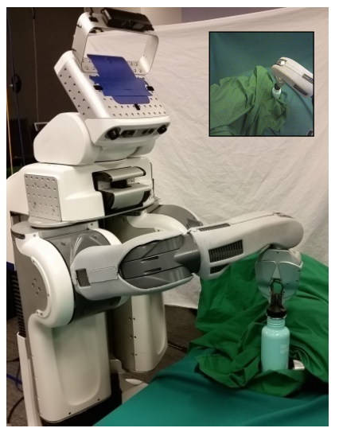
Learning visuomotor policies
Underlying state x: true object position, robot configuration
Observations o: image pixels
Two-part approach:
Learn guiding policy π(a|x) using trajectory-centric RL and control techniques
Learn visuomotor policy π(a|o) by imitating π(a|x)
S. Levine et al. End-to-end training of deep visuomotor policies. JMLR 2016

Slide 11
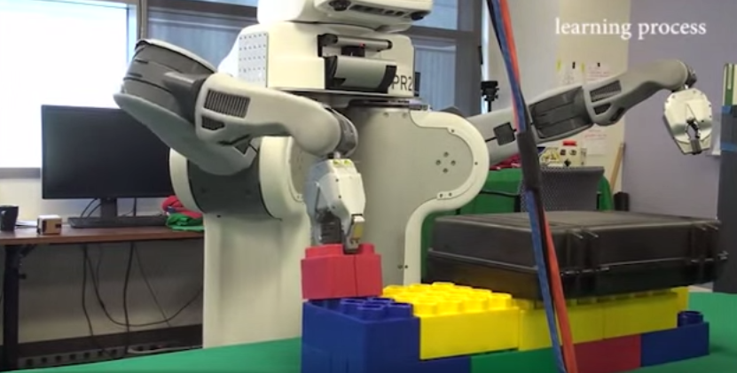
Learning visuomotor policies
Overview video, training video
S. Levine et al. End-to-end training of deep visuomotor policies. JMLR 2016

Slide 12
Outline
Policy learning
Imitation learning
Q-learning
Table-based: TD, SARSA
Deep Q-learning
Actor-Critic RL

Slide 13
Bellman’s Equation
$$U\left(s\right)=R\left(s\right)+γ\max_{a∈A(s)}{\sum_{s′}{P\left(s^{′} | s,a\right)U(s^{′})}}$$
When we talked about solving Bellman’s equation before, we said that the optimum policy is given by the “max” operation: the action that gives you that maximum is the action you should take.

Slide 14
The Quality of an Action
The goal of Q-learning is to learn a function, Q(s,a), such that the best action to take is the action that maximizes Q:
$$π^{∗}(s)\text{=}\underset{a∈A(s)}{argmax}{Q(s,a)}$$
How about if we define Q(s,a) to be “The expected future reward I will achieve if I take action a in state s?”

Slide 15
The Quality of an Action
Suppose we know everything: we know P(s’|s,a), R(s), $γ,$ and U(s). Then we collect our total expected future reward by doing these things:
Collect our current reward, R(s)
Discount all future rewards by $γ$
Make a transition to a future state, s’, according to P(s’|s,a)
Then collect all future rewards, U(s’)
$$Q\left(s,a\right)=R\left(s\right)+γ\sum_{s′}{P\left(s^{′} | s,a\right)U(s^{′})}$$

Slide 16
The Quality of an Action
Whoa! So Bellman’s equation is actually just a simplified version of the Q-function:
$$U\left(s\right)=R\left(s\right)+γ\max_{a∈A(s)}{\sum_{s′}{P\left(s^{′} | s,a\right)U(s^{′})}}$$
$$U(s)=\max_{a∈A(s)}{Q(s,a)}$$

Slide 17
The Q-function: recursive definition
Or, to look at it another way, we could plug $U(s′)=\max_{a′∈A(s′)}{Q(s′,a′)}$ into the definition of the Q-function in order to get
$$Q\left(s,a\right)=R\left(s\right)+γ\sum_{s′}{P\left(s^{′} | s,a\right)\max_{a′∈A(s′)}{Q(s′,a′)}}$$
Remember, it has these steps::
Collect our current reward, R(s)
Discount all future rewards by $γ$
Make a transition to a future state, s’, according to P(s’|s,a)
Choose the optimum action, a’, from state s’, and collect all future rewards.

Slide 18
Example: Gridworld
$$R(s)=\left\{\begin{matrix}+1 & s=(4,3) \\ −1 & s=(4,2) \\ −0.04 & otherwise\end{matrix}\right.$$
$$P\left(s^{′} | s,a\right)=\left\{\begin{matrix}0.8 & intended \\ 0.1 & fall left \\ 0.1 & fall right\end{matrix}\right.$$
$$γ=1$$

Slide 19
Gridworld: Utility of each state
$$U\left(s\right)=R\left(s\right)+γ\max_{a∈A(s)}{\sum_{s′}{P\left(s^{′} | s,a\right)U(s^{′})}}$$
0.81 | 0.87 | 0.92
0.76 |  | 0.66
0.71 | 0.66 | 0.61 | 0.39
(Calculated using value iteration.)

Slide 20
Gridworld: The Q-function
0.78
0.77 | 0.81
0.74
0.83
0.78 | 0.87
0.83
0.88
0.81 | 0.92
0.68
Calculated using a two-step value iteration:
$$Q\left(s,a\right)=R\left(s\right)+γ\sum_{s′}{P\left(s^{′} | s,a\right)U(s^{′})}$$
$$U(s)=\max_{a∈A(s)}{Q(s,a)}$$
0.76
0.72 | 0.72
0.68
0.66
0.64 | -.69
0.42
0.71
0.67 | 0.63
0.66
0.62
0.66 | 0.58
0.62
0.59
0.61 | 0.40
0.55
-0.74
0.39 | 0.21
0.37

Slide 21
Gridworld: Relationship between Q and U
$$U(s)=\max_{a∈A(s)}{Q(s,a)}$$
0.78
0.77 | 0.81
0.74
0.83
0.78 | 0.87
0.83
0.88
0.81 | 0.92
0.68
0.81 | 0.87 | 0.92
0.76 |  | 0.66
0.71 | 0.66 | 0.61 | 0.39
0.76
0.72 | 0.72
0.68
0.66
0.64 | -.69
0.42
0.71
0.67 | 0.63
0.66
0.62
0.66 | 0.58
0.62
0.59
0.61 | 0.40
0.55
-0.74
0.39 | 0.21
0.37

Slide 22
Reinforcement learning: Key concepts
Key concept: What if you don’t know P(s’|s,a) and R(s)? Can you still estimate Q(s,a)?
Method #1: Model-based learning. Estimate P(s’|s,a) and R(s), then use them to compute Q(s,a).
Method #2 (today): Model-free learning. Try some stuff, observe the results, use the results to estimate Q(s,a).

Slide 23
Q-learning
Q(s,a) is the total of all current & future rewards that you expect to get if you perform action a in state s.
…so how about this strategy…
Play the game an infinite number of times.
Each time you try action a in state s, measure the reward that you receive from that point onward for the rest of the game.
Average.

Slide 24
Q-learning: a slightly more practical version
Q(s,a) is the total of all current & future rewards that you expect to get if you perform action a in state s.
…so how about this strategy…
Play the game an infinite finite number of times. Keep track of $Q_{t}(s,a)$, the estimate of Q after the t^{th} iteration.
Each time you try action a in state s, measure the reward that you receive from that point onward for the rest of the game. in the current state, plus $γ$ times $Q_{t}(s′,a′)$.
Average $Q_{t}$ with #2 in order to get $Q_{t+1}$.

Slide 25
TD learning
$$Q\left(s,a\right)=R\left(s\right)+γ\sum_{s′}{P\left(s^{′} | s,a\right)\max_{a′∈A(s′)}{Q(s′,a′)}}$$
Let’s solve these problems as follows:
Instead of $R(s)$, use $R_{t}(s)$, the reward we got this time.
Instead of summing over $P(s’|s,a)$, just set s’ equal to whatever state followed s this time.
Instead of the true value of $Q(s,a)$, use our current estimate, $Q_{t}(s,a)$.

Slide 26
TD learning
$$Q_{local}(s_{t},a_{t})=R_{t}\left(s_{t}\right)+γ\max_{a′∈A(s_{t}′)}{Q_{t}(s_{t}′,a′)}$$
Let’s solve these problems as follows:
Instead of $R(s)$, use $R_{t}(s)$, the reward we got this time.
Instead of summing over $P(s’|s,a)$, just set s’ equal to whatever state followed s this time.
Instead of the true value of $Q(s,a)$, use our current estimate, $Q_{t}(s,a)$.

Slide 27
TD learning
$$Q_{local}(s_{t},a_{t})=R_{t}\left(s_{t}\right)+γ\max_{a′∈A(s_{t}′)}{Q_{t}(s_{t}′,a′)}$$
Problem: NOISY!
$s_{t}′$ is random,
$Q_{t}(s_{t}′,a′)$ is not the real value of Q, only our current estimate,
$Q_{local}\left(s,a\right)$ might be very far away from $Q\left(s,a\right)$. It might even be worse than $Q_{t}(s,a)$.

Slide 28
TD learning
Solution: interpolate, using a small interpolation constant $α$ that’s $0<α<1$:
$$Q_{t+1}\left(s,a\right)=\left(1−α\right)Q_{t}\left(s,a\right)+αQ_{local}\left(s,a\right)$$
$$=Q_{t}\left(s,a\right)+α\left(Q_{local}\left(s,a\right)−Q_{t}\left(s,a\right)\right)$$

Slide 29
TD learning
$Q_{local}\left(s,a\right)−Q_{t}\left(s,a\right)$ is called the “time difference” or TD.
If the TD is positive, it means action $a$ was better than we expected, so $Q_{t+1}\left(s,a\right)=Q_{t}\left(s,a\right)+αTD$ is an increase.
If the TD is negative, it means action $a$ was worse than we expected, so $Q_{t+1}\left(s,a\right)=Q_{t}\left(s,a\right)+αTD$ is a decrease.

Slide 30
Exploration versus exploitation
TD-learning has one gap, still: when you reach state s, how do you choose an action?
You might think that you just choose $a^{∗}=\max_{a∈A(s)}{Q_{t} (s,a)}$, but that has the following problem: what if $Q_{t} (s,a)$ is wrong?
The solution is to use an exploration strategy. For example,
Epsilon-first strategy: if there’s an action we’ve chosen less than $εN$ times, then choose that. Otherwise, choose $a^{∗}$.
Epsilon-greedy strategy: with probability $1−ε$, choose $a^{∗}$. With probability $ε$, choose an action uniformly at random.

Slide 31
TD learning
Putting it all together, here’s the whole TD learning algorithm:
When you reach state s, use your current exploration versus exploitation policy, $π_{t}(s)$, to choose some action ${a=π}_{t}(s)$.
Observe the state s’ that you end up in, and the reward you receive, and then calculate Qlocal:
$$Q_{local}\left(s,a\right)=R_{t}(s)+γ\max_{a′∈A(s′)}{Q_{t}(s′,a′)}$$
Calculate the time difference, and update:
$$Q_{t+1}\left(s,a\right)=Q_{t}\left(s,a\right)+α\left(Q_{local}\left(s,a\right)−Q_{t}\left(s,a\right)\right)$$
Repeat.

Slide 32
TD learning
The action you actually perform
Putting it all together, here’s the whole TD learning algorithm:
When you reach state s, use your current exploration versus exploitation policy, $π_{t}(s)$, to choose some action ${a=π}_{t}(s)$.
Observe the state s’ that you end up in, and the reward you receive, and then calculate Qlocal:
$$Q_{local}\left(s,a\right)=R_{t}(s)+γ\max_{a′∈A(s′)}{Q_{t}(s′,a′)}$$
Calculate the time difference, and update:
$$Q_{t+1}\left(s,a\right)=Q_{t}\left(s,a\right)+α\left(Q_{local}\left(s,a\right)−Q_{t}\left(s,a\right)\right)$$
Repeat.
The action TD-learning assumes you will perform

Slide 33
TD learning is an off-policy learning algorithm
TD learning is called an off-policy learning algorithm because it assumes an action
$$\underset{a′∈A(s′)}{argmax}{Q_{t}(s′,a′)}$$
…which is different from the action dictated by your current exploration versus exploitation policy
$${a^{′}=π}_{t}(s′)$$
Sometimes off-policy learning converges slowly, for example, because the TD-learning update is not taking advantage of your exploration.

Slide 34
On-policy learning: SARSA
We can create an “on-policy learning” algorithm by deciding in advance which action ($a’$) we’ll perform in state $s’$, and then using that action in the update equation:
Use your current exploration versus exploitation policy, $π_{t}(s)$, to choose some action ${a=π}_{t}(s)$.
Observe the state $s’$ that you end up in, and then use your current policy to choose ${a^{′}=π}_{t}(s′)$.
Calculate Qlocal and the update equation as:
$$Q_{local}\left(s,a\right)=R_{t}(s)+γQ_{t}(s′,a′)$$
$$Q_{t+1}\left(s,a\right)=Q_{t}\left(s,a\right)+α\left(Q_{local}\left(s,a\right)−Q_{t}\left(s,a\right)\right)$$
Go to step 2.

Slide 35
On-policy learning: SARSA
This algorithm is called SARSA (state-action-reward-state-action) because:
In order to compute the TD-learning version of $Q_{local}$, you only need to know the tuple $(s,a,R,s’)$:
$$Q_{local}\left(s,a\right)=R_{t}(s)+γ\max_{a′∈A(s′)}{Q_{t}(s′,a′)}$$
In order to compute the SARSA version of $Q_{local}$, you need to have already picked out $(s,a,R,s’,a′)$:
$$Q_{local}\left(s,a\right)=R_{t}(s)+γQ_{t}(s′,a′)$$

Slide 36
Outline
Policy learning
Imitation learning
Q-learning
Table-based: TD, SARSA
Deep Q-learning
Actor-Critic RL

Slide 37
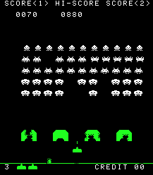
Deep Q learning
Instead of discrete $s$, suppose $\vec{s}$ is a vector of real numbers, e.g., the image from the robot’s eye camera:
$$\vec{s}=\left[s_{1},…,s_{D}\right]=$$
Instead of discrete $a$, suppose $\vec{a}$ is a vector, e.g., cannon angle and velocity,
$$\vec{a}=\left[a_{1},…,a_{C}\right]$$
Deep Q-learning uses a neural network to compute an estimate $Q^{∗} (\vec{s},\vec{a})$ which is as close as possible to $Q(\vec{s},\vec{a})$.
$$Q^{∗} (\vec{s},\vec{a})$$
$$1$$
$$1$$
Copyright Taito.
$$1$$
$$1$$
$$s_{1}$$
$$…$$
$$s_{D}$$
$$a_{1}$$
$$…$$
$$a_{C}$$
$$1$$
$$…$$

Slide 38
MMSE Deep Q learning
Suppose we train the neural network weights in order to minimize the mean-squared error (MMSE):
$$ℒ=\frac{1}{2}E\left[{\left(Q^{∗} \left(\vec{s},\vec{a}\right)−Q(\vec{s},\vec{a}) \right)}^{2}\right]$$
(where I’m using $E\left[∙\right]$ as a lazy way to write “average over all training runs of the game).
Then, for each weight $w$, we update as
$$w←w−η\frac{dℒ}{dw}$$
$$Q^{∗} \left(\vec{s},\vec{a}\right)$$
$$1$$
$$1$$
$$1$$
$$1$$
$$s_{1}$$
$$…$$
$$s_{D}$$
$$a_{1}$$
$$…$$
$$a_{C}$$
$$1$$
$$…$$

Slide 39
What makes deep Q learning harder than normal neural network training
We don’t know the true value of $Q(\vec{s},\vec{a})$for any of the training runs!
$Q\left(\vec{s},\vec{a}\right)$ is defined to be the expected value of performing action $\vec{a}$. We never know its true expected value: all we know is whether we won or lost that particular game.
So we can’t compute $ℒ$, and we can’t compute $\frac{dℒ}{dw}$, and we can’t update $w$!
$$Q^{∗} \left(\vec{s},\vec{a}\right)$$
$$1$$
$$1$$
$$1$$
$$1$$
$$s_{1}$$
$$…$$
$$s_{D}$$
$$a_{1}$$
$$…$$
$$a_{C}$$
$$1$$
$$…$$

Slide 40
The solution: $Q_{local}$
Remember that Q learning was defined as
$$Q_{t+1}\left(s,a\right)=Q_{t}\left(s,a\right)+α\left(Q_{local}\left(s,a\right)−Q_{t}\left(s,a\right)\right)$$
where $Q_{local}\left(s,a\right)$ is defined, e.g., in TD as
$$Q_{local}\left(s,a\right)=R_{t}(s)+γ\max_{a′}{Q_{t}(s′,a′)}$$
…for $s′$ equal to the next state we reach after action $a$ on this particular game.
$$…$$

Slide 41
The solution: $Q_{local}$
Let’s define deep Q learning using the same $Q_{local}$:
$$ℒ=\frac{1}{2}E\left[{\left(Q^{∗} \left(\vec{s},\vec{a}\right)−Q_{local}(\vec{s},\vec{a}) \right)}^{2}\right]$$
where $Q_{local}(\vec{s},\vec{a})$ is:
$$Q_{local}(\vec{s},\vec{a})=R_{t}(\vec{s})+γ\max_{\vec{a}′}{Q^{∗} \left(\vec{s}′,\vec{a}′\right)}$$
Now we have an L that depends only on things we know ($Q^{∗} \left(\vec{s},\vec{a}\right)$, $R_{t}(\vec{s})$, and $Q^{∗} \left(\vec{s}′,\vec{a}′\right)$), so it can be calculated, differentiated, and used to update the neural network.
$$…$$

Slide 42
Dealing with training instability
Challenges
Target values are not fixed
Successive experiences are correlated and dependent on the policy
Policy may change rapidly with slight changes to parameters, leading to drastic change in data distribution
Solutions
Freeze target Q network
Use experience replay

Slide 43
Experience replay
At each time step:
Take action ${\vec{a}}_{t}$ according to epsilon-greedy policy
Store experience $({\vec{s}}_{t},{\vec{a}}_{t},r_{t+1},{\vec{s}}_{t+1})$ in replay memory buffer
$$({\vec{s}}_{1},{\vec{a}}_{1},r_{2},{\vec{s}}_{2})$$
$$({\vec{s}}_{2},{\vec{a}}_{2},r_{3},{\vec{s}}_{3})$$
$$…$$
$$({\vec{s}}_{t},{\vec{a}}_{t},r_{t+1},{\vec{s}}_{t+1})$$
Learning:
Randomly sample a minibatch, $𝒟$, from the replay buffer.
$𝒟=$randomly sampled set of tuples

Slide 44
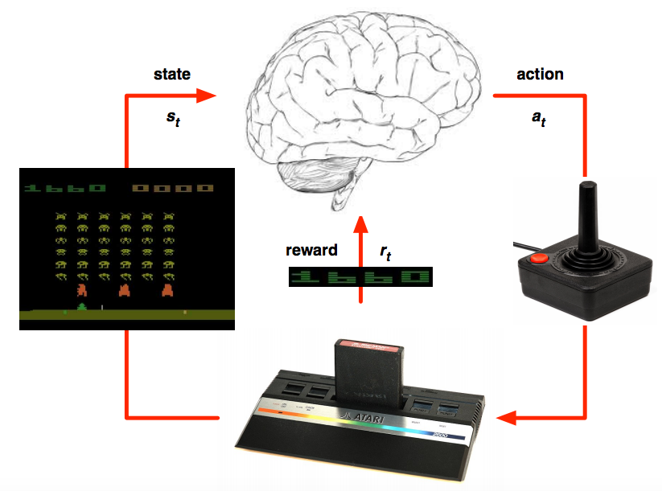
Deep Q learning in Atari
Mnih et al. Human-level control through deep reinforcement learning, Nature 2015

Slide 45
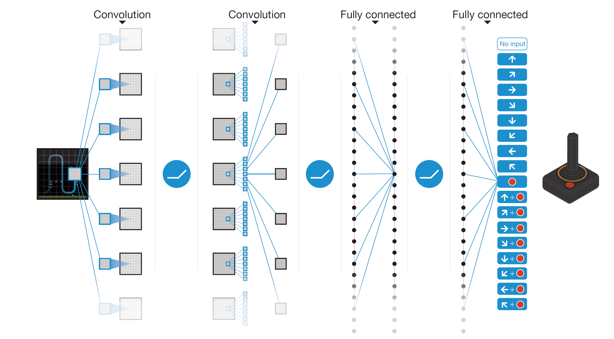
Deep Q learning in Atari
End-to-end learning of Q(s,a) from pixels s
Output is Q(s,a) for 18 joystick/button configurations
Reward is change in score for that step
Q(s,a₁)
Q(s,a₂)
Q(s,a₃)
.
.
.
.
.
.
.
.
.
.
.
Q(s,a₁₈)
Mnih et al. Human-level control through deep reinforcement learning, Nature 2015

Slide 46
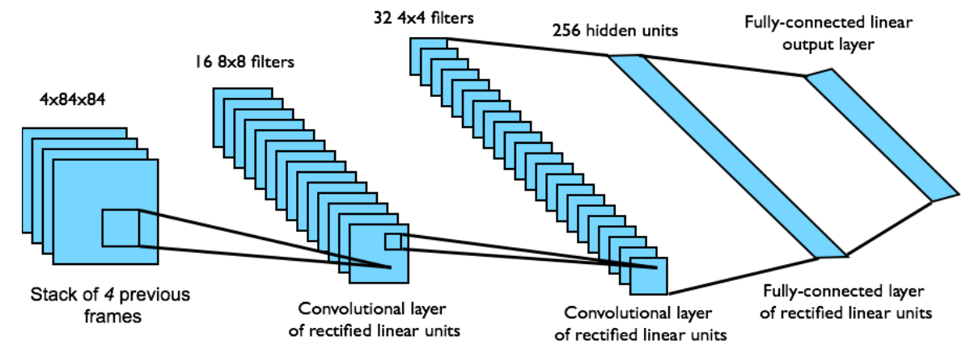
Deep Q learning in Atari
Input state s is stack of raw pixels from last 4 frames
Network architecture and hyperparameters fixed for all games
Mnih et al. Human-level control through deep reinforcement learning, Nature 2015

Slide 47
Outline
Policy learning
Imitation learning
Q-learning
Table-based: TD, SARSA
Deep Q-learning
Actor-Critic RL

Slide 48
Policy learning methods
Suppose that $s$ is continuous, but $a$ is discrete (e.g., a one-hot vector).
Then learning the policy directly can be much faster than learning Q values.
We can train a neural network for a stochastic policy---a policy that chooses an action at random, using the probability distribution:
$$π\left(s,a\right)=\frac{e^{f(s,a)}}{\sum_{a′}{e^{f(s,a′)}}}$$

Slide 49
How do we train $π\left(s,a\right)$?
Expected total reward = Bellman’s utility, $U\left(s\right)$.
If we always choose the best action, then
$$U\left(s\right)=\max_{a}{Q\left(s,a\right)}$$
With a stochastic policy, the utility of state $s$ is suboptimal, given by:
$$U^{π}\left(s\right)=\sum_{a}{π\left(s,a\right)Q\left(s,a\right)}$$
If we knew $Q\left(s,a\right)$, then we’d learn $π\left(s,a\right)$ to maximize $U^{π}\left(s\right)$…

Slide 50
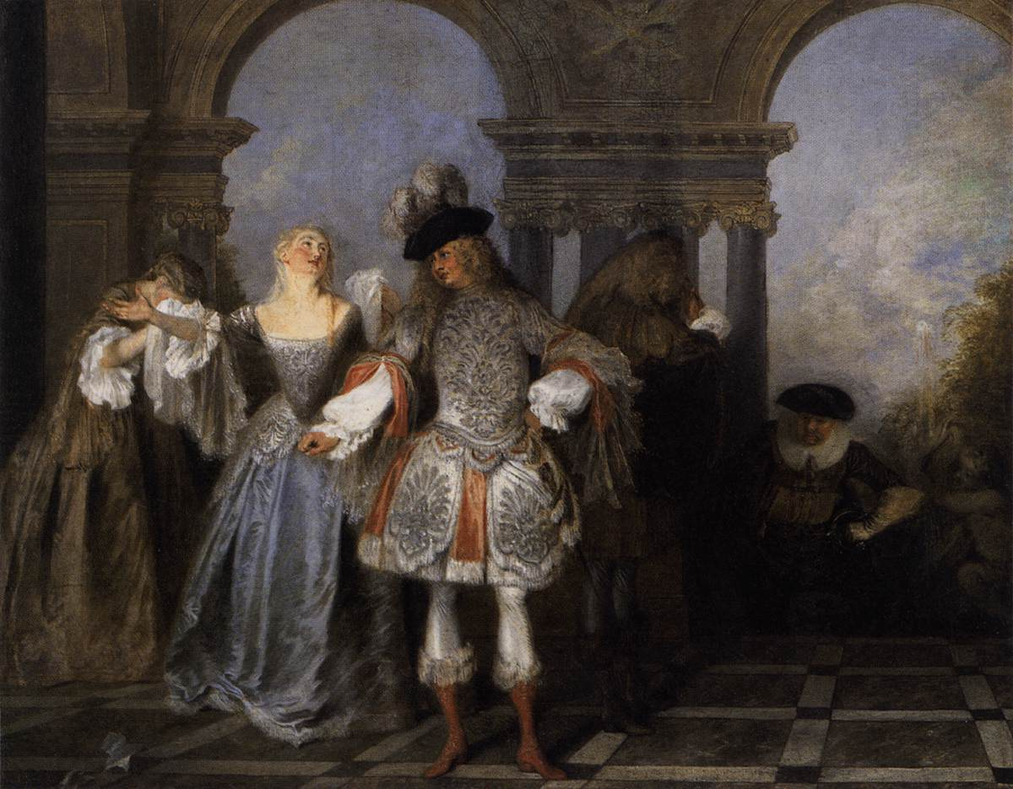
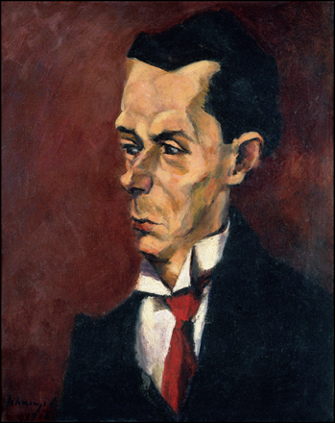
Actor-critic algorithm
So let’s train two neural nets!
$Q_{t}\left(s,a\right)$ is the critic, and is trained according to the deep Q-learning algorithm (MMSE).
$π\left(s,a\right)$ is the actor, and is trained to satisfy the critic:
Actors from the Comédie Française, by Antoine Watteau, 1720. Public Domain, https://commons.wikimedia.org/w/index.php?curid=15418670
The Critic, by Lajos Tihanyi. Oil on canvas, 1916.
Public Domain, https://commons.wikimedia.org/w/index.php?curid=17837438
$$π\left(s,a\right)=argmax\sum_{a}{π\left(s,a\right)Q_{t}\left(s,a\right)}$$

Slide 51
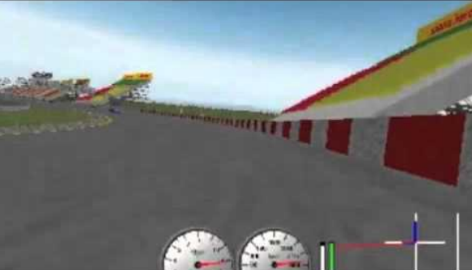
Asynchronous advantage actor-critic (A3C)
TORCS car racing simulation video
Mnih et al. Asynchronous Methods for Deep Reinforcement Learning. ICML 2016

Slide 52
Outline
Policy learning: learn $π\left(s\right)$ directly
Imitation learning
Q-learning: learn $Q\left(s,a\right)=R\left(s\right)+γ\sum_{s′}{P\left(s^{′} | s,a\right)U(s^{′})}$
Table-based: TD, SARSA
Deep Q-learning
Actor-Critic: learn both

