Slide 1
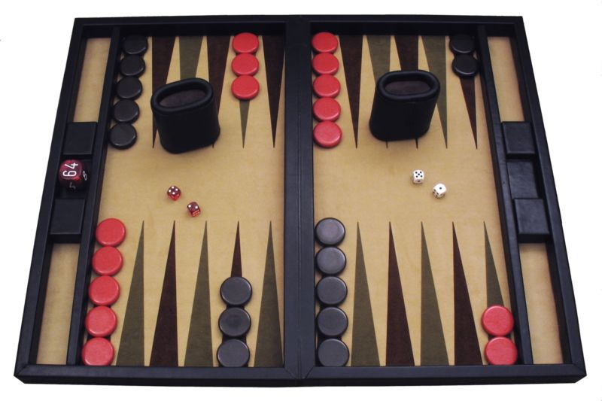
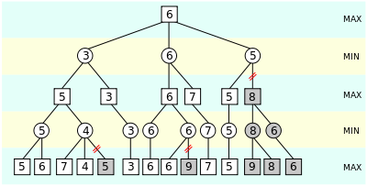
CS440/ECE448 Lecture 19: Alpha-Beta and Expectiminimax
Mark Hasegawa-Johnson, 4/2021
Including slides by Svetlana Lazebnik, 2/2017
CC-BY-4.0: feel free to copy if you cite the source
Alpha-beta pruning.
Jex9999, GFDL, 2007
https://commons.wikimedia.org/wiki/File:AB_pruning.svg
A contemporary backgammon set. Public domain photo by Manuel Hegner, 2013, https://commons.wikimedia.org/w/index.php?curid=25006945

Slide 2
Outline
Alpha-beta pruning
alpha ($α$) is the highest score that MAX knows how to force MIN to accept
beta ($β$) is the lowest score the MIN knows how to force MAX to accept
With optimum move ordering, computational complexity is $O\{n^{d/2}\}$
Expectiminimax: Minimax search for games of chance
Besides MIN and MAX, there’s one more player: CHANCE
The value of a CHANCE node is the expected value of its daughters
Number of levels is doubled, branching factor is large

Slide 3
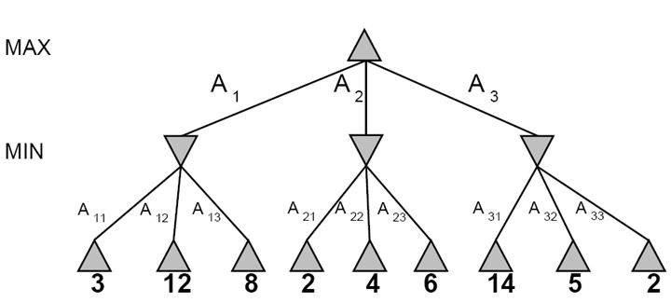
Minimax Search
3
3
2
2
Minimax(node) =
Utility(node) if node is terminal
max_{action} Minimax(Succ(node, action)) if player = MAX
min_{action} Minimax(Succ(node, action)) if player = MIN

Slide 4
Computational complexity of minimax
Suppose that, at each game state, there are n possible moves
Suppose we search to a depth of d
Then the computational complexity is $O\{n^{d}\}$!

Slide 5
Basic idea of alpha-beta pruning
Computational complexity of minimax is $O\{n^{d}\}$
There is no known algorithm to make it polynomial time
But… can we reduce the exponent? For example, could we make the complexity $O\{n^{d/2}\}$?
If we could do that, then it would become possible to search twice as far, using the same amount of computation. This could be the difference between a beginner chess player vs. a grand master.

Slide 6
Basic idea of alpha-beta pruning
The basic idea of alpha-beta pruning is to reduce the complexity of minimax from $O\{n^{d}\}$ to $O\{n^{d/2}\}$.
We can do this by only evaluating half of the levels.
How can we ”only evaluate half the levels” without any reduction of accuracy?

Slide 7
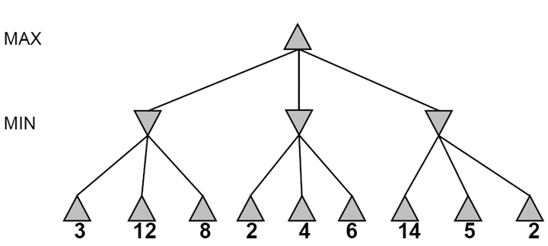
Alpha-beta pruning
Why it works: It is possible to compute the exact minimax decision without expanding every node in the game tree

Slide 8
Alpha-beta pruning
It is possible to compute the exact minimax decision without expanding every node in the game tree
≥3
3

Slide 9
Alpha-beta pruning
It is possible to compute the exact minimax decision without expanding every node in the game tree
≥3
3
≤2

Slide 10
Alpha-beta pruning
It is possible to compute the exact minimax decision without expanding every node in the game tree
≥3
3
≤2
≤14

Slide 11
Alpha-beta pruning
It is possible to compute the exact minimax decision without expanding every node in the game tree
≥3
3
≤2
≤5

Slide 12
Alpha-beta pruning
It is possible to compute the exact minimax decision without expanding every node in the game tree
3
3
≤2
2
Notes:
Could we have done better with the right branch?

Slide 13
The pruning thresholds, alpha and beta
Alpha-beta pruning requires us to keep track of two pruning thresholds, alpha and beta.
alpha ($α$) is the highest score that MAX knows how to force MIN to accept.
beta ($β$) is the lowest score that MIN knows how to force MAX to accept.
$α<β$

Slide 14
Alpha-beta pruning
Why it works: It is possible to compute the exact minimax decision without expanding every node in the game tree
$$α=−∞,$$
$$β=∞$$

Slide 15
Alpha-beta pruning
Why it works: It is possible to compute the exact minimax decision without expanding every node in the game tree
$$α=−∞,$$
$$β=∞$$
$$α=−∞,$$
$$β=∞$$

Slide 16
Alpha-beta pruning
It is possible to compute the exact minimax decision without expanding every node in the game tree
$$α=−∞,$$
$$β=∞$$
$$α=−∞,$$
$$β=3$$
3

Slide 17
Alpha-beta pruning
It is possible to compute the exact minimax decision without expanding every node in the game tree
$$α=3,$$
$$β=∞$$
≥3
$$α=−∞,$$
$$β=3$$
3

Slide 18
Alpha-beta pruning
It is possible to compute the exact minimax decision without expanding every node in the game tree
$$α=3,$$
$$β=∞$$
≥3
$$α=3,$$
$$β=∞$$
3
≤2

Slide 19
Alpha-beta pruning
It is possible to compute the exact minimax decision without expanding every node in the game tree
$$α=3,$$
$$β=∞$$
≥3
PRUNE!
If MAX lets us get to this state, then MIN would achieve a final score <=2
Therefore MAX will never let us get to this state!
Therefore there’s no need to score the remaning children of this node.
$$α=3,$$
$$β=∞$$
3
≤2
X

Slide 20
Alpha-beta pruning
It is possible to compute the exact minimax decision without expanding every node in the game tree
$$α=3,$$
$$β=∞$$
≥3
$$α=3,$$
$$β=∞$$
3
≤2

Slide 21
Alpha-beta pruning
It is possible to compute the exact minimax decision without expanding every node in the game tree
$$α=3,$$
$$β=∞$$
≥3
$$α=3,$$
$$β=14$$
3
≤2

Slide 22
Alpha-beta pruning
It is possible to compute the exact minimax decision without expanding every node in the game tree
$$α=3,$$
$$β=∞$$
≥3
$$α=3,$$
$$β=5$$
3
≤2

Slide 23
Alpha-beta pruning
It is possible to compute the exact minimax decision without expanding every node in the game tree
Violation of $α<β$ means it is now possible to prune any remaining children of this node.
$$α=3,$$
$$β=∞$$
3
$$α=3,$$
$$β=2$$
3
≤2
Notes:
Could we have done better with the right branch?

Slide 24
Outline
Alpha-beta pruning
alpha ($α$) is the highest score that MAX knows how to force MIN to accept
beta ($β$) is the lowest score the MIN knows how to force MAX to accept
With optimum move ordering, computational complexity is $O\{n^{d/2}\}$
Expectiminimax: Minimax search for games of chance
Besides MIN and MAX, there’s one more player: CHANCE
The value of a CHANCE node is the expected value of its daughters
Number of levels is doubled, branching factor is large

Slide 25
Computational complexity of alpha-beta pruning
The basic idea of alpha-beta pruning is to reduce the complexity of minimax from $O\{n^{d}\}$ to $O\{n^{d/2}\}$.
That can be done with no loss of accuracy,
… but only if the children of any given node are optimally ordered.

Slide 26
Optimal ordering
Minimum computational complexity ($O\{n^{d/2}\}$) is only achieved if:
The children of a MAX node are evaluated, in order, starting with the highest-value child.
The children of a MIN node are evaluated, in order, starting with the lowest-value child.

Slide 27
Non-optimal ordering
In this tree, the moves are not optimally ordered, so we were only able to prune two nodes.
3
3
≤2
2
X
X

Slide 28
Optimal ordering
In this tree, the moves ARE optimally ordered, so we are able to prune four nodes (out of nine).
3
3
≤2
≤2
X
X
X
X
2
5
14

Slide 29
Optimal ordering
In this tree, the moves ARE optimally ordered, so we are able to prune four nodes (out of nine).
3
3
≤2
≤2
X
X
X
X
2
5
14

Slide 30
Computational Complexity
X
X
X
X
2
5
14
Consider a sequence of two levels, with n moves per level, and with optimal ordering.
There are $n^{2}$ terminal nodes.
Alpha-beta will evaluate all the daughters of the first daughter: $n$ nodes.
Alpha-beta will also evaluate the first daughter of each non-first daughter: $n−1$ nodes.
In total, alpha-beta will evaluate $2n−1$ out of every $n^{2}$ nodes.
For a tree of depth d, the number of nodes evaluated by alpha-beta is
$${\left(2n−1\right)}^{d/2}= O\{n^{d/2}\}$$

Slide 31
Computational Complexity
X
X
X
X
2
5
14
…but wait… this means we need to know, IN ADVANCE, which move has the highest value, and which move has the lowest value!!
Obviously, it is not possible to know the true value of a move without evaluating it.
However, heuristics often are pretty good.
We use the heuristic to decide which move to evaluate first.
For games like chess, with good heuristics, complexity of alpha-beta is closer to $O\{n^{d/2}\}$ than to $O\{n^{d}\}$.

Slide 32
Alpha-beta pruning
Pruning does not affect final result
Amount of pruning depends on move ordering
Should start with the “best” moves (highest-value for MAX or lowest-value for MIN)
For chess, can try captures first, then threats, then forward moves, then backward moves
Can also try to remember “killer moves” from other branches of the tree
With perfect ordering, the time to find the best move is reduced to O(b^{m/2}) from O(b^{m})
Depth of search is effectively doubled

Slide 33
Outline
Alpha-beta pruning
alpha ($α$) is the highest score that MAX knows how to force MIN to accept
beta ($β$) is the lowest score the MIN knows how to force MAX to accept
With optimum move ordering, computational complexity is $O\{n^{d/2}\}$
Expectiminimax: Minimax search for games of chance
Besides MIN and MAX, there’s one more player: CHANCE
The value of a CHANCE node is the expected value of its daughters
Number of levels is doubled, branching factor is large

Slide 34
Stochastic games
How can we incorporate dice throwing into the game tree?

Slide 35
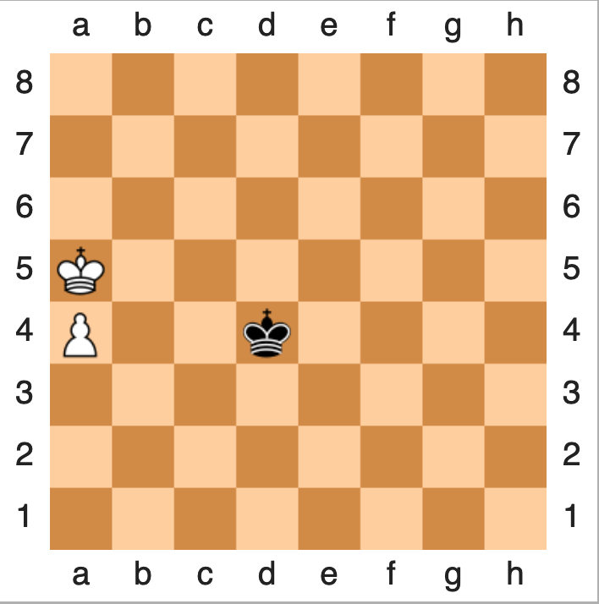
Minimax
State evolves deterministically (when a player acts, that action uniquely determines the following state).
Current state is visible to both players.
Each player tries to maximize his or her own reward:
Maximize (over all possible moves I can make) the
Minimum (over all possible moves Min can make) of the resulting utility:
$$U\left(s\right)=\max_{s′∈C(s)}{U(s^{′})}$$
$$U\left(s′\right)=\min_{s′′∈C(s′)}{U(s^{′′})}$$

Slide 36
Expectiminimax
State evolves stochastically (when a player acts, the game changes RANDOMLY, with a probability distribution $P\left(s^{′} | s,a\right)$that depends on the action, $a$).
Current state, $s$, is visible to the player.
The player tries to maximize his or her own reward:
Maximize (over all possible moves I can make) the
Expected value (over all possible successor states) of the resulting utility:
$$Q\left(s,a\right)=\sum_{s′}{P\left(s^{′} | s,a\right)U(s^{′})}$$

Slide 37
Expectiminimax
State evolves stochastically (when a player acts, that action influences the state transition probability).
Current state is visible to both players.
Each player tries to maximize his or her own reward:
Maximize (over all possible moves I can make) the
Minimum (over all possible moves Min can make) of the
Expected value (over all possible successor states) of the resulting utility:
$$U\left(s\right)=\max_{a}{\sum_{s′}{P\left(s^{′} | s,a\right)U(s^{′})}}$$
$$U\left(s′\right)=\min_{a′}{\sum_{s′′}{P\left(s^{′′} | s′,a′\right)U(s^{′′})}}$$

Slide 38
Expectiminimax: notation
= MAX node. $U\left(s\right)=\max_{a∈A(s)}{Q(s,a)}$
= MIN node. $U\left(s\right)=\min_{a∈A(s)}{Q(s,a)}$
= Chance node. $Q\left(s,a\right)=\sum_{s′}{P\left(s^{′} | s,a\right)U(s^{′})}$

Slide 39
Expectiminimax example
MIN: Min decides whether to count heads (action H) or tails (action T) as a forward movement.
H
Emojis by Twitter, CC BY 4.0, https://commons.wikimedia.org/w/index.php?curid=59974366

Slide 40
Expectiminimax example
MIN: Min decides whether to count heads (action H) or tails (action T) as a forward movement.
H
Emojis by Twitter, CC BY 4.0, https://commons.wikimedia.org/w/index.php?curid=59974366

Slide 41
Expectiminimax example
MIN: Min decides whether to count heads (action H) or tails (action T) as a forward movement.
Chance: she flips a coin and moves her game piece in the direction indicated.
By ICMA Photos - Coin Toss, CC BY-SA 2.0, https://commons.wikimedia.org/w/index.php?curid=71147286
Emojis by Twitter, CC BY 4.0, https://commons.wikimedia.org/w/index.php?curid=59974366

Slide 42
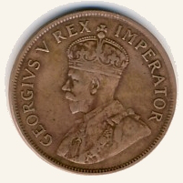
Expectiminimax example
MIN: Min decides whether to count heads (action H) or tails (action T) as a forward movement.
Chance: she flips a coin and moves her game piece in the direction indicated.
By NJR ZA - Own work, CC BY-SA 3.0, https://commons.wikimedia.org/w/index.php?curid=4228918
Emojis by Twitter, CC BY 4.0, https://commons.wikimedia.org/w/index.php?curid=59974366

Slide 43
Expectiminimax example
MIN: Min decides whether to count heads (action H) or tails (action T) as a forward movement.
Chance: she flips a coin and moves her game piece in the direction indicated.
MAX: Max decides whether to count heads (action H) or tails (action T) as a forward movement.
By NJR ZA - Own work, CC BY-SA 3.0, https://commons.wikimedia.org/w/index.php?curid=4228918
H
Emojis by Twitter, CC BY 4.0, https://commons.wikimedia.org/w/index.php?curid=59974366

Slide 44
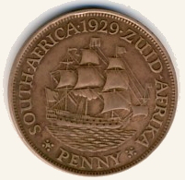
Expectiminimax example
MIN: Min decides whether to count heads (action H) or tails (action T) as a forward movement.
Chance: she flips a coin and moves her game piece in the direction indicated.
MAX: Max decides whether to count heads (action H) or tails (action T) as a forward movement.
Chance: he flips a coin and moves his game piece in the direction indicated.
By NJR ZA - Own work, CC BY-SA 3.0, https://commons.wikimedia.org/w/index.php?curid=4228918
By NJR ZA - Own work, CC BY-SA 3.0, https://commons.wikimedia.org/w/index.php?curid=4228918
Emojis by Twitter, CC BY 4.0, https://commons.wikimedia.org/w/index.php?curid=59974366

Slide 45
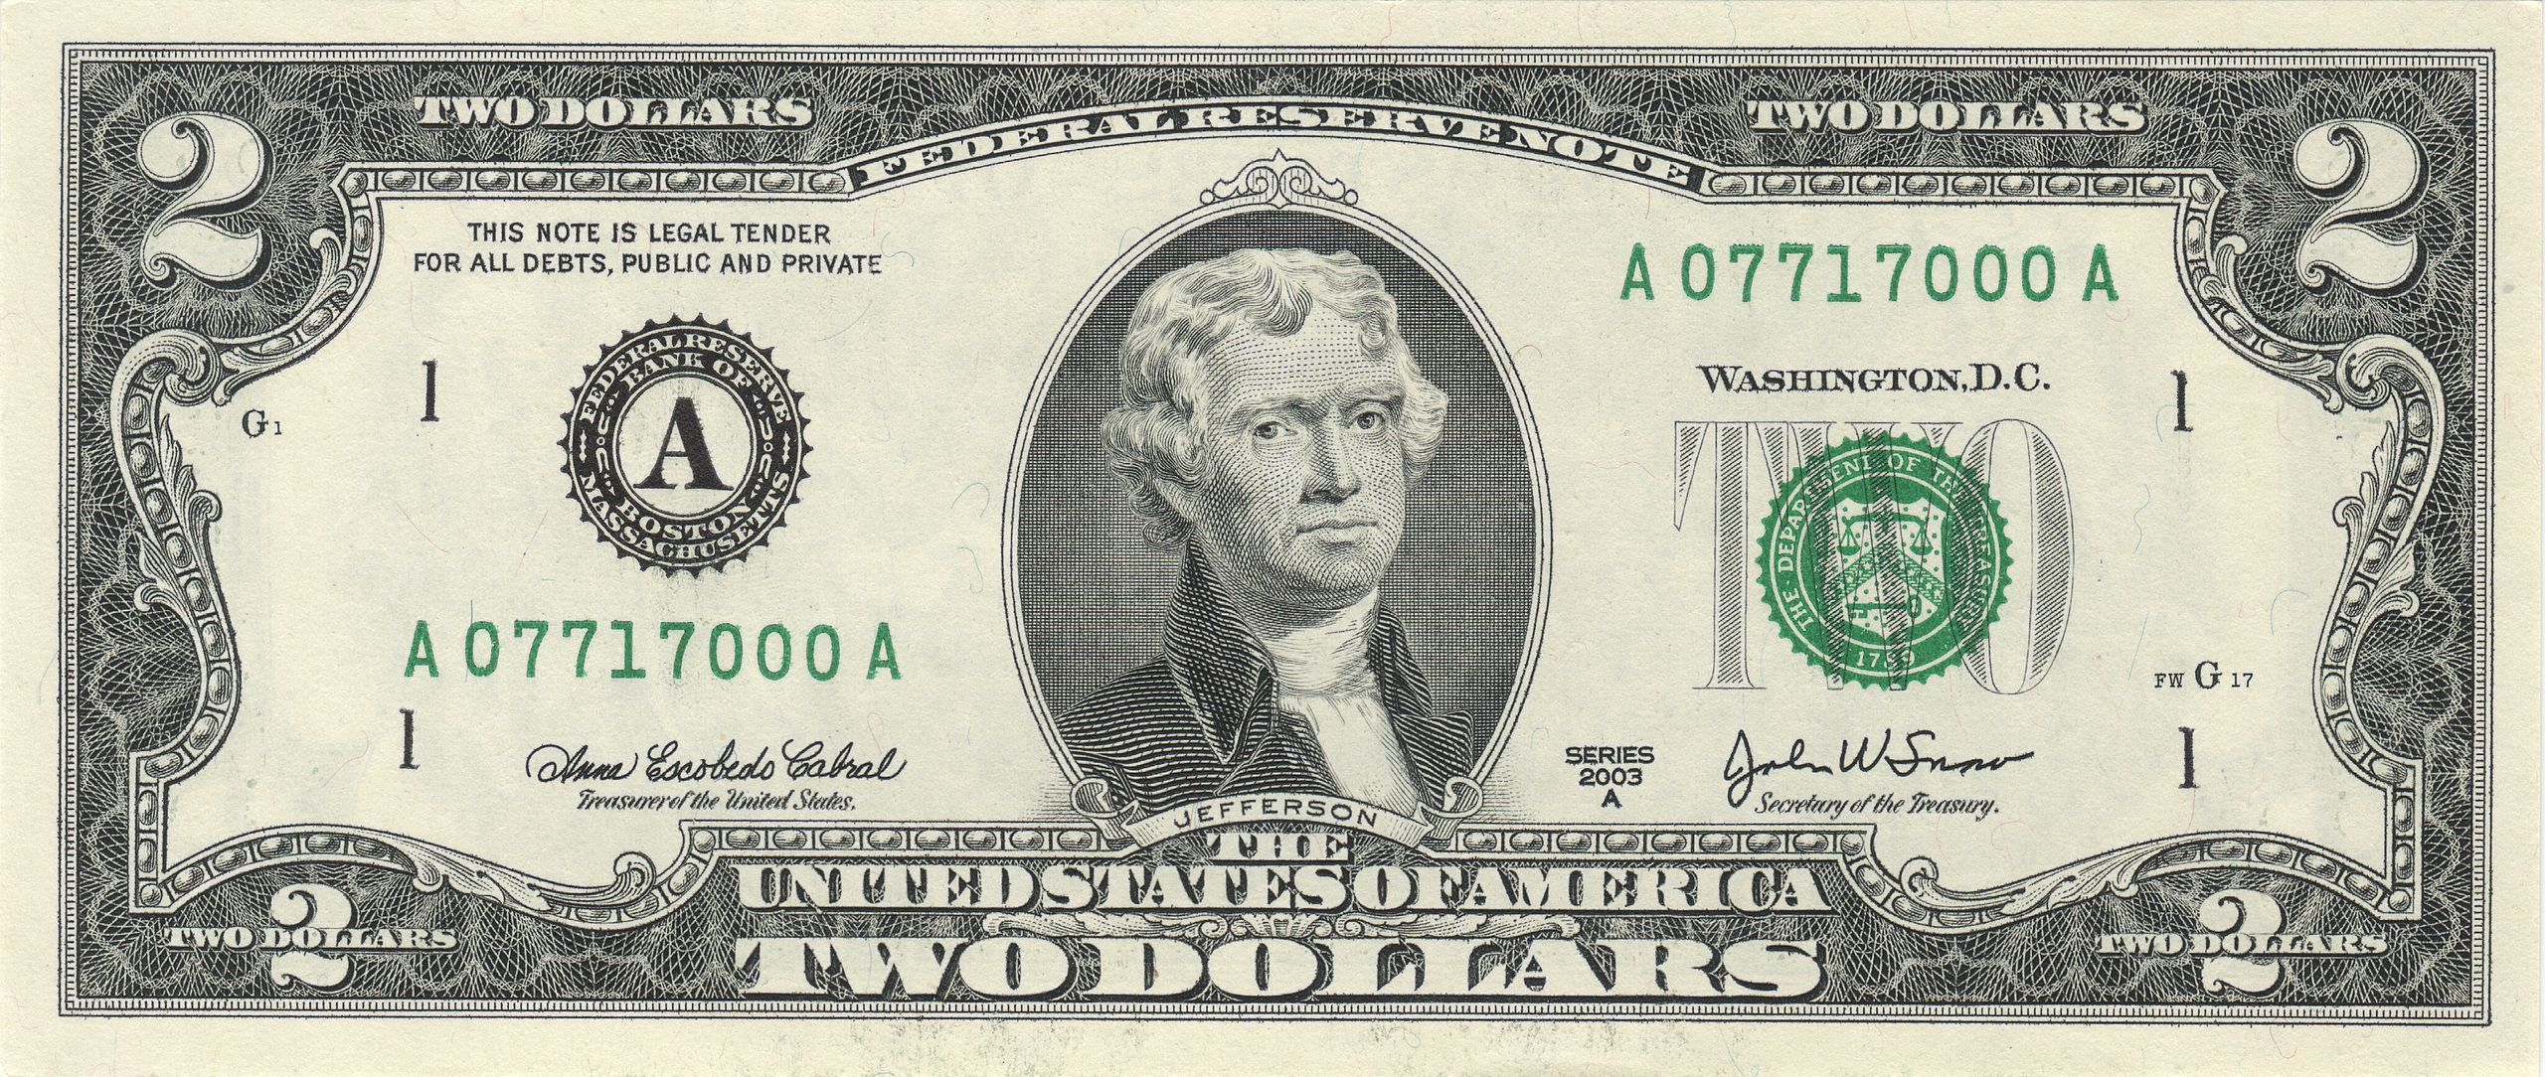
Expectiminimax example
MIN: Min decides whether to count heads (action H) or tails (action T) as a forward movement.
Chance: she flips a coin and moves her game piece in the direction indicated.
MAX: Max decides whether to count heads (action H) or tails (action T) as a forward movement.
Chance: he flips a coin and moves his game piece in the direction indicated.
Reward: $2 to the winner, $0 for a draw.
By NJR ZA - Own work, CC BY-SA 3.0, https://commons.wikimedia.org/w/index.php?curid=4228918
By NJR ZA - Own work, CC BY-SA 3.0, https://commons.wikimedia.org/w/index.php?curid=4228918
Emojis by Twitter, CC BY 4.0, https://commons.wikimedia.org/w/index.php?curid=59974366.
$2 By Bureau of Engraving and Printing: U.S. Department of the Treasury - own scanned, Public Domain, https://commons.wikimedia.org/w/index.php?curid=56299470

Slide 46
Expectiminimax example
MIN: Min decides whether to count heads (action H) or tails (action T) as a forward movement.
Chance: she flips a coin and moves her game piece in the direction indicated.
MAX: Max decides whether to count heads (action H) or tails (action T) as a forward movement.
Chance: he flips a coin and moves his game piece in the direction indicated.
Reward: $2 to the winner, $0 for a draw.
T
H
T
H
T
H
T
H
T
H
T
H
T
H
T
H
H
0
-2
-2
0
2
0
0
2
2
0
0
2
0
-2
-2
0

Slide 47
Expectiminimax example
Chance node:
$Q\left(s,a\right)=\sum_{s′}{P\left(s^{′} | s,a\right)U(s^{′})}$
T
H
T
H
T
H
T
H
T
H
T
H
T
H
-1
-1
1
1
1
1
-1
-1
T
H
H
0
-2
-2
0
2
0
0
2
2
0
0
2
0
-2
-2
0

Slide 48
Expectiminimax example
Max node:
$$U\left(s\right)=\max_{a∈A(s)}{Q(s,a)}$$
T
H
T
H
T
H
-1
1
1
-1
T
H
T
H
T
H
T
H
-1
-1
1
1
1
1
-1
-1
T
H
H
0
-2
-2
0
2
0
0
2
2
0
0
2
0
-2
-2
0

Slide 49
Expectiminimax example
Chance node:
$Q\left(s,a\right)=\sum_{s′}{P\left(s^{′} | s,a\right)U(s^{′})}$
T
H
0
0
T
H
T
H
-1
1
1
-1
T
H
T
H
T
H
T
H
-1
-1
1
1
1
1
-1
-1
T
H
H
0
-2
-2
0
2
0
0
2
2
0
0
2
0
-2
-2
0

Slide 50
Expectiminimax example
0
Min node:
$$U\left(s\right)=\min_{a∈A(s)}{Q(s,a)}$$
T
H
0
0
T
H
T
H
-1
1
-1
1
T
H
T
H
T
H
T
H
-1
-1
1
1
1
1
-1
-1
T
H
H
0
-2
-2
0
2
0
0
2
2
0
0
2
0
-2
-2
0

Slide 51
Outline
Alpha-beta pruning
alpha ($α$) is the highest score that MAX knows how to force MIN to accept
beta ($β$) is the lowest score the MIN knows how to force MAX to accept
With optimum move ordering, computational complexity is $O\{n^{d/2}\}$
Expectiminimax: Minimax search for games of chance
Besides MIN and MAX, there’s one more player: CHANCE
The value of a CHANCE node is the expected value of its daughters
Number of levels is doubled, branching factor is large

Slide 52
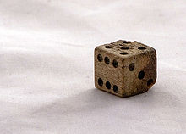
Expectiminimax example #2
MIN: Min decides whether she’s going to move $D−3$ or $3−D$ steps forward, where $D$ is the roll of the dice.
Chance: she rolls the dice and moves her game piece in the direction indicated.
MAX: Max decides whether he’s going to move $D−3$ or $3−D$ steps forward, where $D$ is the roll of the dice.
Chance: he rolls the dice and moves his game piece in the direction indicated.
Reward: loser pays the winner a number of dollars equal to the number of spaces difference.
By Kolby Kirk, CC BY 3.0, https://commons.wikimedia.org/w/index.php?curid=3037476
Emojis by Twitter, CC BY 4.0, https://commons.wikimedia.org/w/index.php?curid=59974366.

Slide 53
Expectiminimax example #2
MIN: Min decides whether she’s going to move $D−3$ or $3−D$ steps forward, where $D$ is the roll of the dice.
Chance: she rolls the dice and moves her game piece in the direction indicated.
MAX: Max decides whether he’s going to move $D−3$ or $3−D$ steps forward, where $D$ is the roll of the dice.
Chance: he rolls the dice and moves his game piece in the direction indicated.
Reward: loser pays the winner a number of dollars equal to the number of spaces difference.
$$D−3$$
$$3−D$$
…
1
2
3
4
5
6
1
…
…
…
…
…
…
…
…
…

Slide 54
Outline
Alpha-beta pruning
alpha ($α$) is the highest score that MAX knows how to force MIN to accept
beta ($β$) is the lowest score the MIN knows how to force MAX to accept
With optimum move ordering, computational complexity is $O\{n^{d/2}\}$
Expectiminimax: Minimax search for games of chance
Besides MIN and MAX, there’s one more player: CHANCE
The value of a CHANCE node is the expected value of its daughters
Number of levels is doubled, branching factor is large

