Slide 1
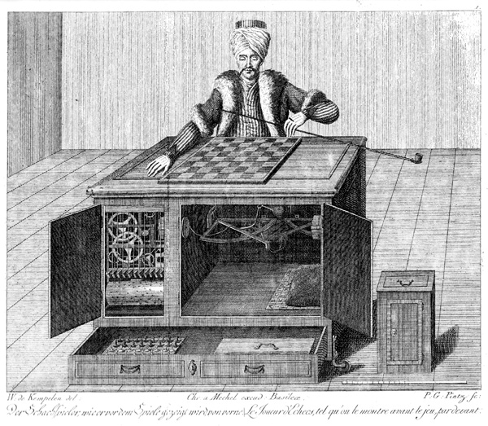
CS440/ECE448 Lecture 18: Two-Player Games
Slides by Mark Hasegawa-Johnson & Svetlana Lazebnik, 3/31/2021
Distributed under CC-BY 4.0 (https://creativecommons.org/licenses/by/4.0/). You are free to share and/or adapt if you give attribution.
By Karl Gottlieb von Windisch - Copper engraving from the book: Karl Gottlieb von Windisch, Briefe über den Schachspieler des Hrn. von Kempelen, nebst drei Kupferstichen die diese berühmte Maschine vorstellen. 1783.Original Uploader was Schaelss (talk) at 11:12, 7. Apr 2004., Public Domain, https://commons.wikimedia.org/w/index.php?curid=424092

Slide 2
Why study games?
Games are a traditional hallmark of intelligence
Games are easy to formalize
Games can be a good model of real-world competitive or cooperative activities
Military confrontations, negotiation, auctions, etc.

Slide 3
Games vs. single-agent search
We don’t know how the opponent will act
The solution is not a fixed sequence of actions from start state to goal state, but a strategy or policy
Definition of policy: a policy is a function $π:𝒮→𝒜$ that maps from world states, $s∈𝒮$, to actions, $a∈𝒜$.

Slide 4
Game AI: Origins
Minimax algorithm: Ernst Zermelo, 1912
Chess playing with evaluation function, quiescence search, selective search: Claude Shannon, 1949 (paper)
Alpha-beta search: John McCarthy, 1956
Checkers program that learns its own evaluation function by playing against itself: Arthur Samuel, 1956

Slide 5
Types of game environments
 | Deterministic | Stochastic
Perfect information (fully observable)
Imperfect information (partially observable)
Chess, Checkers, Go
Backgammon, Monopoly
Battleship
Scrabble, Poker, Bridge

Slide 6
Zero-sum Games

Slide 7
Alternating two-player zero-sum games
Players take turns
Each game outcome or terminal state has a utility for each player (e.g., 1 for win, 0 for tie, -1 for loss)
The sum of both players’ utilities is a constant, e.g.,
Utility(player 0) + Utility(player 1) = 0
Player 0 tries to maximize Utility(player 0). Let’s call this player “Max”
Player 1 tries to minimize Utility(player 0). Let’s call this player “Min”

Slide 8
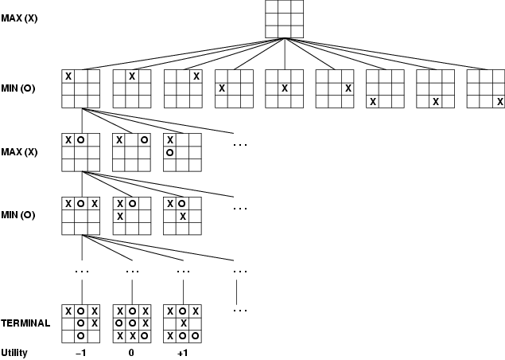
Game tree
A game of tic-tac-toe between two players, “max” and “min”

Slide 9
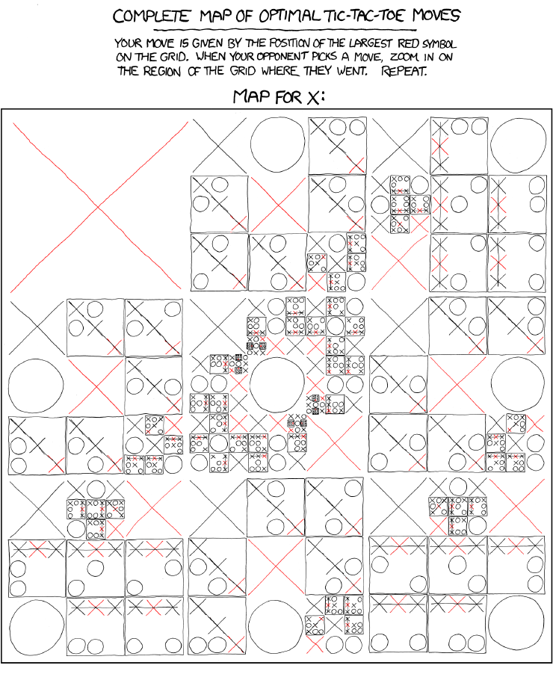
http://xkcd.com/832/

Slide 10
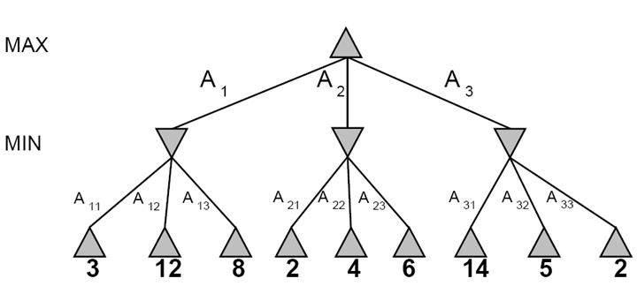
A more abstract game tree
Terminal utilities (for MAX)
A depth-two game

Slide 11
Standard notation for game trees
= game state from which MAX can play
= game state from which MIN can play
number = value of that game state for MAX

Slide 12
Minimax Search

Slide 13
The rules of every game
Every possible outcome has a value (or “utility”) for me.
Zero-sum game: if the value to me is +V, then the value to my opponent is –V.
Phrased another way:
My rational action, on each move, is to choose a move that will maximize the value of the outcome
My opponent’s rational action is to choose a move that will minimize the value of the outcome
Call me “Max”
Call my opponent “Min”

Slide 14
Game tree search
3
3
2
2
Minimax value of a node: the utility (for MAX) of being in the corresponding state, assuming perfect play on both sides
Minimax strategy: Choose the move that gives the best worst-case payoff

Slide 15
Computing the minimax value of a node
3
3
2
2
Minimax(node) =
Utility(node) if node is terminal
max_{action} Minimax(Succ(node, action)) if player = MAX
min_{action} Minimax(Succ(node, action)) if player = MIN

Slide 16
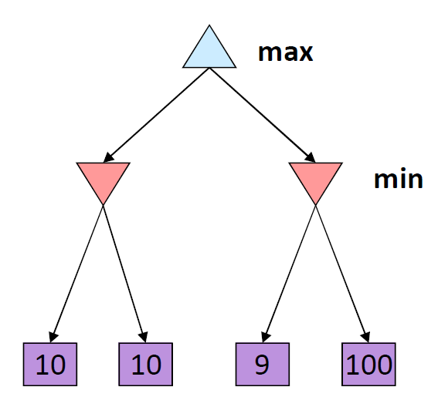
Optimality of minimax
The minimax strategy is optimal against an optimal opponent
What if your opponent is suboptimal?
If you play using the minimax-optimal sequence of moves, then the utility you earn will always be greater than or equal to the amount that you predict.
11
Example from D. Klein and P. Abbeel

Slide 17
Multi-player games; Non-zero-sum games
More than two players. For example:
Dog (🐶) tries to maximize the number of doggie treats
Cat (🐱) tries to maximize the number of cat treats
Mouse (🐭) tries to maximize the number of mouse treats
Non-zero-sum. We can’t just assume that Min’s score is the opposite of Max’s. Instead, utilities are now tuples. For example:
(🐶5, 🐱8, 🐭2) = 5 doggie treats, 8 kitty treats, 2 mouse treats
Each player maximizes their own utility at their node

Slide 18
Minimax in multi-player & non-zero-sum games
(🐶2, 🐱5, 🐭2)
🐶
(🐶1, 🐱2, 🐭6)
(🐶2, 🐱5, 🐭2)
🐱
🐱
(🐶1, 🐱2, 🐭6)
(🐶6, 🐱1, 🐭2)
(🐶2, 🐱5, 🐭2)
(🐶5, 🐱4, 🐭5)
🐭
🐭
🐭
🐭
(🐶1, 🐱2, 🐭6)
(🐶4, 🐱3, 🐭2)
(🐶6, 🐱1, 🐭2)
(🐶7, 🐱4, 🐭1)
(🐶5, 🐱1, 🐭1)
(🐶2, 🐱5, 🐭2)
(🐶7, 🐱7, 🐭1)
(🐶5, 🐱4, 🐭5)

Slide 19
Limited-Horizon Computation

Slide 20
Games vs. single-agent search
We don’t know how the opponent will act
The solution is not a fixed sequence of actions from start state to goal state, but a strategy or policy (a mapping from state to best move in that state)

Slide 21
Games vs. single-agent search
We don’t know how the opponent will act
The solution is not a fixed sequence of actions from start state to goal state, but a strategy or policy (a mapping from state to best move in that state)
Efficiency is critical to playing well
The time to make a move is limited
The branching factor, search depth, and number of terminal configurations are huge
In chess, branching factor ≈ 35 and depth ≈ 100, giving a search tree of 10¹⁵⁴ nodes
Number of atoms in the observable universe ≈ 10⁸⁰
This rules out searching all the way to the end of the game

Slide 22
Limited-Horizon Search
In a practical game, we compute minimax to a limited depth
Depth=1: evaluate every possible current move, look at the resulting game state, decide which resulting game state looks the best, and take that action.
Computational complexity to choose your next move: $𝒪\left\{N\right\}$, if there are N possible moves.
Depth=2: evaluate every possible current move, and every move that your opponent might make in response, and then look at resulting game states.
Computational complexity to choose your next move: $𝒪\left\{N^{2}\right\}$.
Depth=3: evaluate every possible sequence of three moves (mine, my opponent’s, then mine), and look at the resulting game states.
Computational complexity to choose your next move: $𝒪\left\{N^{3}\right\}.$

Slide 23
Evaluation functions
In order to evaluate the quality of a game state $s∈𝒮$, we need to design an evaluation function $v(s)$. It should have the following properties:
$v(s)$ should be a reasonable estimate of the outcome of the game, but
It must be possible to compute $v(s)$ quickly, i.e., typically we desire that its computational complexity is no more than $𝒪\left\{N\right\}$. If its complexity was higher, then we might get better results by using a cheaper evaluation function in a deeper minimax search.

Slide 24
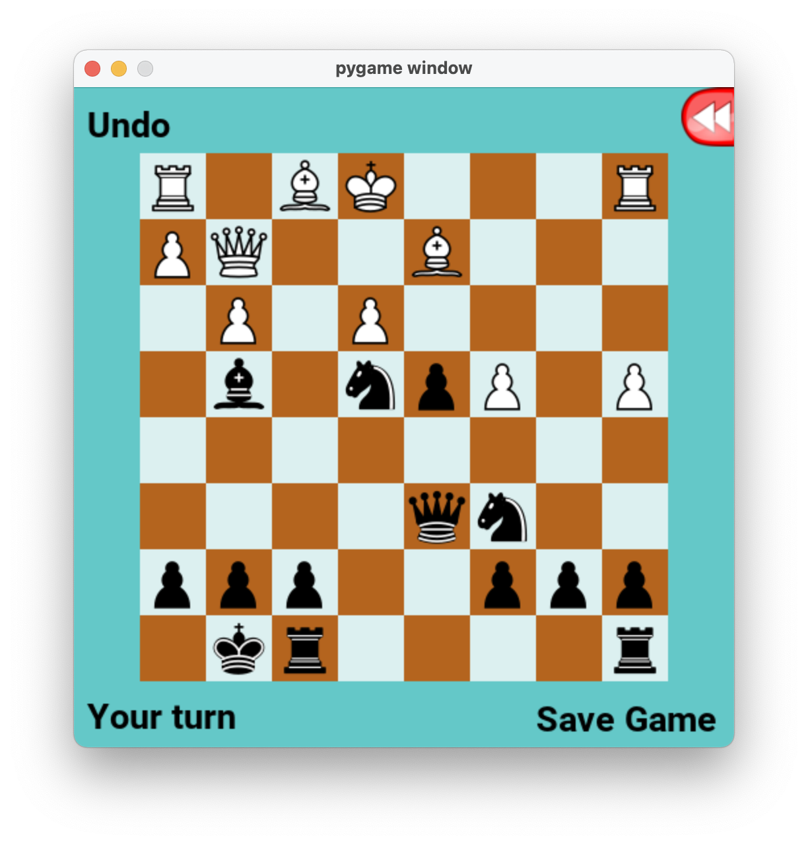
Example: Depth 1 search, Chess
In chess, traditionally, the black player is MIN.
What move should MIN choose, from this board position?
Graphics: created by the PyChess community.
Game board shown: game1.txt from the MP5 distribution.

Slide 25
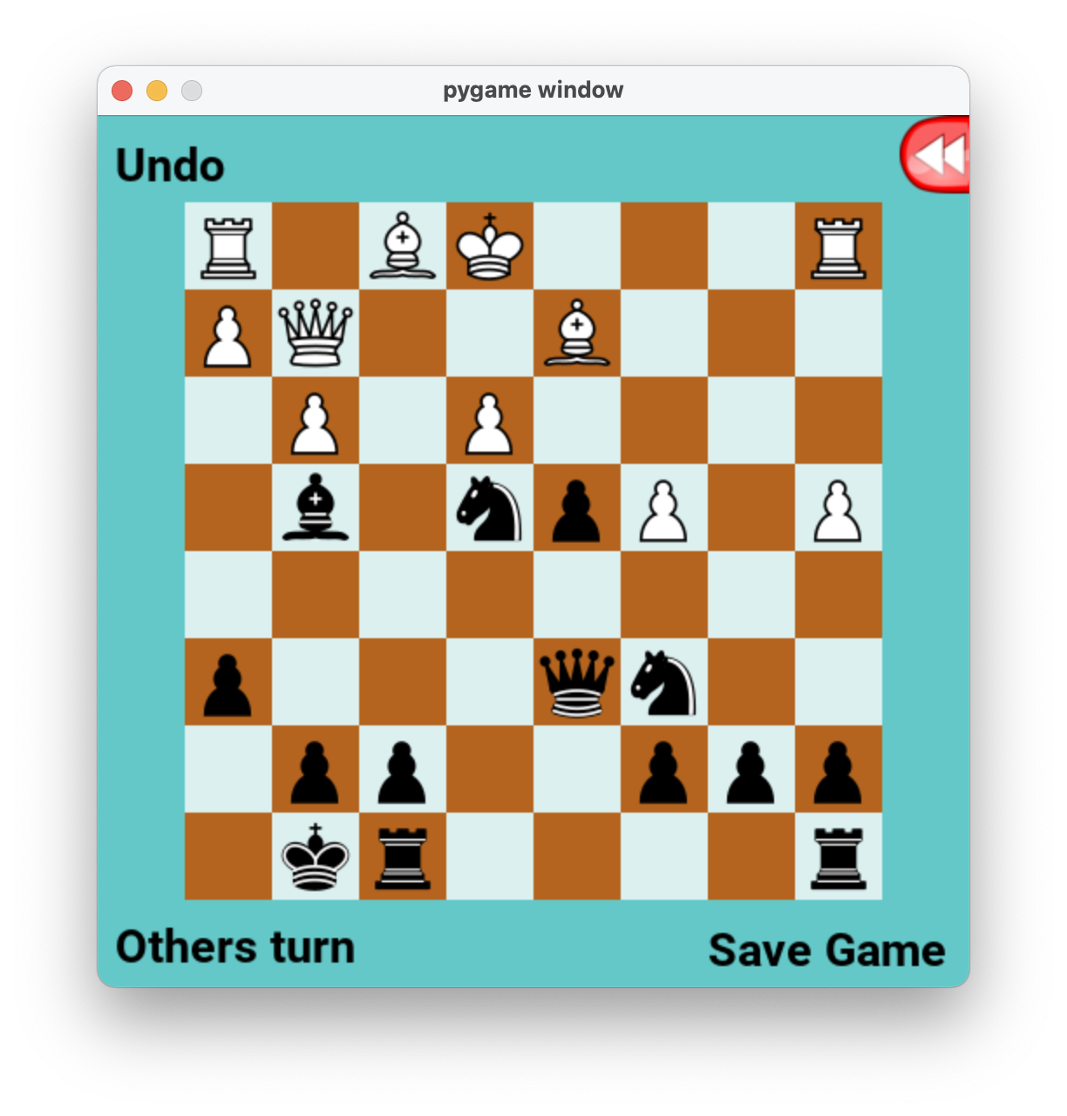
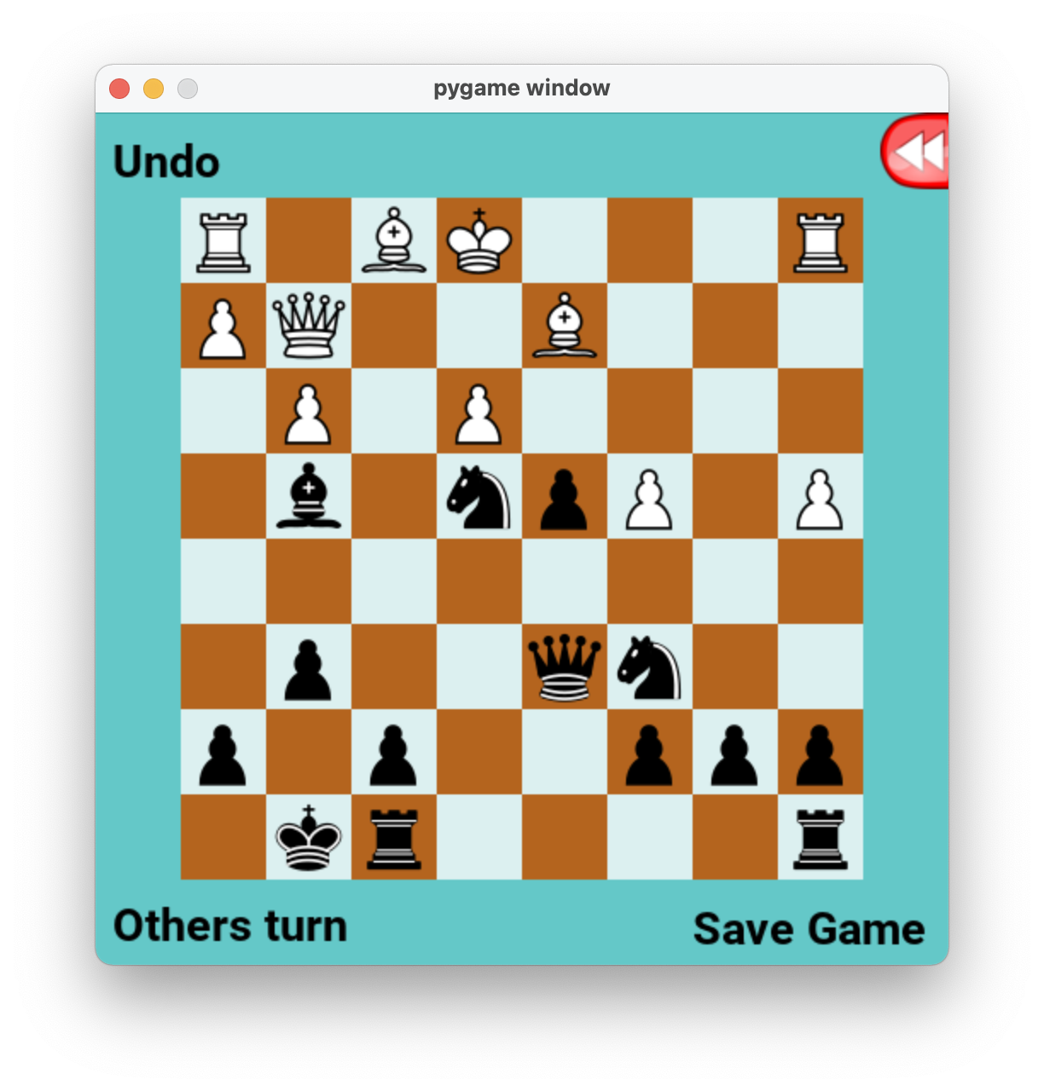
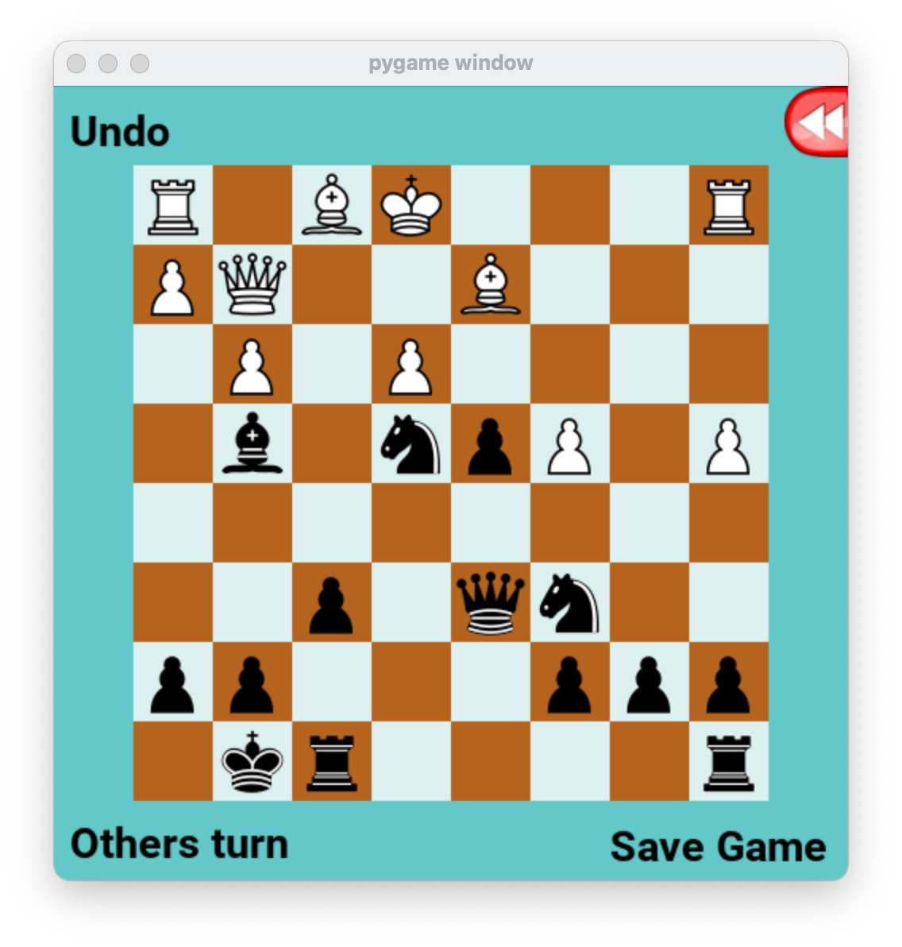
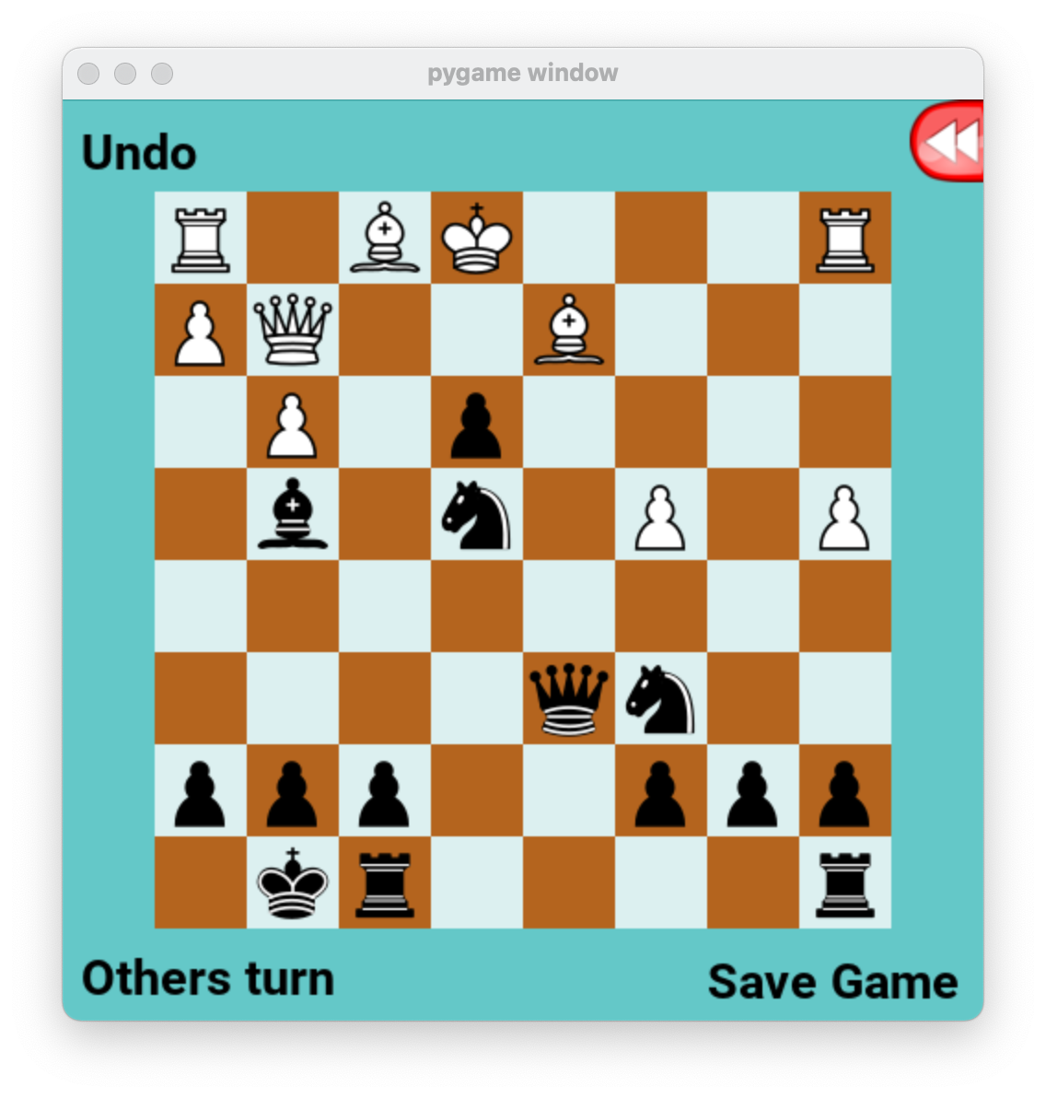
Example: Depth 1 search, Chess
In chess, traditionally, the black player is MIN.
Since one move has a final board value less than the others, MIN will choose that move (in a depth-1 search).
$$v\left(s\right)=−4$$
$$v\left(s\right)=−4$$
$$v\left(s\right)=−4$$
$$v\left(s\right)=−5$$

Slide 26
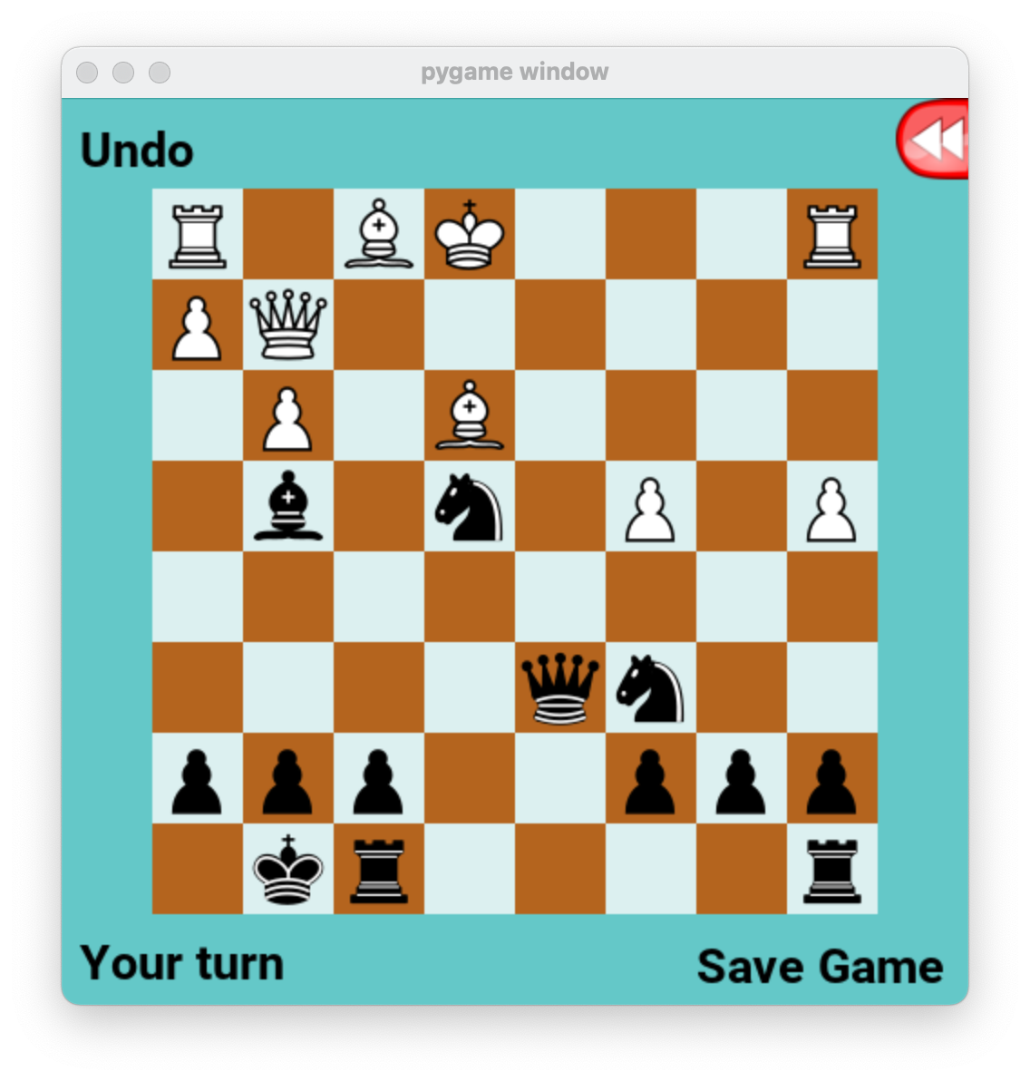
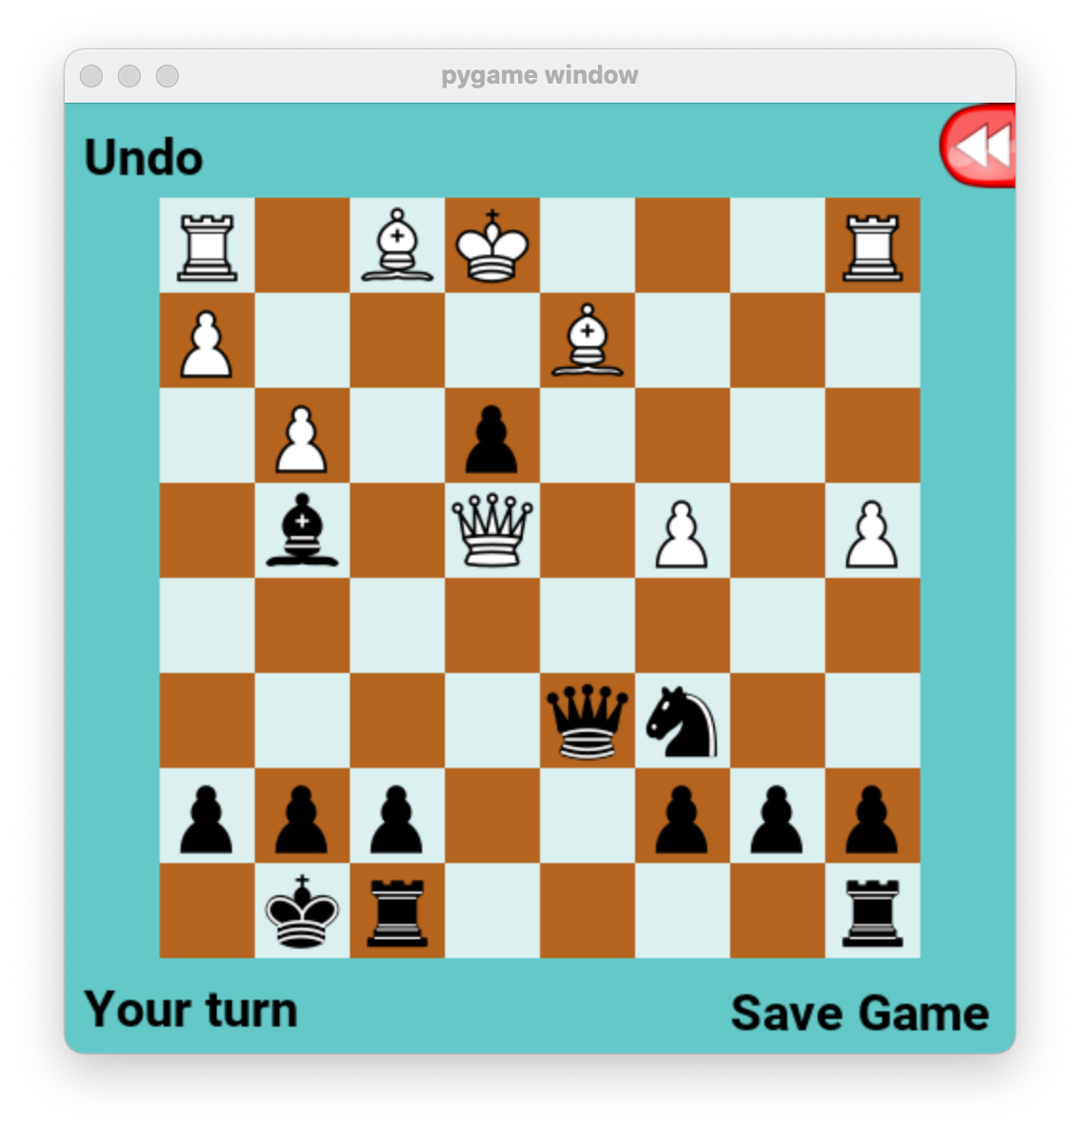
Example: Depth 2 search, Chess
X
$$…$$
$$v\left(s\right)=−5 −1$$
$$…$$
$$…$$
$$…$$
$$…$$
$$…$$
$$v\left(s\right)=−4$$
$$v\left(s\right)=−1$$

Slide 27
Typical chess evaluation function
Each side receives:
9 points per remaining queen
5 points per remaining rook
3 points per remaining bishop
3 points per remaining knight
1 point per remaining pawn
$v\left(s\right)=$ points for white - points for black
The PyChess evaluation function provides extra point depending on the location of each piece on the board.

Slide 28
Evaluation functions in general
Evaluation function must be reasonably accurate, but computationally simple. Often this means a linear evaluation function:
$$v\left(s\right)=w_{1}f_{1}\left(s\right)+w_{2}f_{2}\left(s\right)+⋯$$
$f_{1}\left(s\right), f_{2}\left(s\right),…$ are features of the game state $s$
$w_{1},w_{2}…$ are real-valued weights.
Notice: this is just a one-layer neural net, with input vector $f\left(s\right)=\left[f_{1}\left(s\right), f_{2}\left(s\right),…\right]$ and weight vector $w=\left[w_{1}, w_{2},…\right].$
Recently, deeper neural nets are also sometimes used.

Slide 29
Cutting off search
Horizon effect: you may incorrectly estimate the value of a state by overlooking an event that is just beyond the depth limit
For example, a damaging move by the opponent that can be delayed but not avoided
Remedies: search a small number of possible extensions to depth+1.
Quiescence search: consider only “unstable” moves, e.g., moves that capture a piece.
Singular extension: consider only very strong moves.
Stochastic search: randomly sample a small number of possible future paths.

Slide 30
Stochastic search

Slide 31
Stochastic search
An approximate solution: stochastic search
$$v(s)≈\frac{1}{n}\sum_{i=1}^{n}{v(i^{th} random game starting from s)}$$
Asymptotically optimal: as $n→∞$, the approximation gets better.
Controlled computational complexity: choose n to match the amount of computation you can afford.

Slide 32
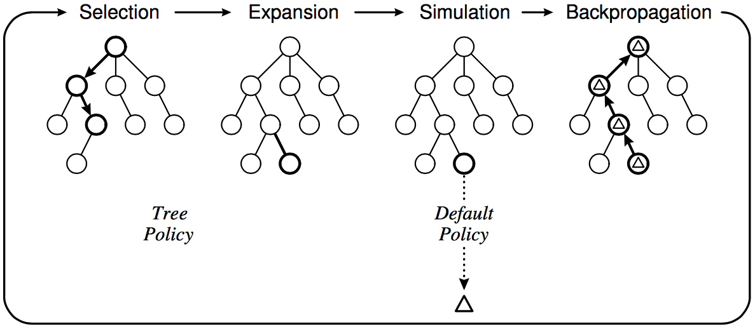
Stochastic search
Instead of depth-limited search with an evaluation function, use randomized simulations
Starting at the current state (root of search tree), iterate:
Select a leaf node for expansion using some type of random move selection policy
Continue until desired depth
For any given move, average the value of the final game states to determine the value of the move.
C. Browne et al., A survey of Monte Carlo Tree Search Methods, 2012

Slide 33
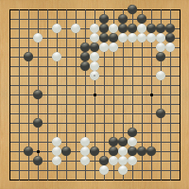
Case study: AlphaGo
“Gentlemen should not waste their time on trivial games -- they should play Go.”
-- Confucius,
The Analects
ca. 500 B. C. E.
Anton Ninno, Roy Laird, Ph.D.
antonninno@yahoo.com roylaird@gmail.com
special thanks to Kiseido Publications

Slide 34
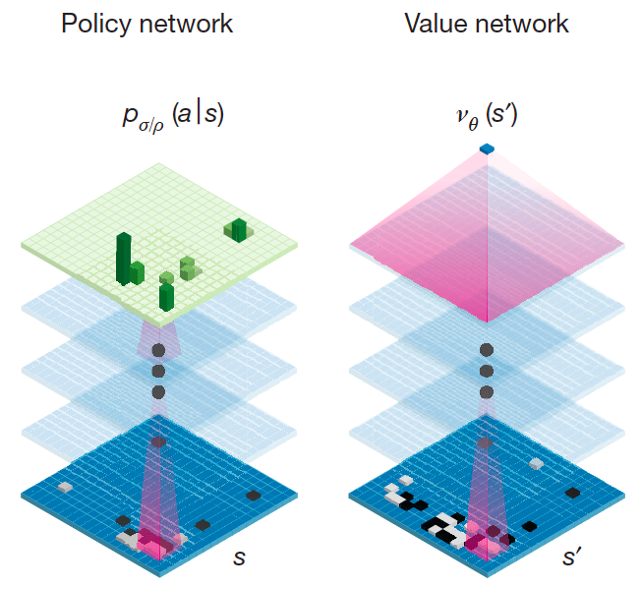
AlphaGo
Deep convolutional neural networks
Treat the Go board as an image
Can be trained to predict distribution over possible moves (policy) or expected value of position
D. Silver et al., Mastering the Game of Go with Deep Neural Networks and Tree Search, Nature 529, January 2016

Slide 35
AlphaGo
Policy network: Given a game state, $s$, predict what would be the best next move.
Input: game board as an image, $s$.
Output: $p(a|s)$, probability that action $a$ is best.
Value network: Given a game state, $s$, compute the expected value of the board for player 0 (MAX).
Input: game board as an image, $s$.
Output: $v(s)$, value of the game state.
D. Silver et al., Mastering the Game of Go with Deep Neural Networks and Tree Search, Nature 529, January 2016

Slide 36
Stochastic Search in AlphaGo
Each edge in the search tree has
Probabilities $p(a|s)$ computed by the policy network
State+Move values $Q\left(s,a\right)$ computed by the value network
Counts $N\left(s,a\right)$ specifying how many times that move has been tried
Tree traversal policy selects actions randomly according to some combination of $p(a|s)$, $Q\left(s,a\right)$, and $N\left(s,a\right)$
At the end of each simulation, values of the final boards are averaged in order to re-estimate the value of the initial move.

Slide 37
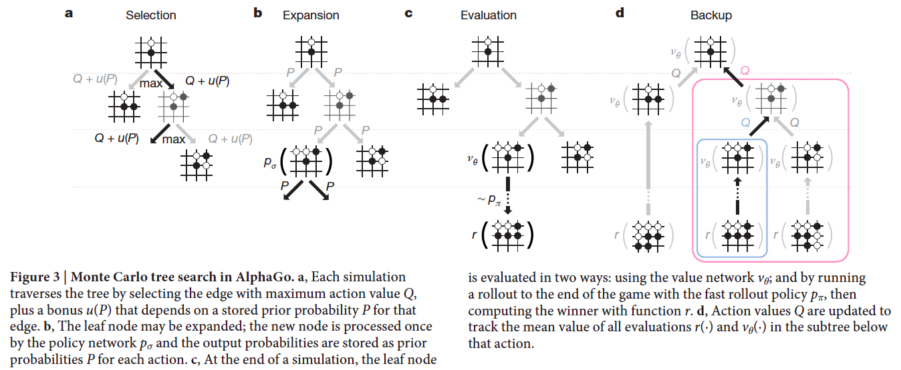
Stochastic Search in AlphaGo
D. Silver et al., Mastering the Game of Go with Deep Neural Networks and Tree Search, Nature 529, January 2016

Slide 38
Summary
A zero-sum game can be expressed as a minimax tree.
Limited-horizon search is always necessary (you can’t search to the end of the game), and always suboptimal.
Evaluation function: a relatively low-complexity function that estimates the value of the board (maybe linear, maybe a neural net)
Stochastic search: randomly choose moves, out to some pre-determined depth, then average the final board positions to estimate the value of the initial move

