Slide 1
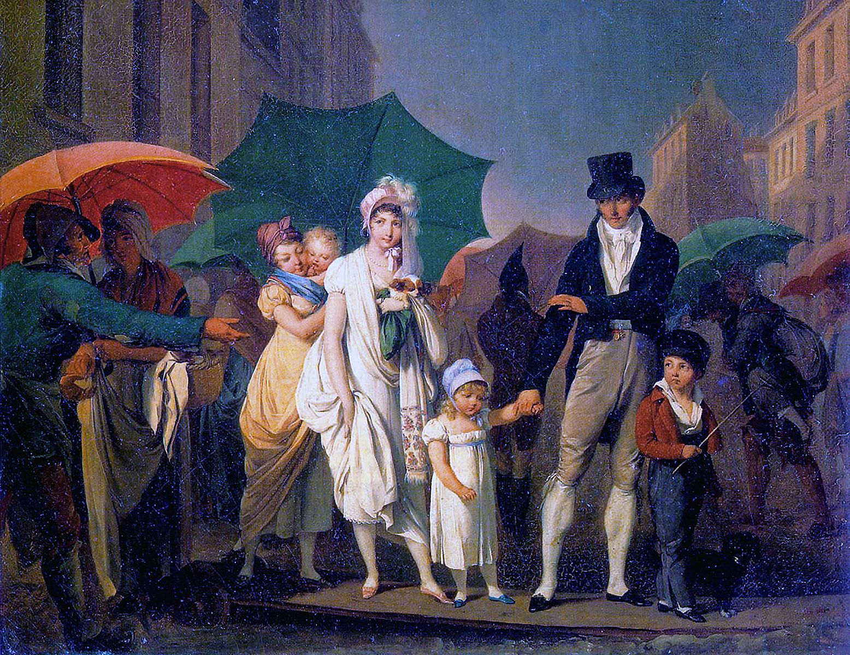
CS440/ECE448 Lecture 16: HMM Inference and the Viterbi Algorithm
Mark Hasegawa-Johnson, 3/2021
CC-BY 4.0: You may remix or redistribute if you cite the source.
Louis-Leopold Boilly, Passer Payez, 1803. Public domain work of art, https://en.wikipedia.org/wiki/Umbrella

Slide 2
Outline
Inference by Enumeration in an HMM
Decoding using the Viterbi Algorithm

Slide 3
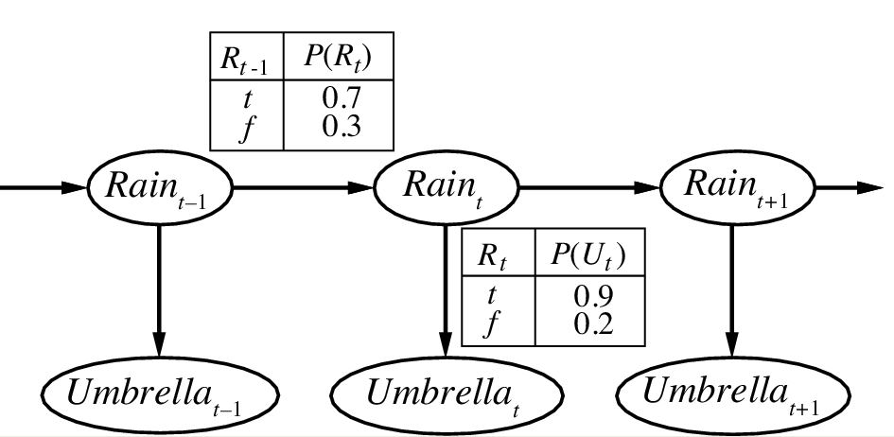
Example Scenario: UmbrellaWorld Characters from the novel Hammered by Elizabeth Bear, Scenario from chapter 15 of Russell & Norvig
Since he has read a lot about rain, Richard proposes a hidden Markov model:
Rain on day t-1 ($R_{t−1}$) makes rain on day t ($R_{t}$) more likely.
Elspeth usually brings her umbrella ($U_{t}$) on days when it rains ($R_{t}$), but not always.
state
observation
Notes:
The example is described in Section 15.1.1

Slide 4
Example Scenario: UmbrellaWorld Characters from the novel Hammered by Elizabeth Bear, Scenario from chapter 15 of Russell & Norvig
Initial
state
model
Richard has no idea whether or not it’s raining on day 1, so he assumes $P(R_{1})=0.5$.
Richard learns that the weather changes on 3 out of 10 days, thus
$$P\left(R_{t}|R_{t−1}\right)=0.7$$
$$P\left(R_{t}|{¬R}_{t−1}\right)=0.3$$
He also learns that Elspeth sometimes forgets her umbrella when it’s raining, and that she sometimes brings an umbrella when it’s not raining. Specifically,
$$P\left(U_{t}|R_{t}\right)=0.9$$
$$P\left(U_{t}|{¬R}_{t}\right)=0.2$$
Transition model
$$P\left(R_{1}\right)$$
$$0.5$$
state
observation
Observation model
Notes:
The example is described in Section 15.1.1

Slide 5
Inference in an HMM: Example
Initial
state
model
Transition
model
Elspeth has no umbrella on day 1.
Elspeth has an umbrella on day 2.
Assume $P\left(R_{1}\right)=0.5$
What is the probability that it’s raining on day 2?
$$P\left(R_{2}|¬U_{1},U_{2}\right)?$$
$$P\left(R_{1}\right)$$
$$0.5$$
state
observation
Observation model

Slide 6
Inference by Enumeration
To calculate a probability $P\left(R_{2}|U_{1}\text{,}U_{2}\right)$:
Select: which variables do we need, in order to model the relationship among $U_{1}$, $U_{2}$, and $R_{2}$?
We need also $R_{1}$.
Multiply to compute joint probability:
$$P\left(R_{1},R_{2},U_{1}\text{,}U_{2}\right)=P\left(R_{1}\right)P\left(U_{1}|R_{1}\right)…P\left(U_{2}|R_{2}\right)$$
Add to eliminate those we don’t care about
$$P\left(R_{2},U_{1}\text{,}U_{2}\right)=\sum_{R_{1}}{P\left(R_{1},R_{2},U_{1}\text{,}U_{2}\right)}$$
Divide: use Bayes’ rule to get the desired conditional
$$P\left(R_{2}|U_{1}\text{,}U_{2}\right)=P\left(R_{2},U_{1}\text{,}U_{2}\right)/P\left(U_{1}\text{,}U_{2}\right)$$
…
R₁
R₂
R_{T-1}
R_{T}
U₁
U₂
U_{T-1}
U_{T}

Slide 7
Computational Complexity of “Inference by Enumeration”
Russell & Norvig call this “inference by enumeration” because you have to enumerate every possible combination of $R_{1},R_{2},U_{1}\text{,}U_{2}$.
The complexity comes from this enumeration: if there are $2^{4}$ possible combinations, then the complexity can’t be less than $2^{4}$!

Slide 8
First simplification for HMMs: only enumerate the values of the hidden variables
Notice: we don’t really need to calculate $P\left(¬R_{1},R_{2},¬U_{1}\text{,}¬U_{2}\right)$ if we have already observed that $U_{2}$ is True!
First computational simplification for HMMs:
Only enumerate the possible values of the hidden variables.
Set the observed variables to their observed values.

Slide 9
Inference by Enumerating only the Hidden Variables
Multiply:
$$P\left(R_{1},R_{2},¬U_{1}\text{,}U_{2}\right)=$$
$$P\left(R_{1}\right)P\left(¬U_{1}|R_{1}\right)P\left(R_{2}|R_{1}\right)P\left(U_{2}|R_{2}\right)$$
Transition model
state
R₁
R₂
 | $$¬R_{1}¬U_{1}U_{2}$$ | $$R_{1}¬U_{1}U_{2}$$
$$¬R_{2}$$ | 0.056 | 0.003
$$R_{2}$$ | 0.108 | 0.0315
observation
U₁
U₂
Transition probabilities
Observation probabilities
 | R_{t} = T | R_{t} = F
R_{t-1} = T | 0.7 | 0.3
R_{t-1} = F | 0.3 | 0.7
 | U_{t} = T | U_{t} = F
R_{t} = T | 0.9 | 0.1
R_{t} = F | 0.2 | 0.8
We only compute joint probabilities that include the observed events, $¬U_{1}$ and $U_{2}$.
The numbers don’t add up to one; they add up to $P\left(¬U_{1}\text{,}U_{2}\right)$.
Notes:
The example is described in Section 15.1.1

Slide 10
Inference by Enumerating only the Hidden Variables
Add:
$$P\left(R_{2},¬U_{1}\text{,}U_{2}\right)=\sum_{R_{1}}{P\left(R_{1},R_{2},¬U_{1}\text{,}U_{2}\right)}$$
Transition model
state
R₁
R₂
 | $$¬U_{1}U_{2}$$
$$¬R_{2}$$ | 0.059
$$R_{2}$$ | 0.1395
observation
U₁
U₂
Transition probabilities
Observation probabilities
 | R_{t} = T | R_{t} = F
R_{t-1} = T | 0.7 | 0.3
R_{t-1} = F | 0.3 | 0.7
 | U_{t} = T | U_{t} = F
R_{t} = T | 0.9 | 0.1
R_{t} = F | 0.2 | 0.8
We only compute joint probabilities that include the observed events, $¬U_{1}$ and $U_{2}$.
The numbers don’t add up to one; they add up to $P\left(¬U_{1}\text{,}U_{2}\right)$.
Notes:
The example is described in Section 15.1.1

Slide 11
Inference by Enumerating only the Hidden Variables
Divide:
$$P\left(R_{2}|¬U_{1}\text{,}U_{2}\right)=\frac{P\left(R_{2},¬U_{1}\text{,}U_{2}\right)}{P\left(¬U_{1}\text{,}U_{2}\right)}$$
Transition model
state
R₁
R₂
 | $$¬U_{1}U_{2}$$
$$¬R_{2}$$ | 0.30
$$R_{2}$$ | 0.70
observation
U₁
U₂
Transition probabilities
Observation probabilities
 | R_{t} = T | R_{t} = F
R_{t-1} = T | 0.7 | 0.3
R_{t-1} = F | 0.3 | 0.7
 | U_{t} = T | U_{t} = F
R_{t} = T | 0.9 | 0.1
R_{t} = F | 0.2 | 0.8
Normalize, so that the column sums to one.
Notes:
The example is described in Section 15.1.1

Slide 12
First simplification for HMMs: only enumerate the values of the hidden variables
Only enumerate the possible values of the hidden variables. Set the observed variables to their observed values.
Inference with binary hidden variables: enumerate $\left(R_{1},…,R_{T}\right)$, complexity is $2^{T+1}=𝒪\left\{2^{T}\right\}$.
Inference with N-ary hidden variables: If each of the variables $R_{t}$ has N possible values, instead of only 2 possible values, then the inference complexity would be $𝒪\left\{N^{T}\right\}$.

Slide 13
Outline
Inference by Enumeration in an HMM
Decoding using the Viterbi Algorithm

Slide 14
Inference complexity in an HMM
$𝒪\left\{N^{T}\right\}$ is still a lot. Can we do better?
For a general Bayes net, no. Bayes net inference, in an arbitrary Bayes net, is NP-complete.
For an HMM, yes, we can do better.

Slide 15
Hard EM for an HMM: the Viterbi Algorithm
The Viterbi algorithm is the inference step of hard EM for an HMM.
Given a particular sequence of observations, what is the most likely underlying sequence of states?

Slide 16
Viterbi Algorithm Example
Given a particular sequence of observations, what is the most likely underlying sequence of states?
Example: given $U_{1}=F,U_{2}=T,U_{3}=T$, $U_{4}=F$
what is the most likely sequence of state variables, $R_{1},R_{2},R_{3},R_{4}$?

Slide 17
The Trellis
T
X-Axis = time
Y-Axis = state variable (rt)
Node = a particular state at a particular time
Edge = possible transition from $R_{t−1}$ to $R_{t}$
…
Value of the hidden variable, $R_{t}$
F
Time
$$U_{1}=F$$
$$U_{2}=T$$
$$U_{3}=T$$
$$U_{4}=F$$

Slide 18
A Path Through the Trellis
T
A path through the trellis is a sequence of connected states.
For example, this path is the sequence $R_{1}=T,R_{2}=F,R_{3}=T,R_{4}=T$
…
Value of the hidden variable, $R_{t}$
F
Time
$$U_{1}=F$$
$$U_{2}=T$$
$$U_{3}=T$$
$$U_{4}=F$$

Slide 19
Viterbi Algorithm Key Concept
Given a particular sequence of observations, what is the most likely underlying sequence of states?
In other words, given a particular sequence of observations, what is the most probable path through the trellis?

Slide 20
Viterbi Algorithm: Key concepts
Nodes and edges have numbers attached to them:
Edge Probability: Probability of taking that transition, and then generating the next observed output
$$e_{ijt}=P\left(R_{t}=j,U_{t}=u_{t}|R_{t−1}=i\right)$$
Node Probability: Probability of the best path until node j at time t
$$v_{jt}=\max_{r_{1},…,r_{t−1} }P\left(U_{1}=u_{1}…, U_{t}=u_{t},R_{1}=r_{1},…, R_{t}=j\right)$$

Slide 21
Edge Probabilities
T
$$e_{ijt}=P\left(R_{t}=j,U_{t}=u_{t}|R_{t−1}=i\right)$$
$$=P\left(R_{t}=j|R_{t−1}=i\right)×$$
$$P\left(U_{t}=u_{t}|R_{t}=j\right)$$
Notice that, since $U_{2}$ and $U_{3}$ have the same observed values, their inbound edges have the same weights.
0.63
0.63
0.07
0.06
0.06
0.24
…
Value of the hidden variable, $R_{t}$
0.27
0.27
0.03
0.14
0.14
0.56
F
Time
$$U_{1}=F$$
$$U_{2}=T$$
$$U_{3}=T$$
$$U_{4}=F$$

Slide 22
Node Probabilities
T
$$v_{jt}=\max_{r_{1},…,r_{t−1} }P\left(U_{1}=u_{1}…, U_{t}=u_{t},R_{1}=r_{1},…, R_{t}=j\right)$$
0.63
0.63
0.07
?
?
?
?
0.06
0.06
0.24
…
Value of the hidden variable, $R_{t}$
0.27
0.27
0.03
?
?
?
?
0.14
0.14
0.56
F
Time
$$U_{1}=F$$
$$U_{2}=T$$
$$U_{3}=T$$
$$U_{4}=F$$

Slide 23
Node Probabilities: Initialization
For example, let’s consider how to find $v_{jt}$ for $t=1$:
$$v_{j1}=P\left(U_{1}=u_{1},R_{1}=j\right)$$
$$=P\left(R_{1}=j\right)×P\left(U_{1}=u_{1}|R_{1}=j\right)$$
$$=\left\{\begin{matrix}(0.5)(0.1) & j=T \\ (0.5)(0.8) & j=F\end{matrix}\right.$$
T
0.63
0.63
0.07
0.05
?
?
?
0.06
0.06
0.24
…
Value of the hidden variable, $R_{t}$
0.27
0.27
0.03
0.40
?
?
?
0.14
0.14
0.56
F
Time
$$U_{1}=F$$
$$U_{2}=T$$
$$U_{3}=T$$
$$U_{4}=F$$

Slide 24
… and what about time t=2?
Notice that, at time t=2, there are two ways to get to any particular state:
The previous state might have been F
The previous state might have been T
T
0.63
0.63
0.07
0.05
?
?
?
0.06
0.06
0.24
…
Value of the hidden variable, $R_{t}$
0.27
0.27
0.03
0.40
?
?
?
0.14
0.14
0.56
F
Time
$$U_{1}=F$$
$$U_{2}=T$$
$$U_{3}=T$$
$$U_{4}=F$$

Slide 25
Viterbi Algorithm: the iteration step
Given edge probabilities defined as
$$e_{ijt}=P\left(R_{t}=j,U_{t}=u_{t}|R_{t−1}=i\right)$$
and node probabilities defined as
$$v_{jt}=\max_{r_{1},…,r_{t−2},i }P\left(U_{1}=u_{1}…, U_{t}=u_{t},R_{1}=r_{1},…,R_{t−1}=i,R_{t}=j\right)$$
The node probability can be efficiently computed as
$$v_{jt}=\max_{i } \left(\max_{r_{1},…,r_{t−2} }P\left(U_{1}=u_{1}…, U_{t−1}=u_{t−1},R_{1}=r_{1},…,R_{t−1}=i\right)×P\left(R_{t}=j,U_{t}=u_{t}|R_{t−1}=i\right) \right)$$

Slide 26
Viterbi Algorithm: the iteration step
Given edge probabilities defined as
$$e_{ijt}=P\left(R_{t}=j,U_{t}=u_{t}|R_{t−1}=i\right)$$
and node probabilities defined as
$$v_{jt}=\max_{r_{1},…,r_{t−2},i }P\left(U_{1}=u_{1}…, U_{t}=u_{t},R_{1}=r_{1},…,R_{t−1}=i,R_{t}=j\right)$$
The node probability can be efficiently computed as
$$v_{jt}=\max_{i } v_{i,t−1}e_{ijt}$$

Slide 27
… and what about time t=2?
$$v_{T,2}=\max_{i } v_{i1}e_{i,T,2}$$
$$=\max\left(\left(0.05\right)\left(0.63\right),(0.4)(0.27)\right)$$
$$= 0.108$$
T
0.63
0.63
0.07
0.05
.108
?
?
0.06
0.06
0.24
…
Value of the hidden variable, $R_{t}$
0.27
0.27
0.03
0.40
?
?
?
0.14
0.14
0.56
F
Time
$$U_{1}=F$$
$$U_{2}=T$$
$$U_{3}=T$$
$$U_{4}=F$$

Slide 28
… and what about time t=2?
$$v_{T,2}=\max_{i }v_{i1}e_{i,T,2}$$
$$=\max\left(\left(0.05\right)\left(0.63\right),(0.4)(0.27)\right)$$
$$= 0.108$$
$$v_{F,2}=\max_{i } v_{i1}e_{i,F,2}$$
$$=\max\left(\left(0.05\right)\left(0.06\right),(0.4)(0.14)\right)$$
$$= 0.056$$
T
0.63
0.63
0.07
0.05
.108
?
?
0.06
0.06
0.24
…
Value of the hidden variable, $R_{t}$
0.27
0.27
0.03
0.40
.056
?
?
0.14
0.14
0.56
F
Time
$$U_{1}=F$$
$$U_{2}=T$$
$$U_{3}=T$$
$$U_{4}=F$$

Slide 29
Node probabilities and backpointers
Node Probability: Probability of the best path until node j at time t
$$v_{jt}=\max_{r_{1},…,r_{t−2},i}P\left(U_{1}=u_{1}…, U_{t}=u_{t},R_{1}=r_{1},…,R_{t−1}=i,R_{t}=j\right)$$
Backpointer: which node, $i$, precedes node $j$ on the best path?
$$i_{jt}^{∗}=\underset{r_{1},…,r_{t−2},i}{argmax}P\left(U_{1},=u_{1}…, U_{t}=u_{t},R_{1}=r_{1},…,R_{t−1}=i,R_{t}=j\right)$$

Slide 30
Backpointers at t=2
$$i_{T,2}^{∗}=\underset{i }{argmax}{ v}_{i1}e_{i,T,2}$$
$$=\operatorname{argmax}\left(\begin{aligned}\left(0.05\right)\left(0.63\right), \\ (0.4)(0.27)\end{aligned}\right)$$
$$=F$$
$$i_{F,2}^{∗}=\underset{i }{argmax}{ v}_{i1}e_{i,F,2}$$
$$=\operatorname{argmax}\left(\begin{aligned}\left(0.05\right)\left(0.06\right), \\ (0.4)(0.14)\end{aligned}\right)$$
$$=F$$
T
0.63
0.63
0.07
0.05
.108
?
?
0.06
0.06
0.24
…
Value of the hidden variable, $R_{t}$
0.27
0.27
0.03
0.40
.056
?
?
0.14
0.14
0.56
F
Time
$$U_{1}=F$$
$$U_{2}=T$$
$$U_{3}=T$$
$$U_{4}=F$$

Slide 31
Backpointers at t=3
$$i_{T,3}^{∗}=\underset{i }{argmax}{ v}_{i2}e_{i,T,3}$$
$$=\operatorname{argmax}\left(\begin{aligned}\left(0.108\right)\left(0.63\right), \\ (0.056)(0.27)\end{aligned}\right)$$
$$=T$$
$$i_{F,3}^{∗}=\underset{i }{argmax}{ v}_{i2}e_{i,F,3}$$
$$=\operatorname{argmax}\left(\begin{aligned}\left(0.108\right)\left(0.06\right), \\ (0.056)(0.14)\end{aligned}\right)$$
$$=F$$
T
0.63
0.63
0.07
0.05
.108
.068
?
0.06
0.06
0.24
…
Value of the hidden variable, $R_{t}$
0.27
0.27
0.03
0.40
.056
.008
?
0.14
0.14
0.56
F
Time
$$U_{1}=F$$
$$U_{2}=T$$
$$U_{3}=T$$
$$U_{4}=F$$

Slide 32
Backpointers at t=4
$$i_{T,4}^{∗}=\underset{i }{argmax}v_{i3}e_{i,T,4}$$
$$=\operatorname{argmax}\left(\begin{aligned}\left(0.068\right)\left(0.07\right), \\ (0.008)(0.03)\end{aligned}\right)$$
$$=T$$
$$i_{F,4}^{∗}=\underset{i }{argmax}{ v}_{i3}e_{i,F,4}$$
$$=\operatorname{argmax}\left(\begin{aligned}\left(0.068\right)\left(0.24\right), \\ (0.008)(0.56)\end{aligned}\right)$$
$$=T$$
T
0.63
0.63
0.07
0.05
.108
.068
.005
0.06
0.06
0.24
…
Value of the hidden variable, $R_{t}$
0.27
0.27
0.03
0.40
.056
.008
.016
0.14
0.14
0.56
F
Time
$$U_{1}=F$$
$$U_{2}=T$$
$$U_{3}=T$$
$$U_{4}=F$$

Slide 33
So which is the best path?
Answer: whichever one is most probable.

Slide 34
Node probabilities at t=4
$$v_{T,4}=\max_{i } v_{i3}e_{i,T,4}$$
$$=\max\left(\begin{aligned}\left(0.068\right)\left(0.07\right), \\ (0.008)(0.03)\end{aligned}\right)$$
$$=0.005$$
$$v_{F,4}=\max_{i } v_{i3}e_{i,F,4}$$
$$=\max\left(\begin{aligned}\left(0.068\right)\left(0.24\right), \\ (0.008)(0.56)\end{aligned}\right)$$
$$=0.016$$
The best path is the one that ends at $R_{4}=F$
T
0.63
0.63
0.07
0.05
.108
.068
.005
0.06
0.06
0.24
…
Value of the hidden variable, $R_{t}$
0.27
0.27
0.03
0.40
.056
.008
.016
0.14
0.14
0.56
F
Time
$$U_{1}=F$$
$$U_{2}=T$$
$$U_{3}=T$$
$$U_{4}=F$$

Slide 35
Termination: which is the best path?
Best final state is whichever final state has the highest node probability.
The best path leading to that state is the most probable one
… but we’ve already found the most probable path…
…we just need to follow the backpointers!

Slide 36
Follow the backpointers!
Given the observations
$$U_{1},U_{2},U_{3},U_{4}=F,T,T,F$$
… and given our hidden Markov model, we conclude that the most probable sequence of state variables is
$$R_{1},R_{2},R_{3},R_{4}=F,T,T,F$$
T
0.63
0.63
0.07
0.05
.108
.068
.005
0.06
0.06
0.24
…
Value of the hidden variable, $R_{t}$
0.27
0.27
0.03
0.40
.056
.008
.016
0.14
0.14
0.56
F
Time
$$U_{1}=F$$
$$U_{2}=T$$
$$U_{3}=T$$
$$U_{4}=F$$

Slide 37
Some conclusions
We have discovered that, if Elspeth brings her umbrella only on days 2 and 3, then the best inference is that it’s raining on only those days.
Well, this was kind of obvious from the beginning!

Slide 38
Some conclusions
Other types of HMMs might be less obvious. For example, consider the following assertion:
A fly flies well. A well does not fly.
In order to decide if these sentences are true or false, you first need to know which words are nouns, which verbs, and which adverbs.
In MP4, you will solve this problem using an HMM.
State variable = part of speech
Observation = word
Transition model: verbs tend to come after nouns.

Slide 39
Final Word: Computational Complexity
Inference by Enumeration in an HMM: $𝒪\left\{N^{T}\right\}$
$$P\left(vars you care about\right)=\sum_{don^{′}t−care vars}{P\left(all vars\right)}$$
Decoding using the Viterbi Algorithm: $𝒪\left\{TN^{2}\right\}$
$$v_{jt}=\max_{i } v_{i,t−1}e_{ijt}$$
Max over N values of $i$, performed for N values of $j$, and for T values of $t$.

