Slide 1
CS440/ECE448 Lecture 12: Autograd
Mark Hasegawa-Johnson
Spring 2021

Slide 2
Outline
Running example: neural net regression
The same example with autograd
forward() saves the state, backward() uses it
torch.nn module: using predefined neural net components
torch.optim module: using predefined second-order optimizers

Slide 3
Running example: neural net regression
So far, we’ve studied classification: network outputs $P(Y=y|X=x)$
A regression network learns a function $\hat{y}=f(x)$ so that the resulting $\hat{y}$ approximates a desired real-valued $y$ as well as possible
A regression network is trained to minimize the mean-squared error or sum-squared error:
$$ℒ=\sum_{i=1}^{n}{{\left({\hat{y}}_{i}−y_{i}\right)}^{2}}$$
Where $(x_{i},y_{i})$ is a training example, and ${\hat{y}}_{i}=f(x_{i})$.

Slide 4
Running example: neural net regression
For example, suppose $y=sin⁡(x)$
Suppose that the network can only model functions of the form
$$\hat{y}=a+bx+cx^{2}+dx^{3}$$
We want to learn a, b, c, d so that $\hat{y} ≈y$

Slide 5
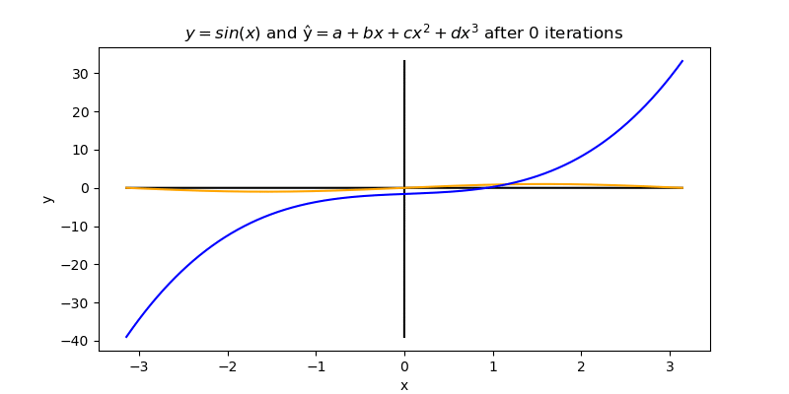
Running example: neural net regression

Slide 6
How a neural network is trained
A neural network is trained using gradient descent. In this case, each iteration updates a, b, c, and d using the equations
$$a=a−η\frac{dℒ}{da}, b=b−η\frac{dℒ}{db}$$
$$c=c−η\frac{dℒ}{dc}, d=d−η\frac{dℒ}{dd}$$
Where, in this case, $η=$1e-6.

Slide 7
How a neural network is trained
Let’s work out the derivatives.
$${\hat{y}}_{i}=a+bx_{i}+c{x_{i}}^{2}+d{x_{i}}^{3}, ℒ=\sum_{i=1}^{n}{{\left({\hat{y}}_{i}−y_{i}\right)}^{2}}$$
$$\frac{dℒ}{da}=\sum_{i=1}^{n}{\frac{dℒ}{d{\hat{y}}_{i}}\frac{d{\hat{y}}_{i}}{da}}$$
$$\frac{dℒ}{d{\hat{y}}_{i}}=2\left({\hat{y}}_{i}−y_{i}\right), \frac{d{\hat{y}}_{i}}{da}=1$$

Slide 8
How a neural network is trained
Calculate $\frac{dℒ}{d{\hat{y}}_{i}}$
Calculate $\frac{dℒ}{da}$ as $\frac{dℒ}{da}=\sum_{i=1}^{n}{\frac{dℒ}{d{\hat{y}}_{i}}}$
Calculate $\frac{dℒ}{db}$ as $\frac{dℒ}{db}=\sum_{i=1}^{n}{\frac{dℒ}{d{\hat{y}}_{i}}}x_{i}$
Calculate $\frac{dℒ}{dc}$ as $\frac{dℒ}{dc}=\sum_{i=1}^{n}{\frac{dℒ}{d{\hat{y}}_{i}}}{x_{i}}^{2}$
Calculate $\frac{dℒ}{dd}$ as $\frac{dℒ}{dd}=\sum_{i=1}^{n}{\frac{dℒ}{d{\hat{y}}_{i}}}{x_{i}}^{3}$
Perform the gradient updates: $a=a−η\frac{dℒ}{da}, b=b−η\frac{dℒ}{db}, c=c−η\frac{dℒ}{dc}, d=d−η\frac{dℒ}{dd}$

Slide 9
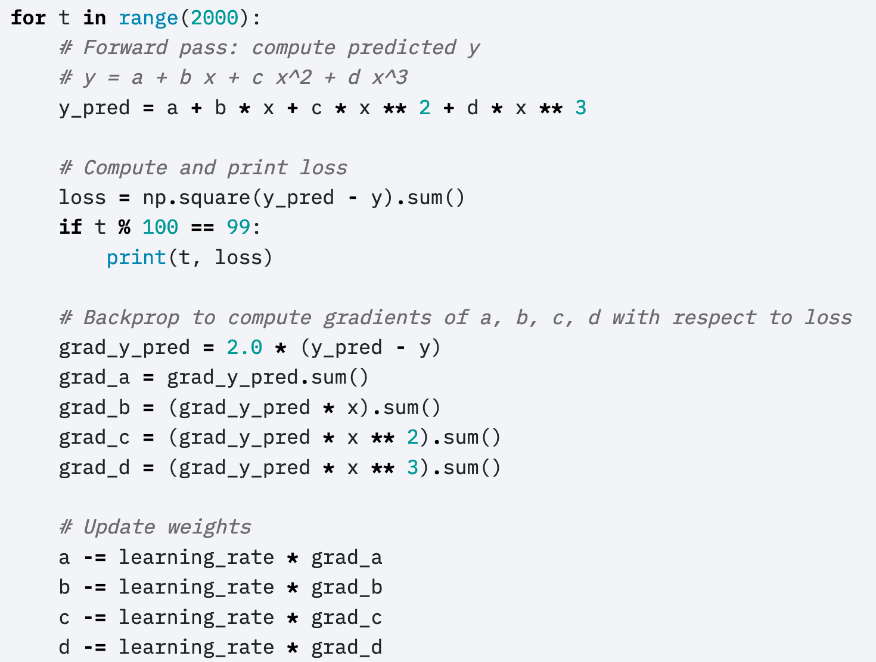
How a neural network is trained
Here’s Justin Johnson’s code for doing those things:
(https://pytorch.org/tutorials/beginner/pytorch_with_examples.html)
© 2017 Pytorch, https://pytorch.org/tutorials/beginner/pytorch_with_examples.html

Slide 10
Outline
Running example: neural net regression
The same example with autograd
forward() saves the state, backward() uses it
torch.nn module: using predefined neural net components
torch.optim module: using predefined second-order optimizers

Slide 11
Autograd
A neural network is a complicated function $\hat{y}=f(x)$, made up of many simple components
If we try to take all the derivatives, $dℒ/dw_{jk}^{(l)}$, all at once, in a big mass of spaghetti code, then the code will be really ugly.
HOWEVER: Each of the components is simple to compute. Furthermore, the derivative of its output w.r.t. its input is simple.

Slide 12
Autograd
The basic idea of autograd is to create a new kind of object that takes responsibility for its own gradient.
For example, the object might be a network weight, $w_{jk}^{(l)}$

Slide 13
Autograd
In pytorch, variables that take responsibility for their own gradients are called “tensors” (https://pytorch.org/docs/stable/tensors.html)
Here’s how Justin Johnson defines tensors for the polynomial regression problem:
© 2017 Pytorch, https://pytorch.org/tutorials/beginner/pytorch_with_examples.html

Slide 14
Autograd
The basic idea of autograd is to create a new kind of object that takes responsibility for its own gradient.
For example, the object might be a network weight, $w_{jk}^{(l)}$
These new objects have overloaded operators, so that any time we use them to compute some output, the input is cached.

Slide 15
Autograd
The operator overload code looks something like this:
class Tensor(torch.autograd.Function):
def __init__(self, weight):
self.weight = weight
self.saved_tensors = ()
def __mul__(self, other):
self.saved_tensors = (self.saved_tensors[:], other)
returnvalue = self.weight * other
return Tensor(returnvalue)
Cache the input, so we can use it later…
Use numpy’s __mul__ operator to compute the return value…
Cast the return value as a Tensor.

Slide 16
Autograd
Here’s how it gets used:
Stores x in b.saved_tensors
Stores x**2 in c.saved_tensors

Slide 17
Autograd
The basic idea of autograd is to create a new kind of object that takes responsibility for its own gradient.
For example, the object might be a network weight, $w_{jk}^{(l)}$
These new objects have overloaded operators, so that any time we use them to compute some output, the input is cached.
During the backward() function, the “network weight” is given the loss gradient with respect to its output, $dℒ/d({w_{jk}^{\left(l\right)}h}_{k}^{\left(l−1\right)})$, from which it computes its input gradient, $dℒ/dh_{k}^{\left(l−1\right)}$, and returns it to the calling function.
It also computes its own gradient, $dℒ/dw_{jk}^{\left(l\right)}$, and stores it internally.

Slide 18
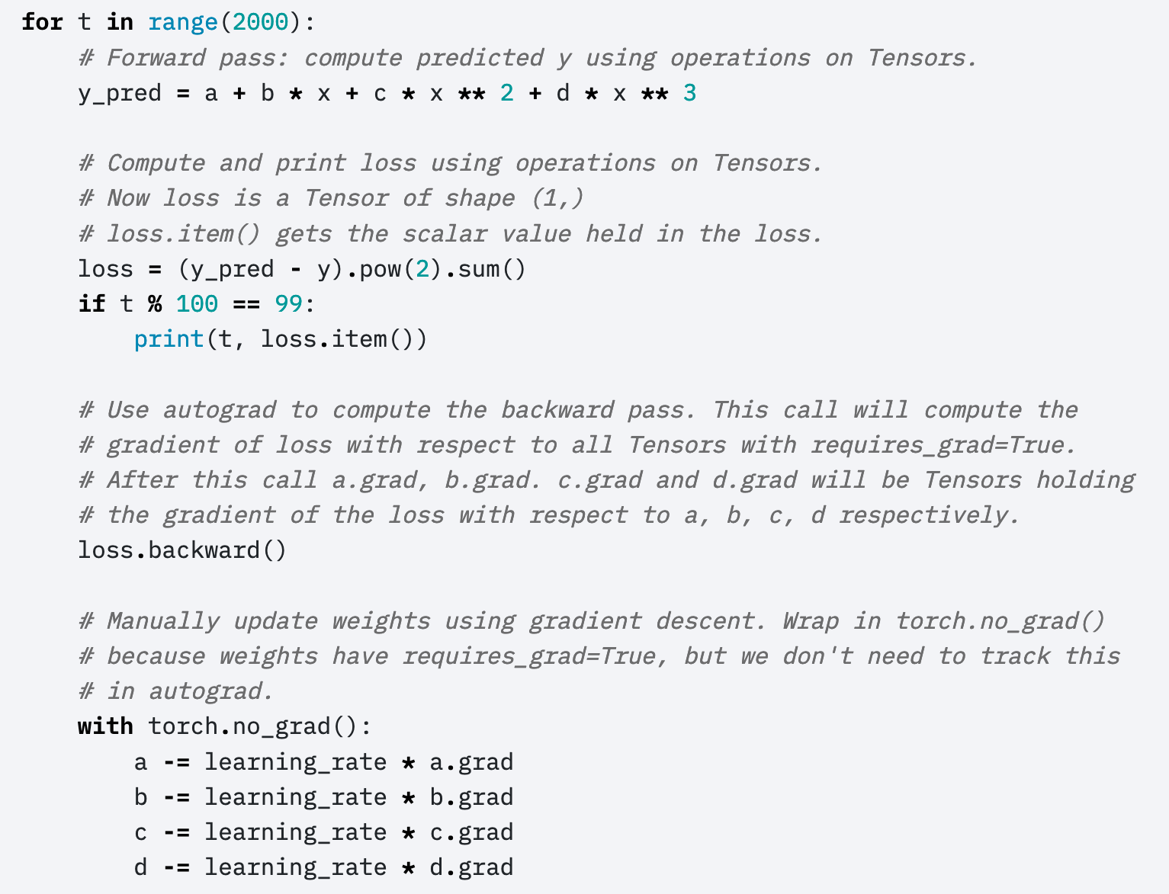
Autograd
loss depends on y_pred, which depends on a, b, c, d.
Calculates the derivative of the loss w.r.t. each of its input tensors.
Uses the resulting derivatives to update the weights.

Slide 19
How to turn off autograd
As you know, every time you add, subtract, multiply or divide a tensor by anything, the tensor stores data in self.saved_tensors, so it can use that information later to compute the gradient
How do you turn this behavior off?

Slide 20
Dynamically turning off Autograd
These weight updates are not part of the neural network forward pass.

Slide 21
Statically turning autograd on and off
a.requires_grad = False
…
(do some stuff for which you don’t want to keep track of gradients)
…
a.requires_grad = True
…
(go back to doing stuff that requires keeping track of gradients)

Slide 22
How to zero out the gradients
When you call backward() over a tensor, it doesn’t zero out any previous gradients
Instead, it adds the current gradient to the previous gradients
A very very very common mistake: running 2000 iterations, with the gradient accumulating from each iteration to the next, instead of zeroing it out in between iterations

Slide 23
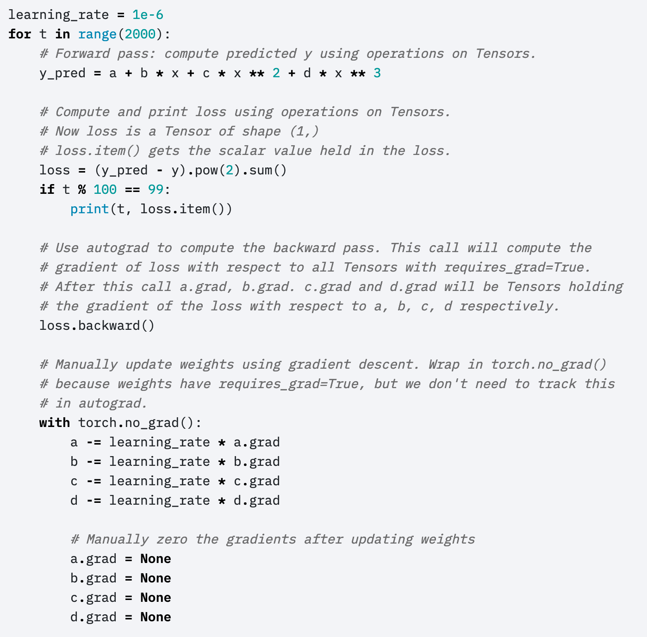
Manually zeroing out the gradients
Here’s the part I didn’t show you before.

Slide 24
Outline
Running example: neural net regression
The same example with autograd
forward() saves the state, backward() uses it
torch.nn module: using predefined neural net components
torch.optim module: using predefined second-order optimizers

Slide 25
Internal state
Being responsible for your own gradient means that you have to cache internal state variables, containing any information you will need, in the future, to compute your own gradient.

Slide 26
Example: Legendre polynomial
Justin Johnson uses this example. Suppose we want an operation that computes a third-order Legendre polynomial:
$$o = \frac{1}{2}(5i^{3}−3i)$$
…where $i$is the input to this module, and $o$ is its output.
The derivative dL/di can be computed from dL/do as:
$$\frac{dℒ}{di}=\frac{dℒ}{do}\frac{do}{di}=\frac{dℒ}{do}\frac{3}{2}(5i^{2}−1)$$

Slide 27
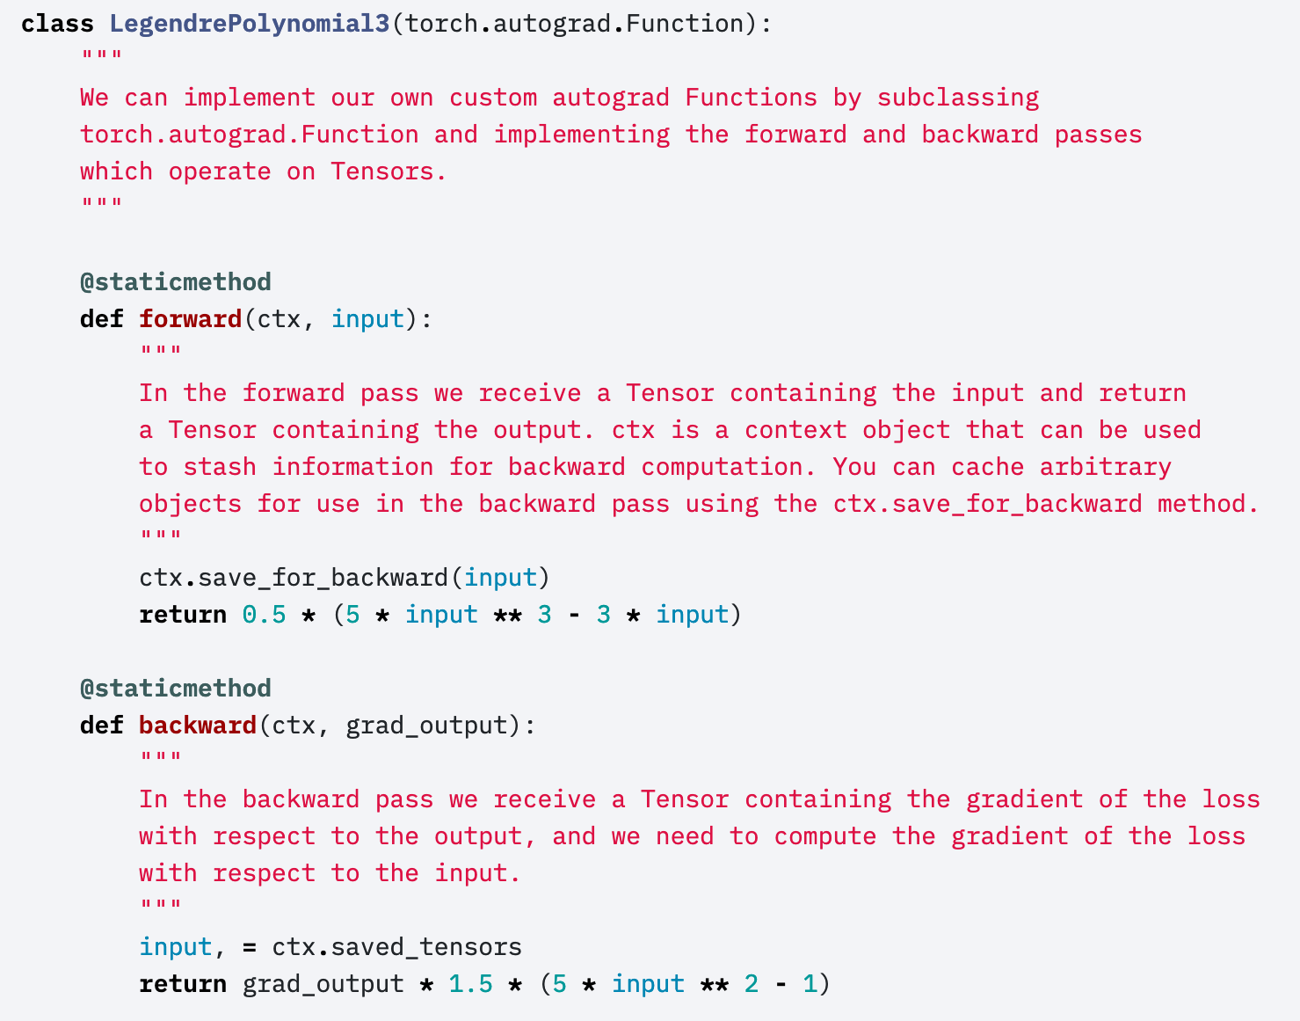
Example: Legendre polynomial
$$o = \frac{1}{2}(5i^{3}−3i)$$
$$\frac{dℒ}{di}=\frac{dℒ}{do}\frac{3}{2}(5i^{2}−1)$$

Slide 28
Outline
Running example: neural net regression
The same example with autograd
forward() saves the state, backward() uses it
torch.nn module: using predefined neural net components
torch.optim module: using predefined second-order optimizers

Slide 29
Pytorch nn module
The autograd feature of pytorch allows you to define only the forward propagation of your neural net. As long as all of the component operations are in pytorch’s library, the back-propagation will be computed for you.
Tensors just do multiplication and addition. What about other types of operations?
General operations are contained in the nn module, using the formalism of a “layer.”

Slide 30
Some types of layers
torch.nn.Linear: a layer that computes $o=iW^{T}+b$
torch.nn.Softmax: a layer that computes $o_{j}=\frac{exp⁡(i_{j})}{\sum_{k}{exp⁡(i_{k})}}$
torch.nn.Sigmoid: a layer that computes $o_{j}=\frac{1}{1−exp⁡(−i_{j})}$
torch.nn.ReLU: a layer that computes $o_{j}=max⁡(0,i_{j})$
torch.nn.Sequential: a model that takes a sequence of layers as its arguments, and applies them, one after the other, in order

Slide 31
torch.nn.Linear
To create the layer object, you call: m=torch.nn.Linear(n_in,n_out)
This creates and initializes a weight matrix in m.weight
It also creates and initializes a bias vector in m.bias
Once you’ve created the object, you can apply it in the forward pass to some input data as output=m(input)
input needs to be a tensor of size (…,n_in)
output will be a tensor of size (…,n_out)
To compute backprop, you could then call output.backward()
…or, you can call backward() on any tensor that is computed from output
The resulting gradient is stored in m.weight.grad and m.bias.grad
Weight update needs to be computed explicitly
m.weight -= learning_rate * m.weight.grad

Slide 32
m=torch.nn.Linear(n_1,n_2)
This creates a model such that o=m(i) performs, on each row of i, the operation:
$$o=iW^{T}+b$$
i can be a tensor of any size, as long as its last dimension (the dimension of each row) is n_1
o is then a tensor of the same shape as i, except that its last dimension (the row length) is now n_2
m.weight (W) is a tensor of size (n_2,n_1)
m.bias (b) is a row vector of length n_2

Slide 33
Example: Linear, Sigmoid, Softmax
$$h_{0}^{(2)}$$
$$h_{1}^{(2)}$$
Here’s an example from lecture 10. We could create the layers as:
excitation1 = torch.nn.Linear(2,3)
activation1 = torch.nn.ReLU()
excitation2 = torch.nn.Linear(3,2)
activation2 = torch.nn.Softmax(2)
Having created them, we could then run forward pass as:
e1 = excitation1(x)
h1 = activation1(e1)
e2 = excitation2(h1)
h2 = activation2(e2)
Then we could calculate all of the gradients by running
h2.backward()
$$g^{(2)}$$
$$g^{(2)}$$
$$e_{0}^{(2)}$$
$$e_{1}^{(2)}$$
$$h_{1}^{(1)}$$
$$h_{2}^{(1)}$$
$$h_{3}^{(1)}$$
$$g^{(1)}$$
$$g^{(1)}$$
$$g^{(1)}$$
$$e_{1}^{(1)}$$
$$e_{2}^{(1)}$$
$$e_{3}^{(1)}$$
$$x_{1}$$
$$x_{2}$$

Slide 34
torch.nn.Sequential
$$h_{0}^{(2)}$$
$$h_{1}^{(2)}$$
torch.nn.Sequential is a special module that creates a sequence of layers, where each layer’s output is the next layer’s input. For example:
model = torch.nn.Sequential(
torch.nn.Linear(2,3),
torch.nn.ReLU(),
torch.nn.Linear(3,2),
torch.nn.Softmax(2))
Then you can run forward pass by just typing:
h2 = model(x)
You can still calculate all of the gradients by running
h2.backward()
$$g^{(2)}$$
$$g^{(2)}$$
$$e_{0}^{(2)}$$
$$e_{1}^{(2)}$$
$$h_{1}^{(1)}$$
$$h_{2}^{(1)}$$
$$h_{3}^{(1)}$$
$$g^{(1)}$$
$$g^{(1)}$$
$$g^{(1)}$$
$$e_{1}^{(1)}$$
$$e_{2}^{(1)}$$
$$e_{3}^{(1)}$$
$$x_{1}$$
$$x_{2}$$

Slide 35
torch.nn.Sequential: where are the parameters?
The layers each have their own parameters, for example, a model created using the commands on the previous slide would have
model[0].weight
model[0].bias
model[2].weight
model[2].bias
Accessing them that way requires you to know which layers have weights and biases, and which don’t. An easier way is to use the function model.parameters(), which iterates through all trainable parameters, regardless of where they are actually stored:
for param in model.parameters():
param -= learning_rate * param.grad

Slide 36
Outline
Running example: neural net regression
The same example with autograd
forward() saves the state, backward() uses it
torch.nn module: using predefined neural net components
torch.optim module: using predefined optimizers

Slide 37
torch.optim: let pytorch do your optimization
Gradient descent is easy to implement yourself
You should remember from calculus: Newton’s method is not just gradient descent. It’s actually
$$w←w−\frac{dℒ/dw}{d^{2}ℒ/{dw}^{2}}$$
Putting the second derivative in the denominator saves us from having to guess the learning rate, so the NN converges in far fewer optimization steps.
Unfortunately, computing the second derivative with respect to a large parameter vector is computationally expensive.
In practice, people use many different types of approximate second-order methods: Adam, LBFGS, RMSprop…. These are computationally cheap but require complicated code, therefore pytorch wrote the code for us.

Slide 38
How to use torch.optim
Instead of computing the loss yourself, use pytorch’s implementation:
loss_fn = torch.nn.MSELoss(reduction='sum’)
loss = loss_fn(y_pred, y)
Instead of doing parameter update yourself, use pytorch’s implementation:
optimizer = torch.optim.SGD(model.parameters(), lr=learning_rate)
loss.backward()
optimizer.step()
… that last step does the parameter update, i.e., all the work that we used to do in:
param -= learning_rate * param.grad

Slide 39
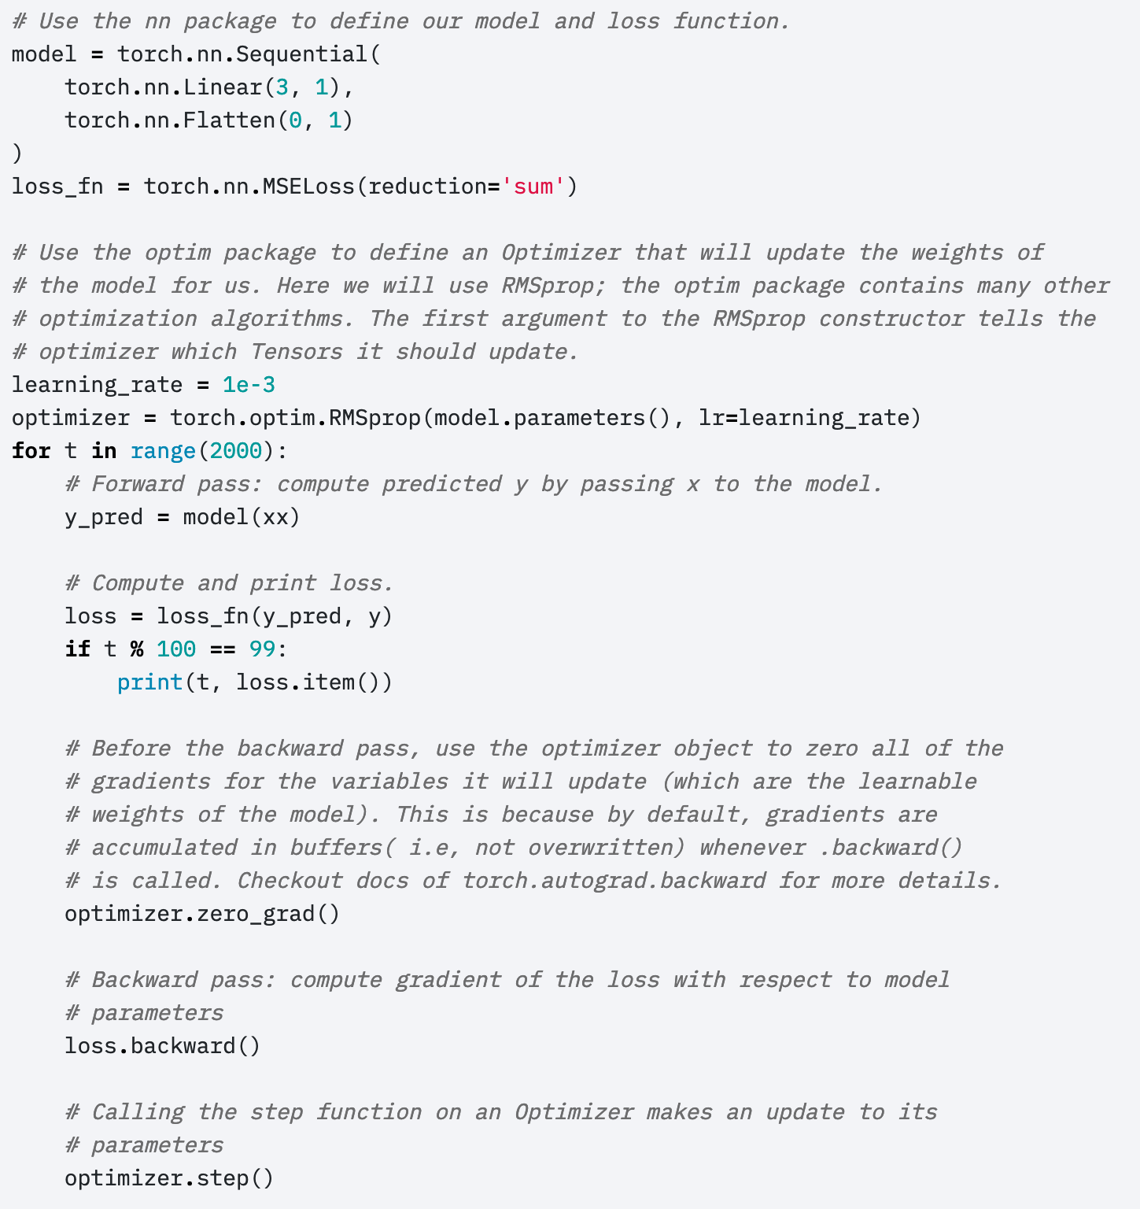
Complete example, in the recommended style
Model
Loss Function
© 2017 Pytorch, https://pytorch.org/tutorials/beginner/pytorch_with_examples.html
Optimizer
Forward Prop
Calculate the loss
Zero out the gradient
Calculate the gradient
Update the model parameters

Slide 40
Outline
Running example: neural net regression
The same example with autograd
forward() saves the state, backward() uses it
torch.nn module: using predefined neural net components
torch.optim module: using predefined second-order optimizers

