Slide 1
Lecture 10: Back-Propagation
$$h_{1}^{(L)}$$
$$h_{2}^{(L)}$$
$$h_{V}^{(L)}$$
$$1$$
Mark Hasegawa-Johnson
March 1, 2021
License: CC-BY 4.0. You may remix or redistribute if you cite the source.
$$1$$
$$h_{1}^{(0)}$$
$$h_{2}^{(1)}$$
$$…$$
$$h_{D}^{(0)}$$
$$1$$

Slide 2
Outline
Breaking the constraints of linearity: multi-layer neural nets
What’s inside a multi-layer neural net?
Forward-propagation example
Gradient descent
Finding the derivative: back-propagation

Slide 3
Biological Inspiration: McCulloch-Pitts Artificial Neuron, 1943
Input
In 1943, McCulloch & Pitts proposed that biological neurons have a nonlinear activation function (a step function) whose input is a weighted linear combination of the currents generated by other neurons.
They showed lots of examples of mathematical and logical functions that could be computed using networks of simple neurons like this.
Weights
x₁
w₁
x₂
w₂
Output: u(w⋅x)
x₃
w₃
.
.
.
w_{D}
x_{D}

Slide 4
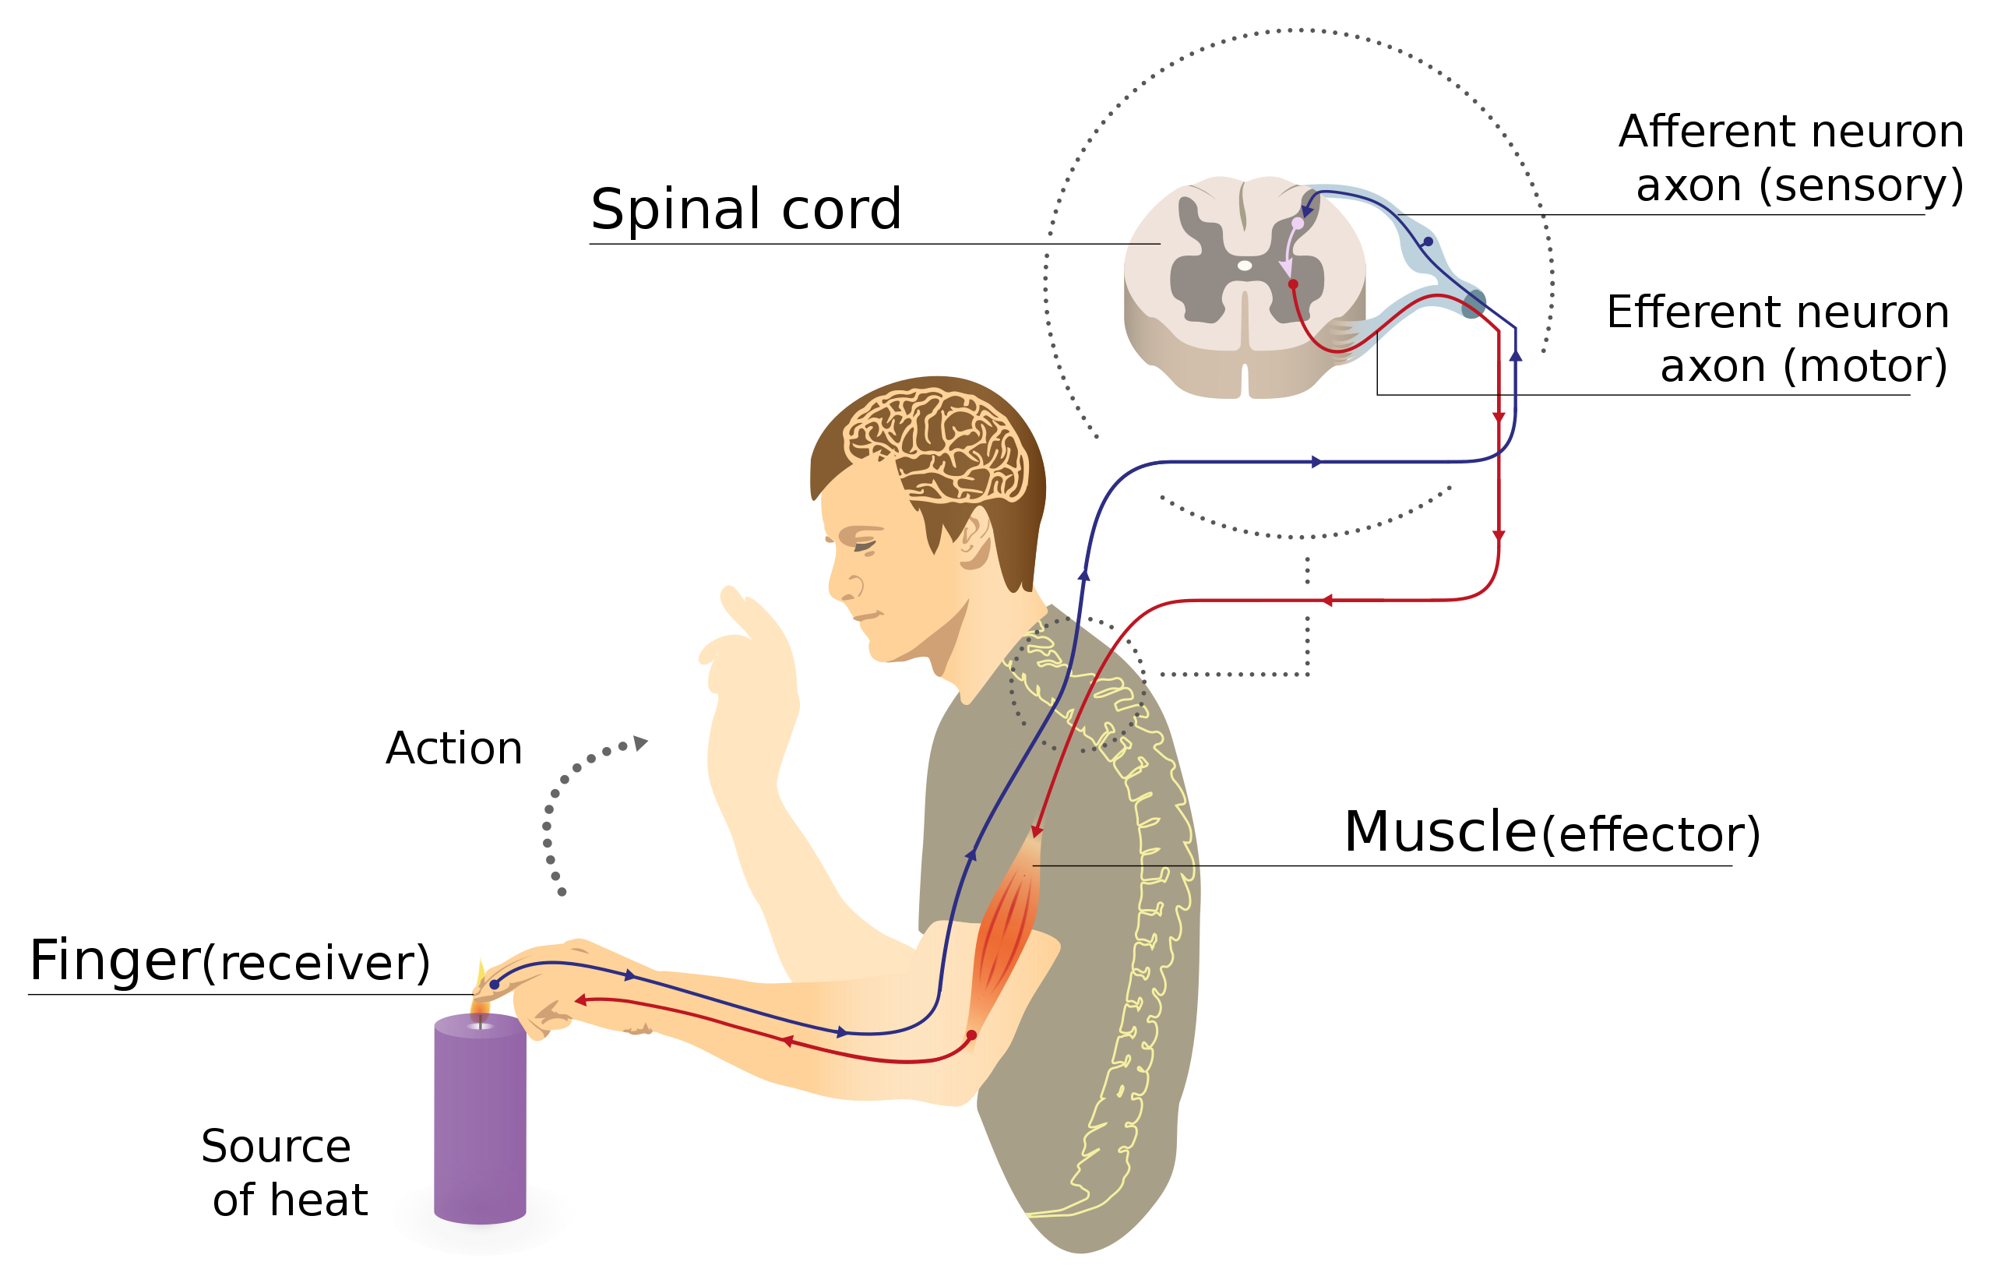
Biological Inspiration: Neuronal Circuits
Even the simplest actions involve more than one neuron, acting in sequence in a neuronal circuit.
One of the simplest neuronal circuits is a reflex arc, which may contain just two neurons:
The sensor neuron detects a stimulus, and communicates an electrical signal to …
The motor neuron, which activates the muscle.
Illustration of a reflex arc: sensor neuron sends a voltage spike to the spinal column, where the resulting current causes a spike in a motor neuron, whose spike activates the muscle.
By MartaAguayo - Own work, CC BY-SA 3.0, https://commons.wikimedia.org/w/index.php?curid=39181552

Slide 5
A McCulloch-Pitts Neuron can compute some logical functions…
When the features are binary ($x_{j}∈\{0,1\}$), many (but not all!) binary functions can be re-written as linear functions. For example, the function
$$\hat{y}=(x_{1}∨x_{2})$$
can be re-written as
$$\hat{y}=u\left(x_{1}+x_{2}−0.5\right)$$
Similarly, the function
$$\hat{y}=(x_{1}∧x_{2})$$
can be re-written as
$$\hat{y}=u\left(x_{1}+x_{2}−1.5\right)$$
$$x_{2}$$
$$x_{2}$$
$$x_{1}$$
$$x_{1}$$

Slide 6
… but not all.
“A linear classifier cannot learn an XOR function.”
…but a two-layer neural net can compute an XOR function!
$$x_{2}$$
$$x_{1}$$

Slide 7
Feature Learning: A way to think about neural nets
$$x_{2}$$
$h_{2}\left(\vec{x}\right)=1$ up in this region
For example, consider the XOR problem. Suppose we create two hidden nodes:
$$h_{1}\left(x\right)=u\left(0.5−x_{1}−x_{2}\right)$$
$$h_{2}\left(x\right)=u\left(x_{1}+x_{2}−1.5\right)$$
Then the XOR function $\hat{y}=(x_{1}⊕x_{2})$ is given by
$$\hat{y}=u\left(0.5−h_{1}\left(x\right)−h_{2}\left(x\right)\right)$$
$h_{1}\left(\vec{x}\right)=1$ down in this region
$$x_{1}$$
Here in the middle, both $h_{1}\left(\vec{x}\right)$and $h_{2}\left(\vec{x}\right)$ are zero.
$$x_{2}$$
$$x_{1}$$

Slide 8
Outline
Breaking the constraints of linearity: multi-layer neural nets
What’s inside a multi-layer neural net?
Forward-propagation example
Gradient descent
Finding the derivative: back-propagation

Slide 9
Multi-layer neural net
$e_{j}^{(l)}=$ excitation of the j^{th} neuron (a.k.a. “node”) in the l^{th} layer
Computed by adding together inputs from many other neurons, each weighted by a corresponding connection strength or connection weight, $w_{jk}^{(l)}$
$h_{j}^{(l)}=$activation of the j^{th} node in the l^{th} layer
This is computed by just passing the excitation through a scalar nonlinear activation function, thus $h_{j}^{(l)}=g(e_{j}^{\left(l\right)})$. The activation functions in different layers differ, so to be pedantic, sometimes we’ll write $h_{j}^{(l)}=g^{(l)}\left(e_{j}^{(l)}\right)$.

Slide 10
Multi-layer neural net
Given: some training token $x=[x_{1},…,x_{D},1]$ and its target label $y$
Initialize: $h_{k}^{(0)}=x_{k}$
Forward-propagation: do some magic
Output: $P(Y=k|x) =h_{k}^{(L)}$

Slide 11
The magical stuff: layers
From activation to excitation is a matrix multiply:
$$e_{j}^{(l)}=\sum_{k}{w_{jk}^{(l)}h_{k}^{(l−1)}}$$
From excitation to activation is a scalar nonlinearity:
$$h_{j}^{(l)}=g^{(l)}\left(e_{j}^{(l)}\right)$$
$$…$$
$$h_{1}^{(l)}$$
$$h_{2}^{(l)}$$
$$h_{N}^{(l)}$$
$$g^{(l)}$$
$$g^{(l)}$$
$$g^{(l)}$$
$$e_{1}^{(l)}$$
$$e_{2}^{(l)}$$
$$…$$
$$e_{N}^{(l)}$$
$$h_{1}^{(l−1)}$$
$$h_{2}^{(l−1)}$$
$$…$$
$$h_{M}^{(l−1)}$$
$$1$$

Slide 12
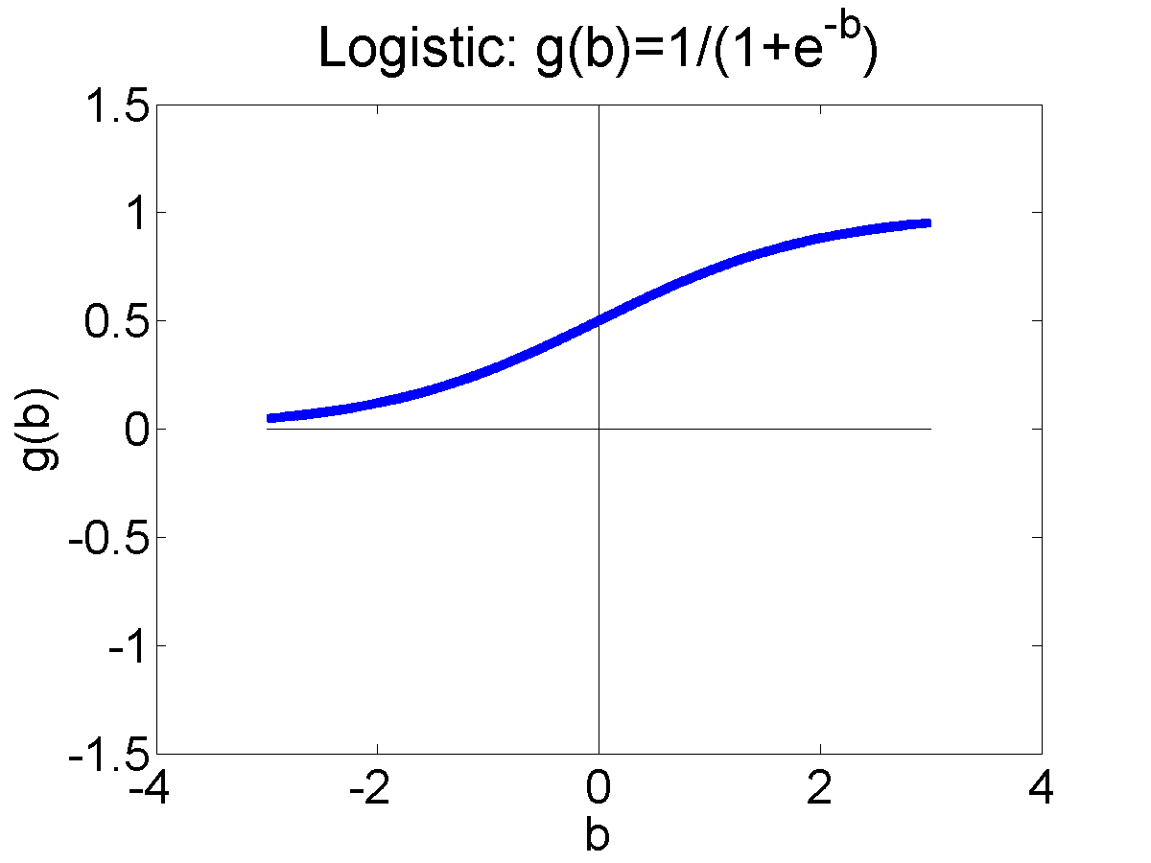
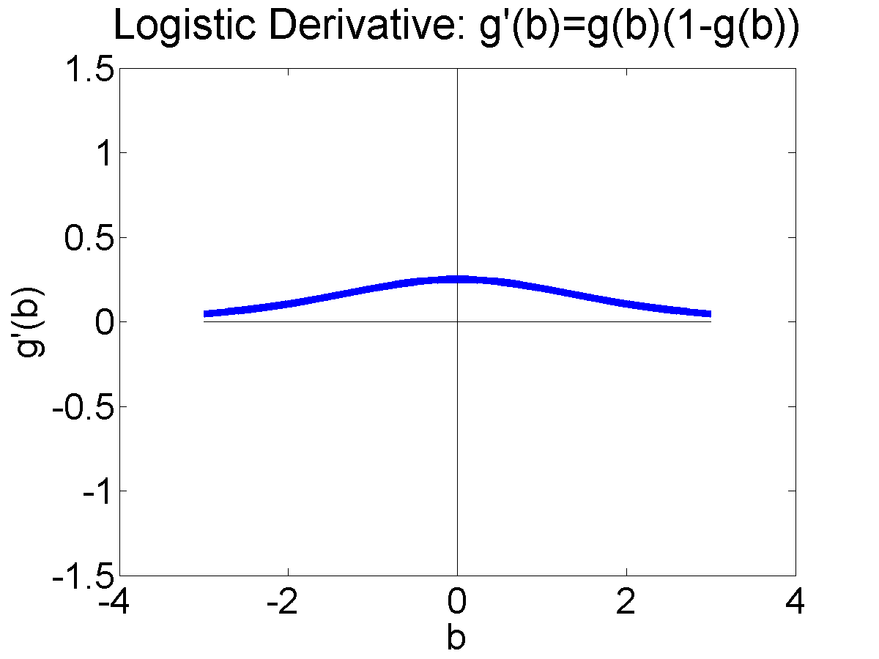
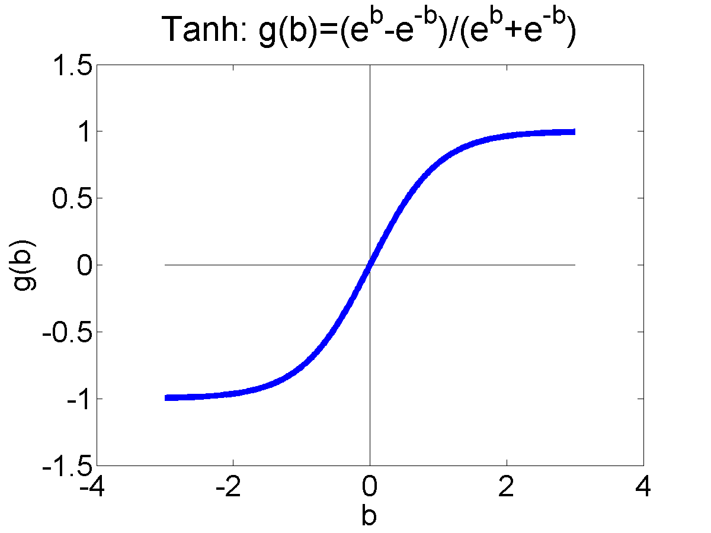
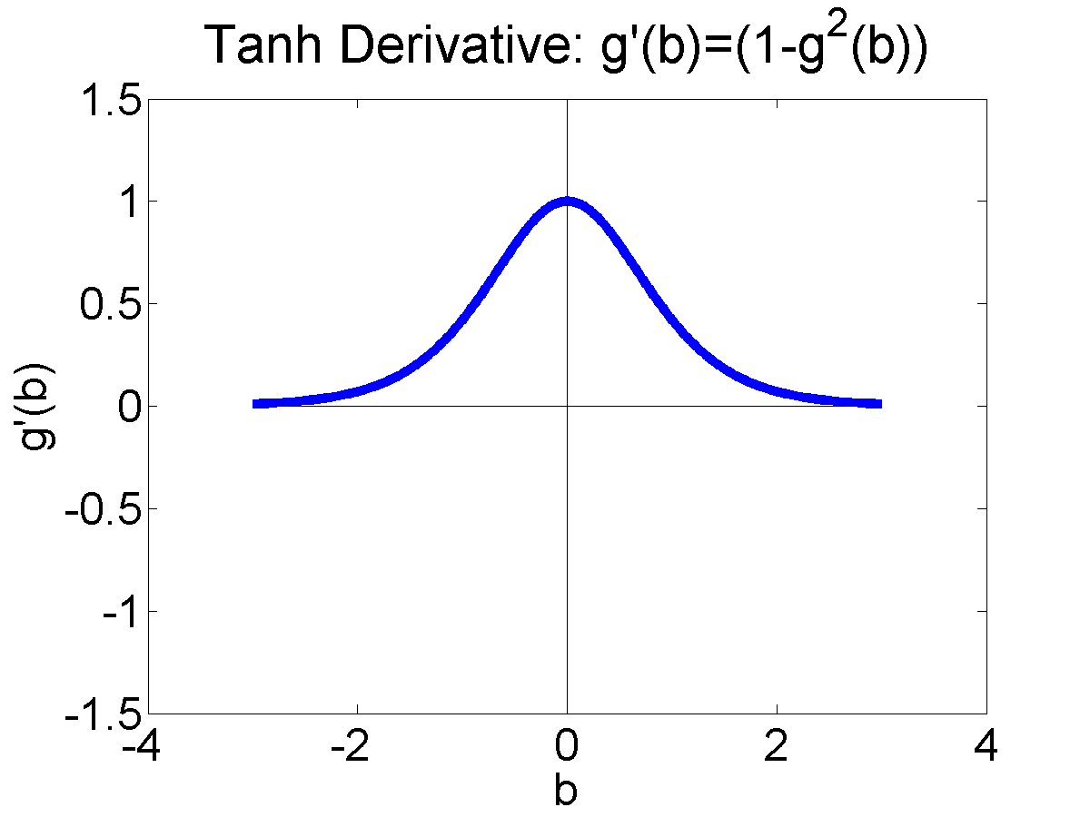
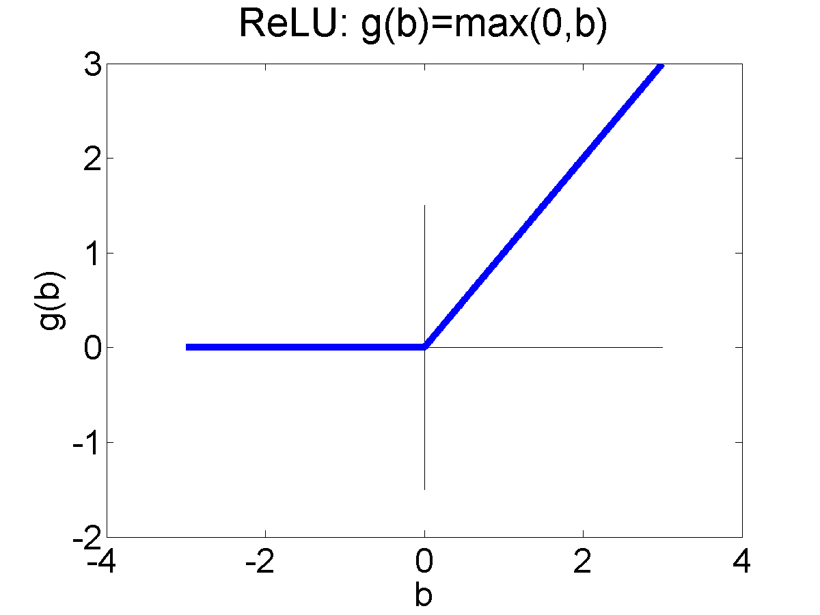
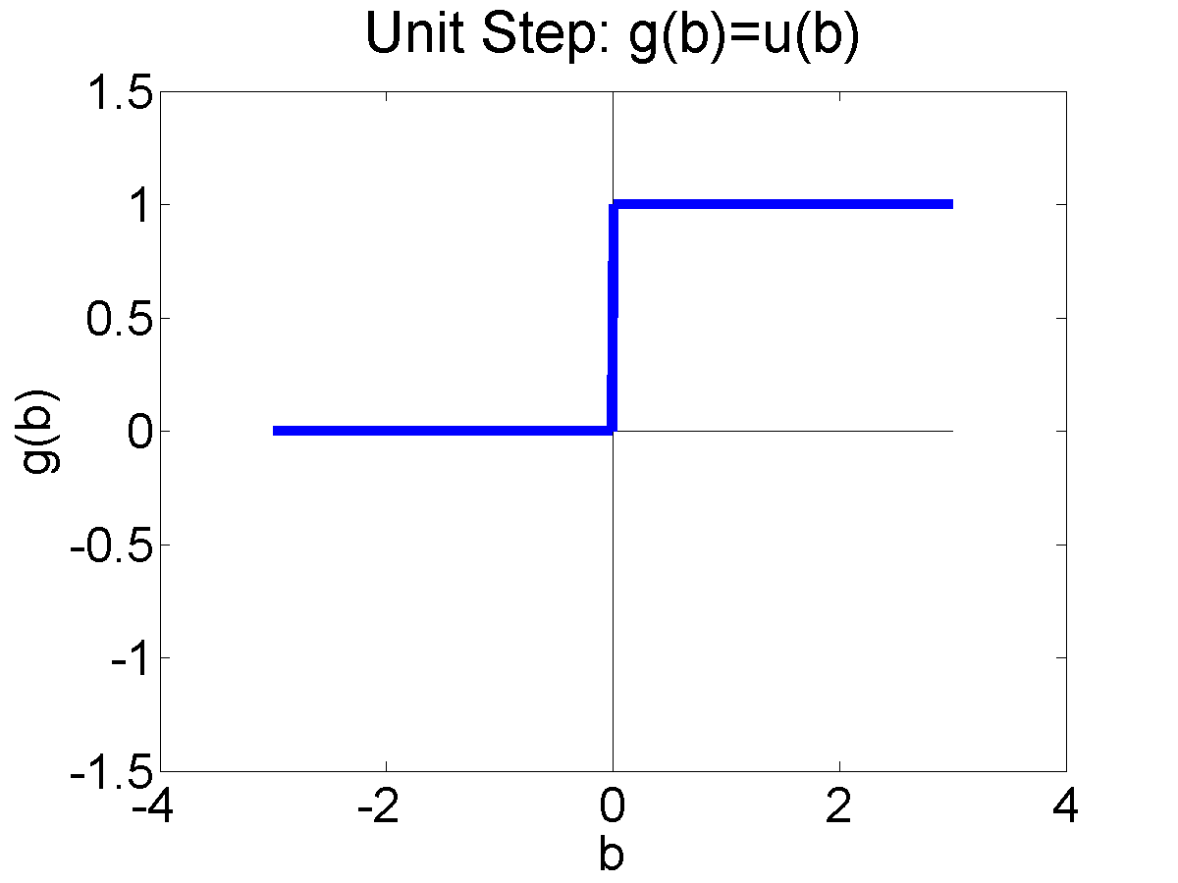
Activation functions
The “activation function,” $g^{(l)}\left(∙\right)$, can be any scalar nonlinearity. For example:
Logistic Sigmoid:
$$σ\left(β\right)=\frac{1}{1+e^{−β}}, σ^{′}\left(β\right)=σ\left(β\right)\left(1−σ\left(β\right)\right)$$
Hyperbolic Tangent (tanh):
$$tanh\left(β\right)=\frac{e^{β}−e^{−β}}{e^{β}+e^{−β}}, \tanh^{′}\left(β\right)=1−\tanh^{2}\left(β\right)$$
Rectified Linear Unit (ReLU):
$$ReLU\left(β\right)=\max\left(0,β\right), {ReLU}^{′}\left(β\right)=u\left(β\right)$$

Slide 13
Outline
Breaking the constraints of linearity: multi-layer neural nets
What’s inside a multi-layer neural net?
Forward-propagation example
Gradient descent
Finding the derivative: back-propagation

Slide 14
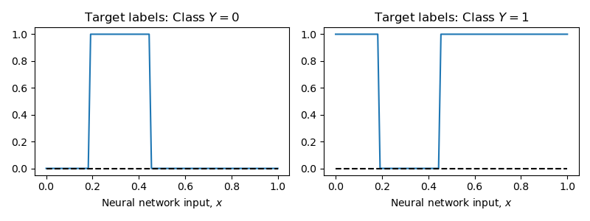
Example
Suppose $x=$scalar
$Y∈\{0,1\}$

Slide 15
Initialize
$$h_{1}^{(0)}=x, h_{2}^{(0)}= 1$$
$$e_{j}^{(1)}=\sum_{k}{w_{jk}^{(1)}h_{k}^{(0)}}$$
$$e_{1}^{(1)}$$
$$e_{2}^{(1)}$$
$$e_{3}^{(1)}$$
$$e_{1}^{(1)}$$
$$e_{2}^{(1)}$$
$$e_{3}^{(1)}$$
$$h_{1}^{(0)}$$
$$h_{2}^{(0)}$$

Slide 16
Excitation to Activation: $h_{j}^{(1)}=ReLU\left(e_{j}^{(1)}\right)$
$$h_{1}^{(1)}$$
$$h_{2}^{(1)}$$
$$h_{3}^{(1)}$$
$$h_{1}^{(1)}$$
$$h_{2}^{(1)}$$
$$h_{3}^{(1)}$$
$$g^{(1)}$$
$$g^{(1)}$$
$$g^{(1)}$$
$$e_{1}^{(1)}$$
$$e_{2}^{(1)}$$
$$e_{3}^{(1)}$$
$$h_{1}^{(0)}$$
$$h_{2}^{(0)}$$

Slide 17
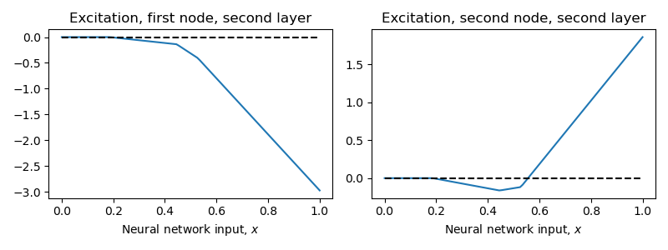
Activation to Excitation: $e_{j}^{(2)}=\sum_{k}{w_{jk}^{(2)}h_{k}^{(1)}}$
$$e_{0}^{(2)}$$
$$e_{1}^{(2)}$$
$$e_{0}^{(2)}$$
$$e_{1}^{(2)}$$
$$h_{1}^{(1)}$$
$$h_{2}^{(1)}$$
$$h_{3}^{(1)}$$
$$g^{(1)}$$
$$g^{(1)}$$
$$g^{(1)}$$
$$e_{1}^{(1)}$$
$$e_{2}^{(1)}$$
$$e_{3}^{(1)}$$
$$h_{1}^{(0)}$$
$$h_{2}^{(0)}$$

Slide 18
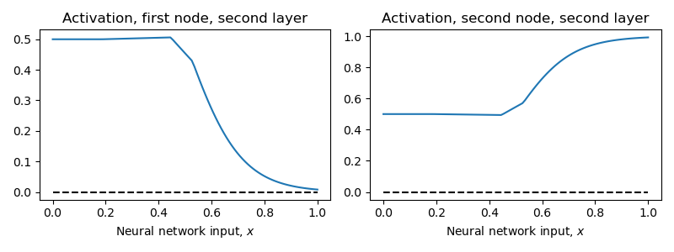
Output: $h_{j}^{(2)}=softmax\left(e_{j}^{(2)}\right)$
$$h_{0}^{(2)}$$
$$h_{1}^{(2)}$$
$$h_{0}^{(2)}$$
$$h_{1}^{(2)}$$
$$g^{(2)}$$
$$g^{(2)}$$
$$e_{0}^{(2)}$$
$$e_{1}^{(2)}$$
$$h_{1}^{(1)}$$
$$h_{2}^{(1)}$$
$$h_{3}^{(1)}$$
$$g^{(1)}$$
$$g^{(1)}$$
$$g^{(1)}$$
$$e_{1}^{(1)}$$
$$e_{2}^{(1)}$$
$$e_{3}^{(1)}$$
$$h_{1}^{(0)}$$
$$h_{2}^{(0)}$$

Slide 19
$$h_{0}^{(2)}$$
$$h_{1}^{(2)}$$
$$h_{0}^{(2)}=P(Y=0|x)$$
$$h_{1}^{(2)}=P(Y=1|x)$$
$$g^{(2)}$$
$$g^{(2)}$$
$$e_{0}^{(2)}$$
$$e_{1}^{(2)}$$
$$h_{1}^{(1)}$$
$$h_{2}^{(1)}$$
$$h_{3}^{(1)}$$
$$g^{(1)}$$
$$g^{(1)}$$
$$g^{(1)}$$
$$e_{1}^{(1)}$$
$$e_{2}^{(1)}$$
$$e_{3}^{(1)}$$
$$h_{1}^{(0)}$$
$$h_{2}^{(0)}$$

Slide 20
Outline
Breaking the constraints of linearity: multi-layer neural nets
What’s inside a multi-layer neural net?
Forward-propagation example
Gradient descent
Finding the derivative: back-propagation

Slide 21
Gradient descent: basic idea
Suppose we have a training token, $x$.
Its target label is $y$.
The neural net produces output $\hat{y}$, which is not $y$.
The difference between $y$ and $\hat{y}$ is summarized by some loss function, $ℒ(y,\hat{y})$.
The output of the neural net is determined by some parameters, $w_{jk}^{(l)}$.
Then we can improve the network by setting:
$$w_{jk}^{(l)}←w_{jk}^{(l)}−η\frac{dℒ}{dw_{jk}^{(l)}}$$

Slide 22
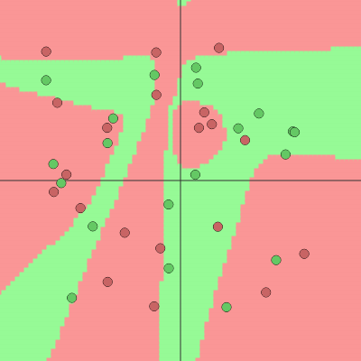
Visualizing gradient descent
https://cs.stanford.edu/people/karpathy/convnetjs/demo/classify2d.html

Slide 23
Outline
Breaking the constraints of linearity: multi-layer neural nets
What’s inside a multi-layer neural net?
Forward-propagation example
Gradient descent
Finding the derivative: back-propagation

Slide 24
Finding the derivative
OK, how do we find $\frac{dℒ}{dw_{jk}^{(l)}}$?
Well, the only way in which $ℒ$ depends on $w_{jk}^{(l)}$ is by way of $e_{j}^{(l)}$: $e_{j}^{(l)}=\sum_{k}{w_{jk}^{(l)}h_{k}^{(l−1)}}$. So we could use the chain rule of calculus:
$$\frac{dℒ}{dw_{jk}^{(l)}}=\frac{dℒ}{de_{j}^{(l)}}×\frac{de_{j}^{(l)}}{dw_{jk}^{(l)}}=\frac{dℒ}{de_{j}^{(l)}}h_{k}^{(l−1)}$$
So we need to forward-propagate from $x$, to find $h_{k}^{(l−1)}$
Then we back-propagate, from y, to find $\frac{dℒ}{de_{j}^{(l)}}$
Then we multiply those two things.

Slide 25
Finding the derivative
Well… how do we find $\frac{dℒ}{de_{j}^{(l)}}$?
Well, the only way in which $ℒ$ depends on $e_{j}^{(l)}$ is by way of $h_{j}^{(l)}$: $h_{j}^{(l)}=g(e_{j}^{\left(l\right)})$. So we could use the chain rule of calculus:
$$\frac{dℒ}{de_{j}^{(l)}}=\frac{dℒ}{dh_{j}^{(l)}}×\frac{dh_{j}^{(l)}}{de_{j}^{(l)}}=\frac{dℒ}{dh_{j}^{(l)}}g′(e_{j}^{\left(l\right)})$$
So we need to forward-propagate from $x$, to find $g(e_{j}^{\left(l\right)})$, and then we look up its derivative in a table, to find $g′(e_{j}^{\left(l\right)})$.
Then we back-propagate, from $y$, to find $\frac{dℒ}{dh_{j}^{(l)}}$
Then we multiply those two things.

Slide 26
Finding the derivative
OK, great! Then how do we find $\frac{dℒ}{dh_{j}^{(l)}}$?
Well, the only way in which $ℒ$ depends on $h_{j}^{(l)}$ is by way of all of the different nodes in layer l+1: $e_{k}^{(l+1)}=\sum_{j}{w_{kj}^{(l+1)}h_{j}^{(l)}}$. So we could use the chain rule of calculus:
$$\frac{dℒ}{dh_{j}^{(l)}}=\sum_{k}{\frac{dℒ}{de_{k}^{(l+1)}}×\frac{de_{k}^{(l+1)}}{dh_{j}^{(l)}}}=\sum_{k}{\frac{dℒ}{de_{k}^{(l+1)}}w_{kj}^{(l+1)}}$$
So we back-propagate, from $y$, to find $\frac{dℒ}{de_{k}^{(l+1)}}$
Then we multiply each of those by the corresponding weight, $w_{kj}^{(l+1)}$, and add them up.

Slide 27
Finding the derivative
$$y$$
Loss
$$h_{k}^{(3)}$$
$$\frac{dℒ}{de_{j}^{(3)}}$$
Forward propagate, from $x$, to find $h_{k}^{(l−1)}$ in each layer
Back-propagate, from $y$, to find $\frac{dℒ}{de_{j}^{(l)}}$ in each layer
Multiply them to get $\frac{dℒ}{dw_{jk}^{(l)}}$, then
$$w_{jk}^{(l)}←w_{jk}^{(l)}−η\frac{dℒ}{dw_{jk}^{(l)}}$$
Layer 3
$$h_{k}^{(2)}$$
$$\frac{dℒ}{de_{j}^{(2)}}$$
Layer 2
$$h_{k}^{(1)}$$
$$\frac{dℒ}{de_{j}^{(1)}}$$
Layer 1
$$x$$

Slide 28
Gradient descent
For example, suppose $ℒ=−\ln{P\left(Y=y|x\right)}=−\ln{h_{y}^{(L)}}$, and the nonlinearity is $h_{j}^{(L)}=softmax\left(e_{j}^{(L)}\right)$. Then we have this derivative, from last time:
$$\frac{d\left(−\ln{h_{y}^{(L)}}\right)}{de_{j}^{(L)}}=\left\{\begin{matrix}\left(\frac{\exp\left(e_{j}^{\left(L\right)}\right)}{\sum_{k=0}^{V−1}{\exp\left(e_{k}^{\left(L\right)}\right)}}−1\right) & j=y \\ \left(\frac{\exp\left(e_{j}^{\left(L\right)}\right)}{\sum_{k=0}^{V−1}{\exp\left(e_{k}^{\left(L\right)}\right)}}−0\right) & j≠y\end{matrix}\right.$$

Slide 29
Back-propagation
Back-propagating excitation back to activation:
$$\frac{dℒ}{dh_{k}^{(l)}}=\sum_{j}{w_{jk}^{(l+1)}\frac{dℒ}{de_{j}^{(l+1)}}}$$
Back-propagating activation back to excitation:
$$\frac{dℒ}{de_{k}^{(l)}}=\frac{dℒ}{dh_{k}^{(l)}}g^{(l)}′\left(e_{k}^{(l)}\right)$$

Slide 30
Gradient descent to minimize loss
$$w_{jk}^{(l)}←w_{jk}^{(l)}−η\frac{dℒ}{dw_{jk}^{\left(l\right)}}=w_{jk}^{(l)}−η\frac{dℒ}{de_{j}^{(l)}}h_{k}^{(l−1)}$$

Slide 31
Outline
Breaking the constraints of linearity: multi-layer neural nets
What’s inside a multi-layer neural net?
Forward-propagation example
Gradient descent
Finding the derivative: back-propagation

