Slide 1
CS440/ECE448 Lecture 8: Perceptron
Mark Hasegawa-Johnson, 2/2021
License: CC-BY 4.0; redistribute at will, as long as you cite the source.

Slide 2
Outline
A little history: perceptron as a model of a biological neuron
The perceptron learning algorithm
Linear separability, $yx$, and convergence
It converges to the right answer, even with $η=1$, if data are linearly separable
If data are not linearly separable, it’s necessary to use $η=1/n$.
Multi-class perceptron

Slide 3
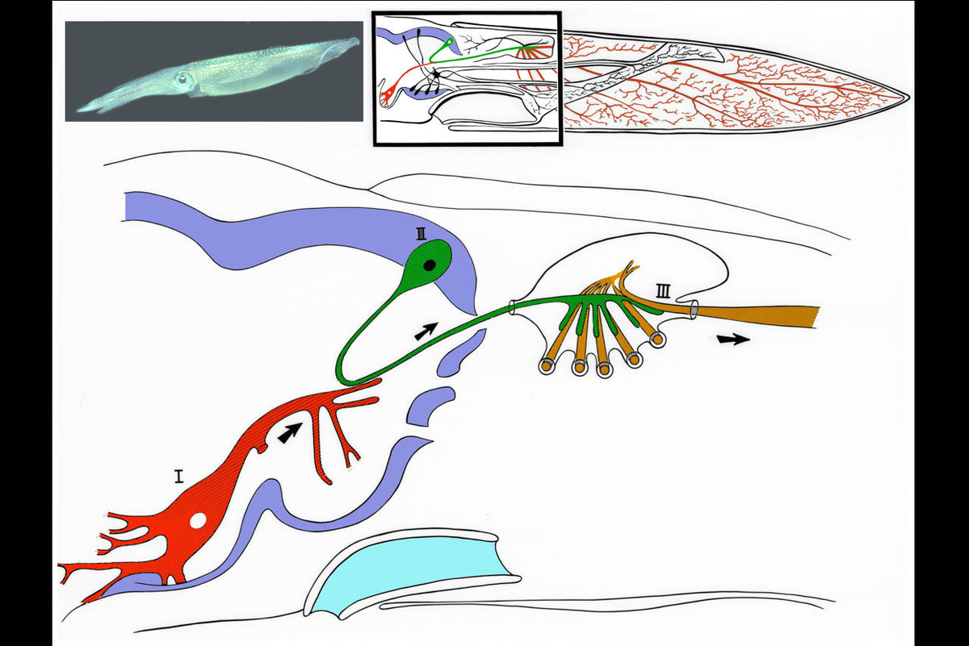
The Giant Squid Axon
1909: Williams describes the giant squid axon (III: 1mm thick)
1939: Young describes the synapse.
1952: Hodgkin & Huxley publish an electrical current model for the generation of binary action potentials from real-valued inputs.
Image released to the public domain by lkkisan, 2007.
Modified from Llinás, Rodolfo R. (1999). The squid Giant Synapse.

Slide 4
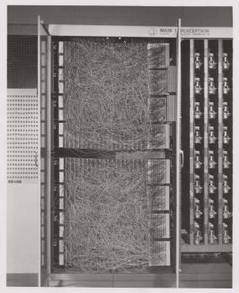
Perceptron
1959: Rosenblatt is granted a patent for the “perceptron,” an electrical circuit model of a neuron.

Slide 5
Perceptron
Perceptron model: action potential = signum(affine function of the features)
$$\hat{y}=sgn⁡(w1x1+ … +wDxD +b)$$
$$= sgn⁡(w^{T}x)$$
Where $w={[w_{1},…,w_{D},b]}^{T}$,
$x={[x_{1},…,x_{D},1]}^{T}$, and
$$sgn(x)=\left\{\begin{matrix}1 & x≥0 \\ −1 & x<0\end{matrix}\right.$$
Input
Can incorporate bias as component of the weight vector by always including a feature with value set to 1
1
b
x₁
w₁
Output: sgn(w^{T}x)
x₂
w₂
.
.
.
w_{D}
x_{D}
Weights

Slide 6
Outline
A little history: perceptron as a model of a biological neuron
The perceptron learning algorithm
Linear separability, $yx$, and convergence
It converges to the right answer, even with $η=1$, if data are linearly separable
If data are not linearly separable, it’s necessary to use $η=1/n$.
Multi-class perceptron

Slide 7
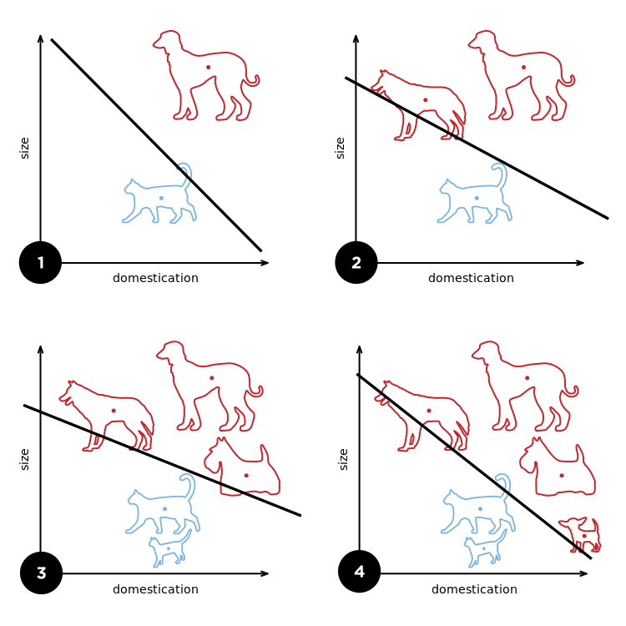
Perceptron
Rosenblatt’s big innovation: the perceptron learns from examples.
Initialize weights randomly
Cycle through training examples in multiple passes (epochs)
For each training example:
If classified correctly, do nothing
If classified incorrectly, update weights
By Elizabeth Goodspeed - Own work, CC BY-SA 4.0, https://commons.wikimedia.org/w/index.php?curid=40188333

Slide 8
Perceptron
For each training instance $x$ with ground truth label $y∈\{−1,1\}$:
Classify with current weights: $\hat{y}=sgn(w^{T}x)$
Update weights:
if $y=\hat{y}$ then do nothing
If $y≠\hat{y}$ then $w=w+\text{η}\text{y}x$
η (eta) is a “learning rate.” For now, let’s assume η=1.

Slide 9
Perceptron example: dogs versus cats
Can you write a program that can tell which ones are dogs, and which ones are cats?
$x_{1}=$ # times the animal comes when called (out of 40).
$x_{2}=$ weight of the animal, in pounds.
$x={[x_{1},x_{2},1]}^{T}$.
$y=1$ means “dog”
$y=−1$ means “cat”
$$\hat{y}=sgn\left(w^{T}x\right)$$

Slide 10
Perceptron training example: dogs vs. cats
Let’s start with the rule “if it comes when called (by at least 20 different people out of 40), it’s a dog.”
Write that as an equation: $\hat{y}=sgn(x_{1}−20)$
Write that as a vector equation:$\hat{y}=sgn(w^{T}x)$, where $w^{T}=\left[1,0,−20\right]$
$$x_{2}$$
$$sgn\left({\vec{w}}^{T}\vec{x}\right)=1$$
$${\vec{w}}^{T}=\left[1,0,−20\right]$$
$$sgn\left({\vec{w}}^{T}\vec{x}\right)=−1$$
$$x_{1}$$

Slide 11
Perceptron training example: dogs vs. cats
The Presa Canario gets misclassified as a cat ($y=1,$ but $\hat{y}=−1$) because it only obeys its trainer, and nobody else ($x_{1}=1$).
Though it rarely comes when called, is very large ($x_{2}=100$ pounds).
${\vec{x}}^{T}=\left[x_{1},x_{2},1\right]=[1,100,1]$.
$$x_{2}$$
$$sgn\left({\vec{w}}^{T}\vec{x}\right)=1$$
$${\vec{w}}^{T}=\left[1,0,−20\right]$$
$$sgn\left({\vec{w}}^{T}\vec{x}\right)=−1$$
$$x_{1}$$

Slide 12
Perceptron training example: dogs vs. cats
The Presa Canario gets misclassified. $x^{T}=\left[x_{1},x_{2},1\right]=[1,100,1]$.
Perceptron learning rule: update the weights as:
$$w =w+yx=\left[\begin{matrix}1 \\ 0 \\ −20\end{matrix}\right]+1×\left[\begin{matrix}1 \\ 100 \\ 1\end{matrix}\right]=\left[\begin{matrix}2 \\ 100 \\ −19\end{matrix}\right]$$
$$x_{2}$$
$$sgn\left({\vec{w}}^{T}\vec{x}\right)=1$$
New $w=\left[\begin{matrix}2 \\ 100 \\ −19\end{matrix}\right]$
Old $w=\left[\begin{matrix}1 \\ 0 \\ −20\end{matrix}\right]$
$$sgn\left({\vec{w}}^{T}\vec{x}\right)=−1$$
$$x_{1}$$

Slide 13
Perceptron training example: dogs vs. cats
The Maltese is small ($x_{2}=10$ pounds) and very tame ($x_{1}=40$): $x=\left[\begin{matrix}40 \\ 10 \\ 1\end{matrix}\right]$.
It’s correctly classified! $\hat{y}=sgn\left(w^{T}x\right)=sgn\left(2×40+100×10−19\right)=+1$,
so $w$is unchanged.
$$x_{2}$$
$$sgn\left({\vec{w}}^{T}\vec{x}\right)=1$$
$${\vec{w}}^{T}=\left[2,100,−19\right]$$
$$sgn\left({\vec{w}}^{T}\vec{x}\right)=−1$$
$$x_{1}$$

Slide 14
Perceptron training example: dogs vs. cats
The Maine Coon cat is big ($x_{2}=20$ pounds: $\vec{x}=\left[0,20,1\right]$), so it gets misclassified as a dog (true label is $y=−1$=“cat,” but the classifier thinks $\hat{y}=1$=“dog”).
$$x_{2}$$
$$sgn\left({\vec{w}}^{T}\vec{x}\right)=1$$
$${\vec{w}}^{T}=\left[2,100,−19\right]$$
$$sgn\left({\vec{w}}^{T}\vec{x}\right)=−1$$
$$x_{1}$$

Slide 15
Perceptron training example: dogs vs. cats
The Maine Coon cat is big ($x_{2}=20$ pounds: $\vec{x}=\left[0,20,1\right]$), so it gets misclassified, so we update w:
$$w =w+yx=\left[\begin{matrix}2 \\ 100 \\ −19\end{matrix}\right]+(−1)×\left[\begin{matrix}0 \\ 20 \\ 1\end{matrix}\right]=\left[\begin{matrix}2 \\ 80 \\ −20\end{matrix}\right]$$
$$x_{2}$$
$$sgn\left({\vec{w}}^{T}\vec{x}\right)=1$$
$$w^{T}=\left[2,80,−20\right]$$
$$sgn\left(w^{T}x\right)=−1$$
$$x_{1}$$

Slide 16
Outline
A little history: perceptron as a model of a biological neuron
The perceptron learning algorithm
Linear separability, $yx$, and convergence
It converges to the right answer, even with $η=1$, if data are linearly separable
If data are not linearly separable, it’s necessary to use $η=1/n$.
Multi-class perceptron

Slide 17
Does the perceptron find an answer? Does it find the correct answer?
Suppose we run the perceptron algorithm for a very long time. Will it converge to an answer? Will it converge to the correct answer?

Slide 18
Does the perceptron find an answer? Does it find the correct answer?
Suppose we run the perceptron algorithm for a very long time. Will it converge to an answer? Will it converge to the correct answer?
That depends on whether or not the data are linearly separable.

Slide 19
Does the perceptron find an answer? Does it find the correct answer?
Suppose we run the perceptron algorithm for a very long time. Will it converge to an answer? Will it converge to the correct answer?
That depends on whether or not the data are linearly separable.
”Linearly separable” means it’s possible to find a line (a hyperplane, in D-dimensional space) that separates the two classes, like this:
$$x_{2}$$
$$x_{1}$$

Slide 20
Does the perceptron find an answer? Does it find the correct answer?
Suppose that, instead of plotting $x$, we plot $yx$.
If $y=1$, plot $x$
If $y=−1$, plot $−x$
$$x_{2}$$
$$x_{1}$$

Slide 21
Does the perceptron find an answer? Does it find the correct answer?
Notice that the original data ($x$) are linearly separable if and only if the signed data ($yx$) are all in the same half-plane.
$$yx_{2}$$
$${yx}_{1}$$

Slide 22
Does the perceptron find an answer? Does it find the correct answer?
Notice that the original data ($x$) are linearly separable if and only if the signed data ($yx$) are all in the same half-plane.
That means that there is some vector $w$ such that $sgn⁡(w^{T}(yx))=1$ for all of the data.
$$w$$
$${yx}_{2}$$
$${yx}_{1}$$

Slide 23
Does the perceptron find an answer? Does it find the correct answer?
Suppose we start out with the wrong $w$, so that one token is misclassified.
$${yx}_{2}$$
$$w$$
$${yx}_{1}$$

Slide 24
Does the perceptron find an answer? Does it find the correct answer?
Suppose we start out with the wrong $w$, so that one token is misclassified. Then we update w as
$$w=w+yx$$
New $w$
$${yx}_{2}$$
$$yx$$
$$w$$
$$yx$$
$${yx}_{1}$$

Slide 25
Does the perceptron find an answer? Does it find the correct answer?
Suppose we start out with the wrong $w$, so that one token is misclassified. Then we update w as
$$w=w+yx$$
…and the boundary moves so that the misclassified token is on the right side.
New $w$
$${yx}_{2}$$
$${yx}_{1}$$

Slide 26
What if the data are not linearly separable?
… well, then in that case, the perceptron algorithm with $η=1$ never converges. The only solution is to use a learning rate, $η$, that gradually decays over time, so that the update $ηyx$ also gradually decays toward zero.
$$w$$
$$yx_{2}$$
$${yx}_{1}$$

Slide 27
What about non-separable data?
If the data are NOT linearly separable, then the perceptron with $\text{η}\text{=1}$doesn’t converge.
In fact, that’s what $\text{η}$ is for.
Remember that $w=w+\text{η}\text{y}x$.
We can force the perceptron to stop wiggling around by forcing $\text{η}$ (and therefore $\text{η}\text{y}\vec{x}$) to get gradually smaller and smaller.
This works: for the $n^{th}$ training token, set $\text{η}\text{=}\frac{1}{n}$.
Notice: $\sum_{n=1}^{∞}{\frac{1}{n}}$ is infinite. Nevertheless, $\text{η}\text{=}\frac{1}{n}$ works, because the $\text{y}x$ tokens are not all in the same direction.

Slide 28
Outline
A little history: perceptron as a model of a biological neuron
The perceptron learning algorithm
Linear separability, $yx$, and convergence
It converges to the right answer, even with $η=1$, if data are linearly separable
If data are not linearly separable, it’s necessary to use $η=1/n$.
Multi-class perceptron

Slide 29
Multi-Class Perceptron
True class is $y∈\{0,1,2,…,V−1\}$
(i.e., $V$=vocabulary size = # of distinct classes).
Classifier output is
$$\hat{y}={argmax}_{c=0}^{V−1}\left(w_{c1}x_{1}+…+w_{cD}x_{D}+b_{c}\right)$$
$$={argmax}_{c=0}^{V−1}\left(w_{c}^{T}x\right)$$
$$∈\{0,1,…,V−1\}$$
Where $w_{c}={[w_{c1},…,w_{cD},b_{c}]}^{T}$
and $x={[x_{1},…,x_{D},1]}^{T}$
Input
Weights
1
$$b_{0}$$
$$b_{1}$$
x₁
Output: ${argmax}_{c=0}^{V−1}\left({\vec{w}}_{c}^{T}\vec{x}\right)$
argmax
x₂
.
.
.
.
.
.
.
.
.
$$b_{V−1}$$
$$w_{0D}$$
$$w_{1D}$$
x_{D}
$$w_{V−1,D}$$

Slide 30
Multi-Class Perceptron
True class is $y∈\{0,1,2,…,V−1\}$
(i.e., $V$=vocabulary size = # of distinct classes).
Classifier output is
$$\hat{y}={argmax}_{c=0}^{V−1}\left(w_{c1}x_{1}+…+w_{cD}x_{D}+b_{c}\right)$$
$$={argmax}_{c=0}^{V−1}\left(w_{c}^{T}x\right)$$
$$∈\{0,1,…,V−1\}$$
Where $w_{c}={[w_{c1},…,w_{cD},b_{c}]}^{T}$
and $x={[x_{1},…,x_{D},1]}^{T}$
$$x_{2}$$
$$\hat{y}=1$$
$$\hat{y}=2$$
$$\hat{y}=3$$
$$\hat{y}=4$$
$$\hat{y}=0$$
$$\hat{y}=5$$
$$\hat{y}=6$$
$$\hat{y}=8$$
$$\hat{y}=9$$
$$\hat{y}=10$$
$$\hat{y}=11$$
$$\hat{y}=12$$
$$\hat{y}=13$$
$$\hat{y}$$
$$=7$$
$$\hat{y}=14$$
$$\hat{y}=15$$
$$\hat{y}=16$$
$$\hat{y}=17$$
$$\hat{y}=18$$
$$\hat{y}=19$$
By Balu Ertl - Own work, CC BY-SA 4.0, https://commons.wikimedia.org/w/index.php?curid=38534275
$$x_{1}$$

Slide 31
Multi-Class Linear Classifiers
$$x_{2}$$
$$\hat{y}=1$$
$$\hat{y}=2$$
$$\hat{y}=3$$
All multi-class linear classifiers have the form
$$\hat{y}={argmax}_{c=0}^{V−1}\left(w_{c}^{T}x\right)$$
The region of x-space associated with each class label is convex with piece-wise linear boundaries. Such regions are called “Voronoi regions.”
$$\hat{y}=4$$
$$\hat{y}=0$$
$$\hat{y}=5$$
$$\hat{y}=6$$
$$\hat{y}=8$$
$$\hat{y}=9$$
$$\hat{y}=10$$
$$\hat{y}=11$$
$$\hat{y}=12$$
$$\hat{y}=13$$
$$\hat{y}$$
$$=7$$
$$\hat{y}=14$$
$$\hat{y}=15$$
$$\hat{y}=16$$
$$\hat{y}=17$$
$$\hat{y}=18$$
$$\hat{y}=19$$
By Balu Ertl - Own work, CC BY-SA 4.0, https://commons.wikimedia.org/w/index.php?curid=38534275
$$x_{1}$$

Slide 32
Training a Multi-Class Perceptron
For each training instance $x$ w/ground truth label $y∈\{0,1,…,V−1\}$:
Classify with current weights: $\hat{y}={argmax}_{c=0}^{V−1}\left(w_{c}^{T}x\right)$
Update weights:
if $\hat{y}$ is correct ($y=\hat{y}$) then do nothing
If $\hat{y}$ is incorrect ($y≠\hat{y}$) then:
Update the correct-class vector as $w_{y}=w_{y}+\text{η}x$
Update the wrong-class vector as $w_{\hat{y}}=w_{\hat{y}}−\text{η}x$
Don’t change the vectors of any other class

Slide 33
Conclusions
Perceptron as a model of a biological neuron: $\hat{y}=sgn(w^{T}x)$
The perceptron learning algorithm: if $y=\hat{y}$ then do nothing, else $w=w+ηyx$.
Linear separability, $yx$, and convergence
It converges to the right answer, even with $η=1$, if data are linearly separable
If data are not linearly separable, it’s necessary to use $η=1/n$.
Multi-class perceptron: if $y=\hat{y}$ then do nothing, else $w_{y}=w_{y}+ηx$, and $w_{\hat{y}}=w_{\hat{y}}−ηx$.

