Slide 1
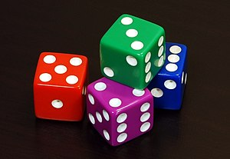
CS 440/ECE 448 Lecture 5: Probability
Mark Hasegawa-Johnson, 2/2021
All content CC-BY-4.0 unless otherwise noted
CC-BY-3.0 Image by Diacritica, 2010
https://commons.wikimedia.org/wiki/File:6sided_dice.jpg

Slide 2
Outline
Motivation: Why use probability?
The axioms of probability
Random variables
Conditional probability
Mutually exclusive vs. Independent vs. Conditionally Independent

Slide 3
Why use probability?
Stochastic environment: outcome of an action might be truly random.
Multi-agent environment:
If other players are rational and their goals are known, then you don’t need probability; you just work out what their rational actions will be.
If other players have unknown goals, then model them as random.
Unknown environment: outcome of an action is not truly random, but you don’t know what the outcome will be.
In this case, “probability” measures your belief: P(Q|A)=the degree to which you believe that action A will produce outcome Q.
Computational complexity:
Instead of searching 1b paths using A*, you could randomly choose 1k paths to try, and then choose the best of those.

Slide 4
Why NOT use probability?
Multi-agent environment:
Maybe it’s better to find out what the other players really want?
Unknown environment:
Maybe it’s better to learn the rules of the game?
Computational complexity:
Maybe it’s better to do a complete search, instead of just a partial search?
Notice: these are quantitative questions. “Better” requires some metric: how much better, and with what probability?

Slide 5
What is probability?
Latin probabilis = probable, commendable, believable, from probare = to test something
If tested, it will (probably) turn out to be true

Slide 6
Outline
Motivation: Why use probability?
The axioms of probability
Random variables
Conditional probability
Mutually exclusive vs. Independent vs. Conditionally Independent

Slide 7
The axioms of probability
A = some future event, e.g., “it will rain tomorrow.”
$P\left(A\right)$ = the degree to which we believe that event A, if tested, will turn out to be true.

Slide 8
The axioms of probability
Axiom 1: every event has a non-negative probability.
$$P\left(A\right)≥0$$
Axiom 2: a certain event has probability 1.
$P(True)=1$
Axiom 3: probability measures behave like set measures.
$$P\left(A⋁B\right)=P\left(A\right)+P\left(B\right)−P(A⋀B)$$

Slide 9
Axiom 3: probability measures behave like set measures.
Area of the whole rectangle is $P\left(True\right)=1$.
A
B
Area of this circle is $P\left(A\right)$.
Area of this circle is $P\left(B\right)$.
Area of their intersection is $P\left(A⋀B\right)$.
Area of their union is $P\left(A⋁B\right)=P\left(A\right)+P\left(B\right)−P(A⋀B)$

Slide 10
Example
A = “it will rain tomorrow.” Suppose $P(A)=0.4$.
B = “it will snow tomorrow.” Suppose $P(B)=0.2$.
$A⋀B$ = “it will both rain and snow tomorrow.” Suppose
$$P(A⋀B)=0.1$$
Then the probability that it will either rain or snow tomorrow is
$$P\left(A⋁B\right)=P\left(A\right)+P\left(B\right)−P\left(A⋀B\right)=0.4+0.2−0.1=0.5$$

Slide 11
Outline
Motivation: Why use probability?
The axioms of probability
Random variables
Conditional probability
Mutually exclusive vs. Independent vs. Conditionally Independent

Slide 12
Random variables
A random variable is a function that maps from the outcomes of an experiment to a set of values
Example: throw four dice, all different colors. X = number of pips showing on the green die.
Then run the experiment…
In this particular outcome, X=3.
In some other outcome, X would have taken a different value.

Slide 13
Notation: $P(X=x)$
Capital letters are random variables. Small letters are values that the random variable might take.
“$X=x$” is an event. As such, it has a probability. For example, we can talk about the probability $P(X=x)$:
$$P(X=x)=\frac{1}{6} ∀ x∈\left\{1,2,3,4,5,6\right\}$$
$∀$ means “for all.” The equation above is shorthand for these six equations:
$$P\left(X=1\right)=\frac{1}{6}, P\left(X=2\right)=\frac{1}{6}, P\left(X=3\right)=\frac{1}{6},$$
$$P\left(X=4\right)=\frac{1}{6}, P\left(X=5\right)=\frac{1}{6}, P(X=6)=\frac{1}{6}$$

Slide 14
Notation: $P\left(X\right)$
$X$ is not an event, and it’s not a value; it’s a function. So $P\left(X\right)$ is NOT a number. Instead, $P\left(X\right)$ is a table, showing all of the values $X$ might take, and the probabilities of each. For example:
$$x$$ | 1 | 2 | 3 | 4 | 5 | 6
$$P(X=x)$$ | $$\frac{1}{6}$$ | $$\frac{1}{6}$$ | $$\frac{1}{6}$$ | $$\frac{1}{6}$$ | $$\frac{1}{6}$$ | $$\frac{1}{6}$$
$$P\left(X\right)=$$

Slide 15
Abuse of Notation: Events and Binary Random Variables
There’s one confusing thing. A capital letter might be either an event (A=“it will rain tomorrow”), or a random variable (X=“number of pips showing”).
P(A) is a number, but P(X) is a table.
You have to pay attention to whether the capital letter is an event, or a random variable.

Slide 16
Outline
Motivation: Why use probability?
The axioms of probability
Random variables
Conditional probability
Mutually exclusive vs. Independent vs. Conditionally Independent

Slide 17
Joint and Conditional probabilities: definitions
$P\left(A⋀B\right)$ is the probability that both event A and event B happen. This is called their joint probability.
$P(B|A)$ is the probability that event B happens, given that event A happens. This is called the conditional probability of B given A.
Example:
A = “it will rain tomorrow”
B = “it will snow tomorrow”
$P\left(A⋀B\right)$ = probability that it will both snow and rain
$P(B|A)$ = probability that it will snow, given that it rains

Slide 18
Joint probabilities are usually given in the problem statement
Area of the whole rectangle is $P\left(True\right)=1$.
A
B
Suppose $P\left(A\right)=0.4$
Suppose $P\left(B\right)=0.2$
Suppose $P\left(A⋀B\right)=0.1$

Slide 19
Conditioning events change our knowledge! For example, given that A is true…
Most of the events in this rectangle are no longer possible!
A
A
B
$$A⋀B$$
Only the events inside this circle are now possible.

Slide 20
Conditioning events change our knowledge! For example, given that A is true…
Given certain knowledge that A has occurred, we now have $P(A)=1$.
A
$$A⋀B$$
Given certain knowledge that A has occurred, the probability that B also occurs is now
$$P(B|A)=\frac{P(A⋀B)}{P(A)}$$

Slide 21
Joint and Conditional distributions of random variables
$P\left(X,Y\right)$ is the joint probability distribution over all possible outcomes $P\left(X=x,Y=y\right)$.
$P(X|Y)$ is the conditional probability distribution of outcomes $P(X=x|Y=y)$.
$$P\left(X=x | Y=y\right)=\frac{P\left(X=x,Y=y\right)}{P\left(Y=y\right)}$$

Slide 22
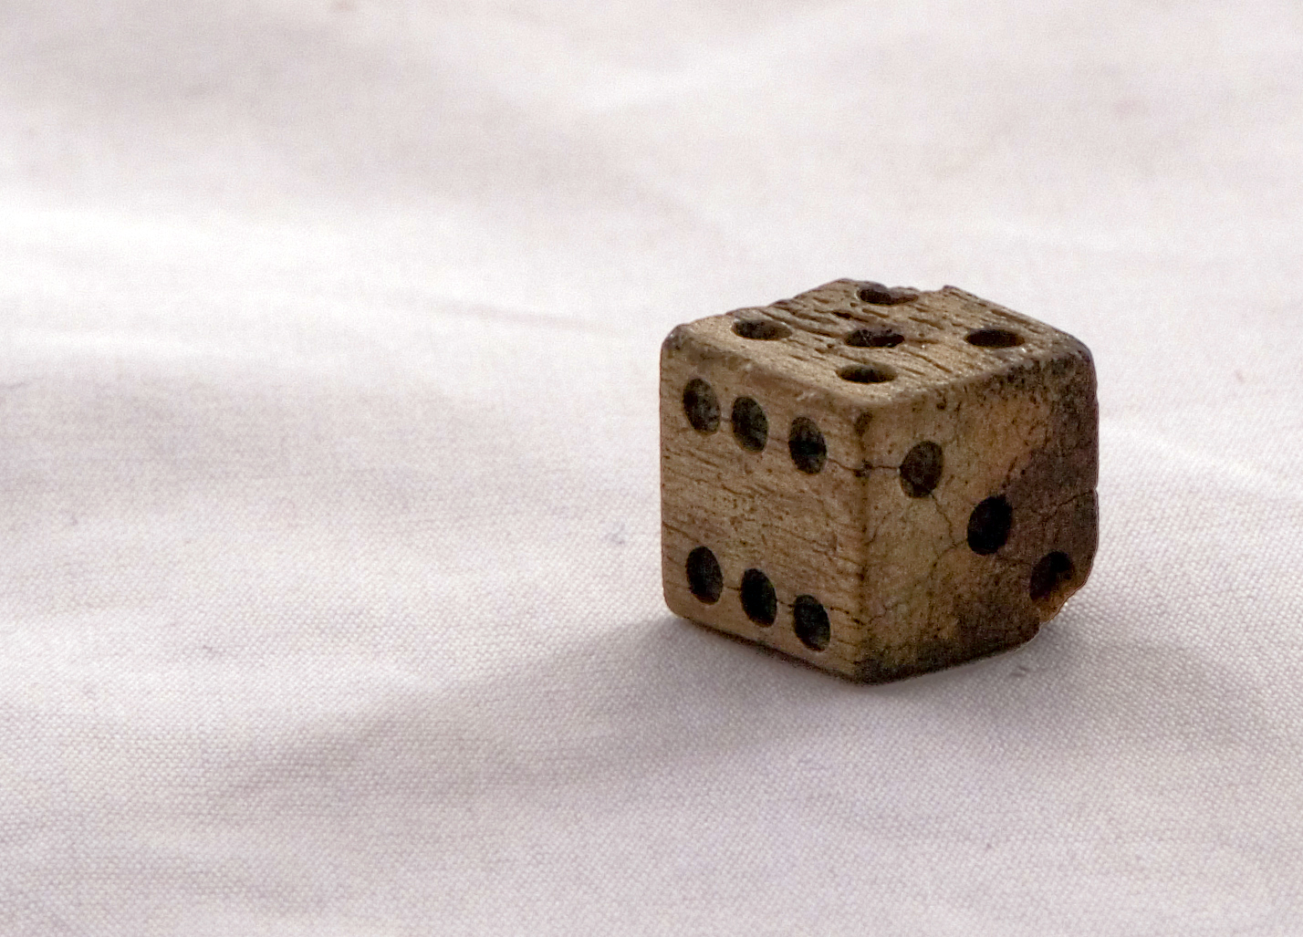
Joint and Conditional distributions of random variables
Example:
X = number of pips on the bone die.
Y = X modulo 2.
The joint probability $P\left(X=5,Y=1\right)=\frac{1}{6}$.
Their joint distribution is:
Bone die found at Cantonment Clinch. CC-BY-3.0, Colby Kirk, 2007.
$$P(X=x,Y=y)$$ | $$P(Y=y | X=x)$$ | $$x$$
 |  | 1 | 2 | 3 | 4 | 5 | 6
$$y$$ | $$0$$ | $$0$$ | $$\frac{1}{6}$$ | $$0$$ | $$\frac{1}{6}$$ | $$0$$ | $$\frac{1}{6}$$
 | $$1$$ | $$\frac{1}{6}$$ | $$0$$ | $$\frac{1}{6}$$ | $$0$$ | $$\frac{1}{6}$$ | $$0$$
$$x$$ | 1 | 2 | 3 | 4 | 5 | 6
$$y$$ | 1 | 0 | 1 | 0 | 1 | 0
$$P(X=x, Y=y)$$ | $$\frac{1}{6}$$ | $$\frac{1}{6}$$ | $$\frac{1}{6}$$ | $$\frac{1}{6}$$ | $$\frac{1}{6}$$ | $$\frac{1}{6}$$
$$P\left(X,Y\right)=$$

Slide 23
Joint and Conditional distributions of random variables
Example:
X = number of pips on the bone die.
Y = X modulo 2.
The conditional probability $P\left(X=5|Y=1\right)=\frac{1}{3}$.
Their joint distribution is:
Bone die found at Cantonment Clinch. CC-BY-3.0, Colby Kirk, 2007.
$$P(X=x | Y=y)$$ | $$P(Y=y | X=x)$$ | $$x$$
 |  | 1 | 2 | 3 | 4 | 5 | 6
$$y$$ | $$0$$ | $$0$$ | $$\frac{1}{3}$$ | $$0$$ | $$\frac{1}{3}$$ | $$0$$ | $$\frac{1}{3}$$
 | $$1$$ | $$\frac{1}{3}$$ | $$0$$ | $$\frac{1}{3}$$ | $$0$$ | $$\frac{1}{3}$$ | $$0$$
$$P\left(X|Y\right)=$$

Slide 24
Normalization trick
If you’re given the joint probability distribution and want to find the conditional distribution, just renormalize so that each row sums to 1.
$$P(X=x,Y=y)$$ | $$P(Y=y | X=x)$$ | $$x$$
 |  | 1 | 2 | 3 | 4 | 5 | 6
$$y$$ | $$0$$ | $$0$$ | $$\frac{1}{6}$$ | $$0$$ | $$\frac{1}{6}$$ | $$0$$ | $$\frac{1}{6}$$
 | $$1$$ | $$\frac{1}{6}$$ | $$0$$ | $$\frac{1}{6}$$ | $$0$$ | $$\frac{1}{6}$$ | $$0$$
$$P(X=x | Y=y)$$ | $$P(Y=y | X=x)$$ | $$x$$
 |  | 1 | 2 | 3 | 4 | 5 | 6
$$y$$ | $$0$$ | $$0$$ | $$\frac{1}{3}$$ | $$0$$ | $$\frac{1}{3}$$ | $$0$$ | $$\frac{1}{3}$$
 | $$1$$ | $$\frac{1}{3}$$ | $$0$$ | $$\frac{1}{3}$$ | $$0$$ | $$\frac{1}{3}$$ | $$0$$

Slide 25
Outline
Motivation: Why use probability?
The axioms of probability
Random variables
Conditional probability
Mutually exclusive vs. Independent vs. Conditionally Independent

Slide 26
Mutually exclusive events
Mutually exclusive events never occur simultaneously:
$$P\left(A⋁B\right)=P\left(A\right)+P\left(B\right)−P\left(A⋀B\right)=P\left(A\right)+P(B)$$
A
B

Slide 27
Independent events
Independent events occur with equal probability, regardless of whether or not the other event has occurred:
$$P\left(A|B\right)=\frac{P(A⋀B)}{P(B)}=P\left(A\right), P\left(B|A\right)=\frac{P(A⋀B)}{P(A)}=P\left(B\right)$$
A
B

Slide 28
Independent events: A more useful definition
Re-arranging terms in the previous slide gives us this more useful definition of independent events:
$$P(A⋀B)=P\left(A\right)P(B)$$
A
B

Slide 29
Independent vs. Mutually Exclusive
Independent events:
$$P(A⋀B)=P\left(A\right)P(B)$$
Mutually exclusive events:
$$P\left(A⋁B\right)=P\left(A\right)+P(B)$$
Don’t confuse them! Mutually exclusive events are not independent. Quite the contrary.

Slide 30
Conditionally independent events
Events A and B are conditionally independent, given C, if
$$P\left(A|B,C\right)=P\left(A|C\right)$$
C
A
B

Slide 31
Conditionally independent events
Events A and B are conditionally independent, given C, if
$$P\left(A|B,C\right)=\frac{P(A⋀B|C)}{P(B|C)}=P\left(A|C\right)$$
C
A
$$A|C$$
$$B|C$$
B

Slide 32
Conditionally independent events
Events A and B are conditionally independent, given C, if
$$P\left(A,B|C\right)=P\left(A|C\right)P(B|C)$$
C
$$A|C$$
$$B|C$$

Slide 33
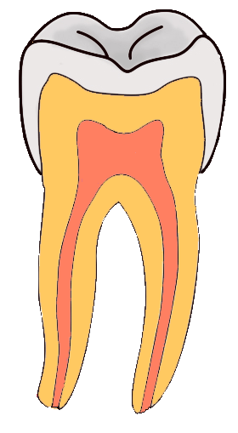
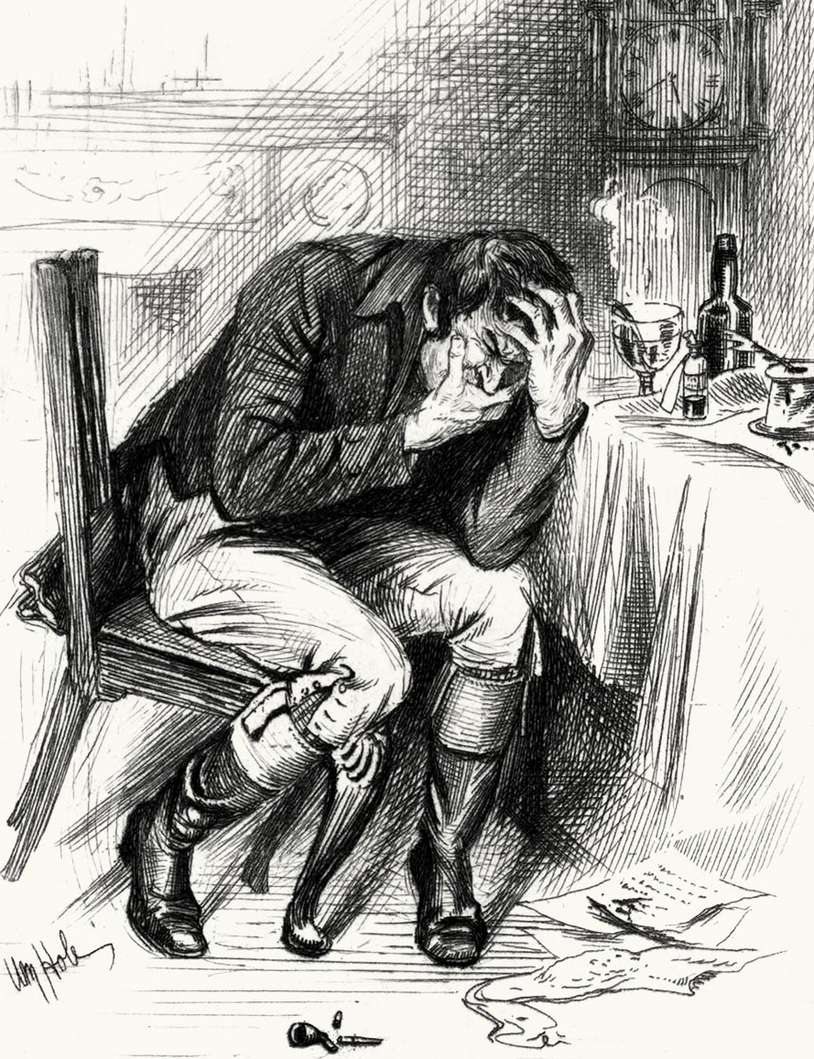
Independence ≠ Conditional Independence
Cavity= the patient has a cavity
Toothache= patient has a toothache
Catch= dentist’s probe catches on something in the mouth
By Aduran, CC-SA 3.0
By William Brassey Hole(Died:1917)
By Dozenist, CC-SA 3.0

Slide 34
These Events are not Independent
If the patient has a toothache, then it’s likely he has a cavity. Having a cavity makes it more likely that the probe will catch on something.
$$P(Catch|Toothache) > P(Catch)$$
If the probe catches on something, then it’s likely that the patient has a cavity. If he has a cavity, then he might also have a toothache.
$$P(Toothache|Catch) > P(Toothache)$$
So Catch and Toothache are not independent

Slide 35
…but they are Conditionally Independent
Dependent
Dependent
Conditionally Dependent given knowledge of Cavity
Here are some reasons the probe might not catch, despite having a cavity:
The dentist might be really careless
The cavity might be really small
Those reasons have nothing to do with the toothache!
$$P\left(Catch | Cavity,Toothache\right)= P(Catch|Cavity)$$
Catch and Toothache are conditionally independent given knowledge of Cavity

Slide 36
…but they are Conditionally Independent
Dependent
Dependent
Conditionally Dependent given knowledge of Cavity
These statements are all equivalent:
$$P\left(Catch | Cavity,Toothache\right)= P\left(Catch | Cavity\right)$$
$$P\left(Toothache | Cavity,Catch\right)= P(Toothache|Cavity)$$
$P\left(Toothache,Catch | Cavity\right)= P(Toothache|Cavity)$ $P\left(Catch | Cavity\right)$
…and they all mean that Catch and Toothache are conditionally independent given knowledge of Cavity

Slide 37
Summary
Here’s today’s most important equation:
$$P(B|A)=\frac{P(A⋀B)}{P(A)}$$
If you haven’t seen this stuff since high school, read appendix A.3.
C-:
A-:
:-B

