Slide 1
Lecture 4: The “animal kingdom” of heuristics: Admissible, Consistent, Zero, Relaxed, Dominant
Mark Hasegawa-Johnson, January 2021
Distributed under CC-BY 3.0
Title image: Peaceable Kingdom by Edward Hicks, National Gallery of Art, Washington, DC

Slide 2
Outline of lecture
Admissible heuristics
Consistent heuristics
The zero heuristic: Uniform Cost Search
Relaxed heuristics
Dominant heuristics

Slide 3
A* Search
$$c\left(m\right)$$
m
S
G
n
$$g\left(n\right)$$
$$≥h\left(n\right)$$
Definition: A* SEARCH
If $h\left(n\right)$ is admissible $(d(n)≥h\left(n\right))$, and
if the frontier is a priority queue sorted according to $g\left(n\right)+h(n)$, then
the FIRST path to goal uncovered by the tree search, path $m$, is guaranteed to be the SHORTEST path to goal
($h\left(n\right)+g\left(n\right)≥c(m)$ for every node $n$ that is not on path $m$)

Slide 4
Bad interaction between A* and the explored set
Explored Set:
empty
Frontier
S: g(n)+h(n)=2, parent=none
Expand: S, put its children A and B on the frontier.

Slide 5
Bad interaction between A* and the explored set
Explored Set:
S
Frontier
A: g(n)+h(n)=5, parent=S
B: g(n)+h(n)=2, parent=S
Expand: B, put its child C on the frontier.

Slide 6
Bad interaction between A* and the explored set
Explored Set:
S, B
Frontier
A: g(n)+h(n)=5, parent=S
C: g(n)+h(n)=4, parent=B
Expand: C, put its child G on the frontier.

Slide 7
Bad interaction between A* and the explored set
Explored Set:
S, B, C
Frontier
A: g(n)+h(n)=5, parent=S
G: g(n)+h(n)=6, parent=C
Expand: A. But we can’t put its child, C, on the frontier, because C is already in the explored set!

Slide 8
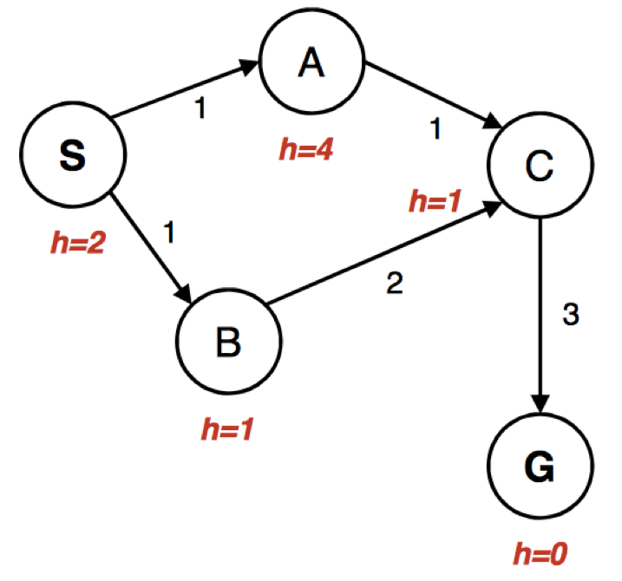
Bad interaction between A* and the explored set
Explored Set:
S, B, C
Frontier
G: g(n)+h(n)=6, parent=C
Expand: G. Return the path SBCG, with cost 6. OOPS!

Slide 9
Why did this happen?
Well, because we used an explored set instead of an explored dict.
explored dict lists the h(n)+g(n) for each explored state
If the same state shows up later, with lower h(n)+g(n), then put it back on the frontier.
An explored set undermines A*, but an explored dict works just fine.
But actually, why did the higher-cost path SBC get explored before the lower-cost path SAC?
That never happens for goal. An admissible heuristic guarantees that the first time you pop Goal from the frontier, it will have its lowest cost.
Can we make the same idea true for every state, not just the goal state?

Slide 10
Outline of lecture
Admissible heuristics
Consistent heuristics
The zero heuristic: Uniform Cost Search
Relaxed heuristics
Dominant heuristics

Slide 11
Consistent (monotonic) heuristic
g$\left(m\right)$
$$d\left(m\right)−d(p)$$
m
S
p
n
$$g\left(n\right)$$
$$d\left(n\right)−d(p)$$
$$≥h\left(n\right)−h(p)$$
Definition: A consistent heuristic is one for which, for every pair of nodes in the graph, $d\left(n\right)−d(p)≥h\left(n\right)−h\left(p\right)$.
In words: the distance between any pair of nodes is greater than or equal to the difference in their heuristics.

Slide 12
A* with an inconsistent heuristic
Explored Set
S, B
Frontier
A: g(n)+h(n)=5, parent=S
C: g(n)+h(n)=4, parent=B
Expand: C

Slide 13
A* with a consistent heuristic
Explored Set
S, B
Frontier
A: g(n)+h(n)=2, parent=S
C: g(n)+h(n)=4, parent=B
Expand: A
h=1

Slide 14
A* with a consistent heuristic
Explored Set
S, B, A
Frontier
C: g(n)+h(n)=3, parent=A
Expand: C
h=1

Slide 15
A* with a consistent heuristic
Explored Set
S, B, A, C
Frontier
G: g(n)+h(n)=5, parent=C
Expand: G
h=1

Slide 16
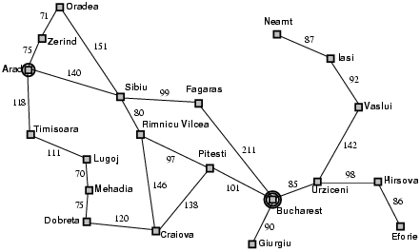
Admissible heuristic example: Romania
Admissible:
$$h(n)≤d(n)$$
Example:
$$d(Sibiu) = 278$$
$$h(Sibiu) ≤ 278$$

Slide 17
Consistent heuristic example: Romania
Consistent:
$$h\left(n\right)−h\left(p\right)≤d\left(n\right)−d(p)$$
Example:
$$d\left(Arad\right)−d(Sibiu) =140$$
$$h\left(Arad\right)−h(Sibiu) ≤140$$
The heuristic difference is always less than or equal to the cost of the action.

Slide 18
Can you use this in the MP?
Maybe.
In the MP, every action has a cost of exactly 1!
…so a consistent heuristic would be one such that, for every pair of neighboring states n and p, $h\left(n\right)−h\left(p\right)≤1$.
Manhattan distance satisfies this condition.
There are good heuristics for parts 3 and 4 that don’t satisfy this condition. If your heuristic is not consistent, just make sure that you use an explored dict, instead of an explored set.

Slide 19
Outline of lecture
Admissible heuristics
Consistent heuristics
The zero heuristic: Uniform Cost Search
Relaxed heuristics
Dominant heuristics

Slide 20
The trivial case: h(n)=0
A heuristic is admissible if and only if $d(n)≥h\left(n\right)$ for every $n$.
A heuristic is consistent if and only if $d\left(n,p\right)≥h\left(n\right)−h\left(p\right)$ for every $n$ and $p$.
Both criteria are satisfied by $h\left(n\right)=0.$

Slide 21
UCS = A* with h(n)=0
Suppose we choose $h\left(n\right)=0$
Then the frontier is a priority queue sorted by
$$g\left(n\right)+h\left(n\right)=g(n)$$
In other words, the first node we pull from the queue is the one that’s closest to START!! (The one with minimum $g\left(n\right)$).
Uniform Cost Search is A* Search with the heuristic $h\left(n\right)=0$ for all states.

Slide 22
Outline of lecture
Admissible heuristics
Consistent heuristics
The zero heuristic: Uniform Cost Search
Relaxed heuristics
Dominant heuristics

Slide 23
Heuristics from relaxed problems
A problem with fewer restrictions on the actions is called a relaxed problem
In most problems, having fewer restrictions on your action means that you can reach the goal faster.
So designing a heuristic is usually the same as finding a relaxed problem that makes it easy to calculate the distance to goal.

Slide 24
Relaxed heuristic example: Manhattan distance
If there were no walls, this would be the path to goal: straight down, then straight right.
If there were no walls in the maze, then the number of steps from position $(x_{n},y_{n})$ to the goal position $(x_{G},y_{G})$ would be
$$h(n)=|x_{n}−x_{G}|+|y_{n}−y_{G}|$$
Start state
$$y_{n}$$
$$y_{G}$$
Goal state
$$x$$
$$x_{n}$$
$$x_{G}$$

Slide 25
Relaxed heuristic example: Euclidean distance
If there were no walls and we could move diagonally
If there were no walls in the maze, and we could move diagonally, then the number of steps from position $(x_{n},y_{n})$ to the goal position $(x_{G},y_{G})$ would be
$$h(n)=\sqrt{{|x_{n}−x_{G}|}^{2}+{|y_{n}−y_{G}|}^{2}}$$
Start state
$$y_{n}$$
$$y_{G}$$
Goal state
$$x$$
$$x_{n}$$
$$x_{G}$$

Slide 26
Relaxed heuristic example: Corner dots
Suppose that, instead of touching ALL of the waypoints, you only had to touch the most extreme waypoints?

Slide 27
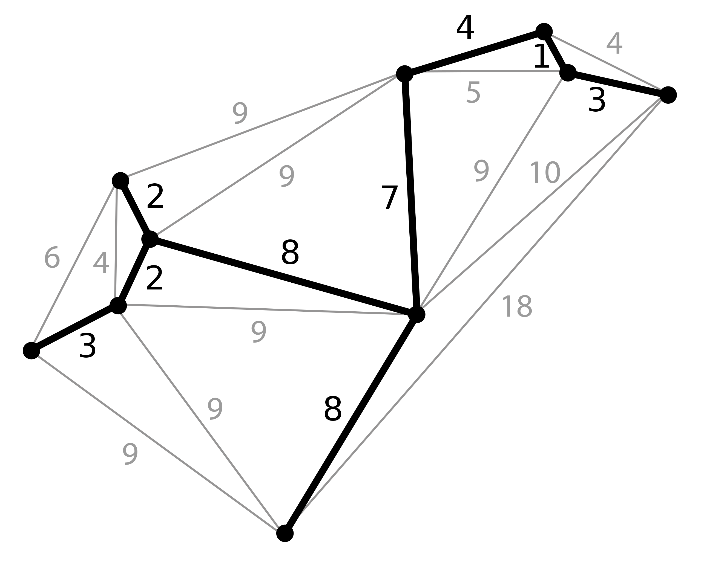
Relaxed heuristic example: Many dots
Suppose that, after you reached a waypoint, you could magically fly back to the nearest branch in the minimum spanning tree?
In other words, you only have to go one-way from where you are to the waypoint – you don’t have to come back again.

Slide 28
Outline of lecture
Admissible heuristics
Consistent heuristics
The zero heuristic: Uniform Cost Search
Relaxed heuristics
Dominant heuristics

Slide 29
Which heuristic is better
If Euclidean distance and Manhattan distance are both admissible heuristics for the single-waypoint maze problem, which one is better?
Computational complexity of A*: If $c(G)$ is true cost of the best path to goal, then A* evaluates every $n$ for which $g(n)+h(n)≤c(G)$
How to minimize computational complexity: make $h(n)$ as large as possible, subject to the constraint that $h(n)≤d(n)$.

Slide 30
Euclidean distance
$$h_{2}(n)=\sqrt{{|x_{n}−x_{G}|}^{2}+{|y_{n}−y_{G}|}^{2}}$$
Start state
$$y_{n}$$
$$y_{G}$$
Goal state
$$x$$
$$x_{n}$$
$$x_{G}$$

Slide 31
Manhattan distance
$$h_{1}(n)=|x_{n}−x_{G}|+|y_{n}−y_{G}|$$
$$h_{1}(n)≥h_{2}(n)$$
Using $h_{1}(n)$, there will be fewer nodes with $g(n)+h(n)≤c(G)$. Therefore, computational complexity is lower. Therefore $h_{1}(n)$ is better.
Start state
$$y_{n}$$
$$y_{G}$$
Goal state
$$x$$
$$x_{n}$$
$$x_{G}$$

Slide 32
Dominance
If h₁ and h₂ are both admissible heuristics and h₂(n) ≥ h₁(n) for all n, (both admissible) then h₂ dominates h₁
As long as they’re both admissible, they will both find the optimum path.
But h₂(n) will require less computation to find it.

Slide 33
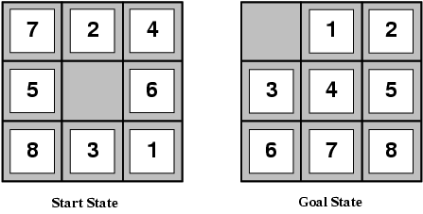
Example: the 8-puzzle
Problem statement: given a shuffled set of numbers (left), re-arrange them in order (right).
State: ordering of the numbers and of the space.
Possible actions: swap the space with any of its neighbors.
Like traveling salesman, this is an NP-complete problem.

Slide 34
8-puzzle: Heuristic $h_{1}(n)$
Suppose that, on each step, we could move any tile, anywhere on the board, regardless of where other tiles were.
Then $h_{1}(n) =$ # tiles that need to be moved.
Example below: $h_{1}\left(n\right)=8$

Slide 35
8-puzzle: Heuristic $h_{2}(n)$
Suppose that, on each step, we could move any tile by just one step horizontally or vertically, regardless of whether there are other tiles in the way.
Then $h_{2}(n) =$ sum of Manhattan distances from the current positions of each tile to their target positions (notice: $h_{2}(n)≥h_{1}(n)$)
Example below: $h_{2}\left(n\right)=3+1+2+2+2+3+3+2=18$

Slide 36
Dominance Experiment results reported by Svetlana Lazebnik
Typical search costs for the 8-puzzle (average number of nodes expanded for different solution depths):
d=12 BFS expands 3,644,035 nodes A*(h₁) expands 227 nodes A*(h₂) expands 73 nodes
d=24 BFS expands 54,000,000,000 nodes A*(h₁) expands 39,135 nodes A*(h₂) expands 1,641 nodes

Slide 37
Combining heuristics
Suppose we have a collection of admissible heuristics h₁(n), h₂(n), …, h_{m}(n), but none of them dominates the others
How can we combine them?
h(n) = max{h₁(n), h₂(n), …, h_{m}(n)}

Slide 38
Outline of lecture
Admissible heuristics: $h(n)≤d(n)$
Consistent heuristics: $h(n)−h(p)≤d(n)−d(p)$
The zero heuristic: Uniform Cost Search: $h(n)=0$
Relaxed heuristics: $h(n)$ is the $d(n)$ from a problem with fewer rules.
Dominant heuristics: if $h_{2}(n)≤h_{1}(n)$ and both are admissible, then $h_{1}(n)$ has lower computational complexity

Slide 39
Five search strategies
Algorithm | Complete? | Optimal? | Time complexity | Space complexity | Implement the Frontier as a…
BFS | Yes | If all step costs equal | $$O\{b^{d}\}$$ | $$O\{b^{d}\}$$ | Queue
DFS | No | No | $$O\{b^{m}\}$$ | $$O\{bm\}$$ | Stack
UCS | Yes | Yes | #nodes s.t. $$g(n) ≤ c(G)$$ | #nodes s.t. $$g(n) ≤ c(G)$$ | Priority Queue: $g(n)$
Greedy | No | No | $$O\{b^{m}\}$$ | $$O\{b^{m}\}$$ | Priority Queue: $h(n)$
A* | Yes | Yes | #nodes s.t. $$g(n)+h(n) ≤ c(G)$$ | #nodes s.t. $$g(n)+h(n) ≤ c(G)$$ | Priority Queue: $h(n)+g(n)$

