Slide 1
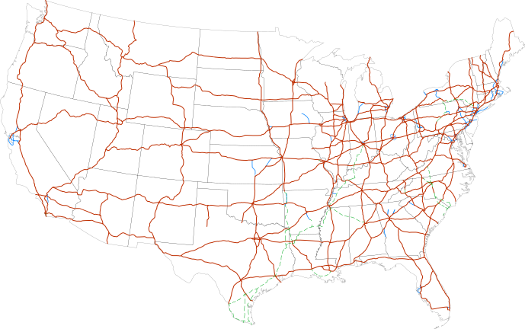
CS440/ECE 448 Lecture 2: Breadth-First Search

Slide 2
Outline of today’s lecture
Initial state, goal state, transition model
General algorithm for solving search problems
First data structure: a frontier queue
Second data structure: a search tree
Third data structure: a “visited states” dict
Breadth-first search (BFS) and Depth-first search (DFS)
Minimum spanning tree (MST)

Slide 3
Search
We will consider the problem of designing goal-based agents in fully observable, deterministic, discrete, static, known environments
Environment is sequential: agent’s action changes its state
Agent must plan the best sequence of actions to achieve a goal
Start state
Goal state

Slide 4
Search problem components
Initial state
Actions
Transition model
What state results from performing a given action in a given state?
Goal state
Path cost
Assume that it is a sum of nonnegative step costs
The optimal solution is the sequence of actions that gives the lowest path cost for reaching the goal
Initial
state
Goal state

Slide 5
Knowledge Representation: State
State = description of the world
Must have enough detail to decide whether or not you’re currently in the initial state
Must have enough detail to decide whether or not you’ve reached the goal state
Often but not always: “defining the state” and “defining the transition model” are the same thing

Slide 6
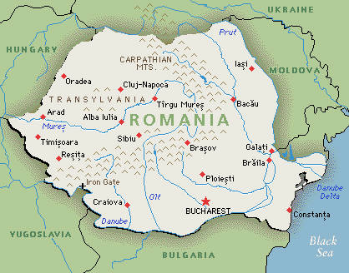
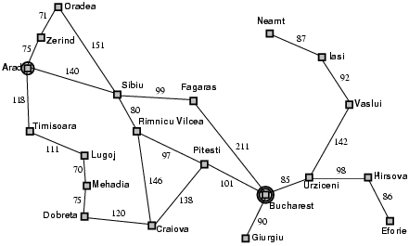
Example of state definition: Romania
On vacation in Romania; currently in Arad
Flight leaves tomorrow from Bucharest
state = name of the city
Path cost
Sum of edge costs (total distance traveled)

Slide 7
Example of state definition: Maze solving
Initial
state
State = (x,y), current position of the agent
Goal state

Slide 8
Example of state definition: Traveling salesman problem
Goal: visit every city in the United States
Path cost: total miles traveled
Initial state: Champaign, IL
Action: travel from one city to another
Transition model: when you visit a city, mark it as “visited.”

Slide 9
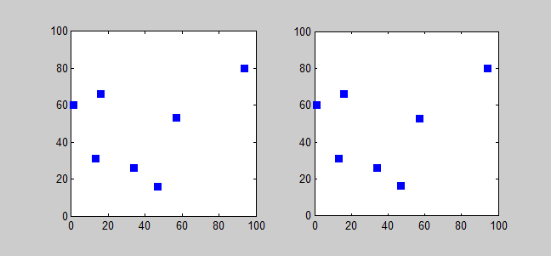
Example of state definition: Traveling salesman problem
state = (agent, goals)
agent = (agent_x,agent_y) is current position of the agent
goals = [goal[0], goal[1], …] lists the goals that have not yet been reached
goal[i] = (goal_x, goal_y) tells the location of the i’th remaining goal
Solving TSP using a branch-and-bound algorithm. CC-BY-SA 3.0, Saurabh Harsh, 2012, https://commons.wikimedia.org/wiki/File:Branchbound.gif

Slide 10
Outline of today’s lecture
Initial state, goal state, transition model
General algorithm for solving search problems
First data structure: a frontier queue
Second data structure: a search tree
Third data structure: a “visited states” dict
Breadth-first search (BFS) and Depth-first search (DFS)
Minimum spanning tree (MST)

Slide 11
How does this problem differ from every problem you’ve ever seen before?
Search differs from most Computer Science problems in that the state space might be infinite. We don’t assume, in advance, that we can enumerate every possible configuration of the world.
Traditional definition of Dijkstra’s algorithm:
First, list all of the possible states in the “not explored” list
Then, move them to the “explored” list after we visit them
Modifying Dijkstra’s algorithm for the infinite-world assumption:
Instead of a list of all possible states, we have a method (next_state,cost)=Transition_Model( current_state, action)
Instead of an infinite “not explored” list, we have a finite “frontier.”

Slide 12
First data structure: Frontier
Frontier = set of nodes that you know how to reach, but you haven’t yet tested to see what comes next after those states
node = ( state, parent_node, path_cost )
Initialize: frontier = { (initial_state, None, 0) }
Iterate, until goal is reached:
Set current_state to some node from the frontier, remove it from the frontier.
Expand current_state:
If it’s the goal, then you’re done! Return the corresponding path.
If not, then find its children, and transition costs, using (next_state,cost)=Transition_Model( current_state, action), and add them to the frontier.

Slide 13
Example: Romania
On vacation in Romania; currently in Arad
Flight leaves tomorrow from Bucharest
Initial state
Arad
Actions
Go from one city to another
Transition model
If you go from city A to city B, you end up in city B
Goal state
Bucharest
Path cost
Sum of edge costs (total distance traveled)

Slide 14
Search step 0
Frontier: { Arad }
Tree:
Arad, 0

Slide 15
Search step 1
Frontier: { Sibiu, Zerind, Timisoara }
Tree:
Arad, 0
Sibiu, 140
Timisoara, 118
Zerind, 75

Slide 16
Tree Search: Basic idea
SEARCH for an optimal solution
Maintain a frontier of unexpanded states
At each step, pick a state from the frontier to expand:
Check to see whether or not this state is the goal state. If so, DONE!
If not, then list all of the states you can reach from this state, add them to the frontier, and add them to the tree
BACK-TRACE: go back up the tree; list, in reverse order, all of the actions you need to perform in order to reach the goal state.
ACT: the agent reads off the sequence of necessary actions, in order, and does them.

Slide 17
Nodes vs. States
State = description of the world
Must have enough detail to decide whether or not you’re currently in the initial state
Must have enough detail to decide whether or not you’ve reached the goal state
Often but not always: “defining the state” and “defining the transition model” are the same thing
Node = a point in the search tree
Knows the ID of its STATE
Knows the ID of its PARENT NODE
Knows the COST of the path
Starting state
Action
Successor state
…
…
…
…
Goal state

Slide 18
Search step 1
Frontier: { Sibiu, Zerind, Timisoara }
Tree:
Arad, 0
Sibiu, 140
Timisoara, 118
Zerind, 75

Slide 19
Search step 2 Expand Sibiu
Frontier: { Sibiu, Zerind, Timisoara }
Tree:
Arad, 0
Sibiu, 140
Timisoara, 118
Zerind, 75

Slide 20
Search step 2 Expanded Sibiu
Frontier: { Zerind, Timisoara, Oradea, Arad,
Rimnicu Vilcea, Fagaras }
Tree:
Arad, 0
Sibiu, 140
Timisoara, 118
Zerind, 75
Oradea, 291
Arad, 280
Rimnicu Vilcea, 220
Fagaras, 239

Slide 21
Tree Search: Computational Complexity
Without an EXPLORED set
b = “branching factor” = max # states you can reach from any given state
d = “depth” = # layers in the tree (# moves that you have made)
Without an explored set: complexity = O{b^d}
Solution: keep track of the states you have explored
When you expand a state, you get the list of its possible child states
ONLY IF a child state is not already explored, put it on the frontier, and put it on the explored set.
Result: complexity = min(O{b^d}, O{# possible world states})

Slide 22
Search step 0
Frontier: { Arad }
Explored: { Arad }
Tree:
Arad, 0

Slide 23
Search step 1
Frontier: { Sibiu, Zerind, Timisoara }
Explored: { Arad, Sibiu, Zerind, Timisoara }
Arad, 0
Sibiu, 140
Timisoara, 118
Zerind, 75

Slide 24
Search step 2
Frontier: { Zerind, Timisoara, Oradea, Rimnicu Vilcea, Fagaras }
Explored: { Arad, Sibiu, Zerind, Timisoara, Oradea, Rimnicu Vilcea, Fagaras }
Arad, 0
Sibiu, 140
Timisoara, 118
Zerind, 75
Oradea, 291
Rimnicu Vilcea, 220
Fagaras, 239

Slide 25
Search step 3: expand Zerind
Frontier: { Zerind, Timisoara, Oradea, Rimnicu Vilcea, Fagaras }
Explored: { Arad, Sibiu, Zerind, Timisoara, Oradea, Rimnicu Vilcea, Fagaras }
Arad, 0
Sibiu, 140
Timisoara, 118
Zerind, 75
Oradea, 291
Rimnicu Vilcea, 220
Fagaras, 239

Slide 26
Whoa… from Zerind, we can reach Oradea with a total path cost of only 75+71=146
Frontier: { Zerind, Timisoara, Oradea, Rimnicu Vilcea, Fagaras }
Explored: { Arad, Sibiu, Zerind, Timisoara, Oradea, Rimnicu Vilcea, Fagaras }
Arad, 0
Sibiu, 140
Timisoara, 118
Zerind, 75
Oradea, 291
Rimnicu Vilcea, 220
Fagaras, 239

Slide 27
Third data structure: Explored Dictionary
Explored = dictionary mapping from state ID to path cost
If we find a new path to the same state, with HIGHER COST, then we ignore it
If we find a new path to the same state, with LOWER COST, then we expand the new path

Slide 28
Frontier: { Zerind:75, Timisoara:118, Oradea:291, Rimnicu Vilcea:220, Fagaras:239 }
Explored: { Arad:0, Sibiu:140, Zerind:75, Timisoara:118, Oradea:291, Rimnicu Vilcea:220, Fagaras:239 }
Arad, 0
Sibiu, 140
Timisoara, 118
Zerind, 75
Oradea, 291
Rimnicu Vilcea, 220
Fagaras, 239
Whoa… from Zerind, we can reach Oradea with a total path cost of only 75+71=146

Slide 29
Search step 3: expanded Zerind
Frontier: { Timisoara:118, Oradea:146, Rimnicu Vilcea:220, Fagaras:239 }
Explored: { Arad:0, Sibiu:140, Zerind:75, Timisoara:118, Oradea:146, Rimnicu Vilcea:220, Fagaras:239 }
Arad, 0
Sibiu, 140
Timisoara, 118
Zerind, 75
Rimnicu Vilcea, 220
Fagaras, 239
Oradea, 146

Slide 30
Outline of today’s lecture
Initial state, goal state, transition model
General algorithm for solving search problems
First data structure: a frontier queue
Second data structure: a search tree
Third data structure: a “visited states” dict
Breadth-first search (BFS) and Depth-first search (DFS)
Minimum spanning tree (MST)

Slide 31
In which order should you pick nodes from the frontier?
FIFO (first-in, first-out):
the next node you expand will always be the one least recently added to the frontier.
corresponds to a breadth-first search (BFS), i.e., the same order that Dijkstra’s algorithm would use
LIFO (last-in, first-out):
the next node you expand will always be the one most recently added to the frontier.
corresponds to a depth-first search (DFS)

Slide 32
BFS: Frontier = FIFO
Example:
explored = { S }
frontier = { A, B }
 | A | S | B
 |  |  |  | G

Slide 33
BFS: Frontier = FIFO
Example:
explored = { S, A, B }
frontier = { C, E }
 | A | S | B
 | C |  | D | G

Slide 34
BFS: Frontier = FIFO
Example:
explored = { S, A, B, C }
frontier = { D, E }
 | A | S | B
 | C |  | D | G
 | E

Slide 35
BFS: Frontier = FIFO
Example:
explored = { S, A, B, C, D }
frontier = { E, G }
 | A | S | B
 | C |  | D | G
 | E

Slide 36
BFS: Frontier = FIFO
Example:
explored = { S, A, B, C, D, E }
frontier = { G, F }
 | A | S | B
 | C |  | D | G
 | E | F

Slide 37
BFS: Frontier = FIFO
Example:
explored = { S, A, B, C, D, E, G }
frontier = { F }
Goal reached!
 | A | S | B
 | C |  | D | G
 | E | F

Slide 38
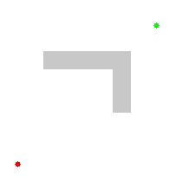
BFS: How to do it
Notice that BFS searches in exactly the same order as Dijkstra’s algorithm.
BFS is the normal way you would implement Dijkstra’s algorithm for a possibly-infinite search space.
Dijkstra’s progress, CC-BY 3.0, Subh83, 2011
https://commons.wikimedia.org/wiki/File:Dijkstras_progress_animation.gif

Slide 39
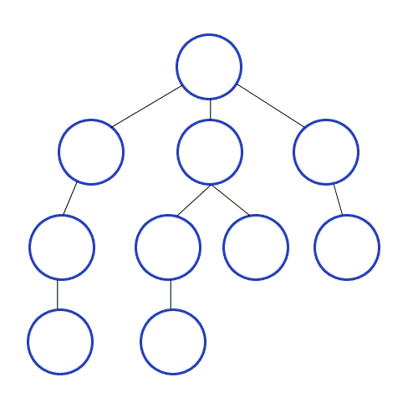
Depth-first search (DFS)
Exactly like BFS, but instead of expanding the frontier in FIFO order, expand it in LIFO order (last in, first out).
Result: most recently discovered path is pursued, all the way to the end.
Very efficient if there are many solutions, very inefficient if there are few solutions.
Depth-first-search. CC-BY-SA 3.0, Mre, 2009
https://commons.wikimedia.org/wiki/File:Depth-First-Search.gif

Slide 40
Analysis of search strategies
Strategies are evaluated along the following criteria:
Completeness: does it always find a solution if one exists?
Optimality: does it always find a least-cost solution?
Time complexity: number of nodes generated
Space complexity: maximum number of nodes in memory
Time and space complexity are measured in terms of
b: maximum branching factor of the search tree
d: depth of the optimal solution
m: maximum length of any path in the state space (may be infinite)

Slide 41
Properties of breadth-first search
Complete?
Yes (if branching factor b is finite).
Even w/o explored-set checking, it still works!
Optimal?
Yes
Time?
Number of nodes in a b-ary tree of depth d: O(b^{d})
(d is the depth of the optimal solution)
Space?
O(b^{d})

Slide 42
Properties of depth-first search
Complete? (always finds a solution if one exists?)
Fails in infinite-depth spaces
Fails if there are loops (unless you keep an “Explored Set”)
Optimal? (always finds an optimal solution?)
No – returns the first solution it finds
Time? (how long does it take, in terms of b, d, m?)
O(b^{m}) (remember BFS was O(b^{d}))
Terrible if m is much larger than d
Space? (how much storage space?)
O(bm), i.e., linear space!
The frontier doesn’t need to keep track of failed paths, only the currently active path

Slide 43
Outline of today’s lecture
Initial state, goal state, transition model
General algorithm for solving search problems
First data structure: a frontier queue
Second data structure: a search tree
Third data structure: a “visited states” set
Breadth-first search (BFS) and Depth-first search (DFS)
Minimum spanning tree (MST)

Slide 44
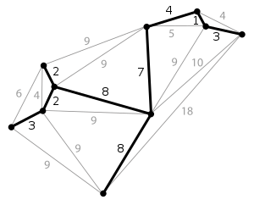
Minimum Spanning Tree (MST)
Digression: something totally different…
An MST is a tree (no cycles) that spans a graph (touches every vertex) with the minimum possible total distance of the selected edges.
In the example at right, total cost of the MST is the cost of all of its selected eges, i.e., 3+2+2+8+8+7+4+1+3=38

Slide 45
Kruskal’s Algorithm
Sort the edges in increasing order of cost.
Start state: every vertex is an independent tree, disconnected from every other
While there is more than one tree:
Expand the next-least-cost edge
If it connects two different trees, merge them into the same tree
If not, discard it
Kruskal’s algorithm. CC-BY-SA 4.0, Shiyu Ji, 2016
https://commons.wikimedia.org/wiki/File:KruskalDemo.gif

Slide 46
Outline of today’s lecture
Initial state, goal state, transition model
General algorithm for solving search problems
First data structure: a frontier queue
Second data structure: a search tree
Third data structure: a “visited states” dict
Breadth-first search (BFS) and Depth-first search (DFS)
Minimum spanning tree (MST)

