Slide 1
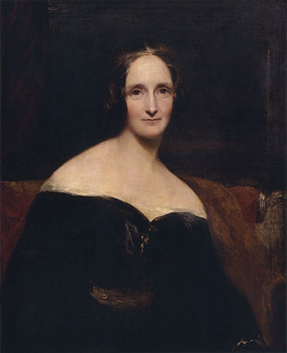
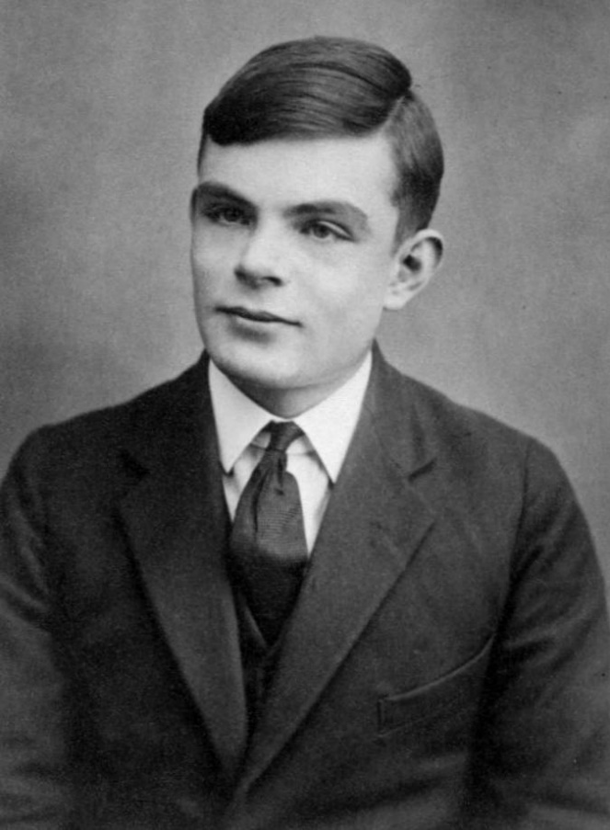
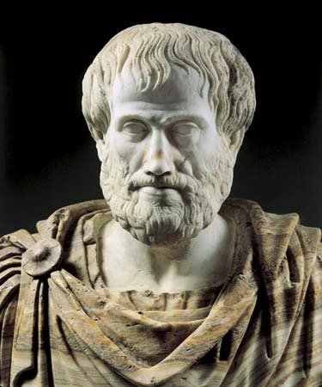
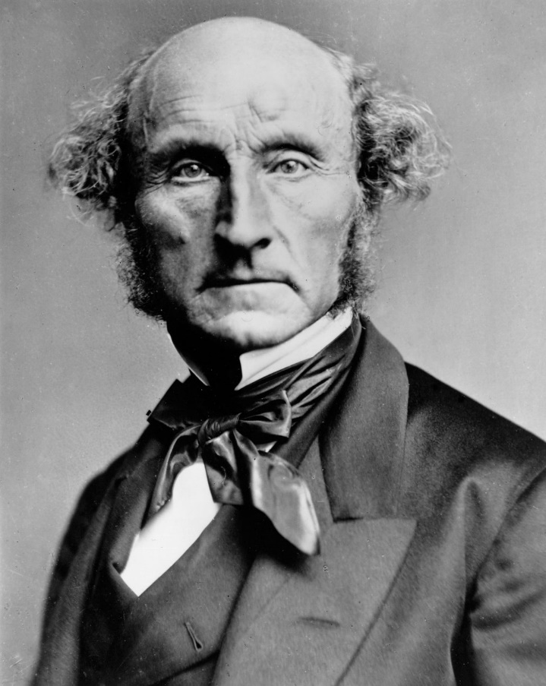
CS440/ECE448: Artificial Intelligence Lecture 1: Course Intro
Mary Shelley
Alfred Turing
Aristotle
John Stuart Mill

Slide 2
Outline
Syllabus: Grades, Exams, Collabs, Homework, Seminar, and Apps
Intelligence
Artificial Intelligence (chapter 1)
A brief history (chapter 1)
Environments in which an AI can operate (chapter 2.3)
Outline of the rest of this course

Slide 3
Course Intro: Syllabus
Web page: https://courses.engr.illinois.edu/ece448/sp2021/
Grading
Exams & Collabs
Homework
Graduate Research Seminar
Apps
Textbook

Slide 4
Grading: 3-credit
Grading: 4-credit
Exams: 36%
Homework (MPs): 50%
Collabs: 14%
Exams: 30%
Homework (MPs): 40%
Collabs: 10%
Research seminar: 20%

Slide 5
Exams
Midterms 3/5 and 4/9, Final during finals week
Synchronous: Take them during the class period
Open-book, open-notes, open-internet
Timed: practice doing problems quickly.
Collab worksheets will be composed of past exam problems.
Collabs
Scheduled in week 1; mandatory from week 2. Most will be M, W, or F, 1-2pm.
Participation: 7% of your grade (be there, help your teammates. Collaborate to solve all the problems on the worksheet.)
Worksheet: 7% of your grade (turn it in to gradescope, every problem answered; answers need not be correct. Correct answers will be distributed after the submission deadline.)

Slide 6
Homework
6 machine problems autograded on gradescope.com.
Language: python. Learn it: https://docs.python.org/3/tutorial/
MP1 (search): released Friday 1/29, due Wednesday 2/10 by 11:59pm.
Late policy:
Late submissions are accepted any time until the end of finals week.
If your submission is late, your autograder score is multiplied by
$0.5+0.5e^{−t/168}, t=$autograder lateness score, in hours
Lateness without penalty is possible if you are in the hospital or in legal custody for most of the last day.

Slide 7
Graduate Research Seminar
Meet weekly, Mondays 1-2pm, starting week 2
Basic format:
Each student gives a 3-slide presentation, each week
Presentation templates distributed in LaTeX, to help you know what to present. Presentation in LaTeX not required but strongly recommended.
Topics:
Week 1: learning LaTeX
Weeks 2-5: Research paper #1
Weeks 6-9: Research paper #2
Weeks 10-13: Research paper #3 (could be one of yours, if you wish)
Grading:
Participation (present, ask questions): 9%
Be session chair, typically 3X in the semester: 1%
Submit your slides after presentation, to gradescope: 10%

Slide 8
Apps
All homework and exams graded and submitted at: https://www.gradescope.com/
Exams: https://compass2g.illinois.edu.
Q/A forum: https://piazza.com
Videos of lectures: https://mediaspace.Illinois.edu

Slide 9
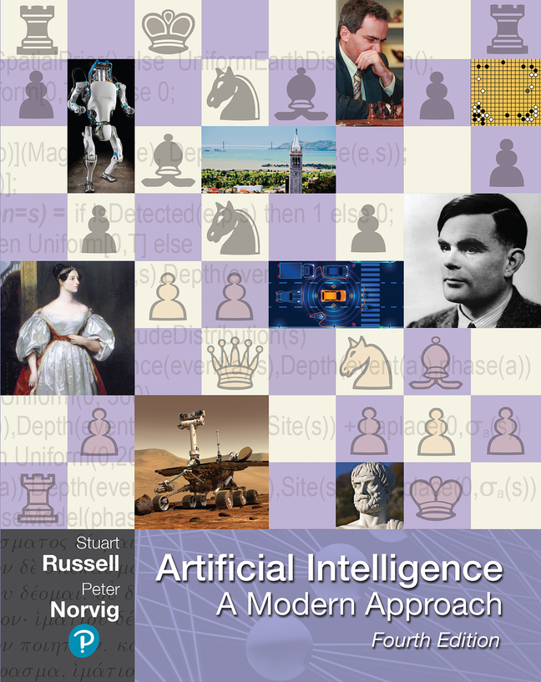
Textbook
Artificial Intelligence, A Modern Approach: Fourth Edition by Russell & Norvig
Pretty good listing of the topics covered in this course
In-depth treatment of knowledge-based/expert-system AI; introduces probabilistic and learning-based methods
Sample problems and readings will be specified when applicable

Slide 10
Outline
Syllabus: Grades, Exams, Collabs, Homework, Seminar, and Apps
Intelligence
Artificial Intelligence (chapter 1)
Artificial Intelligence: a brief history (chapter 2)
Environments in which an AI can operate (chapter 3)
Outline of the rest of this course

Slide 11
What is Intelligence?
The word “intelligence” is surprisingly recent. Ancients used it to mean “the universal mind.” Early moderns (e.g., Bacon, Hobbes; 1500s) ridiculed it, and stopped using it.

Slide 12
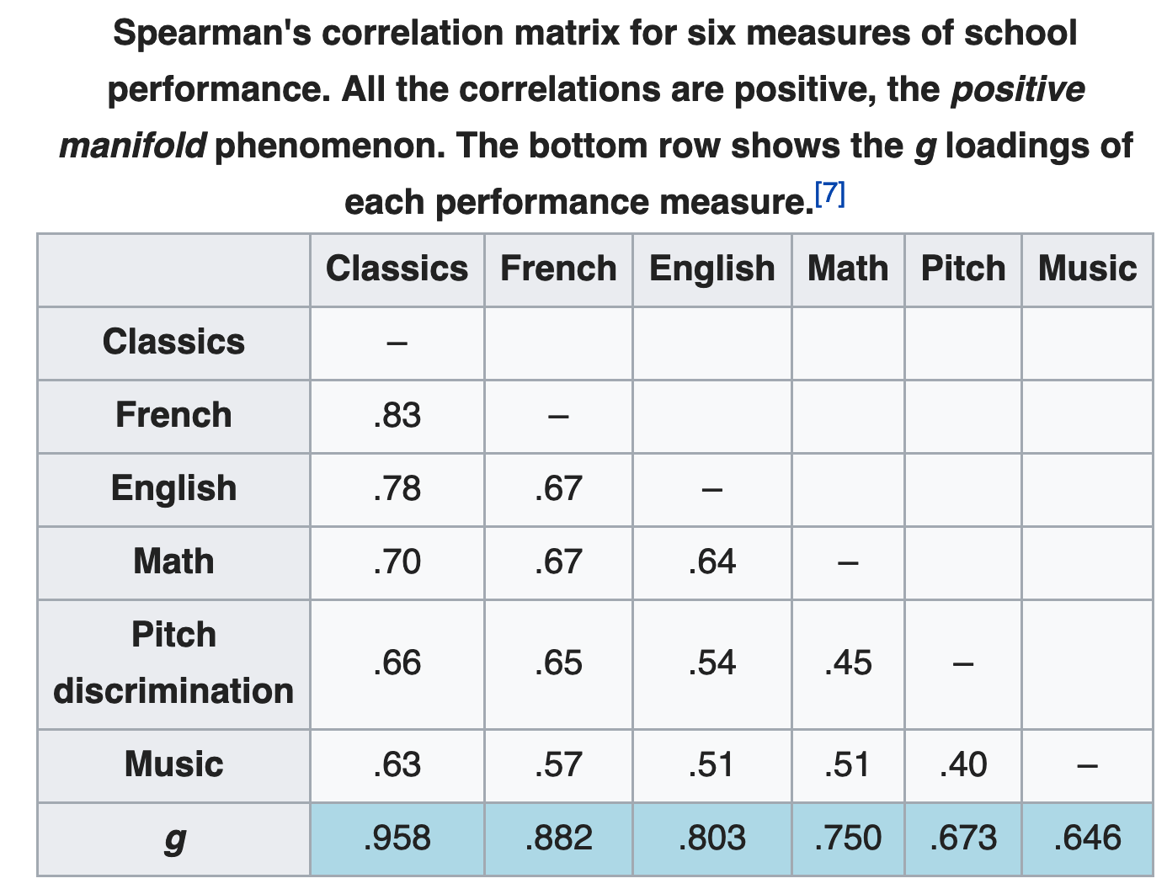
What is Intelligence?
Charles Spearman popularized the modern definition in his paper “General intelligence objectively determined and measured,” American Journal of Psychology 15(2):201-292.
He showed that test scores are correlated across many subjects and proposed “general intelligence” as the faculty that unifies them.
https://en.wikipedia.org/wiki/G_factor_(psychometrics)

Slide 13
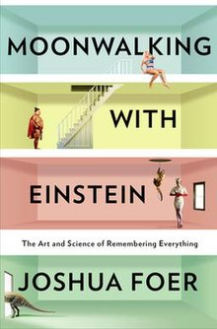
Intelligence can be learned
It is possible to learn new strategies for learning.
By doing so, it is possible to increase your score on tests of general intelligence.

Slide 14
Intelligence is just the beginning
Grit (“passion and perseverance for long-term goals”) is uncorrelated with general intelligence and is a better predictor of long-term success.

Slide 15
Outline
Syllabus: Grades, Exams, Collabs, Homework, Seminar, and Apps
Intelligence
Artificial Intelligence (chapter 1)
A brief history (chapter 2)
Environments in which an AI can operate (chapter 3)
Outline of the rest of this course

Slide 16
What is “Artificial Intelligence”
We usually mean more than just the ability to learn (ability to learn is covered in “Machine Learning”). We usually mean:
Ability to learn (a.k.a. intelligence)
Ability to plan (a.k.a. rationality)
Ability to communicate in natural language (a.k.a. abstraction)
Ability to reason about morality (a.k.a. humanity)

Slide 17
Outline
Syllabus: Grades, Exams, Collabs, Homework, Seminar, and Apps
Intelligence
Artificial Intelligence (chapter 1)
A brief history (chapter 2)
Environments in which an AI can operate (chapter 3)
Outline of the rest of this course

Slide 18
A brief history
1943: Artificial Intelligence imitates neuroscience (ability to learn)
1956: Artificial Intelligence is about symbolic logic (ability to plan)
1984: Artificial Intelligence is about probability (ability to communicate in natural language)
1988: Artificial Intelligence is about the understanding of causality (ability to reason about moral judgments)

Slide 19
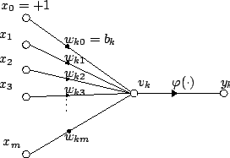
1943: McCulloch-Pitts Neuron Model
Attribution: Plarroy, https://commons.wikimedia.org/wiki/File:Artificial_neuron.png

Slide 20
1956: “Artificial Intelligence”
The term was invented in (John McCarthy, Marvin Minsky, Nathaniel Rochester, and Claude Shannon, “A Proposal for the Dartmouth Summer Research Project on Artificial Intelligence,” August 1955):
“We propose that a 2-month, 10-man study of artificial intelligence be carried out during the summer … An attempt will be made to find how to make machines
use language,
form abstractions and concepts,
solve kinds of problems now reserved for humans
improve themselves.”

Slide 21
1956: Logic Theorist
Socrates is a man
Men are male
Men are human
Reasoning as search:
Root of the search tree: initial hypothesis
Branch: a deduction based on the rules of logic
Goal state: the theorem to be proven
Proved 38 of the first 52 theorems in chapter 2 of the Principia Mathematica.
Socrates is male
Socrates is human
Humans are mortal
Socrates is mortal

Slide 22
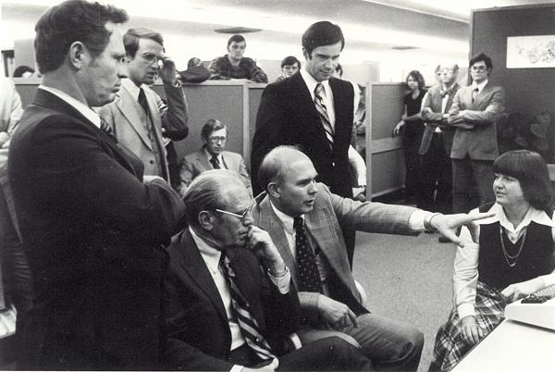
The ALPAC Report of 1966
“They concluded, in a famous 1966 report, that machine translation was more expensive, less accurate and slower than human translation.”
Photo: Eldon Lyttle,
https://commons.wikimedia.org/wiki/File:Computer-translation_Briefing_for_Gerald_Ford.jpg

Slide 23
AI Winter

Slide 24
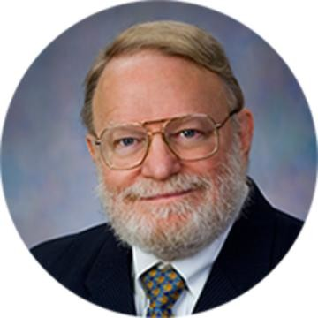
1984: Dragon Dictate 1.0 speech recognizer
Explicitly minimized the probability of error using a new technology called a ”hidden Markov model.”

Slide 25
1988: Probabilistic reasoning becomes causal reasoning
Judea Pearl’s “Bayesian Networks” show computer scientists how to extend the main ideas of the HMM to every other problem in AI.
Introduced a mathematics for reasoning about causality, and therefore, about moral judgments.

Slide 26
Outline
Syllabus: Grades, Exams, Collabs, Homework, Seminar, and Apps
Intelligence
Artificial Intelligence (chapter 1)
A brief history (chapter 2)
Environments in which an AI can operate (chapter 3)
Outline of the rest of this course

Slide 27
Environments in which an AI may operate
Ability to sense your surroundings:
Fully observable vs. Partially observable
Computational limitations on your ability to plan:
Discrete vs. Continuous
Static vs. Dynamic
Deterministic vs. Stochastic
Limitations on your ability to control the environment:
Episodic vs. Sequential
Single-agent vs. Multi-agent
Known vs. Unknown

Slide 28
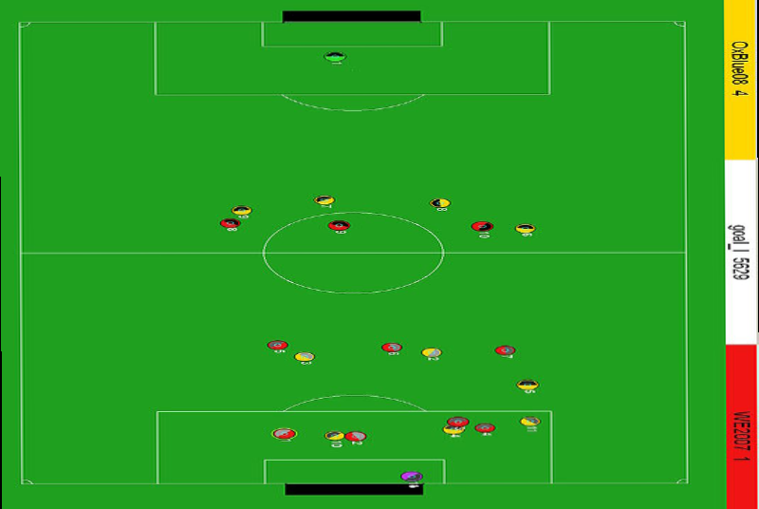
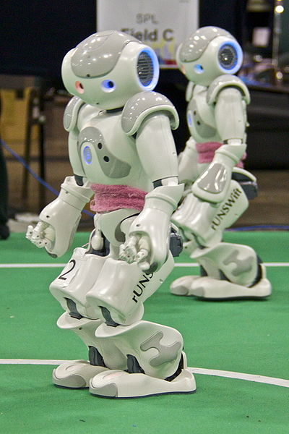
Fully observable vs. partially observable
Do the agent's sensors give it access to the complete state of the environment?
For any given world state, are the values of all the variables known to the agent?
vs.
Source: L. Zettlemoyer

Slide 29
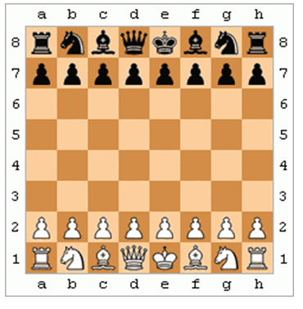
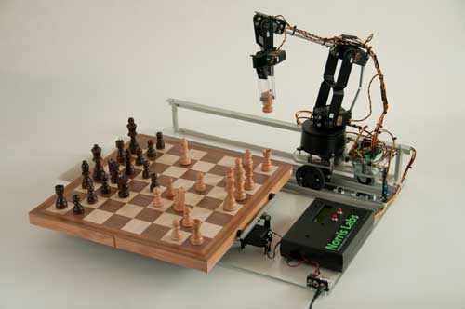
Discrete vs. continuous
Does the environment provide a countable (discrete) or uncountably infinite (continuous) number of distinct percepts, actions, and environment states?
Are the values of the state variables discrete or continuous?
Time can also evolve in a discrete or continuous fashion
“Distinct” = different values of utility
vs.

Slide 30
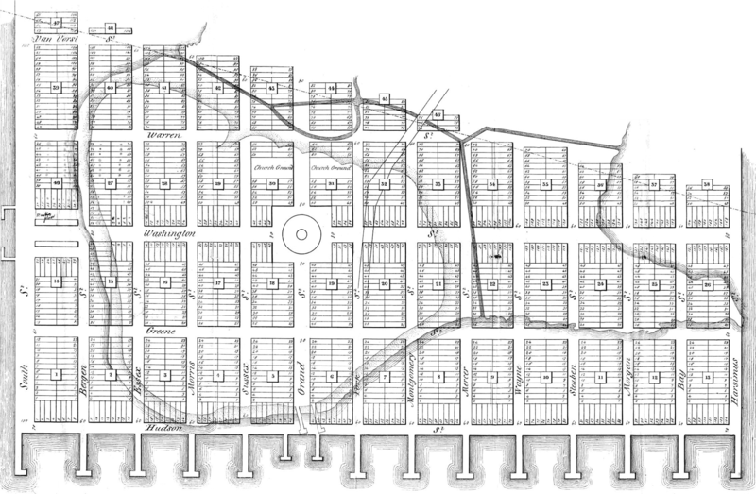
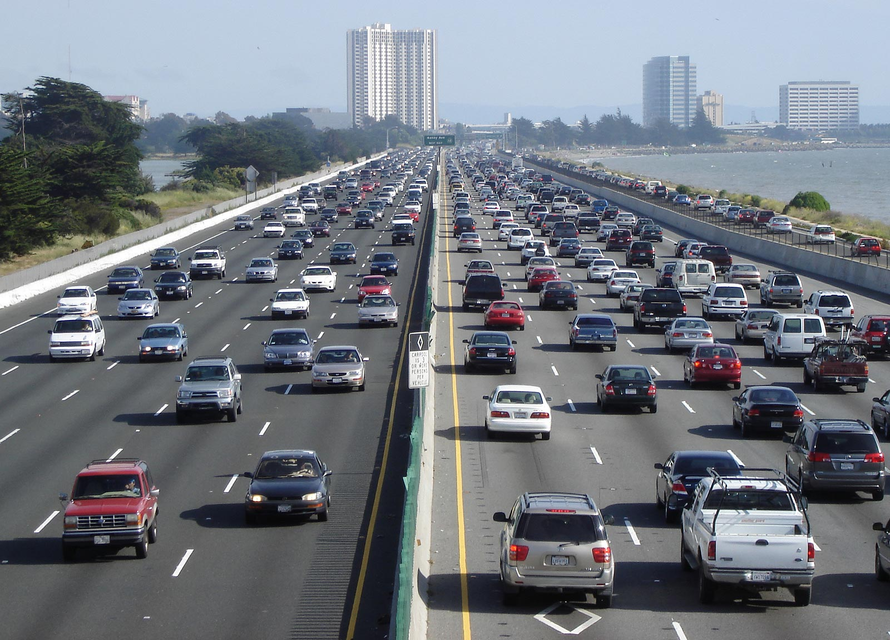
Static vs. dynamic
Is the world changing while the agent is thinking?
vs.
GFDL Image by Minesweeper, 2005

Slide 31
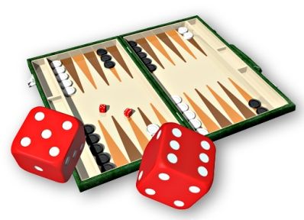
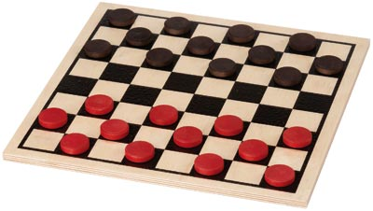
Deterministic vs. stochastic
Is the next state of the environment completely determined by the current state and the agent’s action?
Is the transition model deterministic (unique successor state given current state and action) or stochastic (distribution over successor states given current state and action)?
strategic: the environment is deterministic except for the actions of other agents
vs.

Slide 32
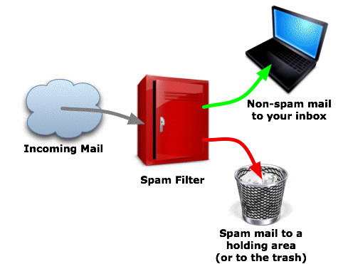
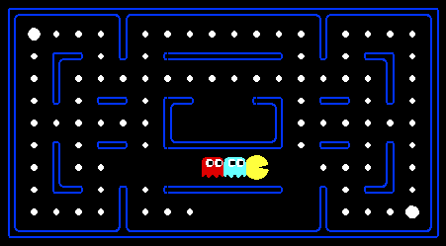
Episodic vs. sequential
Is the agent’s experience divided into unconnected episodes, or is it a coherent sequence of observations and actions?
Does each problem instance involve just one action or a series of actions that change the world state according to the transition model?
vs.
Notes:
Episodic: The agent's experience is divided into atomic “episodes,” and the choice of action in each episode depends only on the episode itself

Slide 33
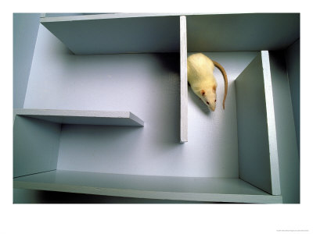
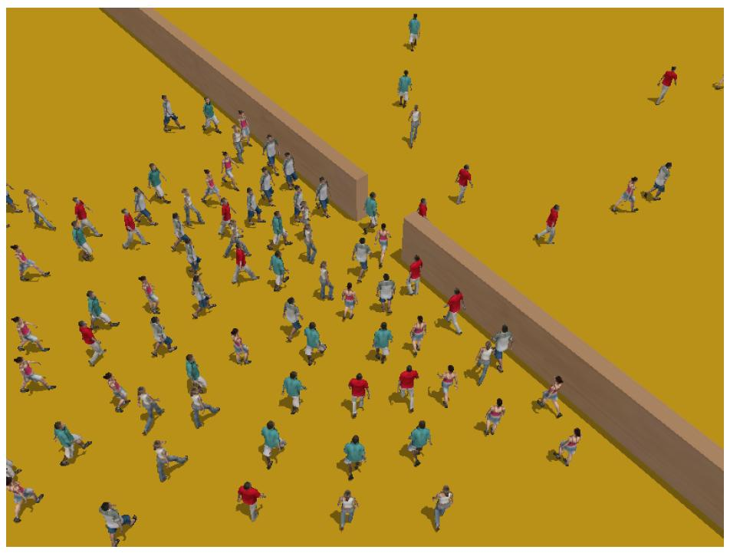
Single-agent vs. multiagent
Is an agent operating by itself in the environment?
vs.

Slide 34
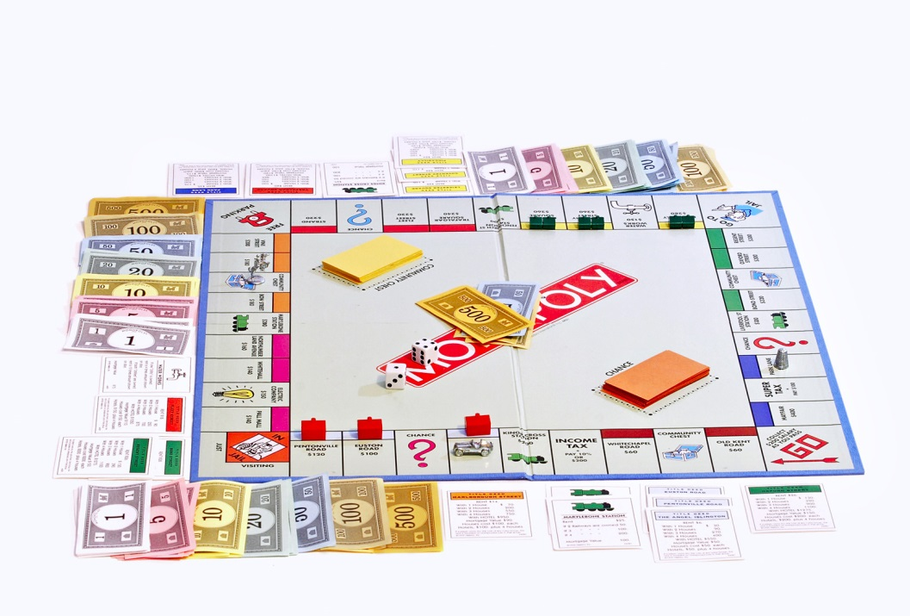
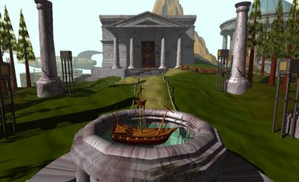
Known vs. unknown
Are the rules of the environment (transition model and rewards associated with states) known to the agent?
Strictly speaking, not a property of the environment, but of the agent’s state of knowledge
vs.
Monopoly, Parker Brothers 1935; photo CC-BY-NC Fir0002/Flagstaffotos
Myst, © Cyan Worlds, 1993

Slide 35
Outline
Syllabus: Grades, Exams, Collabs, Homework, Seminar, and Apps
Intelligence
Artificial Intelligence (chapter 1)
A brief history (chapter 2)
Environments in which an AI can operate (chapter 3)
Map of the rest of the course

Slide 36
Map of the rest of the course
Planning (fully observable, discrete, static, deterministic, sequential, single-agent, known environment)
Learning (unknown env)
Language (stochastic env)
Multi-agent
Planning (partially observable, discrete, dynamic, stochastic, sequential, multi-agent, unknown environment)

