Slide 1
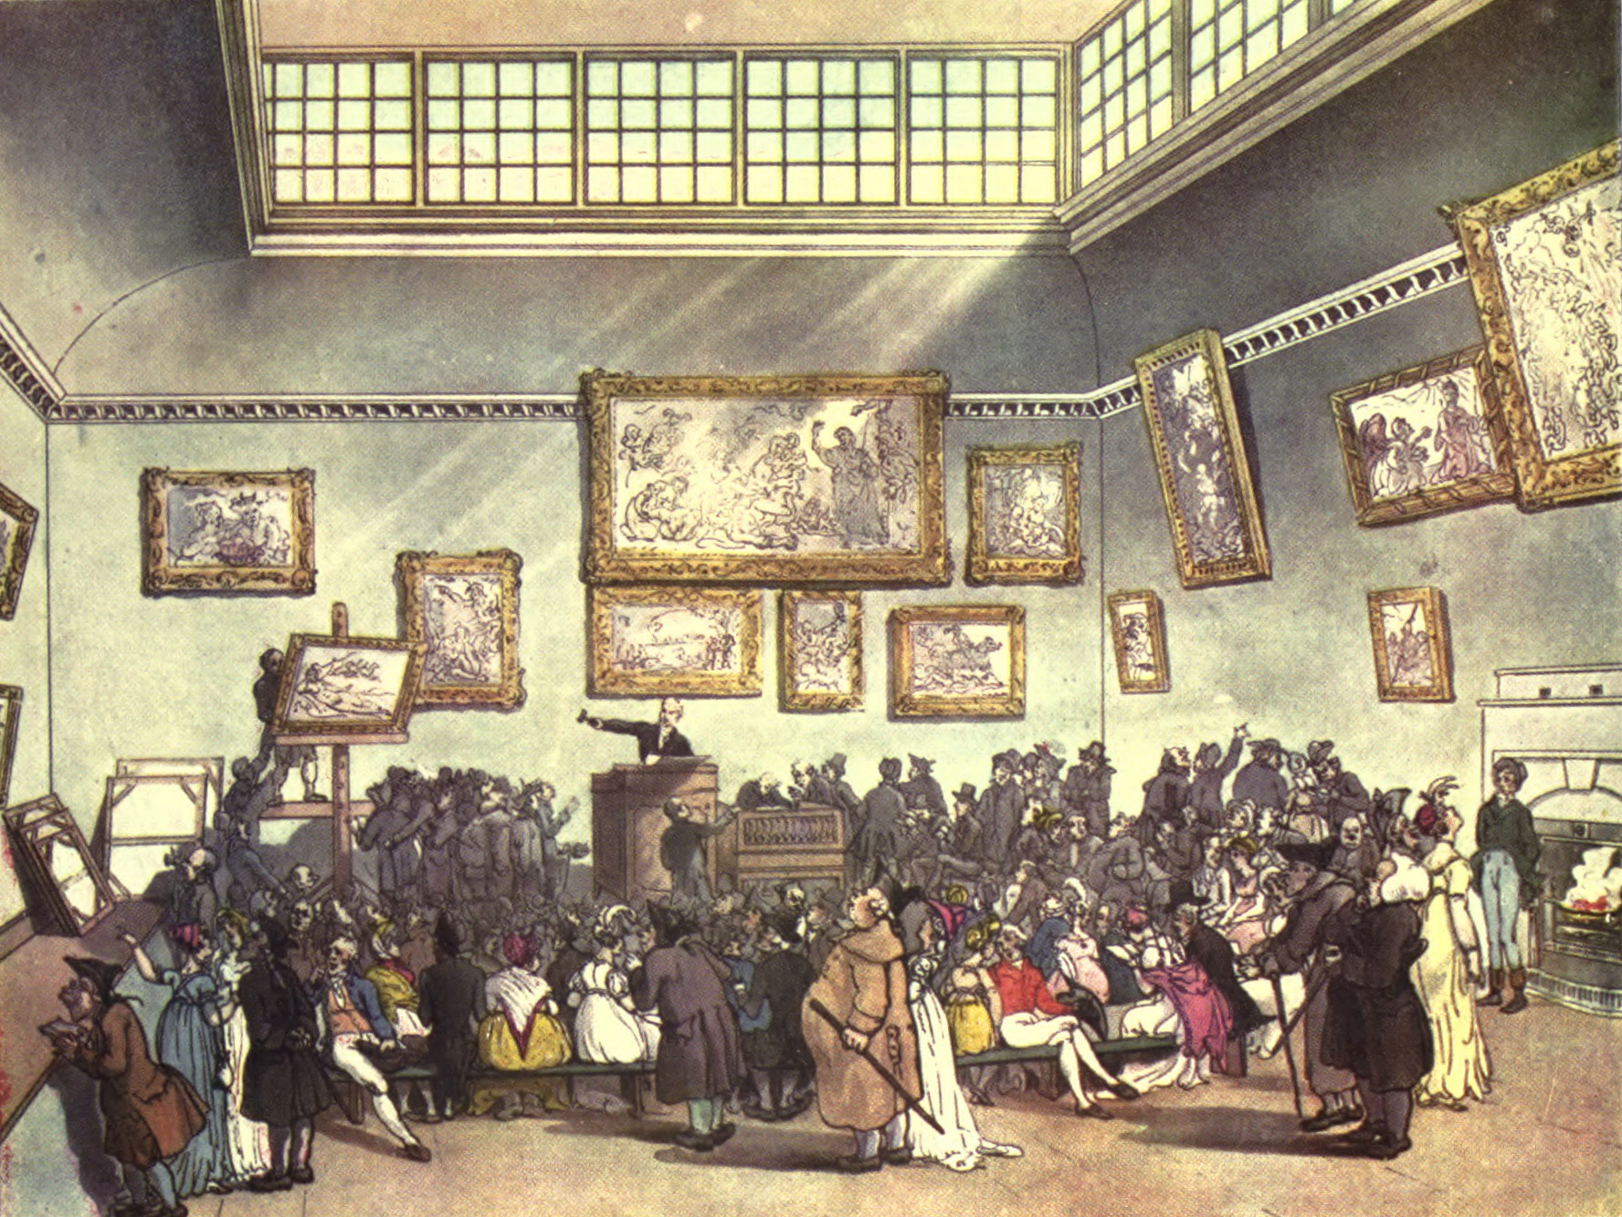
CS 440/ECE448 Lecture 36:
Mechanism Design
Mark Hasegawa-Johnson, 4/2020
Including slides by Svetlana Lazebnik
CC-BY 4.0: You may remix or redistribute if you cite the source.
Thomas Rowlandson & Augustus Charles Pugin, "An Auction" (1808), in The Microcosm of London, Public Domain, https://commons.wikimedia.org/w/index.php?curid=15798707

Slide 2
Outline of today’s lecture
How rational are human beings?
  Nash equilibria and rational decisions
  The “Ultimatum Game”
Iterated games
  Fixed versus random number of iterations
  Iterated Prisoner’s Dilemma and the Evolution of Cooperation
Auctions
  English auction, sealed-bid auction, sealed-bid second-price auction
Tragedy of the Commons
  The VCG (Vickrey-Clarke-Groves) mechanism

Slide 3
How Rational are Human Beings?

Slide 4
Nash equilibria and rational decisions
“Nash equilibria” are so-named because John Nash proved that every game has at least one equilibrium.
The basic idea of a Nash equilibrium: it will necessarily be the outcome of the game, if all of its assumptions are met:
  Both players have the computational resources necessary to compute a rational course of action.
  Player have no other actions available to them, other than the actions listed in the payoff matrix.
  The payoff matrix is accurate (all costs and benefits that are valued by the player are included in the matrix).

Slide 5
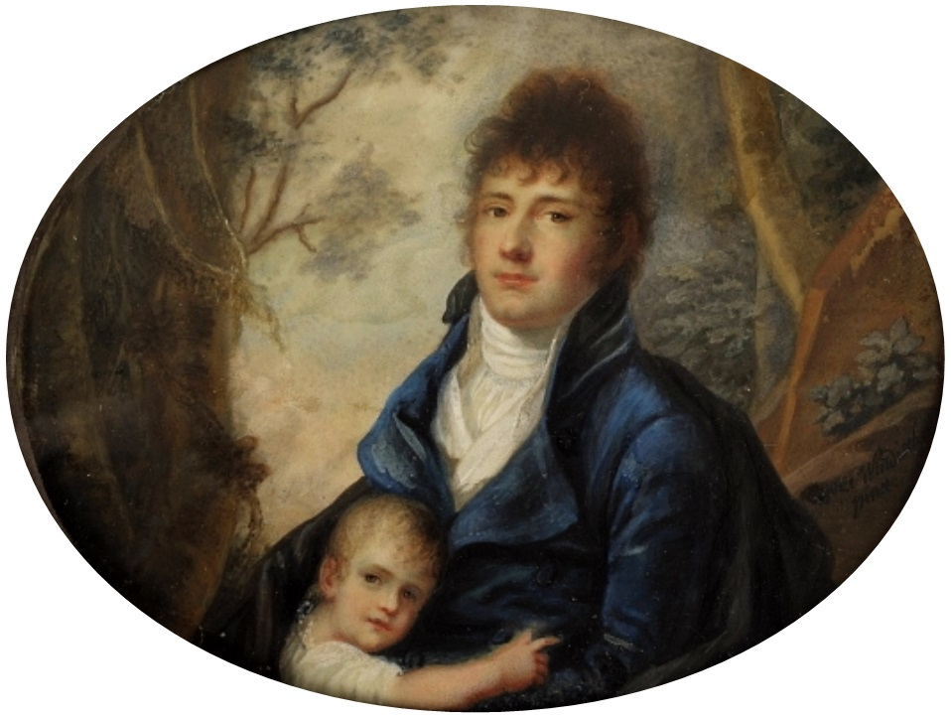
Bounded rationality
Herbert Simon’s theory of “Bounded Rationality” says that rationality is always limited (for either humans or AI, though he didn’t put it that way) by the tractability of the problem, and by the amount of time available to solve it.
The optimum solution is often “satisficing:” accepting the first-discovered solution whose utility exceeds a threshold, where the threshold may decrease as one spends more time trying to solve the problem.
“Paternal Love,” Nanette Rosenzweig (1803), Public Domain, https://commons.wikimedia.org/w/index.php?curid=29519280

Slide 6
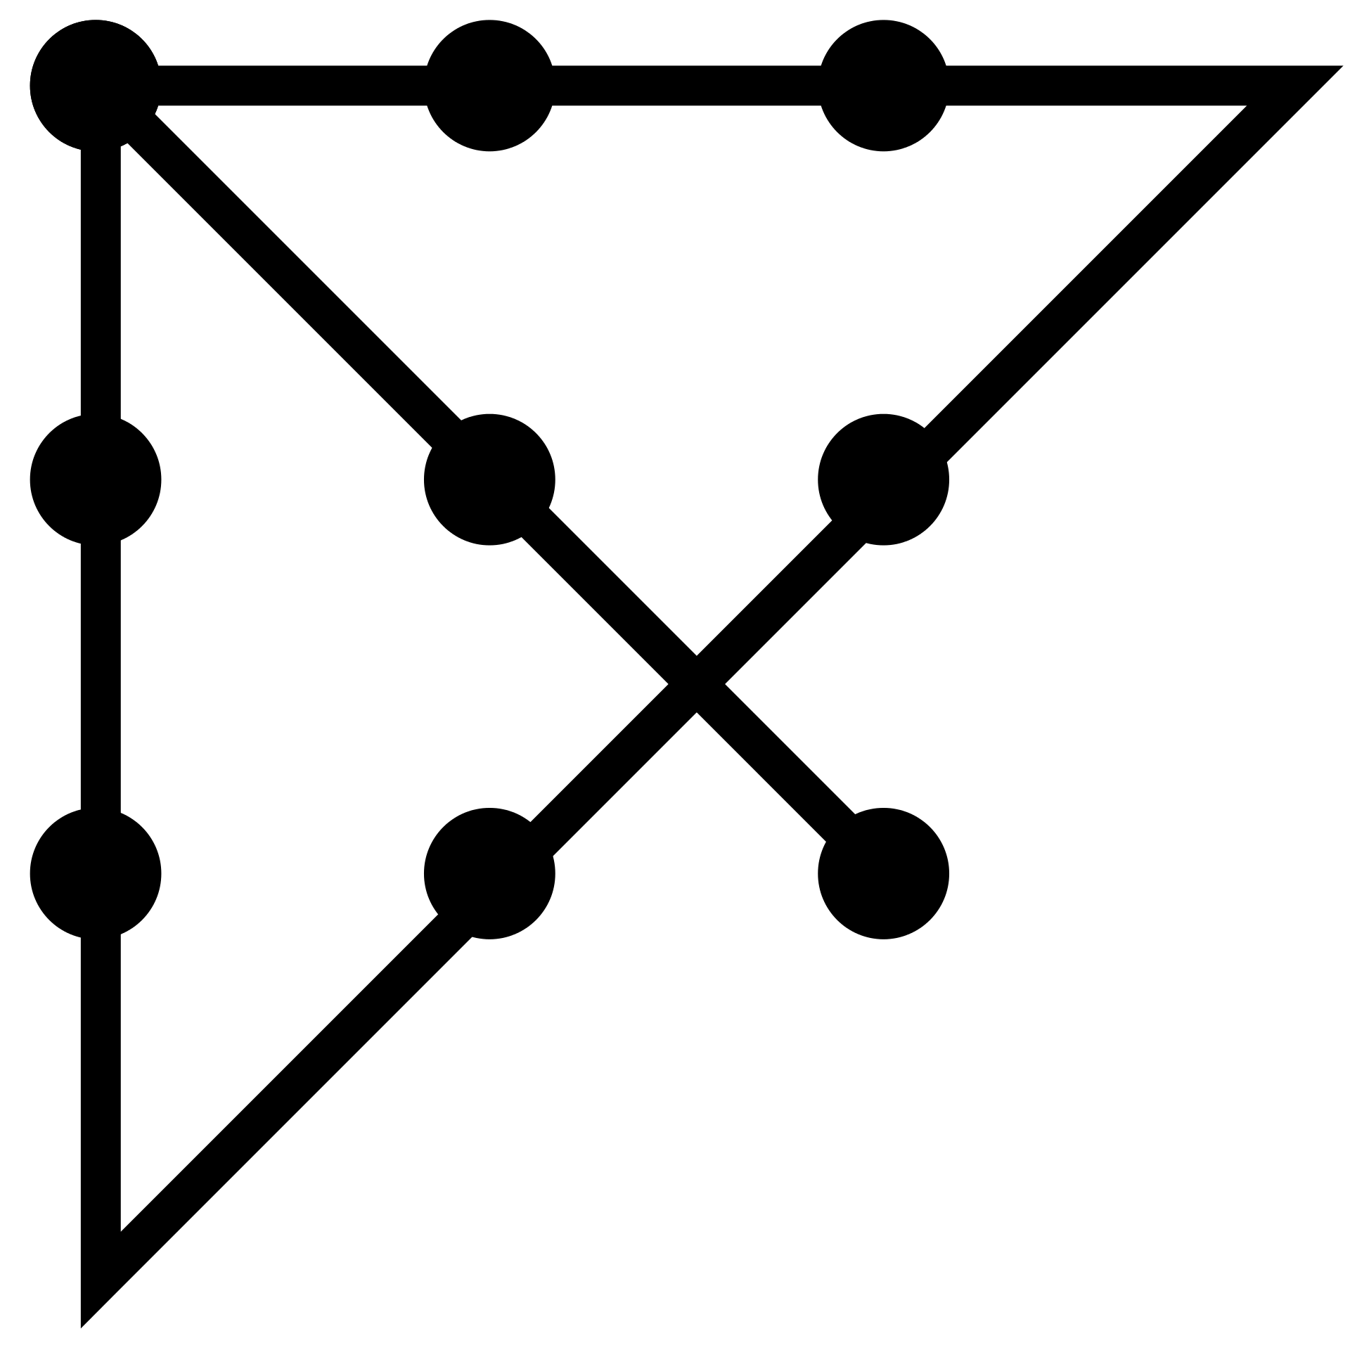
Other actions
Collusion
  Russell & Norvig describe the 1999 German wireless spectrum auction: price signals were used by the bidders to communicate information to one another, completely within the auction rules set by the government.
Seeking information
  In commercial auctions, bidders spend a great deal of time before the auction trying to model the purchasing power of the other bidders, in order to compete more effectively.
Think “outside the box”
  “The skillful leader subdues the enemy's troops without any fighting; he captures their cities without laying siege to them; he overthrows their kingdom without lengthy operations in the field… This is the method of attacking by stratagem.” – Sun Tzu
Ninedots-2.png by Steve Gustafson, CC BY-SA 3.0, https://commons.wikimedia.org/w/index.php?curid=7385041

Slide 7
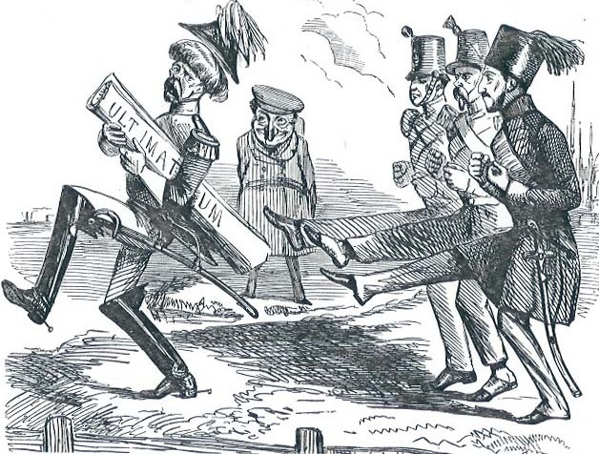
Accurate Payoff Matrix
In ”The Ultimatum Game,” Alice and Bob are given an amount of money to divide.
Alice decides how much of the money she will take ($A). She tells this amount to the experimenter, and to Bob.
Bob then decides how much of what’s left over he will accept ($B).
If A+B is less than the total amount, the experimenters give them each the amount of money they chose. If not, Alice and Bob get nothing.
Since the game is sequential, the Nash equilibrium is easy to compute:
Alice takes all but one penny.
Bob is then left with the choice of taking either one penny, or nothing. If he is rational, he should accept the penny.
Humans don’t do that. If Alice claims more than about 70% of the total, Bob (if he is human) will typically reject the ultimatum, with the result that both players get nothing.
Why?
Punch Magazine (1853). Public Domain, https://en.wikipedia.org/w/index.php?curid=38979560
http://en.wikipedia.org/wiki/Ultimatum_game

Slide 8
Iterated Games

Slide 9
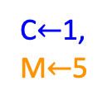
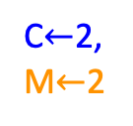
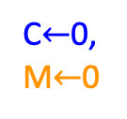
Iterated games: The chain store paradox
Monopolist (M) will open branches in 20 different towns. In each town, M offers to buy out the local competitor (C) for $1M. By eliminating competition, M will earn $5M in expected revenue.
C decides whether to accept the buyout or stay in business.
M decides whether to aggressively lower prices (resulting in 0 net income for either M or C) or charge fair prices (resulting in $2M net income for both M and C).
The paradox: M should use aggressive pricing to drive one of the early competitors out of business. But aggressive pricing is not rational, according to the rules described above.
Let’s explore this…
Competitor
Out
In
C$←$1,
M$←$5
Monopolist
Aggressive
Pricing
Fair
Pricing
C$←$0,
M$←$0
C$←$2,
M$←$2
https://en.wikipedia.org/wiki/Chainstore_paradox

Slide 10
Case #1: Fixed number of iterations
Suppose that there are only 20 competitors; after the 20th, M will never have to face any more competition.
If the 20th competitor stays in, M needs to decide whether to price aggressively or fairly. Pricing aggressively would hurt his profits, with no benefit whatsoever. So the rational decision is to price fairly.
Therefore, the rational decision of the 20th competitor is to stay in business, regardless of how many previous competitors have been driven out of business by M.
In the 19th town, M knows that his actions have no effect on the 20th competitor. Therefore M should price fairly.
Therefore, the rational decision of the 19th competitor is to stay in business, regardless of how many previous competitors have been driven out of business.
… and so on…
Competitor
Out
In
C$←$1,
M$←$5
Monopolist
Aggressive
Pricing
Fair
Pricing
C$←$0,
M$←$0
C$←$2,
M$←$2

Slide 11
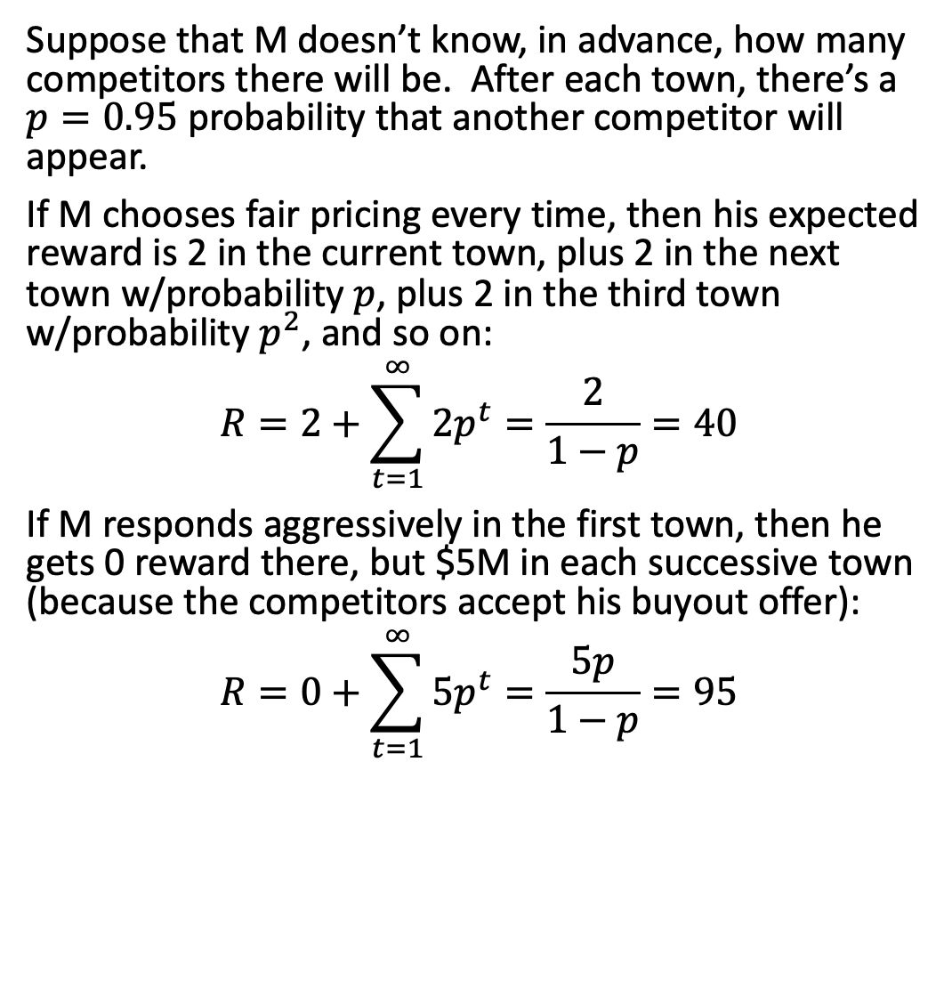
Case #2: Random number of iterations
Suppose that M doesn’t know, in advance, how many competitors there will be. After each town, there’s a $p=0.95$ probability that another competitor will appear.
If M chooses fair pricing every time, then his expected reward is 2 in the current town, plus 2 in the next town w/probability $p$, plus 2 in the third town w/probability $p^{2}$, and so on:
$$R=2+\sum_{t=1}^{∞}{2p^{t}}=\frac{2}{1−p}=40$$
If M responds aggressively in the first town, then he gets 0 reward there, but $5M in each successive town (because the competitors accept his buyout offer):
$$R=0+\sum_{t=1}^{∞}{5p^{t}}=\frac{5p}{1−p}=95$$
Competitor
Out
In
C$←$1,
M$←$5
Monopolist
Aggressive
Pricing
Fair
Pricing
C$←$0,
M$←$0
C$←$2,
M$←$2

Slide 12
What the chain store paradox shows us
If the number of iterations is known in advance, then threats become ineffective: both players know that the monopolist will act rationally, therefore both players can predict his actions.
If the number of iterations is not known in advance, then behavior that seems irrational in the short-term might be rational in the long-term.
Competitor
Out
In
C$←$1,
M$←$5
Monopolist
Aggressive
Pricing
Fair
Pricing
C$←$0,
M$←$0
C$←$2,
M$←$2

Slide 13
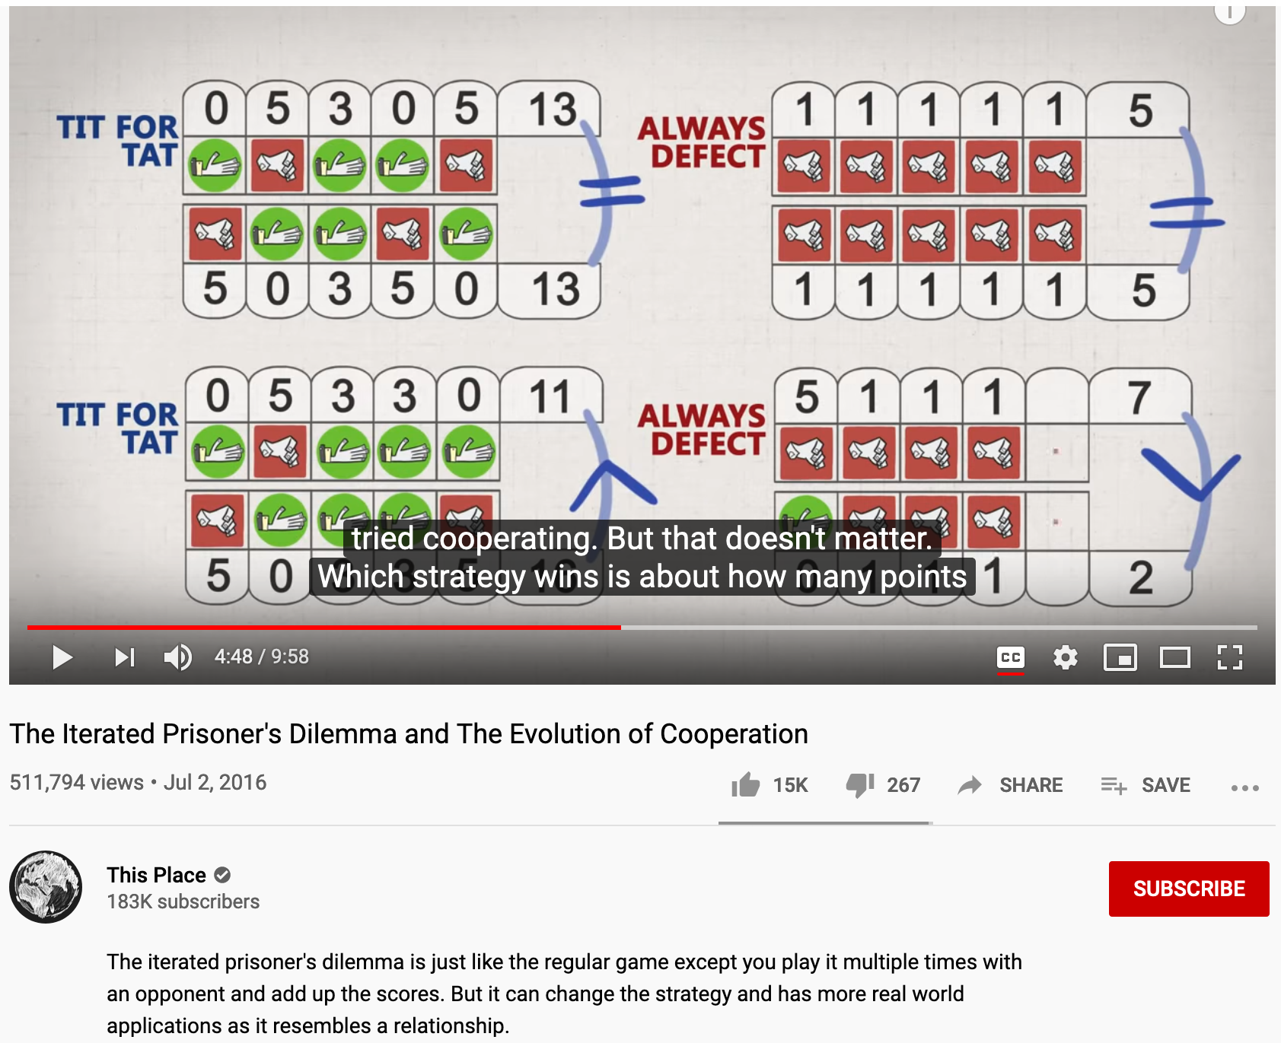
Iterated Prisoner’s Dilemma
This video is called “The Iterated Prisoner’s Dilemma and the Evolution of Cooperation” by Jesse Agar. It’s one of those great educational videos that gives you hope for the future of humanity. Enjoy!

Slide 14
Mechanism Design: Auctions

Slide 15
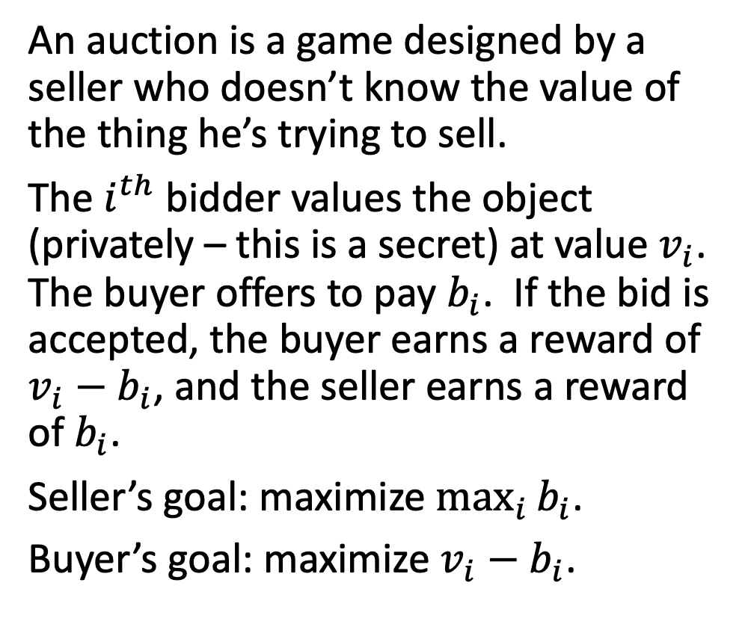
Auctions
An auction is a game designed by a seller who doesn’t know the value of the thing he’s trying to sell.
The $i^{th}$ bidder values the object (privately – this is a secret) at value $v_{i}$. The buyer offers to pay $b_{i}$. If the bid is accepted, the buyer earns a reward of $v_{i}−b_{i}$, and the seller earns a reward of $b_{i}$.
Seller’s goal: maximize $\max_{i}{b_{i}}$.
Buyer’s goal: maximize $v_{i}−b_{i}$.
Thomas Rowlandson & Augustus Charles Pugin, "An Auction" (1808), in The Microcosm of London, Public Domain, https://commons.wikimedia.org/w/index.php?curid=15798707

Slide 16
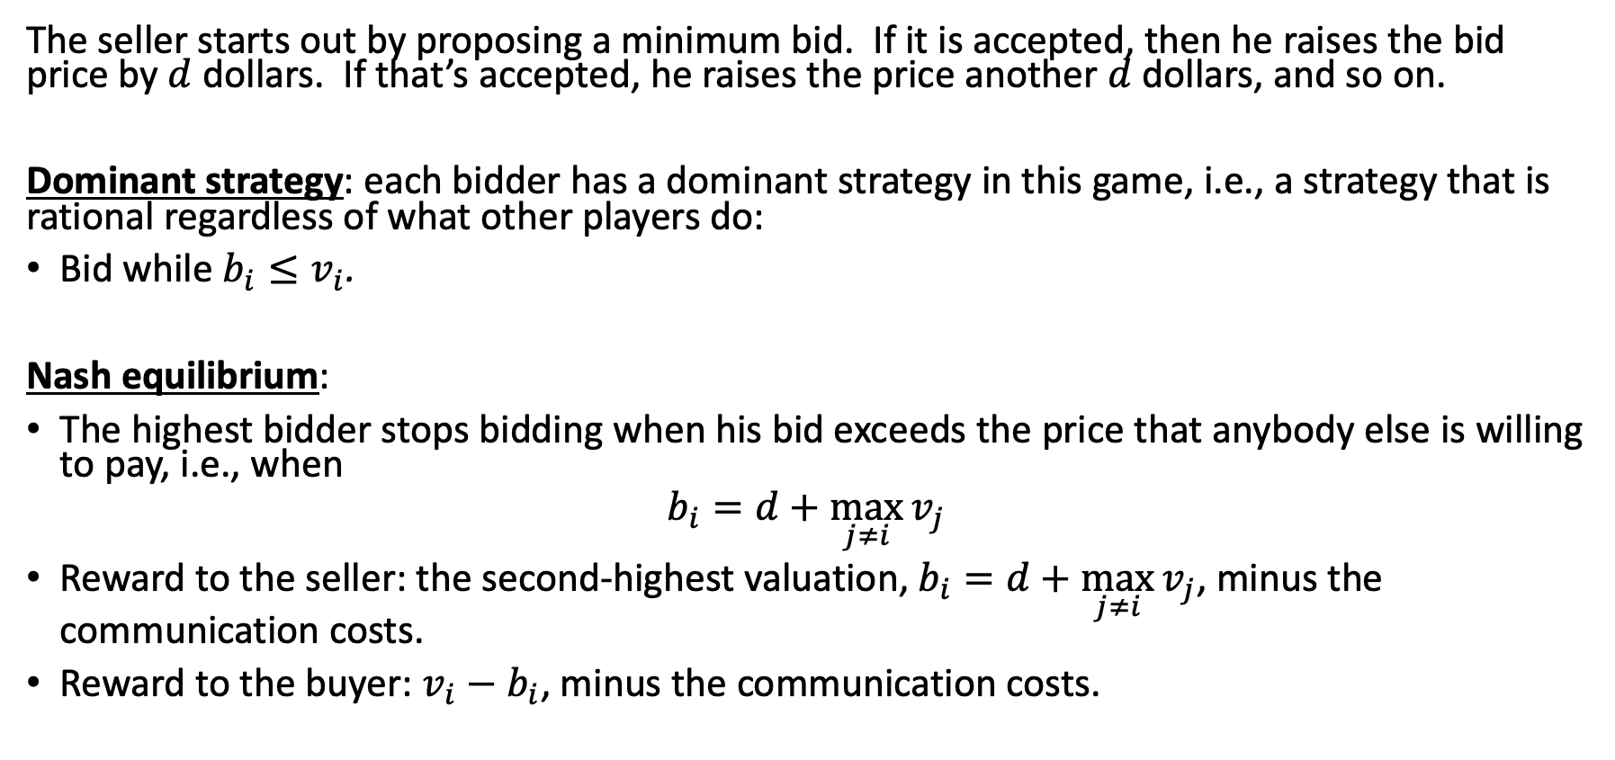
Ascending-bid auction (English auction)
The seller starts out by proposing a minimum bid. If it is accepted, then he raises the bid price by $d$ dollars. If that’s accepted, he raises the price another $d$ dollars, and so on.
Dominant strategy: each bidder has a dominant strategy in this game, i.e., a strategy that is rational regardless of what other players do:
Bid while $b_{i}≤v_{i}$.
Nash equilibrium:
The highest bidder stops bidding when his bid exceeds the price that anybody else is willing to pay, i.e., when
$$b_{i}=d+\max_{j≠i}{v_{j}}$$
Reward to the seller: the second-highest valuation, $b_{i}=d+\max_{j≠i}{v_{j}}$, minus the communication costs.
Reward to the buyer: $v_{i}−b_{i}$, minus the communication costs.

Slide 17
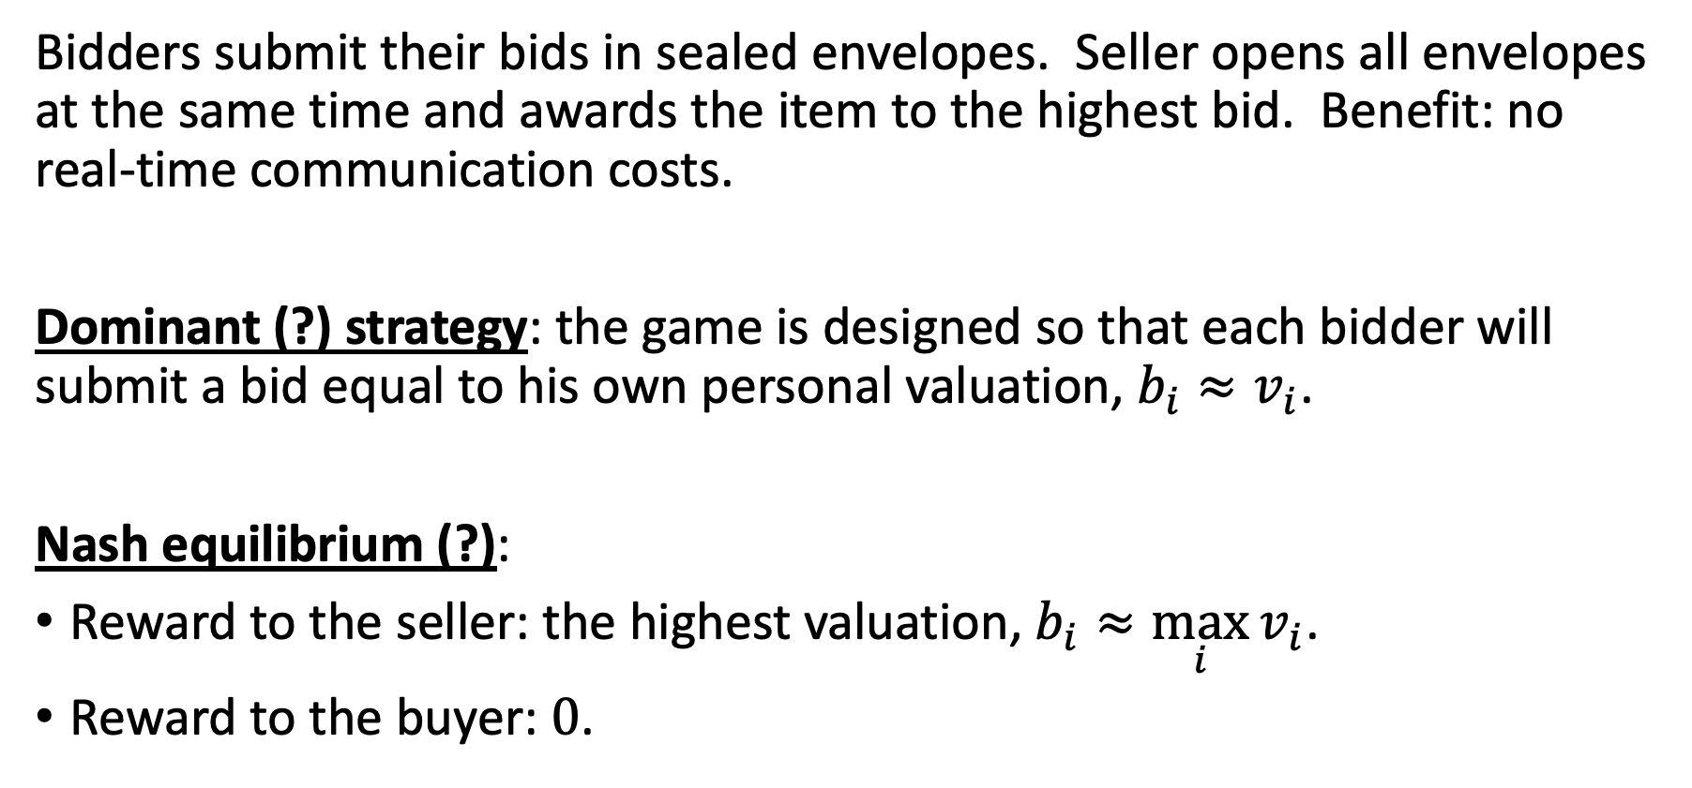
Sealed-bid auction
Bidders submit their bids in sealed envelopes. Seller opens all envelopes at the same time and awards the item to the highest bid. Benefit: no real-time communication costs.
Dominant (?) strategy: the game is designed so that each bidder will submit a bid equal to his own personal valuation, $b_{i}≈v_{i}$.
Nash equilibrium (?):
Reward to the seller: the highest valuation, $b_{i}≈\max_{i}{v_{i}}$.
Reward to the buyer: $0$.

Slide 18
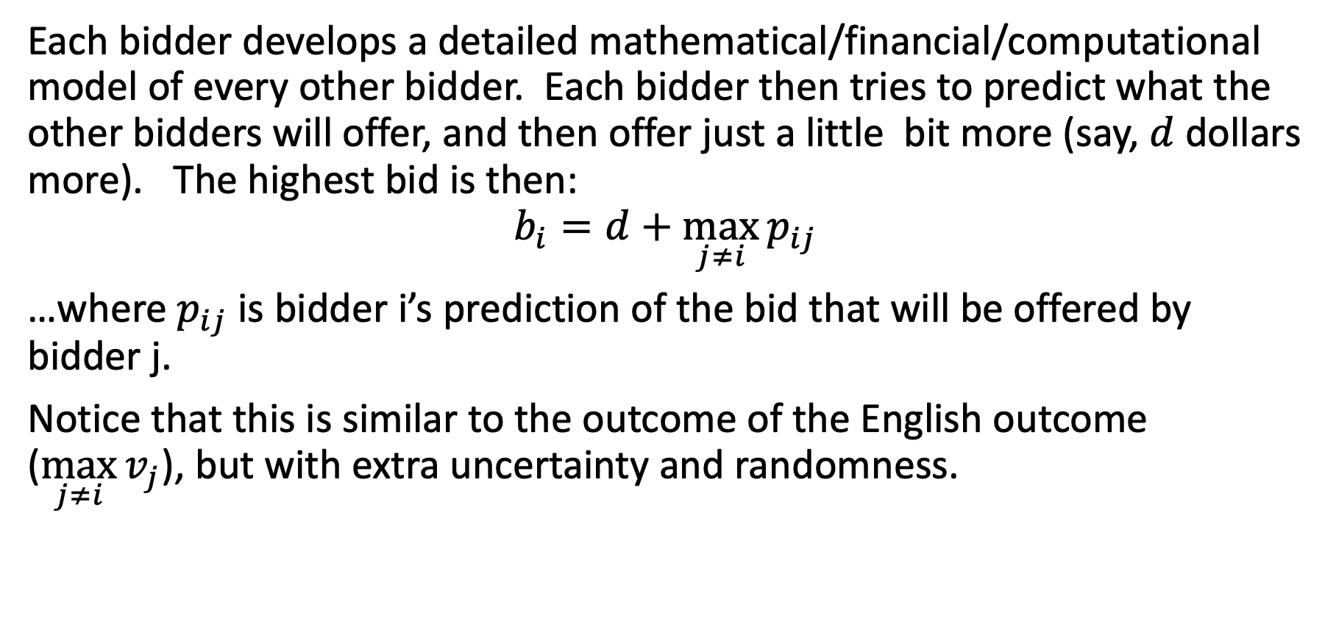
Sealed-bid auction: what actually happens
Each bidder develops a detailed mathematical/financial/computational model of every other bidder. Each bidder then tries to predict what the other bidders will offer, and then offer just a little bit more (say, $d$ dollars more). The highest bid is then:
$$b_{i}=d+\max_{j≠i}{p_{ij}}$$
…where $p_{ij}$ is bidder i’s prediction of the bid that will be offered by bidder j.
Notice that this is similar to the outcome of the English outcome ($\max_{j≠i}{v_{j}}$), but with extra uncertainty and randomness.

Slide 19
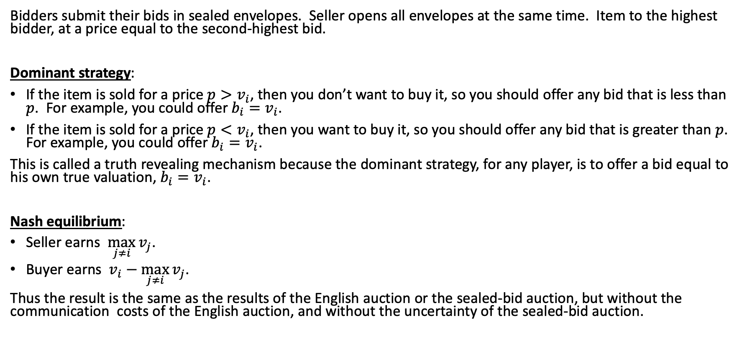
Sealed-bid second-price auction (Vickrey auction)
Bidders submit their bids in sealed envelopes. Seller opens all envelopes at the same time. Item to the highest bidder, at a price equal to the second-highest bid.
Dominant strategy:
If the item is sold for a price $p>v_{i}$, then you don’t want to buy it, so you should offer any bid that is less than $p$. For example, you could offer $b_{i}=v_{i}$.
If the item is sold for a price $p<v_{i}$, then you want to buy it, so you should offer any bid that is greater than $p$. For example, you could offer $b_{i}=v_{i}$.
This is called a truth revealing mechanism because the dominant strategy, for any player, is to offer a bid equal to his own true valuation, $b_{i}=v_{i}$.
Nash equilibrium:
Seller earns $\max_{j≠i}{v_{j}}$.
Buyer earns $v_{i}−\max_{j≠i}{v_{j}}$.
Thus the result is the same as the results of the English auction or the sealed-bid auction, but without the communication costs of the English auction, and without the uncertainty of the sealed-bid auction.

Slide 20
Dollar auction
A malevolent twist on the second-price auction:
Highest bidder gets to buy the object, and pays whatever they bid
Second-highest bidder is required to pay whatever they bid, but gets nothing at all in return
Dramatization: https://www.youtube.com/watch?v=pA-SNscNADk

Slide 21
Mechanism Design: Tragedy of the Commons

Slide 22
Mechanism design
(inverse game theory)
Assuming that agents pick rational strategies, how should we design the game to achieve a socially desirable outcome?
We have multiple agents and a center that collects their choices and determines the outcome

Slide 23
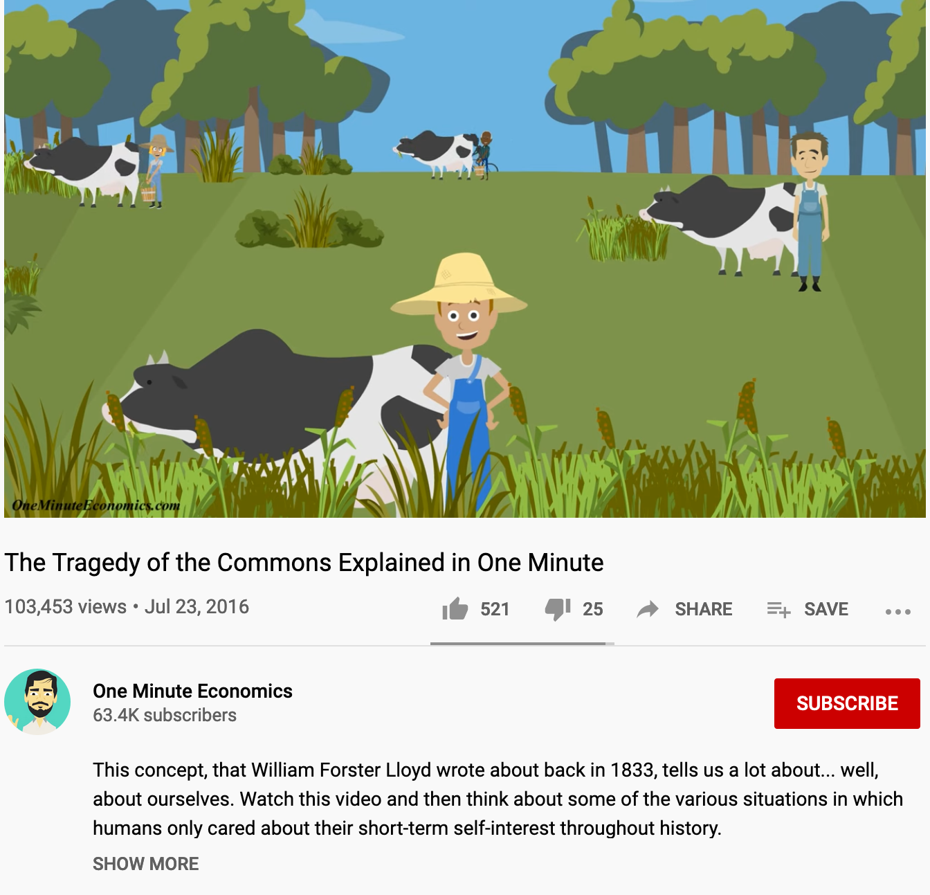
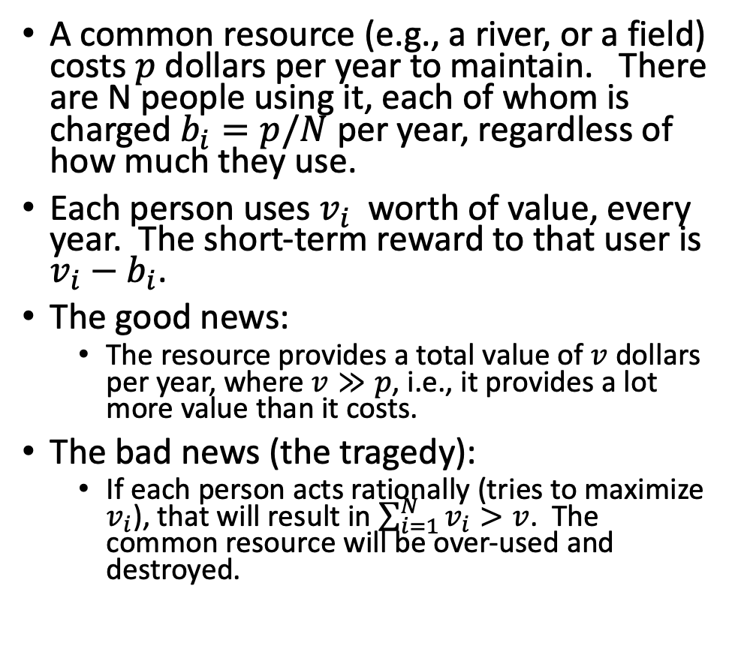
Tragedy of the Commons
A common resource (e.g., a river, or a field) costs $p$ dollars per year to maintain. There are N people using it, each of whom is charged $b_{i}=p/N$ per year, regardless of how much they use.
Each person uses $v_{i}$ worth of value, every year. The short-term reward to that user is $v_{i}−b_{i}$.
The good news:
  The resource provides a total value of $v$ dollars per year, where $v≫p$, i.e., it provides a lot more value than it costs.
The bad news (the tragedy):
  If each person acts rationally (tries to maximize $v_{i}$), that will result in $\sum_{i=1}^{N}{v_{i}}>v$. The common resource will be over-used and destroyed.

Slide 24
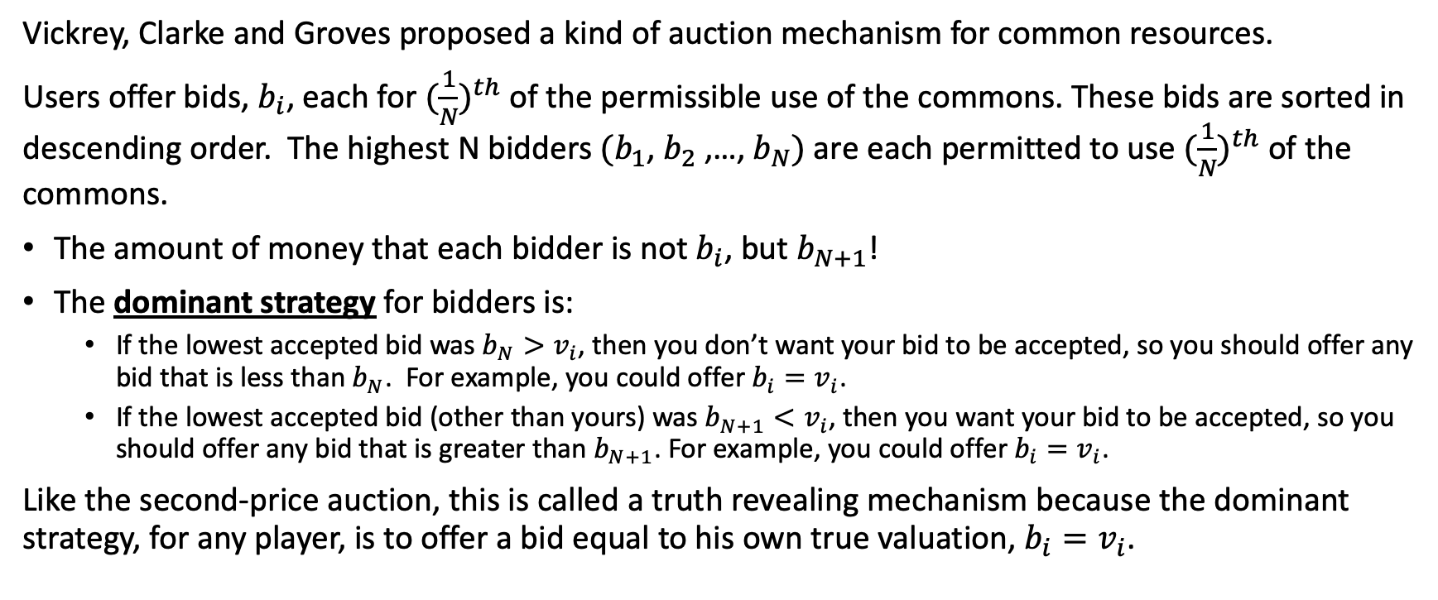
The VCG Mechanism (Vickrey-Clarke-Groves)
Vickrey, Clarke and Groves proposed a kind of auction mechanism for common resources.
Users offer bids, $b_{i}$, each for ${(\frac{1}{N})}^{th}$ of the permissible use of the commons. These bids are sorted in descending order. The highest N bidders $(b_{1}$, $b_{2}$,…, $b_{N})$ are each permitted to use ${(\frac{1}{N})}^{th}$ of the commons.
The amount of money that each bidder is not $b_{i}$, but $b_{N+1}$!
The dominant strategy for bidders is:
  If the lowest accepted bid was $b_{N}>v_{i}$, then you don’t want your bid to be accepted, so you should offer any bid that is less than $b_{N}$. For example, you could offer $b_{i}=v_{i}$.
  If the lowest accepted bid (other than yours) was $b_{N+1}<v_{i}$, then you want your bid to be accepted, so you should offer any bid that is greater than $b_{N+1}$. For example, you could offer $b_{i}=v_{i}$.
Like the second-price auction, this is called a truth revealing mechanism because the dominant strategy, for any player, is to offer a bid equal to his own true valuation, $b_{i}=v_{i}$.

Slide 25
Outline of today’s lecture
The Nash equilibrium is the necessary outcome of the game if its assumptions are met:
  All players have sufficient computational resources to behave rationally, they have no way to perform any action except those in the payoff matrix, and the payoff matrix lists the true value, to each player, of each outcome.
Iterated games
  With fixed iterations, the behavior of every actor can be predicted
  With a random number of iterations, actors might behave in a manner that seems irrational in the short-term, but is rational in the long-term
Auctions
  English auction: winner pays the second-highest valuation
  Sealed-bid auction: winner pays what he guessed to be the second-highest valuation
  Sealed-bid second-price auction: winner pays the second-highest valuation, but his dominant strategy is to tell the auctioneer his own true valuation
Tragedy of the Commons
  The VCG (Vickrey-Clarke-Groves) mechanism: each player’s dominant strategy is to tell the government their true valuation of the common resource

