Slide 1
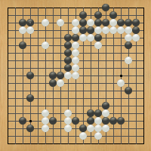
Lecture 33 – Reinforcement Learning for Two-Player Games
Mark Hasegawa-Johnson, 4/2020
CC-BY 4.0: you may remix or redistribute if you cite the source
Snapshot of a gnugo game,
http://www.gnu.org/software/gnugo/

Slide 2
Outline
Review: minimax and alpha-beta
Move ordering: policy network
Evaluation function: value network
Training the value network
Exact training: endgames
Stochastic training: Monte Carlo tree search
Case study: alphago

Slide 3
Minimax games
Let $s$ be the state of the game: complete specification of the board, and a statement about whose turn it is.
If it’s the turn of the MAX player, and if $C(s)$ are the children of $s$ (the set of states reachable in one move), then the value of the board is
$$U\left(s\right)=\max_{s′∈C(s)}{U(s^{′})}$$
If it’s MIN’s turn, then
$$U\left(s\right)=\min_{s′∈C(s)}{U(s^{′})}$$
6
4
3
8
6
4
9
7
2
5
3
2
7
6
6
9
8
1
3
3
1
5
4
4
7
4
1

Slide 4
Minimax games
Let $s$ be the state of the game: complete specification of the board, and a statement about whose turn it is.
If it’s the turn of the MAX player, and if $C(s)$ are the children of $s$ (the set of states reachable in one move), then the value of the board is
$$U\left(s\right)=\max_{s′∈C(s)}{U(s^{′})}$$
If it’s MIN’s turn, then
$$U\left(s\right)=\min_{s′∈C(s)}{U(s^{′})}$$
6
8
9
5
7
9
3
5
7
6
4
3
8
6
4
9
7
2
5
3
2
7
6
6
9
8
1
3
3
1
5
4
4
7
4
1

Slide 5
Minimax games
Let $s$ be the state of the game: complete specification of the board, and a statement about whose turn it is.
If it’s the turn of the MAX player, and if $C(s)$ are the children of $s$ (the set of states reachable in one move), then the value of the board is
$$U\left(s\right)=\max_{s′∈C(s)}{U(s^{′})}$$
If it’s MIN’s turn, then
$$U\left(s\right)=\min_{s′∈C(s)}{U(s^{′})}$$
6
5
3
6
8
9
5
7
9
3
5
7
6
4
3
8
6
4
9
7
2
5
3
2
7
6
6
9
8
1
3
3
1
5
4
4
7
4
1

Slide 6
Minimax games
6
Let $s$ be the state of the game: complete specification of the board, and a statement about whose turn it is.
If it’s the turn of the MAX player, and if $C(s)$ are the children of $s$ (the set of states reachable in one move), then the value of the board is
$$U\left(s\right)=\max_{s′∈C(s)}{U(s^{′})}$$
If it’s MIN’s turn, then
$$U\left(s\right)=\min_{s′∈C(s)}{U(s^{′})}$$
6
5
3
6
8
9
5
7
9
3
5
7
6
4
3
8
6
4
9
7
2
5
3
2
7
6
6
9
8
1
3
3
1
5
4
4
7
4
1

Slide 7
Minimax complexity
6
$b=$branching factor
$d=$search depth
Complexity = $O\{b^{d}\}$
6
5
3
6
8
9
5
7
9
3
5
7
6
4
3
8
6
4
9
7
2
5
3
2
7
6
6
9
8
1
3
3
1
5
4
4
7
4
1

Slide 8
Alpha-Beta Pruning
$$α=−∞$$
$$β=∞$$
Each node has two internal meta-parameters, initialized from its parent:
$α=$ highest value that MAX knows how to force MIN to accept
$β=$ lowest value that MIN knows how to force MAX to accept
$α≤β$
Initial values: $α=−∞, β=∞$
6
4
3
8
6
4
9
7
2
5
3
2
7
6
6
9
8
1
3
3
1
5
4
4
7
4
1

Slide 9
Alpha-Beta Pruning
$$α=−∞$$
$$β=∞$$
Each node has two internal meta-parameters, initialized from its parent:
$α=$ highest value that MAX knows how to force MIN to accept
$β=$ lowest value that MIN knows how to force MAX to accept
$α≤β$
Initial values: $α=−∞, β=∞$
$$α=−∞$$
$$β=∞$$
$$α=−∞$$
$$β=∞$$
6
4
3
8
6
4
9
7
2
5
3
2
7
6
6
9
8
1
3
3
1
5
4
4
7
4
1

Slide 10
Alpha-Beta Pruning
$$α=−∞$$
$$β=∞$$
If $s$ is a MAX node, then:
For each child $s’∈C(s)$:
If you realize that $U\left(s’\right)>β\left(s\right)$ then prune all remaining children of $s$: MIN will never let us reach this node.
Otherwise, if $U(s’)>α\left(s\right)$, then set $α\left(s\right)=U(s’)$. MIN might still choose $s$ (because $U\left(s’\right)≤β\left(s\right)$), then MAX can choose $s’$.
$$α=−∞$$
$$β=∞$$
$$α=−∞$$
$$β=∞$$
6
6
4
3
8
6
4
9
7
2
5
3
2
7
6
6
9
8
1
3
3
1
5
4
4
7
4
1

Slide 11
Alpha-Beta Pruning
$$α=−∞$$
$$β=∞$$
If $s$ is a MAX node, then:
For each child $s’∈C(s)$:
If you realize that $U\left(s’\right)>β\left(s\right)$ then prune all remaining children of $s$: MIN will never let us reach this node.
Otherwise, if $U(s’)>α\left(s\right)$, then set $α\left(s\right)=U(s’)$. MIN might still choose $s$ (because $U\left(s’\right)≤β\left(s\right)$), then MAX can choose $s’$.
$$α=−∞$$
$$β=∞$$
$$α=6$$
$$β=∞$$
6
6
4
3
8
6
4
9
7
2
5
3
2
7
6
6
9
8
1
3
3
1
5
4
4
7
4
1

Slide 12
Alpha-Beta Pruning
$$α=−∞$$
$$β=∞$$
If $s$ is a MIN node, then:
For each child $s’∈C(s)$:
If you realize that $U\left(s’\right)<α\left(s\right)$ then prune all remaining children of $s$: MIN will never let us reach this node.
Otherwise, if $U\left(s’\right)<β\left(s\right)$, then set $β\left(s\right)=U(s’)$. MAX might still choose $s$ (because $U\left(s’\right)≥α\left(s\right)$), then MIN can choose $s’$.
$$α=−∞$$
$$β=6$$
6
6
6
4
3
8
6
4
9
7
2
5
3
2
7
6
6
9
8
1
3
3
1
5
4
4
7
4
1

Slide 13
Alpha-Beta Pruning
$$α=−∞$$
$$β=∞$$
If $s$ is a MAX node, then:
For each child $s’∈C(s)$:
If you realize that $U\left(s’\right)>β\left(s\right)$ then prune all remaining children of $s$: MIN will never let us reach this node.
Otherwise, if $U(s’)>α\left(s\right)$, then set $α\left(s\right)=U(s’)$. MIN might still choose $s$ (because $U\left(s’\right)≤β\left(s\right)$), then MAX can choose $s’$.
$$α=−∞$$
$$β=6$$
6
$$α=−∞$$
$$β=6$$
6
$$≥8$$
X
X
6
4
3
8
6
4
9
7
2
5
3
2
7
6
6
9
8
1
3
3
1
5
4
4
7
4
1

Slide 14
Alpha-Beta Pruning
$$α=−∞$$
$$β=∞$$
If $s$ is a MAX node, then:
For each child $s’∈C(s)$:
If you realize that $U\left(s’\right)>β\left(s\right)$ then prune all remaining children of $s$: MIN will never let us reach this node.
Otherwise, if $U(s’)>α\left(s\right)$, then set $α\left(s\right)=U(s’)$. MIN might still choose $s$ (because $U\left(s’\right)≤β\left(s\right)$), then MAX can choose $s’$.
$$α=−∞$$
$$β=6$$
6
$$α=−∞$$
$$β=6$$
6
$$≥8$$
$$≥9$$
X
X
X
X
6
4
3
8
6
4
9
7
2
5
3
2
7
6
6
9
8
1
3
3
1
5
4
4
7
4
1

Slide 15
Alpha-Beta Pruning
$$α=6$$
$$β=∞$$
If $s$ is a MAX node, then:
For each child $s’∈C(s)$:
If you realize that $U\left(s’\right)>β\left(s\right)$ then prune all remaining children of $s$: MIN will never let us reach this node.
Otherwise, if $U(s’)>α\left(s\right)$, then set $α\left(s\right)=U(s’)$. MIN might still choose $s$ (because $U\left(s’\right)≤β\left(s\right)$), then MAX can choose $s’$.
6
6
$$≥8$$
$$≥9$$
X
X
X
X
6
4
3
8
6
4
9
7
2
5
3
2
7
6
6
9
8
1
3
3
1
5
4
4
7
4
1

Slide 16
Alpha-Beta Pruning
$$α=6$$
$$β=∞$$
6
If $s$ is a MIN node, then:
For each child $s’∈C(s)$:
If you realize that $U\left(s’\right)<α\left(s\right)$ then prune all remaining children of $s$: MAX will never let us reach this node.
Otherwise, if $U\left(s’\right)<β\left(s\right)$, then set $β\left(s\right)=U(s’)$. MAX might still choose $s$ (because $U\left(s’\right)≥α\left(s\right)$), then MIN can choose $s’$.
6
$$α=6$$
$$β=∞$$
$$≤5$$
$$α=6$$
$$β=∞$$
$$≤3$$
X
X
X
X
6
$$≥8$$
$$≥9$$
5
3
X
X
X
X
6
4
3
8
6
4
9
7
2
5
3
2
7
6
6
9
8
1
3
3
1
5
4
4
7
4
1

Slide 17
Optimum node ordering
$$α=6$$
$$β=∞$$
6
Imagine you had an oracle, who could tell you which node to evaluate first. Which one should you evaluate first?
Children of MAX nodes: evaluate the highest-value child first.
Children of MIN nodes: evaluate the lowest-value child first.
6
$$≤5$$
$$≤3$$
X
X
X
X
6
$$≥8$$
$$≥9$$
5
3
X
X
X
X
6
4
3
8
6
4
9
7
2
5
3
2
7
6
6
9
8
1
3
3
1
5
4
4
7
4
1

Slide 18
Complexity of alpha-beta
$$α=6$$
$$β=∞$$
6
If nodes are optimally ordered, then for each node $s$, we evaluate
The $b$ children of its first child.
The first child of each of its other $b−1$ children.
Total complexity: $2b−1=O\{b\}$ per two levels.
With $d$ levels, total complexity = ${(2b−1)}^{d/2}=O\{b^{d/2}\}$.
6
$$≤5$$
$$≤3$$
X
X
X
X
6
$$≥8$$
$$≥9$$
5
3
X
X
X
X
6
4
3
8
6
4
9
7
2
5
3
2
7
6
6
9
8
1
3
3
1
5
4
4
7
4
1
Evaluated

Slide 19
Optimal node ordering???!!!
$$α=6$$
$$β=∞$$
6
How on Earth can we decide which child to evaluate first?
“Children of MAX nodes: evaluate the highest-value child first.”
But if we knew which one had the highest value, we wouldn’t need to search the tree! We would already know the optimal move!
6
$$≤5$$
$$≤3$$
X
X
X
X
6
$$≥8$$
$$≥9$$
5
3
X
X
X
X
6
4
3
8
6
4
9
7
2
5
3
2
7
6
6
9
8
1
3
3
1
5
4
4
7
4
1
Evaluated

Slide 20
Outline
Review: minimax and alpha-beta
Move ordering: policy network
Evaluation function: value network
Training the value network
Exact training: endgames
Stochastic training: Monte Carlo tree search
Case study: alphago

Slide 21
Optimal node ordering???!!!
If we knew which child had the highest value, we wouldn’t need to search the tree! We would already know the optimal move!
Solution: train a policy network, $π\left(s,a\right)$

Slide 22
Policy networks for two-player games
For example, the game of Go:
$s$ (state) is a vector of $19×19=361$ positions, each of which is $1=$black (MAX), $−1=$white (MIN), or $0=$empty.
$a$ (action) is the next move = position on the board to place the next stone.
Neural net estimates $π_{MAX}\left(s,a\right)$ and $π_{MIN}\left(s,a\right),$ probability that action $a$ is the best move for MAX/MIN,
$$π_{MAX}\left(s,a\right)=\frac{e^{f_{MAX}(s,a)}}{\sum_{a′}{e^{f_{MAX}(s,a^{′})}}}$$
Snapshot of a gnugo game,
http://www.gnu.org/software/gnugo/

Slide 23
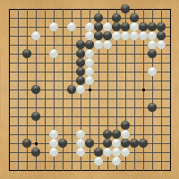
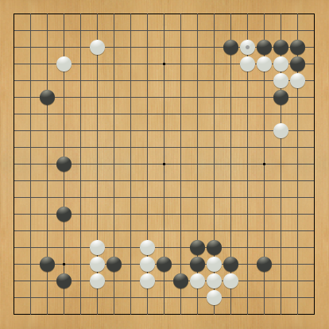
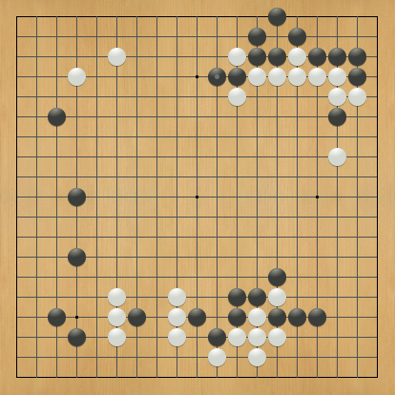
Optimal node ordering using a policy network
How on Earth can we decide which child to evaluate first?
Children of MIN nodes: child with highest value of $π_{MIN}\left(s,a\right)$ (=probability that this node will be evaluated to have the highest value).
Children of MAX nodes: child with highest value of $π_{MAX}\left(s,a\right)$ (= probability that this node will be evaluated to have the lowest value).
6
4
3
8
6
4
9
7
2
5
3
2
7
6
6
9
8
1
3
3
1
5
4
4
7
4
1

Slide 24
Hidden advantage: reduce the branching factor
Policy network can be used to order the moves, as on previous slide.
Policy network can also be used to reduce the branching factor, from $b=361$ (the complete branching factor in Go) to $b≈4$ or $5$. Just choose the 4 or 5 moves with the highest $π\left(s,a\right)$.
Russell & Norvig call this “heuristic minimax.” It’s not guaranteed to work, but it usually works.
?
?
?
?
Snapshot of a gnugo game,
http://www.gnu.org/software/gnugo/

Slide 25
Training the policy network
But how can we train $π\left(s,a\right)$?
Answer: Actor-Critic reinforcement learning!
$$U^{∗}\left(s\right)=\sum_{a}{π_{MAX}\left(s,a\right)Q^{∗}\left(s,a\right)}$$
Train $Q^{∗}\left(s,a\right)$ using deep Q-learning (play the game many times, gain reward each time you win)
Train $π_{MAX}\left(s,a\right)$ to maximize $U^{∗}\left(s\right)$
Train $π_{MIN}\left(s,a\right)$ to minimize $U^{∗}\left(s\right)$.
Snapshot of a gnugo game,
http://www.gnu.org/software/gnugo/

Slide 26
Outline
Review: minimax and alpha-beta
Move ordering: policy network
Evaluation function: value network
Training the value network
Exact training: endgames
Stochastic training: Monte Carlo tree search
Case study: alphago

Slide 27
Complexity of alpha-beta
$$α=6$$
$$β=∞$$
6
If nodes are optimally ordered, then, with $d$ levels, total complexity = ${(2b−1)}^{d/2}=O\{b^{d/2}\}$.
…but wait…
A game of Go has up to 361 moves, each of which takes any of the available 361 points. $O\{{361}^{361/2}\}$ is very large…
6
$$≤5$$
$$≤3$$
X
X
X
X
6
$$≥8$$
$$≥9$$
5
3
X
X
X
X
6
4
3
8
6
4
9
7
2
5
3
2
7
6
6
9
8
1
3
3
1
5
4
4
7
4
1
Evaluated

Slide 28
Limited-horizon game search
$$α=6$$
$$β=∞$$
6
Instead of searching to the end of the game, we choose a depth (d) that’s within our computational resources.
Then, at depth d, call the value network $U^{∗}\left(s\right)$ to estimate the probability that MAX wins from that position.
6
$$≤5$$
$$≤3$$
X
X
X
X
6
$$≥8$$
$$≥9$$
5
3
X
X
X
X
6
4
3
8
6
4
9
7
2
5
3
2
7
6
6
9
8
1
3
3
1
5
4
4
7
4
1
These are not the end of the game! These are actually the outputs of the value network, $U^{∗}\left(s\right)$, at these game positions.

Slide 29
Training the value network
But how can we train $U^{∗}\left(s\right)$?
Answer: Actor-Critic reinforcement learning!
$$U^{∗}\left(s\right)=\sum_{a}{π_{MAX}\left(s,a\right)Q^{∗}\left(s,a\right)}$$
Train $Q^{∗}\left(s,a\right)$ using deep Q-learning (play the game many times, gain reward each time you win)
Train $π_{MAX}\left(s,a\right)$ to maximize $U^{∗}\left(s\right)$
Train $π_{MIN}\left(s,a\right)$ to minimize $U^{∗}\left(s\right)$.
Snapshot of a gnugo game,
http://www.gnu.org/software/gnugo/

Slide 30
Outline
Review: minimax and alpha-beta
Move ordering: policy network
Evaluation function: value network
Training the value network
Exact training: endgames
Stochastic training: Monte Carlo tree search
Case study: alphago

Slide 31
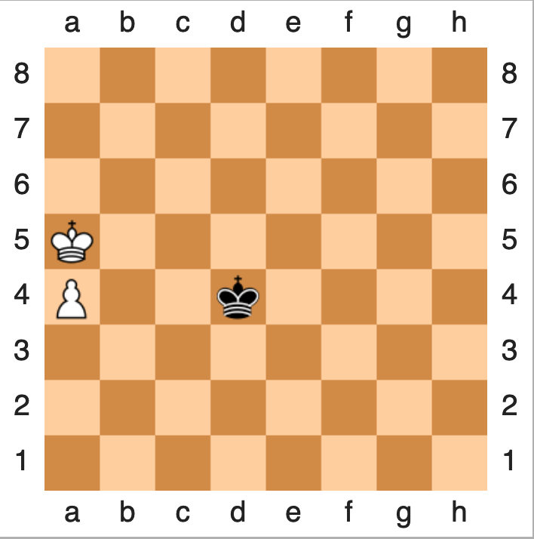
Endgames
$U^{∗}\left(s\right)$ can be exact when the game is near its end. This situation is called “endgame.”
For example, in chess, if there are only three pieces left, then there are just under ${64}^{3}=2^{18}$ possible board positions. With two bytes to encode the value of each, that’s half a megabyte.
Thus we can bypass the neural net, in favor of a lookup table.

Slide 32
How to create an endgame table
Of the $2^{18}$ possible board positions, find all the terminal states (white checkmate, black checkmate, or draw).
Iterate minimax backward from the set of terminal states until you know the result for each of the $2^{18}$ board positions.
Computation is limited not by the search depth, but by the limited number of board positions in the table.

Slide 33
Outline
Review: minimax and alpha-beta
Move ordering: policy network
Evaluation function: value network
Training the value network
Exact training: endgames
Stochastic training: Monte Carlo tree search
Case study: alphago

Slide 34
Monte Carlo Tree Search
Suppose s is too complicated for an endgame search. We still need to estimate its value and policy. How?
Selection: Run minimax forward a few steps, then use value network to estimate values of the nodes at the end of the tree. Select one of those nodes (call it $s$).
Expansion: Minimax one step further using action $a$.
Simulation: Play a random game, starting with node $(s,a)$. At each step, choose a move at random from the current policy network.
Backpropagate: Set $Q_{local}(s,a)$ equal to the average win frequency of the random games starting from $(s,a)$.
After your training dataset gets large enough, re-train $Q^{∗}\left(s,a\right)$ with $Q_{local}(s,a)$ as its target.

Slide 35
Monte Carlo Tree Search
Steps in Monte Carlo Tree Search.
By Rmoss92 - Own work, CC BY-SA 4.0, https://commons.wikimedia.org/w/index.php?curid=88889583

Slide 36
Exploration vs. Exploitation
In order to gain information about the win probability of node (s,a), you need to put some randomness into the game.
Exploration strategies from reinforcement learning, like epsilon-greedy, work well.
AlphaGo used this strategy:
From a large database of human-vs-human games, train the initial “supervised learning” policy network, $π_{SL}\left(s,a\right)$.
From the same database, train another policy network that’s the same, but with too few trainable parameters, hence less accurate. Call this the “rollout network,” $π_{Rollout}\left(s,a\right)$.
Use $π_{Rollout}\left(s,a\right)$ to play games – its low accuracy adds randomness -- use its results to improve $π_{SL}\left(s,a\right)$.

Slide 37
Outline
Review: minimax and alpha-beta
Move ordering: policy network
Evaluation function: value network
Training the value network
Exact training: endgames
Stochastic training: Monte Carlo tree search
Case study: Alpha-Go

Slide 38
Alpha-Go Video by Nature Magazine (8 minutes, 2016)

Slide 39
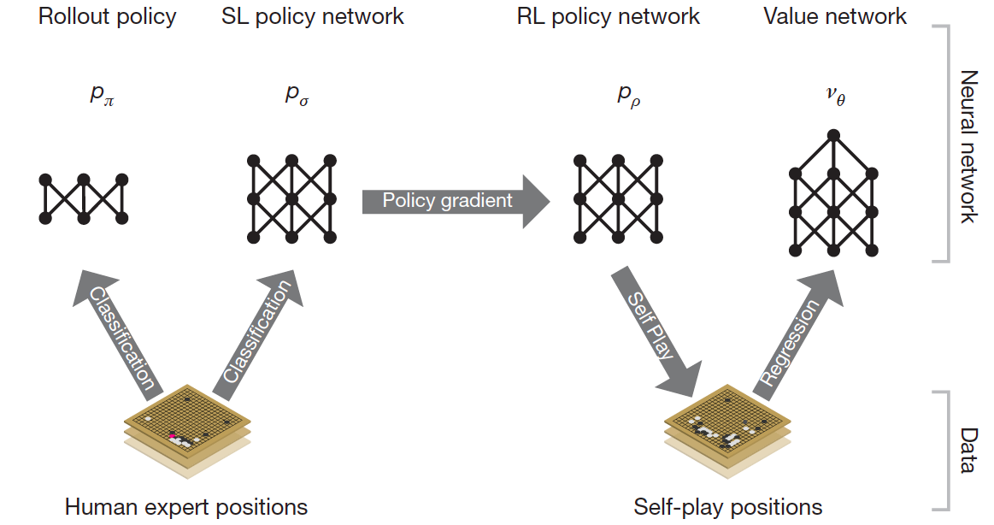
AlphaGo
D. Silver et al., Mastering the Game of Go with Deep Neural Networks and Tree Search, Nature 529, January 2016

Slide 40
Conclusions
Review: minimax and alpha-beta
Complexity: ${(2b−1)}^{d/2}=O\{b^{d/2}\}$ with depth d and branching factor b, if the children of each node are ordered just right (MAX: largest first, MIN: smallest first)
Move ordering: policy network
Can be used to order the children, with no loss of accuracy; Can also limit the set of moves evaluated, with some loss of accuracy
Evaluation function: value network
Estimates the value of each board position in limited-horizon search
Exact value: endgames
Minimax search backward from a set of known terminal positions
Stochastic training: Monte Carlo tree search
Choose a policy that includes exploration vs. exploitation, play games at random, use the data to estimate win frequency

