Slide 1
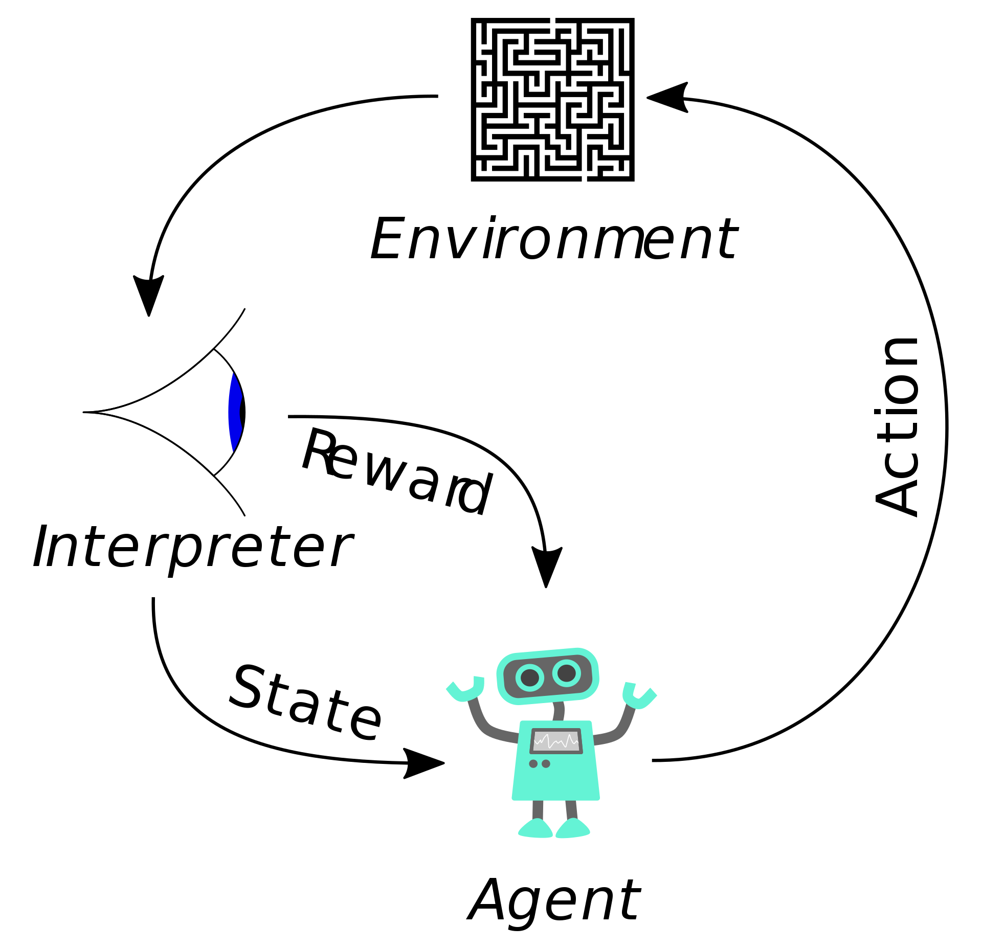
Deep Reinforcement Learning CS440/ECE448 Lecture 32
Mark Hasegawa-Johnson, 4/2020,
including slides by Svetlana Lazebnik, 11/2017
CC-BY 4.0: you may remix or redistribute if you cite the source
Image: Megajuice, CC0, https://commons.wikimedia.org/
w/index.php?curid=57895741

Slide 2
Last lecture: Q-learning for discrete s, a
So far, we’ve assumed a lookup table representation for utility function U(s) or action-utility function Q(s,a)
This does not work if the state space is really large or continuous

Slide 3
This time: Function approximation
Approximate $Q\left(s,a\right)$ by a parameterized function, that is, by a function $\hat{Q}(s, a;W)$ that depends on some matrix of trainable parameters, W.
Learn W by playing the game.

Slide 4
Outline
Deep Q-learning: learn an MMSE estimate of Q(s,a)
Off-policy vs. On-policy
Batch learning (experience replay)
Policy learning: learn the policy with the maximum value
Estimating the value: actor-critic network
Estimating the relative value: advantage actor-critic
Imitation learning: MMSE imitation of a human expert
A good way to initialize Q-learning or policy learning

Slide 5
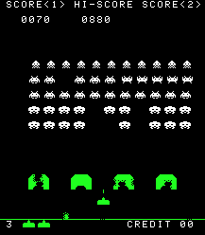
Deep Q learning
Instead of discrete $s$, suppose $\vec{s}$ is a vector of real numbers, e.g., the image from the robot’s eye camera:
$$\vec{s}=\left[s_{1},…,s_{D}\right]=$$
Instead of discrete $a$, suppose $\vec{a}$ is a vector, e.g., cannon angle and velocity,
$$\vec{a}=\left[a_{1},…,a_{C}\right]$$
Deep Q-learning uses a neural network to compute an estimate $Q^{∗} (\vec{s},\vec{a})$ which is as close as possible to $Q(\vec{s},\vec{a})$.
$$Q^{∗} (\vec{s},\vec{a})$$
$$1$$
$$1$$
Copyright Taito.
$$1$$
$$1$$
$$s_{1}$$
$$…$$
$$s_{D}$$
$$a_{1}$$
$$…$$
$$a_{C}$$
$$1$$
$$…$$

Slide 6
MMSE Deep Q learning
Suppose we train the neural network weights in order to minimize the mean-squared error (MMSE):
$$ℒ=\frac{1}{2}E\left[{\left(Q^{∗} \left(\vec{s},\vec{a}\right)−Q(\vec{s},\vec{a}) \right)}^{2}\right]$$
(where I’m using $E\left[∙\right]$ as a lazy way to write “average over all training runs of the game).
Then, for each weight $w$, we update as
$$w←w−η\frac{dℒ}{dw}$$
$$Q^{∗} \left(\vec{s},\vec{a}\right)$$
$$1$$
$$1$$
$$1$$
$$1$$
$$s_{1}$$
$$…$$
$$s_{D}$$
$$a_{1}$$
$$…$$
$$a_{C}$$
$$1$$
$$…$$

Slide 7
What makes deep Q learning harder than normal neural network training
We don’t know the true value of $Q(\vec{s},\vec{a})$for any of the training runs!
$Q\left(\vec{s},\vec{a}\right)$ is defined to be the expected value of performing action $\vec{a}$. We never know its true expected value: all we know is whether we won or lost that particular game.
So we can’t compute $ℒ$, and we can’t compute $\frac{dℒ}{dw}$, and we can’t update $w$!
$$Q^{∗} \left(\vec{s},\vec{a}\right)$$
$$1$$
$$1$$
$$1$$
$$1$$
$$s_{1}$$
$$…$$
$$s_{D}$$
$$a_{1}$$
$$…$$
$$a_{C}$$
$$1$$
$$…$$

Slide 8
The solution: $Q_{local}$
Remember that Q learning was defined as
$$Q_{t+1}\left(s,a\right)=Q_{t}\left(s,a\right)+α\left(Q_{local}\left(s,a\right)−Q_{t}\left(s,a\right)\right)$$
where $Q_{local}\left(s,a\right)$ is defined, e.g., in TD as
$$Q_{local}\left(s,a\right)=R_{t}(s)+γ\max_{a′}{Q_{t}(s′,a′)}$$
…for $s′$ equal to the next state we reach after action $a$ on this particular game.
$$…$$

Slide 9
The solution: $Q_{local}$
Let’s define deep Q learning using the same $Q_{local}$:
$$ℒ=\frac{1}{2}E\left[{\left(Q^{∗} \left(\vec{s},\vec{a}\right)−Q_{local}(\vec{s},\vec{a}) \right)}^{2}\right]$$
where $Q_{local}(\vec{s},\vec{a})$ is:
$$Q_{local}(\vec{s},\vec{a})=R_{t}(\vec{s})+γ\max_{\vec{a}′}{Q^{∗} \left(\vec{s}′,\vec{a}′\right)}$$
Now we have an L that depends only on things we know ($Q^{∗} \left(\vec{s},\vec{a}\right)$, $R_{t}(\vec{s})$, and $Q^{∗} \left(\vec{s}′,\vec{a}′\right)$), so it can be calculated, differentiated, and used to update the neural network.
$$…$$

Slide 10
Outline
Deep Q-learning: learn an MMSE estimate of Q(s,a)
Off-policy vs. On-policy
Batch learning (experience replay)
Policy learning: learn the policy with the maximum value
Estimating the value: actor-critic network
Estimating the relative value: advantage actor-critic
Imitation learning: MMSE imitation of a human expert
A good way to initialize Q-learning or policy learning

Slide 11
Convergence of neural networks
$$L$$
Training Corpus Error
A general neural net (e.g., a classifier) is trained to minimize the training corpus error.
Test corpus error might be very different!
Barron showed: generalization error is $G<$(#hidden nodes/#training tokens)
As #training tokens$→∞$, $G→0$
Test
Corpus Error
$$G$$
$$W$$
Training the neural net finds this set of weights by minimizing the training corpus error.

Slide 12
Does Q-learning Converge?
No!
Because:
$$\vec{a}=\operatorname{argmax}{Q\left(\vec{s},\vec{a}\right)}$$
If we always choose the action that is best, according to our current estimate of the Q-function, then we can never learn anything about any of the other actions!

Slide 13
Epsilon-greedy exploration
At each time step:
With probability $ε$, choose an action at random
With probability $1−ε$, choose $\vec{a}=\operatorname{argmax}{Q\left(\vec{s},\vec{a}\right)}$
(Decaying epsilon version): As $n→∞$,$ε→0$, for example, $ε=1/n$
Result:
As you play the game infinite times, each action is sampled an infinite number of samples, so Q converges, but also,
As you play the game infinite times, you start to exploit your knowledge more and more frequently, so that you converge to the best possible policy.
… actually, it doesn’t always work in practice. To guarantee success, you need a few more tweaks, e.g., Re-Trace algorithm, Munos et al., 2016.

Slide 14
Outline
Deep Q-learning: learn an MMSE estimate of Q(s,a)
Off-policy vs. On-policy
Batch learning (experience replay)
Policy learning: learn the policy with the maximum value
Estimating the value: actor-critic network
Estimating the relative value: advantage actor-critic
Imitation learning: MMSE imitation of a human expert
A good way to initialize Q-learning or policy learning

Slide 15
Dealing with training instability
Challenges
Target values are not fixed
Successive experiences are correlated and dependent on the policy
Policy may change rapidly with slight changes to parameters, leading to drastic change in data distribution
Solutions
Freeze target Q network
Use experience replay

Slide 16
Experience replay
At each time step:
Take action ${\vec{a}}_{t}$ according to epsilon-greedy policy
Store experience $({\vec{s}}_{t},{\vec{a}}_{t},r_{t+1},{\vec{s}}_{t+1})$ in replay memory buffer
$$({\vec{s}}_{1},{\vec{a}}_{1},r_{2},{\vec{s}}_{2})$$
$$({\vec{s}}_{2},{\vec{a}}_{2},r_{3},{\vec{s}}_{3})$$
$$…$$
$$({\vec{s}}_{t},{\vec{a}}_{t},r_{t+1},{\vec{s}}_{t+1})$$
Learning:
Randomly sample a minibatch, $𝒟$, from the replay buffer.
$𝒟=$randomly sampled set of tuples

Slide 17
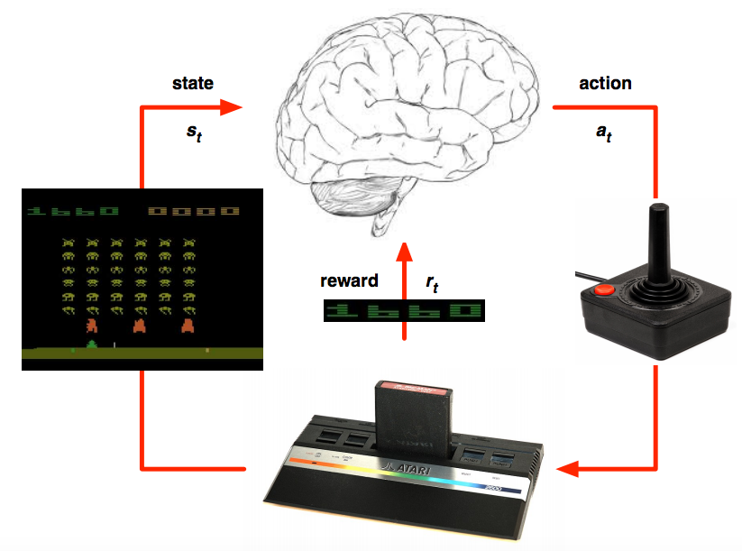
Deep Q learning in Atari
Mnih et al. Human-level control through deep reinforcement learning, Nature 2015

Slide 18
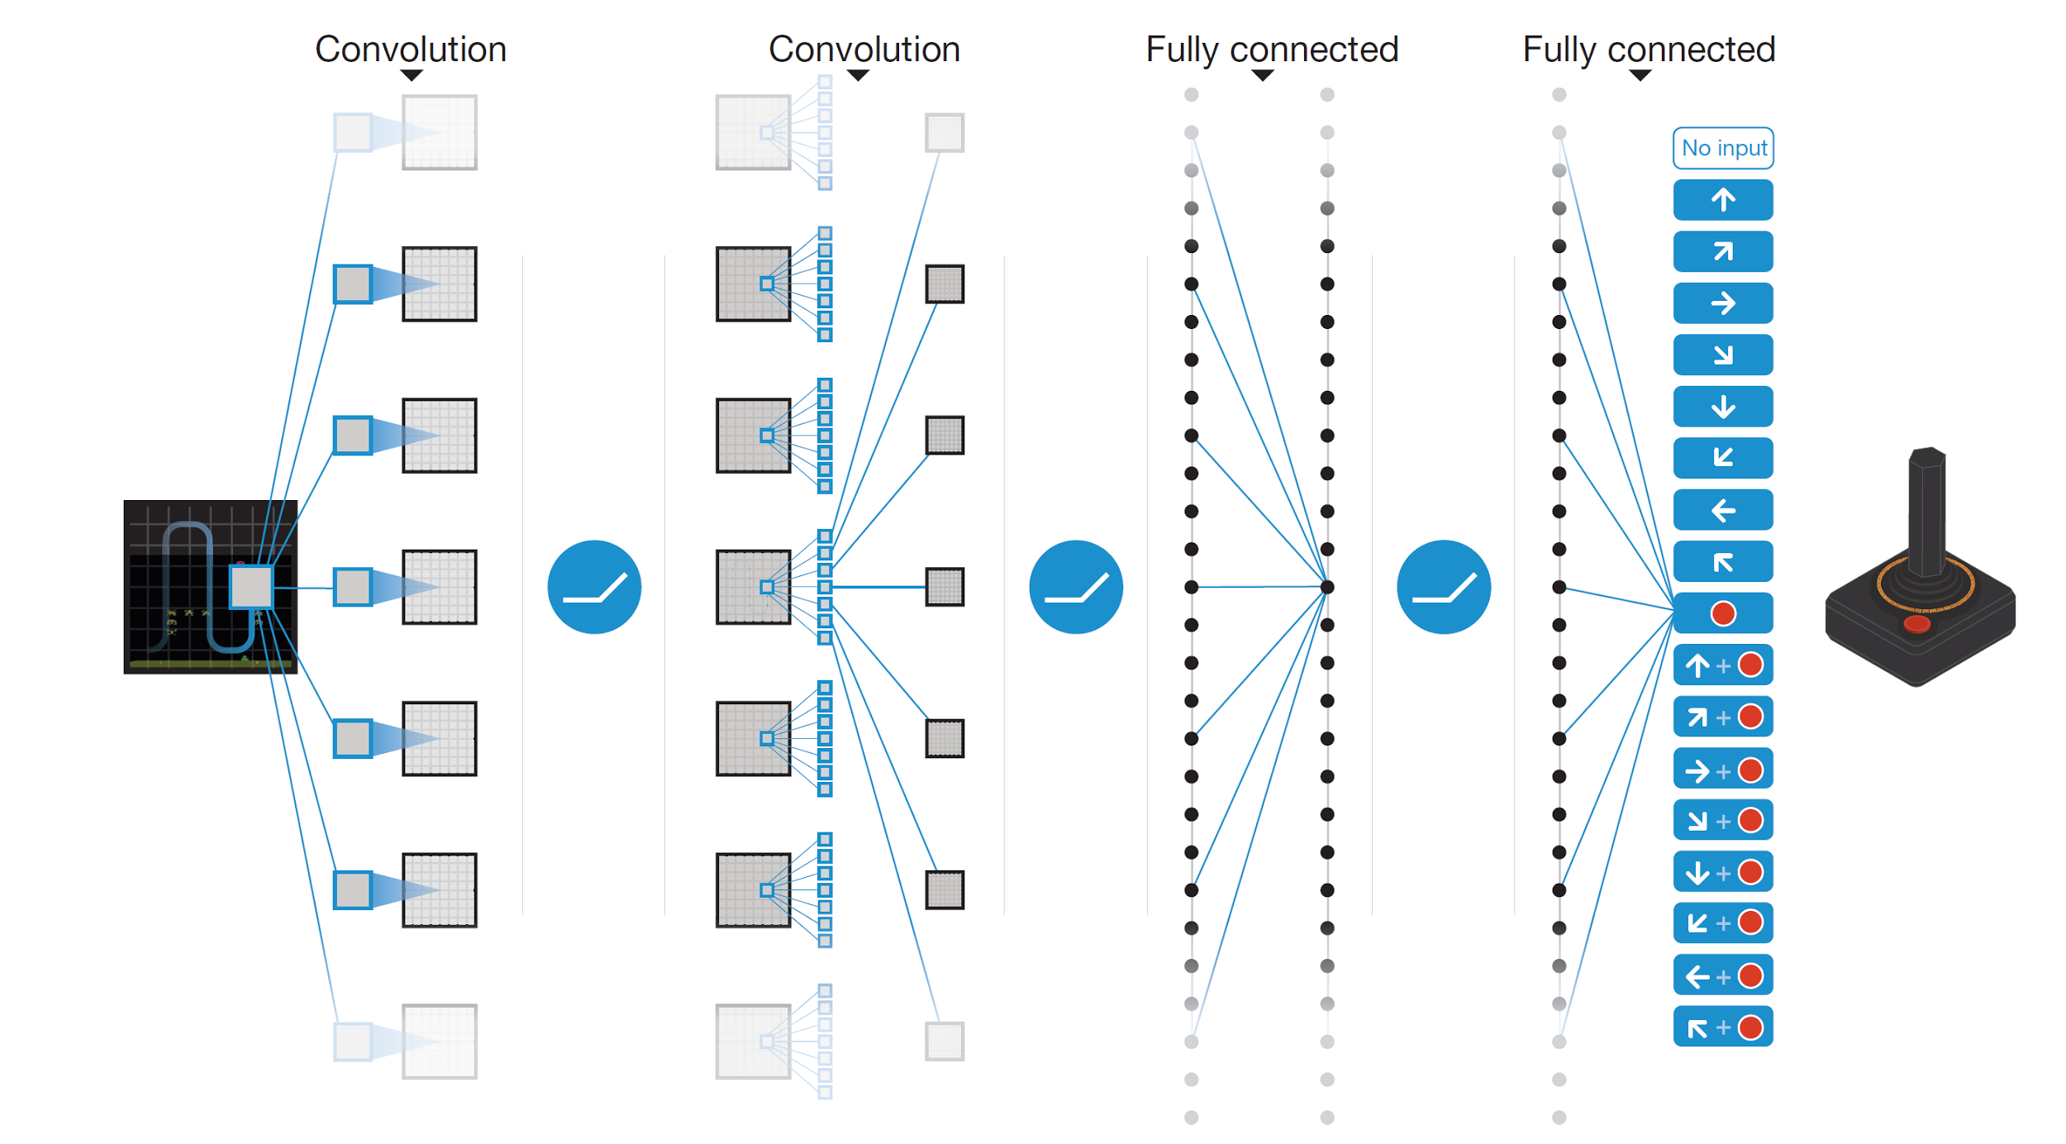
Deep Q learning in Atari
End-to-end learning of Q(s,a) from pixels s
Output is Q(s,a) for 18 joystick/button configurations
Reward is change in score for that step
Q(s,a₁)
Q(s,a₂)
Q(s,a₃)
.
.
.
.
.
.
.
.
.
.
.
Q(s,a₁₈)
Mnih et al. Human-level control through deep reinforcement learning, Nature 2015

Slide 19
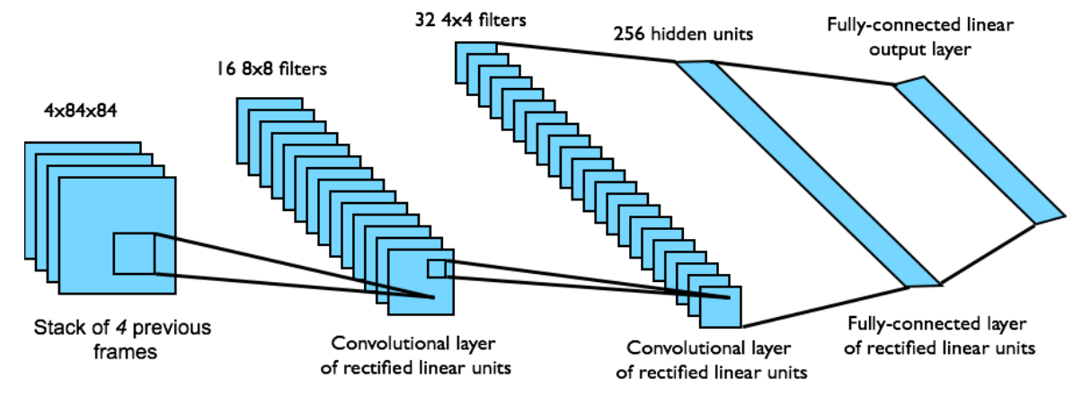
Deep Q learning in Atari
Input state s is stack of raw pixels from last 4 frames
Network architecture and hyperparameters fixed for all games
Mnih et al. Human-level control through deep reinforcement learning, Nature 2015

Slide 20
Outline
Deep Q-learning: learn an MMSE estimate of Q(s,a)
Off-policy vs. On-policy
Batch learning (experience replay)
Policy learning: learn the policy with the maximum value
Estimating the value: actor-critic network
Estimating the relative value: advantage actor-critic
Imitation learning: MMSE imitation of a human expert
A good way to initialize Q-learning or policy learning

Slide 21
Policy learning methods
Suppose that $\vec{s}$ is continuous, but $\vec{a}$ is discrete (e.g., a one-hot vector).
Then learning the policy directly can be much faster than learning Q values.
We can train a neural network for a stochastic policy---a policy that chooses an action at random, using the probability distribution:
$$π^{∗}\left(\vec{s},\vec{a}\right)=\frac{e^{f(\vec{s},\vec{a})}}{\sum_{\vec{a}′}{e^{f(\vec{s},\vec{a}′)}}}$$

Slide 22
How do we train $π^{∗}\left(\vec{s},\vec{a}\right)$?
MMSE loss doesn’t work very well, b/c the true optimum policy is a one-hot vector (choose the best action w/probability=1.0).
Cross-entropy ($−\log{π^{∗}}$ of the best action) is possible, if we know what the best action is. Usually, we don’t.
Let’s propose a new learning criterion: learn the $π^{∗}$that maximizes your expected total reward.

Slide 23
How do we train $π^{∗}\left(\vec{s},\vec{a}\right)$?
Expected total reward = Bellman’s utility, $U\left(\vec{s}\right)$.
If we always choose the best action, then
$$U\left(\vec{s}\right)=\max_{\vec{a}}{Q\left(\vec{s},\vec{a}\right)}$$
With a stochastic policy, the utility of state $\vec{s}$ is suboptimal, given by:
$$U^{π}\left(\vec{s}\right)=\sum_{\vec{a}}{π^{∗}\left(\vec{s},\vec{a}\right)Q\left(\vec{s},\vec{a}\right)}$$
If we knew $Q\left(\vec{s},\vec{a}\right)$, then we’d learn $π^{∗}\left(\vec{s},\vec{a}\right)$ to maximize $U^{π}\left(\vec{s}\right)$. Unfortunately, we don’t…

Slide 24
Outline
Deep Q-learning: learn an MMSE estimate of Q(s,a)
Off-policy vs. On-policy
Batch learning (experience replay)
Policy learning: learn the policy with the maximum value
Estimating the value: actor-critic network
Estimating the relative value: advantage actor-critic
Imitation learning: MMSE imitation of a human expert
A good way to initialize Q-learning or policy learning

Slide 25
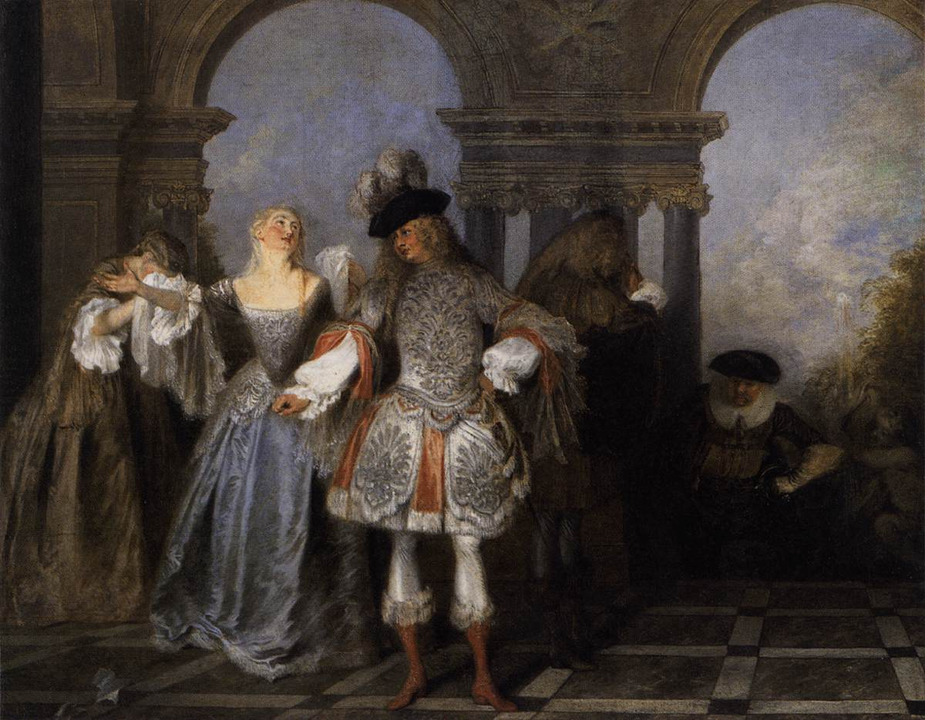
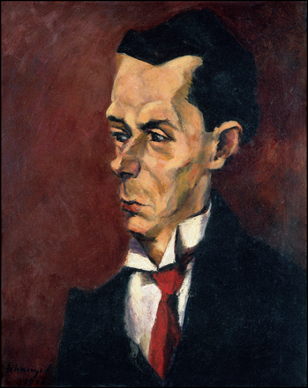
Actor-critic algorithm
So let’s train two neural nets!
$Q^{∗}\left(\vec{s},\vec{a}\right)$ is the critic, and is trained according to the deep Q-learning algorithm (MMSE).
$π^{∗}\left(\vec{s},\vec{a}\right)$ is the actor, and is trained to satisfy the critic:
Actors from the Comédie Française, by Antoine Watteau, 1720. Public Domain, https://commons.wikimedia.org/w/index.php?curid=15418670
The Critic, by Lajos Tihanyi. Oil on canvas, 1916.
Public Domain, https://commons.wikimedia.org/w/index.php?curid=17837438
$$U^{∗}\left(\vec{s}\right)=\sum_{\vec{a}}{π^{∗}\left(\vec{s},\vec{a}\right)Q^{∗}\left(\vec{s},\vec{a}\right)}$$

Slide 26
Actor-Critic Algorithm
Benefits of the actor-critic algorithm
It usually converges faster and more reliably than deep Q-learning, because the softmax probability $π^{∗}\left(\vec{s},\vec{a}\right)$ is usually easier to learn than the real-valued function $Q^{∗}\left(\vec{s},\vec{a}\right)$
Disadvantages of the actor-critic algorithm
…but sometimes, it doesn’t. If $Q^{∗}\left(\vec{s},\vec{a}\right)$ is estimated badly enough, then it will give wrong information to $π^{∗}\left(\vec{s},\vec{a}\right)$, and so $π^{∗}\left(\vec{s},\vec{a}\right)$ will learn a bad policy.

Slide 27
Outline
Deep Q-learning: learn an MMSE estimate of Q(s,a)
Off-policy vs. On-policy
Batch learning (experience replay)
Policy learning: learn the policy with the maximum value
Estimating the value: actor-critic network
Estimating the relative value: advantage actor-critic
Imitation learning: MMSE imitation of a human expert
A good way to initialize Q-learning or policy learning

Slide 28
Advantage actor-critic
$Q^{∗}\left(\vec{s},\vec{a}\right)$ is hard to learn, in part, because it has such a huge dynamic range. Some states are really good, some are really bad. We can reduce the dynamic range by just learning the relative advantage of one action over all of the others:
$$A^{∗}\left(\vec{s},\vec{a}\right)=Q^{∗}\left(\vec{s},\vec{a}\right)−U^{∗}\left(\vec{s} \right)$$
Now we can train the policy network in order to maximize the relative utility, which converges faster, and is more accurate:
$$\sum_{\vec{a}}{π^{∗}\left(\vec{s},\vec{a}\right)A^{∗}\left(\vec{s},\vec{a}\right)}$$
But there’s computational cost. The only way to learn $A^{∗}\left(\vec{s},\vec{a}\right)$ is deep Q-learning (MMSE), which uses $Q_{local}$to update the weights of $A^{∗}\left(\vec{s},\vec{a}\right)+U^{∗}\left(\vec{s}\right)$. So we need to train three neural nets: $π^{∗}\left(\vec{s},\vec{a}\right)$, $A^{∗}\left(\vec{s},\vec{a}\right)$, and $U^{∗}\left(\vec{s} \right)$.

Slide 29
Asynchronous advantage actor-critic (A3C)
Agent 1
Experience 1
Local updates
Agent 2
Experience 2
Local updates
U, π
.
.
.
Agent n
Experience n
Local updates
Asynchronously update global parameters
Mnih et al. Asynchronous Methods for Deep Reinforcement Learning. ICML 2016

Slide 30
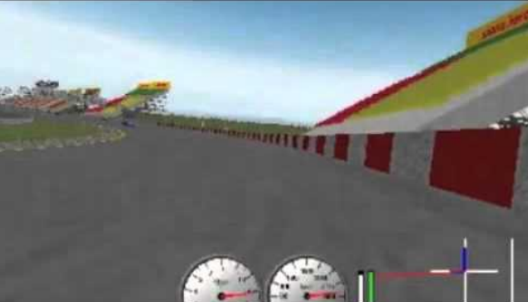
Asynchronous advantage actor-critic (A3C)
TORCS car racing simulation video
Mnih et al. Asynchronous Methods for Deep Reinforcement Learning. ICML 2016

Slide 31
Outline
Deep Q-learning: learn an MMSE estimate of Q(s,a)
Off-policy vs. On-policy
Batch learning (experience replay)
Policy learning: learn the policy with the maximum value
Estimating the value: actor-critic network
Estimating the relative value: advantage actor-critic
Imitation learning: MMSE imitation of a human expert
A good way to initialize Q-learning or policy learning

Slide 32
Imitation learning
In some applications, you cannot bootstrap yourself from random policies
High-dimensional state and action spaces where most random trajectories fail miserably
Expensive to evaluate policies in the physical world, especially in cases of failure
Solution: learn to imitate sample trajectories or demonstrations
This is also helpful when there is no natural reward formulation

Slide 33
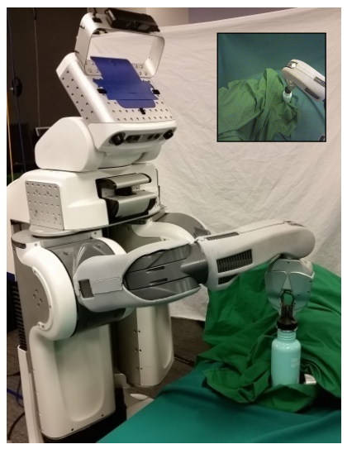
Learning visuomotor policies
Underlying state x: true object position, robot configuration
Observations o: image pixels
Two-part approach:
Learn guiding policy π(a|x) using trajectory-centric RL and control techniques
Learn visuomotor policy π(a|o) by imitating π(a|x)
S. Levine et al. End-to-end training of deep visuomotor policies. JMLR 2016

Slide 34
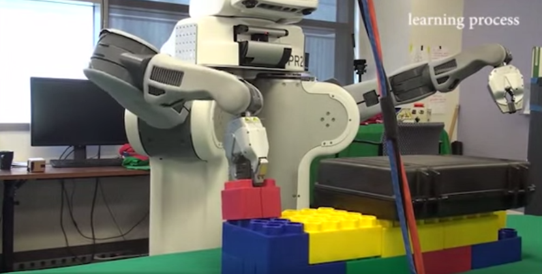
Learning visuomotor policies
Overview video, training video
S. Levine et al. End-to-end training of deep visuomotor policies. JMLR 2016

Slide 35
Conclusions
What is deep Q-learning?
How to make Q-learning converge to the best answer?
How to make it converge more smoothly?
What are policy learning and actor-critic networks?
What is imitation learning?
Estimate Q(s,a) using a neural net.
Epsilon-greedy usually works.
Experience replay.
Actor network: $Pr⁡(a)$. Critic network: $Q(s,a)$, to train the actor.
Learn to imitate an expert player.

