Slide 1
CS 440/ECE448 Lecture 30: Reinforcement Learning
Mark Hasegawa-Johnson, 4/2020
Including slides by Svetlana Lazebnik, 11/2016
By Nicolas P. Rougier - Own work, CC BY-SA 3.0, https://commons.wikimedia.org/w/index.php?curid=29327040

Slide 2
Reinforcement learning
Solving a known MDP
Given:
Transition model $P(s’| s, a)$
Reward function $R(s)$
Find:
Policy $(s)$
Reinforcement learning
Transition model and reward function initially unknown
Still need to find the right policy
“Learn by doing”

Slide 3
Reinforcement learning: Basic scheme
In each time step:
Take some action
Observe the outcome of the action: successor state and reward
Update some internal representation of the environment and policy
If you reach a terminal state, just start over (each pass through the environment is called a trial)
Notes:
See http://en.wikipedia.org/wiki/Reinforcement for discussion of reinforcement learning in psychology

Slide 4
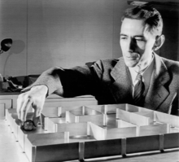
Theseus the Mouse
The study of reinforcement learning by machines goes back at least to 1950, when Claude Shannon built a robot mouse named “Theseus.”
Like his classical namesake, Theseus had to learn how to navigate a maze.
He learned by trial and error.
His reinforcement learning strategy permitted him to adapt to changes in the maze.
Found at Bell Labs website, The photo was part of a press release, widely circulated in the public domain through news articles appearing in national newspapers and books. Its use in Wikipedia is therefore claimed under the Fair use guidelines., https://en.wikipedia.org/w/index.php?curid=4289542
For more information about Theseus, and for a great introduction to the goals of reinforcement learning in general (and the problem of exploration versus exploitation), I recommend this video.

Slide 5
Outline
Types of reinforcement learning
Model-free: keep track of the quality of each action in each state.
Model-based: try to learn P(s’|s,a) explicitly.
Model-based reinforcement learning
The observation -> model -> policy loop
Exploration versus Exploitation
Epsilon-greedy learning versus Epsilon-first learning

Slide 6
Model-based reinforcement learning
Model-based reinforcement learning uses what’s sometimes called the observation -> model -> policy loop.
Test a few actions, and observe the results
Based on those results, estimate a model: a lookup table (or neural network estimate) of the transition probabilities $P(s’|s,a)$, and of the reward function $R(s)$.
Based on the model, use value iteration or policy iteration to find an optimal policy.
… and repeat this loop, as often as you can.

Slide 7
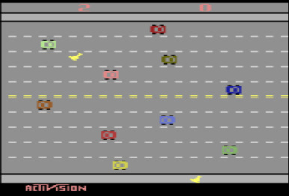
Example of model-based reinforcement learning: Playing classic Atari video games
Model-Based Reinforcement Learning for Atari (Kaiser, Babaeizadeh, Milos, Osinski, Campbell, Czechowski, Erhan, Finn, Kozakowski, Levine, Mohiuddin, Sepassi, Tucker, and Michalewski)
Blog and videos: https://sites.google.com/view/modelbasedrlatari/home
Article: https://arxiv.org/abs/1903.00374
Screenshot of the video game “Freeway,” copyright Activision. Reproduced here under the terms of fair use enumerated at https://en.wikipedia.org/w/index.php?curid=56419703

Slide 8
Model-free reinforcement learning
In model-free reinforcement learning, we never try to explicitly learn what the world is like ($P(s’|s,a)$ and $R(s)$).
Instead, we keep track of a simple lookup table:
In state $s$, if I perform action $a$, what will be my expected utility?
This is called the “quality” of action $a$ in state $s$, $Q(s,a)$.
If the states and actions are discrete, $Q(s,a)$ can be a lookup table. If not, $Q(s,a)$ can be a function learned by a neural network.

Slide 9
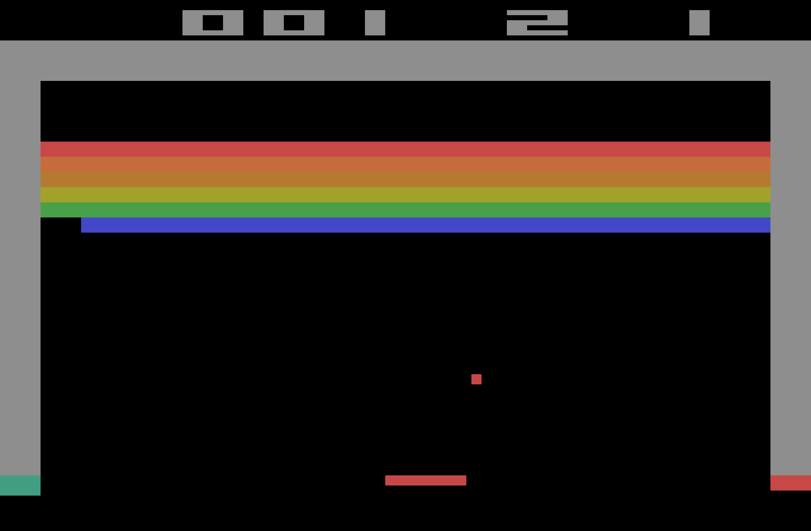
Example of model-free reinforcement learning: Playing classic Atari video games
Playing Atari with Deep Reinforcement Learning (Mnih, Kavukcuoglu, Silver, Graves, Antonoglou, Wierstra, and Riedmiller)
Video: https://www.youtube.com/watch?v=cjpEIotvwFY&feature=youtu.be
Article: https://arxiv.org/abs/1312.5602
Screenshot of the video game “Breakout,” copyright Activision. Reproduced here under the terms of fair use enumerated at https://en.wikipedia.org/w/index.php?curid=52132637

Slide 10
Reinforcement learning strategies
Model-based
Learn the model of the MDP (transition probabilities and rewards) and try to solve the MDP concurrently
Model-free
Learn how to act without explicitly learning the transition probabilities P(s’ | s, a)
Q-learning: learn an action-utility function Q(s,a) that tells us the value of doing action a in state s

Slide 11
Outline
Types of reinforcement learning
Model-free: keep track of the quality of each action in each state.
Model-based: try to learn P(s’|s,a) explicitly.
Model-based reinforcement learning
The observation -> model -> policy loop
Exploration versus Exploitation
Epsilon-greedy learning versus Epsilon-first learning

Slide 12
Model-based reinforcement learning
Basic idea:
Follow some initial policy, to guide your actions.
Try to learn P(s’|s,a) and R(s).
Use your estimated P(s’|s,a) and R(s) to decide on a new policy, and repeat.

Slide 13
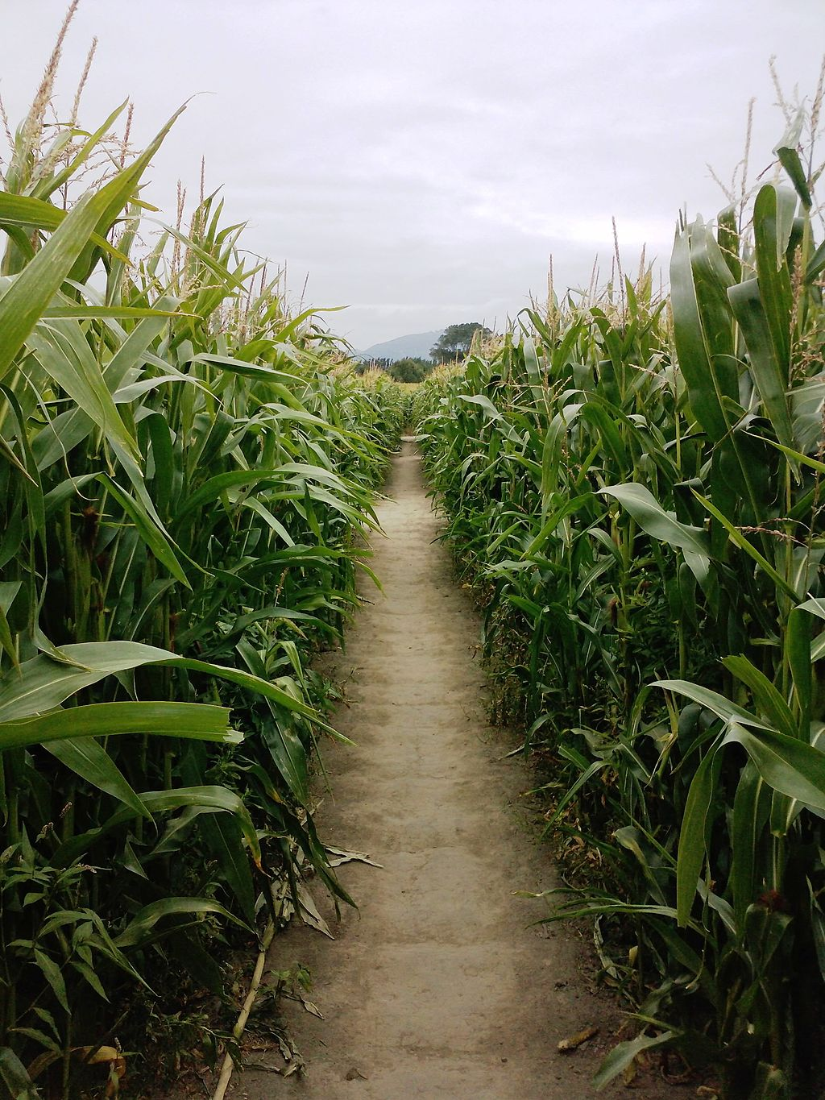
1. Follow some initial policy, to guide your actions
Enter the maze…
A view from inside a corn maze near Christchurch, New Zealand
By Hugho226 - Own work, CC0, https://commons.wikimedia.org/w/index.php?curid=30724285

Slide 14
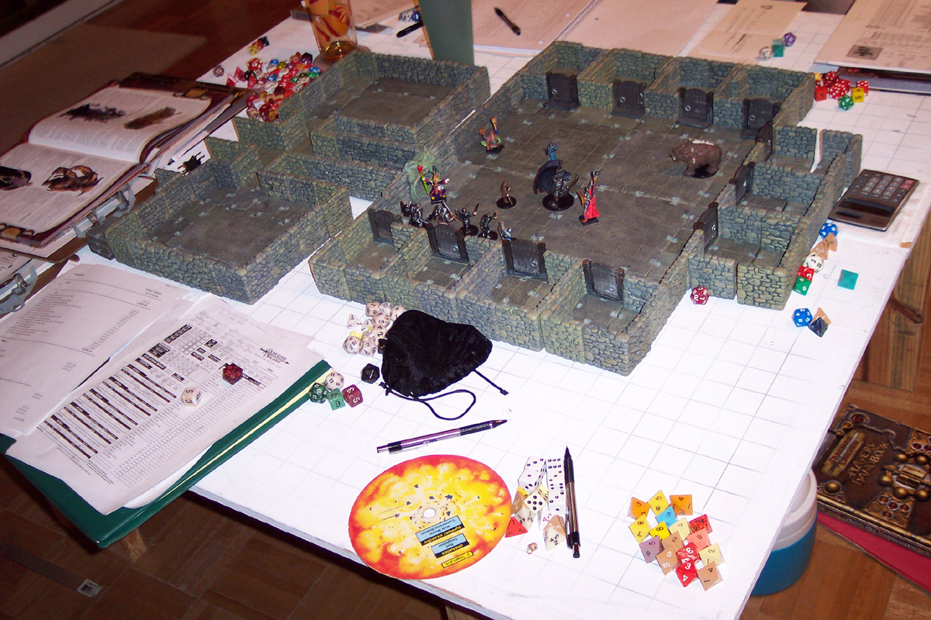
2. Try to learn P(s’|s,a) and R(s)
Enter the maze…
…update your map as you go…
A view from inside a corn maze near Christchurch, New Zealand
By Hugho226 - Own work, CC0, https://commons.wikimedia.org/w/index.php?curid=30724285
By Philip Mitchell - http://www.dwarvenforge.com/dwarvenforums/viewtopic.php?pid=15595#p15595, CC BY-SA 3.0, https://commons.wikimedia.org/w/index.php?curid=1913429

Slide 15
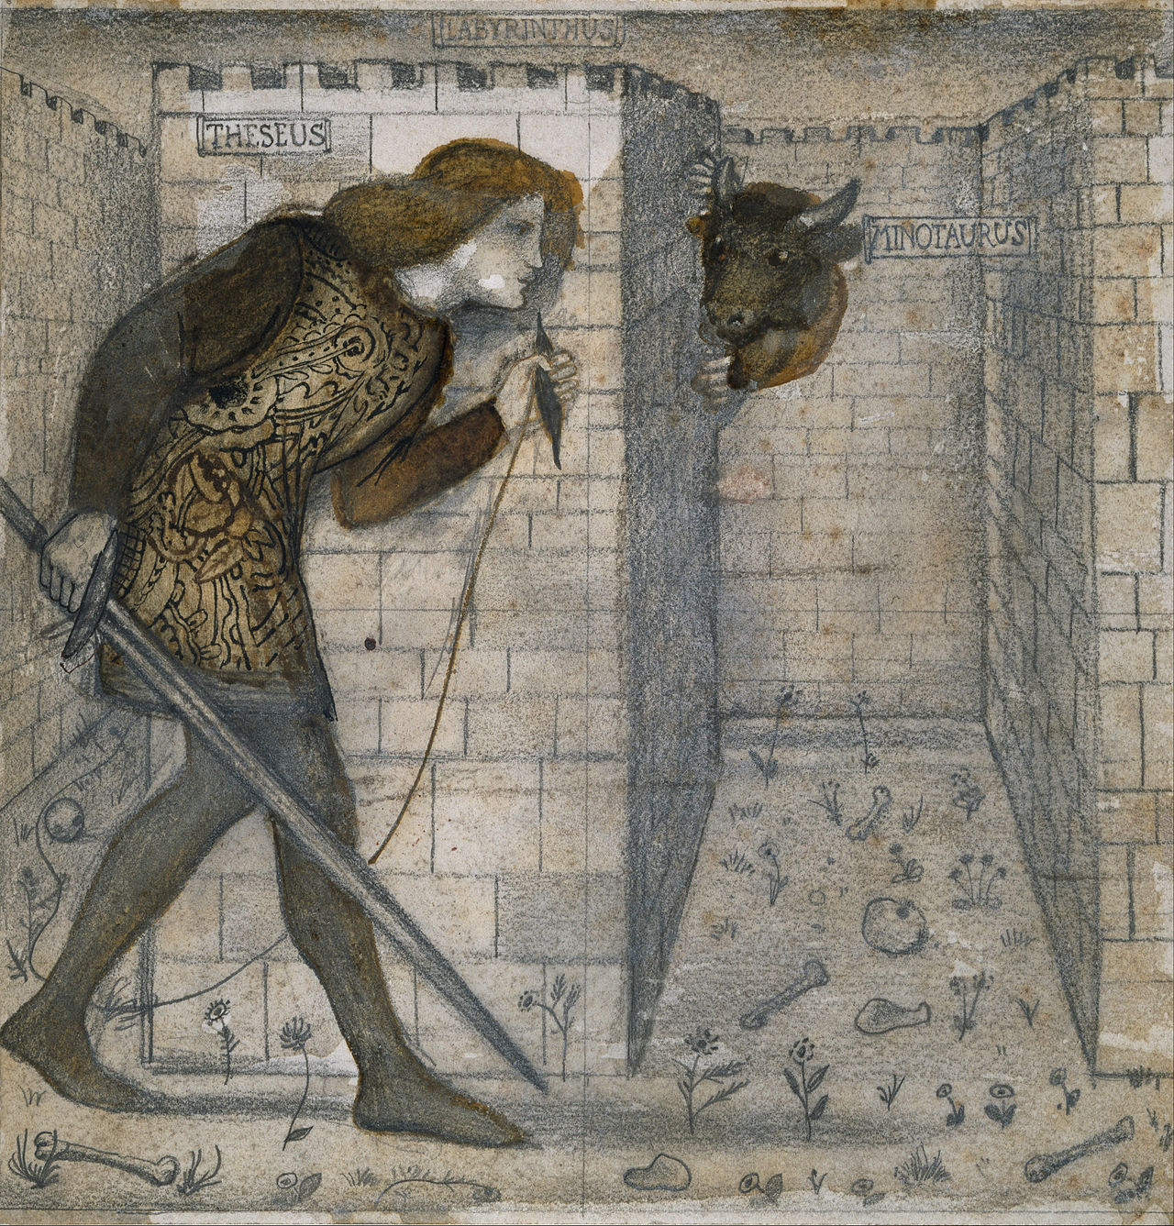
3. Update your policy
…and be ready to act.
…update your map as you go…
By Edward Burne-Jones - lgFxdQtUgyzs7Q at Google Cultural Institute, zoom level maximum, Public Domain, https://commons.wikimedia.org/w/index.php?curid=29661124
By Philip Mitchell - http://www.dwarvenforge.com/dwarvenforums/viewtopic.php?pid=15595#p15595, CC BY-SA 3.0, https://commons.wikimedia.org/w/index.php?curid=1913429

Slide 16
1. Follow some initial policy, to guide your actions
For $t=1$ to $n$ (for some sufficiently large value of $n$):
Observe: find out what is your current state (s).
Act: use your current policy to choose an action (a).
Observe: see what state you move to (s’).
Observe: see what reward you receive (R).
If you finish the game within this many steps, start over, until you reach your desired $n$.
Keep a record of your (s,a,s’,R) tuples. These are now your training database:
$$𝒟=\left\{\left(s_{1},a_{1},s_{1}^{′},R_{1}\right),\left(s_{2},a_{2},s_{2}^{′},R_{2}\right),…,(s_{n},a_{n},s_{n}^{′},R_{n})\right\}$$
By Hugho226 - Own work, CC0, https://commons.wikimedia.org/w/index.php?curid=30724285

Slide 17
2. Try to learn P(s’|s,a) and R(s)
Just like Bayesian networks! Use maximum likelihood parameter learning, possibly also with Laplace smoothing.
$$P\left(s^{′} | s,a\right)=\frac{\# times that action a in state s led to state s′}{\# times action a was performed in state s}$$
$$R\left(s\right)=R that was received when you were in state s$$
If $s$ or $a$ are continuous-valued, you’ll have to estimate these using a neural network or some other parametric model.
By Philip Mitchell - http://www.dwarvenforge.com/dwarvenforums/viewtopic.php?pid=15595#p15595, CC BY-SA 3.0

Slide 18
3. Update your policy
$$U\left(s\right)=R\left(s\right)+γ\max_{a}{\sum_{s′}{P\left(s^{′} | s,a\right)U(s^{′})}}$$
As you know from last lecture, you’ll have to use value iteration or policy iteration to solve for $π(s)$ given $P(s’|s,a)$ and $R(s)$.
By Edward Burne-Jones - lgFxdQtUgyzs7Q at Google Cultural Institute, zoom level maximum, Public Domain, https://commons.wikimedia.org/w/index.php?curid=29661124

Slide 19
Model-based reinforcement learning
Basic idea:
Follow some initial policy, to guide your actions.
Try to learn P(s’|s,a) and R(s).
Use your estimated P(s’|s,a) and R(s) to decide on a new policy, and repeat.
Why does this fail?

Slide 20
Model-based reinforcement learning
Basic idea:
Follow some initial policy, to guide your actions.
Try to learn P(s’|s,a) and R(s).
Use your estimated P(s’|s,a) and R(s) to decide on a new policy, and repeat.
Why does this fail?
$$P\left(s^{′} | s,a\right)=\frac{\# times that action a in state s led to state s′}{\# times action a was performed in state s}$$
If your current policy is $π\left(s\right)=a_{1}$, then you will never perform action $a_{2}$ in state $s.$
Therefore, your estimate of $P\left(s^{′} | s,a_{2}\right)$ will be completely uninformed. You’ll probably think that $P\left(s^{′} | s,a_{2}\right)$is uniform (every $s^{′}$ is equally likely).
If $a_{1}$ leads to a good state more than half the time, then you will conclude that $a_{1}$ is better than $a_{2}$. So when you revise your policy in step 3, you will still choose $π(s)=a_{1}$. …and the trap snaps shut behind you…

Slide 21
Outline
Types of reinforcement learning
Model-free: keep track of the quality of each action in each state.
Model-based: try to learn P(s’|s,a) explicitly.
Model-based reinforcement learning
The observation -> model -> policy loop
Exploration versus Exploitation
Epsilon-greedy learning versus Epsilon-first learning

Slide 22
Exploration vs. Exploitation
Exploration: take a new action with unknown consequences
Pros:
Get a more accurate model of the environment
Discover higher-reward states than the ones found so far
Cons:
When you’re exploring, you’re not maximizing your utility
Something bad might happen
Exploitation: go with the best strategy found so far
Pros:
Maximize reward as reflected in the current utility estimates
Avoid bad stuff
Cons:
Might also prevent you from discovering the true optimal strategy
“Search represents a core feature of cognition:” Exploration versus exploitation in space, mind, and society.

Slide 23
How to trade off exploration vs. exploitation
Epsilon-first strategy: when you reach state s, check how many times you’ve tested each of its available actions.
Explore for the first $εN$ trials: If the least-explored action has been tested fewer than $ϵN$ times, then perform that action.
Exploit thereafter: Once you’ve finished exploring, start exploiting (work to maximize your personal utility).
Epsilon-greedy strategy: in every state, every time, forever,
Explore with probability $ε$: choose any action, uniformly at random.
Exploit with probability $(1−ε)$: choose the action with the highest expected utility, according to your current estimates.

Slide 24
How to trade off exploration vs. exploitation
Epsilon-first strategy:
Advantages:
$εN$ can be chosen to guarantee that your model is correct w/pre-specified level of confidence.
After the first $εN$ trials, you are always getting best possible reward.
Disadvantages:
After the first $εN$ trials, your model stops improving.
If the world changes, you won’t know.
Epsilon-greedy strategy:
Advantages:
If the world is static, epsilon-greedy converges to the correct model.
If the world changes, you’ll find out.
Disadvantages:
Never, at any time, will you focus solely on maximizing your utility (exploiting). You are always “wasting” $ε$ of your time exploring.
There are dozens of other ways you can balance exploration versus exploitation.

