Slide 1
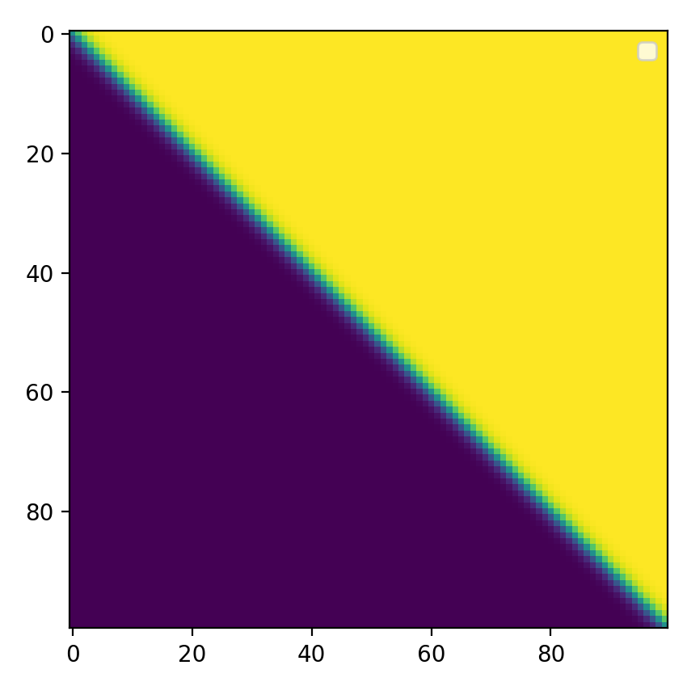
Multi-Class Linear Classifiers
Mark Hasegawa-Johnson, 4/2/2020. CC-BY 4.0: You are free to share and adapt these slides if you cite the original.
$$y_{1}^{∗}={softmax}_{1}\left(β_{j}\right)$$
20
40
60
80
$$β_{0}$$
$$y_{1}^{∗}→0$$
$$y_{1}^{∗}→1$$
$$β_{1}$$

Slide 2
Outline
Multi-Class Perceptron
Testing
Training
Multi-Class Logistic Regression
Testing: softmax function
Training: cross-entropy training criterion
Training: how to differentiate the softmax
Comparing Multi-Class Perceptron and Logistic Regression

Slide 3
Outline
Multi-Class Perceptron
Testing
Training
Multi-Class Logistic Regression
Testing: softmax function
Training: cross-entropy training criterion
Training: how to differentiate the softmax
Comparing Multi-Class Perceptron and Logistic Regression

Slide 4
Review: Two-Class Perceptron
True class is $y∈\{−1,1\}$.
Classifier output is
$$y∗ =\operatorname{sgn}\left(w1x1 + … + wDxD + b\right)$$
$$=\operatorname{sgn}\left({\vec{w}}^{T}\vec{x}\right)$$
$$∈\{−1,1\}$$
Where $\vec{w}={[w_{1},…,w_{D},b]}^{T}$
and $\vec{x}={[x_{1},…,x_{D},1]}^{T}$
Input
Weights
1
b
x₁
w₁
Output: sgn(w⋅x)
x₂
w₂
.
.
.
w_{D}
x_{D}

Slide 5
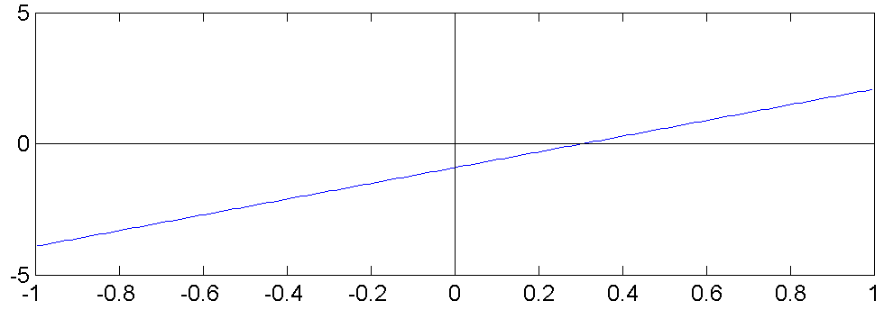
Review: Two-Class Perceptron
True class is $y∈\{−1,1\}$.
Classifier output is
$$y^{∗}=\operatorname{sgn}\left(w1x1 + … + wDxD + b\right)$$
$$=\operatorname{sgn}\left({\vec{w}}^{T}\vec{x}\right)$$
$$∈\{−1,1\}$$
Where $\vec{w}={[w_{1},…,w_{D},b]}^{T}$
and $\vec{x}={[x_{1},…,x_{D},1]}^{T}$
$$y^{∗}=−1$$
$$x_{2}$$
$$y^{∗}=1$$
$$x_{1}$$

Slide 6
Multi-Class Perceptron
True class is $y∈\{0,1,2,…,V−1\}$
(i.e., $V$=vocabulary size = # of distinct classes).
Classifier output is
$$y^{∗}={argmax}_{c=0}^{V−1}\left(w_{c1}x_{1}+…+w_{cD}x_{D}+b_{c}\right)$$
$$={argmax}_{c=0}^{V−1}\left({\vec{w}}_{c}^{T}\vec{x}\right)$$
$$∈\{0,1,…,V−1\}$$
Where ${\vec{w}}_{c}={[w_{c1},…,w_{cD},b_{c}]}^{T}$
and $\vec{x}={[x_{1},…,x_{D},1]}^{T}$
$$x_{2}$$
$$y^{∗}=1$$
$$y^{∗}=2$$
$$y^{∗}=3$$
$$y^{∗}=4$$
$$y^{∗}=0$$
$$y^{∗}=5$$
$$y^{∗}=6$$
$$y^{∗}=7$$
…
…
…
…
…
…
By Balu Ertl - Own work, CC BY-SA 4.0, https://commons.wikimedia.org/w/index.php?curid=38534275
$$x_{1}$$

Slide 7
Multi-Class Perceptron
True class is $y∈\{0,1,2,…,V−1\}$
(i.e., $V$=vocabulary size = # of distinct classes).
Classifier output is
$$y^{∗}={argmax}_{c=0}^{V−1}\left(w_{c1}x_{1}+…+w_{cD}x_{D}+b_{c}\right)$$
$$={argmax}_{c=0}^{V−1}\left({\vec{w}}_{c}^{T}\vec{x}\right)$$
$$∈\{0,1,…,V−1\}$$
Where ${\vec{w}}_{c}={[w_{c1},…,w_{cD},b_{c}]}^{T}$
and $\vec{x}={[x_{1},…,x_{D},1]}^{T}$
Input
Weights
1
$$b_{0}$$
$$b_{1}$$
x₁
Output: ${argmax}_{c=0}^{V−1}\left({\vec{w}}_{c}^{T}\vec{x}\right)$
argmax
x₂
.
.
.
.
.
.
.
.
.
$$b_{V−1}$$
$$w_{0D}$$
$$w_{1D}$$
x_{D}
$$w_{V−1,D}$$

Slide 8
Outline
Multi-Class Perceptron
Testing
Training
Multi-Class Logistic Regression
Testing: softmax function
Training: cross-entropy training criterion
Training: how to differentiate the softmax
Comparing Multi-Class Perceptron and Logistic Regression

Slide 9
Review: Training a Two-Class Perceptron
For each training instance $\vec{x}$ w/ground truth label $y∈\{−1,1\}$:
Classify with current weights: $y^{∗}=sgn({\vec{w}}^{T}\vec{x})$
Update weights:
if $y=y^{∗}$ then do nothing
If $y≠y^{∗}$ then $\vec{w}=\vec{w}+\text{η}\text{y}\vec{x}$

Slide 10
Review: Training a Two-Class Perceptron
For each training instance $\vec{x}$ w/ground truth label $y∈\{−1,1\}$:
Classify with current weights: $y^{∗}=sgn({\vec{w}}^{T}\vec{x})$
Update weights:
if $y=y^{∗}$ then do nothing
If $y≠y^{∗}$ then:
If $y=+1$ then set $\vec{w}=\vec{w}+\text{η}\vec{x}$
If $y=−1$ then set $\vec{w}=\vec{w}−\text{η}\vec{x}$

Slide 11
Training a Multi-Class Perceptron
For each training instance $\vec{x}$ w/ground truth label $y∈\{0,1,…,V−1\}$:
Classify with current weights: $y^{∗}={argmax}_{c=0}^{V−1}\left({\vec{w}}_{c}^{T}\vec{x}\right)$
Update weights:
if $y=y^{∗}$ then do nothing
If $y≠y^{∗}$ then:
Update the correct-class vector as ${\vec{w}}_{y}={\vec{w}}_{y}+\text{η}\vec{x}$
Update the wrong-class vector as ${\vec{w}}_{y^{∗}}={\vec{w}}_{y^{∗}}−\text{η}\vec{x}$
Don’t change the vectors of any other class

Slide 12
Outline
Multi-Class Perceptron
Testing
Training
Multi-Class Logistic Regression
Testing: softmax function
Training: cross-entropy training criterion
Training: how to differentiate the softmax
Comparing Multi-Class Perceptron and Logistic Regression

Slide 13
Multi-Class Logistic Regression
True class is $y∈\{0,1,2,…,V−1\}$
(i.e., $V$=vocabulary size = # of distinct classes).
Classifier output is
$${\vec{y}}^{∗}={softmax}_{c=0}^{V−1}\left({\vec{w}}_{c}^{T}\vec{x}\right)$$
$$=\left[y_{0}^{∗},…,y_{V−1}^{∗}\right]$$
The “argmax” of perceptron is replaced by a “softmax.”
The “softmax” is a V-dimensional vector, each of whose elements is between 0 and 1.
If the classifier is working well, then the $y^{th}$ element of this vector should be close to 1, and all other elements should be close to 0.
Input
Weights
1
$$b_{0}$$
$$b_{1}$$
x₁
Output: ${softmax}_{c=0}^{V−1}\left({\vec{w}}_{c}^{T}\vec{x}\right)$
softmax
x₂
.
.
.
.
.
.
.
.
.
$$b_{V−1}$$
$$w_{0D}$$
$$w_{1D}$$
x_{D}
$$w_{V−1,D}$$

Slide 14
Multi-Class Logistic Regression
True class is $y∈\{0,1,2,…,V−1\}$
(i.e., $V$=vocabulary size = # of distinct classes).
Classifier output is
$${\vec{y}}^{∗}={softmax}_{c=0}^{V−1}\left(W\vec{x}\right)$$
$$=\left[y_{0}^{∗},…,y_{V−1}^{∗}\right]$$
The “softmax” function is defined as follows:
$${softmax}_{c}\left(W\vec{x}\right)=\frac{\exp\left({\vec{w}}_{c}^{T}\vec{x}\right)}{\sum_{j=0}^{V−1}{\exp\left({\vec{w}}_{j}^{T}\vec{x}\right)}}$$
where $W$ is the weight matrix whose ${\left(c,d\right)}^{th}$ element is $w_{cd}$.
The vector ${\vec{w}}_{c}={[w_{c1},…,w_{cD},b_{c}]}^{T}$
Input
Weights
1
$$b_{0}$$
$$b_{1}$$
x₁
Output: ${softmax}_{c=0}^{V−1}\left({\vec{w}}_{c}^{T}\vec{x}\right)$
softmax
x₂
.
.
.
.
.
.
.
.
.
$$b_{V−1}$$
$$w_{0D}$$
$$w_{1D}$$
x_{D}
$$w_{V−1,D}$$

Slide 15
One-Hot Vectors
Let’s redefine the “ground truth” label, so it’s easier to train the softmax function.
The softmax output is
$${\vec{y}}^{∗}=\left[y_{0}^{∗},…,y_{V−1}^{∗}\right]$$
where $0<y_{c}^{∗}<1$ and $\sum_{j=0}^{V−1}{y_{j}^{∗}}=1$.
Let’s redefine the “ground truth” label so it has the same format. Let’s define
$$\vec{y}=\left[y_{0},…,y_{V−1}\right]$$
where
$y_{j}=1$ if $j$ is the correct class
$y_{j}=0$ otherwise
This is called a ONE-HOT VECTOR.
Classifier output:
softmax vector
Input
Weights
1
$$b_{0}$$
$$b_{1}$$
x₁
Output: ${softmax}_{c=0}^{V−1}\left({\vec{w}}_{c}^{T}\vec{x}\right)$
softmax
Ground truth:
one-hot vector
x₂
.
.
.
.
.
.
.
.
.
$$b_{V−1}$$
$$w_{0D}$$
$$w_{1D}$$
x_{D}
$$w_{V−1,D}$$

Slide 16
One-Hot Vector
Example: if the example is from class 1, then $\vec{y}=[0,1,0]$
$$y_{j}=\left\{\begin{matrix}1 & \text{example} \text{is} \text{from} \text{class} \text{j} \\ 0 & \text{example} \text{is} \text{NOT} \text{from} \text{class} \text{j}\end{matrix}\right.$$
Call $y_{j}$ the reference label, and call $y_{j}^{∗}$ the hypothesis. Then notice that:
$y_{j}=$ True value of $P\left(class=j \right| \vec{x})$, because the true probability is always either 1 or 0!
$y_{j}^{∗}=$ Estimated value of $P\left(class=j \right| \vec{x})$, $0<y_{j}^{∗}<1, \sum_{j=1}^{c}{y_{j}^{∗}}=1$

Slide 17
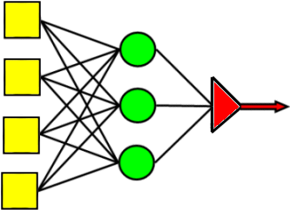
Comparing the argmax and the softmax
The multi-class perceptron calculates
$$y^{∗}={argmax}_{c=0}^{V−1}\left({\vec{w}}_{c}^{T}\vec{x}\right)$$
The multi-class logistic regression calculates
$$y_{c}^{∗}={softmax}_{c}\left(W\vec{x}\right)=\frac{\exp\left({\vec{w}}_{c}^{T}\vec{x}\right)}{\sum_{j=0}^{V−1}{\exp\left({\vec{w}}_{j}^{T}\vec{x}\right)}}$$
How do these two things compare?
Max
Perceptrons w/ weights w_{c}
Inputs

Slide 18
Comparing the argmax and softmax
$$y_{1}^{∗}={argmax}_{1}\left(β_{j}\right)$$
20
40
60
80
$$β_{0}$$
Here’s the second term in a two-class argmax function:
$$y_{1}^{∗}=\left\{\begin{matrix}1 & if β_{1}={argmax}_{j=0}^{1}\left(β_{j}\right) \\ 0 & otherwise\end{matrix}\right.$$
Where I’m using the abbreviation $β_{j}={\vec{w}}_{j}^{T}\vec{x}$
20
$$y_{1}^{∗}=0$$
40
60
$$y_{1}^{∗}=1$$
80
20
40
60
80
$$β_{1}$$

Slide 19
Comparing the argmax and softmax
$$y_{1}^{∗}={softmax}_{1}\left(β_{j}\right)$$
20
40
60
80
$$β_{0}$$
Here’s the second term in a two-class softmax function:
$$y_{1}^{∗}=\frac{\exp\left(β_{1}\right)}{\sum_{j=0}^{1}{\exp\left(β_{j}\right)}}$$
$$y_{1}^{∗}→0$$
$$y_{1}^{∗}→1$$
$$β_{1}$$

Slide 20
Outline
Multi-Class Perceptron
Testing
Training
Multi-Class Logistic Regression
Testing: softmax function
Training: cross-entropy training criterion
Training: how to differentiate the softmax
Comparing Multi-Class Perceptron and Logistic Regression

Slide 21
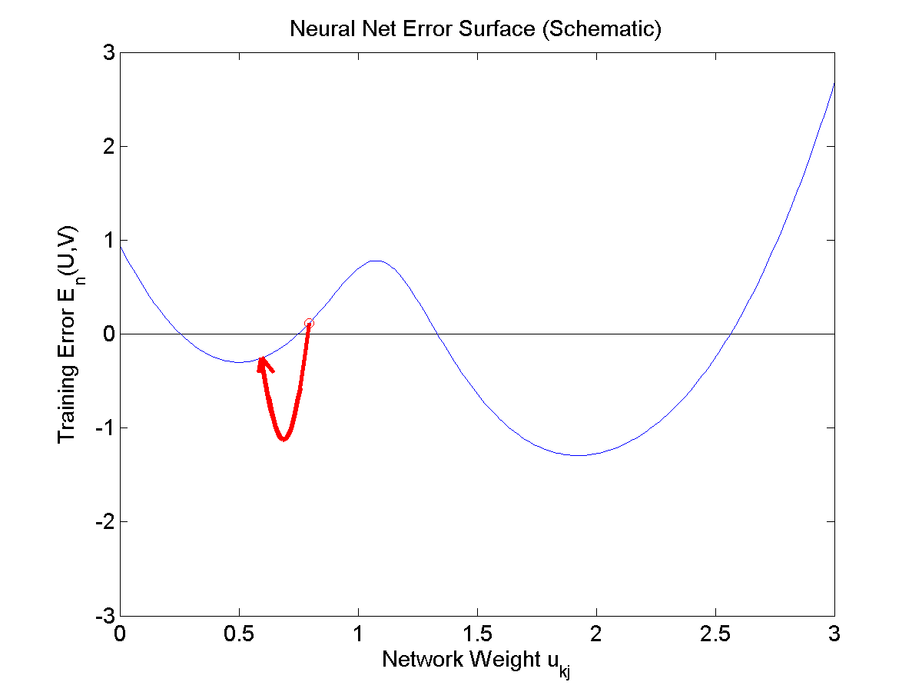
Training a Softmax Neural Network
We want to train the neural network to represent a training database as well as possible. If we can define the training error to be some function L, then we want to update the weights according to
$$w_{cd}=w_{cd}−η\frac{dL}{dw_{cd}}$$
So what is L?

Slide 22
Training: Maximize the probability of the training data
Remember, the whole point of that denominator in the softmax function is that it allows us to use softmax as
$$y_{j}^{∗}= \text{Estimated} \text{value} \text{of} P\left(class=j \right| \vec{x})$$
Suppose we decide to estimate the network weights $w_{cd}$ in order to maximize the probability of the training database, in the sense of
$$w_{cd}=\underset{W}{argmax}{P\left(training labels \right| training feature vectors)}$$

Slide 23
Training: Maximize the probability of the training data
Remember, the whole point of that denominator in the softmax function is that it allows us to use softmax as
$$y_{j}^{∗}= \text{Estimated} \text{value} \text{of} P\left(class=j \right| \vec{x})$$
If we assume the training tokens are independent, this is:
$$w_{cd}=\underset{W}{argmax}{\prod_{i=1}^{n}{P\left(reference label of the i^{th}token \right| i^{th}feature vector)}}$$

Slide 24
Training: Maximize the probability of the training data
Remember, the whole point of that denominator in the softmax function is that it allows us to use softmax as
$$y_{j}^{∗}= \text{Estimated} \text{value} \text{of} P\left(class=j \right| \vec{x})$$
OK. We need to create some notation to mean “the reference label for the $i^{th}$ token.” Let’s call it $j(i)$.
$$w_{cd}=\underset{W}{argmax}{\prod_{i=1}^{n}{P\left(class=j(i) \right| \vec{x})}}$$

Slide 25
Training: Maximize the probability of the training data
Wow, Cool!! So we can maximize the probability of the training data by just picking the softmax output corresponding to the correct class $j(i)$, for each token, and then multiplying them all together:
$$w_{cd}=\underset{W}{argmax}{\prod_{i=1}^{n}{y_{j(i)}^{∗}}}$$
So, hey, let’s take the logarithm, to get rid of that nasty product operation.
$$w_{cd}=\underset{W}{argmax}{\sum_{i=1}^{n}{\ln{y_{j(i)}^{∗}}}}$$

Slide 26
Training: Minimizing the negative log probability
Softmax neural networks are almost always trained in order to minimize the negative log probability of the training data:
$$w_{cd}=\underset{W}{argmin}{L}$$
$$L=\sum_{i=1}^{n}{−\ln{y_{j(i)}^{∗}}}$$
This loss function is called the cross-entropy loss. Cross-entropy is a measure of dissimilarity between two probability distributions. In this case, we’re minimizing the dissimilarity between the true and estimated classes:
$y_{j}=$ True $P\left(class=j \right| \vec{x})=\left\{\begin{matrix}1 & j=j(i) \\ 0 & otherwise\end{matrix}\right.$
$y_{j}^{∗}=$ Estimated $P\left(class=j \right| \vec{x})=\frac{\exp\left({\vec{w}}_{j}^{T}\vec{x}\right)}{\sum_{k=0}^{V−1}{\exp\left({\vec{w}}_{k}^{T}\vec{x}\right)}}$

Slide 27
Outline
Multi-Class Perceptron
Testing
Training
Multi-Class Logistic Regression
Testing: softmax function
Training: cross-entropy training criterion
Training: how to differentiate the softmax
Comparing Multi-Class Perceptron and Logistic Regression

Slide 28
Training a Softmax Neural Network
We want to train the neural network to represent a training database as well as possible. If we can define the training error to be some function L, then we want to update the weights according to
$$w_{cd}=w_{cd}−η\frac{dL}{dw_{cd}}$$
So what is $\frac{dL}{dw_{cd}}$?

Slide 29
Differentiating the cross-entropy
The cross-entropy loss function is:
$$L=\sum_{i=1}^{n}{−\ln{y_{j(i)}^{∗}}}$$
Let’s try to differentiate it:
$$\frac{dL}{dw_{cd}}=\sum_{i=1}^{n}{−\left(\frac{1}{y_{j(i)}^{∗}}\right)\frac{dy_{j(i)}^{∗}}{dw_{cd}}}$$
So what is $\frac{dy_{j(i)}^{∗}}{dw_{cd}}$?

Slide 30
Differentiating the cross-entropy
The cross-entropy loss function is:
$$y_{j(i)}^{∗}={softmax}_{j}\left(β_{k}\right)=\frac{exp⁡(β_{j(i)})}{\sum_{k=0}^{V−1}{exp⁡(β_{k})}}$$
Let’s try to differentiate it:
$$\frac{dy_{j(i)}^{∗}}{dw_{cd}}=\left(\frac{1}{\sum_{k=0}^{V−1}{exp⁡(β_{k})}}\right)\left(\frac{dexp⁡(β_{j(i)})}{dw_{cd}}\right)−\left(\frac{exp⁡(β_{j(i)})}{{\left(\sum_{k=0}^{V−1}{exp⁡(β_{k})}\right)}^{2}}\right)\left(\frac{d\left(\sum_{l=0}^{V−1}{exp⁡(β_{l})}\right)}{dw_{cd}}\right)$$
$$=\left(\frac{exp⁡(β_{j(i)})}{\sum_{j=0}^{V−1}{exp⁡(β_{k})}}\right)\left(\frac{dβ_{j(i)}}{dw_{cd}}\right)−\sum_{l=0}^{V−1}{\left(\frac{\exp\left(β_{j(i)}\right)\exp\left(β_{l}\right)}{{\left(\sum_{k=0}^{V−1}{exp⁡(β_{k})}\right)}^{2}}\right)\left(\frac{dβ_{l}}{dw_{cd}}\right)}$$
$$=y_{j(i)}^{∗}\left(\frac{dβ_{j(i)}}{dw_{cd}}\right)−\sum_{l=0}^{V−1}{y_{j\left(i\right)}^{∗}y_{l}^{∗}\left(\frac{dβ_{l}}{dw_{cd}}\right)}=(y_{j\left(i\right)}^{∗}y_{c}−y_{j\left(i\right)}^{∗}y_{c}^{∗})x_{d}$$
Where the last line uses $β_{j}={\vec{w}}_{j}^{T}\vec{x}$, and therefore $\frac{dβ_{j}}{dw_{cd}}=\left\{\begin{matrix}x_{d} & if j=c \\ 0 & otherwise\end{matrix}\right.$

Slide 31
Putting it all together…
$$w_{cd}=w_{cd}−η\frac{dL}{dw_{cd}}$$
$$=w_{cd}+η\sum_{i=1}^{n}{\left(\frac{1}{y_{j(i)}^{∗}}\right)\frac{dy_{j(i)}^{∗}}{dw_{cd}}}$$
$$=w_{cd}+η\sum_{i=1}^{n}{(y_{c}−y_{c}^{∗})x_{d}}$$
where
$y_{c}=$ True $P\left(class=c \right| \vec{x})=\left\{\begin{matrix}1 & c=j(i) \\ 0 & otherwise\end{matrix}\right.$
$y_{c}^{∗}=$ Estimated $P\left(class=c \right| \vec{x})=\frac{\exp\left({\vec{w}}_{c}^{T}\vec{x}\right)}{\sum_{k=0}^{V−1}{\exp\left({\vec{w}}_{k}^{T}\vec{x}\right)}}$

Slide 32
Training Multi-Class Logistic Regression
Putting it all together, we wind up with a surprisingly simple result:
$${\vec{w}}_{c}={\vec{w}}_{c}+η\sum_{i=1}^{n}{\left(y_{c}−y_{c}^{∗}\right)}\vec{x}$$
where $y_{c}=1$ if and only if the i’th token is of class c. In other words,
If $c$ is the correct class, but $y_{c}^{∗}≈0$, then ${\vec{w}}_{c}={\vec{w}}_{c}+\text{η}\vec{x}$
If $y_{c}^{∗}≈1$, but $c$ is the wrong class, then ${\vec{w}}_{c}={\vec{w}}_{c}−\text{η}\vec{x}$

Slide 33
Outline
Multi-Class Perceptron
Testing
Training
Multi-Class Logistic Regression
Testing: softmax function
Training: cross-entropy training criterion
Training: how to differentiate the softmax
Comparing Multi-Class Perceptron and Logistic Regression

Slide 34
Training a Multi-Class Perceptron
For each training instance $\vec{x}$ w/ground truth label $y∈\{0,1,…,V−1\}$:
Classify with current weights: $y^{∗}={argmax}_{c=0}^{V−1}\left({\vec{w}}_{c}^{T}\vec{x}\right)$
Update weights:
if $y=y^{∗}$ then do nothing
If $y≠y^{∗}$ then:
Update the correct-class vector as ${\vec{w}}_{y}={\vec{w}}_{y}+\text{η}\vec{x}$
Update the wrong-class vector as ${\vec{w}}_{y^{∗}}={\vec{w}}_{y^{∗}}−\text{η}\vec{x}$

Slide 35
Training Multi-Class Logistic Regression
Putting it all together, we wind up with a surprisingly simple result:
$${\vec{w}}_{c}={\vec{w}}_{c}+η\sum_{i=1}^{n}{\left(y_{c}−y_{c}^{∗}\right)}\vec{x}$$
where $y_{c}=1$ if and only if the i’th token is of class c. In other words,
If $c$ is the correct class, but $y_{c}^{∗}≈0$, then ${\vec{w}}_{c}={\vec{w}}_{c}+\text{η}\vec{x}$
If $y_{c}^{∗}≈1$, but $c$ is the wrong class, then ${\vec{w}}_{c}={\vec{w}}_{c}−\text{η}\vec{x}$

Slide 36
Conclusion: Comparing Multi-Class Perceptron and Logistic Regression
Perceptron: If classifier output is incorrect, then:
Update the correct-class, y, as ${\vec{w}}_{y}={\vec{w}}_{y}+\text{η}\vec{x}$
Update the wrong-class, $y^{∗}$, as ${\vec{w}}_{y^{∗}}={\vec{w}}_{y^{∗}}−\text{η}\vec{x}$
Logistic Regression: for every class $c$,
$${\vec{w}}_{c}={\vec{w}}_{c}+\text{η}\left(y_{c}−y_{c}^{∗}\right)\vec{x}$$
$$≈\left\{\begin{matrix}{\vec{w}}_{c}+\text{η}\vec{x} & if c is the correct class \left(y_{c}=1\right) and y_{c}^{∗}≈0 \\ {\vec{w}}_{c}−\text{η}\vec{x} & if c is the wrong class \left(y_{c}=0\right) and y_{c}^{∗}≈1\end{matrix}\right.$$
Conclusion: they’re almost exactly the same thing! The main difference is that, for logistic regression, $0<y_{c}^{∗}<1$: it’s never exactly equal to either 0 or 1.

