Slide 1
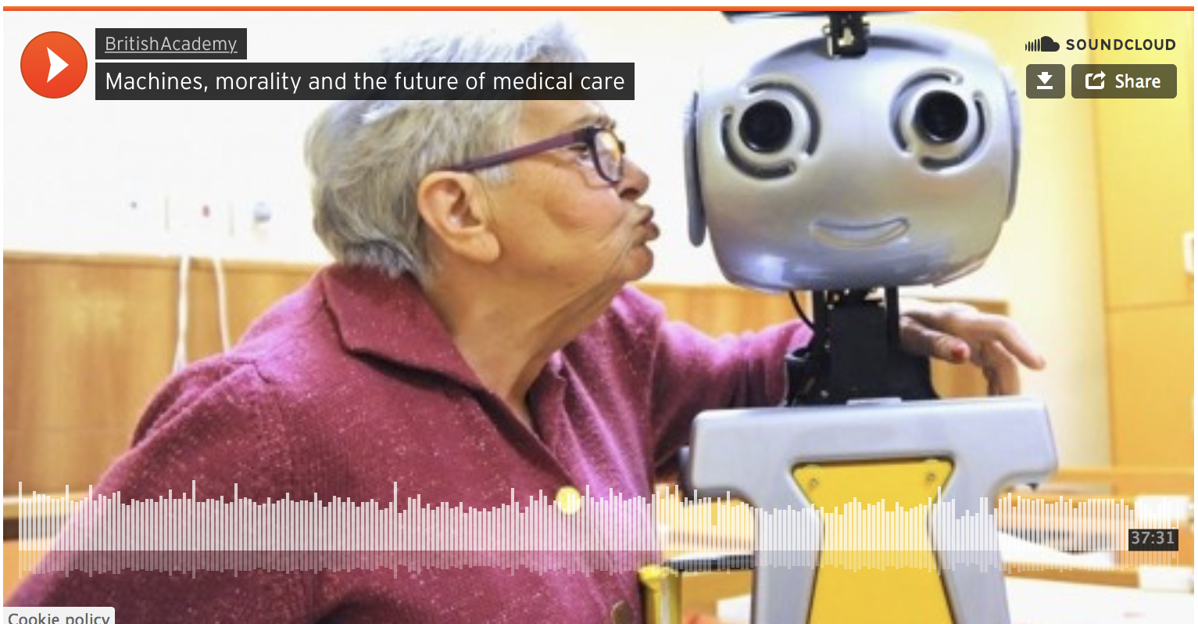
CS440/ECE448 Lecture 26: Societal Impacts of AI
Slides by Svetlana Lazebnik, 12/2017
Modified by Mark Hasegawa-Johnson, 4/2018
Image source: https://www.britac.ac.uk/
audio/machines-morality-and-future-medical-care

Slide 2
Outline
AI as a Tool
Privacy vs. Convenience
Health
Jobs
Autonomous AI
Bias and fairness
Safety
AI weapons
Superintelligence

Slide 3
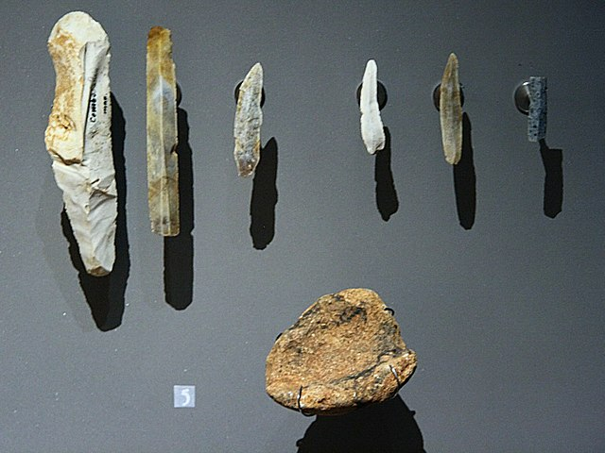
AI as a Tool
By Sémhur - Own work, CC BY-SA 4.0, https://commons.wikimedia.org/w/index.php?curid=8247730

Slide 4
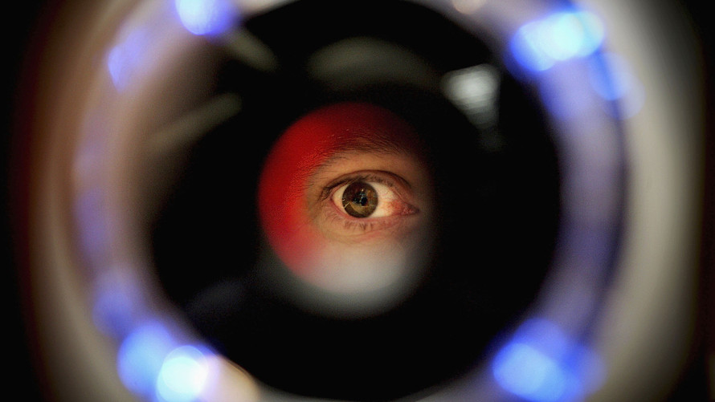
Privacy vs. Convenience
Image source

Slide 5
Privacy vs. Convenience
Types of data collected
Relatively insensitive: shopping, browsing, web search history, social media, personal preferences
Sensitive: face, identity, financial and medical records
Very sensitive: geospatial location as a function of time
Entities collecting data
“Big data” companies: Facebook, Google, Apple, Amazon, Microsoft, etc.
Stores, employers, health insurers, banks, etc.
Government, law enforcement, hostile parties

Slide 6
AI and privacy
Concerns
Personal data being inadvertently revealed or falling into the wrong hands
Personal data being misused by the parties who collected it
Personal data enabling individuals to be manipulated without their knowledge
Potential solutions
Technological: encryption, differential confidentiality, anonymizing tools
Regulation: require the use of a technology; forbid disclosure

Slide 7
Example Problem: Inadvertent Revelation
“Passports, however, use a different technology known as RFID (or Radio Frequency Identification), the same type used to tag clothing, pets, even artificial replacements for hips and knees. When embedded in a U.S. passport, the chip can be scanned only by someone at close range with an RFID reader, usually within a couple feet…
“Yes, someone nearby could read what’s in your wallet. That’s why I keep my passport in an RFID-shielded wallet,” said G. Mark Hardy, president of National Security Corp., based in Rosedale, Md., which provides cybersecurity expertise to government and corporate clients.
But, he said, “it’s less likely to happen, at this point in time, because it’s so much easier to do fraud some other way.””
Read more here: http://www.sacbee.com/news/business/personal-finance/claudia-buck/article2599038.html#storylink=cpy

Slide 8
Example Solution: Differential Confidentiality
A social scientist wants to collect data about some sensitive behavior. She tells her subjects:
Toss a coin.
If it’s heads, answer truthfully. If tails, use a second coin toss to decide what you’ll tell me.
Outcomes:
It’s impossible to know whether or not any individual engages in that behavior.
… but if X% of subjects say “yes,” then the truth is that ((X-25)/50% of the population engage in this behavior.

Slide 9
Health Care

Slide 10
AI and Health Care
Mining Healthcare records
Pro: better and faster health service; MUCH more accurate diagnosis; epidemiology
Con: potential for misuse of data
AI-assisted diagnosis, e.g., in Radiology
Pro: AI can detect things that a physician might miss
Con: Lack of explainability
AI-assisted design of treatment plans
AI-assisted drug creation
Long-term health care: the robot nurse, the robot doctor

Slide 11
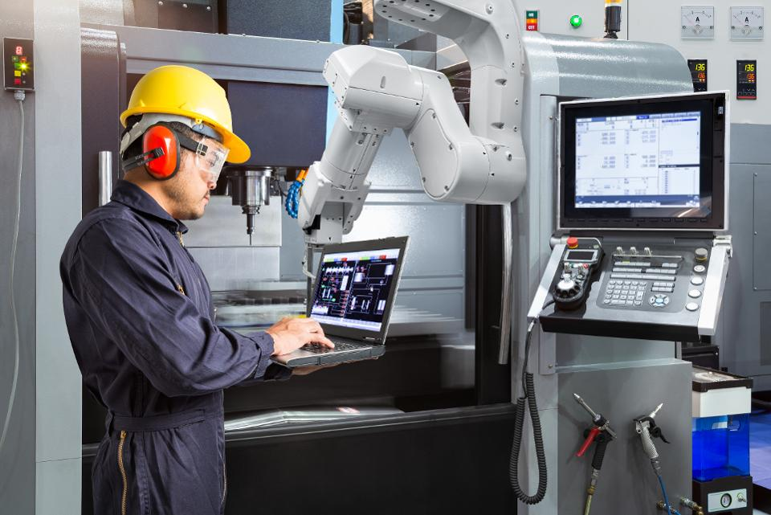
AI and jobs
Source

Slide 12
AI and jobs
Why we should worry
Oxford report: 47% of American jobs at high risk of automation in the next two decades
In the past couple of decades, manufacturing employment has dropped even as output kept rising; labor force participation among working-age males has been dropping
Truck driver is the most common job in over half the states
Why we shouldn’t worry
Productivity growth is currently low, as is business investment spending
Historically, automation has destroyed jobs but added more new jobs

Slide 13
AI and jobs
Keep it from happening?
Regulating automation, mandating new jobs
Help the people who are displaced?
Investing in retraining programs
Policy solutions: welfare, universal basic income, redistribution of assets
Revolution of human values?
“Netherlands is among the nations with the shortest work weeks, according to CNN Money. Netherlands has an average of 29 working hours per week and an average annual income amounting to $47,000.” – https://nltimes.nl/2013/07/11/worlds-shortest-work-weeks

Slide 14
AI and jobs
Reading
Moshe Vardi talk (YouTube)
AI NOW report (2017)
Technological unemployment (Wikipedia)
A world without work (The Atlantic, July 2015)
The automation paradox (The Atlantic, Jan. 2016)
AI will transform the economy. But how much, how soon? (New York Times, Nov. 2017)
Welcoming our new robot overlords (New Yorker, Oct. 2017)
The great tech panic: robots won’t take all our work (Wired, Aug. 2017)

Slide 15
Autonomous AI

Slide 16
Accidental Replication of Human Bias
Training an AI requires lots of data
The data contains biases representative of the attitudes of the people who generated the data
Without special care, the AI absorbs the bias

Slide 17
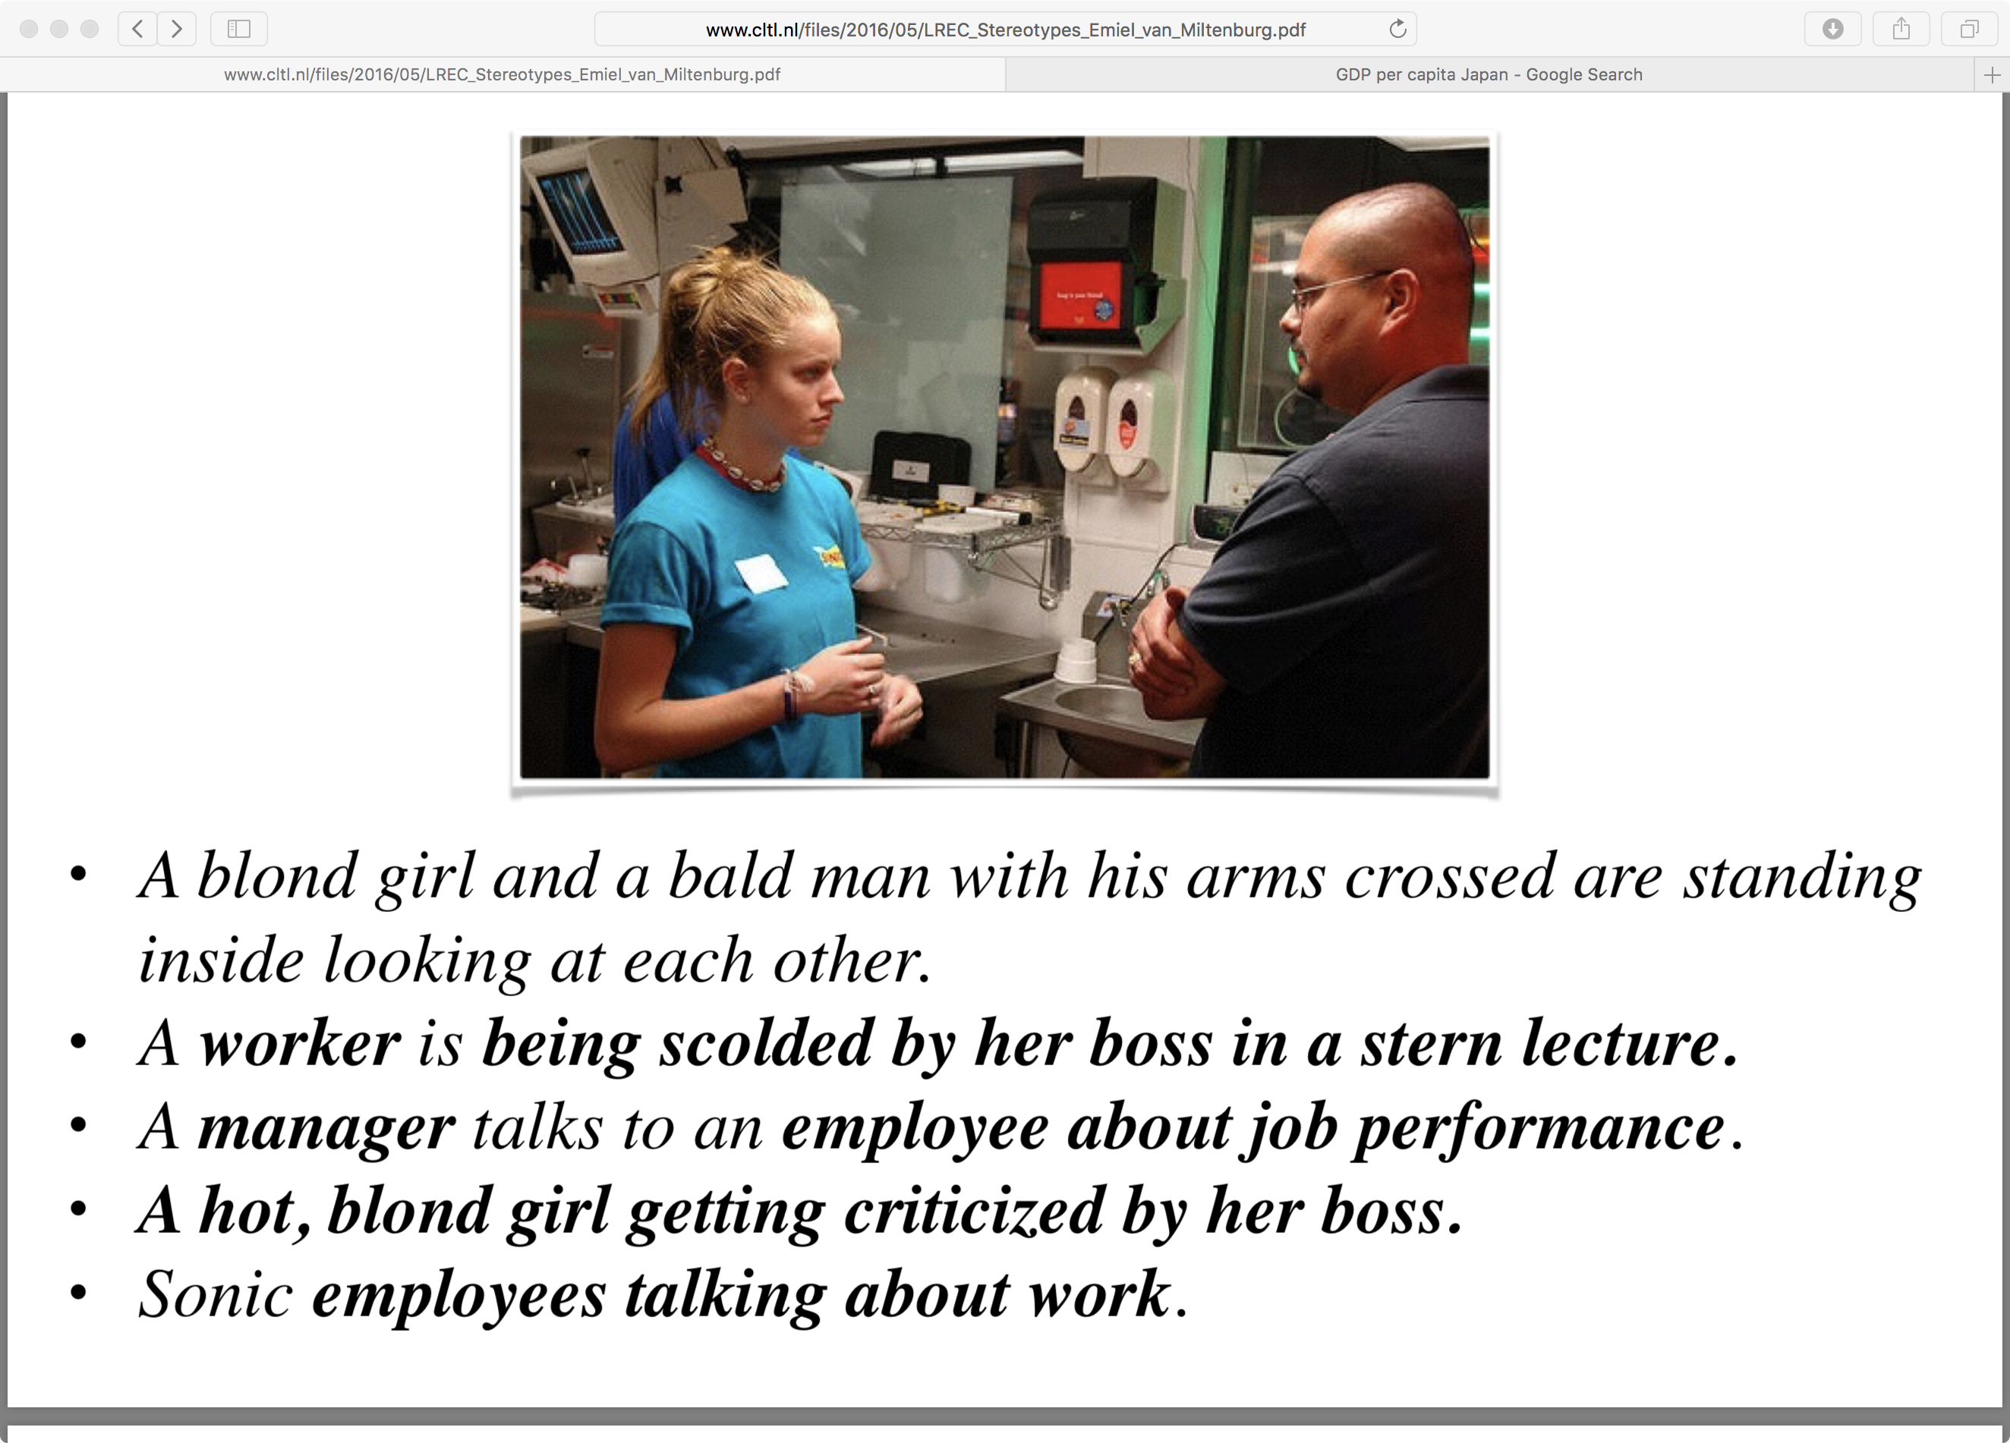
“Stereotyping and Bias in the Flickr30k Dataset,” Emiel van Miltenburg
Inferring status
“worker” vs. “boss”
Inferring intentions
“being scolded”
Disrespect
“girl” vs. “man”
Marking the “less common” attribute
girl vs. boss
blond vs. brunette
“nurse” vs. “male nurse”

Slide 18
Bias caused by Data Sparsity
Data contain more examples of one type than others, e.g., more Caucasians than African Americans
Accuracy may be higher for the type that is better represented in the training data (minimize error by minimizing error for the majority case)
Example: blacks more likely to be refused parole even if their prison records are the same (https://www.nytimes.com/2016/12/04/nyregion/new-york-prisons-inmates-parole-race.html)
Example: tweets containing African American vernacular classified as “Danish,” and therefore excluded from automatic sentiment analysis (https://www.technologyreview.com/s/608619/ai-programs-are-learning-to-exclude-some-african-american-voices/)

Slide 19
AI, bias, and fairness
Concerns
AI will inadvertently absorb biases from data
Making important decisions based on biased data will exacerbate bias: especially for law enforcement, employment, loans, health insurance, etc.
Even well-intentioned applications can create negative side effects: filter bubbles, targeted advertising
Outcomes cannot be appealed because AI systems are opaque and proprietary
Potential solutions
Regulation and transparency: e.g., right to explanation
More inclusivity among AI technologists: AI4ALL
Notes:
AI4ALL is a nonprofit working to increase diversity and inclusion in artificial intelligence. We create pipelines for underrepresented talent through education and mentorship programs around the U.S. and Canada that give high school students early exposure to AI for social good.

Slide 20
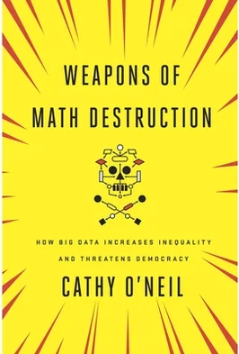
AI, bias, and fairness
Readings
AI NOW report (2017)
Weapons of math destruction
Notes:
The AI Now Institute at New York University is an interdisciplinary research center dedicated to understanding the social implications of artificial intelligence.
O’Neil is an academic mathematician turned Wall Street quant turned data scientist who has been involved in Occupy Wall Street and recently started an algorithmic auditing company.

Slide 21
AI safety
Robustness to changes in data distribution
Avoiding catastrophic “corner cases”
Robustness to adversarial examples or attacks
Avoiding negative side effects in reward function
Avoiding “reward hacking”
Reading: Concrete AI safety problems

Slide 22
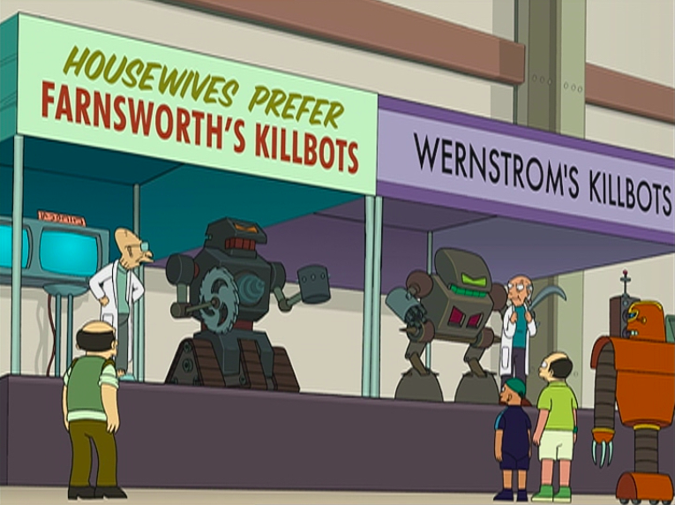
AI weapons

Slide 23
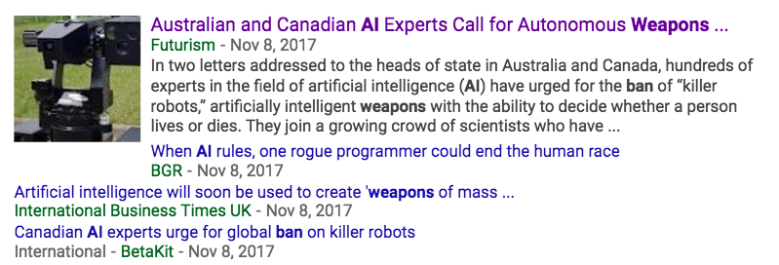
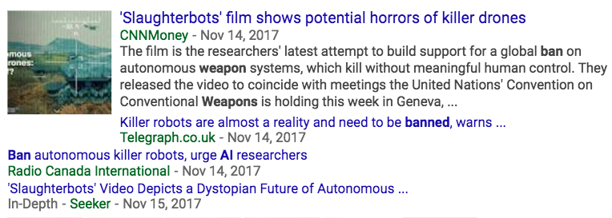

AI weapons

Slide 24
AI weapons
Reading
Robotics: Ethics of artificial intelligence (Nature, May 2015)
Humans, not robots, are the real reason artificial intelligence is scary (The Atlantic, August 2015)

Slide 25
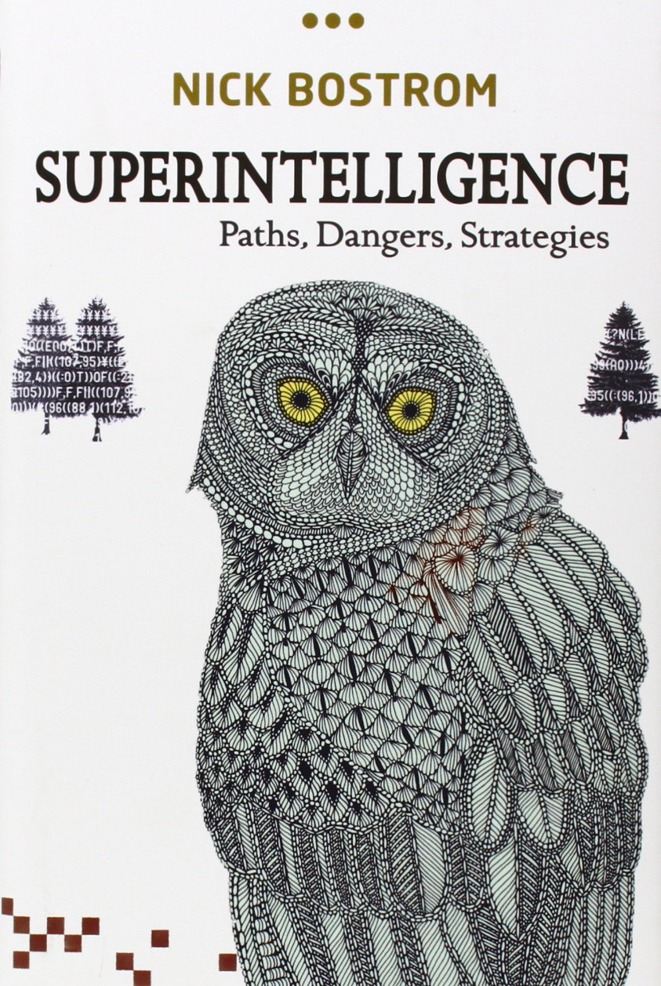
Superintelligence

Slide 26
Superintelligence
Why we should worry
Recent dramatic progress in AI – we could be at the “knee” of an exponential growth curve
No fundamental reasons why general human-level AI cannot be achieved
Positive feedback loops will kick in once a certain level of intelligence has been achieved
Historically, people have not seen disruptive innovations coming or underestimated their probability
Pascal’s wager
Notes:
From https://intelligence.org/2017/10/13/fire-alarm/
In 1901, two years before helping build the first heavier-than-air flyer, Wilbur Wright told his brother that powered flight was fifty years away.
In 1939, three years before he personally oversaw the first critical chain reaction in a pile of uranium bricks, Enrico Fermi voiced 90% confidence that it was impossible to use uranium to sustain a fission chain reaction.

Slide 27
Superintelligence
Why we shouldn’t worry
Technological obstacles to general AI are still too great (and have historically been underestimated by AI scientists)
The notion of “superintelligence” is too simplistic: intelligence is multifaceted, embodied, collective, reliant on (and limited by) the physical world
We have no evidence that recursively self-improving intelligence is possible
It is unclear why “superintelligent” AI would develop or single-mindedly pursue destructive goals
High intelligence is neither necessary nor sufficient for controlling the physical world effectively

Slide 28
Superintelligence
Why we shouldn’t worry
The Extraterrestrials will kill us first
The Russians will kill us first
Environmental disaster will kill us first
AI is just a tool…
Potential solutions
Asimov’s three laws of robotics: hard-coded limitations
Game theory: humans vs. AI? “Humans do not have general purpose minds, and neither will AIs.”

Slide 29
Superintelligence
Readings
Discussion of “superintelligence” (Neil Lawrence)
The Myth of a Superhuman AI (Kevin Kelly)
Seven deadly sins of predicting the future of AI (Rodney Brooks)

Slide 30
AI ethics
We should be aware of all these issues when developing AI technologies!
Privacy violations
Potential for deception, misuse and manipulation
Exacerbating bias and unfair outcomes
Lack of transparency and due process
Threats to human rights and dignity
Weaponization
Unintended consequences

