Slide 1
CS440/ECE448 Lecture 25: Perception
4/23/2018
Mark Hasegawa-Johnson

Slide 2
Perception
Web Texts
Sentiment Analysis; Information Retrieval; Information Extraction
Speech and Natural Language Processing
Parsing; Machine Translation; Speech Recognition
Computer Vision
Motion Vectors; Object Recognition; Object Localization; image2speech

Slide 3
Sentiment Analysis (Textbook section 22.2: Text Classification)
Image source:
John Cawley, Data Analysts, 5/20/2017
https://www.quora.com/Who-are-the-leading-providers-of-sentiment-analysis-for-social-media-data-and-which-companies-use-them-versus-developing-their-own-technology

Slide 4
Sentiment Analysis
Objective: automatically troll the internet to find out if people like or dislike your product.
Methods:
Recognize keywords
Stemming --- convert different morphological forms to the same root
Tokenization --- merge phrases like “White House” into single words
Partial parsing, to handle negation
Examples: from Wikipedia
Easy: ”Pastel-colored 1980s day cruisers from Florida are ugly.”
Hard: “I love my mobile but would not recommend it to my colleagues.”

Slide 5

Sentiment Analysis: an online demo, with partial source code

Slide 6
Perception
Web Texts
Sentiment Analysis; Information Retrieval; Information Extraction
Speech and Natural Language Processing
Parsing; Machine Translation; Speech Recognition
Computer Vision
Optical Flow; Object Recognition; Object Detection; image2speech

Slide 7
Information Retrieval Textbook section 22.3; CS 410, 510
Given:
A corpus of documents
A query posed in some query language
Generate:
A list of results, usually rank-ordered
In order to maximize:
Some measure of utility

Slide 8
IR Measures of Utility
Is there any relevant document on the first page?
Precision at N = (# correct documents in the first N)/N
How many of the target documents did I get?
Recall at N = (# correct documents in first N)/(# correct in the database)
How far do I have to search in order to find the correct document?
Expected reciprocal rank = E [ 1/n ], where n = rank of the correct document

Slide 9
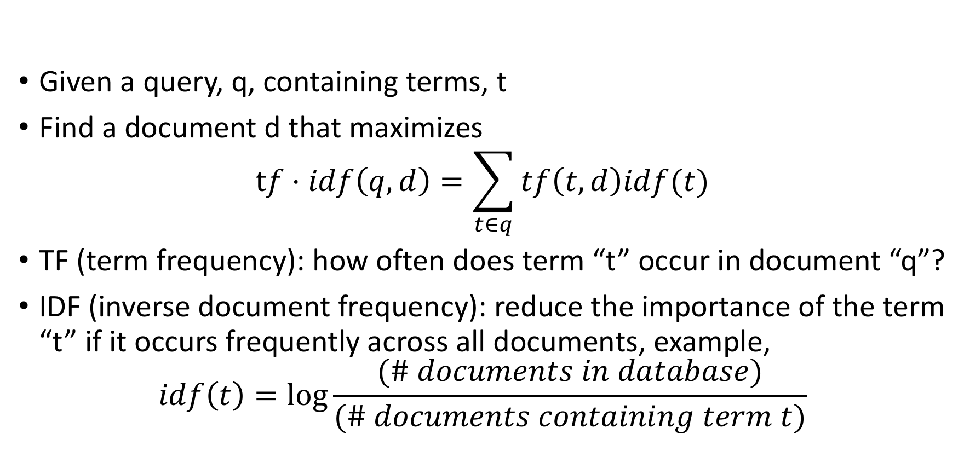
TF-IDF (term freq -inverse document freq) Karen Sparck Jones, 1972
Given a query, q, containing terms, t
Find a document d that maximizes
$$tf⋅idf\left(q,d\right)=\sum_{t∈q}{tf\left(t,d\right)idf(t)}$$
TF (term frequency): how often does term “t” occur in document “q”?
IDF (inverse document frequency): reduce the importance of the term “t” if it occurs frequently across all documents, example,
$$idf\left(t\right)=\log{\frac{(\# documents in database)}{(\# documents containing term t)}}$$

Slide 10
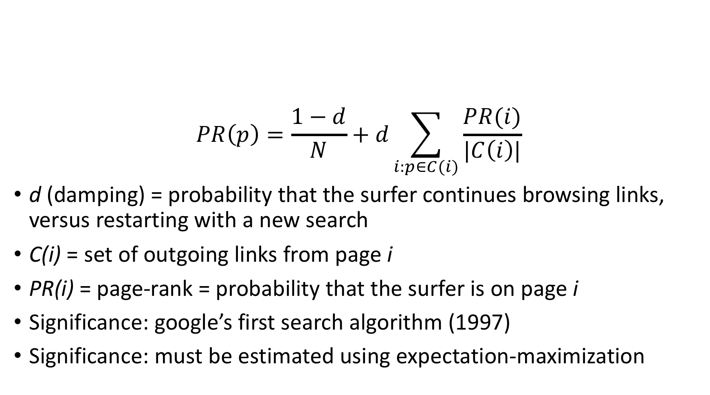
PageRank (Brin and Page, 1998)
$$PR\left(p\right)=\frac{1−d}{N}+d\sum_{i:p∈C(i)}{\frac{PR(i)}{|C\left(i\right)|}}$$
d (damping) = probability that the surfer continues browsing links, versus restarting with a new search
C(i) = set of outgoing links from page i
PR(i) = page-rank = probability that the surfer is on page i
Significance: google’s first search algorithm (1997)
Significance: must be estimated using expectation-maximization

Slide 11
Perception
Web Texts
Sentiment Analysis; Information Retrieval; Information Extraction
Speech and Natural Language Processing
Parsing; Machine Translation; Speech Recognition
Computer Vision
Motion Vectors; Object Recognition; Object Detection; image2speech

Slide 12
Information Extraction Text Section 22.4; CS 412, 512
Pattern recognition
Ontology extraction
Attribute extraction

Slide 13
Pattern Matching in text: Regular Expressions
Invented by Stephen Cole Kleene in the 1950s
Just three basic operators:
+ --- union of two sub-languages
x --- concatenation of two sub-languages
* --- zero or more repetitions of a sub-language
This expression contains (two|several) (very)* useful examples.
This expression contains several very useful examples.
This expression contains several very very useful examples.
This expression contains several very very very useful examples.
This expression contains two useful examples.

Slide 14
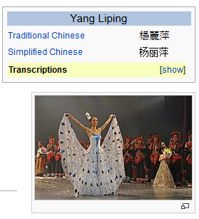


Ontology Extraction: Entity Discovery and Linking
Slide credit: Heng Ji
13岁以前的杨丽萍，是云南一个山村小镇里光着脚丫到处拾麦穗的乡下小姑娘，在洱海之源过着艰苦而又不无乐趣的童年生活。
Now, Ms. Yang, one of China's best-known dancers, is the director, choreographer and star of …
Aunque nacida en Dali, a la edad de nueve años Yang se mudó con su familia a Xishuangbanna. Debido a su extraordinario talento, la eligieron para integrar la Agrupación Artística de Canto …
…
KB
Liping Yang
Liping Yang
Cross-lingual knowledge fusion: For certain entities and events, new and detailed information is only available in low-resource foreign incident languages
Cross-lingual Knowledge transfer: Build cross-lingual links to transfer resources (e.g., annotated data, gazetteers and rich knowledge representations) from English to foreign language EDL

Slide 15
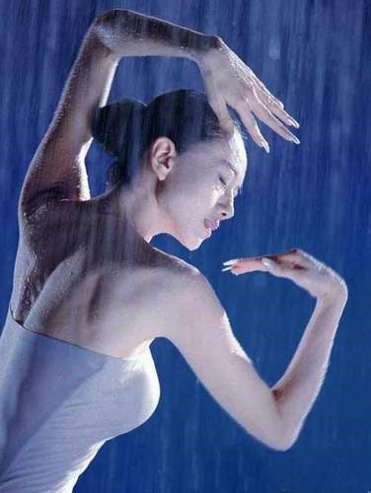
Attribute Extraction: Combine with Tri-lingual Slot Filling
KB
Slide Credit: Heng Ji
Each query = an entity cluster of
multi-lingual mentions, with type, KB ID,
and each mention’s Document ID, offsets
Source Collection
State/Province-of-Residence: 云南
13岁以前的杨丽萍，是云南一个山村小镇里光着脚丫到处拾麦穗的乡下小姑娘，在洱海之源过着艰苦而又不无乐趣的童年生活。十几年后，她摇身一变，成为舞台 上最绚丽的“孔雀”…而关于杨丽萍的感情问题，曾经有个爆料人称，杨丽萍的前夫是中央民 族歌舞团里的才子，一直帮着杨丽萍策划舞蹈，但后来，一个叫做托尼的美籍台湾人(刘淳晴)出现后，把杨丽萍给撬走了。
Spouse: 刘淳晴
Title: dancer, director, choreographer
Now, Ms. Yang, one of China's best-known dancers, is the director, choreographer and star of a new show that is drawing sellout crowds all over the country.
Notes:
Sfv, already part of cross-lingual knowledge transfer

Slide 16
Perception
Web Texts
Sentiment Analysis; Information Retrieval; Information Extraction
Speech and Natural Language Processing
Parsing; Machine Translation; Speech Recognition
Computer Vision
Motion Vectors; Object Recognition; Object Detection; image2speech

Slide 17

Morphology: What is a word?
Most morphological rules can be written as Regular Expressions (e.g., English pluralization), but some are less regular than others:
(example: Harald Trost)
The rules, and the exceptions, are usually learned by expectation maximization from dictionaries, e.g.,
https://github.com/AdolfVonKleist/Phonetisaurus
…but in some interesting & influential cases, large parsers are constructed by hand, e.g., https://catalog.ldc.upenn.edu/ldc2004l02

Slide 18
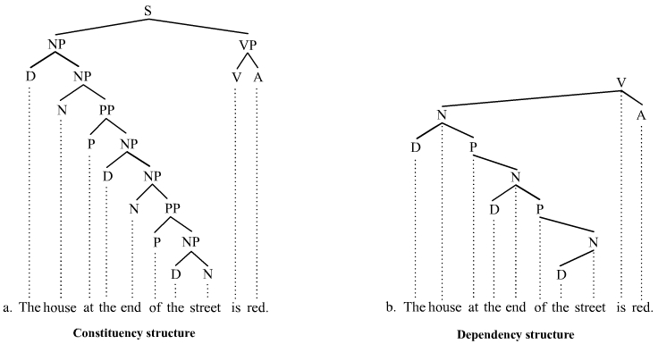
Syntax: What is a sentence? Textbook section 23.1-3
By Tjo3ya - Own work, CC BY-SA 3.0, https://commons.wikimedia.org/w/index.php?curid=18436919

Slide 19
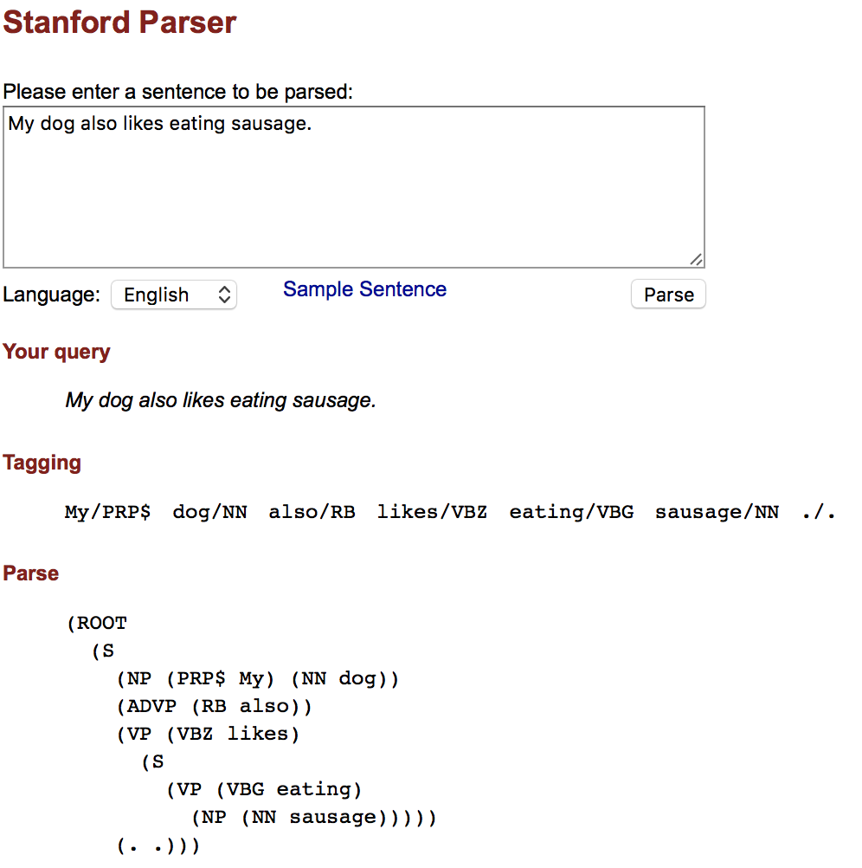
Syntax example: the Stanford Parser

Slide 20
Parsing: UIUC courses
CS 447, Natural Language Processing
CS 546, Machine Learning in Natural Language Processing
LING 406, Computational Linguistics
LING 506, Computational Linguistics

Slide 21
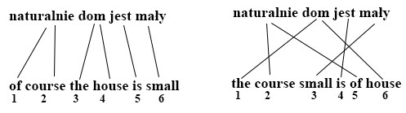
Machine Translation Textbook section 23.4; UIUC course LING 415, Machine Translation
Includes two processes: word reordering + word translation
By Krz.wolk - Own work, CC BY-SA 4.0, https://commons.wikimedia.org/w/index.php?curid=44522757

Slide 22
Perception
Web Texts
Sentiment Analysis; Information Retrieval; Information Extraction
Speech and Natural Language Processing
Parsing; Machine Translation; Speech Recognition
Computer Vision
Motion Vectors; Object Recognition; Object Detection; image2speech

Slide 23
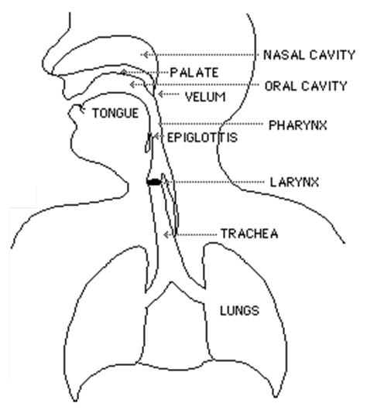
3 steps to produce sounds Slide credit: Odette Scharenborg
step 3: articulation =
distortion of air
time-varying formant-frequency
pattern
= speech
step 2: phonation
step 1: initiation
Filter
Source
Notes:
Step 1: air from the lungs is pushed past the vocal cords
If they start to vibrate it is called phonation
Step 3: the air, whether vibrating or not, travels through the oral and nasal cavity. Here the air is distorted/changed depending on the shape of the lips, teeth, tongue.

Slide 24
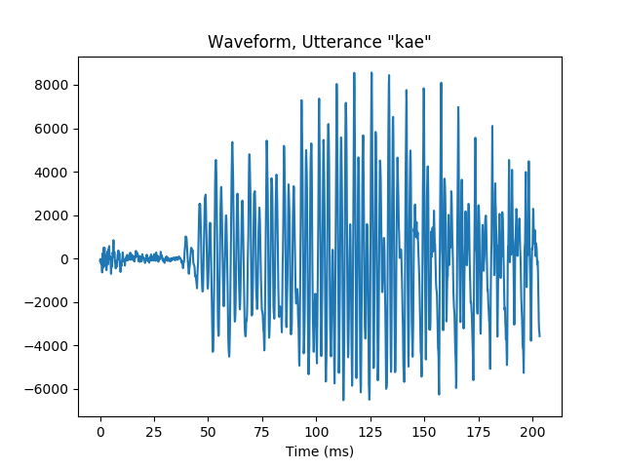
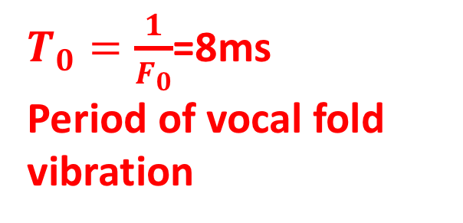
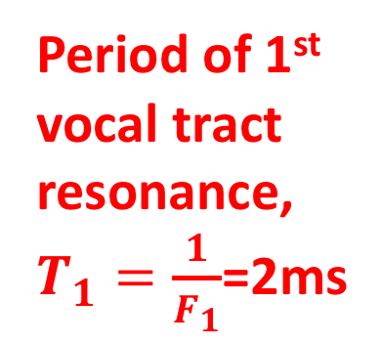
Speech signal: Time domain Slide credit: ECE 417
Period of 1st vocal tract resonance,
$T_{1}=\frac{1}{F_{1}}$=2ms
$T_{0}=\frac{1}{F_{0}}$=8ms
Period of vocal fold vibration
/k/ burst
/k/ aspiration
voicing

Slide 25
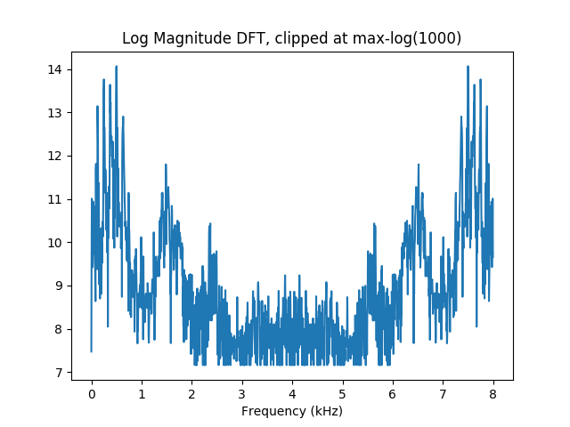
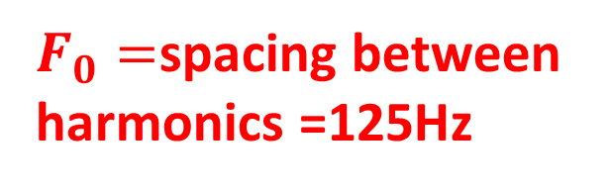

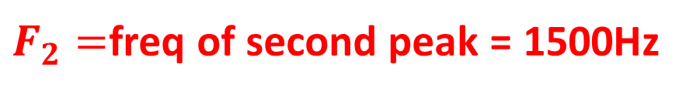
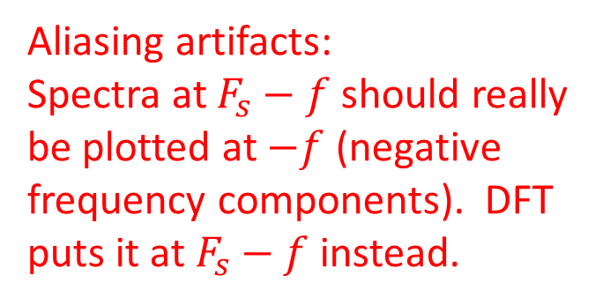
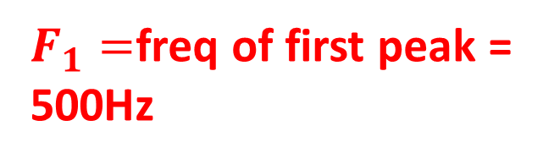
Speech signal: Log Magnitude Transform Slide credit: ECE 417
$F_{1}=$freq of first peak =
500Hz
Aliasing artifacts:
Spectra at $F_{s}−f$ should really
be plotted at $−f$ (negative
frequency components). DFT
puts it at $F_{s}−f$ instead.
$F_{0}=$spacing between
harmonics =125Hz
$F_{2}=$freq of second peak = 1500Hz
$$F_{3}$$

Slide 26
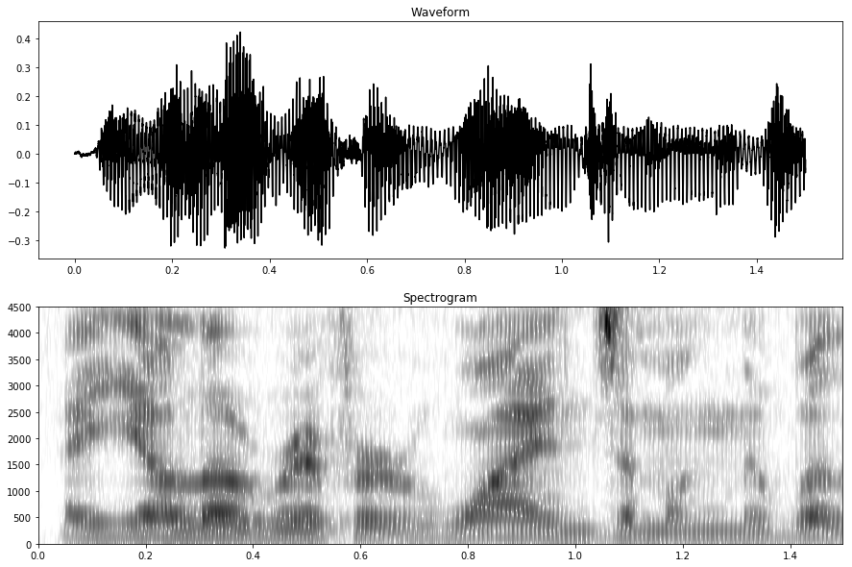
Spectrogram: One spectral vector every 10ms Slide credit: ECE 590SIP

Slide 27
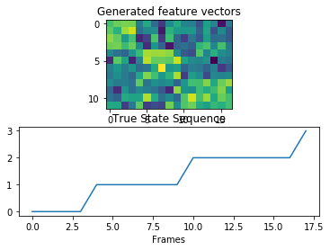
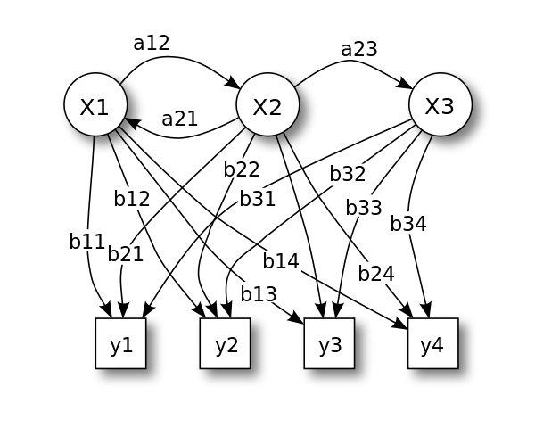
Recognition: Hidden Markov Model
Source: By Tdunningvectorization: Own work - Own work, CC BY 3.0, https://commons.wikimedia.org/w/index.php?curid=18125206
Source: Mark Hasegawa-Johnson, ECE 417

Slide 28
Speech Processing: UIUC courses Textbook section 23.5
ECE 417: Multimedia Signal Processing (Speech & Video)
ECE 537: Speech Processing
ECE 594: Mathematical Models of Language
CS 598PS: Machine Learning for Signal Processing

Slide 29
Perception
Web Texts
Sentiment Analysis; Information Retrieval; Information Extraction
Speech and Natural Language Processing
Parsing; Machine Translation; Speech Recognition
Computer Vision
Motion Vectors; Object Recognition; Object Detection; image2speech

Slide 30
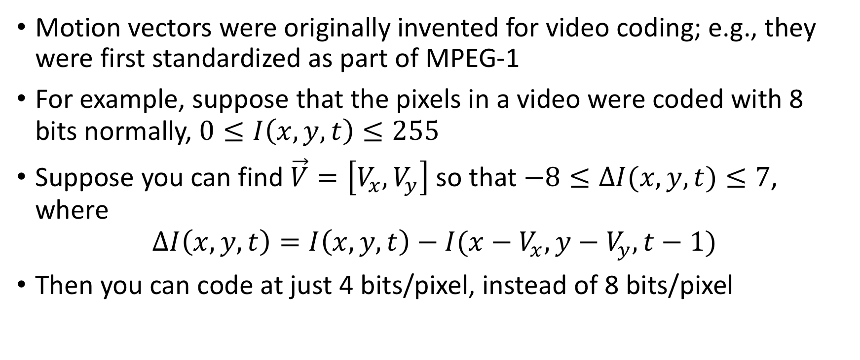
Motion Vectors Textbook section 24.2.3; ECE417
Motion vectors were originally invented for video coding; e.g., they were first standardized as part of MPEG-1
For example, suppose that the pixels in a video were coded with 8 bits normally, $0≤I\left(x,y,t\right)≤255$
Suppose you can find $\vec{V}=\left[V_{x},V_{y}\right]$ so that $−8≤ΔI(x,y,t)≤7$, where
$$ΔI\left(x,y,t\right)=I\left(x,y,t\right)−I(x−V_{x},y−V_{y},t−1)$$
Then you can code at just 4 bits/pixel, instead of 8 bits/pixel

Slide 31
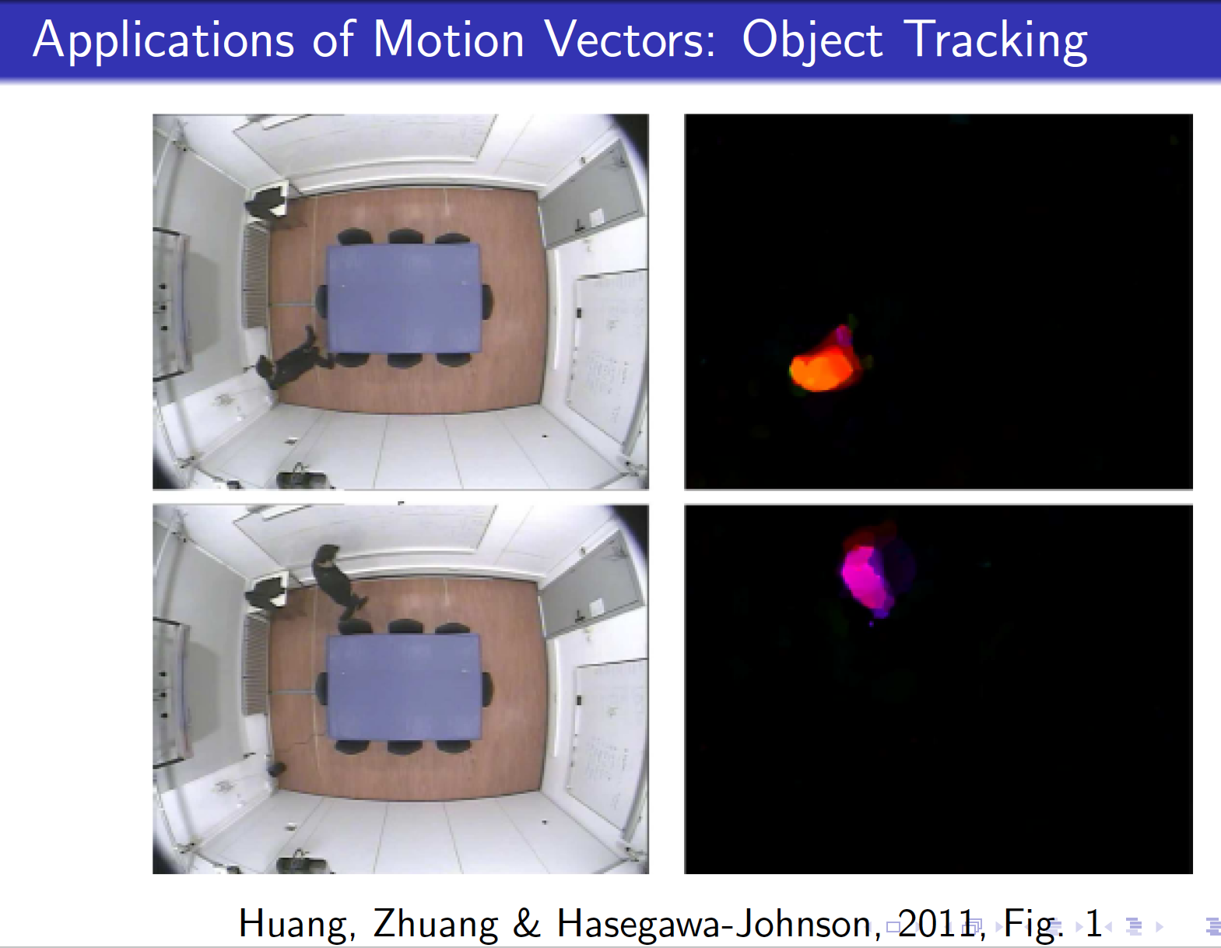

Slide 32
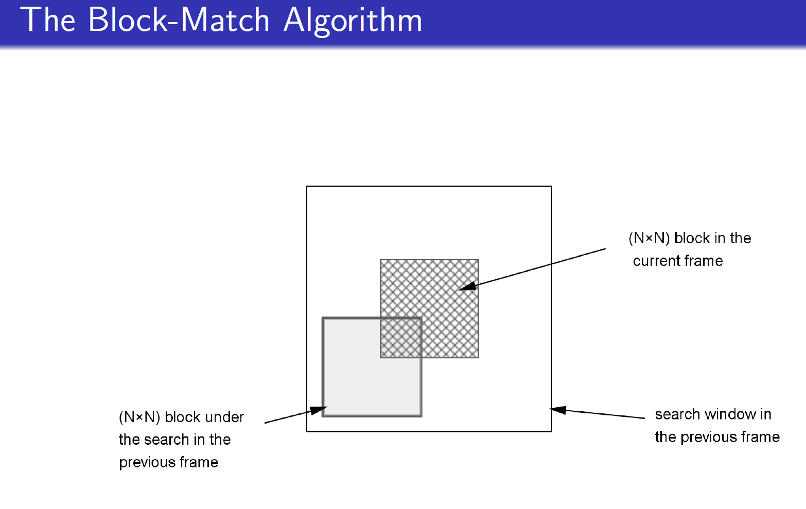
By German iris – Own work, CC BY-SA 4.0, https://commons.Wikimedia.org/w/index.php?curid=472

Slide 33
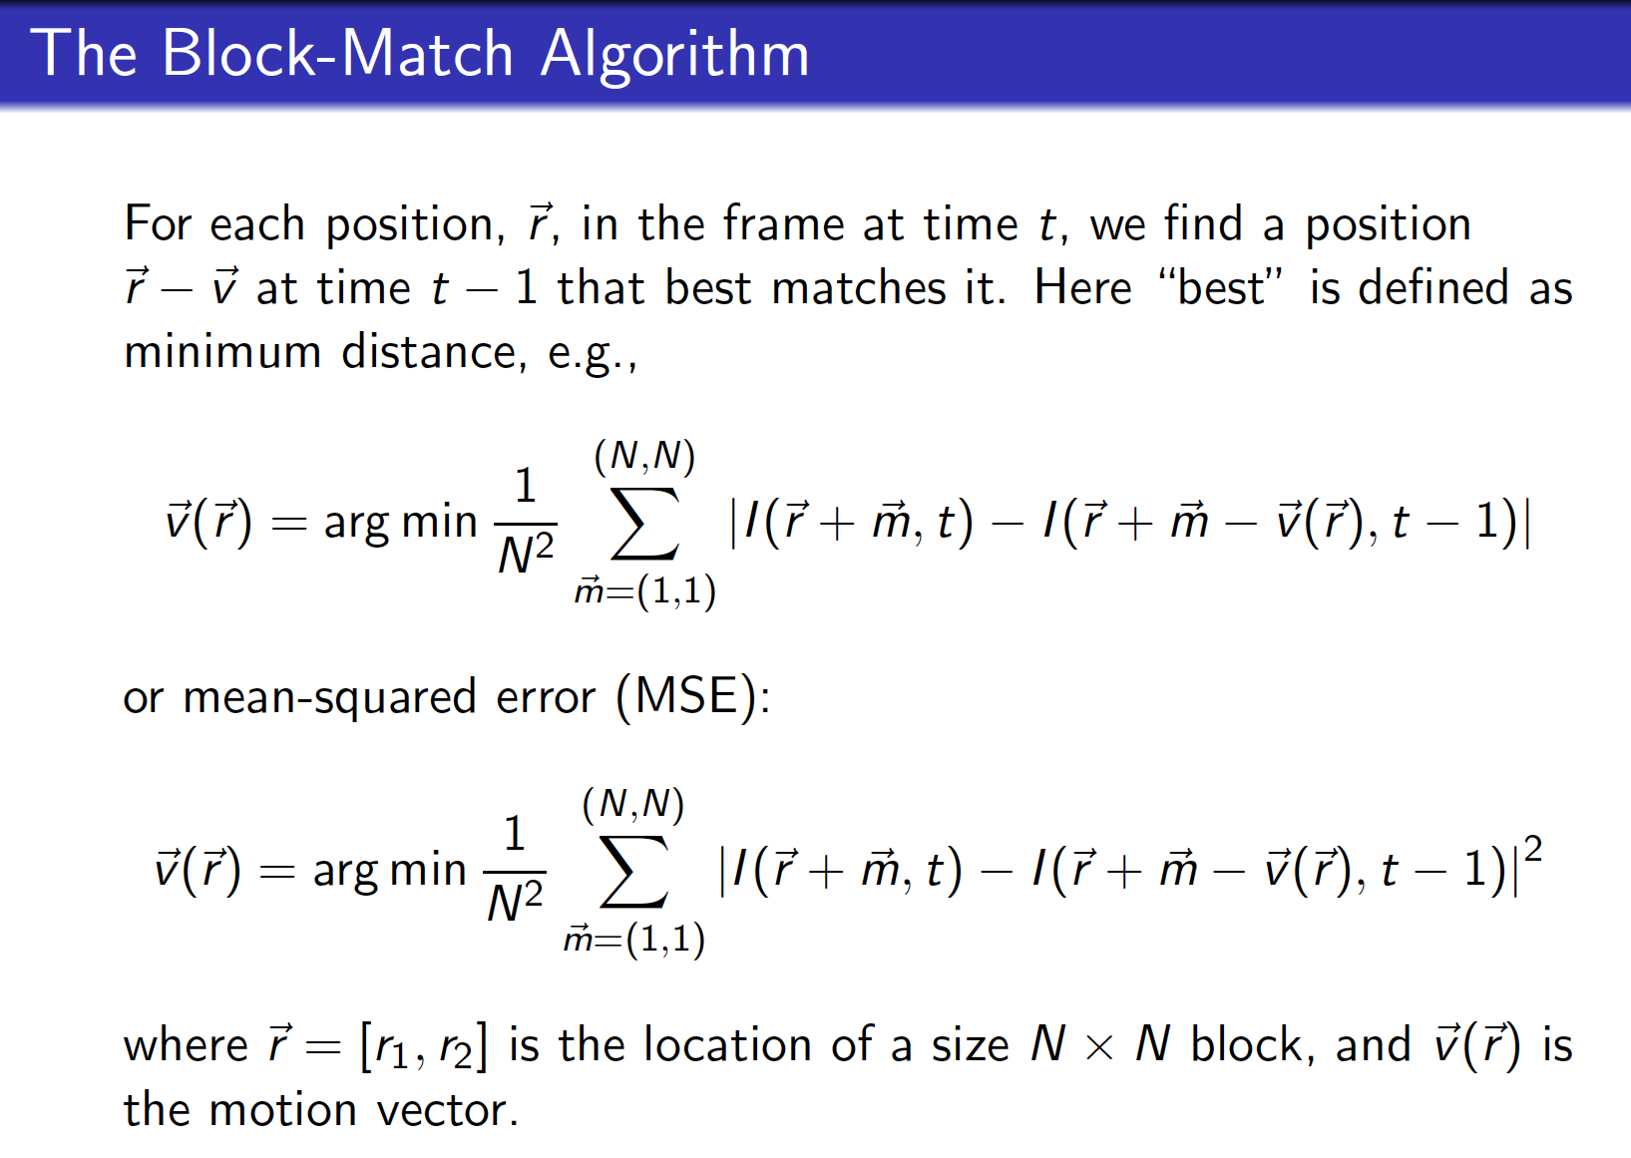

Slide 34
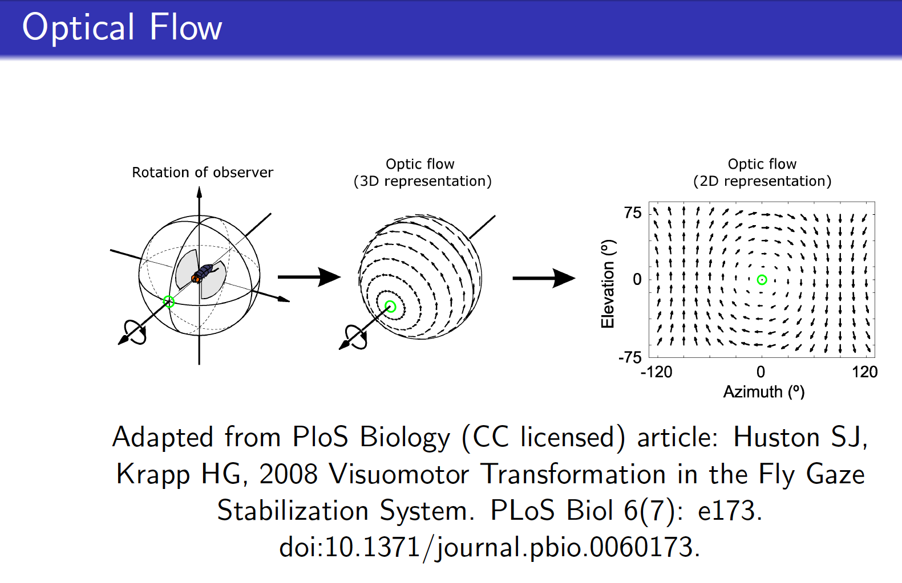

Slide 35
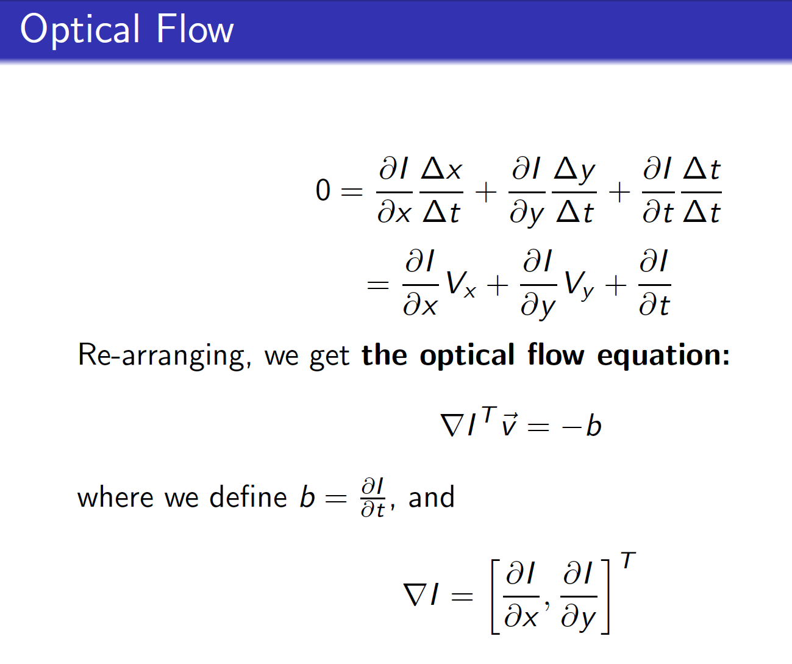

Slide 36
Perception
Web Texts
Sentiment Analysis; Information Retrieval; Information Extraction
Speech and Natural Language Processing
Parsing; Machine Translation; Speech Recognition
Computer Vision
Motion Vectors; Object Recognition; Object Localization; image2speech

Slide 37
Object Recognition Textbook chapter 24; CS 446, 546, 549
Now a classic problem in machine learning, thanks to big databases like imagenet
Basically: given an input image, try to say what type of object is most visible in the input image

Slide 38
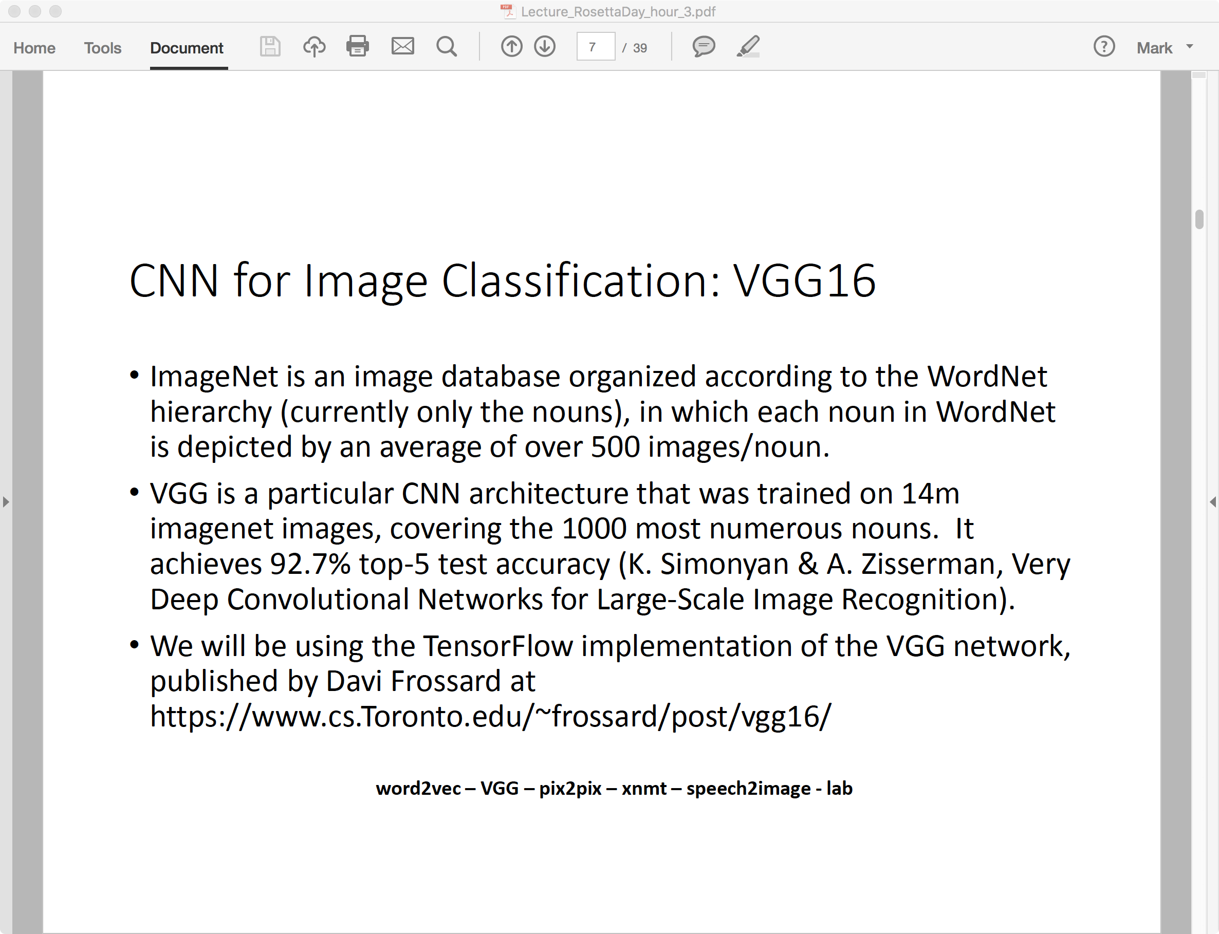

Slide 39
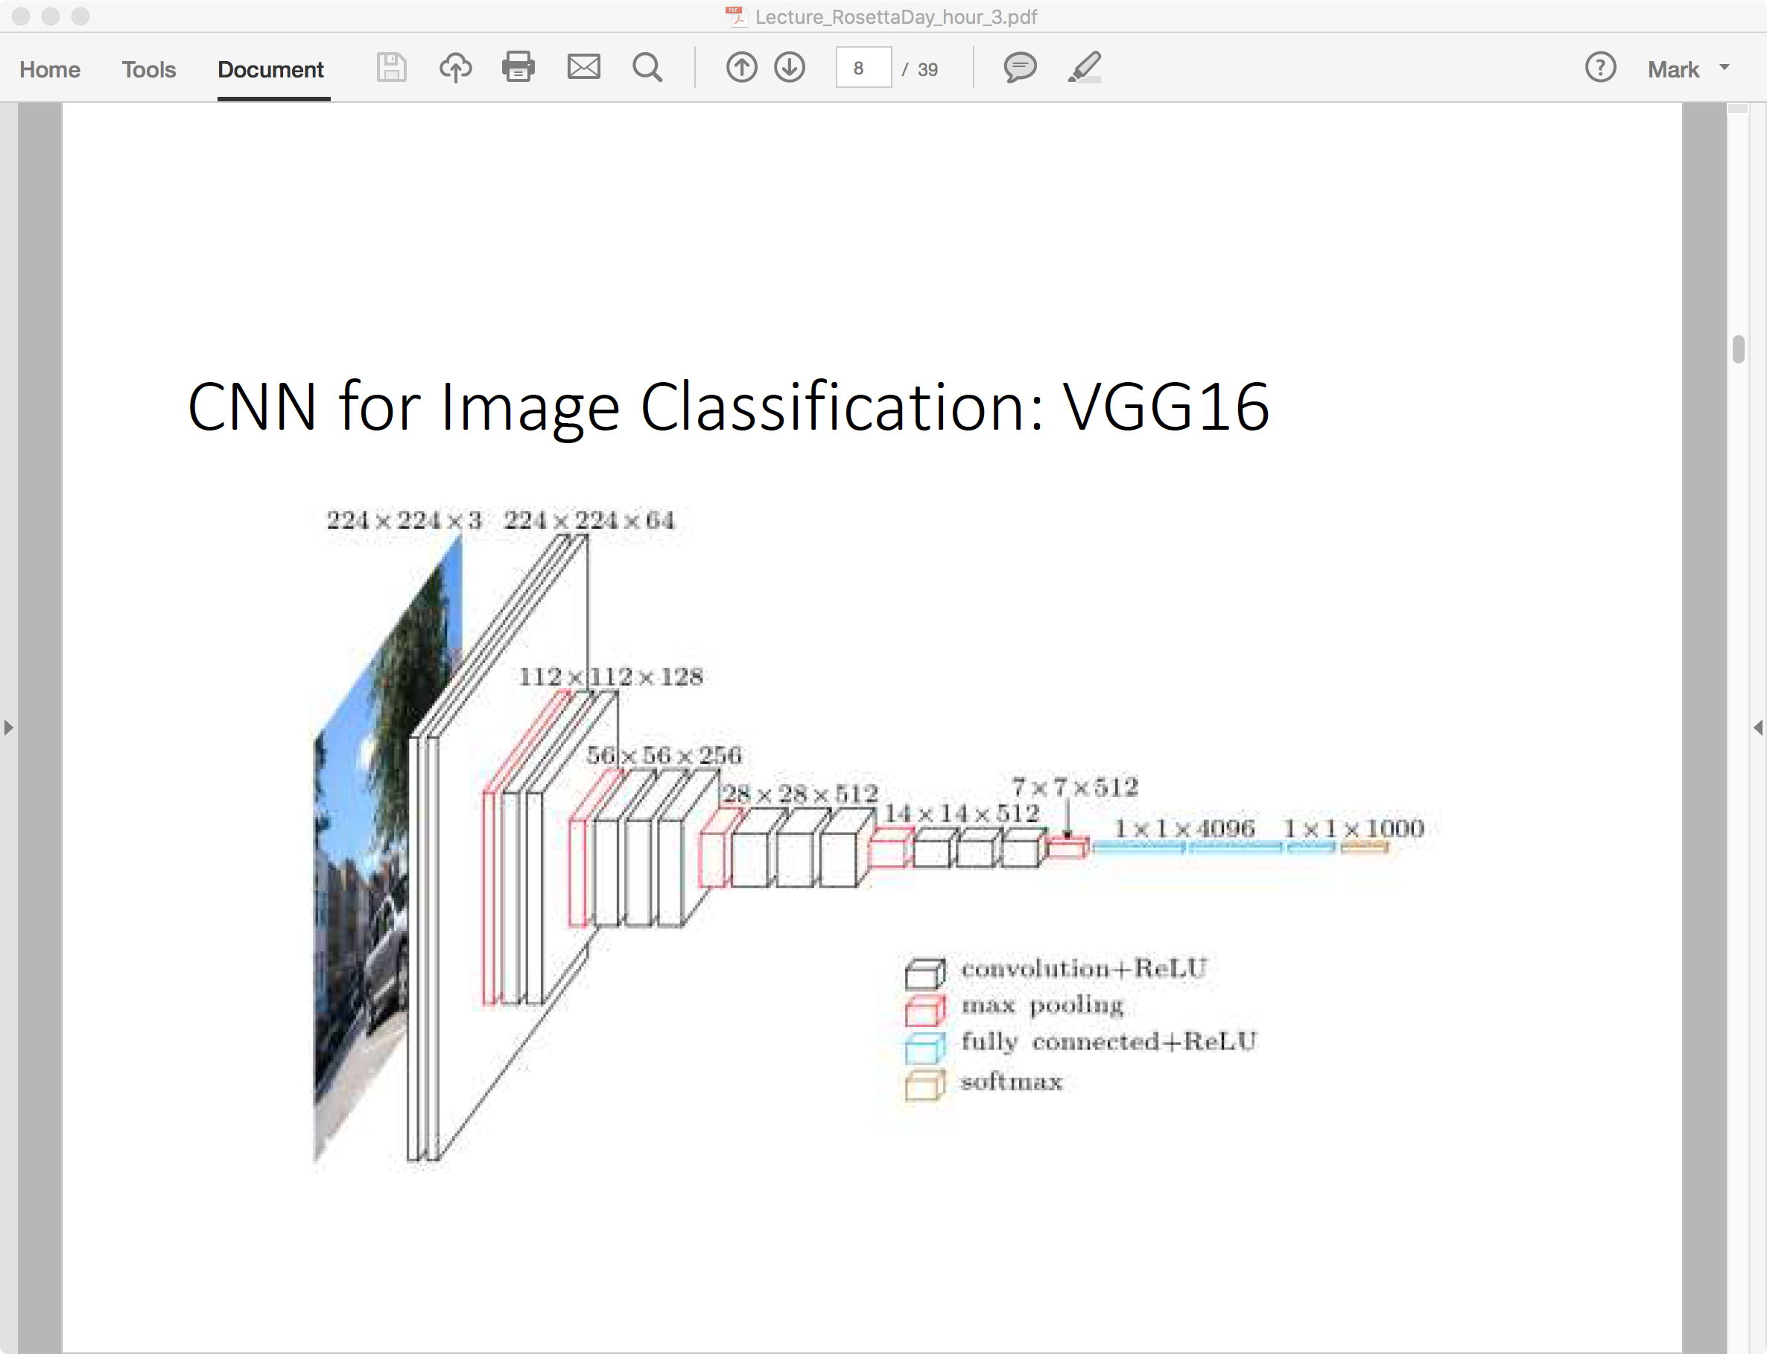

Slide 40
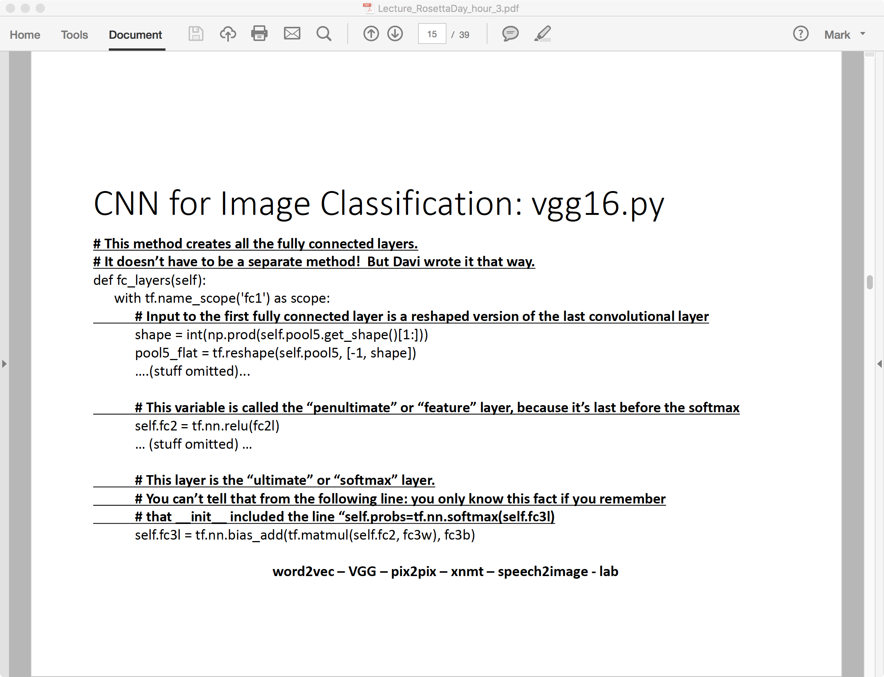

Slide 41
Perception
Web Texts
Sentiment Analysis; Information Retrieval; Information Extraction
Speech and Natural Language Processing
Parsing; Machine Translation; Speech Recognition
Computer Vision
Motion Vectors; Object Recognition; Object Localization; image2speech

Slide 42
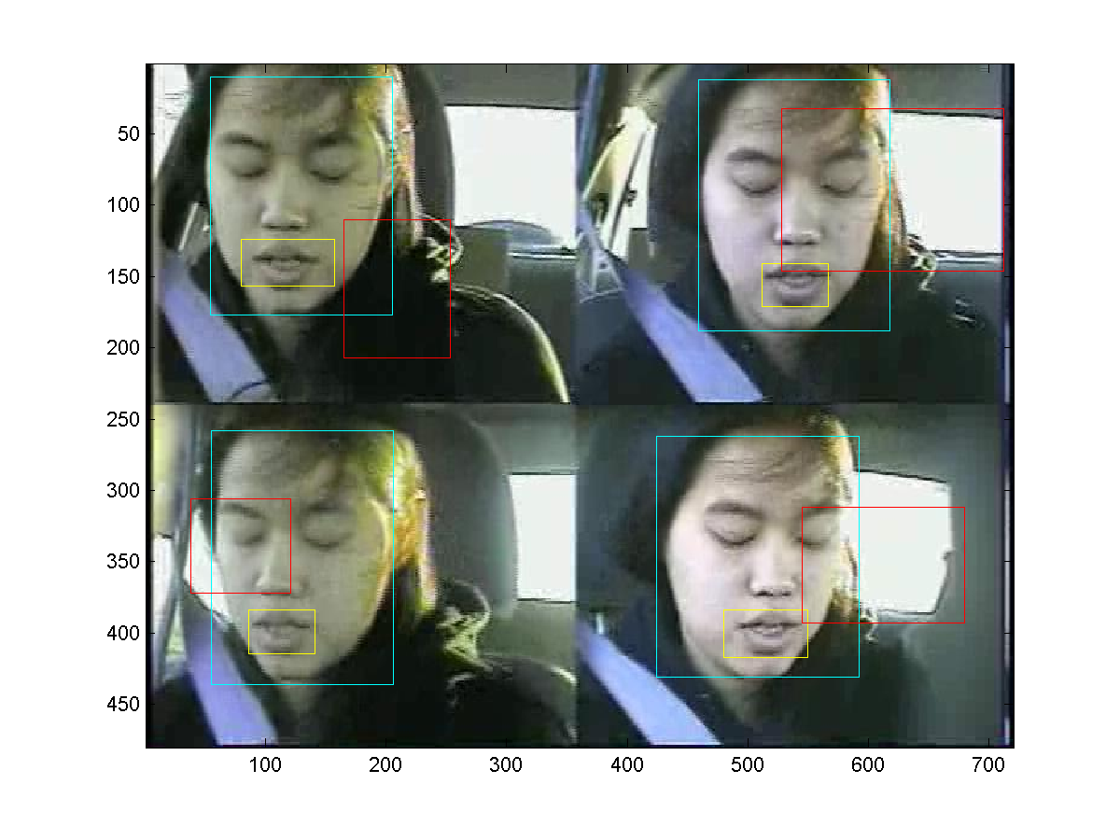
Face Detection Slide credit: ECE 417
rects.txt:
12 rectangles per line: lips, face, other
4 ints/rectangle: [xmin,ymin,width,height]
showrects.m plots
Yellow: lips (first 4/line)
Cyan: face (next 4/line)
Red: other (next 4/line)
MP:
Discriminate face vs. other

Slide 43
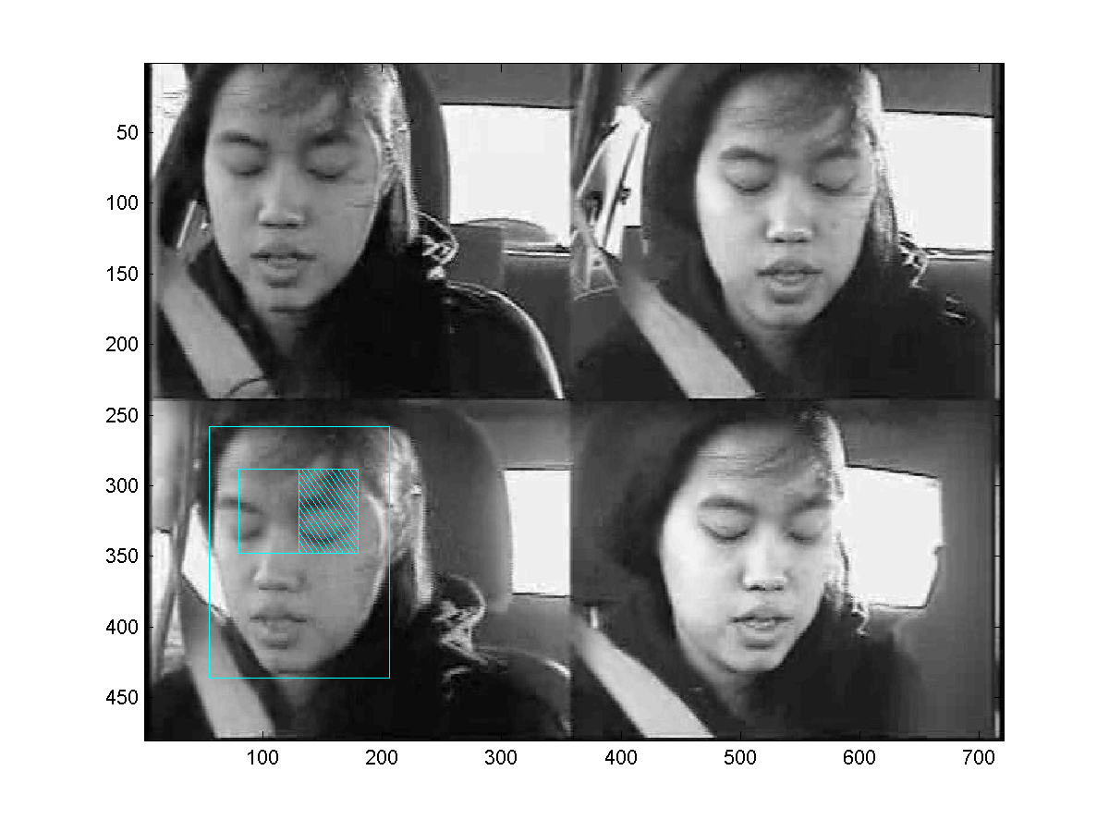
Example features: order 2, horizontal
Feature f(x;fr,q=2,v=0)
An order-2 horizontal feature is the sum of the right half, minus the sum of the left half.

Slide 44

Other useful features: order 3, vertical
Feature f(x;fr,q=3,v=1)
An order-3 vertical feature is the sum of the outer thirds, minus the sum of the middle third.

Slide 45
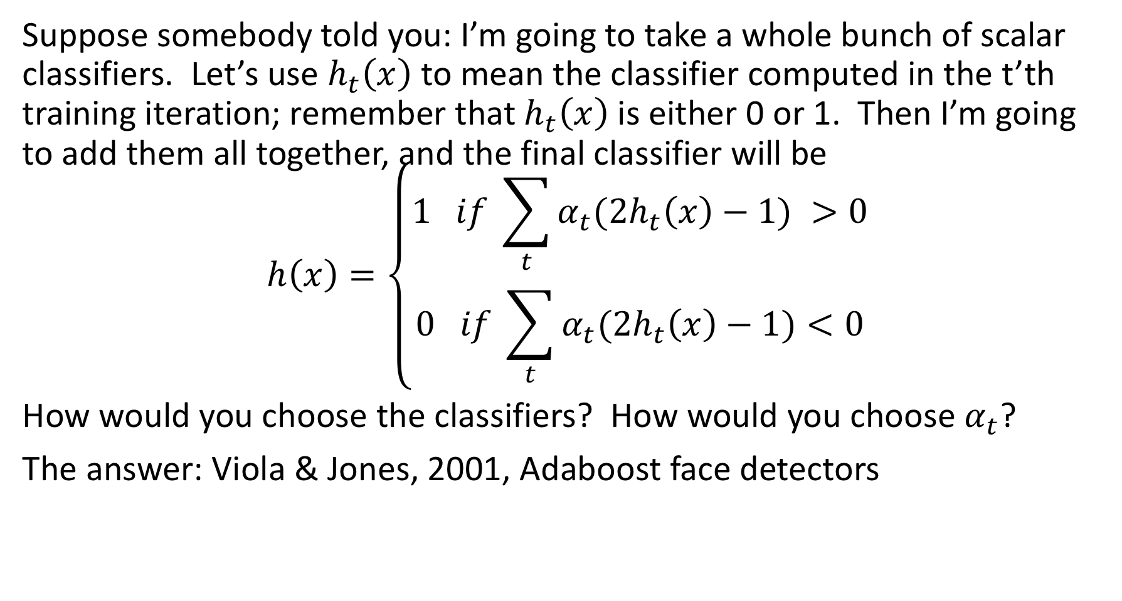
Adaboost
Suppose somebody told you: I’m going to take a whole bunch of scalar classifiers. Let’s use $h_{t}\left(x\right)$ to mean the classifier computed in the t’th training iteration; remember that $h_{t}\left(x\right)$ is either 0 or 1. Then I’m going to add them all together, and the final classifier will be
$$h\left(x\right)=\left\{\begin{aligned}1 if \sum_{t}{α_{t}{(2h}_{t}\left(x\right)−1) >0} \\ 0 if \sum_{t}{α_{t}{(2h}_{t}\left(x\right)−1)<0}\end{aligned}\right.$$
How would you choose the classifiers? How would you choose $α_{t}$?
The answer: Viola & Jones, 2001, Adaboost face detectors

Slide 46
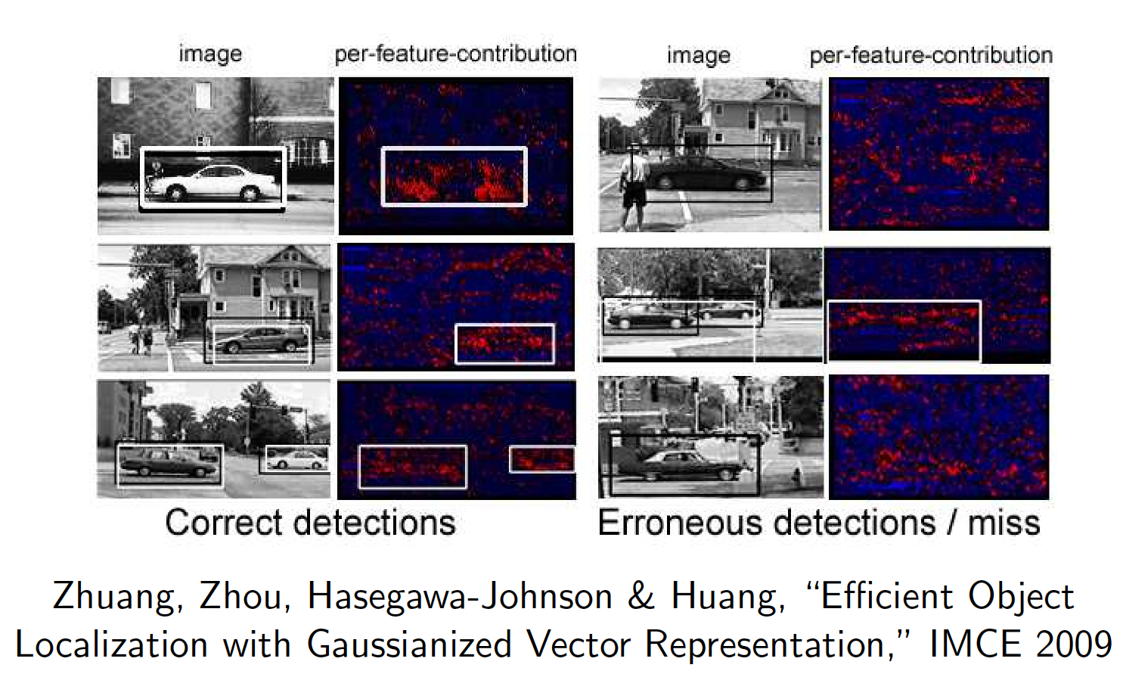
I-Vector Object Detectors

Slide 47
Perception
Web Texts
Sentiment Analysis; Information Retrieval; Information Extraction
Speech and Natural Language Processing
Parsing; Machine Translation; Speech Recognition
Computer Vision
Motion Vectors; Object Recognition; Object Localization; image2speech

Slide 48
How many languages are there in the world?
According to ethnologue, there are 6900 languages. Methods of writing have been invented for about 4000 of them.
There are 206 countries in the world, of which 193 have an official language; 101 have more than one. There are no figures on the number of different “official” languages, but maybe it is 300 languages.
So the number of distinct languages in which children are taught to READ and WRITE (as opposed to just speaking) is about 300.
All of the other 6900 – 300 = 6600 languages (dialects; codes) are purely spoken: a writing system may exist, but is rarely used.

Slide 49
Image2speech = img2txt + TTS - text
If there is no writing system, then speech is the only communication tool, but:
Must one speak in Modern Standard Arabic to be understood by one’s cell phone?
Task Definition: Can we develop speech technology in a dialect that is almost never written down in any standardized text format?
Definition: An image2speech algorithm is an algorithm that observes an image, and generates a spoken description of the image, without requiring that the language of the description has any standardized text format.

Slide 50
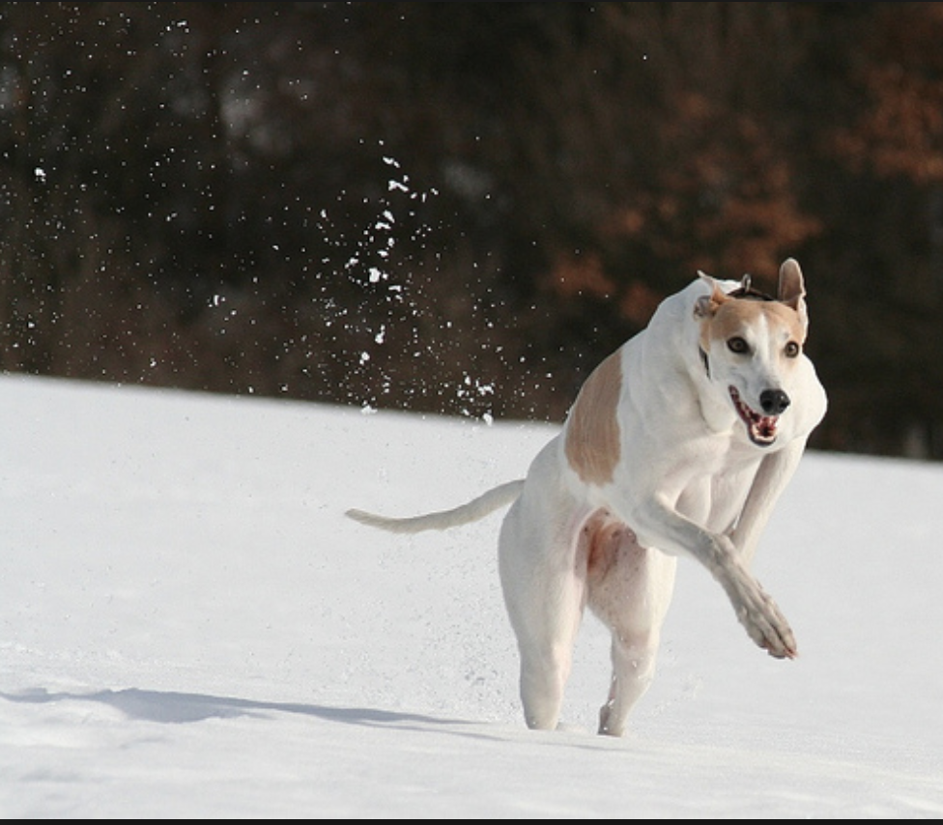
Datasets
AMT recordings obtained from Flickr8k - 40k spoken captions available online (Julia Hockenmaier et al., 2009)
https://groups.csail.mit.edu/sls/downloads/
D. Harwath and J. Glass, “Deep multimodal semantic embeddings for speech and images” in IEEE ASRU, Scottsdale, Arizona, USA, December 2015
-A brown and white dog is running through the snow
-A dog is running in the snow
-A dog running through snow
-A white and brown dog is running through a snow covered field
-The white and brown dog is running over the surface of the snow

Slide 51
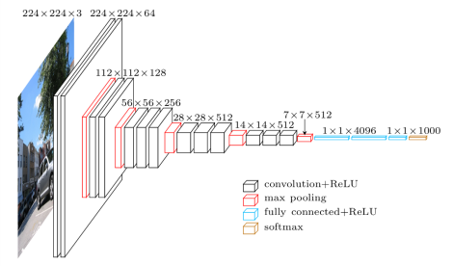

Image representation: CNNFEAT ${\vec{s}}_{mn}$
ImageNet = >500 images/noun of each of the nouns in WordNet.
VGG = 13-layer CNN + 2-layer FCN, trained on 14m images, covering the 1000 most numerous nouns, 92.7% top-5 test accuracy.
CNNFEAT: 196 feature vectors/image, 512d/vector, from the last CNN layer. Each receptive field covers about 40x40 pixels in the original 224x224 image.
VGGFEAT (used later in today’s talk, not right now): 1 vector/image, 4096d/vector, from penultimate FCN layer
Figure copied from Simonyan & Zisserman, 2014.

Slide 52
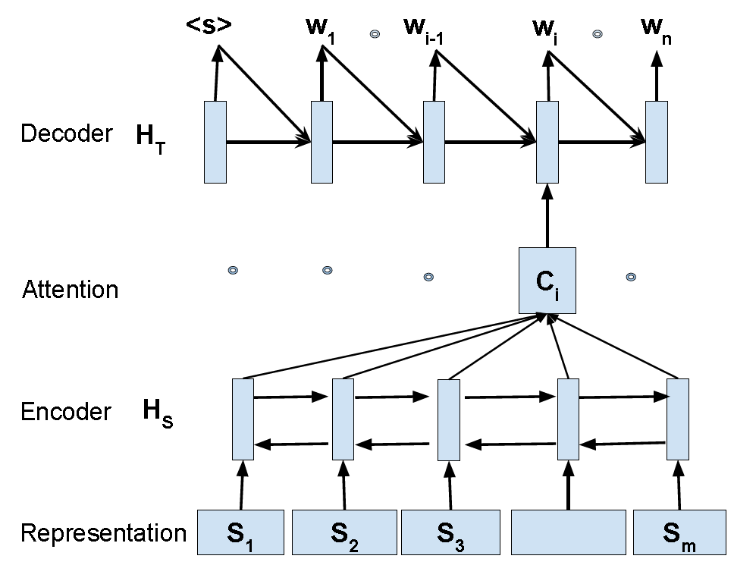
im2ph: phones from images
“Representation:” 196 vectors/image
“Encoder:” PyramidalLSTM with one 128d state vector. Sequence is row-wise raster scan of the image.
“Attention:” StandardAttender, 128d input, 128d state vector, N hidden nodes
“Decoder:” MlpSoftmaxDecoder, 3 layers, 1024d hidden vectors
Output vocabulary: synthetic phones (MSCOCO), force-aligned phones (flickr8k), or acoustic unit discoveries (both)
Figure copied without permission from Duong, Anastasopoulos, Chiang, Bird & Cohn, NAACL-HLT 2016.

Slide 53

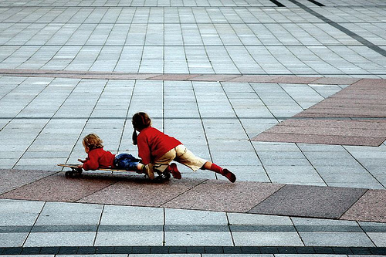
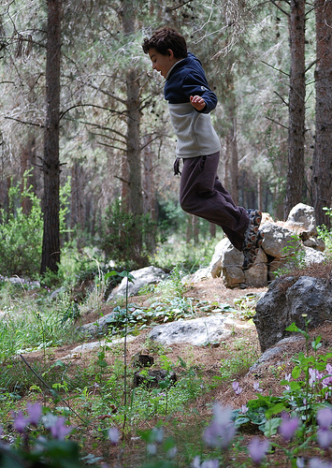
flickr8K: American phones
Reference 1: “The boy +um+ laying face down on a skateboard is being pushed along the ground by +laugh+ another boy.”
Reference 2: “Two girls +um+ play on a skateboard +breath+ in a court +laugh+ yard.”
Hypothesis (128d attender): SIL +BREATH+ SIL T UW M EH N AA R R AY D IX NG AX R EH D AE N W AY T SIL R EY S SIL
Hypothesis (64d attender): SIL +BREATH+ SIL T UW W IH M AX N W AO K IX NG AA N AX S T R IY T SIL
Reference 1: “A boy +laugh+ in a blue top +laugh+ is jumping off some rocks in the woods.”
Reference 2: “A boy +um+ jumps off a tan rock.”
Hypothesis (128d attender): SIL +BREATH+ SIL EY M AE N IH Z JH AH M P IX NG IH N DH AX F AO R EH S T SIL
Hypothesis (64d attender): SIL +BREATH+ SIL EY Y AH NG B OY W EY R IX NG AX B L UW SH ER T SIL IH Z R AY D IX NG AX HH IH L SIL
Images and Reference Texts: Hodosh, Young & Hockenmaier, 2013. Waveforms: Harwath and Glass, 2015

Slide 54
Perception
Web Texts
Sentiment Analysis; Information Retrieval; Information Extraction
Speech and Natural Language Processing
Parsing; Machine Translation; Speech Recognition
Computer Vision
Motion Vectors; Object Recognition; Object Localization; image2speech

