Slide 1

CS440/ECE448 Lecture 13: Random Variables
Mark Hasegawa-Johnson, 3/2018

Slide 2
Random Variables
Expected Value
Probability Mass Function
Domain of a Random Variable
  Domain Type: Categorical vs. Numerical
  Domain Size: Finite vs. Countably Infinite vs. Uncountably Infinite
Joint, Marginal, and Conditional Random Variables
  Marginalization and Conditioning
  Law of Total Probability
  Random Vectors
  Jointly Random Class and Measurement Variables
Functions of Random Variables
  Probability Mass Function
  Expectation

Slide 3
Expected Value
Expected Value of a random variable = the average value, averaged over an infinite number of independent trials

Slide 4

Expected Value
Example: D = number of pips showing on a die
Expected Value of a random variable = the average value, averaged over an infinite number of independent trials
E[D] = lim(n->∞) (1/n) * (1*(#times D=1)+2*(#times D=2)+…+6*(#times D=6))
= 1*(1/6) + 2*(1/6) + …. + 6*(1/6)
= (1+2+3+4+5+6)/6
= 3.5

Slide 5
Expected Value
Expected Value of a random variable = the average value, averaged over an infinite number of independent trials
= sum{ value * P(variable=value) }

Slide 6

Center of Mass (from physics)
Center of Mass
= sum{ position * Mass(position) }

Slide 7
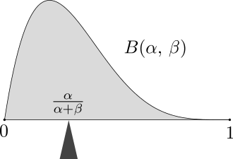
Expected Value = Center of Probability “Mass”
Expected Value of a random variable = the average value, averaged over an infinite number of independent trials
= sum{ value * P(variable=value) }
Wikipedia: “The mass of probability distribution is balanced at the expected value.”

Slide 8
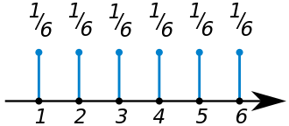
Probability Mass Function
The “Probability Mass Function” (pmf) of a random variable X is defined to be the function P(X=value), as a function of the different possible values.
Why it’s useful: expected value = center of mass.
Wikipedia: “The probability mass function of a fair die. All the numbers on the die have an equal chance of appearing on top when the die stops rolling.” The expected value is 3.5.

Slide 9
Requirements for a Probability Mass Function
Axioms of Probability
P(A) ≥ 0 for every event A
1 = P(True)
P(A ∨ B) = P(A) + P(B) – P(A ∧ B)
Requirements for a PMF
P(X=x) ≥ 0 for every x
1 = Sum_x P(X=x)
P(X=x ∨ X=y) = P(X=x)+P(X=y)
Notice: the last one assumes that X=x and X=y are mutually exclusive events.

Slide 10
Random Variables
Expected Value
Probability Mass Function
Domain of a Random Variable
  Domain Type: Categorical vs. Numerical
  Domain Size: Finite vs. Countably Infinite vs. Uncountably Infinite
Joint, Marginal, and Conditional Random Variables
  Marginalization and Conditioning
  Law of Total Probability
  Random Vectors
  Jointly Random Class and Measurement Variables
Functions of Random Variables
  Probability Mass Function
  Expectation

Slide 11
Domain of a Random Variable
The “Domain” of a Random Variable is the set of its possible values.

Slide 12

Domain of a Random Variable
The domain can be numerical. For example:
  The number of pips showing on a die
  The age, in years, of a person that you choose at random off the street
  The number of days of sunshine in the month of March
  The minimum temperature tonight, in degrees Celsius
The domain can also be categorical. For example:
  The color chosen by a spinner in the game of Twister
  The color of the shirt worn by a person chosen at random
  The type of weather tomorrow: { sunny, cloudy with no precipitation, raining, snowing, sleet }

Slide 13
Expectation and PMF
Expected Value is only well defined for numerical domains.
E[X] = sum value * P(X=value)
PMF is well defined even for categorical domains.
Example: X = color shown on the spinner
P(X=red) = (1/4)
P(X=blue) = (1/4)
P(X=green) = (1/4)
P(X=yellow) = (1/4)

Slide 14
Size of the Domain = # Different Possible Values
Domain of a random variable can be finite.
Example: D = value, in dollars, of the next coin you find. Domain = {1.00, 0.50, 0.25, 0.10, 0.05, 0.01}, Size of the domain=6.
Domain of a random variable can be “countably infinite.”
Example: X = number of words in the next Game of Thrones novel. No matter how large you guess, it’s possible it might be even longer, so we say the domain is infinite.
Requirement: 1 = sum P(X=x)
Domain of a random variable can be “uncountably infinite.”
Example: a variable whose value can be ANY REAL NUMBER.
How we deal with this: P(X=x) is ill-defined, but P(a≤X<b) is well-defined.

Slide 15

Expectation and PMF
Expected value can be calculated from PMF only if the domain is finite, or countably infinite.
E[X] = sum value * P(X=value)
Example: X = number of words in the next GoT novel.
E[X] = P(X=1) + 2*P(X=2) + 3*P(X=3) + …
If you know P(X=x) for all x (even if “all x” is an infinite set), then you can compute this expectation by solving the infinite series.

Slide 16
Random Variables
Expected Value
Probability Mass Function
Types of Random Variables
  Domain Type: Categorical vs. Numerical
  Domain Size: Finite vs. Countably Infinite vs. Uncountably Infinite
Joint, Marginal, and Conditional Random Variables
  Marginalization and Conditioning
  Law of Total Probability
  Random Vectors
  Jointly Random Class and Measurement Variables
Functions of Random Variables
  Probability Mass Function
  Expectation

Slide 17

Joint Random Variables
Jointly distributed random variables (W,X,Y,Y) have a joint pmf, which specifies the probability P(W=w,X=x,Y=y,Z=z) for every tuple of values (w,x,y,z).
Example: W=red, X=purple, Y=green, Z=blue
w | x | y | z | P(W=w,X=x,Y=y,Z=z)
1 | 1 | 1 | 1 | 1/1296
1 | 1 | 1 | 2 | 1/1296
… |  | … |  | …
6 | 6 | 6 | 4 | 1/1296
6 | 6 | 6 | 5 | 1/1296
6 | 6 | 6 | 6 | 1/1296

Slide 18
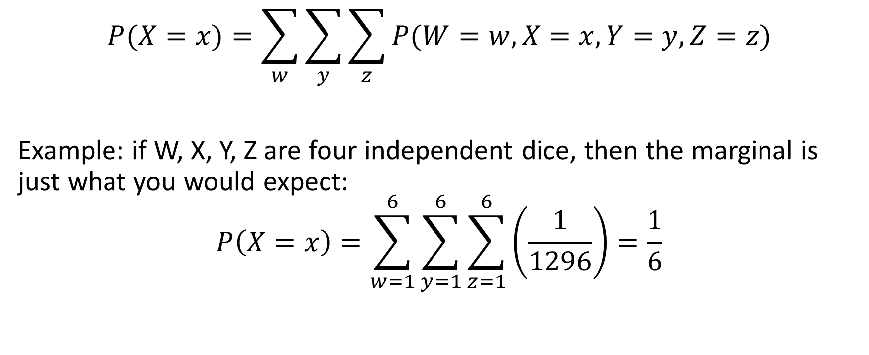
Marginalization
$$P(X=x)=\sum_{w}{\sum_{y}{\sum_{z}{P(W=w,X=x,Y=y,Z=z)}}}$$
Example: if W, X, Y, Z are four independent dice, then the marginal is just what you would expect:
$$P\left(X=x\right)=\sum_{w=1}^{6}{\sum_{y=1}^{6}{\sum_{z=1}^{6}{\left(\frac{1}{1296}\right)}}}=\frac{1}{6}$$

Slide 19
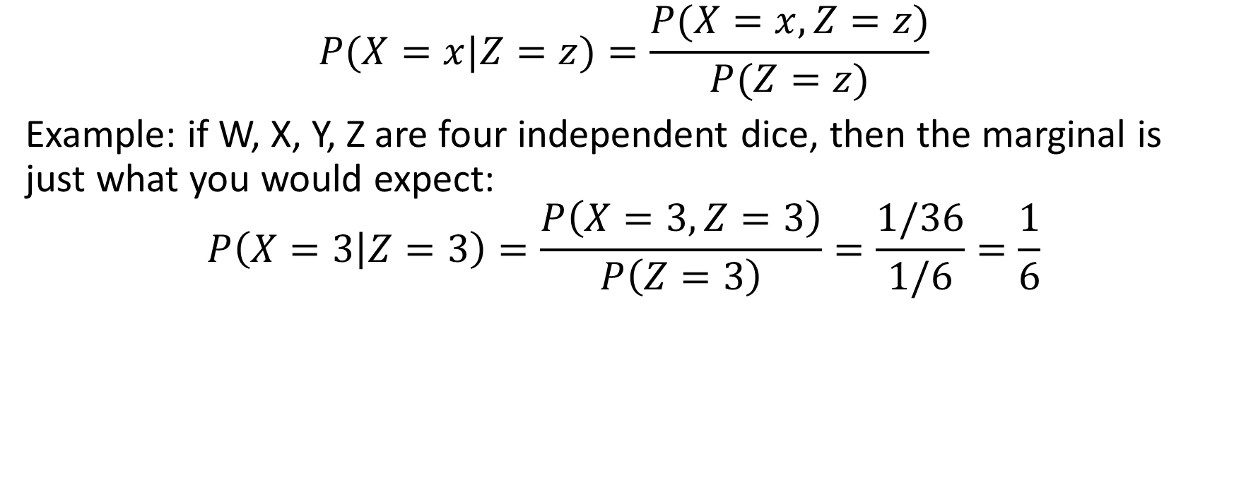
Conditioning
$$P(X=x|Z=z)=\frac{P(X=x,Z=z)}{P(Z=z)}$$
Example: if W, X, Y, Z are four independent dice, then the marginal is just what you would expect:
$$P\left(X=3 | Z=3\right)=\frac{P\left(X=3,Z=3\right)}{P\left(Z=3\right)}=\frac{1/36}{1/6}=\frac{1}{6}$$

Slide 20
Law of total probability

Slide 21
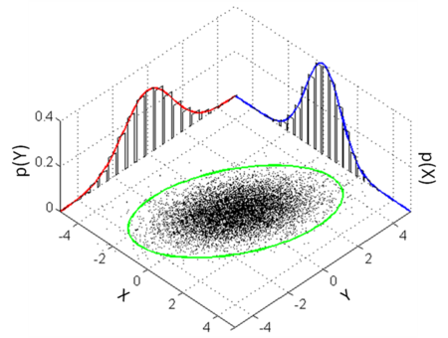
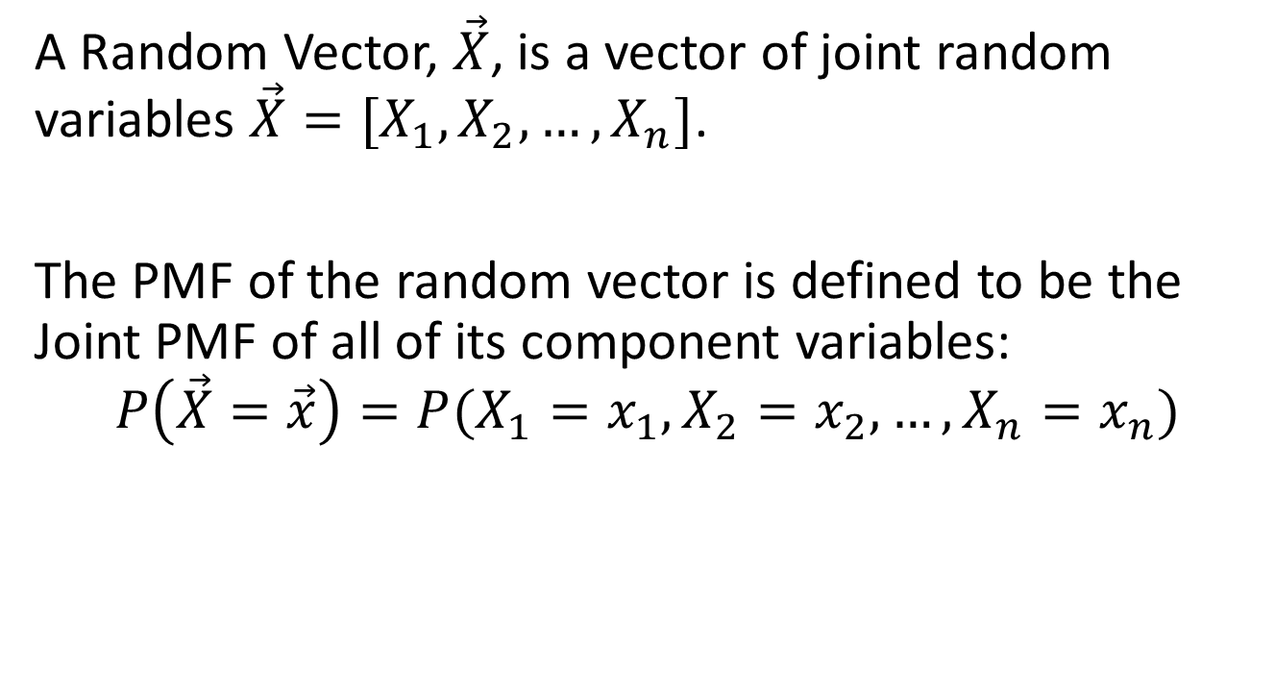
Random Vector
A Random Vector, $\vec{X}$, is a vector of joint random variables $\vec{X}=[X_{1},X_{2},…,X_{n}]$.
The PMF of the random vector is defined to be the Joint PMF of all of its component variables:
$$P\left(\vec{X}=\vec{x}\right)=P(X_{1}=x_{1},X_{2}=x_{2},…,X_{n}=x_{n})$$

Slide 22
Jointly Random Class and Measurement Variables
The most important case of joint random variables for AI: jointly random categorical (class) and numerical (measurement) variables.
For example, Y= type of fruit, X = weight of the fruit.
We’ll talk A LOT more about this in the next lecture (Bayesian inference).
x | y | P(X=x,Y=y)
10g | Grape | 0.68
10g | Apple | 0.06
100g | Grape | 0.02
100g | Apple | 0.34

Slide 23
Random Variables
Expected Value
Probability Mass Function
Types of Random Variables
  Domain Type: Categorical vs. Numerical
  Domain Size: Finite vs. Countably Infinite vs. Uncountably Infinite
Joint, Marginal, and Conditional Random Variables
  Marginalization and Conditioning
  Law of Total Probability
  Random Vectors
Functions of Random Variables
  Probability Mass Function
  Expectation

Slide 24
Functions of Random Variables: PMF
The PMF for a function of random variables is computed the same way as any other marginal: by adding up the component probabilities.
Example: S = W+X+Y+Z
w | x | y | z | s | P(W=w,X=x,Y=y,Z=z,S=s)
1 | 1 | 1 | 1 | 4 | 1/1296
1 | 1 | 1 | 2 | 5 | 1/1296
1 | 1 | 2 | 1 | 5 | 1/1296
… | … | … | … | … | …
s | P(S=s)
4 | 1/1296
5 | 4/1296
… | …

Slide 25
Functions of Random Variables: PMF
Example: A = X^2
w | a | P(A=a)
1 | 1 | 1/6
2 | 4 | 1/6
3 | 9 | 1/6
4 | 16 | 1/6
5 | 25 | 1/6
6 | 36 | 1/6

Slide 26
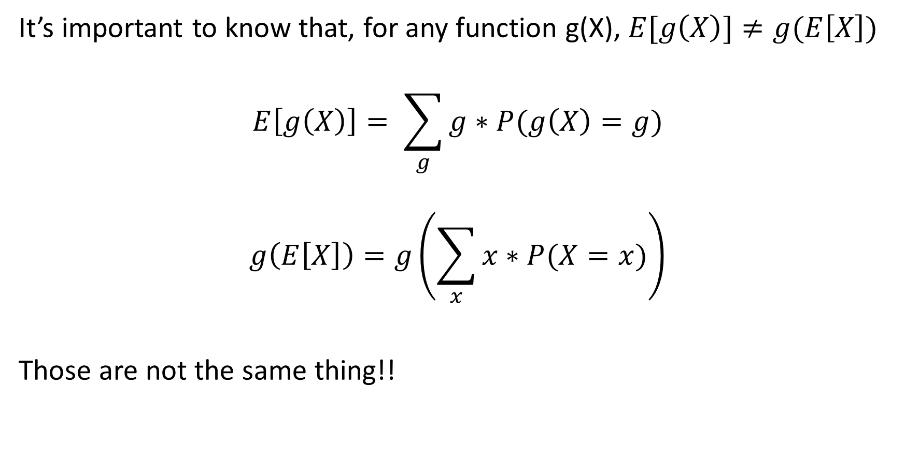
Functions of Random Variables: Expectation
It’s important to know that, for any function g(X), $E[g\left(X\right)]≠g(E\left[X\right])$
$$E\left[g\left(X\right)\right]= \sum_{g}{g∗P(g\left(X\right)=g)}$$
$$g\left(E\left[X\right]\right)=g\left(\sum_{x}{x∗P(X=x)}\right)$$
Those are not the same thing!!

Slide 27

Functions of Random Variables: Expectation
Example: $E[X^{2}]≠{E[X]}^{2}$
$$E\left[X^{2}\right]=1\left(\frac{1}{6}\right)+4\left(\frac{1}{6}\right)+…+36\left(\frac{1}{6}\right)=15.1667$$
$${E[X]}^{2}={(3.5)}^{2}=12.25$$
Those are not the same thing!!

Slide 28
Summary: Random Variables
Expected Value
Probability Mass Function
Domain of a Random Variable
  Domain Type: Categorical vs. Numerical
  Domain Size: Finite vs. Countably Infinite vs. Uncountably Infinite
Joint, Marginal, and Conditional Random Variables
  Marginalization and Conditioning
  Law of Total Probability
  Random Vectors
  Jointly Random Class and Measurement Variables
Functions of Random Variables
  Probability Mass Function
  Expectation

Slide 29
