Slide 1
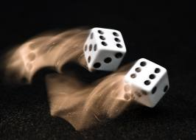
CS 440/ECE 448 Lecture 12:
Probability
Slides by Svetlana Lazebnik, 9/2016
Modified by Mark Hasegawa-Johnson, 10/2017

Slide 2
Outline
Motivation: Why use probability?
  Laziness, Ignorance, and Randomness
  Rational Bettor Theorem
Review of Key Concepts
  Outcomes, Events
  Random Variables; probability mass function (pmf)
  Jointly random variables: Joint, Marginal, and Conditional pmf
  Independent vs. Conditionally Independent events

Slide 3
Outline
Motivation: Why use probability?
  Laziness, Ignorance, and Randomness
  Rational Bettor Theorem
Review of Key Concepts
  Outcomes, Events, and Random Variables
  Joint, Marginal, and Conditional
  Independence and Conditional Independence

Slide 4
Motivation: Planning under uncertainty
Recall: representation for planning
States are specified as conjunctions of predicates
  Start state: At(P1, CMI) ∧ Plane(P1) ∧ Airport(CMI) ∧ Airport(ORD)
  Goal state: At(P1, ORD)
Actions are described in terms of preconditions and effects:
  Fly(p, source, dest)
    Precond: At(p, source) ∧ Plane(p) ∧ Airport(source) ∧ Airport(dest)
    Effect: ¬At(p, source) ∧ At(p, dest)

Slide 5
Motivation: Planning under uncertainty
Let action A_{t} = leave for airport t minutes before flight
  Will A_{t} succeed, i.e., get me to the airport in time for the flight?
Problems:
    Partial observability (road state, other drivers' plans, etc.)
    Noisy sensors (traffic reports)
    Uncertainty in action outcomes (flat tire, etc.)
    Complexity of modeling and predicting traffic
Hence a purely logical approach either
    Risks falsehood: “A₂₅ will get me there on time,” or
    Leads to conclusions that are too weak for decision making:
    A₂₅ will get me there on time if there's no accident on the bridge and it doesn't rain and my tires remain intact, etc., etc.
    A₁₄₄₀ will get me there on time but I’ll have to stay overnight in the airport

Slide 6
Probability
Probabilistic assertions summarize effects of
  Laziness: reluctance to enumerate exceptions, qualifications, etc. --- possibly a deterministic and known environment, but with computational complexity limitations
  Ignorance: lack of explicit theories, relevant facts, initial conditions, etc. --- environment that is unknown (we don’t know the transition function) or partially observable (we can’t measure the current state)
  Intrinsically random phenomena – environment is stochastic, i.e., given a particular (action,current state), the (next state) is drawn at random with a particular probability distribution

Slide 7
Outline
Motivation: Why use probability?
  Laziness, Ignorance, and Randomness
  Rational Bettor Theorem
Review of Key Concepts
  Outcomes, Events, and Random Variables
  Joint, Marginal, and Conditional
  Independence and Conditional Independence

Slide 8
Making decisions under uncertainty
Suppose the agent believes the following:
  P(A₂₅ gets me there on time) = 0.04
  P(A₉₀ gets me there on time) = 0.70
  P(A₁₂₀ gets me there on time) = 0.95
  P(A₁₄₄₀ gets me there on time) = 0.9999
Which action should the agent choose?
  Depends on preferences for missing flight vs. time spent waiting
  Encapsulated by a utility function
The agent should choose the action that maximizes the expected utility:
  P(A_{t} succeeds) * U(A_{t} succeeds) + P(A_{t} fails) * U(A_{t} fails)

Slide 9
Making decisions under uncertainty
More generally: the expected utility of an action is defined as:
EU(action) = Σ_{outcomes of action} P(outcome | action) U(outcome)
Utility theory is used to represent and infer preferences
Decision theory = probability theory + utility theory

Slide 10
Where do probabilities come from?
Frequentism
  Probabilities are relative frequencies
  For example, if we toss a coin many times, P(heads) is the proportion of the time the coin will come up heads
  But what if we’re dealing with events that only happen once?
    E.g., what is the probability that Team X will win the Superbowl this year?
    “Reference class” problem
Subjectivism
  Probabilities are degrees of belief
  But then, how do we assign belief values to statements?
  What would constrain agents to hold consistent beliefs?

Slide 11
The Rational Bettor Theorem
Why should a rational agent hold beliefs that are consistent with axioms of probability?
  For example, P(A) + P(¬A) = 1
Suppose an agent believes that P(A)=0.7, and P(¬A)=0.7
Offer the following bet: if A occurs, agent wins $100. If A doesn’t occur, agent loses $105. Agent believes P(A)>100/(100+105), so agent accepts the bet.
Offer another bet: if ¬A occurs, agent wins $100. If ¬A doesn’t occur, agent loses $105. Agent believes P(¬A)>100/(100+105), so agent accepts the bet. Oops…
Theorem: An agent who holds beliefs inconsistent with axioms of probability can be convinced to accept a combination of bets that is guaranteed to lose them money
Notes:
If A occurs, the agent wins $6. If A does not occur, the agend loses $4. EU(bet) = 0.4 * 6 – 0.6 * 4 = 0

Slide 12
Are humans “rational bettors”?
Humans are pretty good at estimating some probabilities, and pretty bad at estimating others. What might cause humans to mis-estimate the probability of an event?
  Large-scale nonlinearities upset weather forecasts
  System might change over time
  Large number of options
  People over-estimate probability of very rare events
  Under-estimate (or over-estimate?) probability of very bad events
  Over-estimate how much we know about the situation
  Emotional attachment to any particular outcome
  Over-estimate probability of highly visible/much talked-of events
What are some of the ways in which a “rational bettor” might take advantage of humans who mis-estimate probabilities?
  Insurance sales: over-estimate probability of bad events
  War & politics
  Stock market

Slide 13
Outline
Motivation: Why use probability?
  Laziness, Ignorance, and Randomness
  Rational Bettor Theorem
Review of Key Concepts
  Outcomes, Events, and Random Variables
  Joint, Marginal, and Conditional
  Independence and Conditional Independence

Slide 14
Outcomes of an Experiment
The SET OF POSSIBLE OUTCOMES (a.k.a. the “sample space”) is a listing of all of the things that might happen:
Mutually exclusive. It’s not possible that two different outcomes might both happen.
Collectively exhaustive. Every outcome that could possibly happen is one of the items in the list.
Finest grain. After the experiment occurs, somebody tells you the outcome, and there is nothing else you need to know.
Example experiment: Alice, Bob, Carol and Duane run a 10km race to decide who will buy pizza tonight.
Outcome = a listing of the exact finishing times of each participant.

Slide 15
Events
Probabilistic statements are defined over events, or sets of world states
  A = “It is raining”
  B = “The weather is either cloudy or snowy”
  C = “The sum of the two dice rolls is 11”
  D = “My car is going between 30 and 50 miles per hour”
An EVENT is a SET of OUTCOMES
  B = { outcomes : cloudy OR snowy }
  C = { outcomes : d1+d2 = 11 }
Notation: p(A) or P(A) is the probability of the set of world states (outcomes) in which proposition A holds

Slide 16
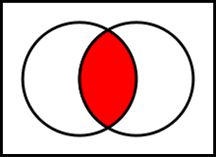
Kolmogorov’s axioms of probability
For any propositions (events) A, B
  0 ≤ P(A) ≤ 1
  P(True) = 1 and P(False) = 0
  P(A ∨ B) = P(A) + P(B) – P(A ∧ B)
    Subtraction accounts for double-counting
Based on these axioms, what is P(¬A)?
These axioms are sufficient to completely specify probability theory for discrete random variables
  For continuous variables, need density functions
A
A∧B
B

Slide 17
Outcomes = Atomic events
OUTCOME or ATOMIC EVENT: is a complete specification of the state of the world, or a complete assignment of domain values to all random variables
  Atomic events are mutually exclusive and exhaustive
E.g., if the world consists of only two Boolean variables Cavity and Toothache, then there are four outcomes:
¬Cavity ∧ ¬Toothache
¬Cavity ∧ Toothache
Cavity ∧ ¬Toothache
Cavity ∧ Toothache

Slide 18
Random variables
We describe the (uncertain) state of the world using random variables
  Denoted by capital letters
  R: Is it raining?
  W: What’s the weather?
  D: What is the outcome of rolling two dice?
  S: What is the speed of my car (in MPH)?
Just like variables in CSPs, random variables take on values in a domain
  Domain values must be mutually exclusive and exhaustive
  R in {True, False}
  W in {Sunny, Cloudy, Rainy, Snow}
  D in {(1,1), (1,2), … (6,6)}
  S in [0, 200]

Slide 19
Random variables
A random variable can be viewed as a function that maps from outcomes to real numbers (or integers, or strings)
For example: the event “Speed=45mph” is the set of all outcomes for which the speed of my car is 45mph

Slide 20
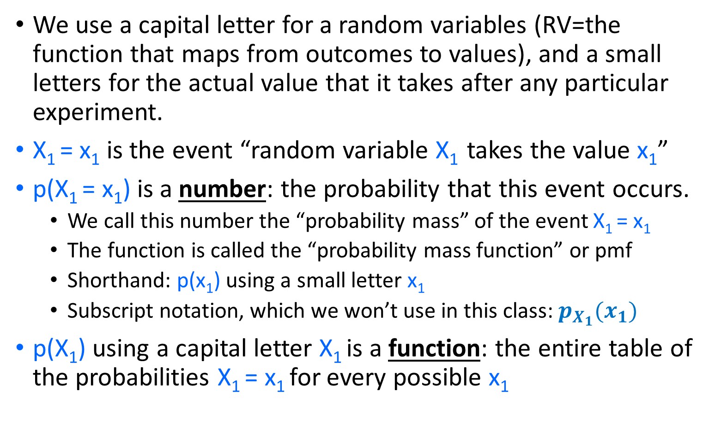
Probability Mass Function (pmf)
We use a capital letter for a random variables (RV=the function that maps from outcomes to values), and a small letters for the actual value that it takes after any particular experiment.
X₁ = x₁ is the event “random variable X₁ takes the value x₁”
p(X₁ = x₁) is a number: the probability that this event occurs.
  We call this number the “probability mass” of the event X₁ = x₁
  The function is called the “probability mass function” or pmf
  Shorthand: p(x₁) using a small letter x₁
  Subscript notation, which we won’t use in this class: $p_{X_{1}}(x_{1})$
p(X₁) using a capital letter X₁ is a function: the entire table of the probabilities X₁ = x₁ for every possible x₁

Slide 21
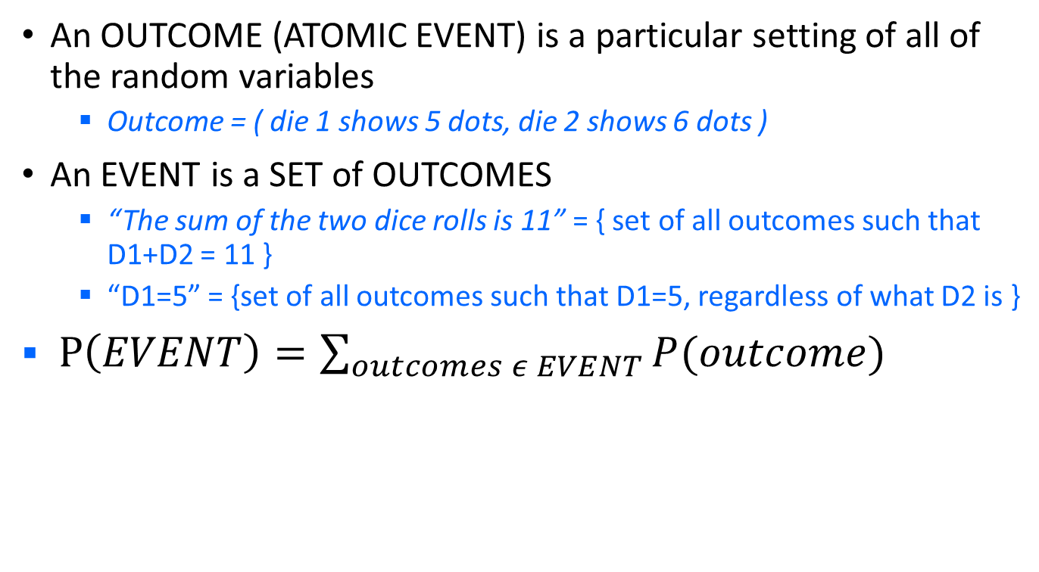
Events and Outcomes
An OUTCOME (ATOMIC EVENT) is a particular setting of all of the random variables
  Outcome = ( die 1 shows 5 dots, die 2 shows 6 dots )
An EVENT is a SET of OUTCOMES
  “The sum of the two dice rolls is 11” = { set of all outcomes such that D1+D2 = 11 }
  “D1=5” = {set of all outcomes such that D1=5, regardless of what D2 is }
$P\left(EVENT\right)=\sum_{outcomes ε EVENT}{P(outcome)}$

Slide 22
Functions of Random Variables
Suppose we are not really interested in any given random variable, instead we’re only interested in a function of the random variables
Example: the game of craps. We’re only interested in the sum of the two dice, e.g., what is the probability that the sum of the two dice is greater than 10.
Define S=D1+D2. How can we calculate the pmf for S?

Slide 23
Outline
Motivation: Why use probability?
  Laziness, Ignorance, and Randomness
  Rational Bettor Theorem
Review of Key Concepts
  Outcomes, Events, and Random Variables
  Joint, Marginal, and Conditional
  Independence and Conditional Independence

Slide 24
Joint probability distributions
A joint distribution is an assignment of probabilities to every possible atomic event
  Why does it follow from the axioms of probability that the probabilities of all possible atomic events must sum to 1?
Atomic event | P
¬Cavity ∧ ¬Toothache | 0.8
¬Cavity ∧ Toothache | 0.1
Cavity ∧ ¬Toothache | 0.05
Cavity ∧ Toothache | 0.05

Slide 25
Joint probability distributions
A joint distribution is an assignment of probabilities to every possible atomic event
Suppose we have a joint distribution of N random variables, each of which takes values from a domain of size D
  What is the size of the probability table?
  Impossible to write out completely for all but the smallest distributions

Slide 26
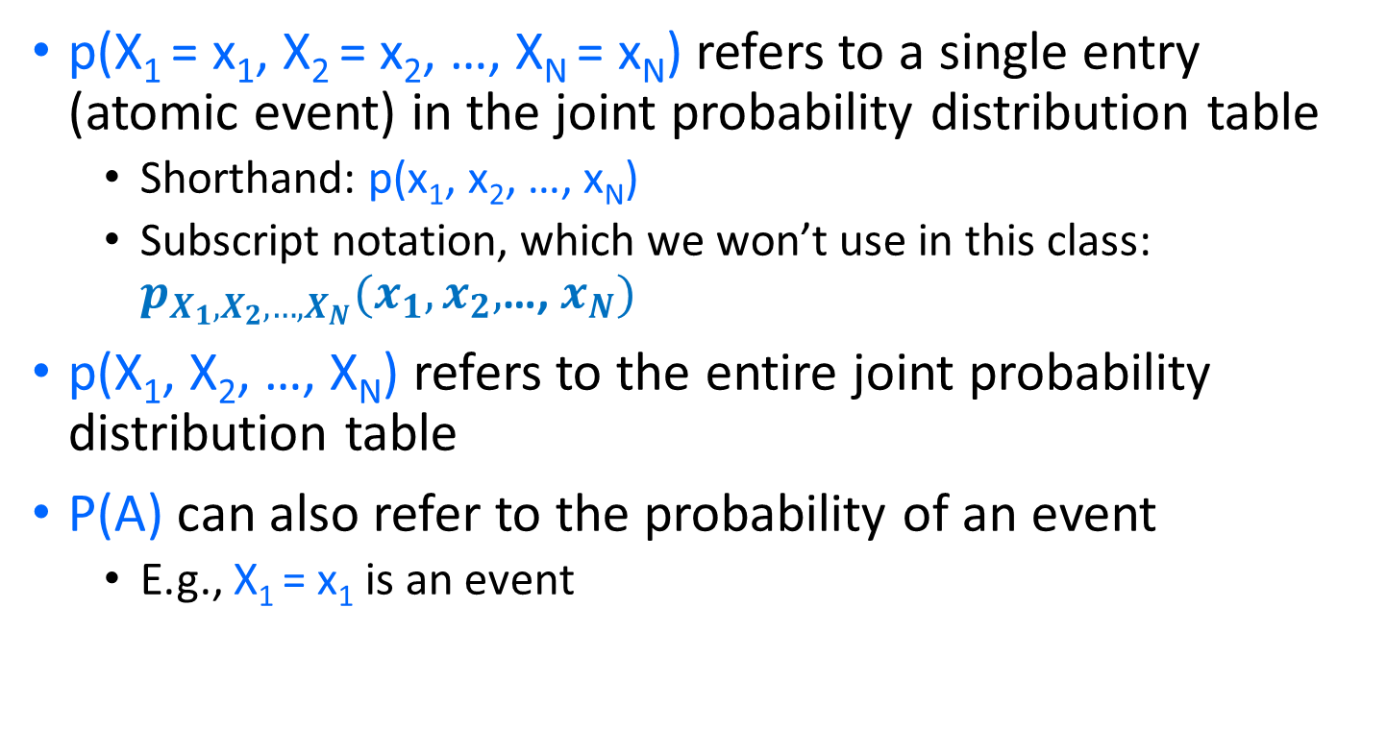
Notation
p(X₁ = x₁, X₂ = x₂, …, X_{N} = x_{N}) refers to a single entry (atomic event) in the joint probability distribution table
  Shorthand: p(x₁, x₂, …, x_{N})
  Subscript notation, which we won’t use in this class: $p_{X_{1},X_{2},…,X_{N}}(x_{1},x_{2},$…, $x_{N})$
p(X₁, X₂, …, X_{N}) refers to the entire joint probability distribution table
P(A) can also refer to the probability of an event
  E.g., X₁ = x₁ is an event

Slide 27
Marginal probability distributions
From the joint distribution p(X,Y) we can find the marginal distributions p(X) and p(Y)
P(Cavity, Toothache)
¬Cavity ∧ ¬Toothache | 0.8
¬Cavity ∧ Toothache | 0.1
Cavity ∧ ¬Toothache | 0.05
Cavity ∧ Toothache | 0.05
P(Cavity)
¬Cavity | ?
Cavity | ?
P(Toothache)
¬Toothache | ?
Toochache | ?

Slide 28
Joint -> Marginal by adding the outcomes
From the joint distribution p(X,Y) we can find the marginal distributions p(X) and p(Y)
To find p(X = x), sum the probabilities of all atomic events where X = x:
This is called marginalization (we are marginalizing out all the variables except X)
$$P\left(X=1\right)=P\left(X=1,Y=1\right)+P\left(X=1,Y=2\right)+P\left(X=1,Y=3\right)+…$$

Slide 29
Conditional Probability: renormalize (divide)
Probability of cavity given toothache:
P(Cavity = true | Toothache = true)
For any two events A and B,
P(A ∧ B)
P(A)
P(B)

Slide 30
Conditional probability
P(Cavity, Toothache)
¬Cavity ∧ ¬Toothache | 0.8
¬Cavity ∧ Toothache | 0.1
Cavity ∧ ¬Toothache | 0.05
Cavity ∧ Toothache | 0.05
P(Cavity)
¬Cavity | 0.9
Cavity | 0.1
P(Toothache)
¬Toothache | 0.85
Toochache | 0.15
What is p(Cavity = true | Toothache = false)?
  p(Cavity|¬Toothache) = ?
What is p(Cavity = false | Toothache = true)?
  p(¬Cavity|Toothache) = ?

Slide 31
Conditional distributions
A conditional distribution is a distribution over the values of one variable given fixed values of other variables
P(Cavity, Toothache)
¬Cavity ∧ ¬Toothache | 0.8
¬Cavity ∧ Toothache | 0.1
Cavity ∧ ¬Toothache | 0.05
Cavity ∧ Toothache | 0.05
P(Cavity | Toothache = true)
¬Cavity | 0.667
Cavity | 0.333
P(Cavity|Toothache = false)
¬Cavity | 0.941
Cavity | 0.059
P(Toothache | Cavity = true)
¬Toothache | 0.5
Toochache | 0.5
P(Toothache | Cavity = false)
¬Toothache | 0.889
Toochache | 0.111

Slide 32
Normalization trick
To get the whole conditional distribution p(X | Y = y) at once, select all entries in the joint distribution table matching Y = y and renormalize them to sum to one
P(Cavity, Toothache)
¬Cavity ∧ ¬Toothache | 0.8
¬Cavity ∧ Toothache | 0.1
Cavity ∧ ¬Toothache | 0.05
Cavity ∧ Toothache | 0.05
Select
Toothache, Cavity = false
¬Toothache | 0.8
Toochache | 0.1
Renormalize
P(Toothache | Cavity = false)
¬Toothache | 0.889
Toochache | 0.111

Slide 33
Normalization trick
To get the whole conditional distribution p(X | Y = y) at once, select all entries in the joint distribution table matching Y = y and renormalize them to sum to one
Why does it work?
by marginalization

Slide 34
Product rule
Definition of conditional probability:
Sometimes we have the conditional probability and want to obtain the joint:

Slide 35
Product rule
Definition of conditional probability:
Sometimes we have the conditional probability and want to obtain the joint:
The chain rule:

Slide 36
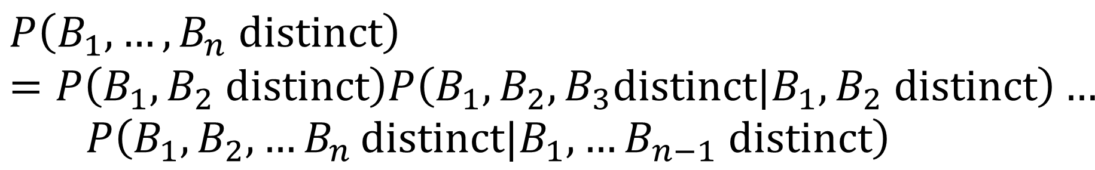
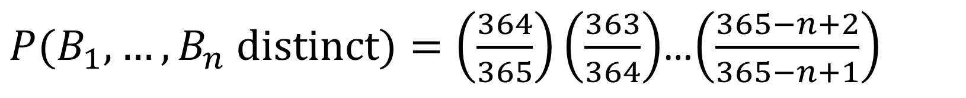
Product Rule Example: The Birthday problem
We have a set of n people. What is the probability that two of them share the same birthday?
Easier to calculate the probability that n people do not share the same birthday
$$P\left(B_{1},…,B_{n} distinct\right)=P\left(B_{1},B_{2} distinct\right)P\left(B_{1},B_{2},B_{3}distinct|B_{1},B_{2} distinct\right)…$$
$$P\left(B_{1},B_{2},{…B}_{n}distinct|B_{1},…B_{n−1} distinct\right)$$
$P(B_{1},…,B_{n} distinct)=\left(\frac{364}{365}\right)\left(\frac{363}{364}\right)$…$\left(\frac{365−n+2}{365−n+1}\right)$

Slide 37
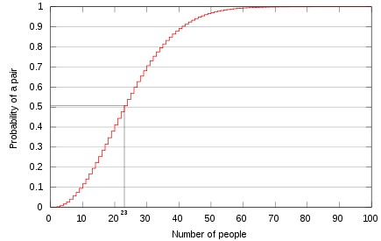
The Birthday problem
For 23 people, the probability of sharing a birthday is above 0.5!
http://en.wikipedia.org/wiki/Birthday_problem

Slide 38
Outline
Motivation: Why use probability?
  Laziness, Ignorance, and Randomness
  Rational Bettor Theorem
Review of Key Concepts
  Outcomes, Events, and Random Variables
  Joint, Marginal, and Conditional
  Independence and Conditional Independence

Slide 39
Independence ≠ Mutually Exclusive
Two events A and B are independent if and only if
p(A ∧ B) = p(A, B) = p(A) p(B)
  In other words, p(A | B) = p(A) and p(B | A) = p(B)
  This is an important simplifying assumption for modeling, e.g., Toothache and Weather can be assumed to be independent?
Are two mutually exclusive events independent?
  No! Quite the opposite! If you know A happened, then you know that B _didn’t_ happen!!
  p(A ∨ B) = p(A) + p(B)

Slide 40
Independence ≠ Conditional Independence
Two events A and B are independent if and only if
p(A ∧ B) = p(A) p(B)
  In other words, p(A | B) = p(A) and p(B | A) = p(B)
  This is an important simplifying assumption for modeling, e.g., Toothache and Weather can be assumed to be independent
Conditional independence: A and B are conditionally independent given C iff
p(A ∧ B | C) = p(A | C) p(B | C)
  Equivalent:
  p(A | B, C) = p(A | C)
  Equivalent:
  p(B | A, C) = p(B | C)

Slide 41
Conditional independence: Example
Toothache: boolean variable indicating whether the patient has a toothache
Cavity: boolean variable indicating whether the patient has a cavity
Catch: whether the dentist’s probe catches in the cavity
If the patient has a cavity, the probability that the probe catches in it doesn't depend on whether he/she has a toothache
  p(Catch|Toothache, Cavity) = p(Catch|Cavity)
Therefore, Catch is conditionally independent of Toothache given Cavity
Likewise, Toothache is conditionally independent of Catch given Cavity
p(Toothache|Catch, Cavity) = p(Toothache | Cavity)
Equivalent statement:
  p(Toothache, Catch|Cavity) = p(Toothache|Cavity) p(Catch|Cavity)

Slide 42
Random Audience Participation Slide
List some pairs of events that are independent
  … here is a pair of events ….
List some pairs of events that are mutually exclusive
  …. here is some different pair of events ….
List some pairs of events that are conditionally independent given knowledge of some third event
  … whoa, now we need event triples. …

