Slide 1
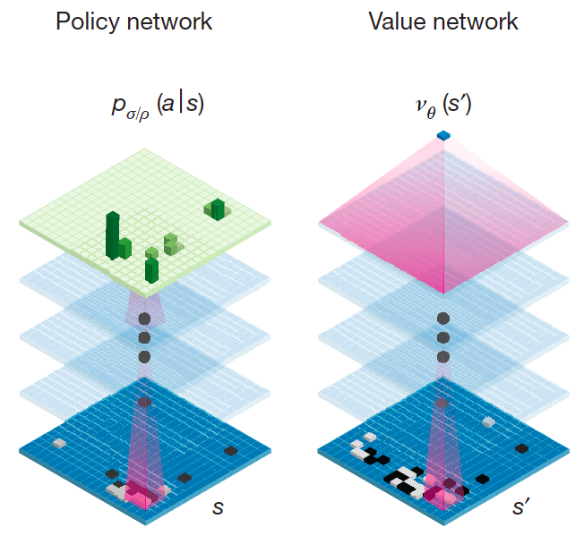
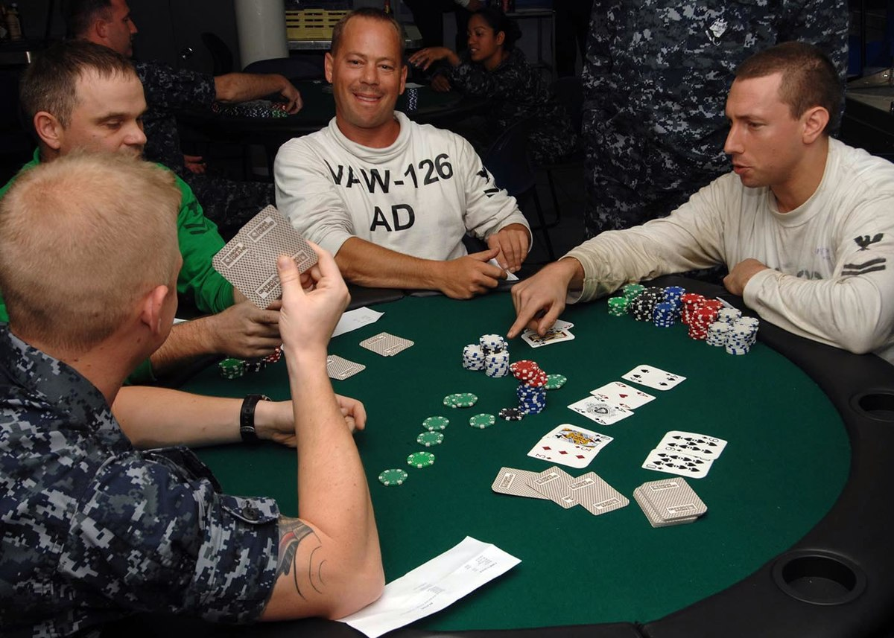
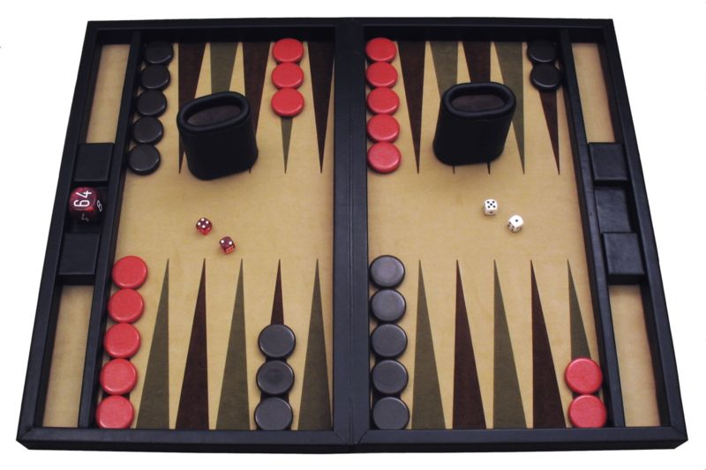
CS440/ECE448 Lecture 10:
Stochastic Games, Stochastic Search, and Learned Evaluation Functions
Slides by Svetlana Lazebnik, 9/2016
Modified by Mark Hasegawa-Johnson, 1/2018

Slide 2
Types of game environments
 | Deterministic | Stochastic
Perfect information (fully observable)
Imperfect information (partially observable)
Chess, checkers, go
Backgammon, monopoly
Battleship
Scrabble, poker, bridge

Slide 3
Content of today’s lecture
Stochastic games: the Expectiminimax algorithm
Imperfect information
  Minimax formulation
  Expectiminimax formulation
Stochastic search, even for deterministic games
Learned evaluation functions
Case study: Alpha-Go

Slide 4
Stochastic games
How can we incorporate dice throwing into the game tree?

Slide 5
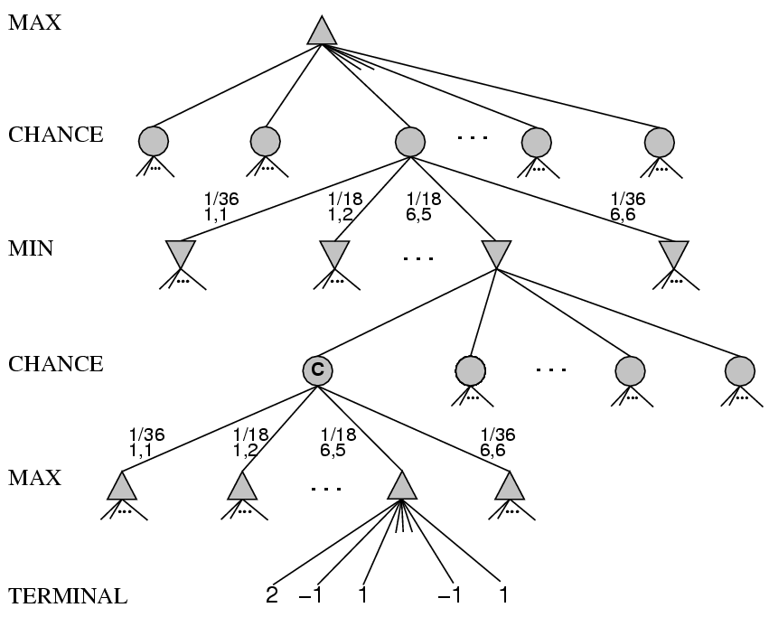
Stochastic games

Slide 6
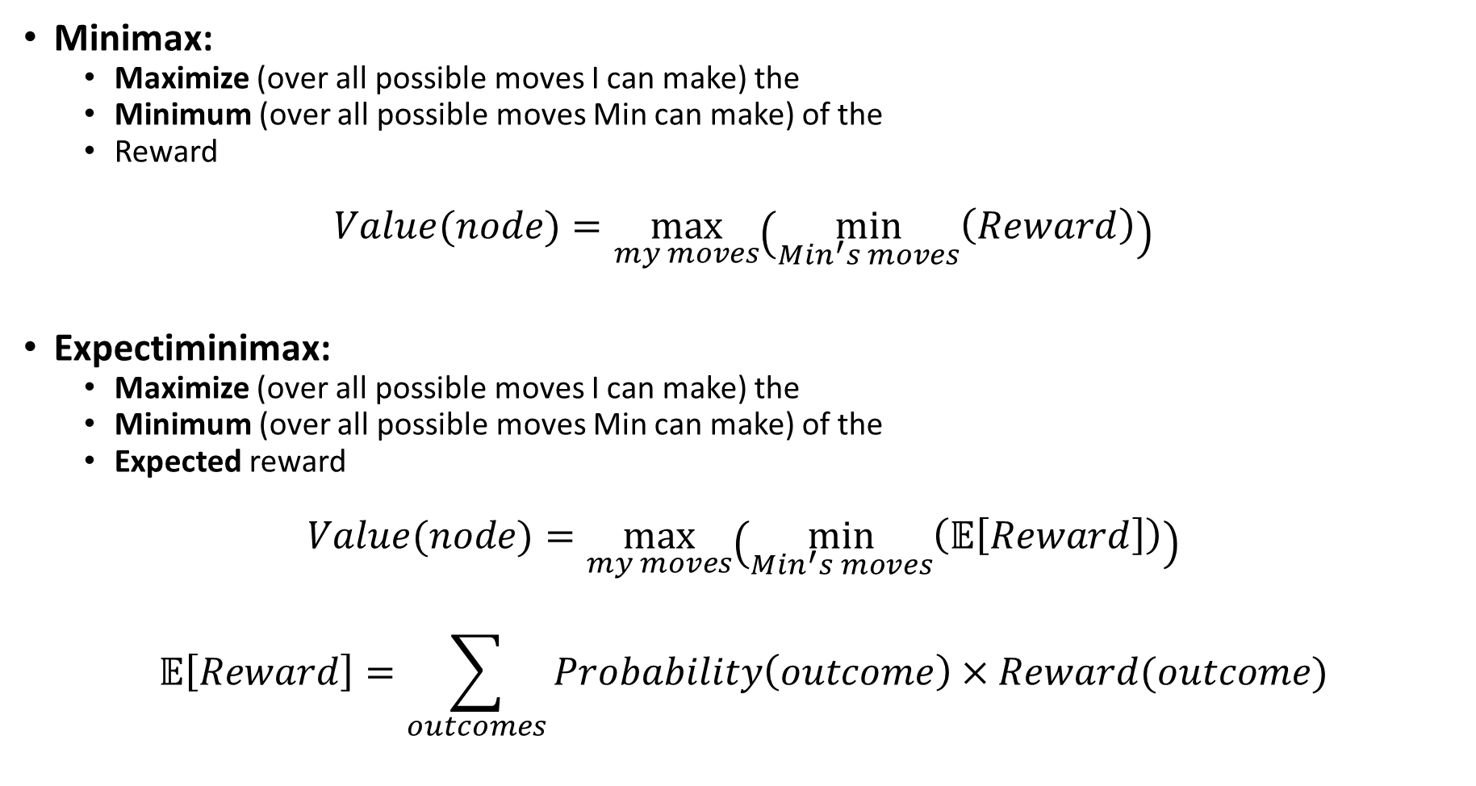
Minimax vs. Expectiminimax
Minimax:
  Maximize (over all possible moves I can make) the
  Minimum (over all possible moves Min can make) of the
  Reward
$$Value(node)=\max_{my moves}\left(\min_{Min^{′}s moves}\left(Reward\right)\right)$$
Expectiminimax:
  Maximize (over all possible moves I can make) the
  Minimum (over all possible moves Min can make) of the
  Expected reward
$$Value(node)=\max_{my moves}\left(\min_{Min^{′}s moves}\left(𝔼\left[Reward\right]\right)\right)$$
$$𝔼\left[Reward\right]=\sum_{outcomes}{Probability\left(outcome\right)×Reward(outcome)}$$

Slide 7
Stochastic games
Expectiminimax: for chance nodes, sum values of successor states weighted by the probability of each successor
Value(node) =
  Utility(node) if node is terminal
  max_{action} Value(Succ(node, action)) if type = MAX
  min_{action} Value(Succ(node, action)) if type = MIN
  sum_{action} P(Succ(node, action)) * Value(Succ(node, action)) if type = CHANCE

Slide 8
Expectiminimax example
½
H
T
RANDOM: Max flips a coin. It’s heads or tails.
MAX: Max either stops, or continues.
  Stop on heads: Game ends, Max wins (value = $2).
  Stop on tails: Game ends, Max loses (value = -$2).
  Continue: Game continues.
RANDOM: Min flips a coin.
  HH: value = $2
  TT: value = -$2
  HT or TH: value = 0
MIN: Min decides whether to keep the current outcome (value as above), or pay a penalty (value=$1).
2
-1
½
2
-1
-2
H
T
H
T
1
0
0
-2
2
1
0
1
0
1
-2
1

Slide 9
Expectiminimax summary
All of the same methods are useful:
  Alpha-Beta pruning
  Evaluation function
  Quiescence search, Singular move
Computational complexity is pretty bad
  Branching factor of the random choice can be high
  Twice as many “levels” in the tree

Slide 10
Games of Imperfect Information

Slide 11
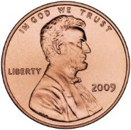
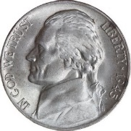
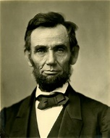
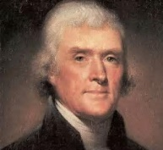
Imperfect information example
Min chooses a coin.
I say the name of a U.S. President.
  If I guessed right, she gives me the coin.
  If I guessed wrong, I have to give her a coin to match the one she has.
1
-1
-5
5

Slide 12
Imperfect information example
The problem: I don’t know which state I’m in. I only know it’s one of these two.
1
-1
-5
5

Slide 13
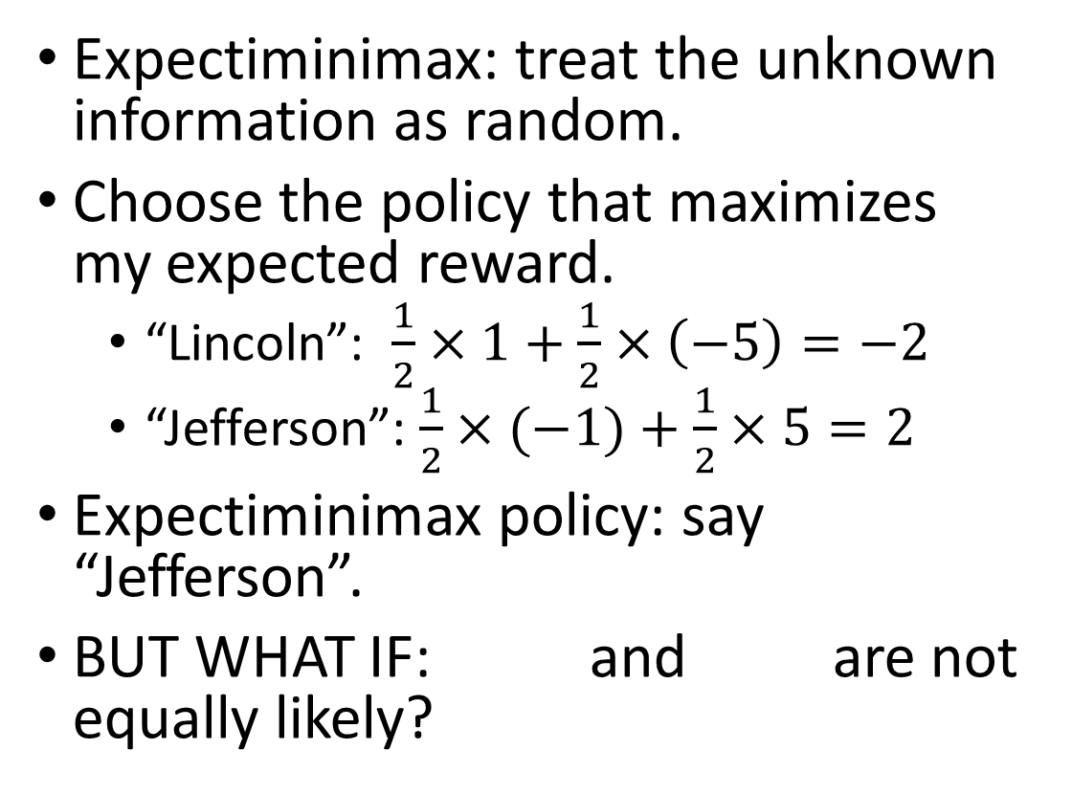
Method #1: Treat “unknown” as “random”
Expectiminimax: treat the unknown information as random.
Choose the policy that maximizes my expected reward.
  “Lincoln”: $\frac{1}{2}×1+\frac{1}{2}×\left(−5\right)=−2$
  “Jefferson”: $\frac{1}{2}×(−1)+\frac{1}{2}×5=2$
Expectiminimax policy: say “Jefferson”.
BUT WHAT IF: and are not equally likely?
1
-1
-5
5

Slide 14
Method #2: Treat “unknown” as “unknown”
Suppose Min can choose whichever coin she wants. She knows that I will pick Jefferson – then she will pick the penny!
Another reasoning: I want to know what is my worst-case outcome (e.g., to decide if I should even play this game…)
The solution: choose the policy that maximizes my minimum reward.
  “Lincoln”: minimum reward is -5.
  “Jefferson”: minimum reward is -1.
Miniminimax policy: say “Jefferson”.
1
-1
-5
5

Slide 15
How to deal with imperfect information
If you think you know the probabilities of different settings, and if you want to maximize your average winnings (for example, you can afford to play the game many times): expectiminimax
If you have no idea of the probabilities of different settings; or, if you can only afford to play once, and you can’t afford to lose: miniminimax
If the unknown information has been selected intentionally by your opponent: use game theory

Slide 16
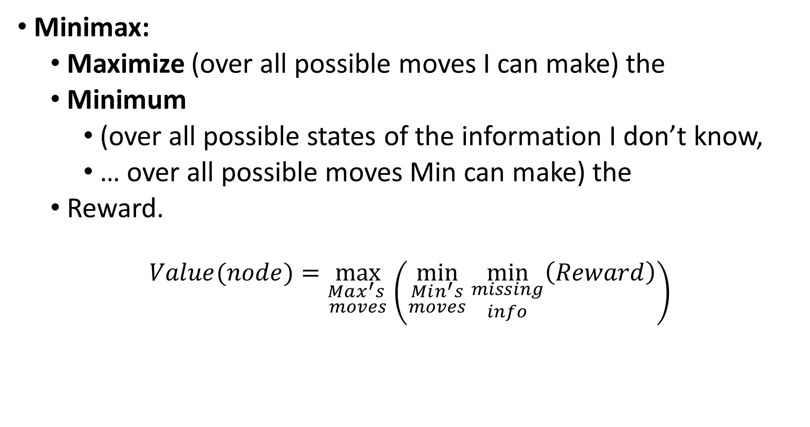
Miniminimax with imperfect information
Minimax:
  Maximize (over all possible moves I can make) the
  Minimum
    (over all possible states of the information I don’t know,
    … over all possible moves Min can make) the
  Reward.
$$Value(node)=\max_{\begin{aligned}Max^{′}s \\ moves\end{aligned}}\left(\min_{\begin{aligned}Min^{′}s \\ moves\end{aligned}}{\min_{\begin{aligned}missing \\ info\end{aligned}}\left(Reward\right)}\right)$$

Slide 17
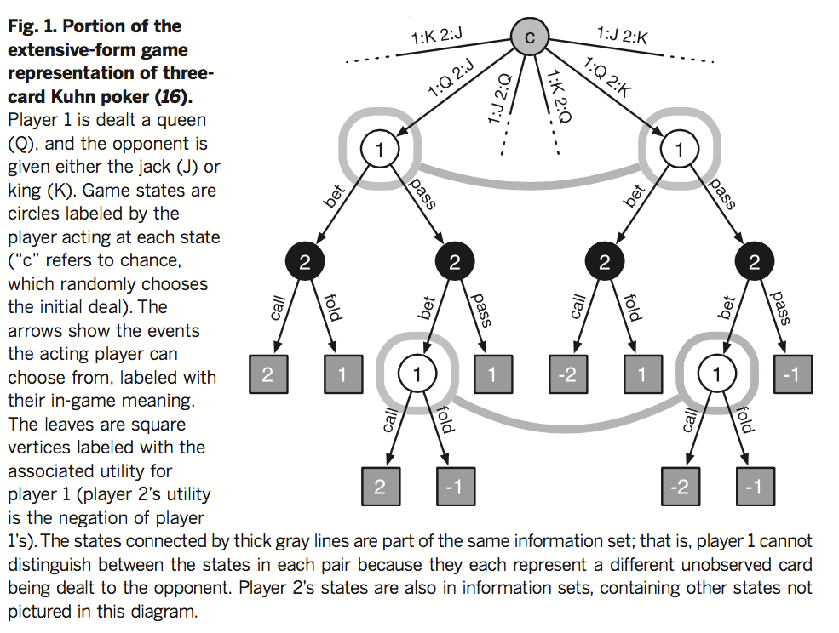
Stochastic games of imperfect information
States are grouped into information sets for each player
Source

Slide 18
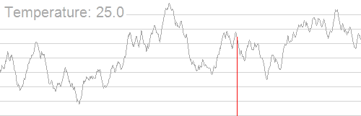
Stochastic search

Slide 19
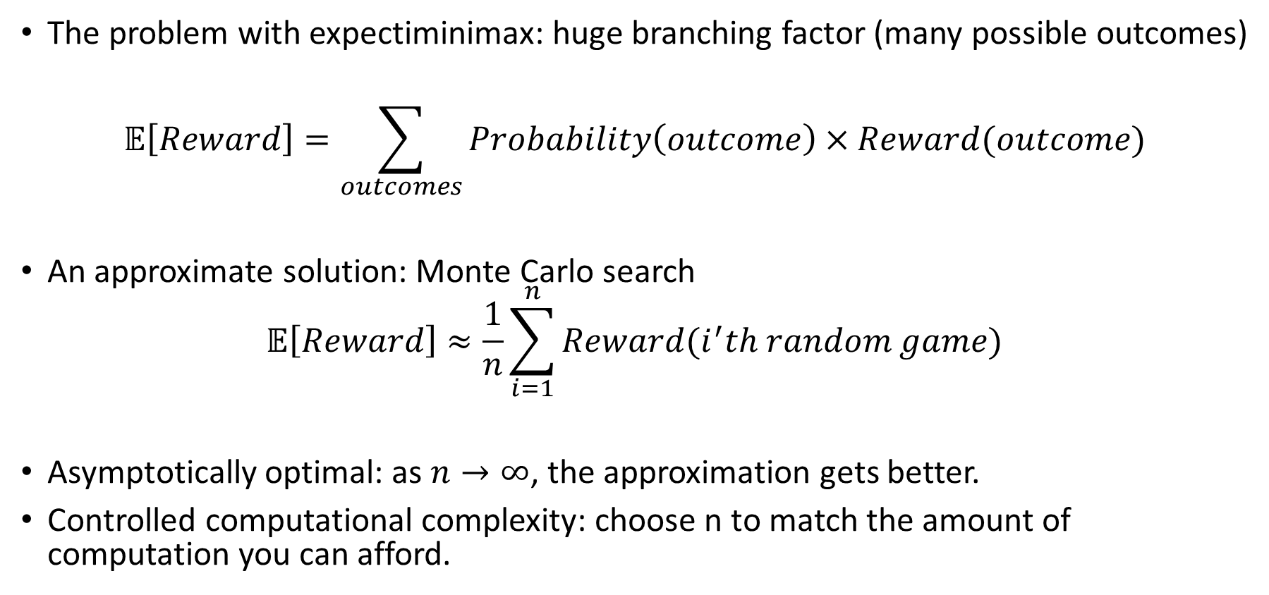
Stochastic search for stochastic games
The problem with expectiminimax: huge branching factor (many possible outcomes)
$$𝔼\left[Reward\right]=\sum_{outcomes}{Probability\left(outcome\right)×Reward(outcome)}$$
An approximate solution: Monte Carlo search
$$𝔼\left[Reward\right]≈\frac{1}{n}\sum_{i=1}^{n}{Reward(i^{′}th random game)}$$
Asymptotically optimal: as $n→∞$, the approximation gets better.
Controlled computational complexity: choose n to match the amount of computation you can afford.

Slide 20
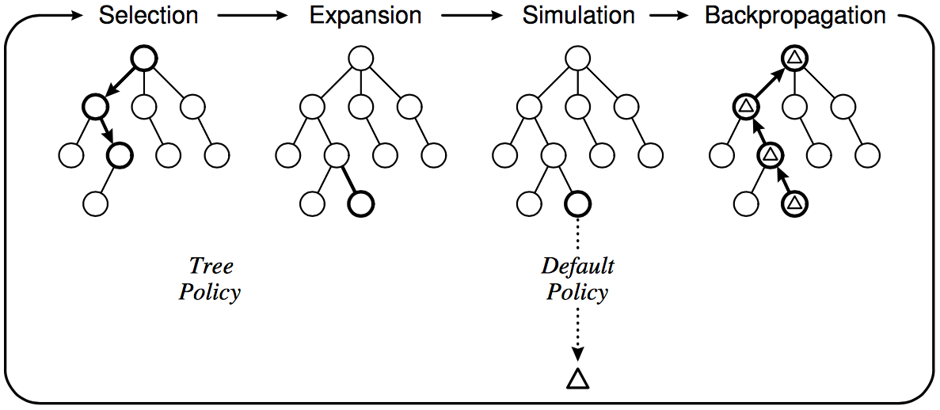
Monte Carlo Tree Search
What about deterministic games with deep trees, large branching factor,
and no good heuristics – like Go?
Instead of depth-limited search with an evaluation function,
use randomized simulations
Starting at the current state (root of search tree), iterate:
  Select a leaf node for expansion
  using a tree policy (trading off
  exploration and exploitation)
  Run a simulation using
  a default policy (e.g., random
  moves) until a terminal state
  is reached
  Back-propagate the outcome
  to update the value estimates
  of internal tree nodes
C. Browne et al., A survey of Monte Carlo Tree Search Methods, 2012

Slide 21
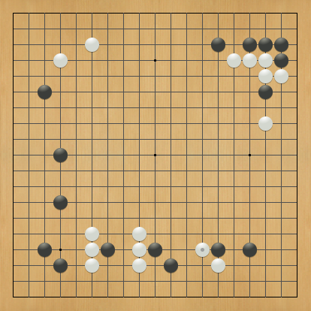
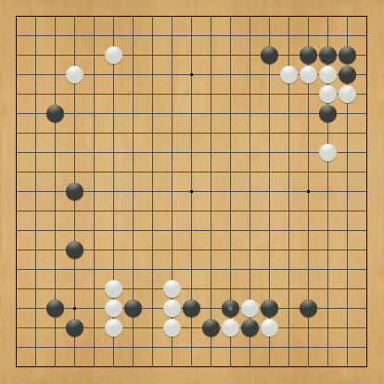
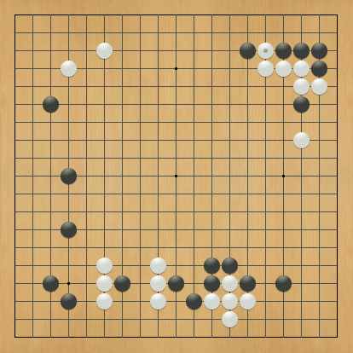
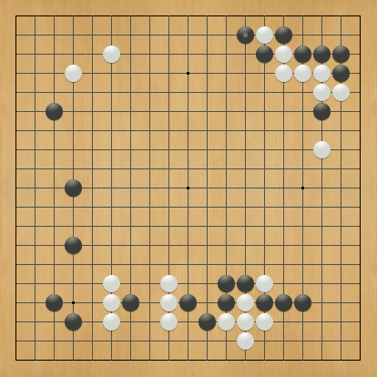
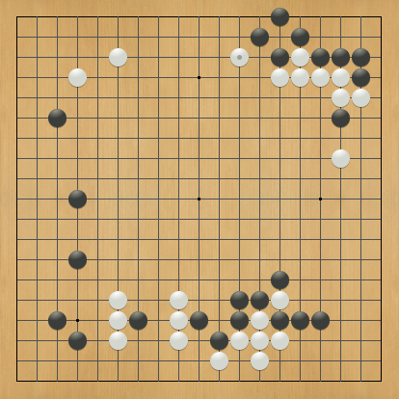
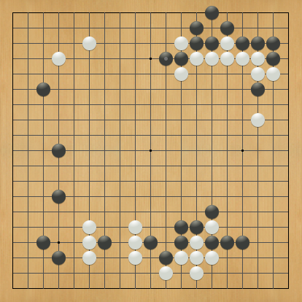
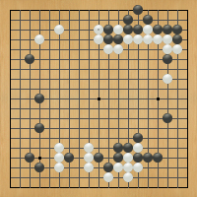
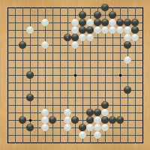
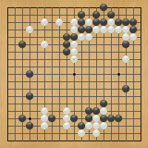
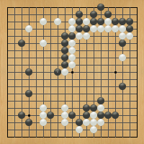
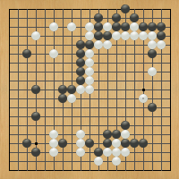
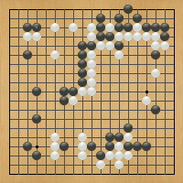
Learned evaluation functions

Slide 22
Stochastic search off-line
Training phase:
Spend a few weeks allowing your computer to play billions of random games from every possible starting state
Value of the starting state = average value of the ending states achieved during those billion random games
Testing phase:
During the alpha-beta search, search until you reach a state whose value you have stored in your value lookup table
Oops…. Why doesn’t this work?

Slide 23


Evaluation as a pattern recognition problem
Training phase:
Spend a few weeks allowing your computer to play billions of random games from billions of possible starting states.
Value of the starting state = average value of the ending states achieved during those billion random games
Generalization:
Featurize (e.g., x1=number of patterns, x2 = number of patterns, etc.)
Linear regression: find a1, a2, etc. so that Value(state) ≈ a1*x1+a2*x2+…
Testing phase:
During the alpha-beta search, search as deep as you can, then estimate the value of each state at your horizon using Value(state) ≈ a1*x1+a2*x2+…

Slide 24
Pros and Cons
Learned evaluation function
  Pro: off-line search permits lots of compute time, therefore lots of training data
  Con: there’s no way you can evaluate every starting state that might be achieved during actual game play. Some starting states will be missed, so generalized evaluation function is necessary
On-line stochastic search
  Con: limited compute time
  Pro: it’s possible to estimate the value of the state you’ve reached during actual game play

Slide 25
Case study: AlphaGo
“Gentlemen should not waste their time on trivial games -- they should play go.”
-- Confucius,
The Analects
ca. 500 B. C. E.
Anton Ninno Roy Laird, Ph.D.
antonninno@yahoo.com roylaird@gmail.com
special thanks to Kiseido Publications

Slide 26
AlphaGo
Deep convolutional neural networks
  Treat the Go board as an image
  Powerful function approximation machinery
  Can be trained to predict distribution over possible moves (policy) or expected value of position
D. Silver et al., Mastering the Game of Go with Deep Neural Networks and Tree Search, Nature 529, January 2016

Slide 27
AlphaGo
SL policy network
  Idea: perform supervised learning (SL) to predict human moves
  Given state s, predict probability distribution over moves a, P(a|s)
  Trained on 30M positions, 57% accuracy on predicting human moves
  Also train a smaller, faster rollout policy network (24% accurate)
RL policy network
  Idea: fine-tune policy network using reinforcement learning (RL)
  Initialize RL network to SL network
  Play two snapshots of the network against each other, update parameters to maximize expected final outcome
  RL network wins against SL network 80% of the time, wins against open-source Pachi Go program 85% of the time
D. Silver et al., Mastering the Game of Go with Deep Neural Networks and Tree Search, Nature 529, January 2016

Slide 28
AlphaGo
SL policy network
RL policy network
Value network
  Idea: train network for position evaluation
  Given state s, estimate v(s), expected outcome of play starting with position s and following the learned policy for both players
  Train network by minimizing mean squared error between actual and predicted outcome
  Trained on 30M positions sampled from different self-play games
D. Silver et al., Mastering the Game of Go with Deep Neural Networks and Tree Search, Nature 529, January 2016

Slide 29
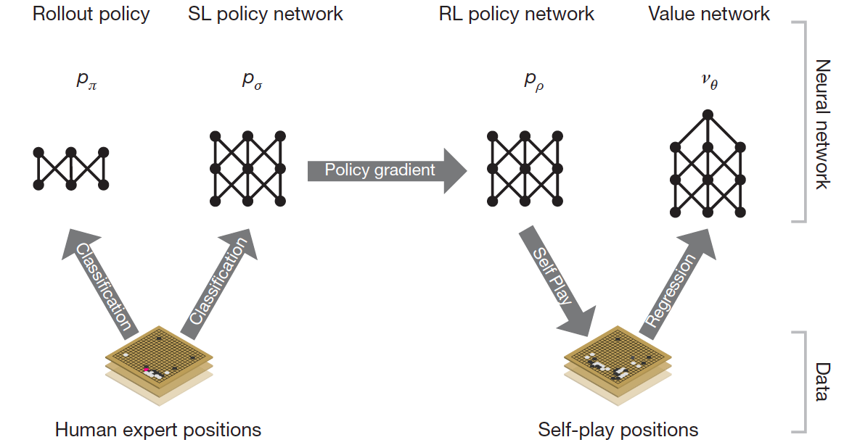
AlphaGo
D. Silver et al., Mastering the Game of Go with Deep Neural Networks and Tree Search, Nature 529, January 2016

Slide 30
AlphaGo
Monte Carlo Tree Search
  Each edge in the search tree maintains prior probabilities P(s,a), counts N(s,a), action values Q(s,a)
  P(s,a) comes from SL policy network
  Tree traversal policy selects actions that maximize Q value plus exploration bonus (proportional to P but inversely proportional to N)
  An expanded leaf node gets a value estimate that is a combination of value network estimate and outcome of simulated game using rollout network
  At the end of each simulation, Q values are updated to the average of values of all simulations passing through that edge
D. Silver et al., Mastering the Game of Go with Deep Neural Networks and Tree Search, Nature 529, January 2016

Slide 31
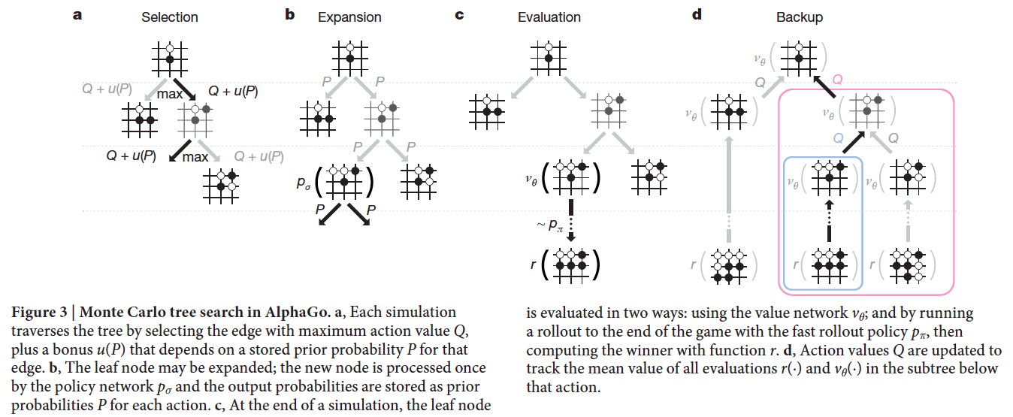
AlphaGo
Monte Carlo Tree Search
D. Silver et al., Mastering the Game of Go with Deep Neural Networks and Tree Search, Nature 529, January 2016

Slide 32
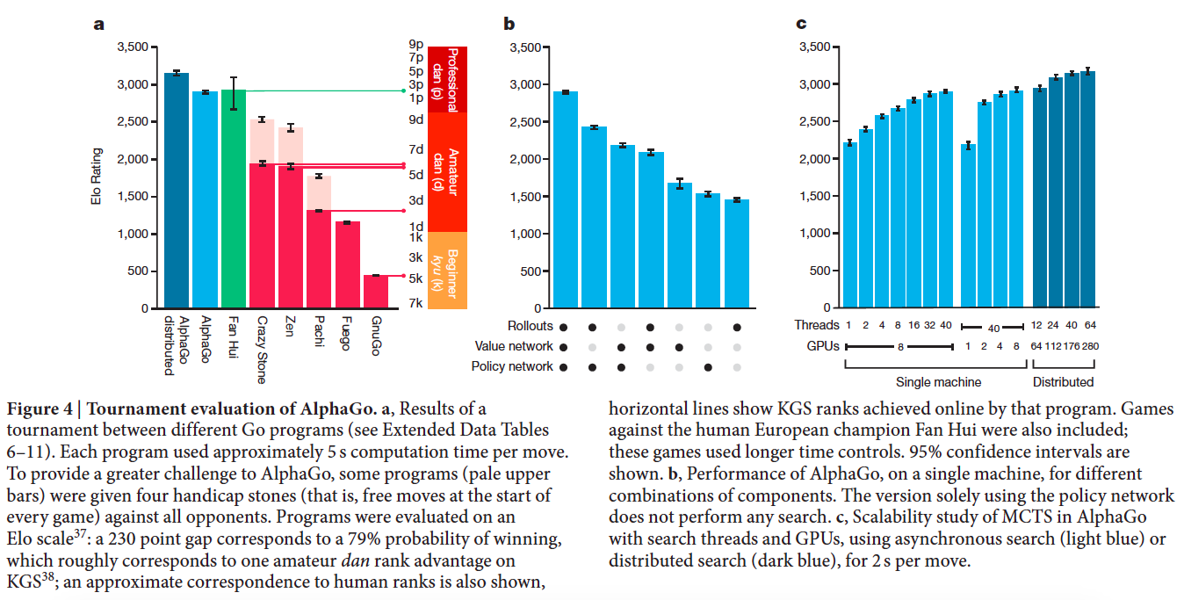
AlphaGo
D. Silver et al., Mastering the Game of Go with Deep Neural Networks and Tree Search, Nature 529, January 2016

Slide 33
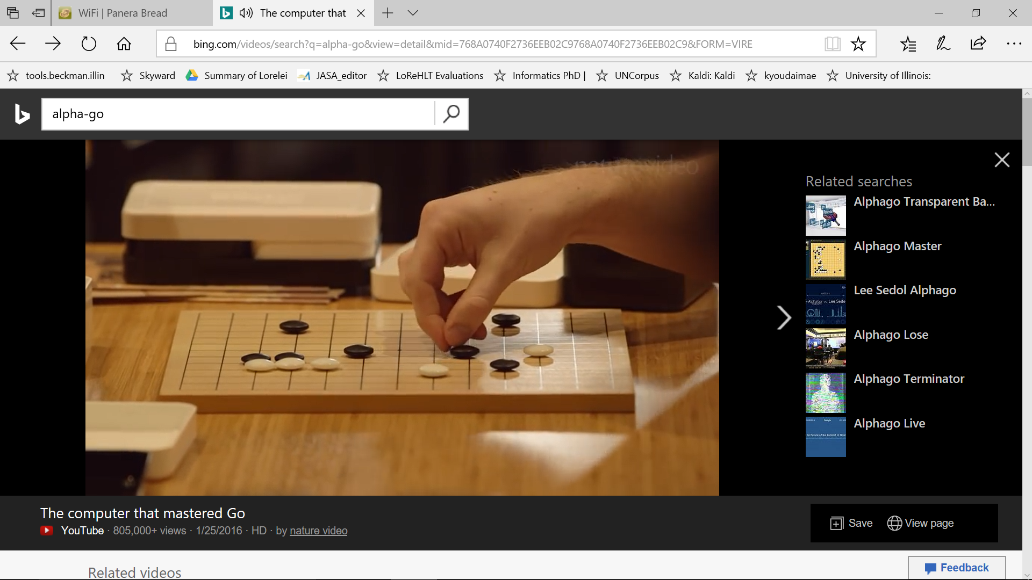
Alpha-Go video

Slide 34
Game AI: Origins
Minimax algorithm: Ernst Zermelo, 1912
Chess playing with evaluation function, quiescence search, selective search:
Claude Shannon, 1949 (paper)
Alpha-beta search: John McCarthy, 1956
Checkers program that learns its own evaluation function by playing against itself: Arthur Samuel, 1956 (Rodney Brooks blog post)

Slide 35
Game AI: State of the art
Computers are better than humans:
  Checkers: solved in 2007
  Chess:
    State-of-the-art search-based systems now better than humans
    Deep learning machine teaches itself chess in 72 hours, plays at International Master Level (arXiv, September 2015)
Computers are competitive with top human players:
  Backgammon: TD-Gammon system (1992) used reinforcement learning to learn a good evaluation function
  Bridge: top systems use Monte Carlo simulation and alpha-beta search
  Go: computers were not considered competitive until AlphaGo in 2016

Slide 36
Game AI: State of the art
Computers are not competitive with top human players:
  Poker
    Heads-up limit hold’em poker is solved (2015)
      Simplest variant played competitively by humans
      Smaller number of states than checkers, but partial observability makes it difficult
      Essentially weakly solved = cannot be beaten with statistical significance
      in a lifetime of playing
    CMU’s Libratus system beats four of the best human players at no-limit Texas Hold’em poker (2017)

Slide 37
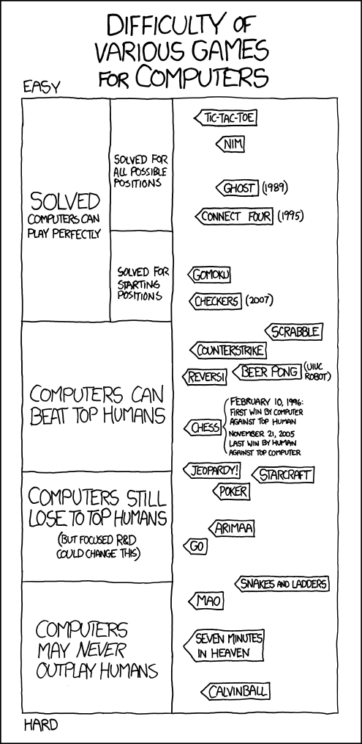
http://xkcd.com/1002/
See also: http://xkcd.com/1263/

Slide 38
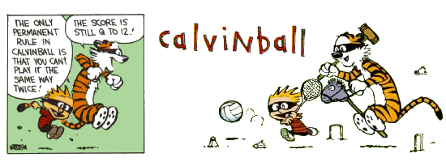
Calvinball:
Play it online
Watch an instructional video

