Slide 1
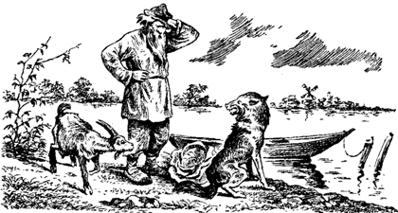
Planning (Chapter 10) Slides by Svetlana Lazebnik, 9/2016 with modifications by Mark Hasegawa-Johnson, 1/2018
CC BY-SA 3.0, https://commons.wikimedia.org/w/index.php?curid=18656684

Slide 2
Planning Problems
Examples: River Crossing, Cargo Delivery, Design-for-Disassembly, Story-Telling, Translation Alignment, Tower of Hanoi
Planning as a search problem
Formulation
Computational Complexity: PSPACE > NP
Algorithms for planning
Forward Chaining
Backward Chaining
Polynomial Heuristics that Reduce the Exponent
Number of Steps
Planning Graph
Mutex (Mutually Exclusive) pairs

Slide 3
Example: River Crossing Problems https://en.wikipedia.org/wiki/River_crossing_puzzle
A farmer has a fox, a goat, and a bag of beans to get across the river
His boat will only carry him + one object
He can’t leave the fox with the goat
He can’t leave the goat with the bag of beans

Slide 4
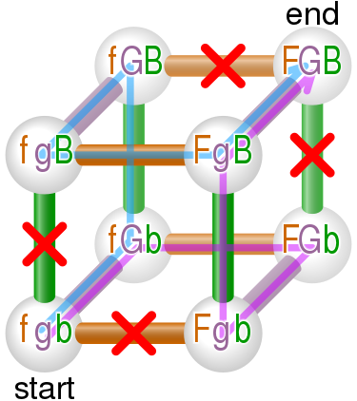
Solution https://en.wikipedia.org/wiki/River_crossing_puzzle
fgb -----(farmer, goat)----→ fGb
fGb ←-----(farmer)-----------
-----(farmer,fox)-----→ FGb
Fgb ←--(farmer,goat)------
-----(farmer,beans)---→ FgB
FgB ←-------(farmer)--------
-----(farmer,goat)----→ FGB

Slide 5
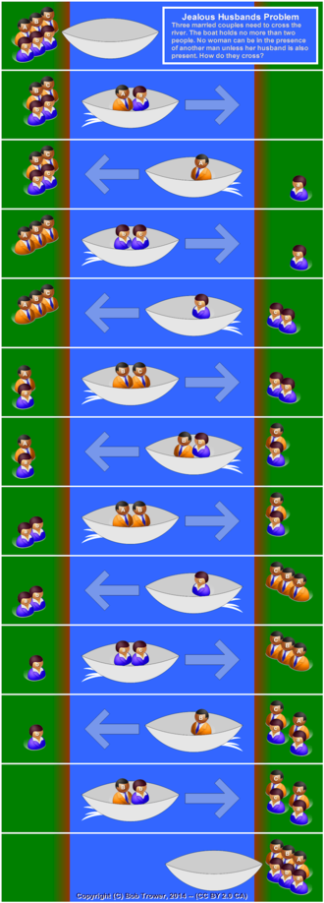
Example: Jealous husbands problem https://en.wikipedia.org/wiki/Missionaries_and_cannibals_problem
Three couples come to a river. The boat will only hold two people.
No woman can be alone in the boat, or on either shore, with a man other than her husband.

Slide 6
Example: Cargo delivery problem
You have packages waiting for pickup at Atlanta, Boston, Charlotte, Denver, Edmonton, and Fairbanks
They must be delivered to Albuquerque, Baltimore, Chicago, Des Moines, El Paso, and Frisco
You have two trucks. Each truck can hold only two packages at a time.

Slide 7
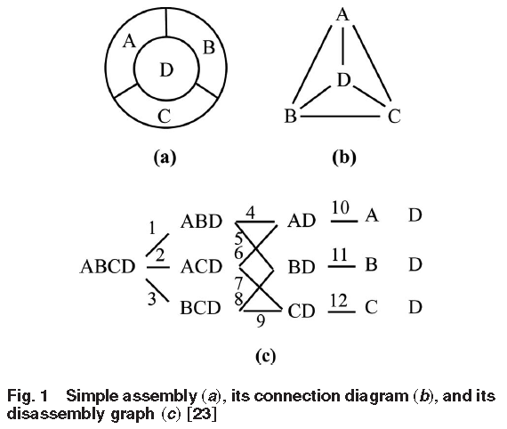
Example: Design for Disassembly ”Simultaneous Selective Disassembly and End-of-Life Decision Making for Multiple Products That Share Disassembly Operations,” Sara Behdad, Minjung Kwak, Harrison Kim and Deborah Thurston. J. Mech. Des 132(4), 2010, doi:10.1115/1.4001207
Design decisions limit the sequence in which you can disassemble a product at the end of its life
Problem statement: design the product in order to make disassembly as cheap as possible

Slide 8

Application of planning: Automated storytelling
https://research.cc.gatech.edu/inc/mark-riedl

Slide 9
Application of planning: Automated storytelling
Applications
Personalized experience in games
Automatically generating training scenarios (e.g., for the army)
Therapy for kids with autism
Computational study of creativity
https://research.cc.gatech.edu/inc/mark-riedl

Slide 10
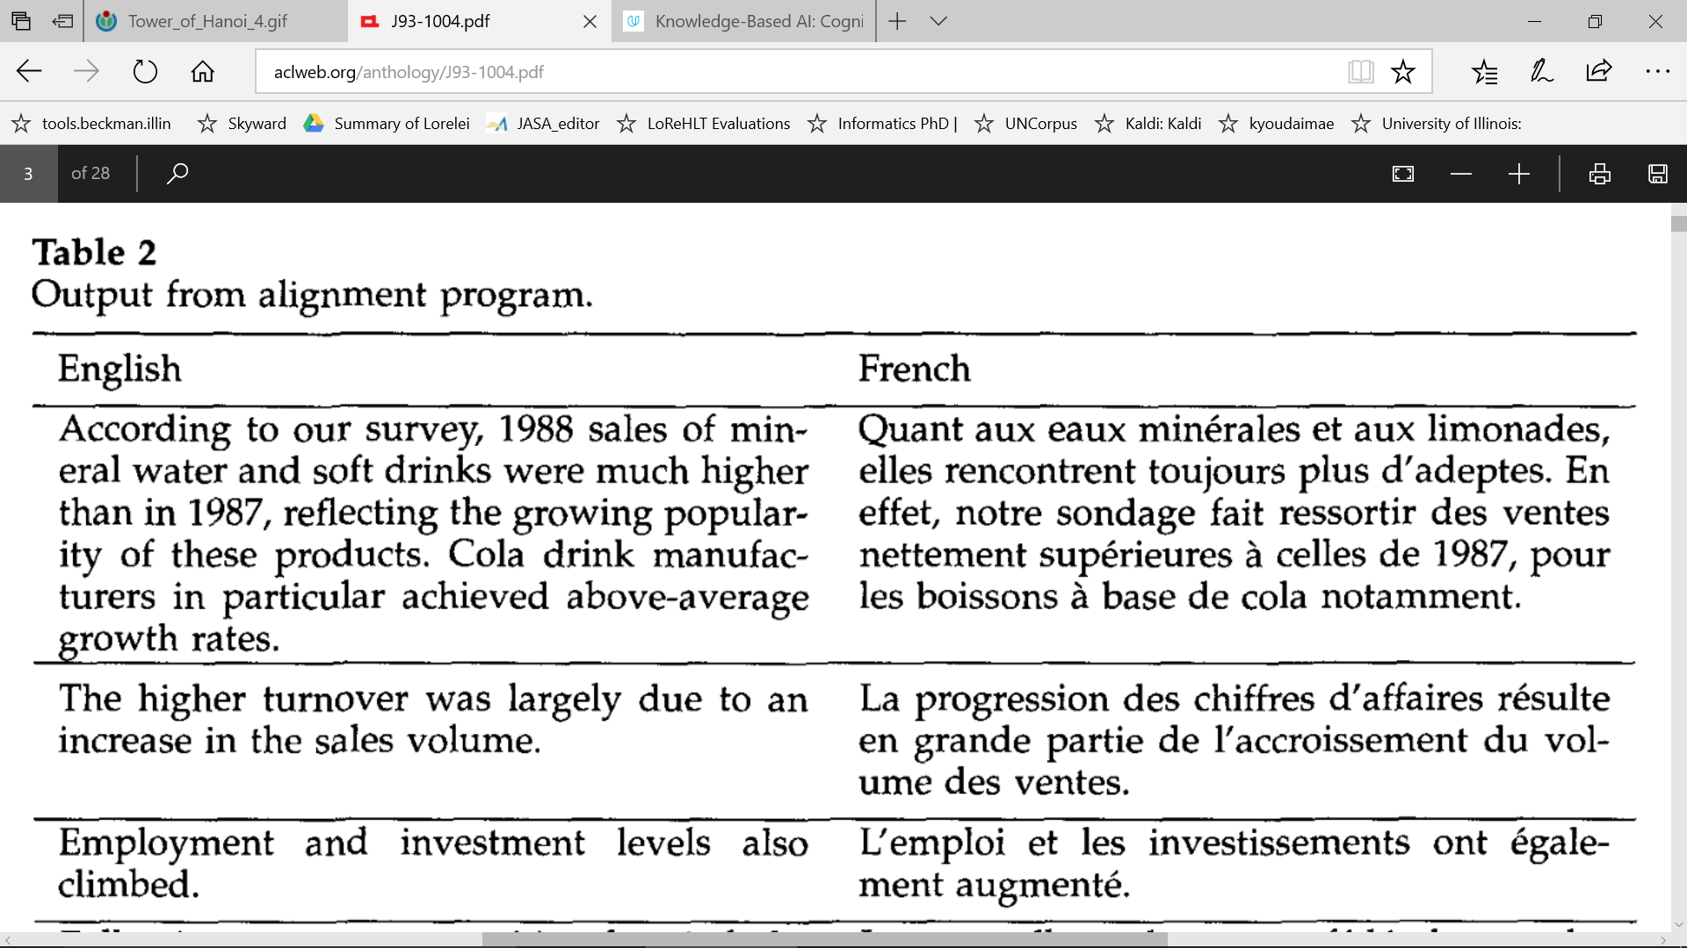
Application of planning: the Gale-Church alignment algorithm for machine translation

Slide 11
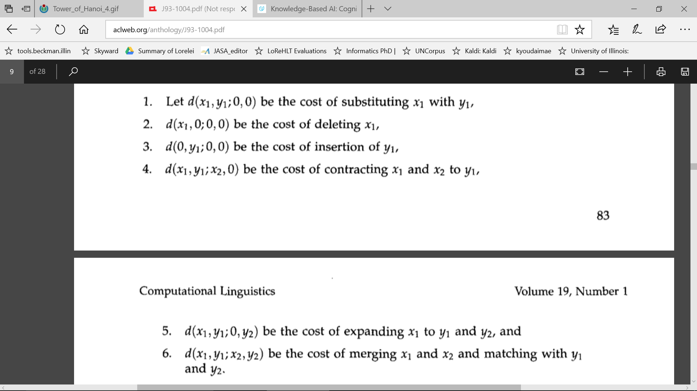
Application of planning: the Gale-Church alignment algorithm for machine translation

Slide 12
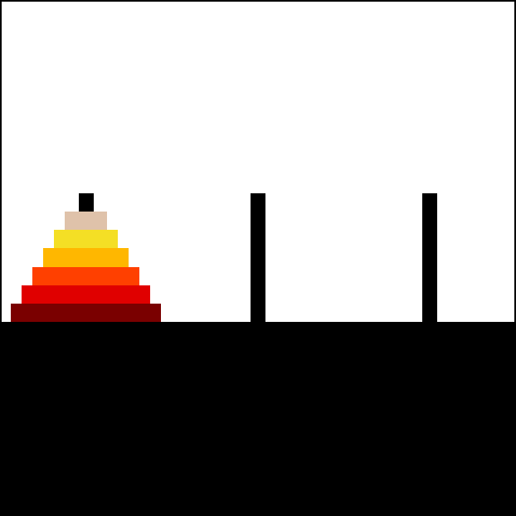
Example: Tower of Hanoi https://en.wikipedia.org/wiki/Tower_of_Hanoi
Description | English: This is a visualization generated with the walnut based on my implementation at [1] of the iterative algorithm described in Tower of Hanoi
Date | 30 April 2015
Source | I designed this using http://thewalnut.io/
Author | Trixx

Slide 13
Planning Problems
Examples: River Crossing, Cargo Delivery, Design-for-Disassembly, Story-Telling, Translation Alignment, Tower of Hanoi
Planning as a search problem
Formulation
Computational Complexity: PSPACE > NP
Algorithms for planning
Forward Chaining
Backward Chaining
Polynomial Heuristics that Reduce the Exponent
Number of Steps
Planning Graph
Mutex (Mutually Exclusive) pairs

Slide 14
Search review
A search problem is defined by STATES and ACTIONS:
States: Initial state, Goal state, Transition model
Actions: Transition model, Cost

Slide 15
Planning as Search
States defined by variable=value tuples
Example: fox=left, goat=right, beans=left
Variables, Values determined by the problem
Usually you have freedom to decide which is which
Initial state = particular setting of variables to values
Goal state = desired setting of variables to values
This is just like CSP!!!

Slide 16
Planning as Search
Pre-specified set of possible actions
Example: carry_left(beans), carry_right(goat)
Action = function of one or more variables
Result = variables changed in pre-defined way
With pre-defined cost
This is not at all like CSP. Order of the actions is important.
Constraints apply not just to the goal state, but also to every intermediate state.

Slide 17
A representation for planning
STRIPS (Stanford Research Institute Problem Solver): classical planning framework from the 1970s
States are specified as conjunctions of predicates
Start state: At(home) ∧ Sells(SM, Milk) ∧ Sells(SM, Bananas) ∧ Sells(HW, drill)
Goal state: At(home) ∧ Have(Milk) ∧ Have(Banana) ∧ Have(drill)
Actions are described in terms of preconditions and effects:
Go(x, y)
Precond: At(x)
Effect: ¬At(x) ∧ At(y)
Buy(x, store)
Precond: At(store) ∧ Sells(store, x)
Effect: Have(x)
Planning is “just” a search problem

Slide 18

Complexity
Planning is PSPACE-complete > NP-complete
The computational complexity of finding a plan is exponential
The length of the plan is exponential
Space necessary to represent it
Time necessary to implement it
The only thing that’s polynomial: the amount of space necessary to represent the world state while finding or implementing a plan
Example: towers of Hanoi

Slide 19
Complexity of planning
Planning is PSPACE-complete
The length of a plan can be exponential in the number of “objects” in the problem!
So is game search
Archetypal PSPACE-complete problem: quantified boolean formula (QBF)
Example: is this formula true? ∃x₁∀x₂ ∃x₃∀x₄ (x₁∨¬x₃∨x₄)∧(¬x₂∨x₃∨¬x₄)
Compare to SAT: ∃x₁ ∃x₂ ∃x₃ ∃x₄ (x₁∨¬x₃∨x₄)∧(¬x₂∨x₃∨¬x₄)
Relationship between SAT and QBF is akin to the relationship between puzzles and games

Slide 20
Planning Problems
Examples: River Crossing, Cargo Delivery, Design-for-Disassembly, Story-Telling, Translation Alignment, Tower of Hanoi
Planning as a search problem
Formulation
Computational Complexity: PSPACE > NP
Algorithms for planning
Forward Chaining
Backward Chaining
Polynomial Heuristics that Reduce the Exponent
Number of Steps
Planning Graph
Mutex (Mutually Exclusive) pairs

Slide 21
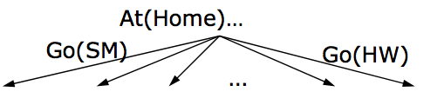
Algorithms for planning
Forward (progression) state-space search: starting with the start state, find all applicable actions (actions for which preconditions are satisfied), compute the successor state based on the effects, keep searching until goals are met
Can work well with good heuristics
https://www.youtube.com/watch?v=QLNSkFnBYuM

Slide 22
Algorithms for planning
Forward (progression) state-space search: starting with the start state, find all applicable actions (actions for which preconditions are satisfied), compute the successor state based on the effects, keep searching until goals are met
Can work well with good heuristics
Backward (regression) relevant-states search: to achieve a goal, what must have been true in the previous state?

Slide 23
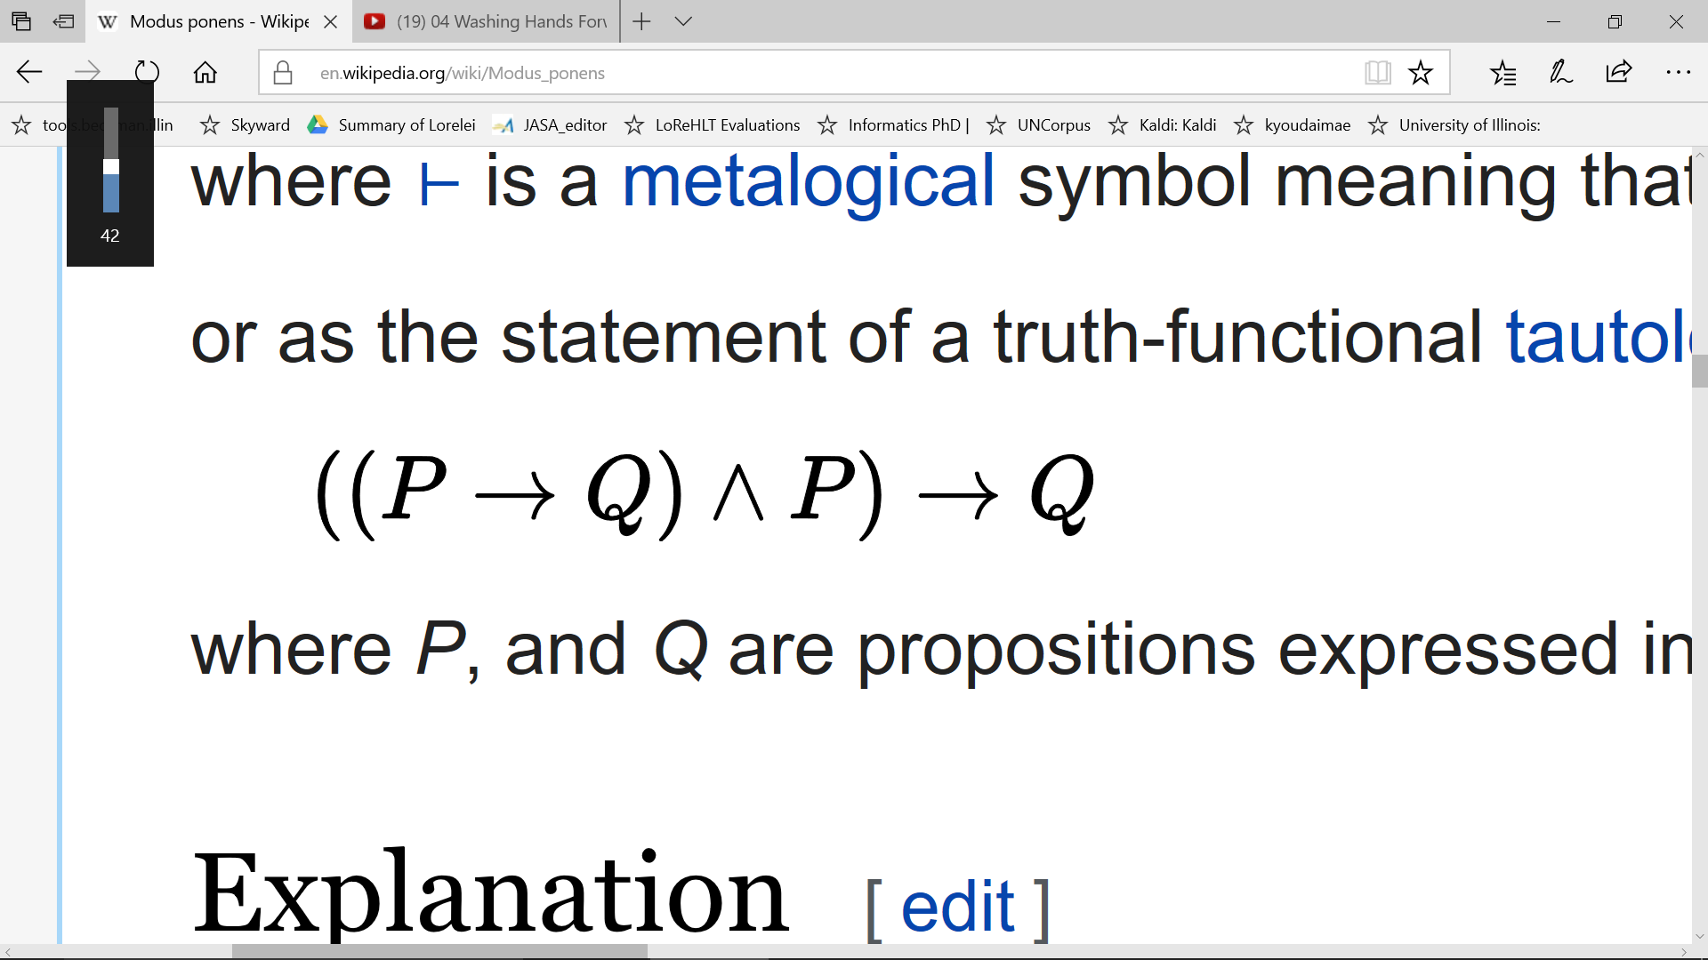
Forward-chaining: each step in the search finds a possible next state
In forward-chaining, we start from a state, P, that the search process has already achieved
We then check to see whether it is possible to apply modus ponens: given the current state P, is there any operation P→Q available?

Slide 24
Backward-chaining: each step in the search finds a relevant previous state
In backward-chaining, we start from a state, Q, that we want to achieve
We then check to see whether it is possible to apply modus ponens in order to generate Q from any other state, P:

Slide 25
Planning Problems
Examples: River Crossing, Cargo Delivery, Design-for-Disassembly, Story-Telling, Translation Alignment, Tower of Hanoi
Planning as a search problem
Formulation
Computational Complexity: PSPACE > NP
Algorithms for planning
Forward Chaining
Backward Chaining
Polynomial Heuristics that Reduce the Exponent
Number of Steps
Planning Graph
Mutex (Mutually Exclusive) pairs

Slide 26

A* Heuristics by Constraint Relaxation
Heuristics from Constraint Relaxation: The heuristic h(n) is the number of steps it would take to get from n to G, if problem constraints were relaxed --- this guarantees that h(n) is admissible
$h_{1}(n)$ dominates $h_{2}(n)$ ($h_{1}(n)≥h_{2}(n)$) if $h_{1}(n)$ is computed by relaxing fewer constraints.

Slide 27
First heuristic: number of goal fluents left to achieve
Terminology: the fluent Xk is defined to be true iff the variable X is equal to the value k, and false otherwise.
Heuristic #1: Count the number of actions necessary to generate all of the fluents in the goal state that aren’t already true.
What got relaxed: we ignore action pre-requisites.
Example: 6 people on left side of the river, we want 6 people on the right side, we have a 2-person boat. Minimum # actions: h(n) = 3.

Slide 28
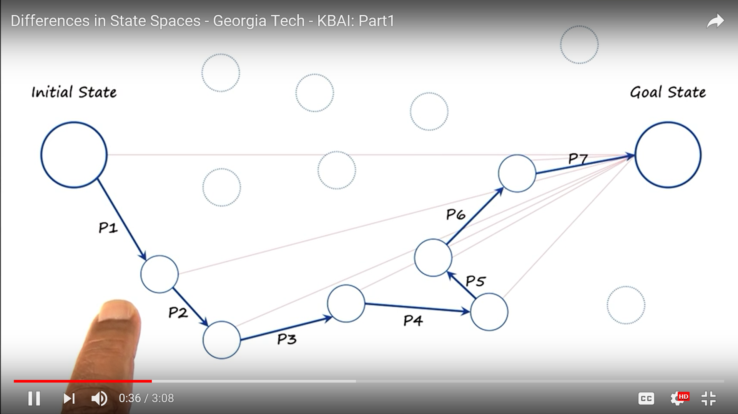
Heuristics for planning: means-ends analysis

Slide 29
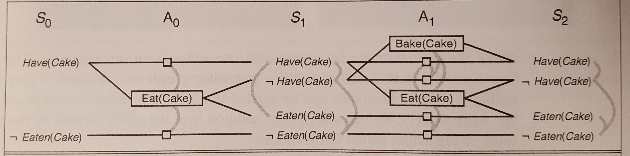
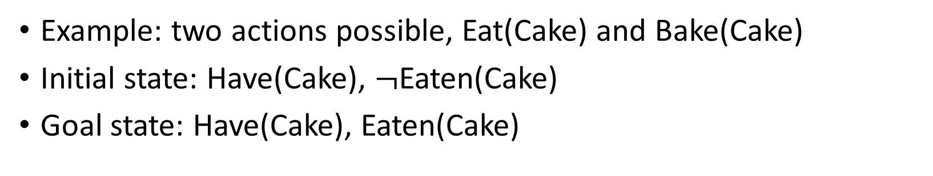
Example problem that we’ll use for next two heuristics
Example: two actions possible, Eat(Cake) and Bake(Cake)
Initial state: Have(Cake), $¬$Eaten(Cake)
Goal state: Have(Cake), Eaten(Cake)

Slide 30
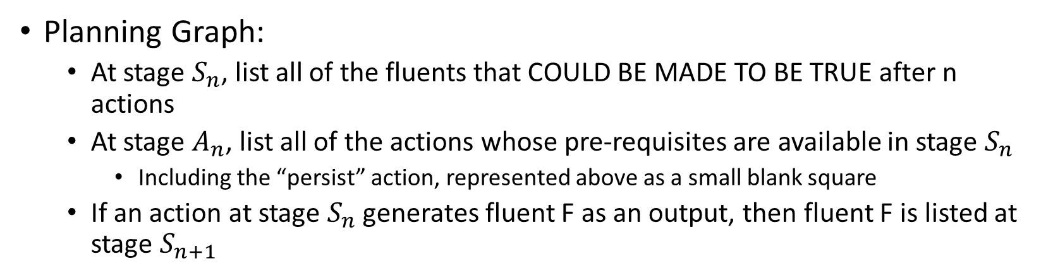
Heuristic #2: Get the fluents into the planning graph
Planning Graph:
At stage $S_{n}$, list all of the fluents that COULD BE MADE TO BE TRUE after n actions
At stage $A_{n}$, list all of the actions whose pre-requisites are available in stage $S_{n}$
Including the “persist” action, represented above as a small blank square
If an action at stage $S_{n}$ generates fluent F as an output, then fluent F is listed at stage $S_{n+1}$

Slide 31
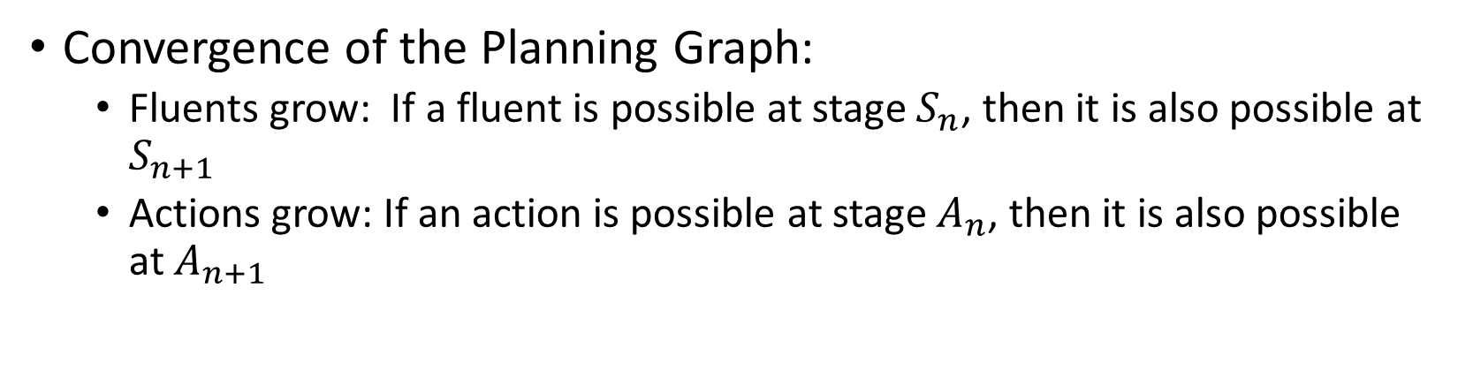
Heuristic #2: Get the fluents into the planning graph
Convergence of the Planning Graph:
Fluents grow: If a fluent is possible at stage $S_{n}$, then it is also possible at $S_{n+1}$
Actions grow: If an action is possible at stage $A_{n}$, then it is also possible at $A_{n+1}$

Slide 32
Heuristic #2: Get the fluents into the planning graph
Heuristic:
h(n) = # stages between the current stage and the first stage at which all of the goal-state fluents COULD BE MADE TO BE TRUE
“Current stage” can be defined in a few different ways:
Based on the number of actions you’ve already done, … or …
The first stage at which all of the fluents in your current world state are already present

Slide 33
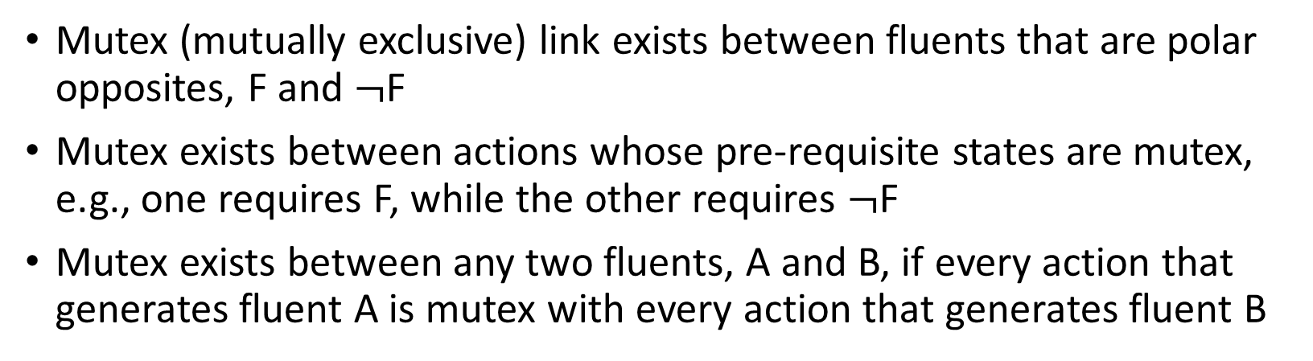
Heuristic #3: Mutex links
Mutex (mutually exclusive) link exists between fluents that are polar opposites, F and $¬$F
Mutex exists between actions whose pre-requisite states are mutex, e.g., one requires F, while the other requires $¬$F
Mutex exists between any two fluents, A and B, if every action that generates fluent A is mutex with every action that generates fluent B

Slide 34
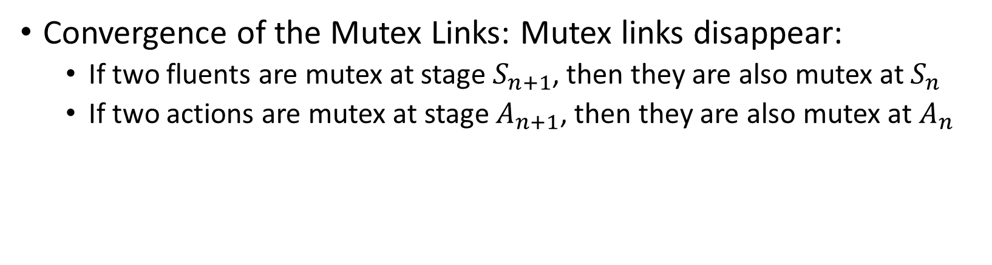
Heuristic #3: Get the fluents into the planning graph
Convergence of the Mutex Links: Mutex links disappear:
If two fluents are mutex at stage $S_{n+1}$, then they are also mutex at $S_{n}$
If two actions are mutex at stage $A_{n+1}$, then they are also mutex at $A_{n}$

Slide 35
Heuristic #3: Get the fluents into the planning graph
Heuristic: h(n) = # stages from the current world state until the first stage at which the goal state is non-mutex
In fact, this is exactly the true path cost, if all constraints are binary

Slide 36
Situation space planning vs. plan space planning
Situation space planners: each node in the search space represents a world state, arcs are actions in the world
Plans are sequences of actions from start to finish
Must be totally ordered
Plan space planners: nodes are (incomplete) plans, arcs are transformations between plans
Actions in the plan may be partially ordered
Principle of least commitment: avoid ordering plan steps unless absolutely necessary

Slide 37
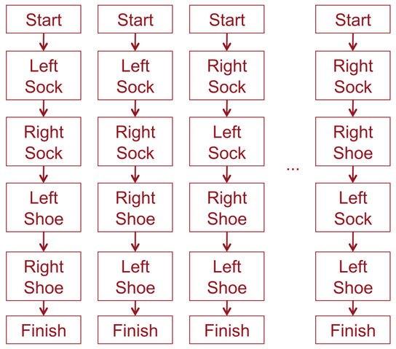
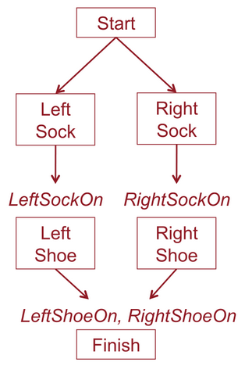
Partial order planning
Task: put on socks and shoes
Partial order plan
Total order (linear) plans

Slide 38
Partial Order Planning Example
Start
Sells(SM, Milk)
At(Home)
Sells(SM, Bananas)
Start: empty plan
Action: find flaw in the plan and modify plan to fix the flaw
Have(Milk)
Have(Bananas)
Finish

Slide 39
Partial Order Planning Example
Start
Sells(SM, Milk)
At(Home)
Sells(SM, Bananas)
At(x3)
Go(x3, SM)
At(SM)
Sells(x1, Milk)
At(x1)
At(x2)
Sells(x2, Bananas)
Buy(x1, Milk)
Buy(x2, Bananas)
Have(Milk)
Have(Bananas)
x1 = SM
Have(Milk)
Have(Bananas)
x2 = SM
x3 = Home
Finish

Slide 40
Real-world planning
Resource constraints
Instead of “static,” the world is “semidynamic:” we can’t think forever
Actions at different levels of granularity: hierarchical planning
In order to make the depth of the search smaller, we might convert the world from “fully observable” to “partially observable”
Contingencies: actions failing
Instead of being “deterministic,” maybe the world is “stochastic”
Incorporating sensing and feedback
Possibly necessary to address stochastic or multi-agent environments

