Slide 1

CS440/ECE448 Lecture 5:
Search Order
Slides by Svetlana Lazebnik, 9/2016
Revised by Mark Hasegawa-Johnson, 1/2018

Slide 2
Prioritized Search
Review: Tree Search vs. Dijkstra’s Algorithm
Criteria for evaluating a search algorithm: completeness, optimality, computational cost, storage cost
Search algorithms without side information: BFS, DFS, IDS, UCS
Search algorithms with side information: GBFS vs. A*
  Heuristics to guide search
  Greedy best-first search
  A* search
  Admissible vs. Consistent heuristics
  Designing heuristics: Relaxed problem, Sub-problem, Dominance, Max

Slide 3
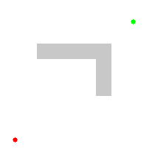
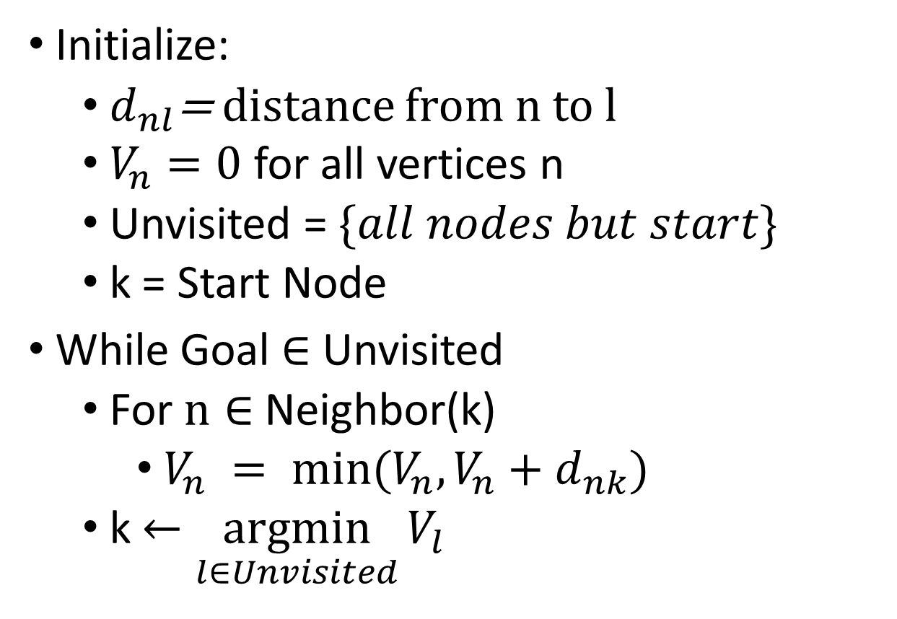
Dijkstra’s Shortest Path Algorithm
Initialize:
  $d_{nl}$= distance from n to l
  $V_{n}=0$ for all vertices n
  Unvisited = $\{all nodes but start\}$
  k = Start Node
While Goal $∈$ Unvisited
  For $n∈$ Neighbor(k)
    $V_{n} = min⁡(V_{n},V_{n}+d_{nk})$
  k $←\underset{l∈Unvisited}{argmin}{V_{l}}$

Slide 4
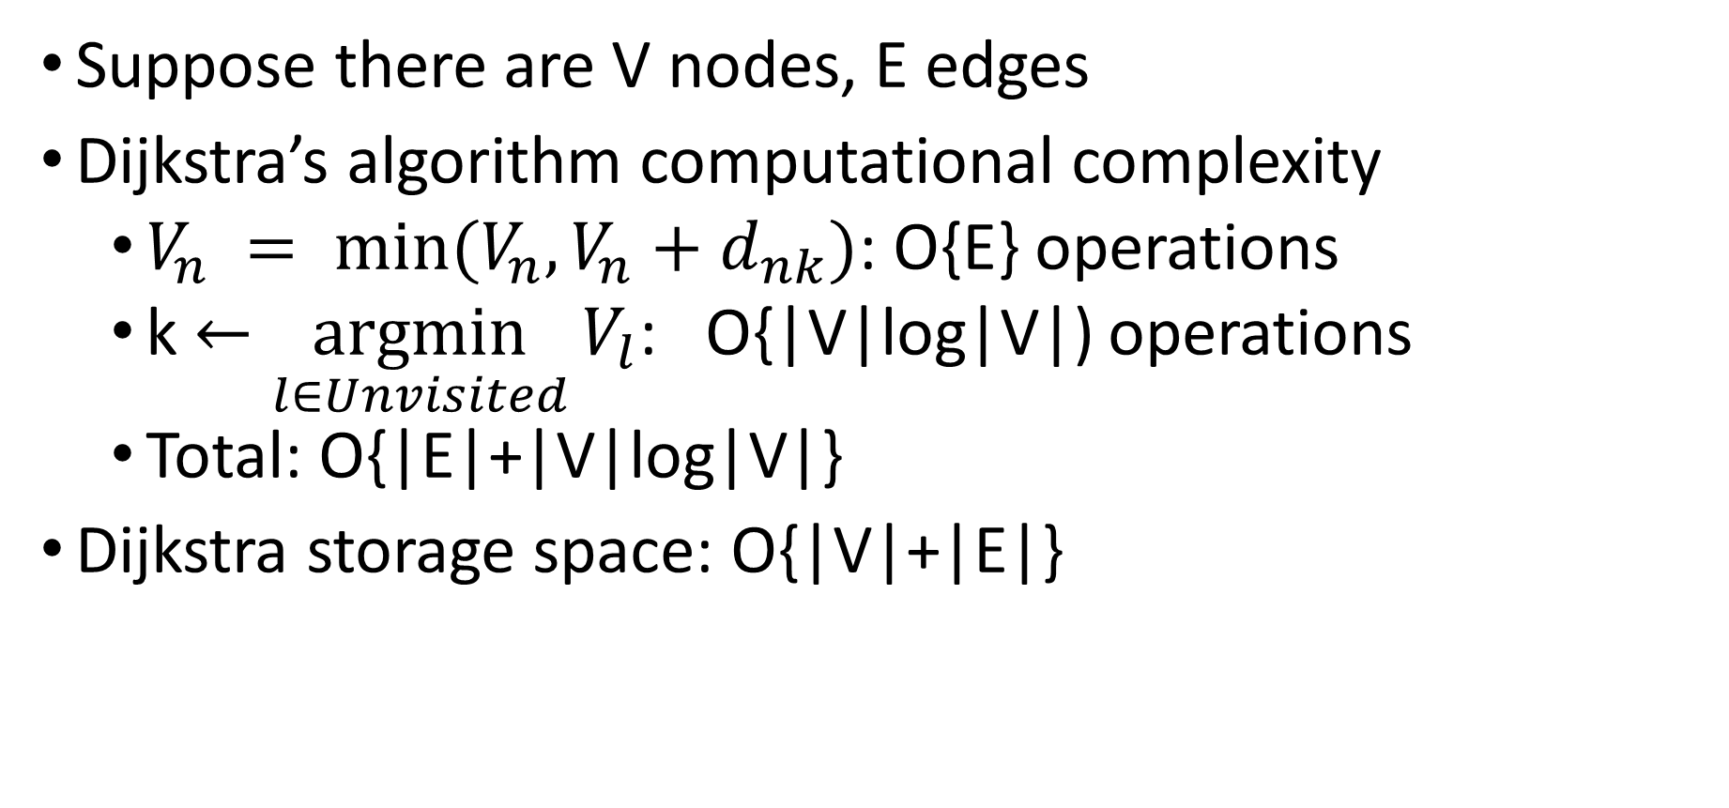
Dijkstra Algorithm Complexity
Suppose there are V nodes, E edges
Dijkstra’s algorithm computational complexity
  $V_{n} = min⁡(V_{n},V_{n}+d_{nk})$: O{E} operations
  k $←\underset{l∈Unvisited}{argmin}{V_{l}}$: O{|V|log|V|) operations
  Total: O{|E|+|V|log|V|}
Dijkstra storage space: O{|V|+|E|}

Slide 5
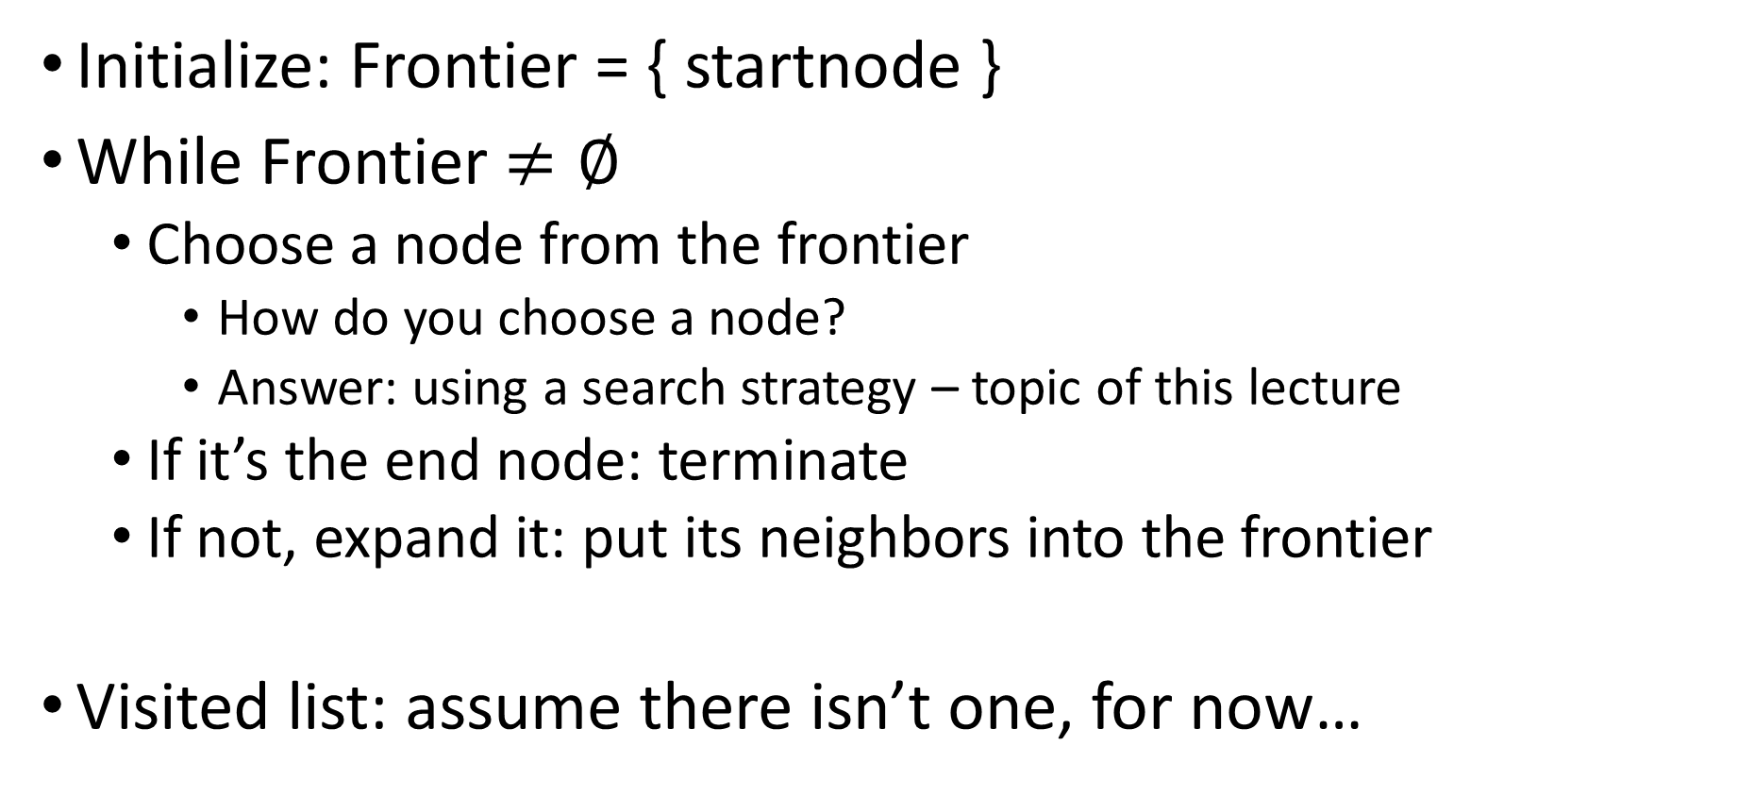
Tree Search Algorithm
Initialize: Frontier = { startnode }
While Frontier $≠∅$
  Choose a node from the frontier
    How do you choose a node?
    Answer: using a search strategy – topic of this lecture
  If it’s the end node: terminate
  If not, expand it: put its neighbors into the frontier
Visited list: assume there isn’t one, for now…

Slide 6
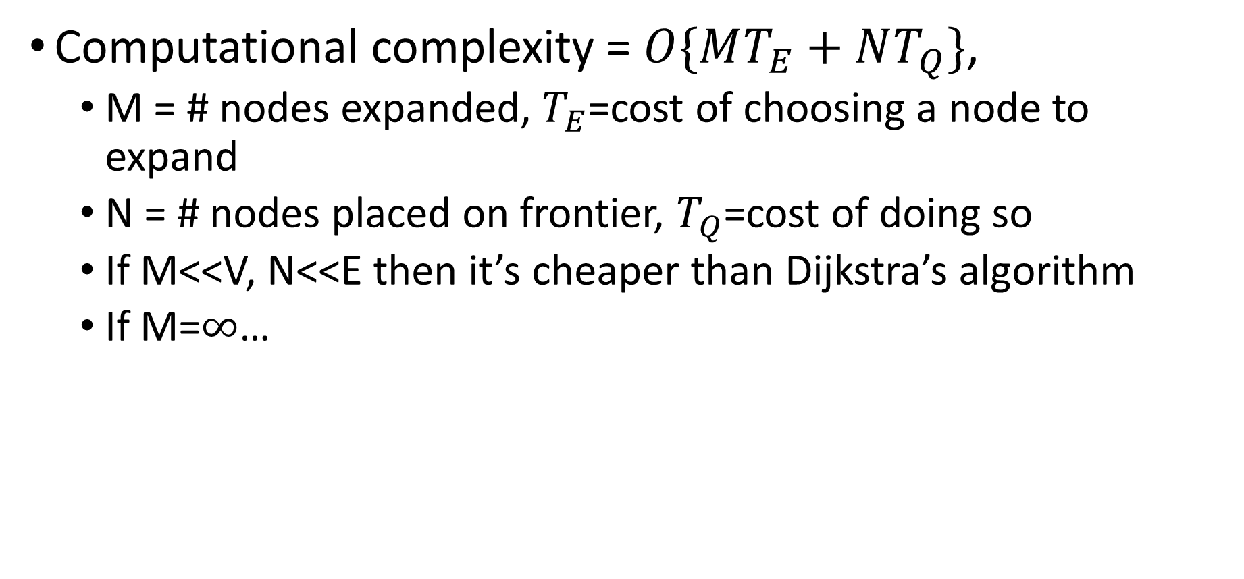
Tree Search Algorithm
Computational complexity = $O\{MT_{E}+NT_{Q}\}$,
  M = # nodes expanded, $T_{E}$=cost of choosing a node to expand
  N = # nodes placed on frontier, $T_{Q}$=cost of doing so
  If M<<V, N<<E then it’s cheaper than Dijkstra’s algorithm
  If M=$∞$…

Slide 7
Prioritized Search
Review: Tree Search vs. Dijkstra’s Algorithm
Criteria for evaluating a search algorithm: completeness, optimality, computational cost, storage cost
Search algorithms without side information: BFS, DFS, IDS, UCS
Search algorithms with side information: GBFS vs. A*
  Heuristics to guide search
  Greedy best-first search
  A* search
  Admissible vs. Consistent heuristics
  Designing heuristics: Relaxed problem, Sub-problem, Dominance, Max

Slide 8
Analysis of search strategies
Strategies are evaluated along the following criteria:
  Completeness: does it always find a solution if one exists?
  Optimality: does it always find a least-cost solution?
  Time complexity: number of nodes generated
  Space complexity: maximum number of nodes in memory
Time and space complexity are measured in terms of
  b: maximum branching factor of the search tree
  d: depth of the optimal solution
  m: maximum length of any path in the state space (may be infinite)

Slide 9
Prioritized Search
Review: Tree Search vs. Dijkstra’s Algorithm
Criteria for evaluating a search algorithm: completeness, optimality, computational cost, storage cost
Search algorithms without side information: BFS, DFS, IDS, UCS
Search algorithms with side information: GBFS vs. A*
  Heuristics to guide search
  Greedy best-first search
  A* search
  Admissible vs. Consistent heuristics
  Designing heuristics: Relaxed problem, Sub-problem, Dominance, Max

Slide 10
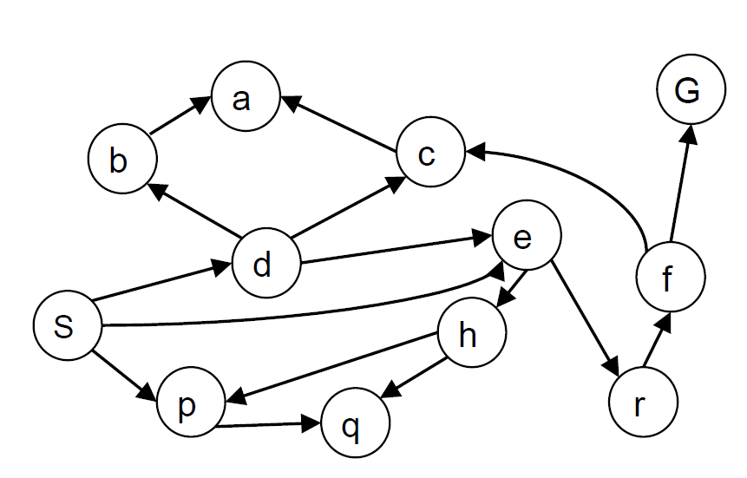
Depth-first search
Expand deepest unexpanded node
Implementation: frontier is a LIFO queue
Example state space graph for a tiny search problem

Slide 11
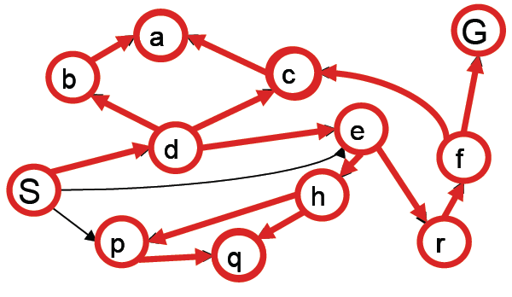
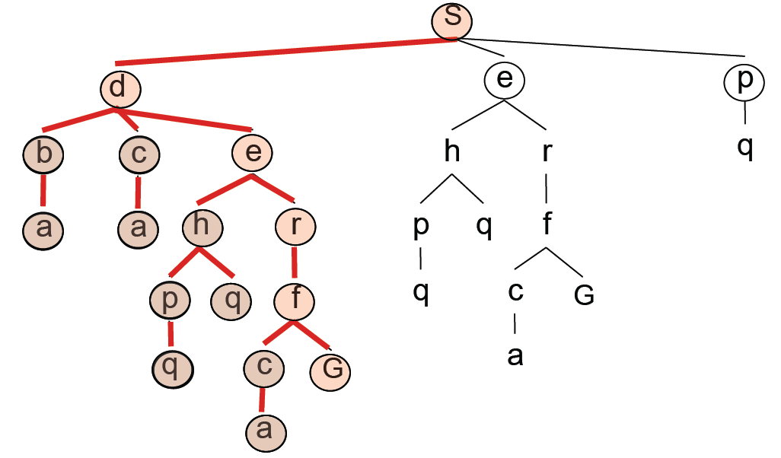
Depth-first search
Expansion order:
(s,d,b,a,
c,a,
e,h,p,q,
q,
r,f,c,a,
G)

Slide 12
Properties of depth-first search
Complete? (always finds a solution if one exists?)
  Fails in infinite-depth spaces, spaces with loops
  Modify to avoid repeated states along path
    → complete in finite spaces
Optimal? (always finds an optimal solution?)
  No – returns the first solution it finds
Time? (how long does it take, in terms of b, d, m?)
  Could be the time to reach a solution at maximum depth m: O(b^{m})
  Terrible if m is much larger than d
  But if there are lots of solutions, may be much faster than BFS
Space? (how much storage space, in terms of b, d, m?)
  O(bm), i.e., linear space!

Slide 13
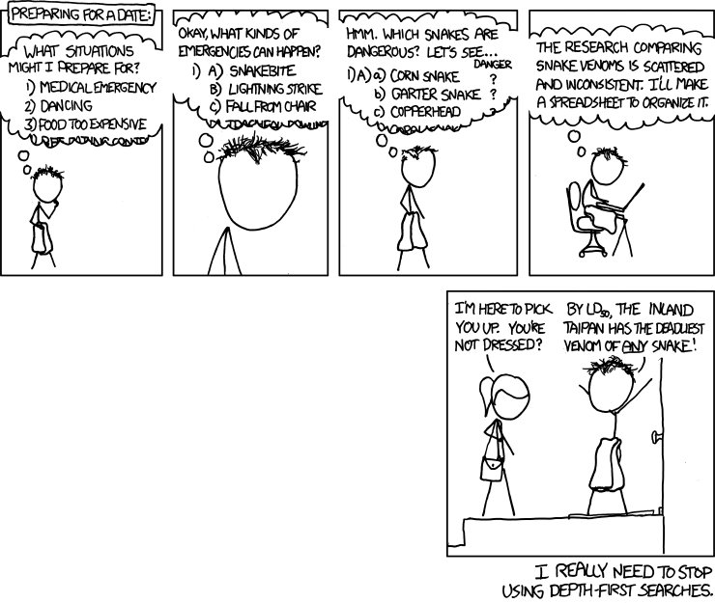
http://xkcd.com/761/

Slide 14
Breadth-first search
Expand shallowest unexpanded node
Implementation: frontier is a FIFO queue
Example from P. Abbeel and D. Klein

Slide 15
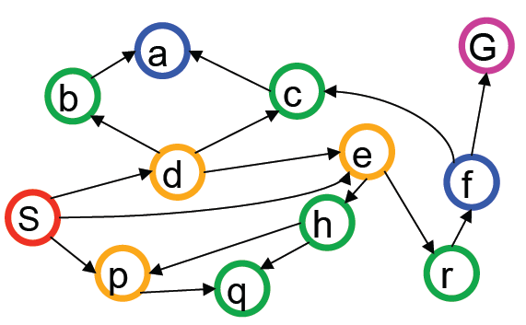
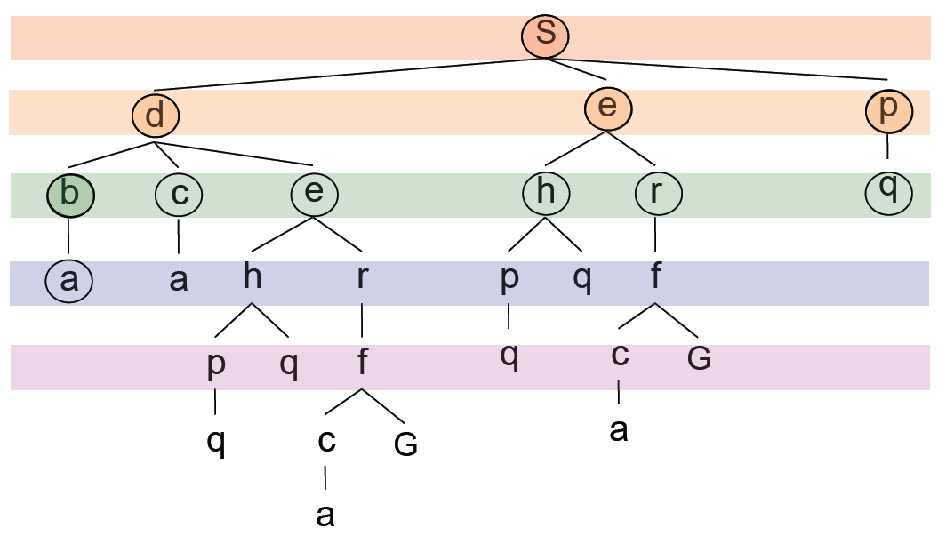
Breadth-first search
Expansion order:
(s,
d,e,p,
b,c,e,h,r,q,
a,a,h,r,p,q,f,
p,q,f,q,c,G)

Slide 16
Properties of breadth-first search
Complete?
  Yes (if branching factor b is finite).
  Even w/o repeated-state checking, it still works.
Optimal?
  Yes – if cost = 1 per step (uniform cost search will fix this)
Time?
  Number of nodes in a b-ary tree of depth d: O(b^{d})
  (d is the depth of the optimal solution)
Space?
  O(b^{d})
Space is the bigger problem (more than time)

Slide 17
Iterative deepening search
Use DFS as a subroutine
  Check the root
  Do a DFS searching for a path of length 1
  If there is no path of length 1, do a DFS searching for a path of length 2
  If there is no path of length 2, do a DFS searching for a path of length 3…

Slide 18
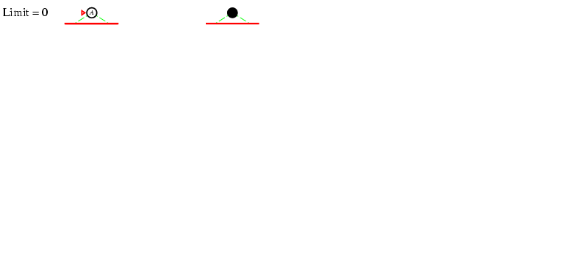
Iterative deepening search

Slide 19
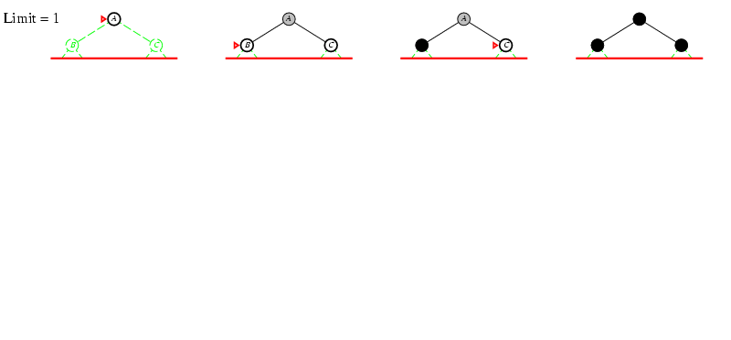
Iterative deepening search

Slide 20
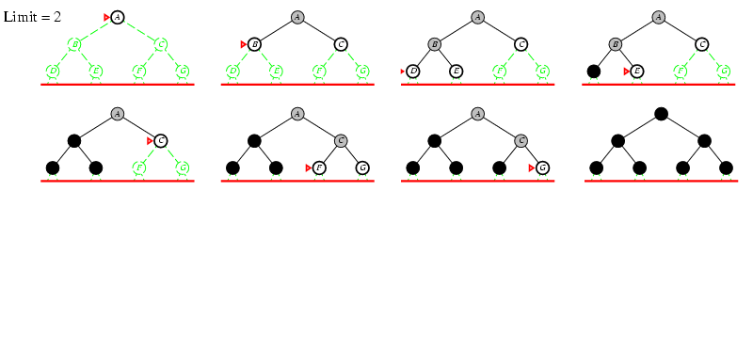
Iterative deepening search

Slide 21
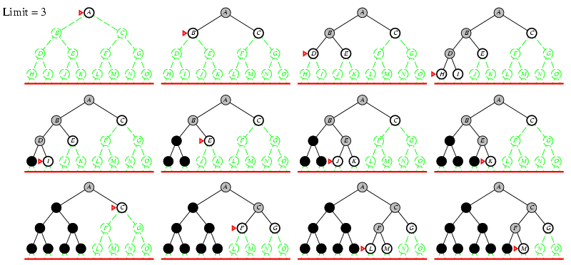
Iterative deepening search

Slide 22
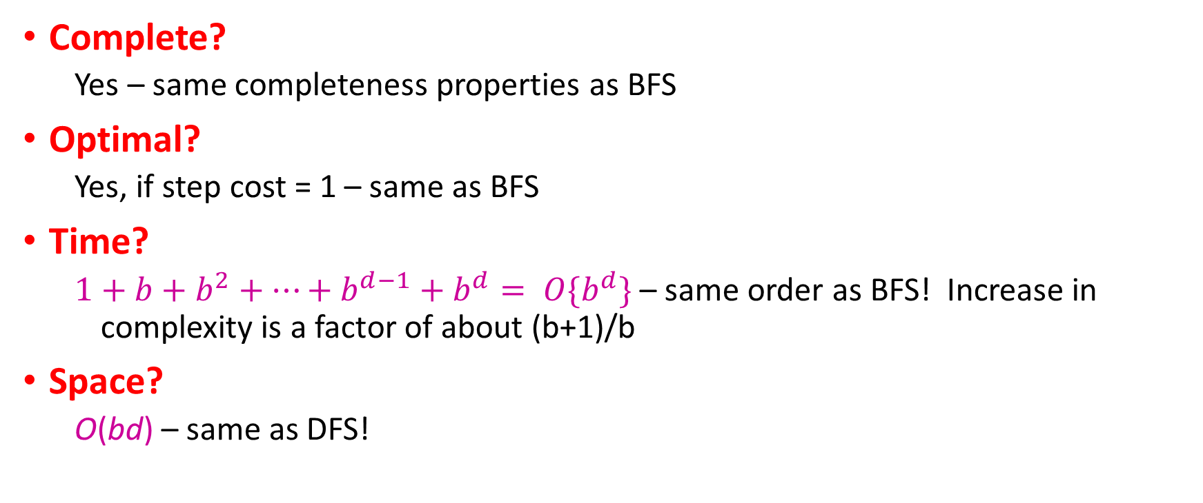
Properties of iterative deepening search
Complete?
  Yes – same completeness properties as BFS
Optimal?
  Yes, if step cost = 1 – same as BFS
Time?
  $1+b+b^{2}+…+b^{d−1}+b^{d}= O\{b^{d}\}$ – same order as BFS! Increase in complexity is a factor of about (b+1)/b
Space?
  O(bd) – same as DFS!

Slide 23
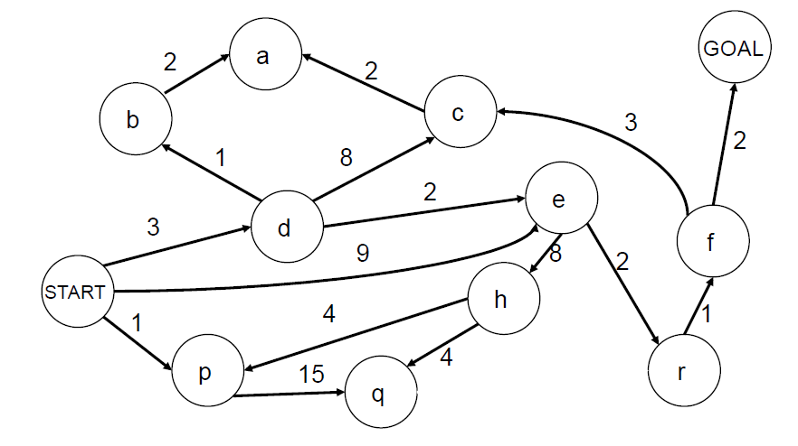
Search with varying step costs
BFS finds the path with the fewest steps, but does not always find the cheapest path

Slide 24
Uniform-cost search
For each frontier node, save the total cost of the path from the initial state to that node
Expand the frontier node with the lowest path cost
Implementation: frontier is a priority queue ordered by path cost
Equivalent to breadth-first if step costs all equal
Equivalent to Dijkstra’s algorithm, if Dijkstra’s algorithm is modified so that a node’s value is computed only when it becomes nonzero

Slide 25
Uniform-cost search example

Slide 26
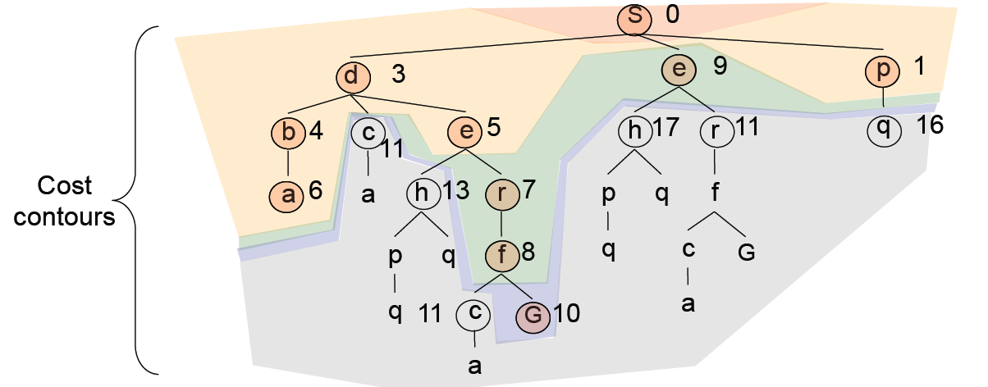
Uniform-cost search example
Expansion order:
(s,p(1),
d(3),b(4),
e(5),r(7),f(8)
e(9),
G(10))

Slide 27
Properties of uniform-cost search
Complete?
  Yes, if step cost is greater than some positive constant ε (we don’t want infinite sequences of steps that have a finite total cost)
Optimal?
  Yes

Slide 28
Prioritized Search
Review: Tree Search vs. Dijkstra’s Algorithm
Criteria for evaluating a search algorithm: completeness, optimality, computational cost, storage cost
Search algorithms without side information: BFS, DFS, IDS, UCS
Search algorithms with side information: GBFS vs. A*
  Heuristics to guide search
  Greedy best-first search
  A* search
  Admissible vs. Consistent heuristics
  Designing heuristics: Relaxed problem, Sub-problem, Dominance, Max

Slide 29
Informed search strategies
Idea: give the algorithm “hints” about the desirability of different states
  Use an evaluation function to rank nodes and select the most promising one for expansion
Greedy best-first search
A* search

Slide 30

Heuristic function
= node we’re currently expanding
Most obvious thing to do: go toward the goal, i.e.,
Start state
Goal state

Slide 31
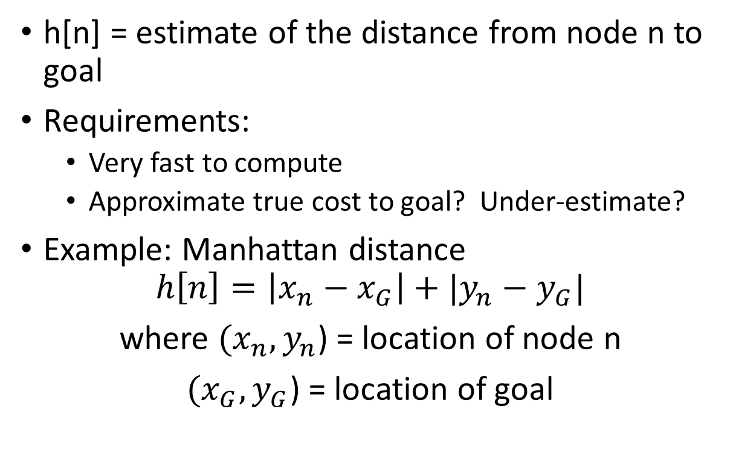
Heuristic function
h[n] = estimate of the distance from node n to goal
Requirements:
  Very fast to compute
  Approximate true cost to goal? Under-estimate?
Example: Manhattan distance
$$h\left[n\right]=\left|x_{n}−x_{G}\right|+|y_{n}−y_{G}|$$
where $(x_{n},y_{n}$) = location of node n
$(x_{G},y_{G}$) = location of goal
Start state
Goal state

Slide 32
Greedy best-first search
Expand the node that has the lowest value of the heuristic function h(n)

Slide 33
Greedy best-first search
Start state
Goal state

Slide 34
Greedy best-first search
Start state
Goal state

Slide 35
Greedy best-first search
Start state
Goal state

Slide 36
Greedy best-first search
Start state
Goal state

Slide 37
Greedy best-first search
Start state
Goal state

Slide 38
Greedy best-first search
Start state
Goal state

Slide 39
Properties of greedy best-first search
Complete?
  No – can get stuck in loops
Optimal?
  No
Time?
  Worst case: O(b^{m})
  Can be much better with a good heuristic
Space?
  Worst case: O(b^{m})

Slide 40
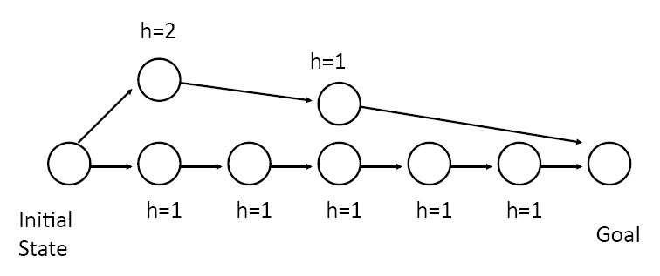
How can we fix the greedy problem?

Slide 41
A* search
Idea: avoid expanding paths that are already expensive
The evaluation function f(n) is the estimated total cost of the path through node n to the goal:
f(n) = g(n) + h(n)
  g(n): cost so far to reach n (path cost)
  h(n): estimated cost from n to goal (heuristic)
Notes:
Dates back to 1968

Slide 42
BFS vs. A* search
Source: Wikipedia

Slide 43
Admissible heuristics
An admissible heuristic never overestimates the cost to reach the goal
A heuristic h(n) is admissible if for every node n,
h(n) ≤ h*(n), where h*(n) is the true cost to reach
the goal state from n
Example:
  straight line distance never overestimates the actual road distance
  Manhattan distance never overestimates actual road distance if all roads are on a Manhattan grid
Theorem: If h(n) is admissible, and if we don’t do repeated-state detection, then A* is optimal

Slide 44
Optimality of A*
Theorem: If h(n) is admissible, A* is optimal
(if we don’t do repeated state detection)
Proof sketch:
  A* expands all nodes for which f(n) ≤ C*, i.e., the estimated path cost to the goal is less than or equal to the actual path cost to the first goal encountered
  When we reach the goal node, all the other nodes remaining on the frontier have estimated path costs to the goal that are at least as big as C*
  Because we are using an admissible heuristic, the true path costs to the goal for these nodes cannot be less than C*

Slide 45
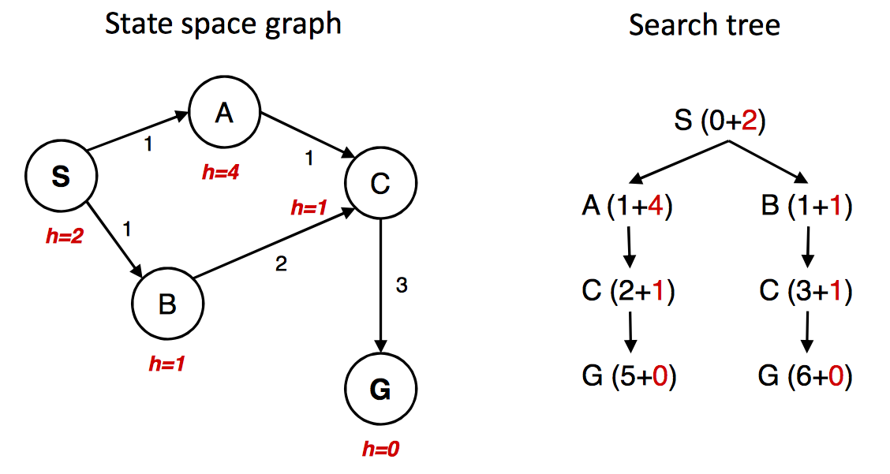
A* gone wrong?
Source: Berkeley CS188x

Slide 46
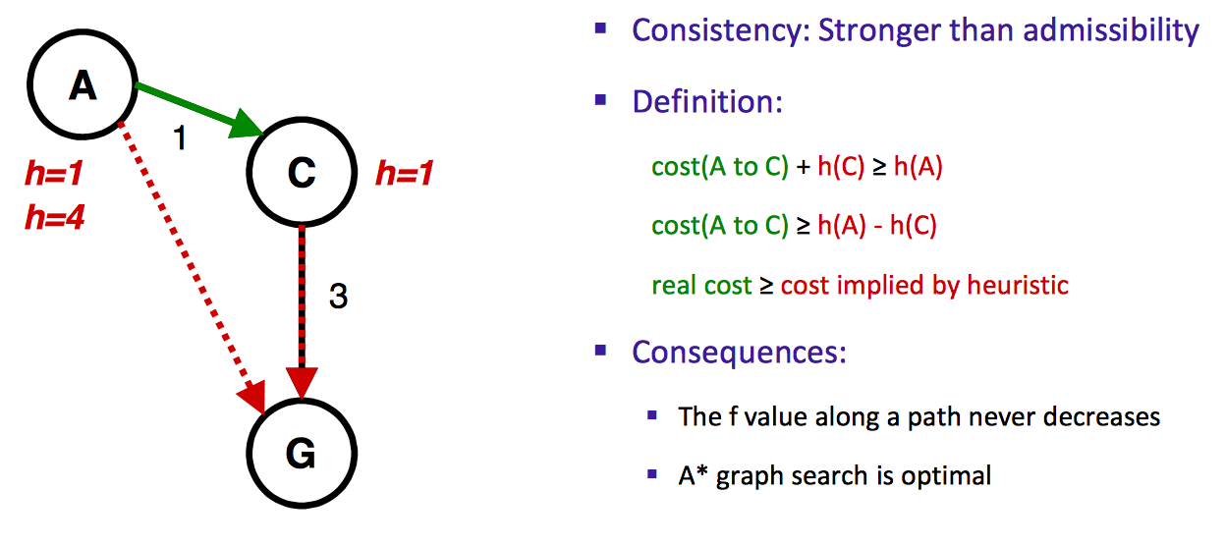
Consistency of heuristics
h=4
Source: Berkeley CS188x

Slide 47
Optimality of A*
Tree search (i.e., search without repeated state detection):
  A* is optimal if heuristic is admissible (and non-negative)
Graph search (i.e., search with repeated state detection)
  A* optimal if heuristic is consistent 􏰄
Consistency implies admissibility
  In general, most natural admissible heuristics tend to be consistent, especially if from relaxed problems
Source: Berkeley CS188x

Slide 48
Optimality of A*
A* is optimally efficient – no other tree-based algorithm that uses the same heuristic can expand fewer nodes and still be guaranteed to find the optimal solution
  Any algorithm that does not expand all nodes with f(n) ≤ C* risks missing the optimal solution

Slide 49
Properties of A*
Complete?
  Yes – unless there are infinitely many nodes with f(n) ≤ C*
Optimal?
  Yes
Time?
  Number of nodes for which f(n) ≤ C* (exponential)
Space?
  Exponential

Slide 50
Prioritized Search
Review: Tree Search vs. Dijkstra’s Algorithm
Criteria for evaluating a search algorithm: completeness, optimality, computational cost, storage cost
Search algorithms without side information: BFS, DFS, IDS, UCS
Search algorithms with side information: GBFS vs. A*
  Heuristics to guide search
  Greedy best-first search
  A* search
  Admissible vs. Consistent heuristics
  Designing heuristics: Relaxed problem, Sub-problem, Dominance, Max

Slide 51
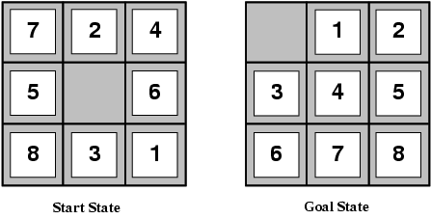
Designing heuristic functions
Heuristics for the 8-puzzle
  h₁(n) = number of misplaced tiles
  h₂(n) = total Manhattan distance (number of squares from desired location of each tile)
  h₁(start) = 8
  h₂(start) = 3+1+2+2+2+3+3+2 = 18
Are h₁ and h₂ admissible?

Slide 52
Heuristics from relaxed problems
A problem with fewer restrictions on the actions is called a relaxed problem
The cost of an optimal solution to a relaxed problem is an admissible heuristic for the original problem
If the rules of the 8-puzzle are relaxed so that a tile can move anywhere, then h₁(n) gives the shortest solution
If the rules are relaxed so that a tile can move to any adjacent square, then h₂(n) gives the shortest solution

Slide 53
Heuristics from subproblems
Let h₃(n) be the cost of getting a subset of tiles
(say, 1,2,3,4) into their correct positions
Can precompute and save the exact solution cost for every possible subproblem instance – pattern database

Slide 54
Dominance
If h₁ and h₂ are both admissible heuristics and
h₂(n) ≥ h₁(n) for all n, (both admissible) then
h₂ dominates h₁
Which one is better for search?
  A* search expands every node with f(n) < C* or
  h(n) < C* – g(n)
  Therefore, A* search with h₁ will expand more nodes

Slide 55
Dominance
Typical search costs for the 8-puzzle (average number of nodes expanded for different solution depths):
d=12 IDS = 3,644,035 nodes
A*(h₁) = 227 nodes
A*(h₂) = 73 nodes
d=24 IDS ≈ 54,000,000,000 nodes
A*(h₁) = 39,135 nodes
A*(h₂) = 1,641 nodes

Slide 56
Combining heuristics
Suppose we have a collection of admissible heuristics h₁(n), h₂(n), …, h_{m}(n), but none of them dominates the others
How can we combine them?
h(n) = max{h₁(n), h₂(n), …, h_{m}(n)}

Slide 57
All search strategies
Algorithm | Complete? | Optimal? | Time complexity | Space complexity | Implement the Frontier as a…
BFS | Yes | If all step costs are equal | O(b^d) | O(b^d) | Queue
DFS | No | No | O(b^m) | O(bm) | Stack
IDS | Yes | If all step costs are equal | O(b^d) | O(bd) | Stack
UCS | Yes | Yes | Number of nodes w/ g(n) ≤ C* | Number of nodes w/ g(n) ≤ C* | Priority Queue sorted by g(n)
Greedy | No | No | Worst case: O(b^m) Best case: O(bd) | Worse case: O(b^m) Best case: O(bd) | Priority Queue sorted by h(n)
A* | Yes | Yes | Number of nodes w/ g(n)+h(n) ≤ C* | Number of nodes w/ g(n)+h(n) ≤ C* | Priority Queue sorted by h(n)+g(n)

