Slide 1
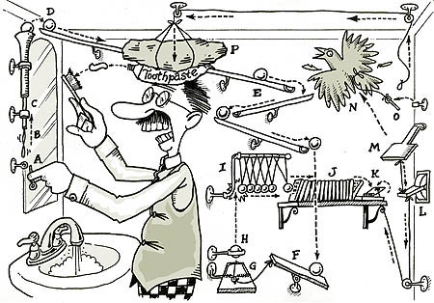
Planning (Chapter 10)
Slides by Svetlana Lazebnik, 9/2016 with modifications by Mark Hasegawa-Johnson, 9/2017
http://en.wikipedia.org/wiki/Rube_Goldberg_machine

Slide 2
Planning
Problem: I’m at home and I need milk, bananas,
and a drill.
How is planning different from regular search?
  States and action sequences typically have complex internal structure
  State space and branching factor are huge
  Multiple subgoals at multiple levels of resolution
Examples of planning applications
  Scheduling of tasks in space missions
  Logistics planning for the army
  Assembly lines, industrial processes
  Robotics
  Games, storytelling

Slide 3
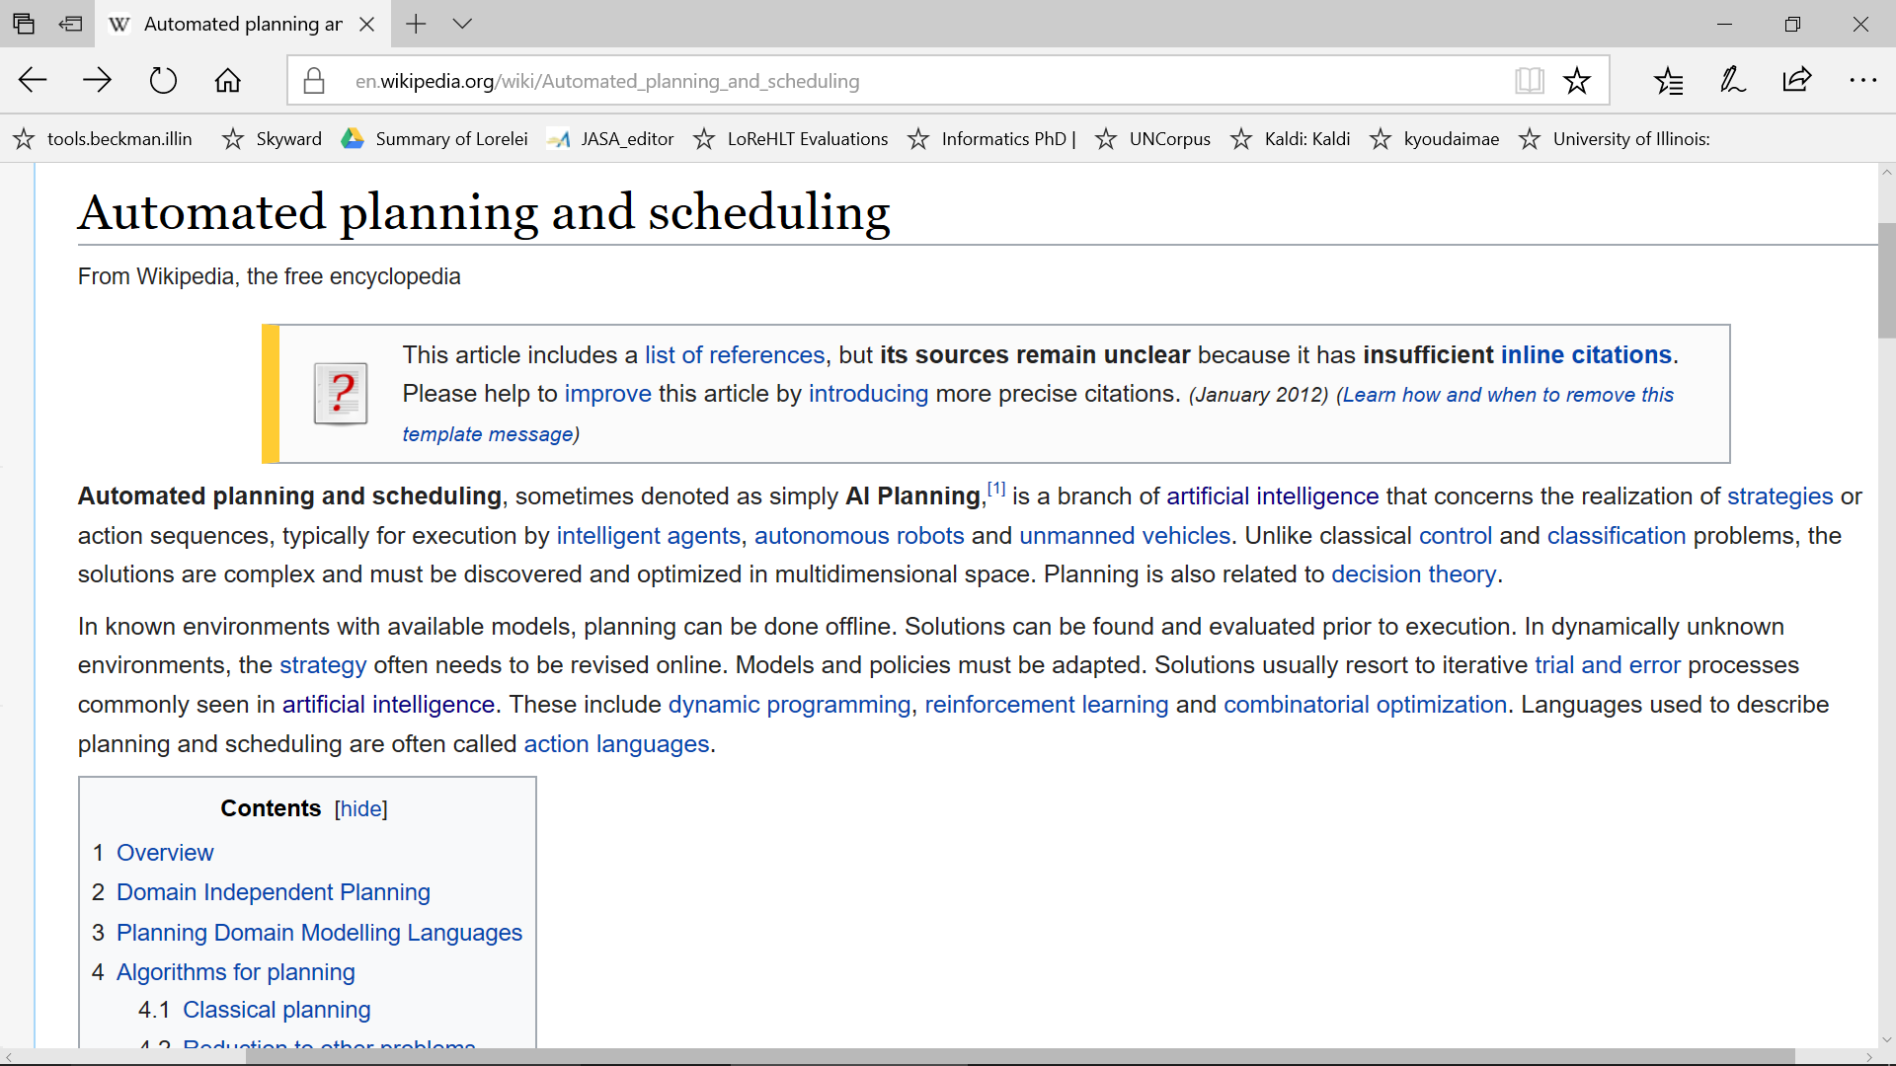

Slide 4
A representation for planning
STRIPS (Stanford Research Institute Problem Solver): classical planning framework from the 1970s
States are specified as conjunctions of predicates
  Start state: At(home) ∧ Sells(SM, Milk) ∧ Sells(SM, Bananas) ∧ Sells(HW, drill)
  Goal state: At(home) ∧ Have(Milk) ∧ Have(Banana) ∧ Have(drill)
Actions are described in terms of preconditions and effects:
  Go(x, y)
    Precond: At(x)
    Effect: ¬At(x) ∧ At(y)
  Buy(x, store)
    Precond: At(store) ∧ Sells(store, x)
    Effect: Have(x)
Planning is “just” a search problem

Slide 5
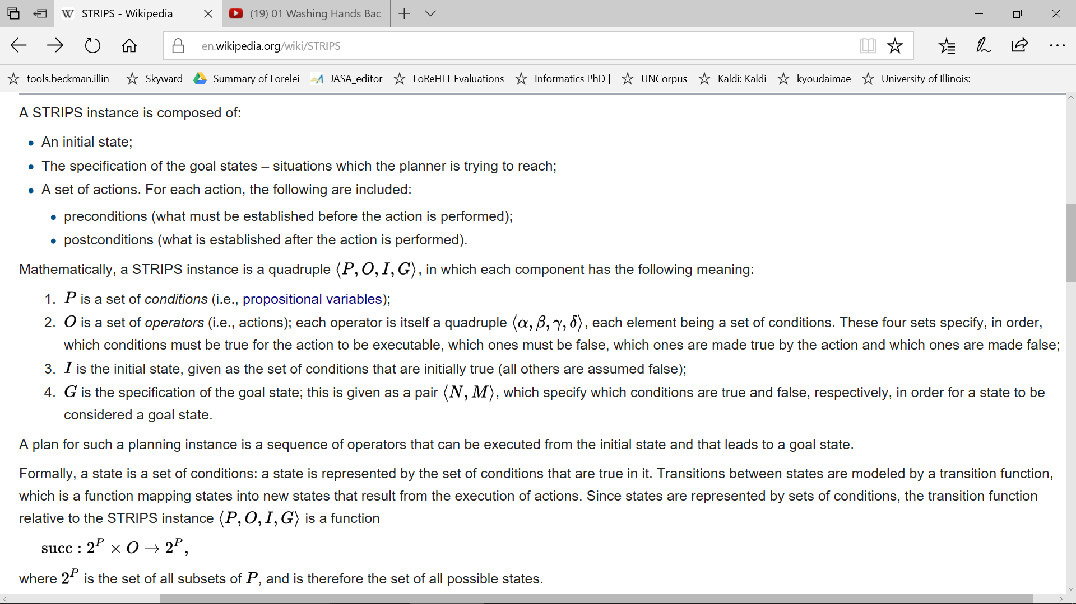

Slide 6
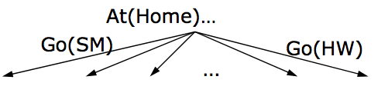
Algorithms for planning
Forward (progression) state-space search: starting with the start state, find all applicable actions (actions for which preconditions are satisfied), compute the successor state based on the effects, keep searching until goals are met
  Can work well with good heuristics
https://www.youtube.com/watch?v=QLNSkFnBYuM

Slide 7
Algorithms for planning
Forward (progression) state-space search: starting with the start state, find all applicable actions (actions for which preconditions are satisfied), compute the successor state based on the effects, keep searching until goals are met
  Can work well with good heuristics
Backward (regression) relevant-states search: to achieve a goal, what must have been true in the previous state?

Slide 8
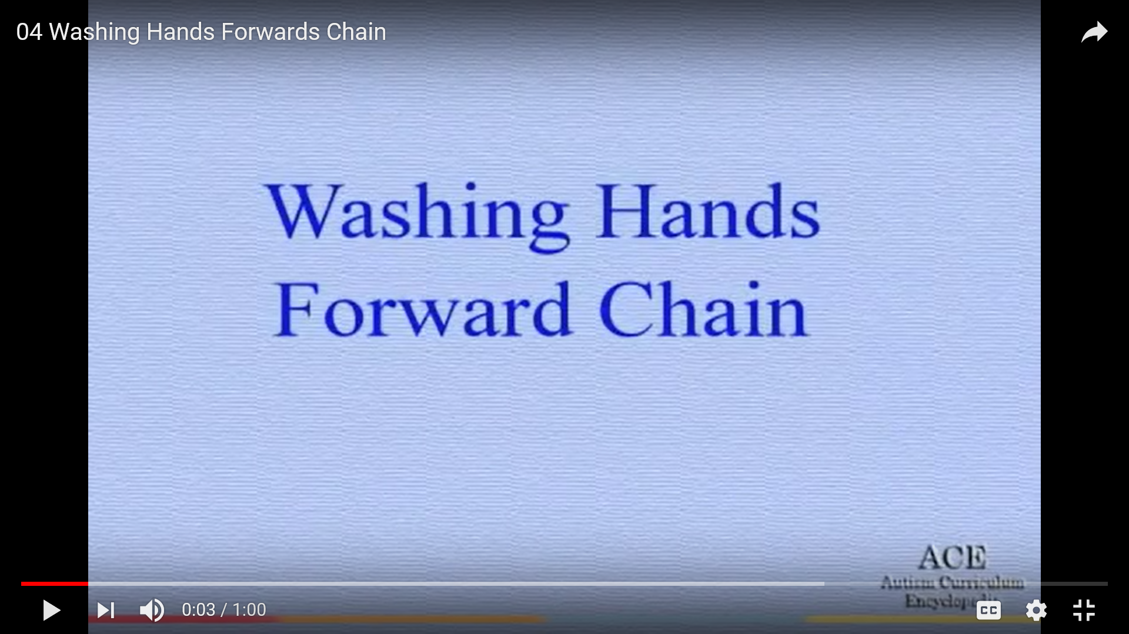
Forward chaining = start with what you already have, and then learn the next step

Slide 9
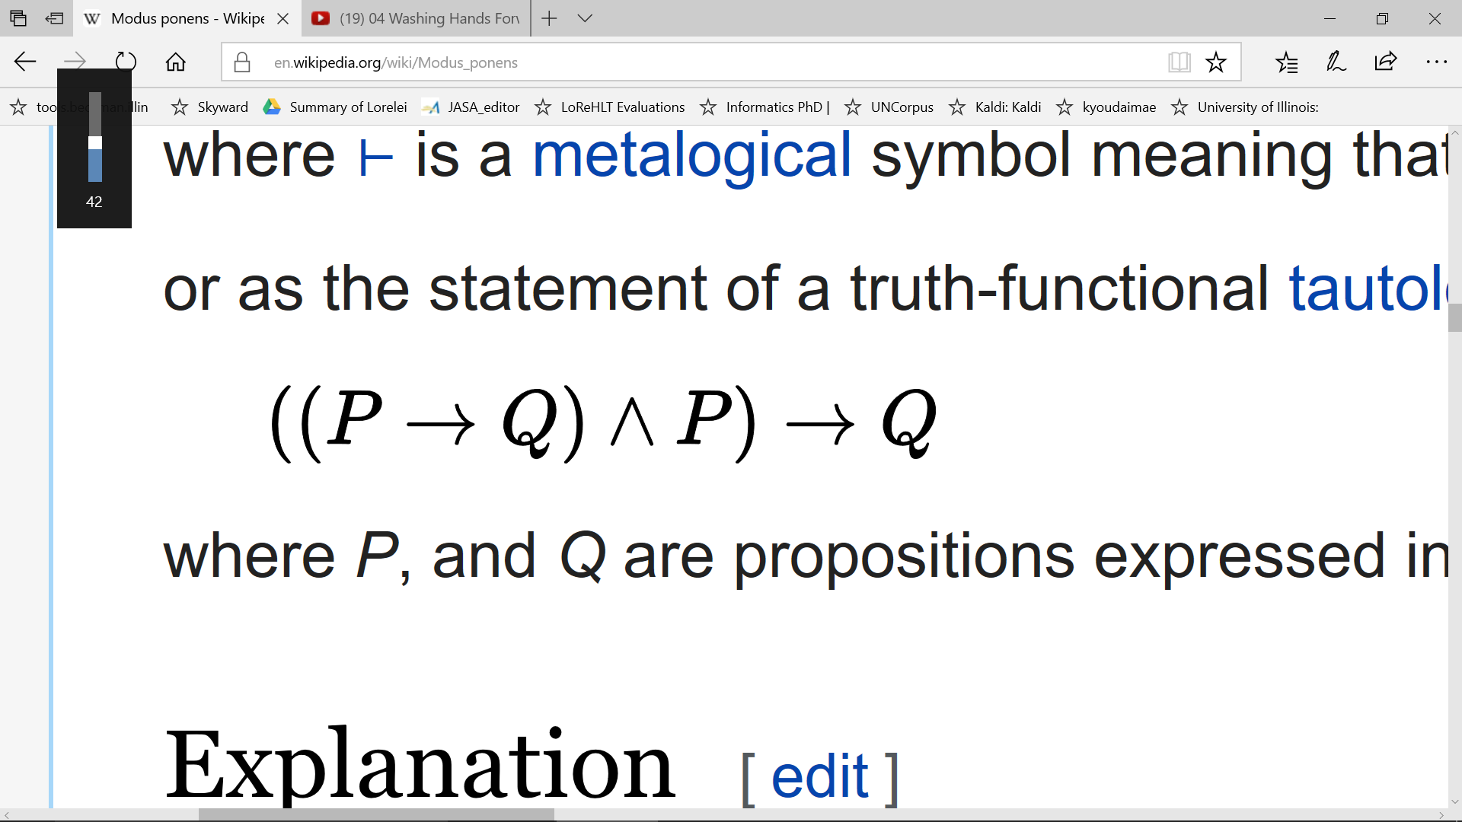
Forward-chaining: each step in the search is one application of modus ponens
In forward-chaining, we start from a state, P, that the search process has already achieved
We then check to see whether it is possible to apply modus ponens: given the current state P, is there any operation P→Q available?

Slide 10
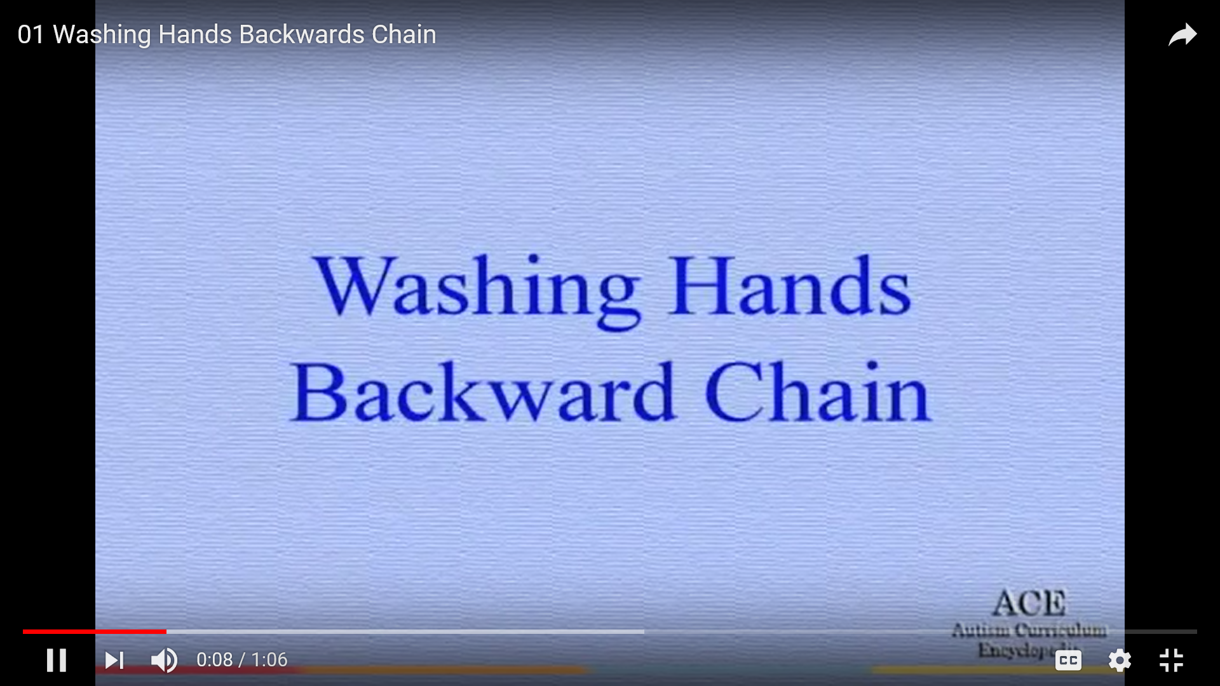
Backward chaining = start with the goal state, and search backward

Slide 11
Forward-chaining: each step in the search is one application of modus ponens
In backward-chaining, we start from a state, Q, that we want to achieve
We then check to see whether it is possible to apply modus ponens in order to generate Q from any other state, P:

Slide 12
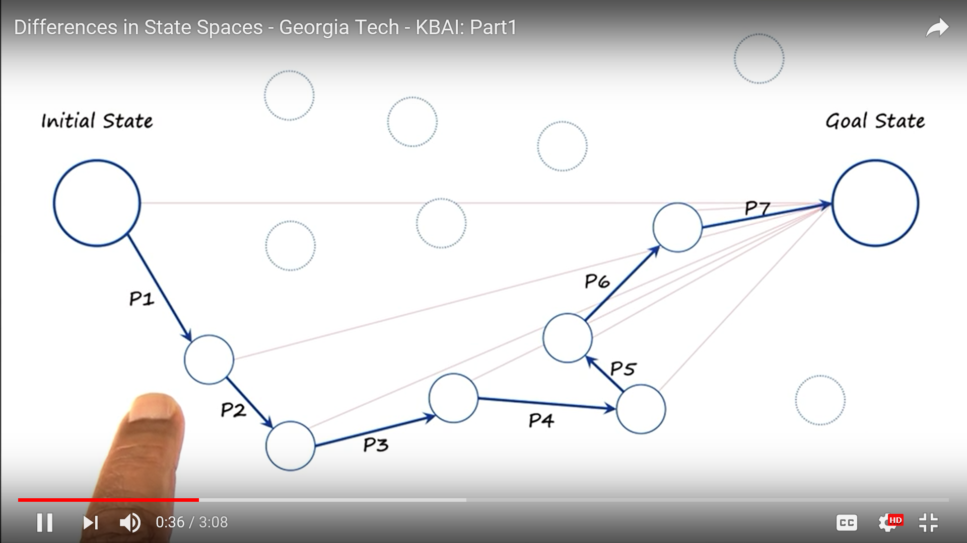
Heuristics for planning: means-ends analysis

Slide 13
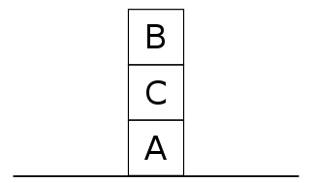

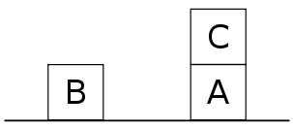

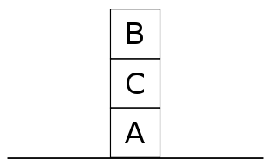
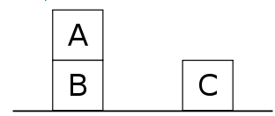
Challenges of planning: “Sussman anomaly”
Start state:
Goal state:
On(A,B)
On(B,C)
Let’s try to achieve On(A,B):
Let’s try to achieve On(B,C):
http://en.wikipedia.org/wiki/Sussman_Anomaly

Slide 14
Challenges of planning: “Sussman anomaly”
Shows the limitations of non-interleaved planners that consider subgoals in sequence and try to satisfy them one at a time
  If you try to satisfy subgoal X and then subgoal Y, X might undo some preconditions for Y, or Y might undo some effects of X
More powerful planning approaches must interleave the steps towards achieving multiple subgoals
http://en.wikipedia.org/wiki/Sussman_Anomaly

Slide 15
Situation space planning vs. plan space planning
Situation space planners: each node in the search space represents a world state, arcs are actions in the world
  Plans are sequences of actions from start to finish
  Must be totally ordered
Plan space planners: nodes are (incomplete) plans, arcs are transformations between plans
  Actions in the plan may be partially ordered
  Principle of least commitment: avoid ordering plan steps unless absolutely necessary

Slide 16
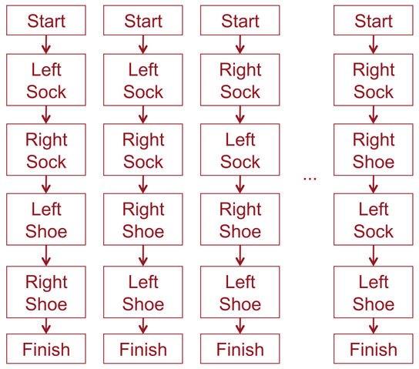
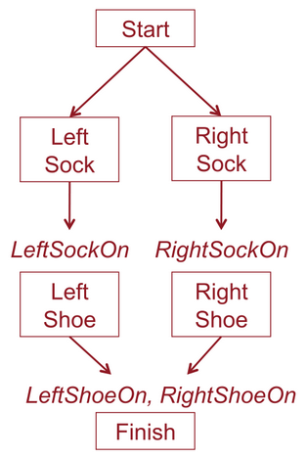
Partial order planning
Task: put on socks and shoes
Partial order plan
Total order (linear) plans

Slide 17
Partial Order Planning Example
Start
Sells(SM, Milk)
At(Home)
Sells(SM, Bananas)
Start: empty plan
Action: find flaw in the plan and modify plan to fix the flaw
Have(Milk)
Have(Bananas)
Finish

Slide 18
Partial Order Planning Example
Start
Sells(SM, Milk)
At(Home)
Sells(SM, Bananas)
At(x3)
Go(x3, SM)
At(SM)
Sells(x1, Milk)
At(x1)
At(x2)
Sells(x2, Bananas)
Buy(x1, Milk)
Buy(x2, Bananas)
Have(Milk)
Have(Bananas)
x1 = SM
Have(Milk)
Have(Bananas)
x2 = SM
x3 = Home
Finish

Slide 19

Application of planning: Automated storytelling
https://research.cc.gatech.edu/inc/mark-riedl

Slide 20
Application of planning: Automated storytelling
Applications
  Personalized experience in games
  Automatically generating training scenarios (e.g., for the army)
  Therapy for kids with autism
  Computational study of creativity
https://research.cc.gatech.edu/inc/mark-riedl

Slide 21
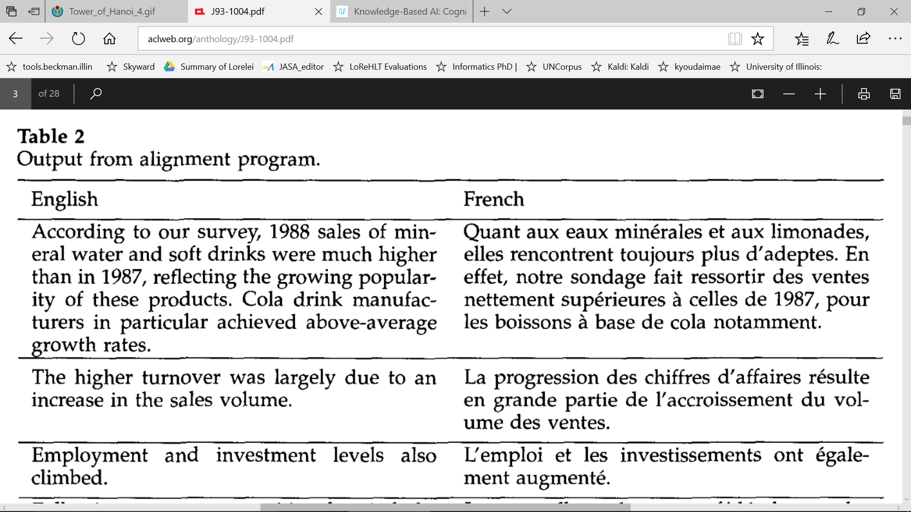
Application of planning: the Gale-Church alignment algorithm

Slide 22
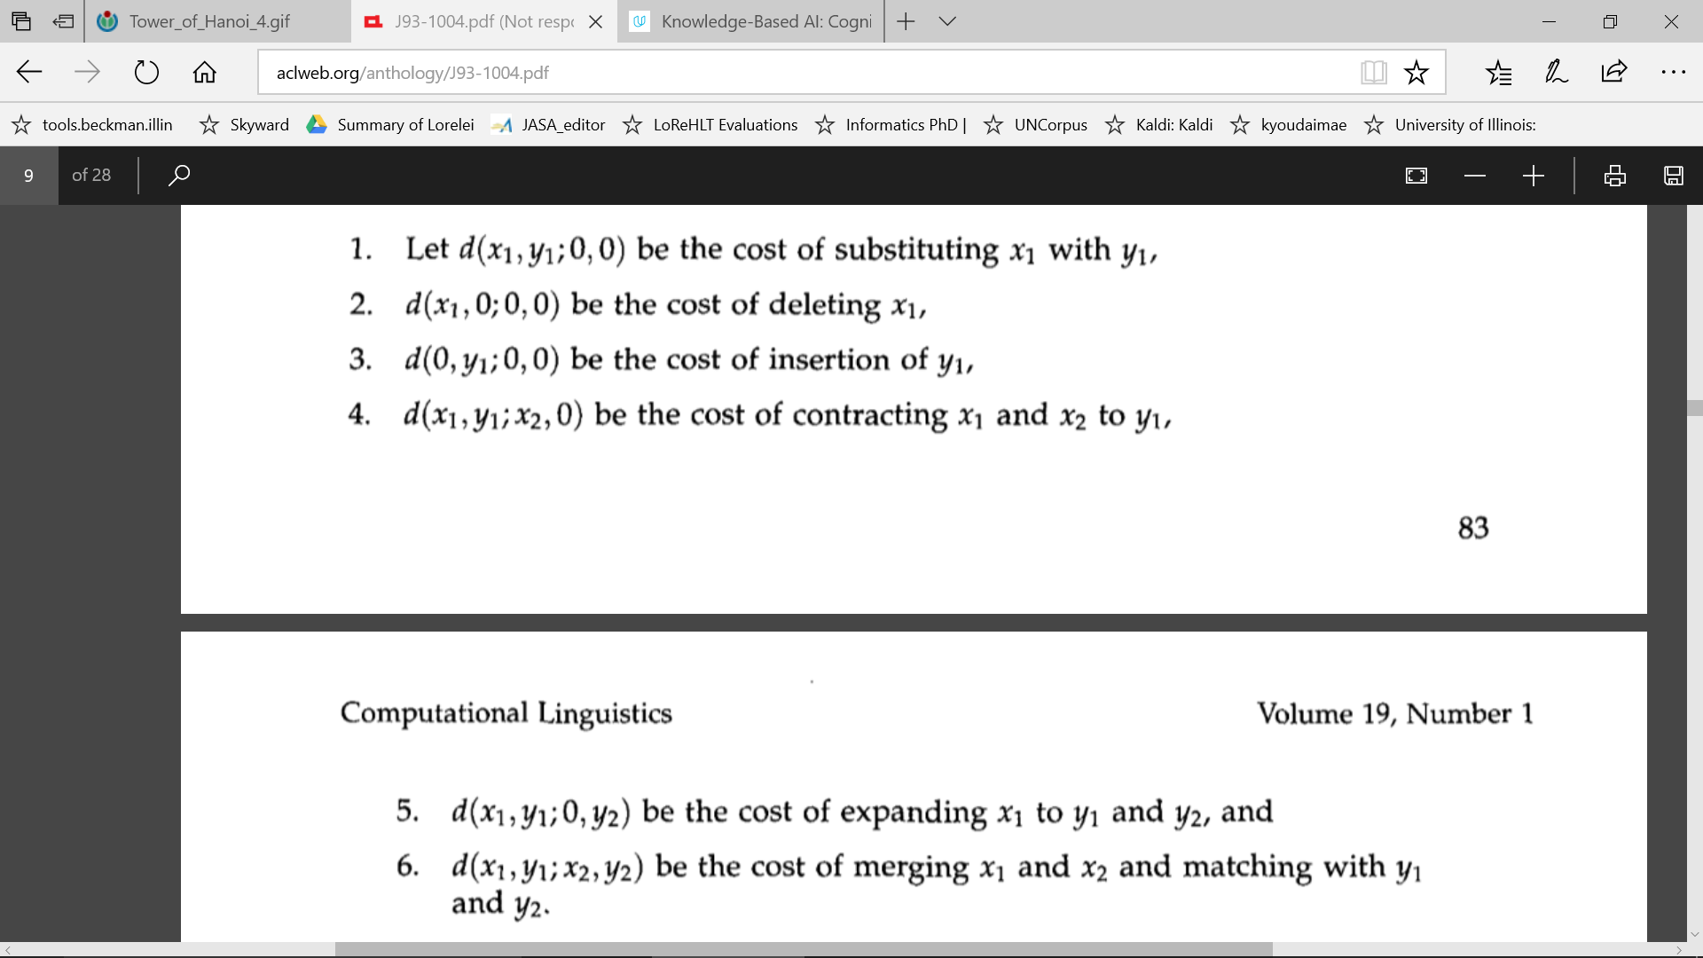
Application of planning: the Gale-Church alignment algorithm

Slide 23

Complexity of planning
Planning is PSPACE-complete
  The length of a plan can be exponential in the number of “objects” in the problem!
Example: towers of Hanoi

Slide 24
Complexity of planning
Planning is PSPACE-complete
  The length of a plan can be exponential in the number of “objects” in the problem!
  So is game search
Archetypal PSPACE-complete problem: quantified boolean formula (QBF)
  Example: is this formula true?
  ∃x₁∀x₂ ∃x₃∀x₄ (x₁∨¬x₃∨x₄)∧(¬x₂∨x₃∨¬x₄)
Compare to SAT:
∃x₁ ∃x₂ ∃x₃ ∃x₄ (x₁∨¬x₃∨x₄)∧(¬x₂∨x₃∨¬x₄)
Relationship between SAT and QBF is akin to the relationship between puzzles and games

Slide 25
Real-world planning
Resource constraints
  Instead of “static,” the world is “semidynamic:” we can’t think forever
Actions at different levels of granularity: hierarchical planning
  In order to make the depth of the search smaller, we might convert the world from “fully observable” to “partially observable”
Contingencies: actions failing
  Instead of being “deterministic,” maybe the world is “stochastic”
Incorporating sensing and feedback
  Possibly necessary to address stochastic or multi-agent environments

