Slide 1
CS 440/ECE448 Lecture 20:
Bayes Net Inference & Learning
Slides by Svetlana Lazebnik, 11/2016
Modified by Mark Hasegawa-Johnson, 11/2017

Slide 2
Bayes Network Inference & Learning
Bayes net is a memory-efficient model of dependencies among:
  Query variables: X
  Evidence (observed) variables and their values: E = e
  Unobserved variables: Y
Inference problem: answer questions about the query variables given the evidence variables
  This can be done using the posterior distribution P(X | E = e)
  The posterior can be derived from the full joint P(X, E, Y)
  How do we make this computationally efficient?
Learning problem: given some training examples, how do we learn the parameters of the model?
  Parameters = p(variable|parents), for each variable in the net
Notes:
2

Slide 3
Outline
Inference Examples
Inference Algorithms
  Trees: Sum-product algorithm
  Graphs: No polynomial-time algorithm
Parameter Learning
  Expectation Maximization
Structure Learning
  Regularized Maximum Likelihood

Slide 4
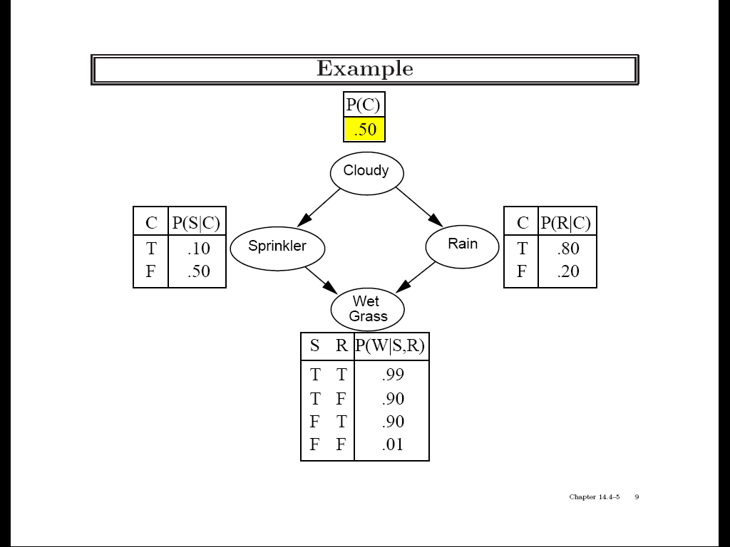
Practice example 1
Variables: Cloudy, Sprinkler, Rain, Wet Grass

Slide 5
Practice example 1
Given that the grass is wet, what is the probability that it has rained?

Slide 6
Practice example 2
What determines whether you will pass the exam?
  A: Do you attend class?
  S: Do you study?
  Pr: Are you prepared
  for the exam?
  F: Is the grading fair?
  Pa: Do you get a passing
  grade on the exam?
A
S
F
Pr
Pa
Source: UMBC CMSC 671, Tamara Berg

Slide 7
Practice example 2
P(A=T) = 0.8
P(S=T) = 0.6
A
S
P(F=T) = 0.9
F
Pr
A | S | P(Pr|A,S)
T | T | 0.9
T | F | 0.5
F | T | 0.7
F | F | 0.1
Pa
Pr | A | F | P(Pa|A,Pr,F)
T | T | T | 0.9
T | T | F | 0.6
T | F | T | 0.2
T | F | F | 0.1
F | T | T | 0.4
F | T | F | 0.2
F | F | T | 0.1
F | F | F | 0.2
Source: UMBC CMSC 671, Tamara Berg

Slide 8
Practice example 2
Query: What is the probability that a student attended class, given that they passed the exam?
A
S
F
Pr
Pa
Source: UMBC CMSC 671, Tamara Berg

Slide 9
Outline
Inference Examples
Inference Algorithms
  Trees: Sum-product algorithm
  Graphs: No polynomial-time algorithm
Parameter Learning
  Expectation Maximization
Structure Learning
  Regularized Maximum Likelihood

Slide 10
Efficient exact inference
Key idea: compute the results of
sub-expressions in a bottom-up way and cache them for later use
  Form of dynamic programming
  Polynomial time and space complexity for polytrees: networks with at most one undirected path between any two nodes

Slide 11
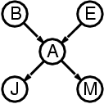
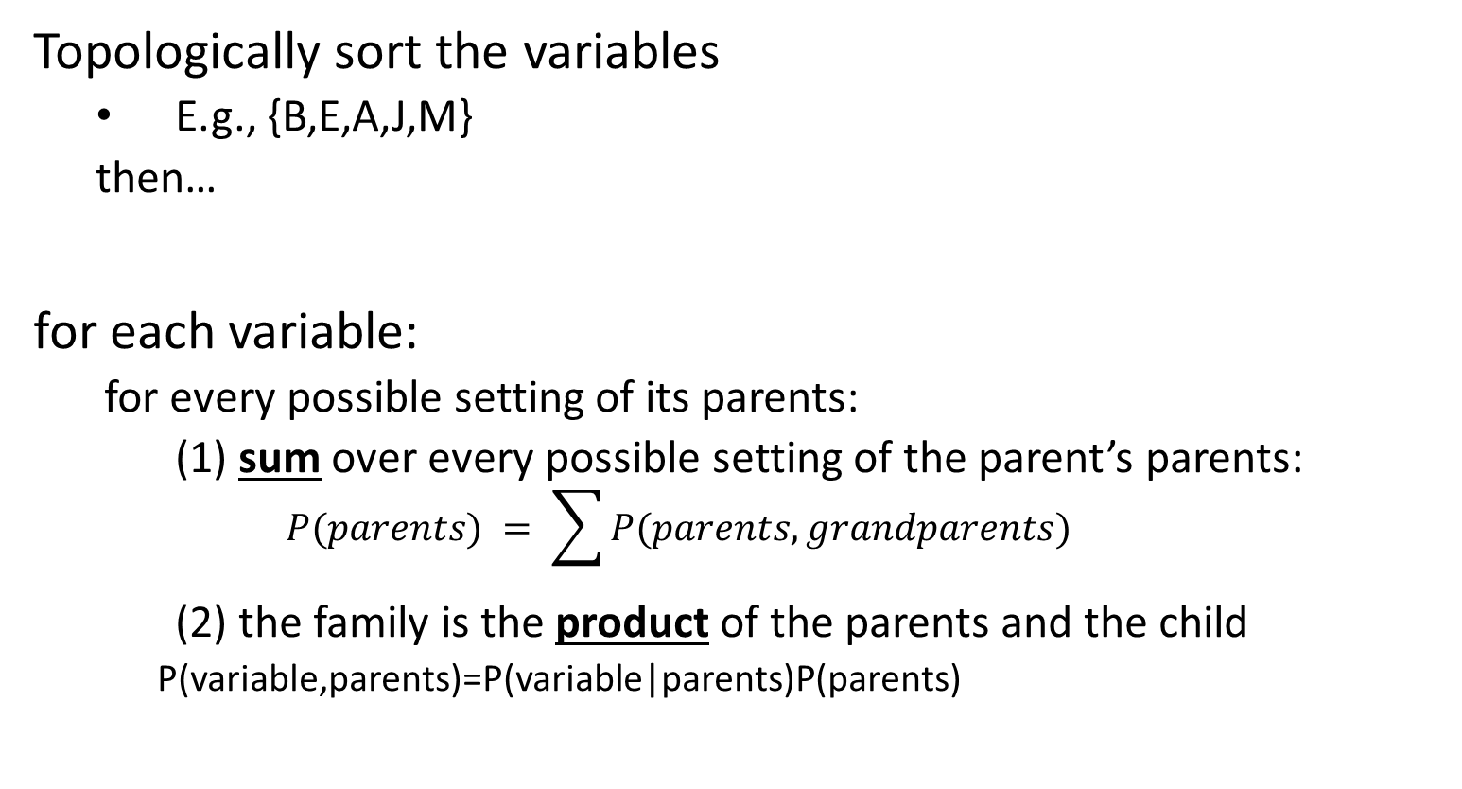
Sum-Product Algorithm for Trees
Topologically sort the variables
  E.g., {B,E,A,J,M}
  then…
for each variable:
  for every possible setting of its parents:
  (1) sum over every possible setting of the parent’s parents:
    $$P(parents) = \sum{P(parents,grandparents)}$$
  (2) the family is the product of the parents and the child
    P(variable,parents)=P(variable|parents)P(parents)

Slide 12
Practice example 3
Query: P(B=True | J=True, M=True)
Can we compute this sum efficiently?

Slide 13
Practice example 3: Sum-product algorithm
To compute p(query variable|evidence variables) you need to find p(query,evidence) for every value of the query, but only for the given values of the evidence.
  In this case the query variable is B (two possible settings: T or F)
  The evidence variable is the pair (J,M) (we only need to consider one setting: both T)
Find a path through the polytree, including all variables
  In this case, the path (B,E,A,J,M) will work.
  We’ll consider all possible settings of (B,E,A), but only the given settings of (J=T,M=T)
We will need to use the sum-product algorithm to propagate probabilities along that path, in order to finally compute p(B=b,J=T,M=T).

Slide 14
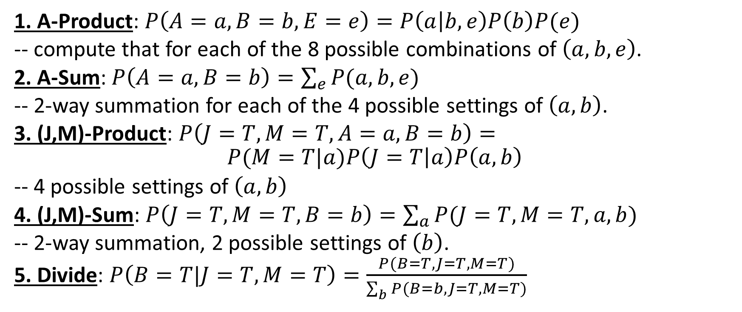
Practice example 3: Sum-product algorithm
1. A-Product: $P\left(A=a,B=b,E=e\right)=P\left(a | b,e\right)P\left(b\right)P(e)$
-- compute that for each of the 8 possible combinations of $\left(a,b,e\right)$.
2. A-Sum: $P\left(A=a,B=b\right)=\sum_{e}{P(a,b,e)}$
-- 2-way summation for each of the 4 possible settings of $\left(a,b\right)$.
3. (J,M)-Product: $P\left(J=T,M=T,A=a,B=b\right)=$
$$P(M=T|a)P\left(J=T | a\right)P\left(a,b\right)$$
-- 4 possible settings of $\left(a,b\right)$
4. (J,M)-Sum: $P\left(J=T,M=T,B=b\right)=\sum_{a}{P(J=T,M=T, a,b)}$
-- 2-way summation, 2 possible settings of $\left(b\right)$.
5. Divide: $P\left(B=T|J=T,M=T\right)=\frac{P(B=T,J=T,M=T)}{\sum_{b}{P(B=b,J=T,M=T)}}$

Slide 15
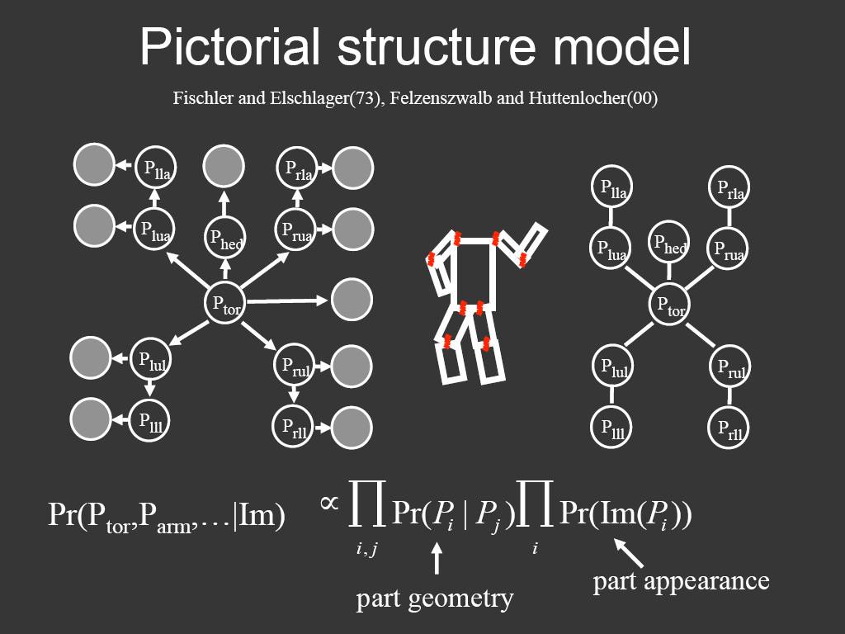
Representing people

Slide 16
Outline
Inference Examples
Inference Algorithms
  Trees: Sum-product algorithm
  Graphs: No polynomial-time algorithm
Parameter Learning
  Expectation Maximization
Structure Learning
  Regularized Maximum Likelihood

Slide 17
Bayesian network inference
In full generality, NP-hard
  More precisely, #P-hard: equivalent to counting satisfying assignments
We can reduce satisfiability to Bayesian network inference
  Decision problem: is P(Y) > 0?

Slide 18
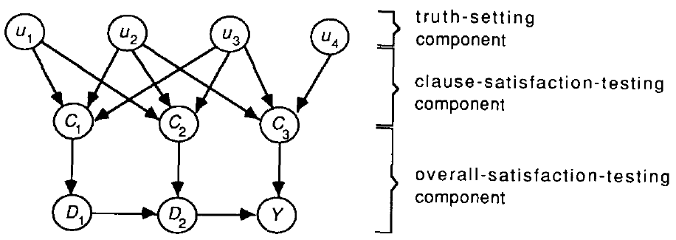
Bayesian network inference
In full generality, NP-hard
  More precisely, #P-hard: equivalent to counting satisfying assignments
We can reduce satisfiability to Bayesian network inference
  Decision problem: is P(Y) > 0?
C₁
C₂
C₃
G. Cooper, 1990

Slide 19
Bayesian network inference

Slide 20
Bayesian network inference
Why can’t we use the sum-product algorithm to efficiently compute Pr(Y)?

Slide 21
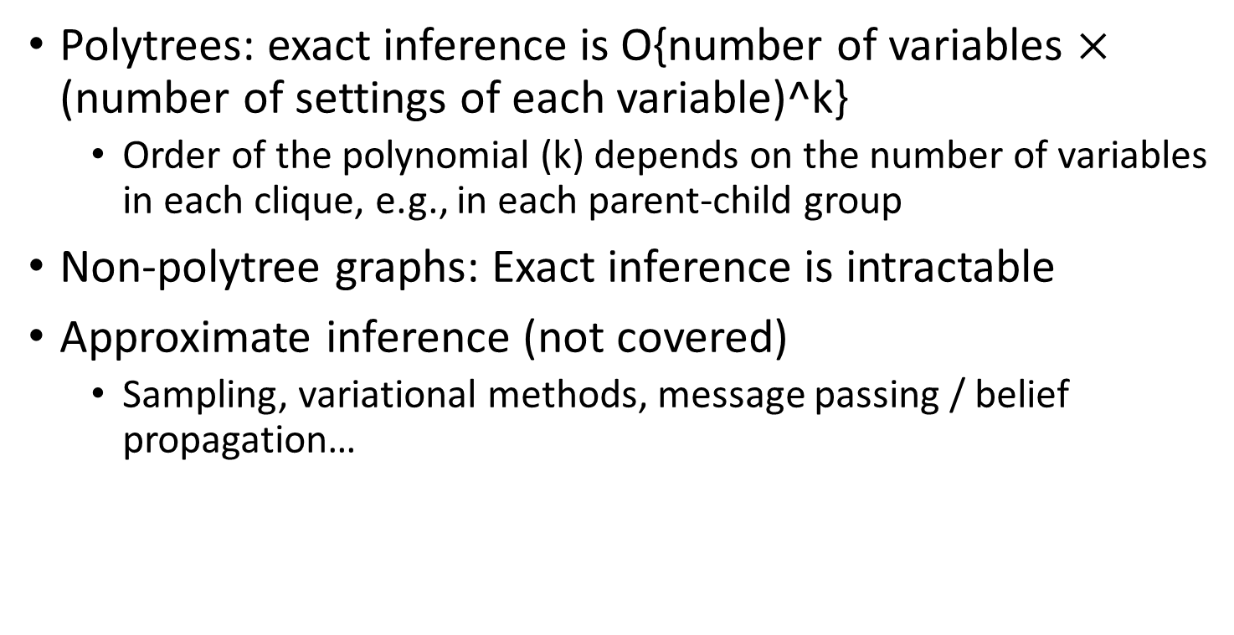
Bayesian network inference:
Big picture
Polytrees: exact inference is O{number of variables $×$ (number of settings of each variable)^k}
  Order of the polynomial (k) depends on the number of variables in each clique, e.g., in each parent-child group
Non-polytree graphs: Exact inference is intractable
Approximate inference (not covered)
  Sampling, variational methods, message passing / belief propagation…
Notes:
Start here

Slide 22
Outline
Inference Examples
Inference Algorithms
  Trees: Sum-product algorithm
  Graphs: No polynomial-time algorithm
Parameter Learning
  Expectation Maximization
Structure Learning
  Regularized Maximum Likelihood

Slide 23
Parameter learning
  Inference problem: given values of evidence variables E = e, answer questions about query variables X using the posterior P(X | E = e)
Learning problem: estimate the parameters of the probabilistic model P(X | E) given a training sample {(x₁,e₁), …, (x_{n},e_{n})}
Notes:
23

Slide 24
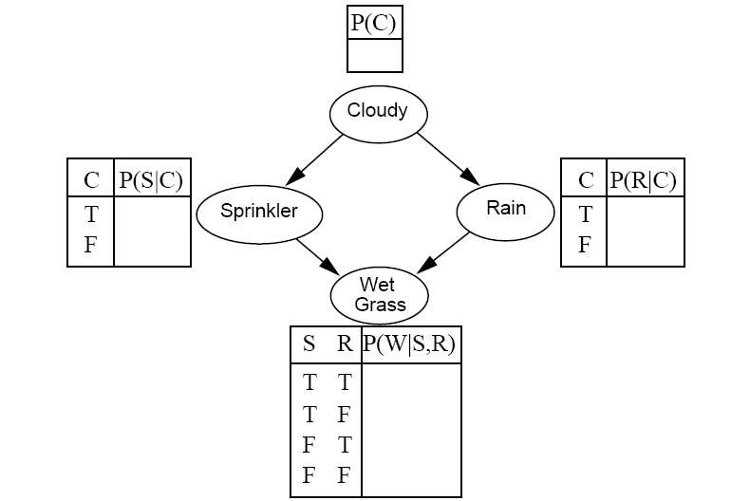
Parameter learning
Suppose we know the network structure (but not the parameters), and have a training set of complete observations
Training set
?
Sample | C | S | R | W
1 | T | F | T | T
2 | F | T | F | T
3 | T | F | F | F
4 | T | T | T | T
5 | F | T | F | T
6 | T | F | T | F
… | … | … | …. | …
?
?
?
?
?
?
?
?

Slide 25
Parameter learning
Suppose we know the network structure (but not the parameters), and have a training set of complete observations
  P(X | Parents(X)) is given by the observed frequencies of the different values of X for each combination of parent values

Slide 26
Parameter learning
Incomplete observations
Expectation maximization (EM) algorithm for dealing with missing data
?
Training set
Sample | C | S | R | W
1 | ? | F | T | T
2 | ? | T | F | T
3 | ? | F | F | F
4 | ? | T | T | T
5 | ? | T | F | T
6 | ? | F | T | F
… | … | … | …. | …
?
?
?
?
?
?
?
?
Notes:
Roughly speaking, alternate between doing inference on the missing data (“filling in” the missing data) and re-estimating the parameters of the model given the estimated missing data

Slide 27
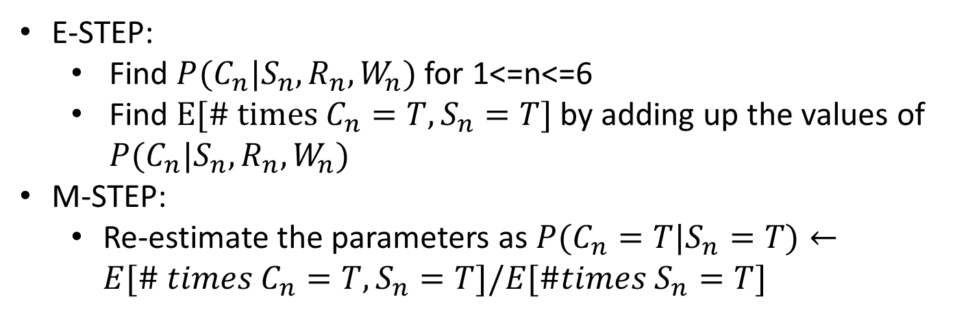
Parameter learning: EM
Sample | C | S | R | W
1 | ? | F | T | T
2 | ? | T | F | T
3 | ? | F | F | F
4 | ? | T | T | T
5 | ? | T | F | T
6 | ? | F | T | F
… | … | … | …. | …
E-STEP:
  Find $P(C_{n}|S_{n},R_{n},W_{n})$ for 1<=n<=6
  Find $E[\# times C_{n}=T,S_{n}=T]$ by adding up the values of $P(C_{n}|S_{n},R_{n},W_{n})$
M-STEP:
  Re-estimate the parameters as $P(C_{n}=T|S_{n}=T)←E[\# times C_{n}=T,S_{n}=T]/E[\#times S_{n}=T]$
Notes:
Roughly speaking, alternate between doing inference on the missing data (“filling in” the missing data) and re-estimating the parameters of the model given the estimated missing data

Slide 28
Outline
Inference Examples
Inference Algorithms
  Trees: Sum-product algorithm
  Graphs: No polynomial-time algorithm
Parameter Learning
  Expectation Maximization
Structure Learning
  Regularized Maximum Likelihood

Slide 29
Structure learning
What if the network structure is unknown?
Training set
C
Sample | C | S | R | W
1 | T | F | T | T
2 | F | T | F | T
3 | T | F | F | F
4 | T | T | T | T
5 | F | T | F | T
6 | T | F | T | F
… | … | … | …. | …
?
S
R
W

Slide 30
Structure learning
For every possible set of edges:
  Compute the data likelihood given this structure
  Penalize complexity (e.g., subtract # edges)
Find the structure with highest penalized likelihood
Sample | C | S | R | W
1 | T | F | T | T
2 | F | T | F | T
3 | T | F | F | F
4 | T | T | T | T
5 | F | T | F | T
6 | T | F | T | F
… | … | … | …. | …
?
S
R
W

Slide 31
Summary: Bayesian networks
Structure
Parameters
Inference
Learning

