Slide 1
CS440/ECE448 Lecture 18: Bayesian Networks
Slides by Svetlana Lazebnik, 10/2016
Modified by Mark Hasegawa-Johnson, 10/2017

Slide 2
Review: Bayesian inference
A general scenario:
Query variables: X
Evidence (observed) variables and their values: E = e
Inference problem: answer questions about the query variables given the evidence variables
This can be done using the posterior distribution P(X | E = e)
Example of a useful question: Which X is true?
More formally: what value of X has the least probability of being wrong?
Answer: MPE = MAP (argmin P(error) = argmax P(X=x|E=e))
Notes:
2

Slide 3
Today: What if P(X,E) is complicated?
Very, very common problem: P(X,E) is complicated because both X and E depend on some hidden variable Y
SOLUTION:
Draw a bunch of circles and arrows that represent the dependence
When your algorithm performs inference, make sure it does so in the order of the graph
FORMALISM: Bayesian Network

Slide 4
Hidden Variables
A general scenario:
Query variables: X
Evidence (observed) variables and their values: E = e
Unobserved variables: Y
Inference problem: answer questions about the query variables given the evidence variables
This can be done using the posterior distribution P(X | E = e)
In turn, the posterior needs to be derived from the full joint P(X, E, Y)
Bayesian networks are a tool for representing joint probability distributions efficiently
Notes:
4

Slide 5


Bayesian networks
More commonly called graphical models
A way to depict conditional independence relationships between random variables
A compact specification of full joint distributions

Slide 6
Outline
Review: Bayesian inference
Bayesian network: graph semantics
The Los Angeles burglar alarm example
Constructing a Bayesian network
Conditional independence ≠ Independence
Real-world examples

Slide 7
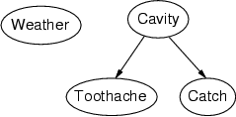
Bayesian networks: Structure
Nodes: random variables
Arcs: interactions
An arrow from one variable to another indicates direct influence
Must form a directed, acyclic graph

Slide 8
Example: N independent coin flips
Complete independence: no interactions
…
X₁
X₂
X_{n}

Slide 9
Example: Naïve Bayes document model
Random variables:
X: document class
W₁, …, W_{n}: words in the document
X
…
W₁
W₂
W_{n}

Slide 10
Outline
Review: Bayesian inference
Bayesian network: graph semantics
The Los Angeles burglar alarm example
Constructing a Bayesian network
Conditional independence ≠ Independence
Real-world examples

Slide 11

Example: Los Angeles Burglar Alarm
I have a burglar alarm that is sometimes set off by minor earthquakes. My two neighbors, John and Mary, promised to call me at work if they hear the alarm
Example inference task: suppose Mary calls and John doesn’t call. What is the probability of a burglary?
What are the random variables?
Burglary, Earthquake, Alarm, JohnCalls, MaryCalls
What are the direct influence relationships?
A burglar can set the alarm off
An earthquake can set the alarm off
The alarm can cause Mary to call
The alarm can cause John to call

Slide 12
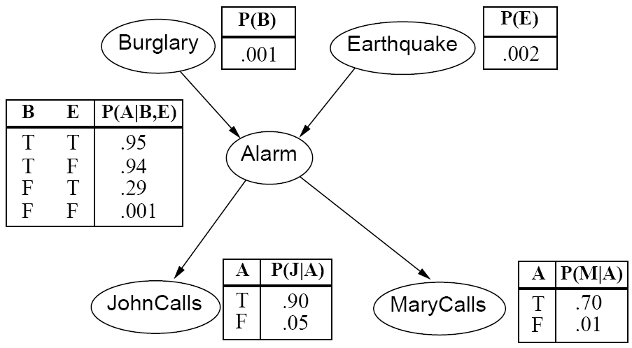
Example: Burglar Alarm

Slide 13




Conditional independence and the joint distribution
Key property: each node is conditionally independent of its non-descendants given its parents
Suppose the nodes X₁, …, X_{n} are sorted in topological order
To get the joint distribution P(X₁, …, X_{n}), use chain rule:

Slide 14
Conditional probability distributions
To specify the full joint distribution, we need to specify a conditional distribution for each node given its parents: P (X | Parents(X))
…
Z₁
Z₂
Z_{n}
X
P (X | Z₁, …, Z_{n})

Slide 15





Example: Burglar Alarm
$$P(B)$$
$$P(E)$$
$$P(A|B,E)$$
$$P(J|A)$$
$$P(M|A)$$

Slide 16
Example: Burglar Alarm
$$P(B)$$
$$P(E)$$
A “model” is a complete specification of the dependencies.
The conditional probability tables are the model parameters.
$$P(A|B,E)$$
$$P(J|A)$$
$$P(M|A)$$

Slide 17
Outline
Review: Bayesian inference
Bayesian network: graph semantics
The Los Angeles burglar alarm example
Constructing a Bayesian network
Conditional independence ≠ Independence
Real-world examples

Slide 18
Constructing Bayesian networks
Choose an ordering of variables X₁, … , X_{n}
For i = 1 to n
add X_{i} to the network
select parents from X₁, … ,X_{i-1} such that P(X_{i} | Parents(X_{i})) = P(X_{i} | X₁, ... X_{i-1})

Slide 19
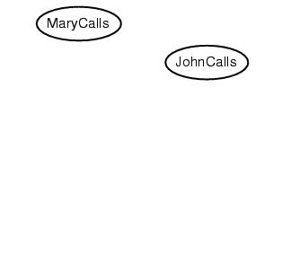
Example
Suppose we choose the ordering M, J, A, B, E

Slide 20
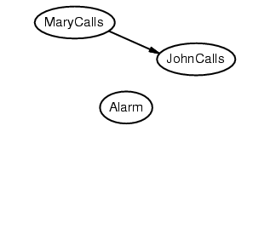
Example
Suppose we choose the ordering M, J, A, B, E

Slide 21
Example
Suppose we choose the ordering M, J, A, B, E

Slide 22
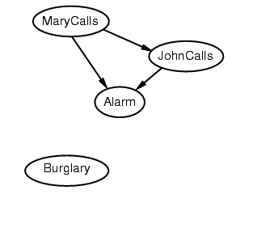
Example
Suppose we choose the ordering M, J, A, B, E

Slide 23
Example
Suppose we choose the ordering M, J, A, B, E

Slide 24
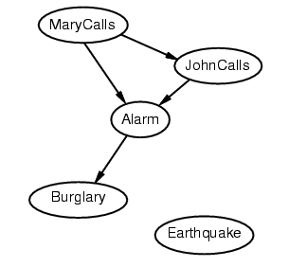
Example
Suppose we choose the ordering M, J, A, B, E

Slide 25
Example
Suppose we choose the ordering M, J, A, B, E

Slide 26
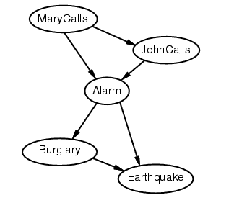
Example
Suppose we choose the ordering M, J, A, B, E

Slide 27
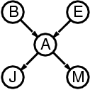
Example contd.
Deciding conditional independence is hard in noncausal directions
The causal direction seems much more natural
Network is less compact: 1 + 2 + 4 + 2 + 4 = 13 numbers needed (vs. 1+1+4+2+2=10 for the causal ordering)
versus

Slide 28
Why store it in causal order? A: Saves memory
Suppose we have a Boolean variable X_{i} with k Boolean parents. How many rows does its conditional probability table have?
2^{k} rows for all the combinations of parent values
Each row requires one number for P(X_{i} = true | parent values)
If each variable has no more than k parents, how many numbers does the complete network require?
O(n · 2^{k}) numbers – vs. O(2^{n}) for the full joint distribution
How many nodes for the burglary network?
1 + 1 + 4 + 2 + 2 = 10 numbers (vs. 2⁵-1 = 31)

Slide 29
Outline
Review: Bayesian inference
Bayesian network: graph semantics
The Los Angeles burglar alarm example
Constructing a Bayesian network
Conditional independence ≠ Independence
Real-world examples

Slide 30
The joint probability distribution
For example,
$$\text{P}\text{(}\text{j}\text{, }\text{m}\text{, }\text{a}\text{, }¬\text{b}\text{,}¬\text{e}\text{) = }\text{P}\text{(}¬\text{b}\text{) }\text{P}\text{(}¬\text{e}\text{) }\text{P}\text{(}\text{a}\text{|}¬\text{b}\text{,}¬\text{e}\text{) }\text{P}\text{(}\text{j}\text{|}\text{a}\text{) }\text{P}\text{(}\text{m}\text{|}\text{a}\text{)}$$

Slide 31
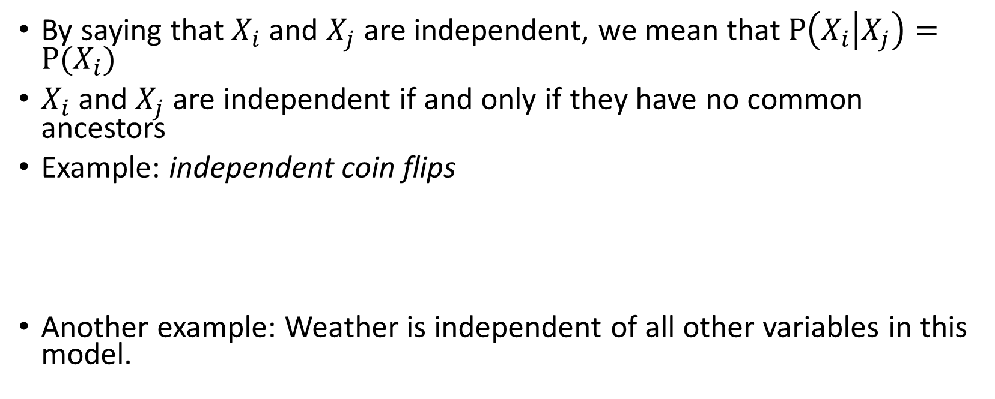
Independence
By saying that $X_{i}$and $X_{j}$are independent, we mean that $P\left(X_{i} | X_{j}\right)=P(X_{i})$
$X_{i}$and $X_{j}$ are independent if and only if they have no common ancestors
Example: independent coin flips
Another example: Weather is independent of all other variables in this model.
…
X₁
X₂
X_{n}

Slide 32
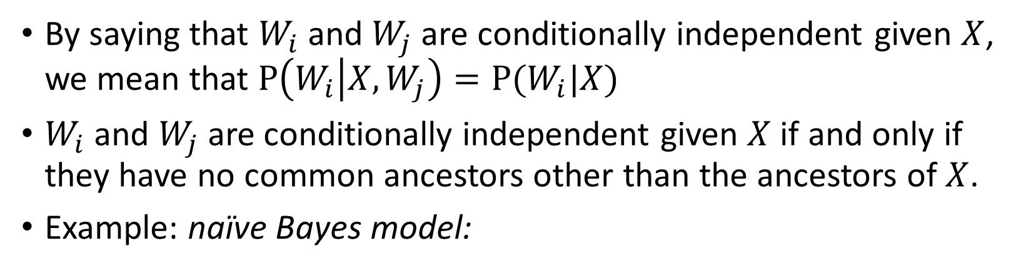
Conditional independence
By saying that $W_{i}$and $W_{j}$are conditionally independent given $X$, we mean that $P\left(W_{i} | X,W_{j}\right)=P(W_{i}|X)$
$W_{i}$and $W_{j}$are conditionally independent given $X$ if and only if they have no common ancestors other than the ancestors of $X$.
Example: naïve Bayes model:
X
…
W₁
W₂
W_{n}

Slide 33
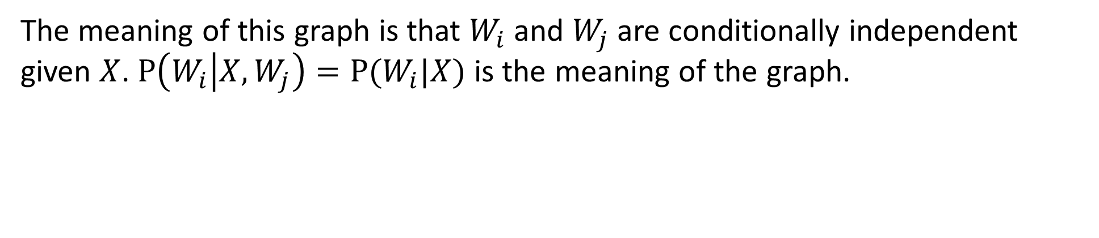
Conditional independence
X
…
W₁
W₂
W_{n}
The meaning of this graph is that $W_{i}$and $W_{j}$are conditionally independent given $X$. $P\left(W_{i} | X,W_{j}\right)=P(W_{i}|X)$ is the meaning of the graph.

Slide 34
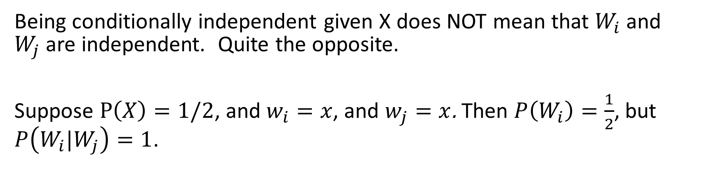
Conditional independence ≠ Independence
X
…
W₁
W₂
W_{n}
Being conditionally independent given X does NOT mean that $W_{i}$and $W_{j}$are independent. Quite the opposite.
Suppose $P\left(X\right)=1/2$, and $w_{i}=x$, and $w_{j}=x$. Then $P\left(W_{i}\right)=\frac{1}{2}$, but $P\left(W_{i}|W_{j}\right)=1$.

Slide 35
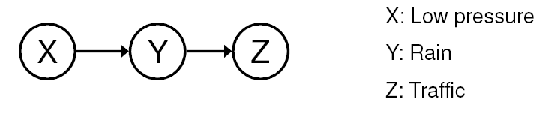
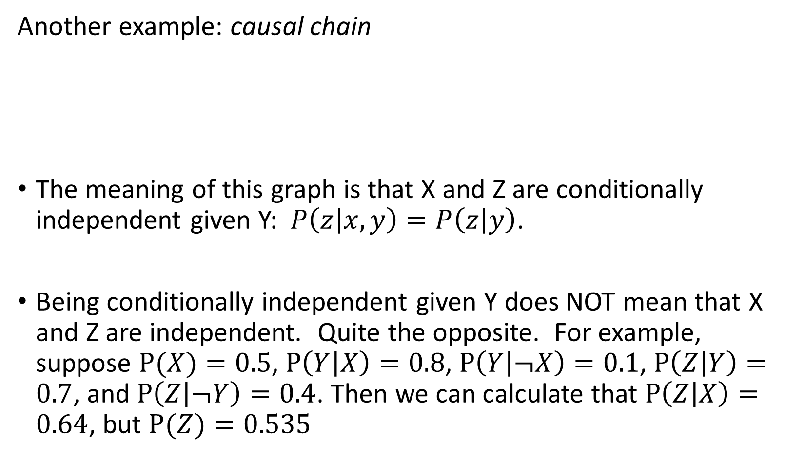
Conditional independence
Another example: causal chain
The meaning of this graph is that X and Z are conditionally independent given Y: $P\left(z | x,y\right)=P\left(z | y\right)$.
Being conditionally independent given Y does NOT mean that X and Z are independent. Quite the opposite. For example, suppose $P(X)=0.5$, $P\left(Y | X\right)=0.8$, $P\left(Y | ¬X\right)=0.1$, $P\left(Z | Y\right)=0.7$, and $P\left(Z | ¬Y\right)=0.4$. Then we can calculate that $P\left(Z | X\right)=0.64$, but $P(Z)=0.535$

Slide 36
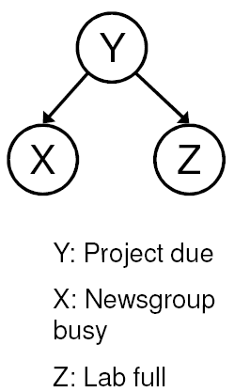
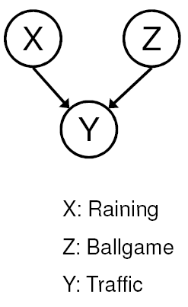
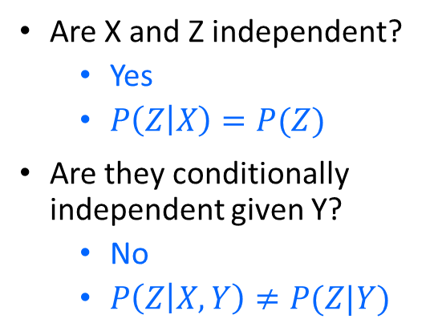
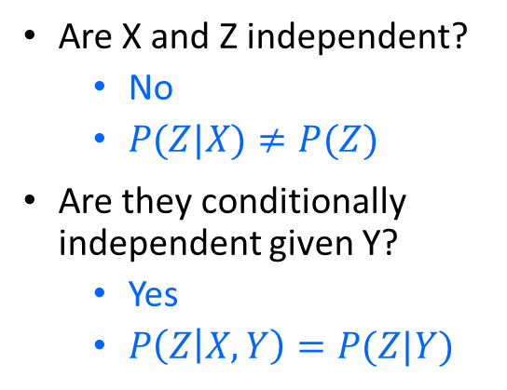
Conditional independence ≠ Independence
Common cause
Common effect
Are X and Z independent?
No
$P(Z|X)≠P(Z)$
Are they conditionally independent given Y?
Yes
$P\left(Z | X,Y\right)=P(Z|Y)$
Are X and Z independent?
Yes
$P\left(Z | X\right)=P(Z)$
Are they conditionally independent given Y?
No
$P\left(Z | X,Y\right)≠P(Z|Y)$
Notes:
Is P(Raining | Traffic) the same as P(Raining | Traffic, Ballgame)?

Slide 37
Outline
Review: Bayesian inference
Bayesian network: graph semantics
The Los Angeles burglar alarm example
Constructing a Bayesian network
Conditional independence ≠ Independence
Real-world examples

Slide 38
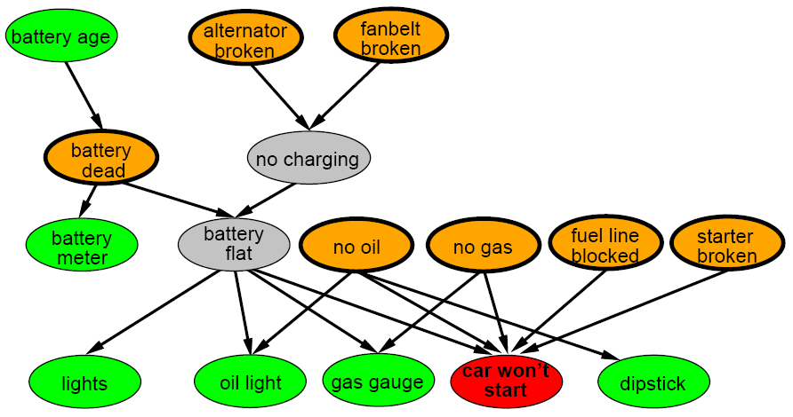
A more realistic Bayes Network: Car diagnosis
Initial observation: car won’t start
Orange: “broken, so fix it” nodes
Green: testable evidence
Gray: “hidden variables” to ensure sparse structure, reduce parameters

Slide 39
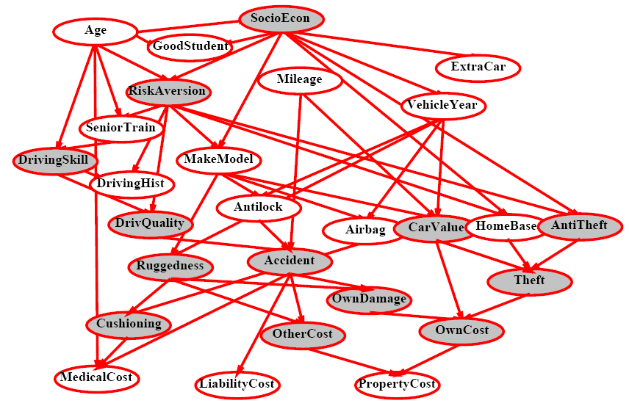
Car insurance

Slide 40
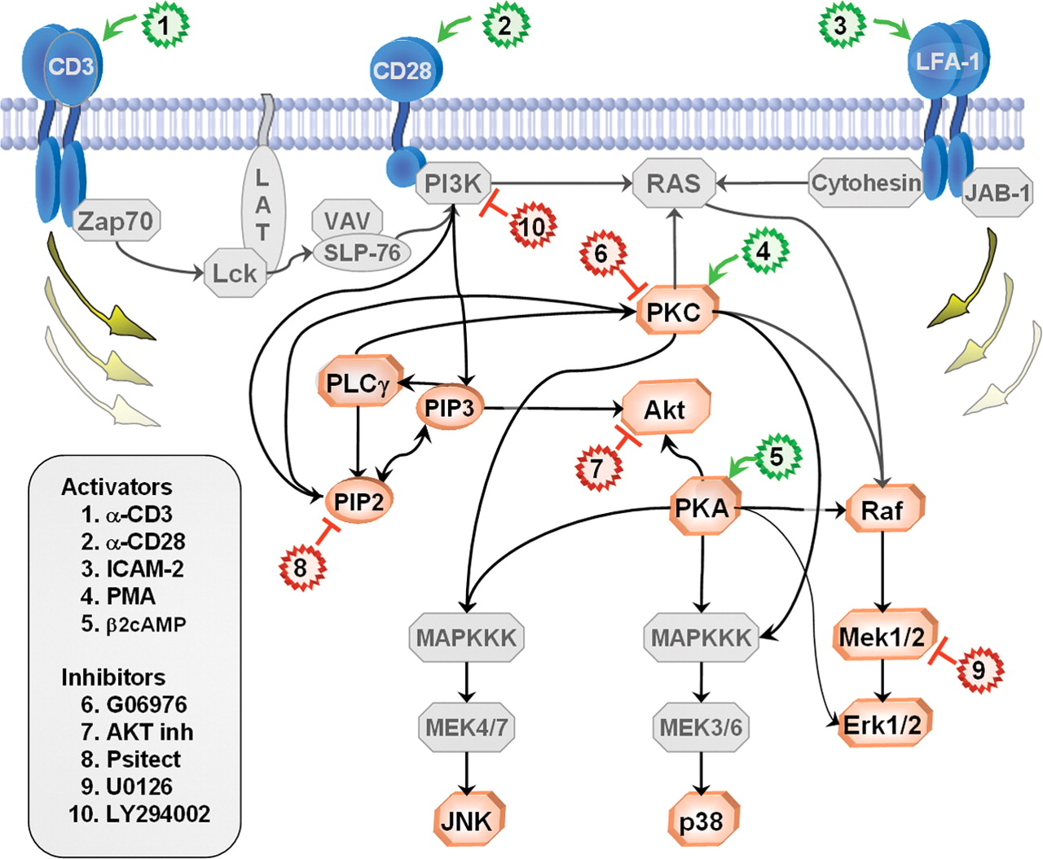
In research literature…
Causal Protein-Signaling Networks Derived from Multiparameter Single-Cell Data
Karen Sachs, Omar Perez, Dana Pe'er, Douglas A. Lauffenburger, and Garry P. Nolan
(22 April 2005) Science 308 (5721), 523.

Slide 41
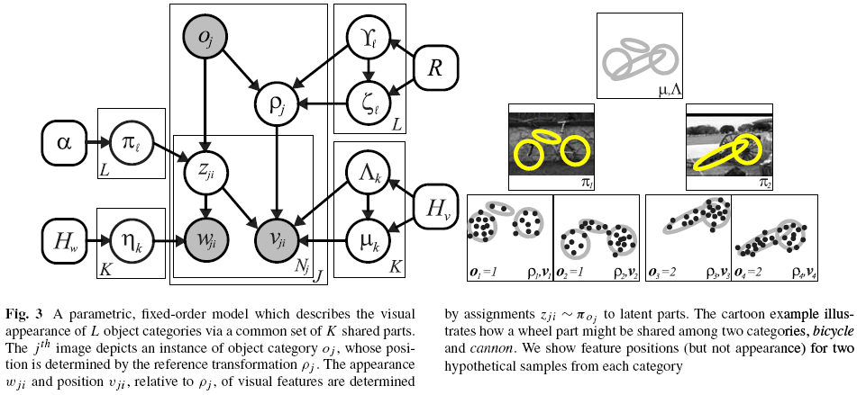
In research literature…
Describing Visual Scenes Using Transformed Objects and Parts
E. Sudderth, A. Torralba, W. T. Freeman, and A. Willsky.
International Journal of Computer Vision, No. 1-3, May 2008, pp. 291-330.

Slide 42
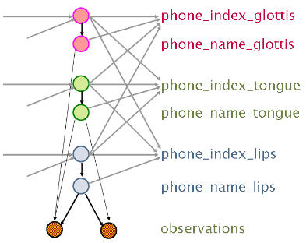
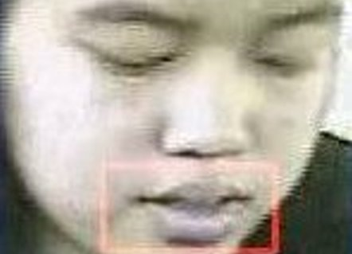
In research literature…
Audiovisual Speech Recognition with Articulator Positions as Hidden Variables
Mark Hasegawa-Johnson, Karen Livescu, Partha Lal and Kate Saenko
International Congress on Phonetic Sciences 1719:299-302, 2007

Slide 43
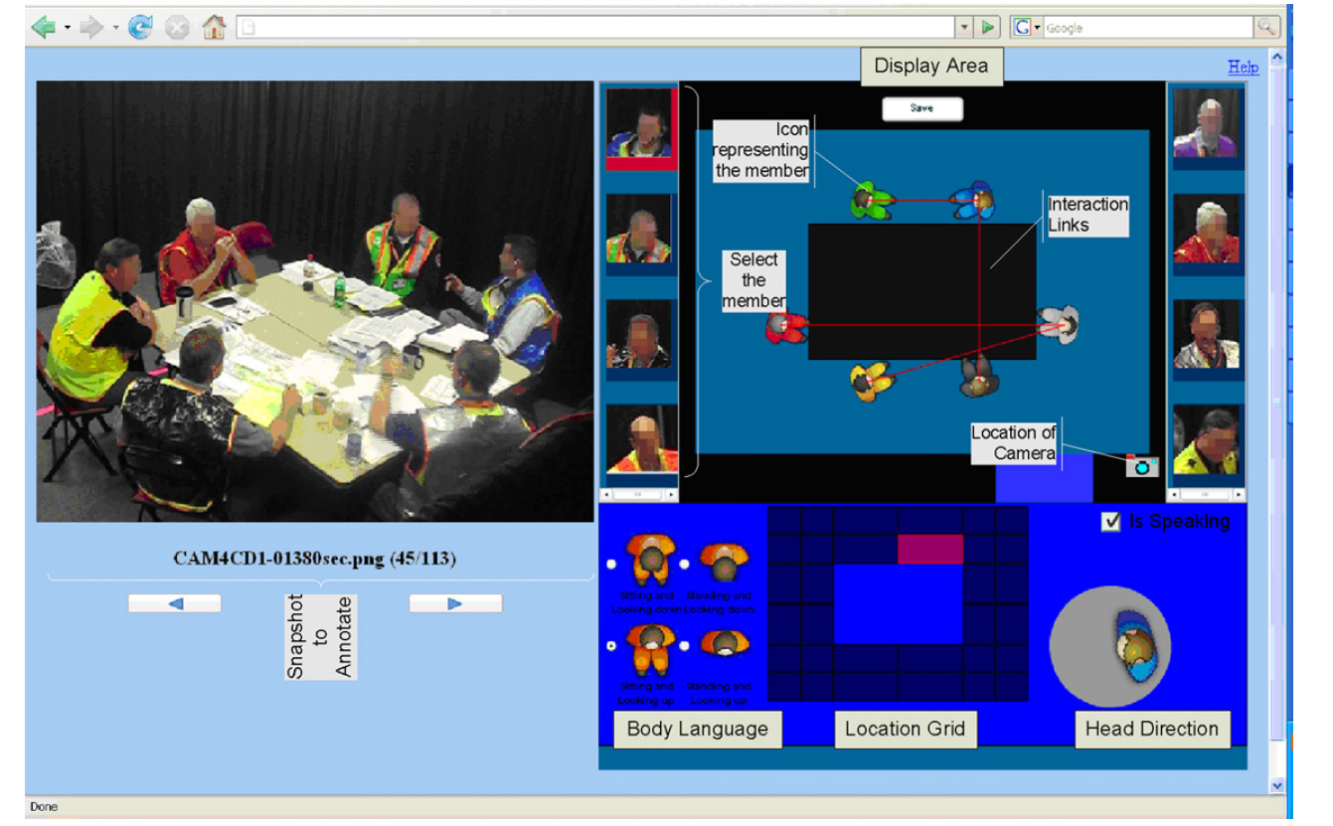
In research literature…
Detecting interaction links in a collaborating group using manually annotated data
S. Mathur, M.S. Poole, F. Pena-Mora, M. Hasegawa-Johnson, N. Contractor
Social Networks 10.1016/j.socnet.2012.04.002

Slide 44
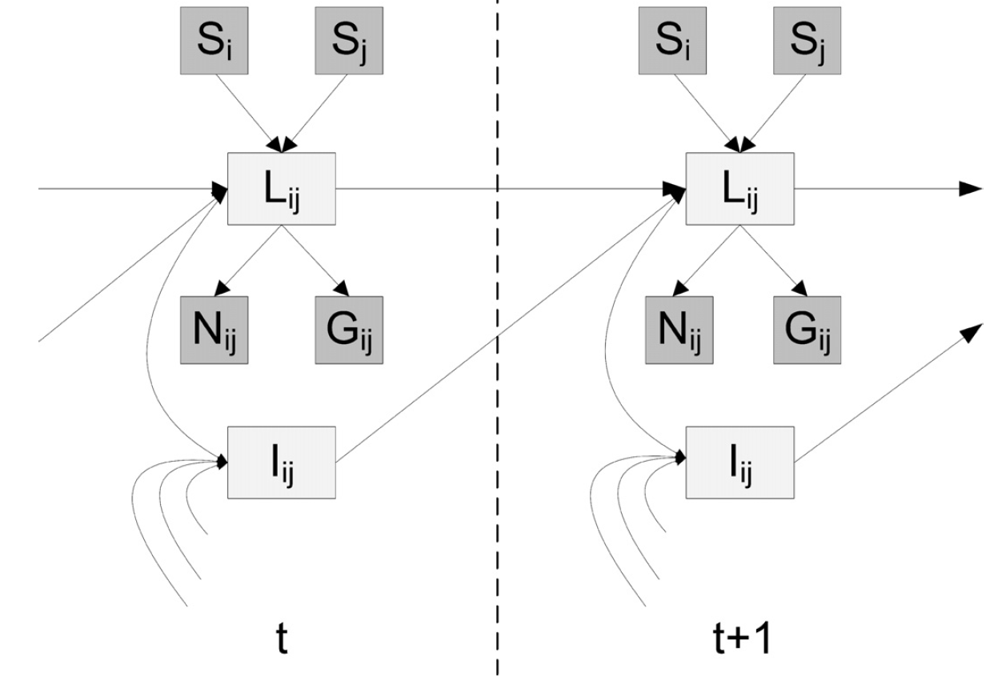
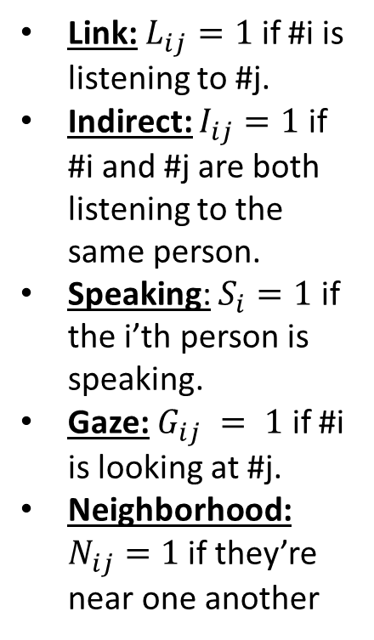
In research literature…
Link: $L_{ij}=1$ if #i is listening to #j.
Indirect: $I_{ij}=1$ if #i and #j are both listening to the same person.
Speaking: $S_{i}=1$ if the i’th person is speaking.
Gaze: $G_{ij} = 1$ if #i is looking at #j.
Neighborhood: $N_{ij}=1$ if they’re near one another
Detecting interaction links in a collaborating group using manually annotated data
S. Mathur, M.S. Poole, F. Pena-Mora, M. Hasegawa-Johnson, N. Contractor
Social Networks 10.1016/j.socnet.2012.04.002

Slide 45
Summary
Bayesian networks provide a natural representation for (causally induced) conditional independence
Topology + conditional probability tables
Generally easy for domain experts to construct

