Slide 1
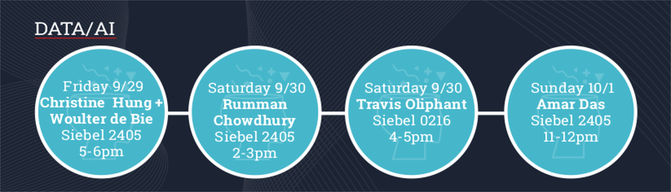
ECE Reflections | Projections
The Reflections|Projections conference is bringing a host of distinguished speakers in the AI/ML field to UIUC this weekend. The list Includes Christine Hung: Head of Spotify Data Science, Amar Das: Director of Healthcare Research at IBM Watson, and Travis Oliphant: creator of NumPy. More information and registration can be found at acmrp.org.

Slide 2
Announcements
MP1 is due Monday at 23:59:59
If you think you need an extension (e.g., because you have an exam or MP due in another class on Monday), you need to send me e-mail by tonight (9/28/2017 23:59:59).

Slide 3
CS440/ECE448 Lecture 10: Stochastic Games, Stochastic Search, and Learned Evaluation Functions
Slides by Svetlana Lazebnik, 9/2016
Modified by Mark Hasegawa-Johnson, 9/2017

Slide 4
Types of game environments
 | Deterministic | Stochastic
Perfect information (fully observable)
Imperfect information (partially observable)
Chess, checkers, go
Backgammon, monopoly
Battleship
Scrabble, poker, bridge

Slide 5
Content of today’s lecture
Stochastic games: the Expectiminimax algorithm
Imperfect information
Minimax formulation
Expectiminimax formulation
Stochastic search, even for deterministic games
Learned evaluation functions
Case study: Alpha-Go

Slide 6
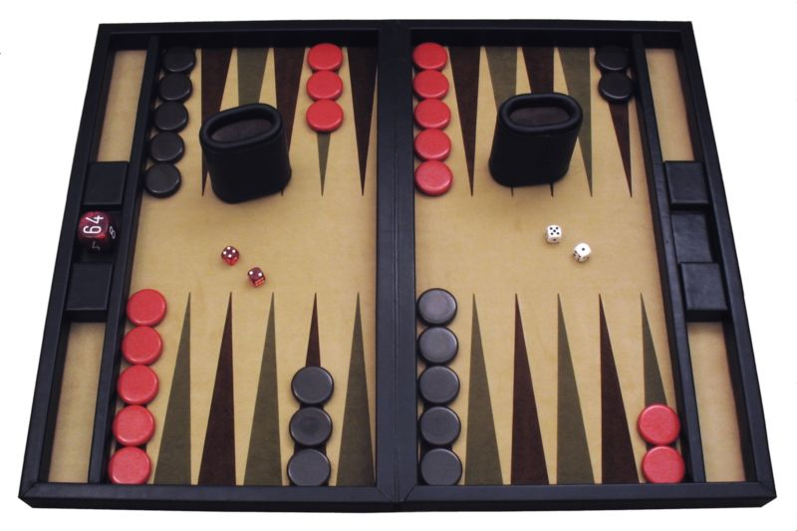
Stochastic games
How can we incorporate dice throwing into the game tree?

Slide 7
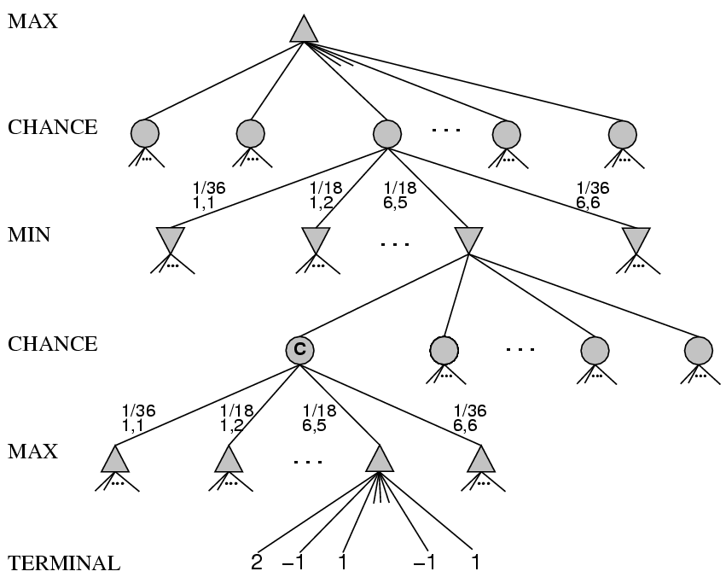
Stochastic games

Slide 8
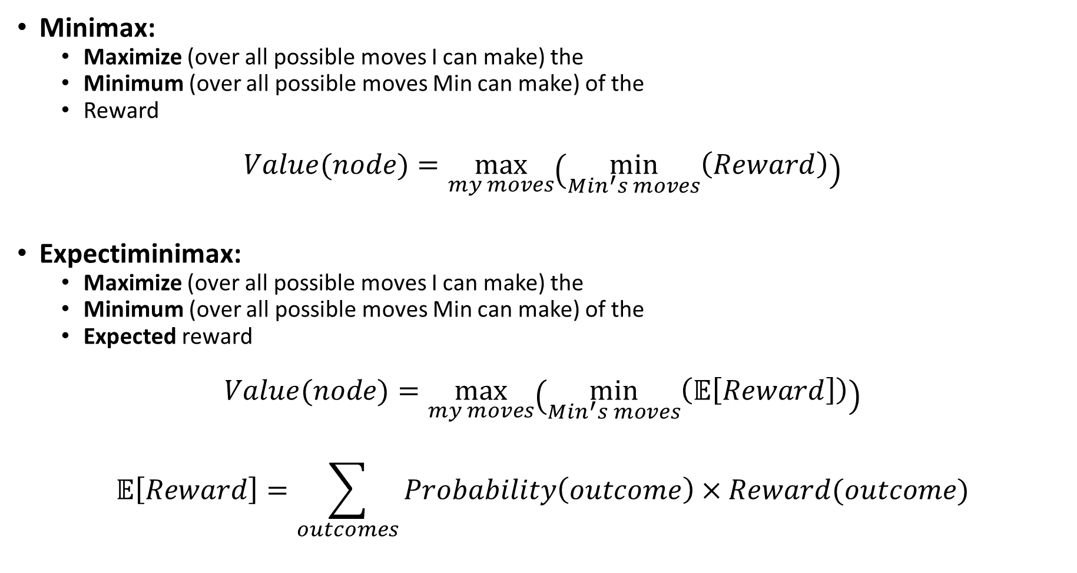
Minimax vs. Expectiminimax
Minimax:
Maximize (over all possible moves I can make) the
Minimum (over all possible moves Min can make) of the
Reward
$$Value(node)=\max_{my moves}\left(\min_{Min^{′}s moves}\left(Reward\right)\right)$$
Expectiminimax:
Maximize (over all possible moves I can make) the
Minimum (over all possible moves Min can make) of the
Expected reward
$$Value(node)=\max_{my moves}\left(\min_{Min^{′}s moves}\left(𝔼\left[Reward\right]\right)\right)$$
$$𝔼\left[Reward\right]=\sum_{outcomes}{Probability\left(outcome\right)×Reward(outcome)}$$

Slide 9
Stochastic games
Expectiminimax: for chance nodes, sum values of successor states weighted by the probability of each successor
Value(node) =
Utility(node) if node is terminal
max_{action} Value(Succ(node, action)) if type = MAX
min_{action} Value(Succ(node, action)) if type = MIN
sum_{action} P(Succ(node, action)) * Value(Succ(node, action)) if type = CHANCE

Slide 10
Expectiminimax example
½
H
T
RANDOM: Max flips a coin. It’s heads or tails.
MAX: Max either stops, or continues.
Stop on heads: Game ends, Max wins (value = $2).
Stop on tails: Game ends, Max loses (value = -$2).
Continue: Game continues.
RANDOM: Min flips a coin.
HH: value = $2
TT: value = -$2
HT or TH: value = 0
MIN: Min decides whether to keep the current outcome (value as above), or pay a penalty (value=$1).
2
-1
½
2
-1
-2
H
T
H
T
1
0
0
-2
2
1
0
1
0
1
-2
1

Slide 11
Expectiminimax summary
All of the same methods are useful:
Alpha-Beta pruning
Evaluation function
Quiescence search, Singular move
Computational complexity is pretty bad
Branching factor of the random choice can be high
Twice as many “levels” in the tree

Slide 12
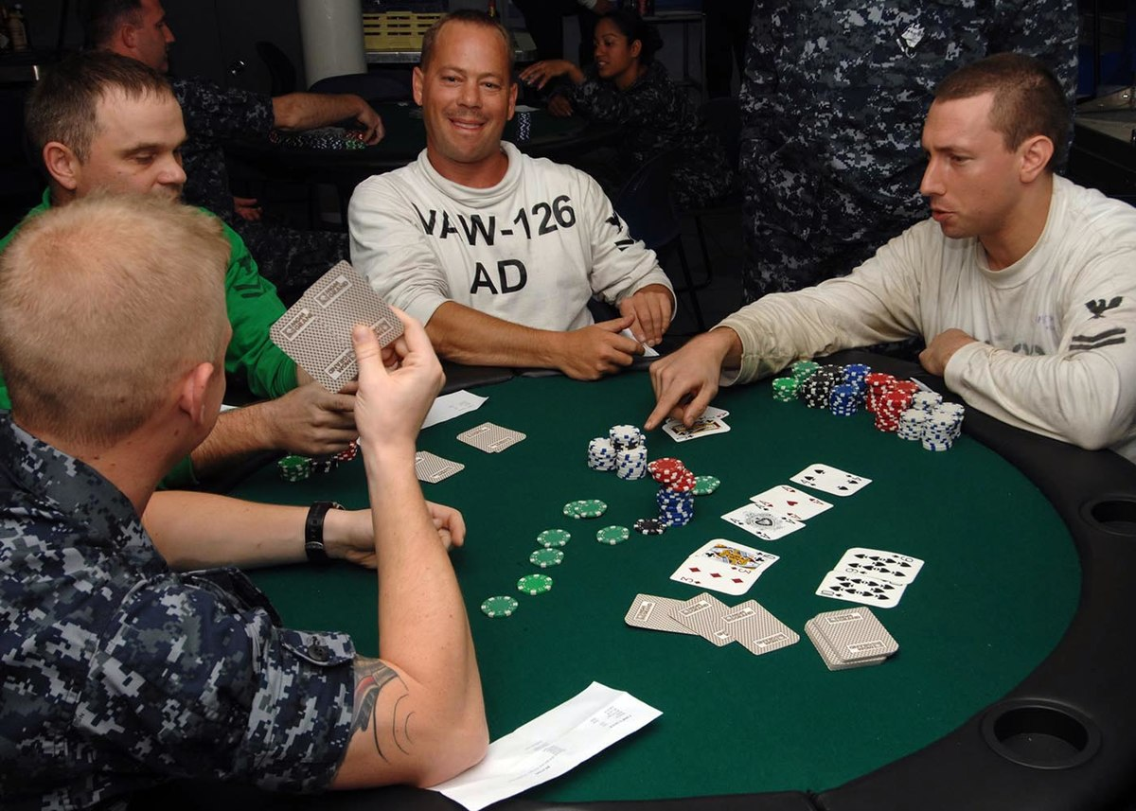
Games of Imperfect Information

Slide 13
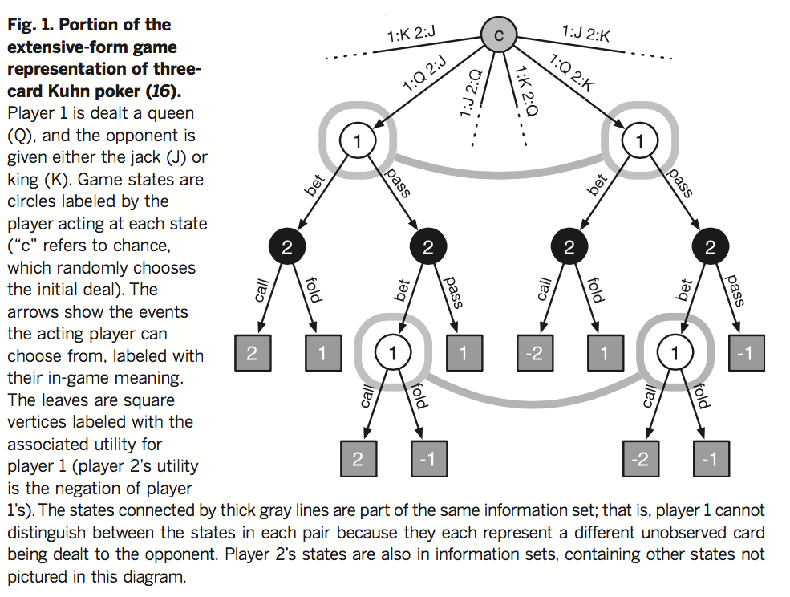
Stochastic games of imperfect information
States are grouped into information sets for each player
Source

Slide 14
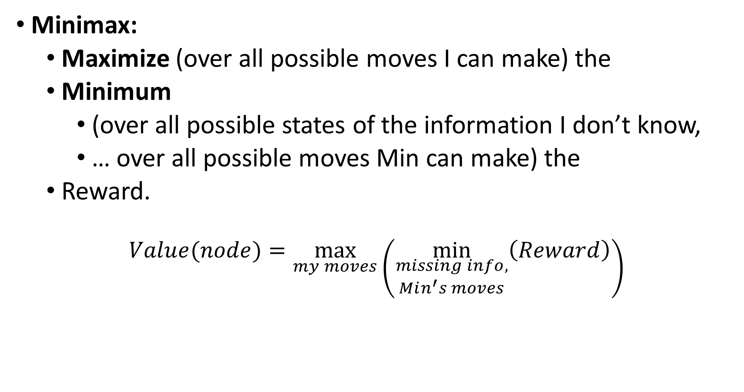
Miniminimax with imperfect information
Minimax:
Maximize (over all possible moves I can make) the
Minimum
(over all possible states of the information I don’t know,
… over all possible moves Min can make) the
Reward.
$$Value(node)=\max_{my moves}\left(\min_{\begin{aligned}missing info, \\ Min^{′}s moves\end{aligned}}\left(Reward\right)\right)$$

Slide 15
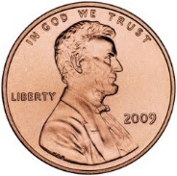
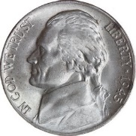
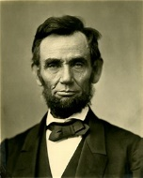
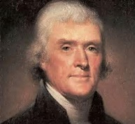
Imperfect information example
Min chooses a coin.
I say the name of a U.S. President.
If I guessed right, she gives me the coin.
If I guessed wrong, I have to give her a coin to match the one she has.
1
-1
-5
5

Slide 16
Method #1: Treat “unknown” as “unknown”
The problem: I don’t know which state I’m in. I only know it’s one of these two.
The solution: choose the policy that maximizes my minimum reward.
“Lincoln”: minimum reward is -5.
“Jefferson”: minimum reward is -1.
Miniminimax policy: say “Jefferson”.
1
-1
-5
5

Slide 17
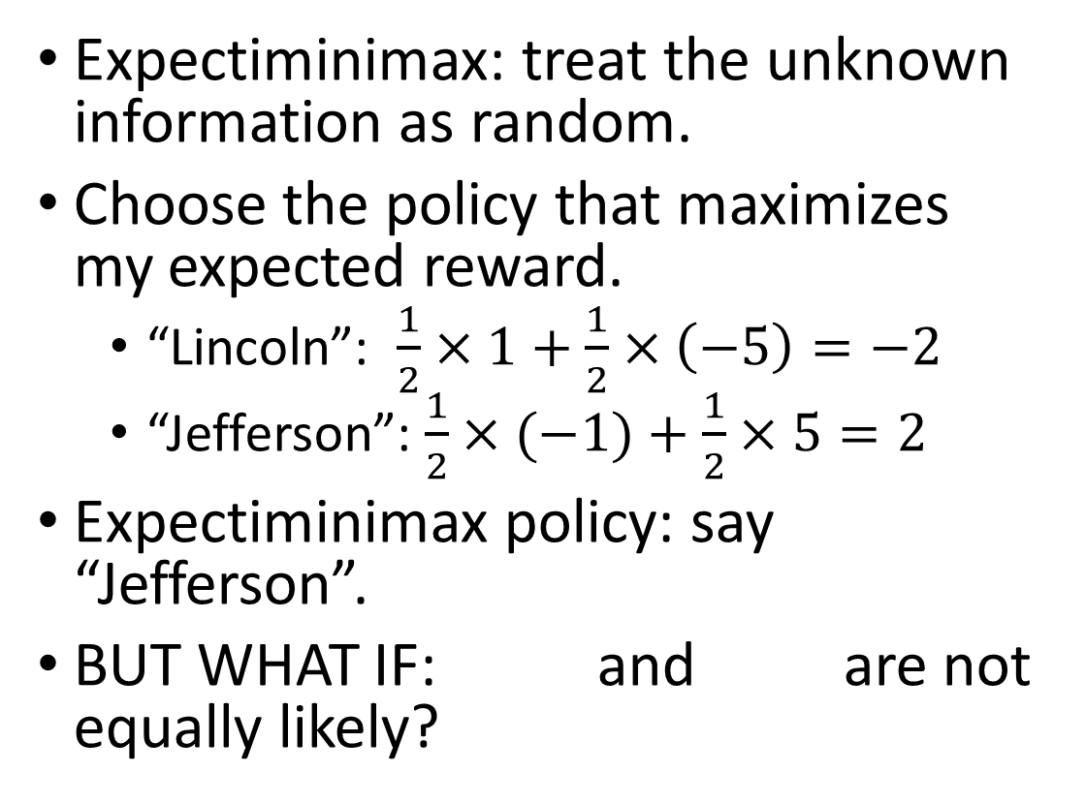
Method #2: Treat “unknown” as “random”
Expectiminimax: treat the unknown information as random.
Choose the policy that maximizes my expected reward.
“Lincoln”: $\frac{1}{2}×1+\frac{1}{2}×\left(−5\right)=−2$
“Jefferson”: $\frac{1}{2}×(−1)+\frac{1}{2}×5=2$
Expectiminimax policy: say “Jefferson”.
BUT WHAT IF: and are not equally likely?
1
-1
-5
5

Slide 18
How to deal with imperfect information
If you think you know the probabilities of different settings, and if you want to maximize your average winnings (for example, you can afford to play the game many times): expectiminimax
If you have no idea of the probabilities of different settings; or, if you can only afford to play once, and you can’t afford to lose: miniminimax
If the unknown information has been selected intentionally by your opponent: use game theory

Slide 19
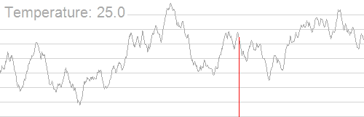
Stochastic search

Slide 20
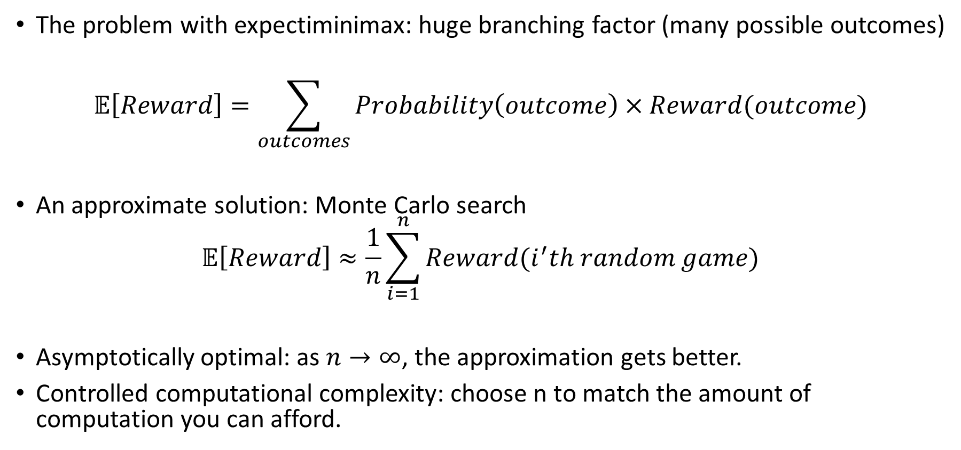
Stochastic search for stochastic games
The problem with expectiminimax: huge branching factor (many possible outcomes)
$$𝔼\left[Reward\right]=\sum_{outcomes}{Probability\left(outcome\right)×Reward(outcome)}$$
An approximate solution: Monte Carlo search
$$𝔼\left[Reward\right]≈\frac{1}{n}\sum_{i=1}^{n}{Reward(i^{′}th random game)}$$
Asymptotically optimal: as $n→∞$, the approximation gets better.
Controlled computational complexity: choose n to match the amount of computation you can afford.

Slide 21
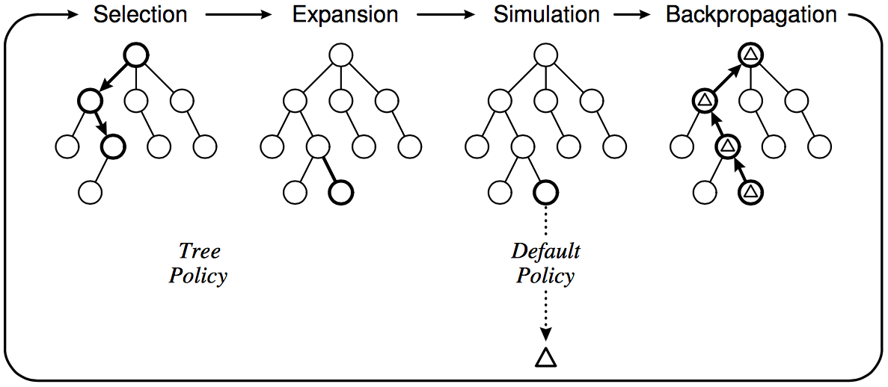
Monte Carlo Tree Search
What about deterministic games with deep trees, large branching factor, and no good heuristics – like Go?
Instead of depth-limited search with an evaluation function, use randomized simulations
Starting at the current state (root of search tree), iterate:
Select a leaf node for expansion using a tree policy (trading off exploration and exploitation)
Run a simulation using a default policy (e.g., random moves) until a terminal state is reached
Back-propagate the outcome to update the value estimates of internal tree nodes
C. Browne et al., A survey of Monte Carlo Tree Search Methods, 2012

Slide 22
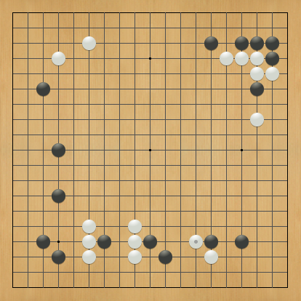
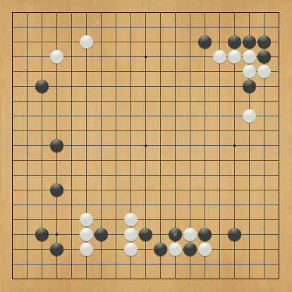
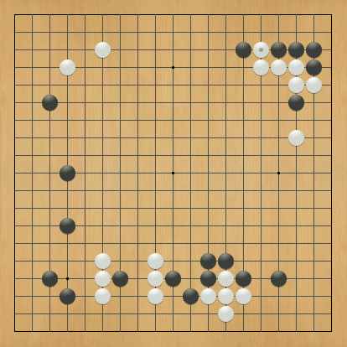
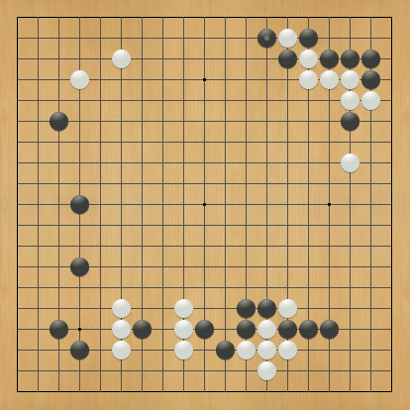
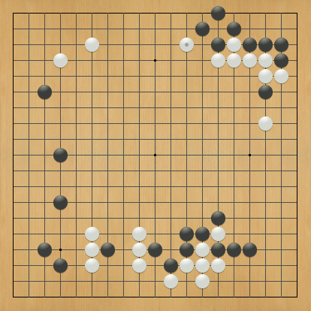
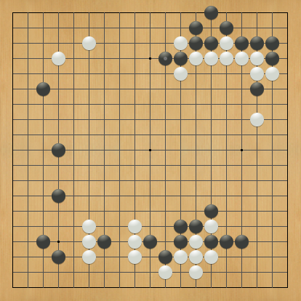
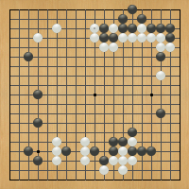
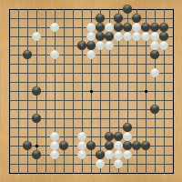
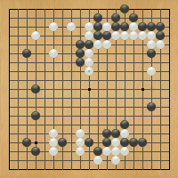
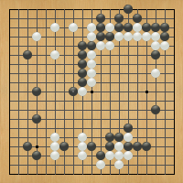
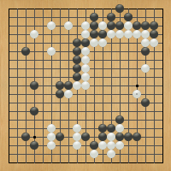
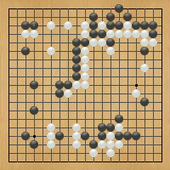
Learned evaluation functions

Slide 23
Stochastic search off-line
Training phase:
Spend a few weeks allowing your computer to play billions of random games from every possible starting state
Value of the starting state = average value of the ending states achieved during those billion random games
Testing phase:
During the alpha-beta search, search until you reach a state whose value you have stored in your value lookup table
Oops…. Why doesn’t this work?

Slide 24


Evaluation as a pattern recognition problem
Training phase:
Spend a few weeks allowing your computer to play billions of random games from billions of possible starting states.
Value of the starting state = average value of the ending states achieved during those billion random games
Generalization:
Featurize (e.g., x1=number of patterns, x2 = number of patterns, etc.)
Linear regression: find a1, a2, etc. so that Value(state) ≈ a1*x1+x2*x2+…
Testing phase:
During the alpha-beta search, search as deep as you can, then estimate the value of each state at your horizon using Value(state) ≈ a1*x1+x2*x2+…

Slide 25
Pros and Cons
Learned evaluation function
Pro: off-line search permits lots of compute time, therefore lots of training data
Con: there’s no way you can evaluate every starting state that might be achieved during actual game play. Some starting states will be missed, so generalized evaluation function is necessary
On-line stochastic search
Con: limited compute time
Pro: it’s possible to estimate the value of the state you’ve reached during actual game play

Slide 26
Case study: AlphaGo
“Gentlemen should not waste their time on trivial games -- they should play go.”
-- Confucius,
The Analects
ca. 500 B. C. E.
Anton Ninno Roy Laird, Ph.D.
antonninno@yahoo.com roylaird@gmail.com
special thanks to Kiseido Publications

Slide 27
Game AI: State of the art
Computers are better than humans:
Checkers: solved in 2007
Chess:
State-of-the-art search-based systems now better than humans
Deep learning machine teaches itself chess in 72 hours, plays at International Master Level (arXiv, September 2015)
Computers are competitive with top human players:
Backgammon: TD-Gammon system (1992) used reinforcement learning to learn a good evaluation function
Bridge: top systems use Monte Carlo simulation and alpha-beta search

Slide 28
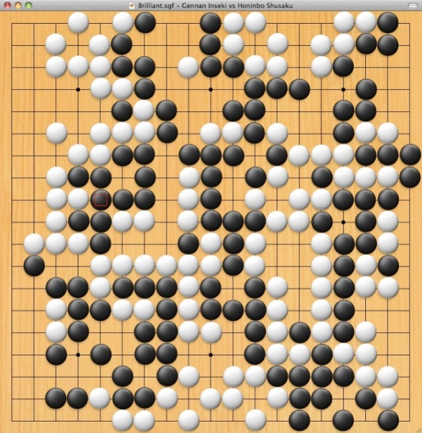
Game AI: State of the art
Computers are not competitive with top human players:
Poker
Heads-up limit hold’em poker has been solved (Science, Jan. 2015)
Simplest variant played competitively by humans
Smaller number of states than checkers, but partial observability makes it difficult
Essentially weakly solved = cannot be beaten with statistical significance in a lifetime of playing
Huge increase in difficulty from limit to no-limit poker, but AI has made progress
Go
Branching factor 361, no good evaluation functions have been found
Best existing systems use Monte Carlo Tree Search and pattern databases
New approaches: deep learning (44% accuracy for move prediction, can win against other strong Go AI)

Slide 29
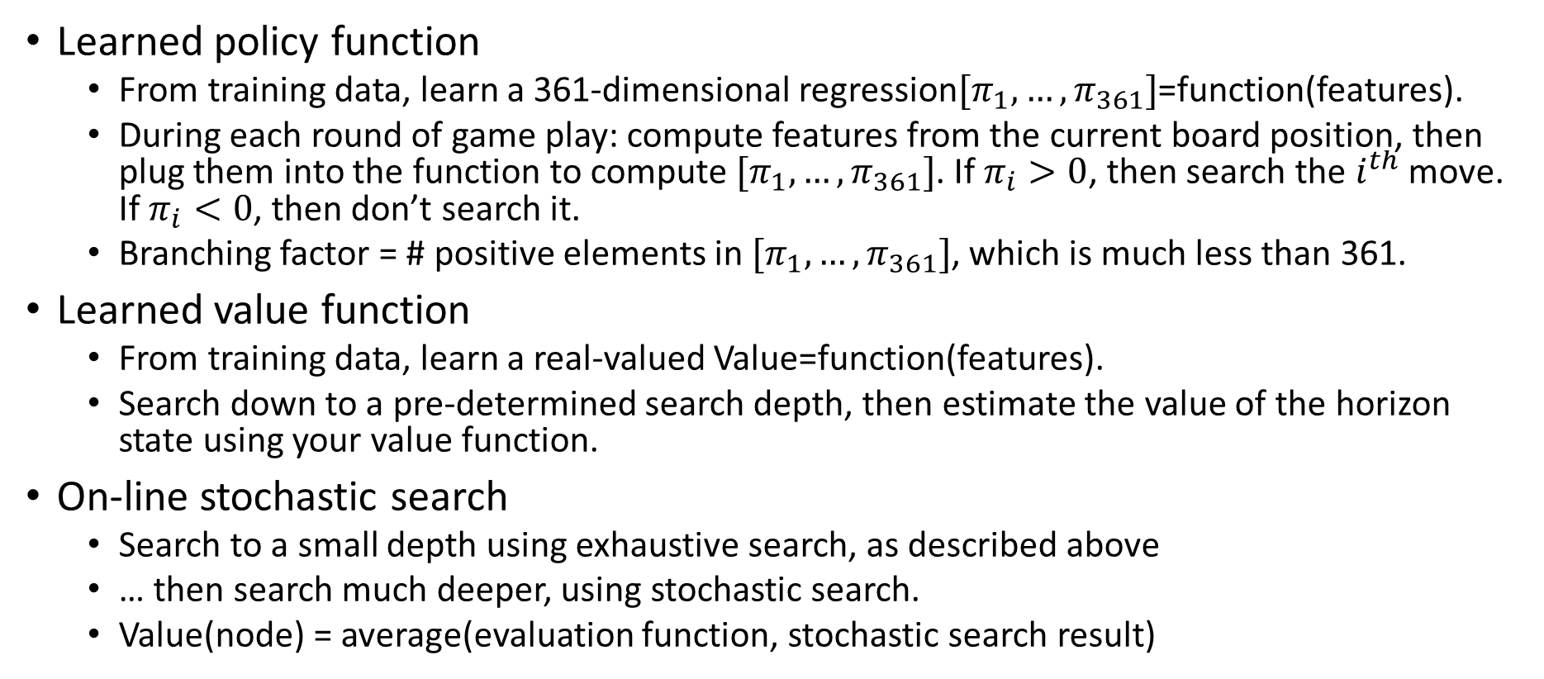
Alpha-Go Innovations
Learned policy function
From training data, learn a 361-dimensional regression$[π_{1},…,π_{361}]$=function(features).
During each round of game play: compute features from the current board position, then plug them into the function to compute $[π_{1},…,π_{361}]$. If $π_{i}>0$, then search the $i^{th}$ move. If $π_{i}<0$, then don’t search it.
Branching factor = # positive elements in $[π_{1},…,π_{361}]$, which is much less than 361.
Learned value function
From training data, learn a real-valued Value=function(features).
Search down to a pre-determined search depth, then estimate the value of the horizon state using your value function.
On-line stochastic search
Search to a small depth using exhaustive search, as described above
… then search much deeper, using stochastic search.
Value(node) = average(evaluation function, stochastic search result)

Slide 30
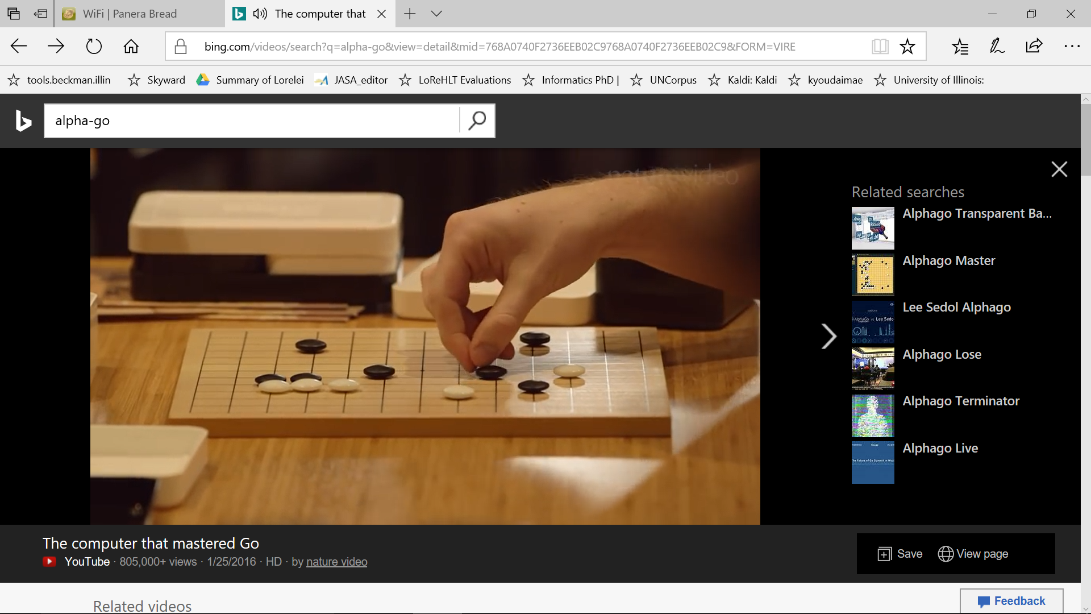
Alpha-Go video

Slide 31
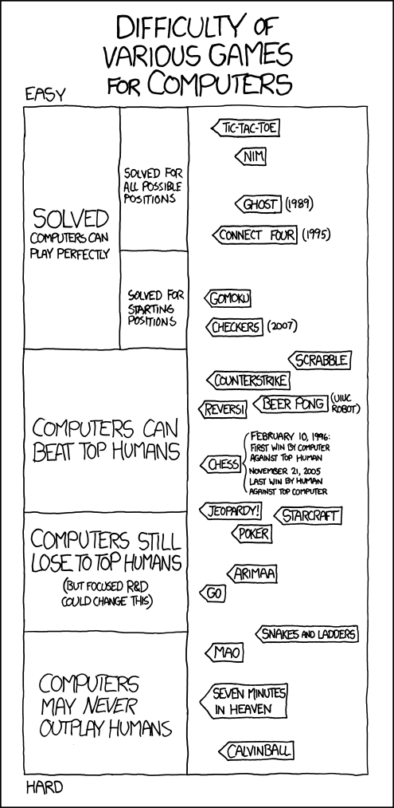
http://xkcd.com/1002/
See also: http://xkcd.com/1263/

Slide 32
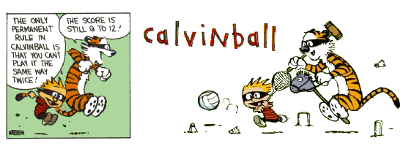
Calvinball:
Play it online
Watch an instructional video

