Slide 1
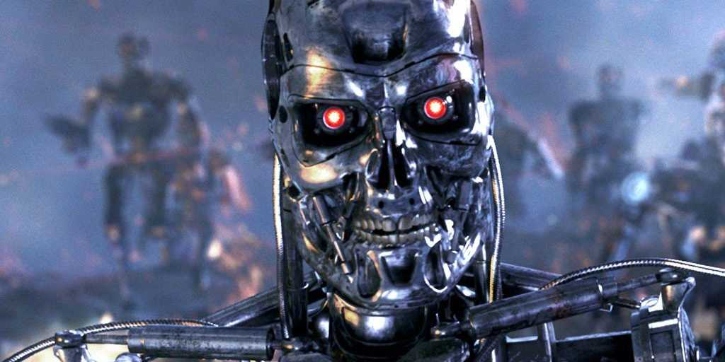
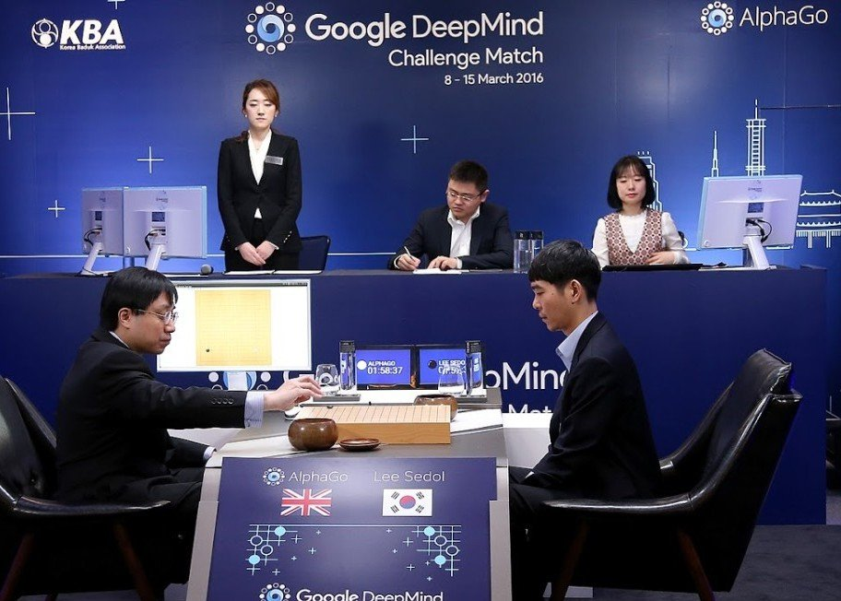
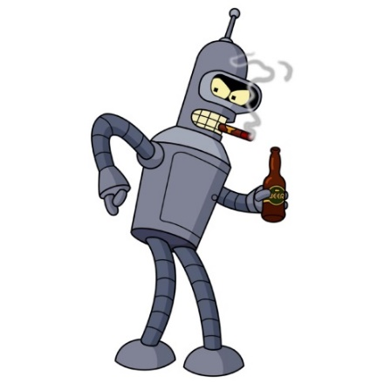
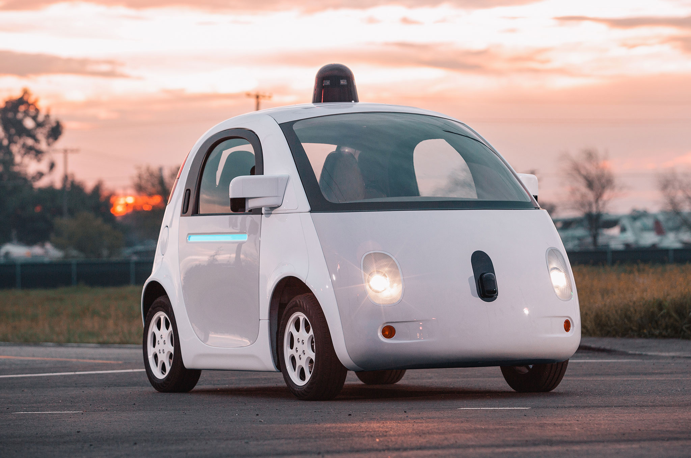
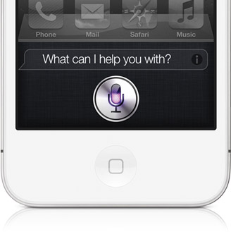
CS440/ECE448: Artificial Intelligence
Lecture 1: What is AI?
Slides by Svetlana Lazebnik, 9/2016
Modified by Mark Hasegawa-Johnson, 8/2017

Slide 2
CS440/ECE448: Artificial Intelligence
Website:
http://courses.engr.Illinois.edu/ece448/

Slide 3
What is AI?
Candidate definitions from the textbook:
1. Thinking humanly | 2. Acting humanly
3. Thinking rationally | 4. Acting rationally

Slide 4
Defining AI: Narrow vs. Broad AI
What’s the advantage of defining AI in terms of how you act, rather than how you think?
  Sufficient to pass Turing test
  Lots easier to measure
  Thought process might be alien; that’s OK
  Possible to use “intelligence” to describe behavior of materials etc.
What’s the advantage of defining AI in terms of how you think, rather than how you act?
  React to new situations not previously planned/observed
  Easier to improve it because you know rationale behind actions
  Doesn’t have to always respond to same situation in same way
  Space of actions is too large; can only define AI in terms of strategy

Slide 5
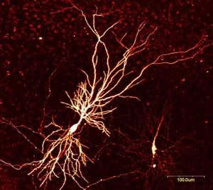
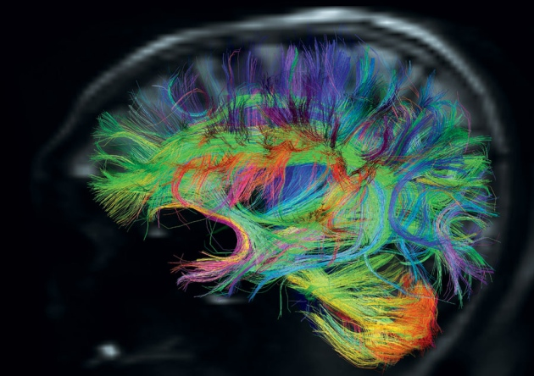
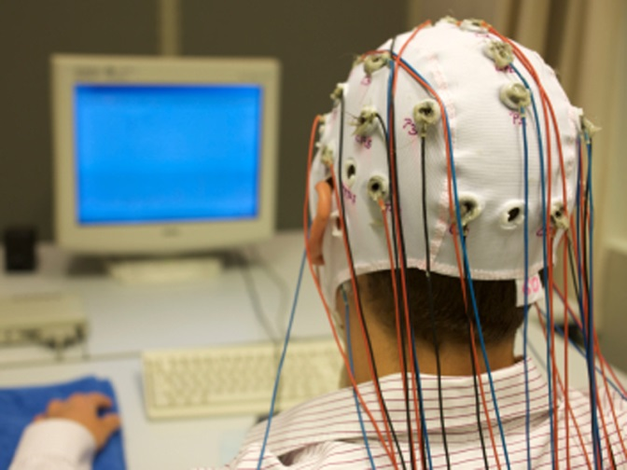
AI definition 1: Thinking humanly
Need to study the brain as an information processing machine: cognitive science and neuroscience

Slide 6
AI definition 1: Thinking humanly
Should we build a brain?
The “embodied cognition” movement exemplified:
https://www.youtube.com/watch?v=uoXAPSdXiZg
Source: L. Zettlemoyer

Slide 7
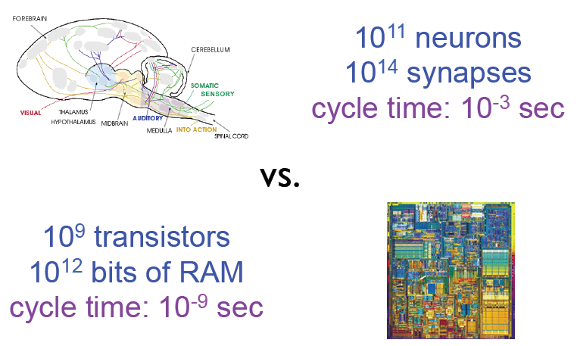
AI definition 1: Thinking humanly
CAN we build a brain?
The problem: parallel versus serial!!!!!

Slide 8
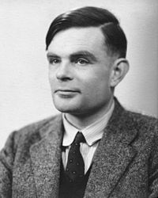
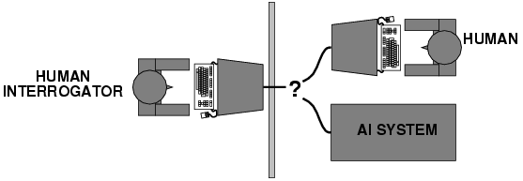
AI definition 2: Acting humanly
The Turing Test: https://www.youtube.com/watch?v=3wLqsRLvV-c
What capabilities would a computer need to have to pass the Turing Test?
  Natural language processing
  Knowledge representation
  Automated reasoning
  Machine learning
Turing predicted that by the year 2000, machines would be able to fool 30% of human judges for five minutes
A. Turing, Computing machinery and intelligence, Mind 59, pp. 433-460, 1950

Slide 9
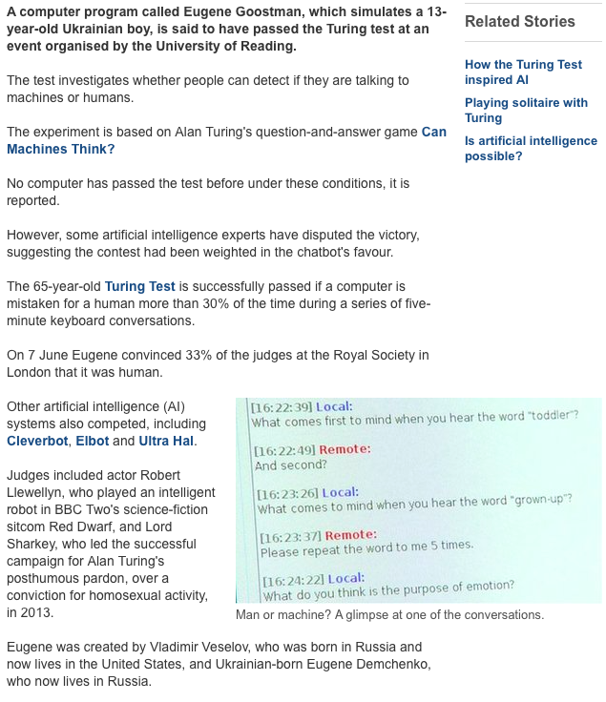
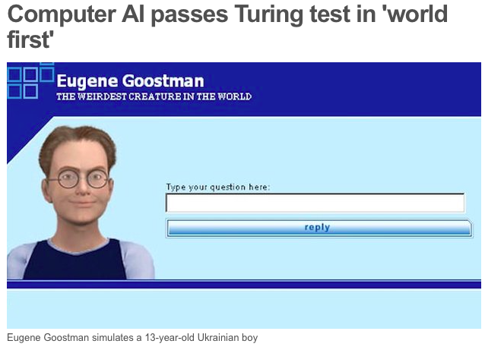
AI is solved?
http://www.bbc.com/news/technology-27762088
http://en.wikipedia.org/wiki/Eugene_Goostman
http://www.scottaaronson.com/blog/?p=1858

Slide 10
What’s wrong with the Turing test?
Variability in protocols, judges
Success depends on deception!
Chatbots can do well using “cheap tricks”
  First example: ELIZA (1966)
  Javascript implementation of ELIZA

Slide 11
A better Turing test?
Winograd schema: Multiple choice questions that can be easily answered by people but cannot be answered by computers using “cheap tricks”
The trophy would not ﬁt in the brown suitcase because it was so small.
What was so small?
  The trophy
  The brown suitcase
H. Levesque, On our best behaviour, IJCAI 2013
http://www.newyorker.com/online/blogs/elements/2013/08/why-cant-my-computer-understand-me.html

Slide 12
A better Turing test?
Winograd schema: Multiple choice questions that can be easily answered by people but cannot be answered by computers using “cheap tricks”
The trophy would not ﬁt in the brown suitcase because it was so large.
What was so large?
  The trophy
  The brown suitcase
H. Levesque, On our best behaviour, IJCAI 2013
http://www.newyorker.com/online/blogs/elements/2013/08/why-cant-my-computer-understand-me.html

Slide 13
Winograd schema
Advantages over standard Turing test
  Test can be administered and graded by machine
  Does not depend on human subjectivity
  Does not require ability to generate English sentences
  Questions cannot be evaded using verbal dodges
  Questions can be made “Google-proof” (at least for now…)
Winograd schema challenge
  Held at IJCAI conference in July 2016
  Six entries, best system got 58% of 60 questions correct
  (humans get 90% correct)

Slide 14

AI definition 3: Thinking rationally
Aristotle, 384-322 BC

Slide 15
AI definition 3: Thinking rationally
Idealized or “right” way of thinking
Logic: patterns of argument that always yield correct conclusions when supplied with correct premises
  “Socrates is a man; all men are mortal;
  therefore Socrates is mortal.”
Logicist approach to AI: describe problem in formal logical notation and apply general deduction procedures to solve it
Problems with the logicist approach
  Computational complexity of finding the solution
  Describing real-world problems and knowledge in logical notation
  Dealing with uncertainty
  A lot of “rational” behavior has nothing to do with logic

Slide 16
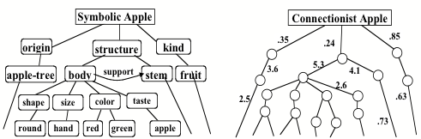
AI definition 3: Thinking rationally
  Most of the approaches in this class (search … Bayesian nets) are capable of incorporating a logist approach (left), though they might go beyond it
  Perceptrons and deep learnings usually give up the symbolic representation in favor of better end-to-end performance (right)

Slide 17
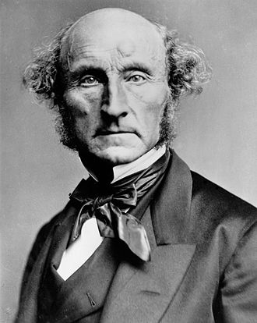
AI definition 4: Acting rationally
John Stuart Mill, 1806-1873

Slide 18
AI definition 4: Acting rationally
A rational agent acts to optimally achieve its goals
  Goals are application-dependent and are expressed in terms of the utility of outcomes
  Being rational means maximizing your (expected) utility
This definition of rationality only concerns the decisions/actions that are made, not the cognitive process behind them
An unexpected step: rational agent theory was originally developed in the field of economics
  Norvik and Russell: “most people think Economists study money. Economists think that what they study is the behavior of rational actors seeking to maximize their own happiness.”
By standard economic definitions: a rational agent is any agent that acts rationally, e.g., human 3-year-olds:
https://www.youtube.com/watch?v=EjzadtXR-zs

Slide 19
Utility maximization formulation
Advantages
  Generality: goes beyond explicit reasoning, and even human cognition altogether
  Practicality: can be adapted to many real-world problems
  Naturally accommodates uncertainty
  Amenable to good scientific and engineering methodology
  Avoids philosophy and psychology
Disadvantages
  Practical disadvantage: In practice, utility optimization is subject to the agent’s computational constraints (bounded rationality or bounded optimality)
  Theoretical disadvantage: does being human involve anything other than rationality? Are the other aspects of being human important? Would it be useful if a machine had them, whatever they are?
  What is utility?
Notes:
Disadvantages: it may be hard to formulate utility functions, especially for complex open-ended tasks. Has limited applicability to humans.

Slide 20
What is AI?
What is the advantage of defining AI in terms of action, rather than thought? What is its disadvantage?
What is the advantage of defining AI in terms of being rational, instead of being human-like? What is its disadvantage?
What is the Turing test? What are some problems with the Turing test? How might they be solved? What is the Winograd schema? Why is it better than the Turing test? Why might it fail?
What is the logicist approach to AI?
What is a rational agent? What is utility?

