Slide 1
PCB Assignment Recap and Soldering Assignment Information
March 11, 2022

Slide 2
PCB design process step 1: Schematic (abstract)

Slide 3
PCB design process step 2: Layout (physical)

Slide 4
PCB Assignment Solution Observations
Spot check of submissions looks pretty good
Please share any feedback you have regarding the assignment
Not all students submitted a solution
Late policy on assignments: 25% reduction per day late, i.e.,
$\text{Late} \text{score}\text{ = }\text{Score} × {\left(1−25\%\right)}^{n}$
where $n$ is the number of days late

Slide 5
Soldering Assignment Logistics
The soldering assignment is an “individual assignment” (all students must complete the assignment)
Due date: Friday, March 11, 5pm
Location: Senior design lab (D225)
Sign up for a time slot here: https://docs.qq.com/sheet/DR1VKVW5yVVhyeG5V?tab=BB08J2

Slide 6
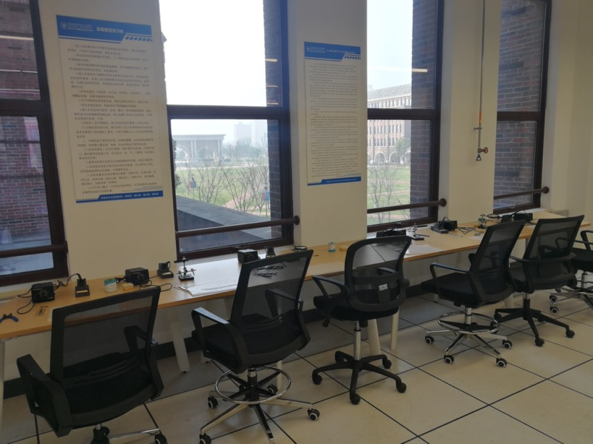
Soldering Assignment Logistics
Complete the assignment and take the (tested) PCB home with you
TAs will grade the assignment
Today (3.11), 4:00-5:00 PM, D225 Lab
Bring your soldered PCB to the lab for and demo it with a TA
Who to contact for help:
Lab staff: Shilei Zhang and Si Li
TAs
Course staff

Slide 7
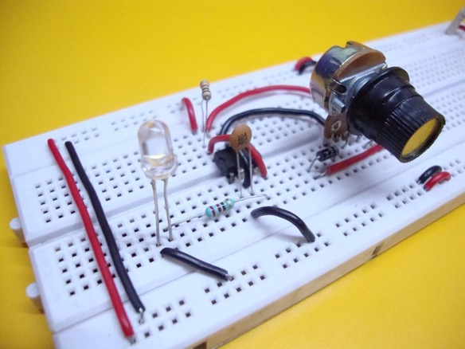
Purpose of the PCB and soldering assignments
It is true: you may never construct a PCB or solder an electronic component again in your engineering career
A circuit breadboard is useful for prototyping
The ultimate goal of senior design is a professional final project demonstration
A mess of wires and components gives a poor impression
Time and again students scramble to find loose wires and components during live demos

Slide 8
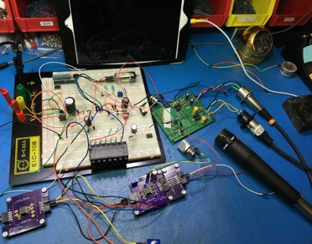
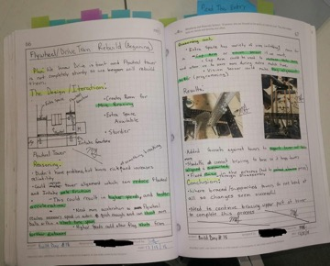
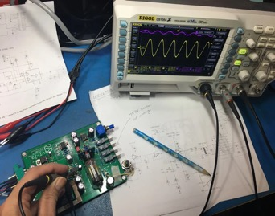
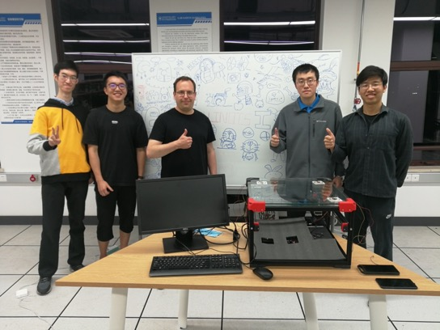
The Design Process
2b. Prototype
2a. Design
2c. Testing / validation
1. Ideation and specification
3. Final demonstration

Slide 9
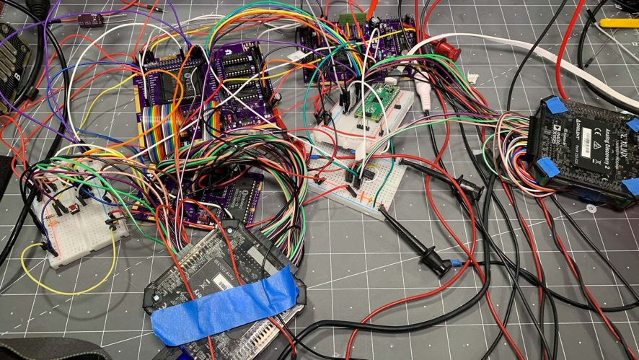
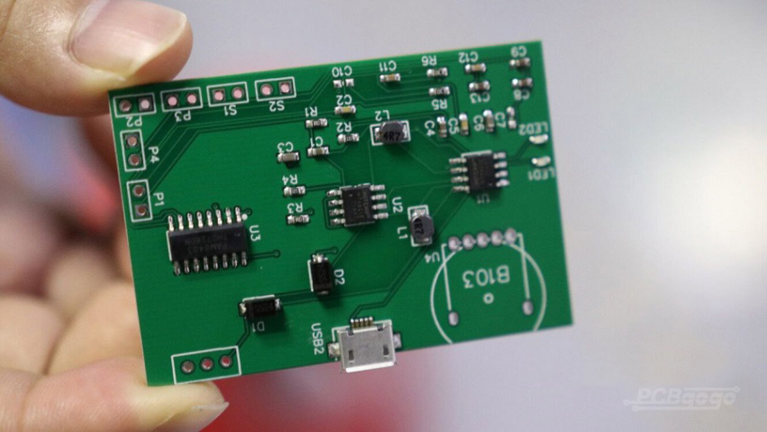
Which is more robust?

Slide 10
Breadboards vs. PCBs Conclusions
Breadboards are for prototyping
PCB design and construction takes some skill:
Soldering is not always easy
Certain situations (e.g., high power / frequency) offer much greater challenge
Compared to UIUC in the USA, we have advantages in China:
Rapid turnaround time (days instead of weeks to receive a custom PCB)
Low cost

